Slide 1

SEARCH ENGINE
Assignment #1 - Presentation
Presented By: 2021-CS-118

Slide 2
Agenda
Probabilistic Retrieval Model
Non Overlapped List Model
Proximal Nodes Model

Slide 3
Objective
Probabilistic Retrieval Model: To retrieve and rank documents using a probabilistic approach and present the top-K most relevant documents.
Non-Overlapped List Model: To combine document lists for different terms using a union operation, avoiding redundancy. Make use of the Link List data Structure.
Proximal Nodes Model: To identify and retrieve documents related to the query by leveraging graph connections.

Slide 4
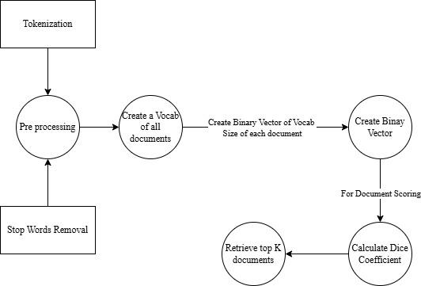
Probabilistic Retrieval Model: BIM

Slide 5
Probabilistic Retrieval Model: BIM
Given documents:
Doc1: "The quick brown fox jumps over the lazy dog."
Doc 2: "Never jump over the lazy dog quickly."
Doc 3: "A fox is quick and a dog is lazy."
Query: "quick fox"
Vocabulary: ['a', 'brown', 'dog', 'fox', 'is', 'jump', 'lazy', 'never', 'over', 'quick', 'the']
Query vector: [0, 0, 0, 1, 0, 0, 0, 0, 0, 1, 0]
Document vectors:
Doc 1: [0, 1, 1, 1, 0, 1, 1, 0, 1, 1, 1]
Doc 2: [0, 0, 1, 0, 0, 1, 1, 1, 1, 1, 1]
Doc 3: [1, 0, 1, 1, 1, 0, 1, 0, 0, 1, 0]
Similarity Scores using the dice coefficient b/w documents and Query:
Doc 1: 0.67
Doc 2: 0.5
Doc 3: 0.75
Ranked results: Doc 3, Doc 1, Doc 2.

Slide 6
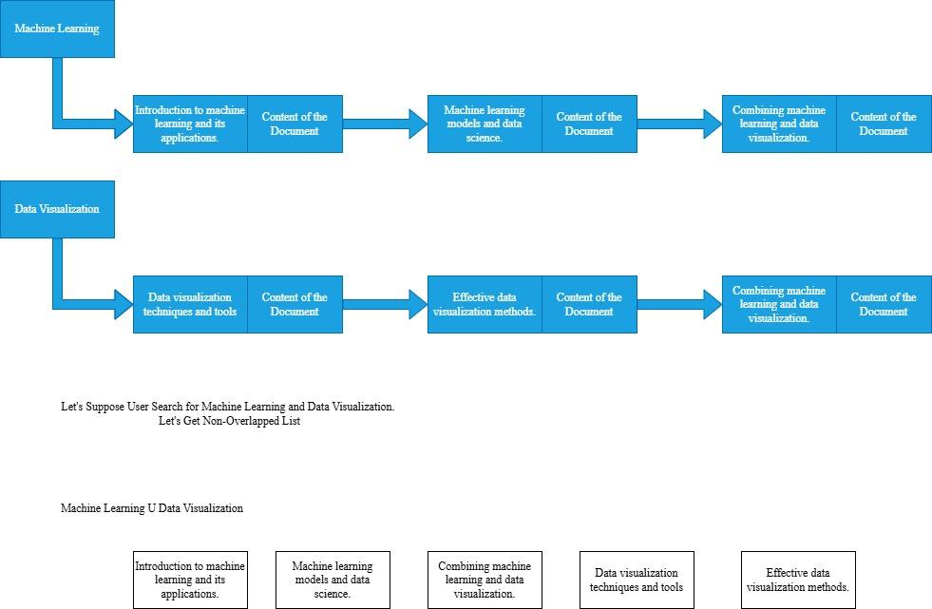
Non Overlapped List Model

Slide 7
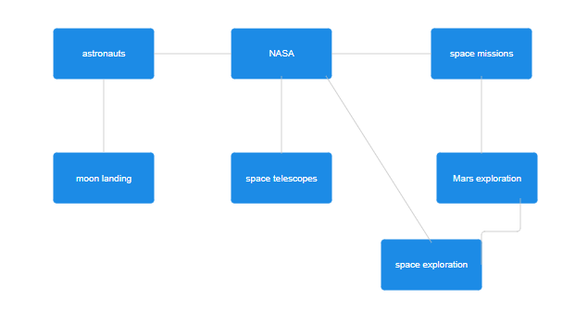
Proximal Nodes Model

Slide 8
Thank You!

