Slide 1

Probabilistic IR Models
Assignment #7 - Presentation
Interference & Belief Network Models
Presented By: 2021-CS-118

Slide 2
Agenda
Introduction
Objective
Inference Model data flow diagram
Belief Network Model data flow diagram

Slide 3
Introduction
Probabilistic Information Retrieval (IR) models build on classical IR models by introducing the concept of uncertainty and probability. In these models, we consider the likelihood of a document being relevant to a query as a probability.
Types of Probabilistic Retrieval Model
Inference
Belief Networks

Slide 4
Inference Model

Slide 5
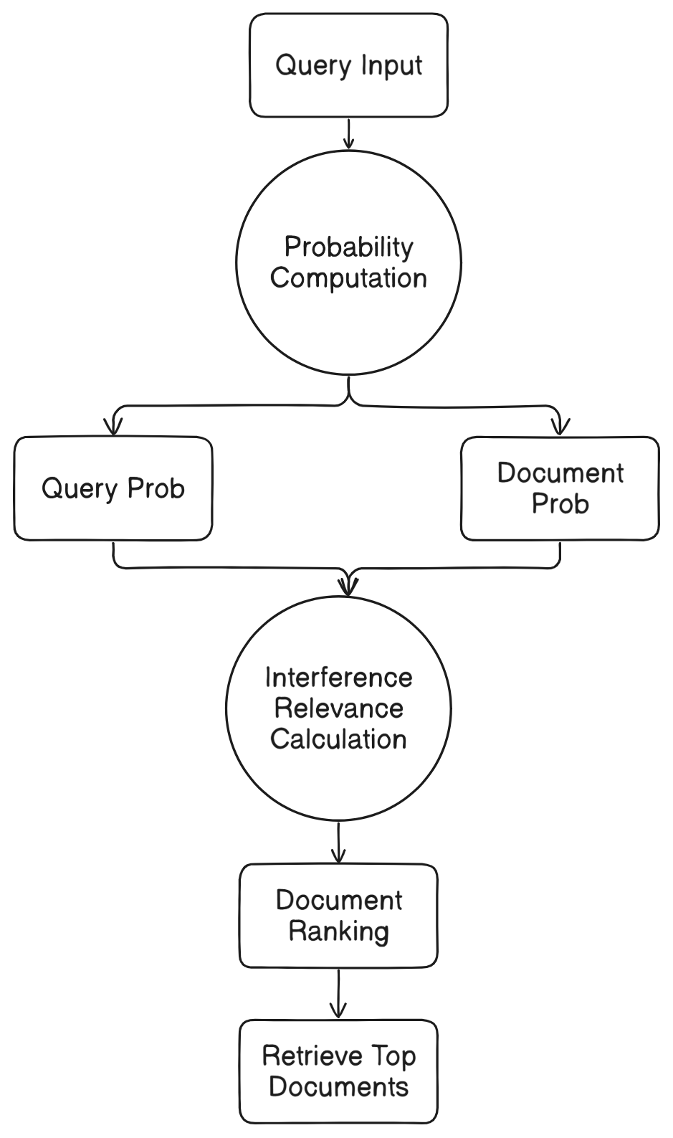
Inference Model

Slide 6
Belief Network Model

Slide 7
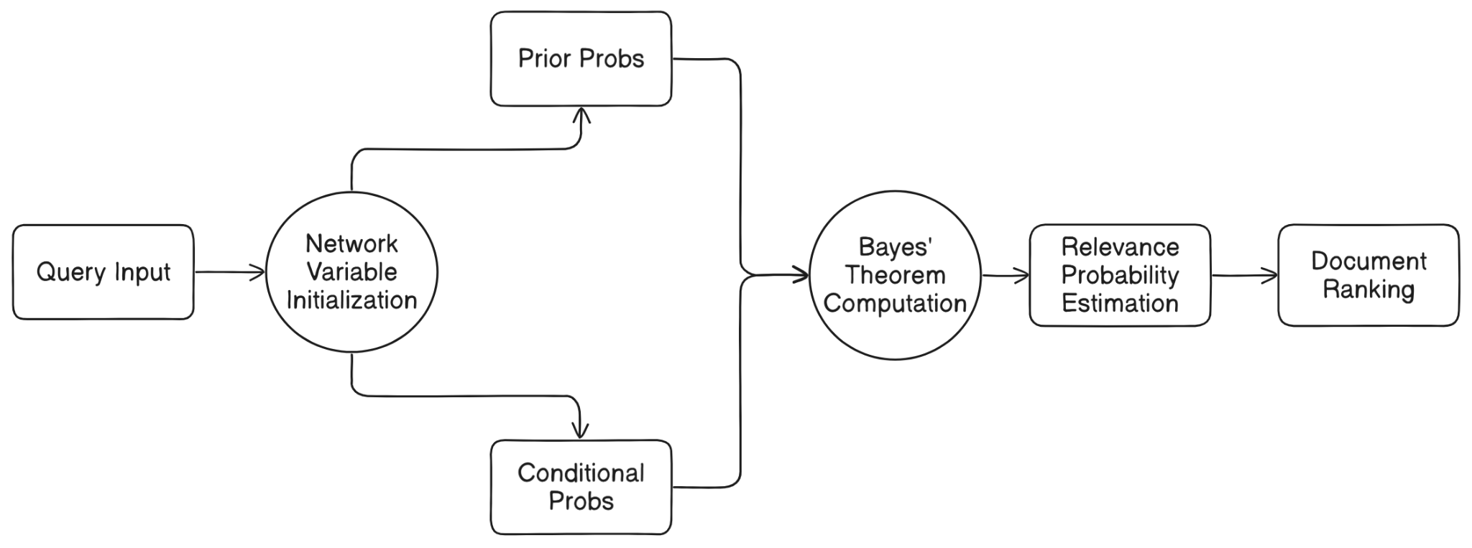
Belief Network Model

Slide 8
Thank You!

