Slide 1

Set-Theoretic IR Models
Assignment #6 - Presentation
Neural Network in Context Of Information Retrieval
Presented By: 2021-CS-118

Slide 2
Agenda
Introduction
Objective
Steps in development
Data flow diagram
Understanding with example

Slide 3
Introduction
This assignment explores the implementation of a neural network-inspired approach to information retrieval, specifically focusing on a voice assistant's ability to understand and process user queries semantically.

Slide 4
Objective
Develop a custom neural network-inspired information retrieval system
Implement semantic query understanding and expansion

Slide 5
Steps in development
Step 1: Text Preprocessing
Step 2: Semantic Knowledge Base
Step 3: TF-IDF Vectorization
Step 4: Cosine Similarity

Slide 6
Step 1: Text Preprocessing
Convert text to lowercase
Tokenize the query
Remove stop words (simplified in this implementation)

Slide 7
Step 2: Semantic Knowledge Base
Create a dictionary mapping words to their semantic equivalents:
semantic_knowledge = {
'benefits': ['advantages', 'positive effects', 'gains'],
'exercise': ['workouts', 'physical activity', 'training'],
'health': ['wellness', 'well-being', 'vitality']
}
Insted we can use Word2Vec, GloVe, or FastText for better semantic understanding by creating vector representations of words based on their contextual usage.

Slide 8
Step 3: TF-IDF Vectorization
Calculate Term Frequency (TF)
Calculate Inverse Document Frequency (IDF)
Multiply TF and IDF
We can use transformers by Hugging Face to compute contextual embeddings using models like BERT or RoBERTa. These models provide sentence-level and word-level contextual embeddings.

Slide 9
Step 4: Cosine Similarity
Measure document relevance using cosine similarity:
cos(θ) = (A · B) / (||A|| * ||B||)
Where:
A and B are document vectors
A · B is the dot product
||A|| and ||B|| are vector magnitudes
We can use vector search libraries like faiss for efficient document similarity calculations on high-dimensional embeddings.

Slide 10
Understanding With Example
Sample Documents:
"Regular exercise provides numerous benefits for physical and mental health"
"Workouts can improve cardiovascular wellness and overall fitness"
"Physical activity is crucial for maintaining good health and preventing diseases"
Sample Query:
"Find me articles about the benefits of exercise for health"
Query Processing:
Preprocessing:
Tokens: ['find', 'me', 'articles', 'about', 'benefits', 'of', 'exercise', 'for', 'health']
Semantic Expansion:
Expanded Tokens: ['benefits', 'advantages', 'exercise', 'workouts', 'health', 'wellness']
TF-IDF Vectorization
Cosine Similarity Calculation
Document Ranking

Slide 11
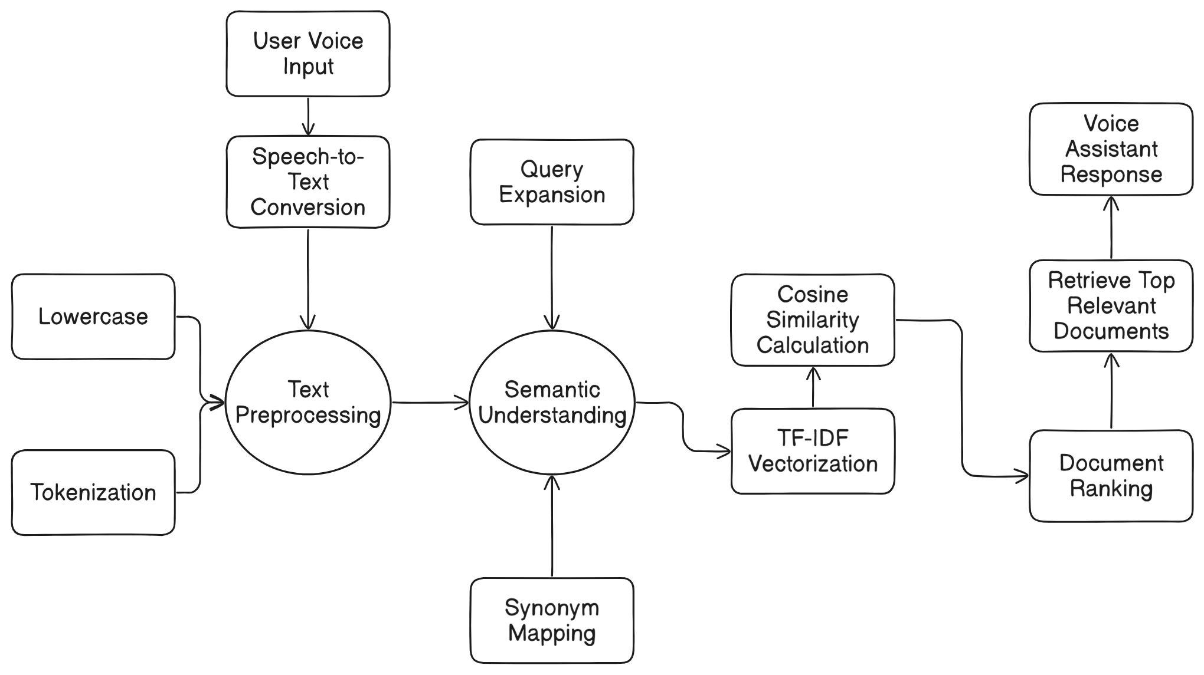
Data Flow Diagram

Slide 12
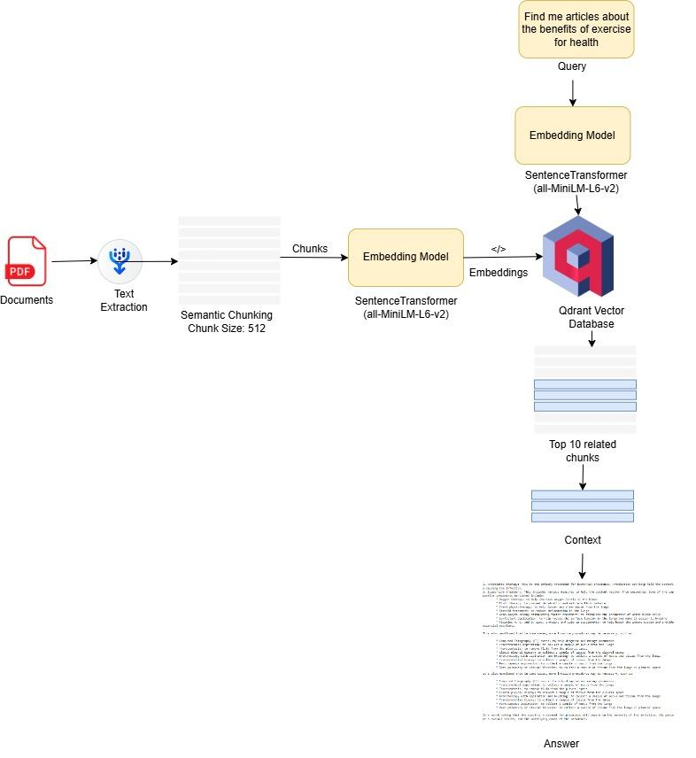
Data Flow Diagram

Slide 13
Thank You!

