Slide 1

TF-IDF SEARCH ENGINE
Assignment #4 - Presentation
Presented By: 2021-CS-118

Slide 2
Agenda
Structure Guided Browsing
Introduction
Objective
Steps in development
Conclusion
Hypertext Model
Introduction
Objective
Steps in development
Conclusion

Slide 3
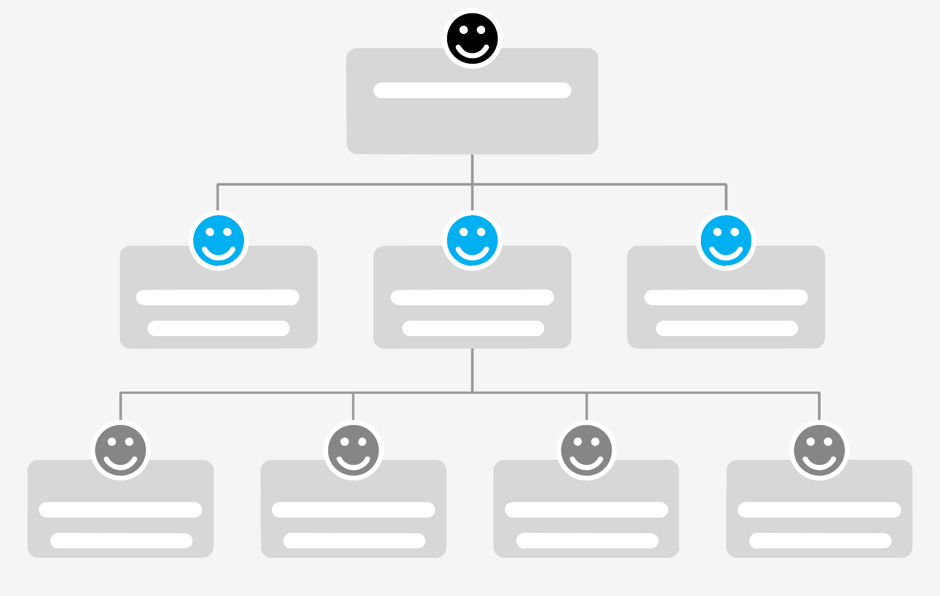
Structure Guided Browsing

Slide 4
Introduction
Structure Guided Browsing groups documents covering related topics using the HASH MAP.
I have used this same idea to a single document.

Slide 5
Objective
The goal is
To implement Structure guided browsing and
To provide users with an intuitive way to explore a hierarchical structure of topics and categories, enabling efficient access to information. The implementation emphasizes interactivity and user-friendly navigation.

Slide 6
Steps in development
Step 1: Define the Content Hierarchy
Step 2: Create a Visual Content Map
Step 3: Implement Navigation Elements
Step 4: Implement Interactive Features

Slide 7
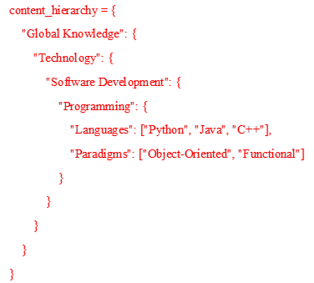
Step1: Define the Content Hierarchy
Each key represents a category or topic, and its value can be:
A dictionary: Indicates subcategories or subtopics.
A list: Represents terminal nodes with specific items or concepts.

Slide 8
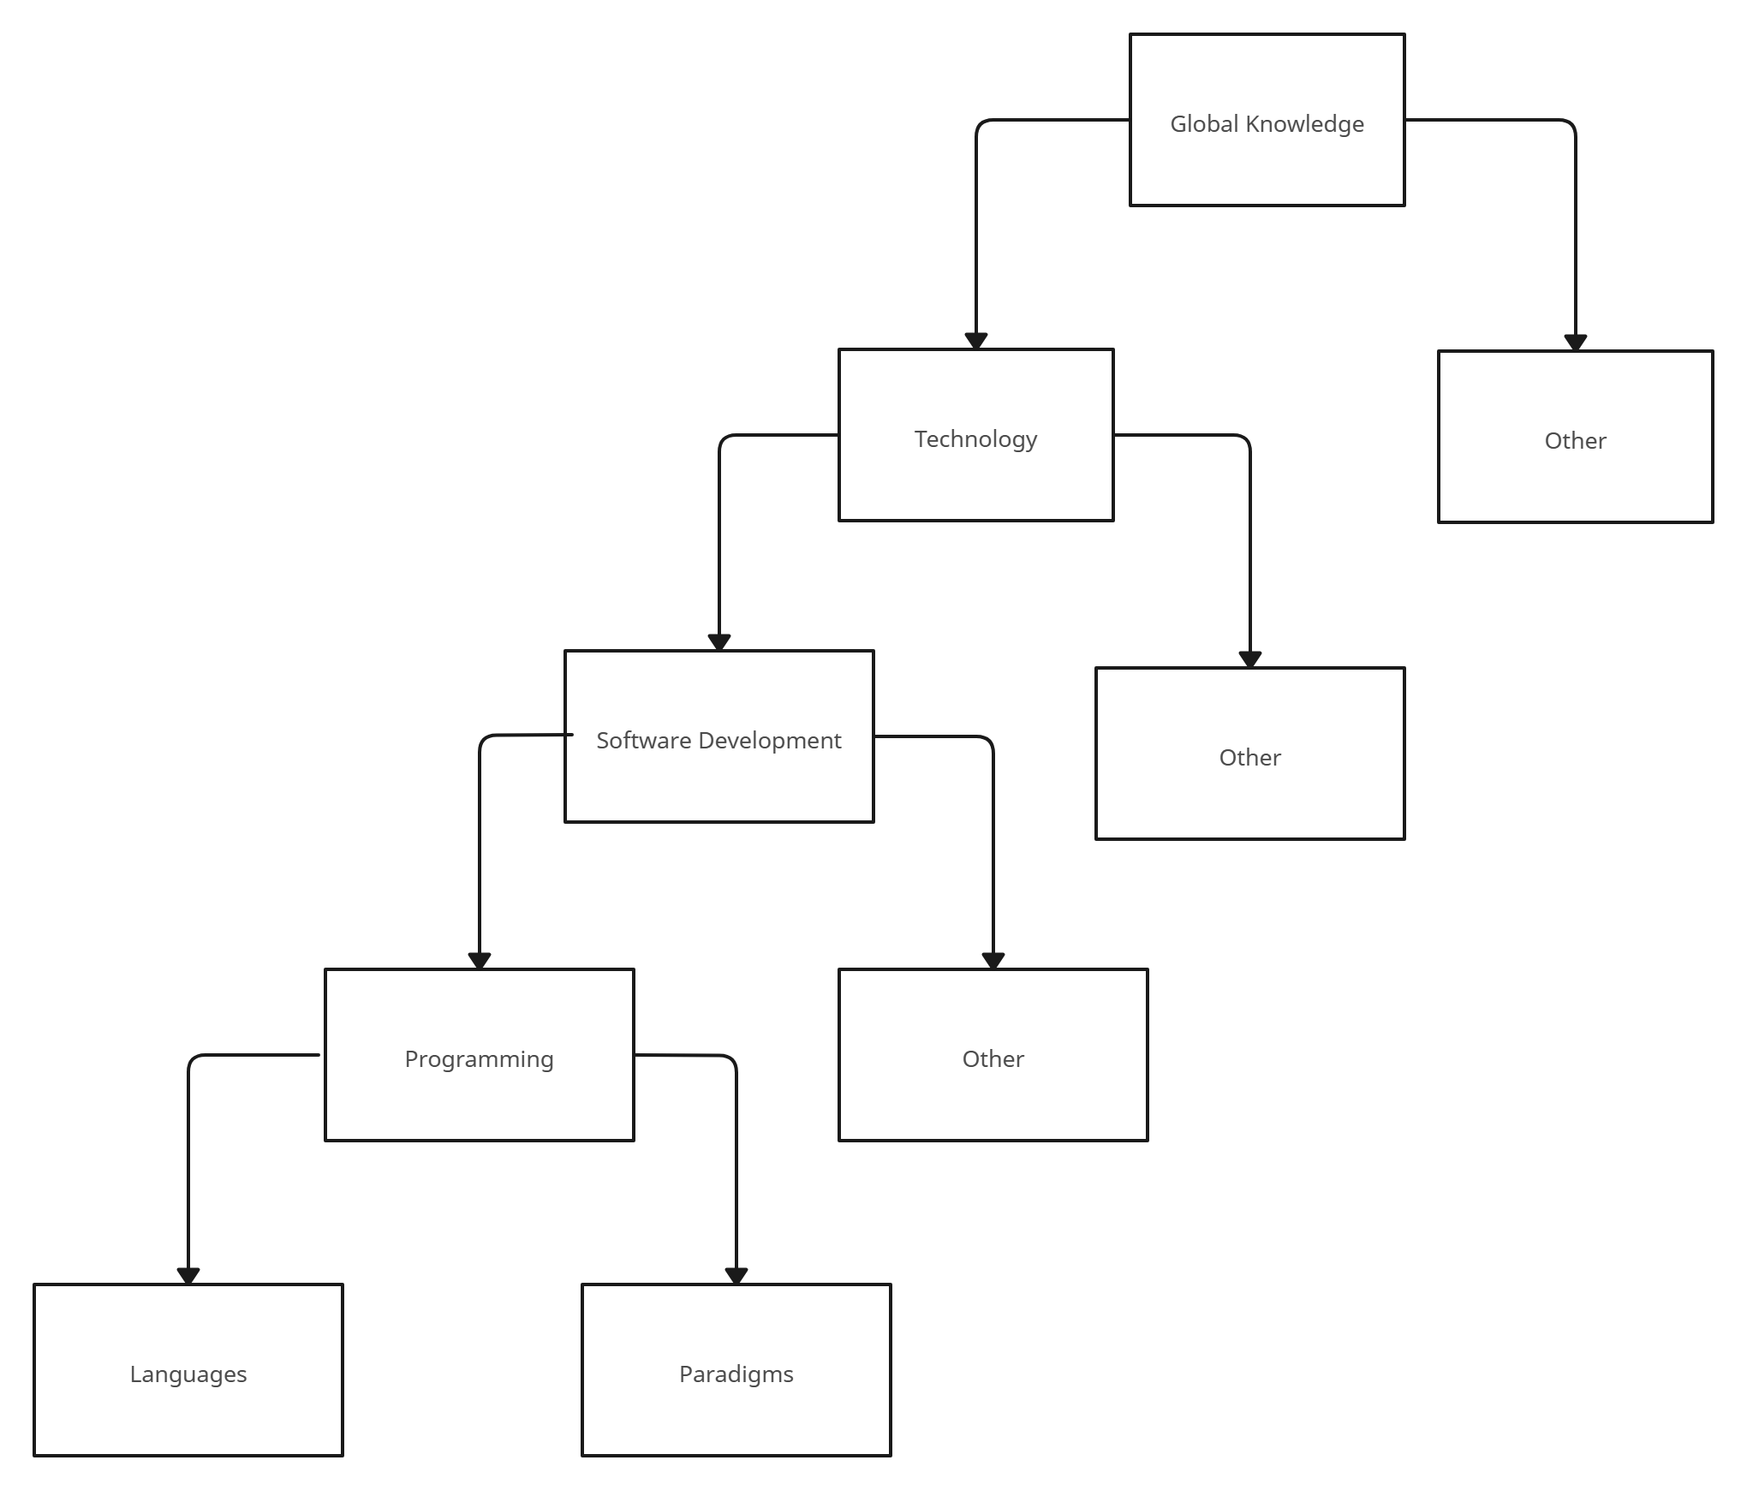
Step1: Define the Content Hierarchy

Slide 9
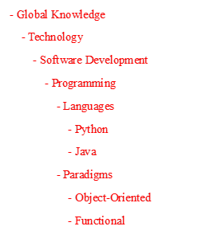
Step2: Create a Visual Content Map
I have generated a visual map of the hierarchy. It indents sublevels for clarity, helping users visualize the structure.

Slide 10
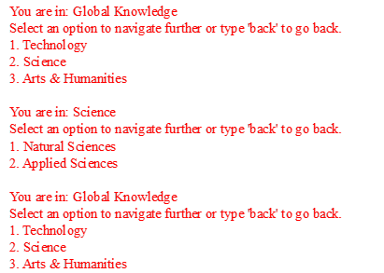
Step 3: Implement Navigation Elements
Key features include:
Dynamic Navigation: Users choose options to drill down into subcategories.
Backtracking: Users can return to a previous level using the 'back' command.
Error Handling: Invalid inputs prompt re-selection.

Slide 11
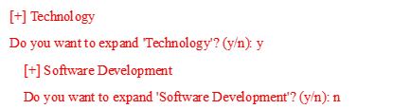
Step 4: Implement Interactive Features
For the interactive feature, I have implemented the collapsible sections. Where users can open article of their interest.

Slide 12
Conclusion
This assignment covers the Structure Guided Browsing:
By combining
hierarchical representation,
interactive features, and
user-friendly navigation,
it provides a robust framework for content management.

Slide 13
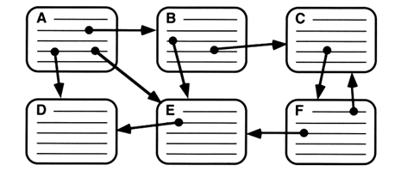
HyperText Model

Slide 14
Introduction
The objective of this assignment is to design and implement a hypertext model in the form of an e-book application. This application will allow users to navigate through chapters and sections as interconnected nodes. The assignment uses Python for its simplicity and support for structured data handling.

Slide 15
Objective
Dynamic Navigation: Users can explore chapters through interconnected links.
Backtracking: Users can return to the previous chapter with ease.
Interactive CLI: Offers a user-friendly way to navigate an e-book.

Slide 16
Steps in development
Step 1: Defining Nodes and Content
Step 2: Creating Links
Step 3: Designing User Interface

Slide 17
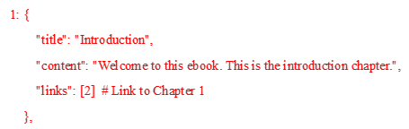
Step 1: Defining Nodes and Content
I have chosen the e-book for HyperText model. The e-book is structured as a dictionary where:
Keys represent chapter IDs.
Values include the title, content, and links to other chapters.

Slide 18
Step 2: Creating Links
Links are defined as an array of chapter IDs, representing navigable chapters. For example, Chapter 1 links to Chapter 2, forming a bidirectional connection.

Slide 19
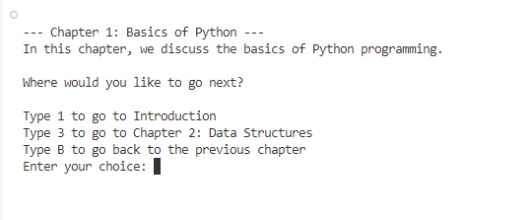
Step 3: Designing User Interface
The user interface is a simple command-line interaction. Users input commands to navigate between chapters. If they want to go back, they can type 'B'.

Slide 20
Conclusion
The hypertext-based e-book application effectively demonstrates the concept of interconnected nodes.
By implementing features like
hyperlinks and
backtracking,
it provides an interactive reading experience. Further enhancements can expand its functionality and user appeal.

Slide 21
Thank You!

