Slide 1
CS 371 Artificial Intelligence
Samyan Qayyum Wahla
Fall 2023
Course Credits: Stanford-CS221

Slide 2


Slide 3
Problem Reduction Methods
Goal centric
Divides into sub-problems/sub-goals
Goal reduction methods
Answers
How?
Why?

Slide 4
Examples
Factorial
Blocks Handling
Integration

Slide 5
Factorial Python Recursive Code
def recur_factorial(n):
if n == 1:
return n
else:
return n*recur_factorial(n-1)

Slide 6
Fibonacci Python – Recursive Code
# Python program to display the Fibonacci sequence
def rec_fib(n):
if n <= 1:
return n
else:
return(rec_fib(n-1) + rec_fib(n-2)

Slide 7
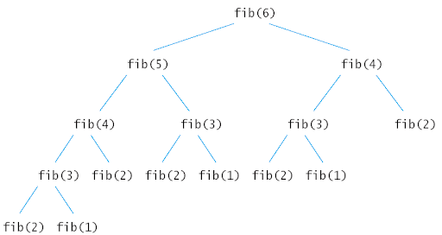
Notes:
https://www.google.com/url?sa=i&url=http%3A%2F%2Fwww.math.bas.bg%2F~nkirov%2F2004%2FHorstman%2Fch14%2Fch14.html&psig=AOvVaw2OwdFMlZwGWsW8wFWmDGwY&ust=1602580587217000&source=images&cd=vfe&ved=0CAMQjB1qFwoTCMjA9IbbruwCFQAAAAAdAAAAABAJ

Slide 8
Blocks: Demonstration

Slide 9
Blocks: Sub-problems
MOVER – block manipulation and answers questions
PUT <B1> ON <B2> - place one block on top of another block, activates other procedures – find specific place on top of the target block, grasping, moving and ungrasping.
GET-SPACE – finds space on the top of a target block
MAKESPACE – creates room for a travelling block
GRASP – arrange to clear off the top of the object to be grasped
CLEAR-TOP – getting rid of everything on top of the object to be grasped
GET-RID-OF – gets rid of an obstructing object by putting it on table
UNGRASP – let go of whatever it is holding
MOVE – moves objects

Slide 10
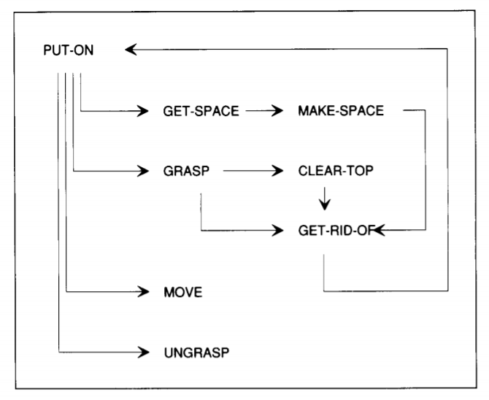

Slide 11
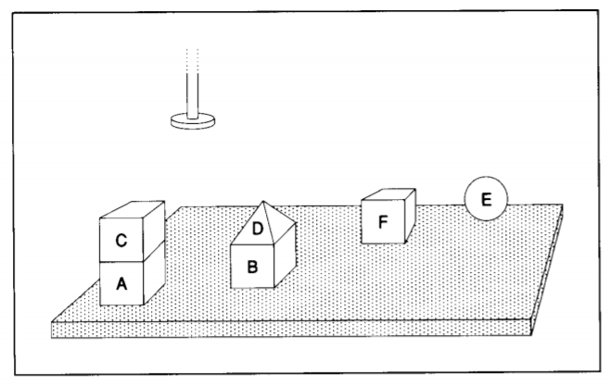
MOVER
Mover is a procedure for planning motion sequences in the world of bricks, pyramids, balls, and of a robot hand

Slide 12
COMMAND
PUT BLOCK A ON BLOCK B

Slide 13
COMMAND – PUT BLOCK A ON BLOCK B
GRASP D
MOVE D TO SOME LOCATION ON THE TABLE
UNGRASP D
GRASP C
MOVE C TO SOME LOCATION ON THE TABLE
UNGRASP C
GRASP A
MOVE A TO SOME LOCATON ON B
UNGRASP A

Slide 14
Question: HOW?
How do the procedures in MOVER find the appropriate sequence?

Slide 15
Answer: HOW?
How do the procedures in MOVER find the appropriate sequence?
PUT-ON asks GET-SPACE to identify a place for block A on top of block B
GET-SPACE appeals to MAKE-SPACE because block D is in the way.
MAKE-SPACE asks GET-RID-OF to help by getting rid of block D
GET-RID-OF obliges by finding a place for block D on the table and by moving block D to that place using PUT-ON – new job PUT D on the table (RECURSION)

Slide 16
Answer: HOW?
How do the procedures in MOVER find the appropriate sequence?
With block D gone, MAKE-SPACE can find a place for block A to go on top of block B
MAKE-SPACE was asked by GET-SPACE (to put A on B)
PUT-ON ask GRASP for a. PUT-ON cannot grasp A because C is in the way.
GRASP ASKS FOR CLEAR-TOP
CLEAR-TOP asks GET-RID-OF
GET-RID-OF arranges for block C to go on table using PUT-ON
CLEAR-TOP finished as block A is cleared.

Slide 17
Answer: HOW?
How do the procedures in MOVER find the appropriate sequence?
CLEAR-TOP finished as block A is cleared.
GRASP can now do its job
PUT-ON can ask MOVE to move block A to the place found previously on top of block B.
PUT-ON asks UNGRASP to let block A go.

Slide 18
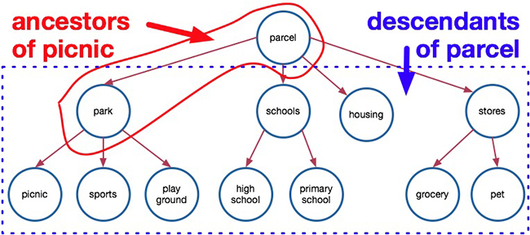
Key Idea in Problem Reduction – Goal Tree
A semantic tree is a semantic net with special links, called branches each of which connects two nodes.
A semantic tree is a representation
Links are called braches
Head node – parent node
Tail node – child node
If node has no parent then it is called root node
Node with no children – Leaf nodes
When two nodes are connected to each other by a chain of two or more branches, one is said to be the ancestor; the other is said to be the descendant

Slide 19
Goal Tree
Constructors
Connect a parent node to a child node with a branch link
Readers
Produce a list of a given node’s children
Produce a given node’s parent

Slide 20
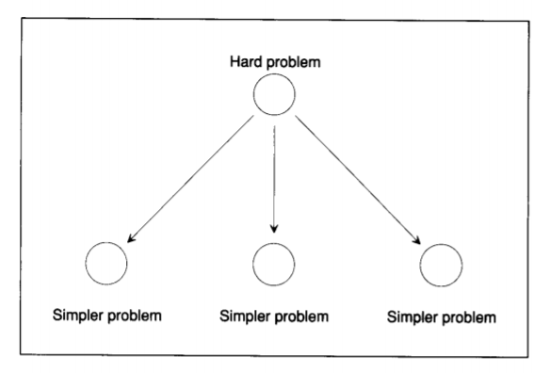
What is goal tree?
A goal tree, is a semantic tree in which nodes represent goals and branches indicate how you can achieve goals by solving one or more subgoals.
Each node’s children correspond to immediate subgoals; each node’s parent corresponds to the immediate subgoals.

Slide 21
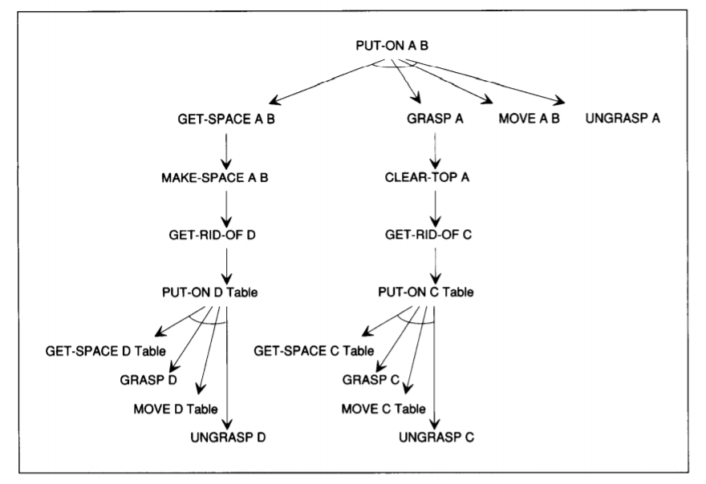
Goal Tree – Transparent Procedures
Goals that are satisfied only when all of their immediate subgoals are satisfied
Goals that are satisfied only when all of their immediate subgoals are satisfied are called AND goals and corresponding nodes are called AND nodes.
Arcs are placed on the branches of AND nodes.
OR goals are satisfied when any of their immediate subgoals are satisfied.
Unmarked nodes are called OR nodes.
Leaf goals – no subgoals and corresponding nodes are called leaf nodes.
Goal trees are also called AND-OR Trees

Slide 22
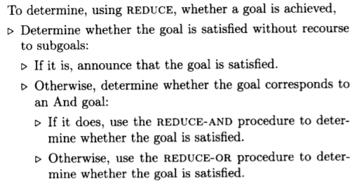
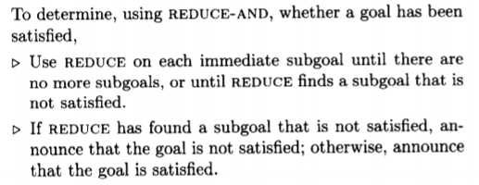
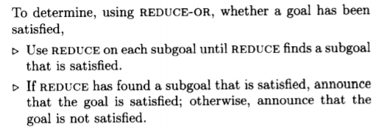
Test – How goal is achieved?
REDUCE
REDUCE- AND
REDUCE-OR

Slide 23
Introspective Question Answering
Problem: PUT BLOCK A ON BLOCK B
Questions:
Q: How did you clear the top of A?
Ans: By getting rid of block C
Q: Why did you clear the top of A?
Ans: To grasp block A
HOW?
You identify goal involved in AND-OR tree
If goal is an AND goal, report all immediate subgoals.
If goal is an OR goal, report immediate subgoal that was achieved
Why?
Identify the goal and report the immediate super-goal
Why?
How?

Slide 24
Optimization Problems

Slide 25
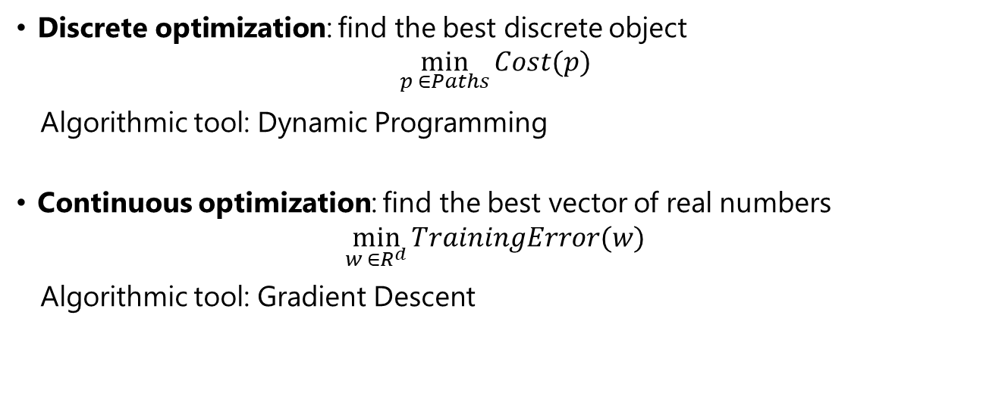
Optimizations
Discrete optimization: find the best discrete object
$$\min_{p ∈Paths}{Cost(p)}$$
Algorithmic tool: Dynamic Programming
Continuous optimization: find the best vector of real numbers
$$\min_{w ∈R^{d}}{TrainingError(w)}$$
Algorithmic tool: Gradient Descent
Notes:
We are now done with the high-level motivation for the class. Let us now dive into some technical details. Let us focus on the inference and the learning aspect of the modeling-inference-learning paradigm.
We will approach inference and learning from an optimization perspective, which allows us to decouple the mathematical specification of what we want to compute from the algorithms for how to compute it.
In total generality, optimization problems ask that you find the x that lives in a constraint set C that
makes the function F (x) as small as possible.
There are two types of optimization problems we’ll consider: discrete optimization problems (mostly for inference) and continuous optimization problems (mostly for learning). Both are backed by a rich research field and are interesting topics in their own right. For this course, we will use the most basic tools from these topics: dynamic programming and gradient descent.
Let us do two practice problems to illustrate each tool. For now, we are assuming that the model (opti- mization problem) is given and only focus on algorithms.

Slide 26

Problem: Computing Edit Distance
Input: two strings, s and t
Output: minimum number of character insertions, deletions, and substitutions it takes to change s into t
Examples:
”cat”, ”cat” | ⇒ | 0
”cat”, ”dog” | ⇒ | 3
”cat”, ”at” | ⇒ | 1
”cat”, ”cats” | ⇒ | 1
”a cat!”, ”the cats!” | ⇒ | 4
Notes:
Let’s consider the formal task of computing the edit distance (or more precisely the Levenshtein dis- tance) between two strings. These measures of dissimilarity have applications in spelling correction and computational biology (applied to DNA sequences).
As a first step, you should think of breaking down the problem into subproblems. Observation 1: inserting into s is equivalent to deleting a letter from t (ensures subproblems get smaller). Observation 2: perform edits at the end of strings (might as well start there).
Consider the last letter of s and t. If these are the same, then we don’t need to edit these letters, and we can proceed to the second-to-last letters. If they are different, then we have three choices. (i) We can substitute the last letter of s with the last letter of t. (ii) We can delete the last letter of s. (iii) We can insert the last letter of t at the end of s.
In each of those cases, we can reduce the problem into a smaller problem, but which one? We simply try
all of them and take the one that yields the minimum cost!
We can express this more formally with a mathematical recurrence. These types of recurrences will show up throughout the course, so it’s a good idea to be comfortable with them. Before writing down the actual recurrence, the first step is to express the quantity that we wish to compute. In this case: let

Slide 27
Solution
def distance(a,b,n,m):
if a or b is empty:
return length of non-empty string
else if last character is same:
return distance(a,b,n-1,m-1)
else:
find c1 cost of substitution
find c2 cost of deletion
find c3 cost of addition
return min(c1,c2,c3)

Slide 28
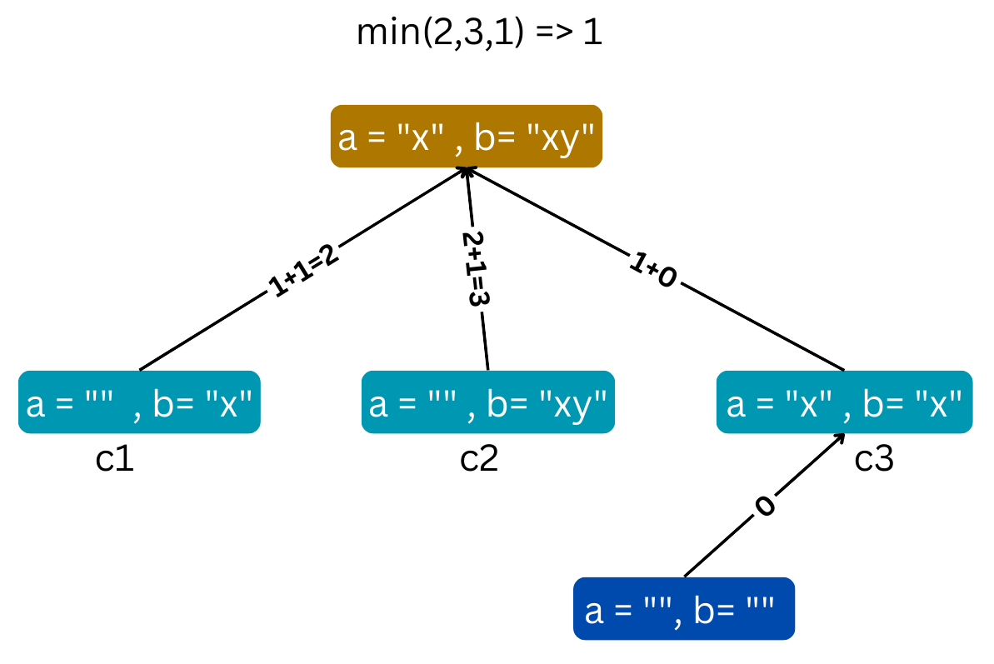
Solution
Example:
distance(x, xy, 1, 2)

Slide 29
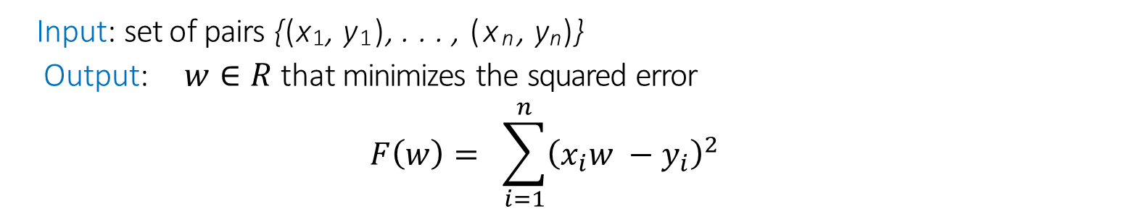
Problem: Finding the Least Square Lines
Input: set of pairs {(x₁, y₁), . . . , (x_{n}, y_{n})}
Output: $w∈R$that minimizes the squared error
$$F\left(w\right)= \sum_{i=1}^{n}{{\left(x_{i}w −y_{i}\right)}^{2}}$$
Examples:
{(2, 4)} | ⇒ | 2
{(2, 4), (4, 2)} | ⇒ | ?
Notes:
The formal task is this: given a set of n two-dimensional points (x_{i}, y_{i}) which defines F (w), compute the
w that minimizes F (w).
Linear regression is an important problem in machine learning, which we will come to later. Here’s a motivation for the problem: suppose you’re trying to understand how your exam score (y) depends on the number of hours you study (x). Let’s posit a linear relationship y = wx (not exactly true in practice, but maybe good enough). Now we get a set of training examples, each of which is a (x_{i}, y_{i}) pair. The goal is to find the slope w that best fits the data.
Back to algorithms for this formal task. We would like an algorithm for optimizing general types of F (w). So let’s abstract away from the details. Start at a guess of w (say w = 0), and then iteratively update w based on the derivative (gradient if w is a vector) of F (w). The algorithm we will use is called gradient descent.
If the derivative F^{t}(w) < 0, then increase w; if F^{t}(w) > 0, decrease w; otherwise, keep w still. This
motivates the following update rule, which we perform over and over again: w ← w − ηF^{t}(w), where
η > 0 is a step size that controls how aggressively we change w.
If η is too big, then w might bounce around and not converge. If η is too small, then w might not move very far to the optimum. Choosing the right value of η can be rather tricky. Theory can give rough guidance, but this is outside the scope of this class. Empirically, we will just try a few values and see which one works best. This will help us develop some intuition in the process.
Now to specialize to our function, we just need to compute the derivative, which is an elementary calculus

Slide 30
Solution

