Slide 1
CS 371 Artificial Intelligence
Samyan Qayyum Wahla
Fall 2023
Course Credits: Stanford-CS221

Slide 2


Slide 3
Week 3 – Lecture 1

Slide 4
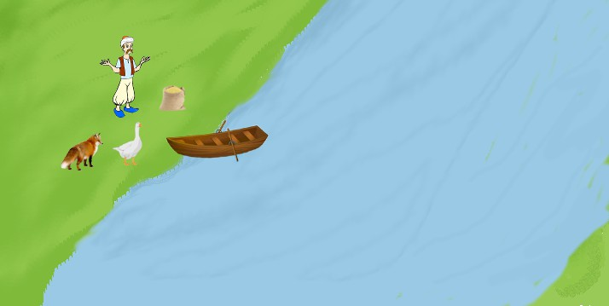
Storytelling…
Fox, River, Goose, Grain and Farmer…
Notes:
[1] https://www.google.com/url?sa=i&url=https%3A%2F%2Fsuresolv.com%2Fbrain-teaser%2Ffarmer-fox-goose-and-bag-corn-crossing-river-puzzle&psig=AOvVaw2DDOEVKAAhldTTxaWwJbrx&ust=1601960557689000&source=images&cd=vfe&ved=0CAIQjRxqFwoTCOC0lJjVnOwCFQAAAAAdAAAAABAD

Slide 5
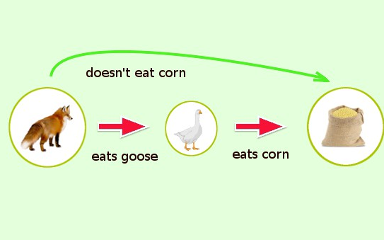

Representation - English?
Constraints:
Farmer wants to move everything across river
Ship is small
He can move only one possession at a time
Notes:
[1] https://www.google.com/url?sa=i&url=https%3A%2F%2Fsuresolv.com%2Fbrain-teaser%2Ffarmer-fox-goose-and-bag-corn-crossing-river-puzzle&psig=AOvVaw2DDOEVKAAhldTTxaWwJbrx&ust=1601960557689000&source=images&cd=vfe&ved=0CAIQjRxqFwoTCOC0lJjVnOwCFQAAAAAdAAAAABAJ
[2] https://www.google.com/url?sa=i&url=https%3A%2F%2Fwww.instructables.com%2Fid%2FFarmer-Fox-Goose-Grain-Puzzle%2F&psig=AOvVaw2DDOEVKAAhldTTxaWwJbrx&ust=1601960557689000&source=images&cd=vfe&ved=0CAIQjRxqFwoTCOC0lJjVnOwCFQAAAAAdAAAAABAQ

Slide 6
Trick Question
Farmer wants to get his corn, goose, and wolf across a river. He has a boat that only holds two. He cannot leave the corn and goose alone or the goose and wolf alone. How many river crossings does he need?
4
5
6
7
No solution

Slide 7
How to Solve?
Your might solved it like:
Trying to send the farmer over with the goose and observing the consequences. If nothing got eaten, you might continue with the next action. Otherwise, you undo that move and try something else.
How can we get a machine to do solve all problems like this automatically?
A systematic approach involves using search problems to define possibilities and search algorithms to explore them.

Slide 8
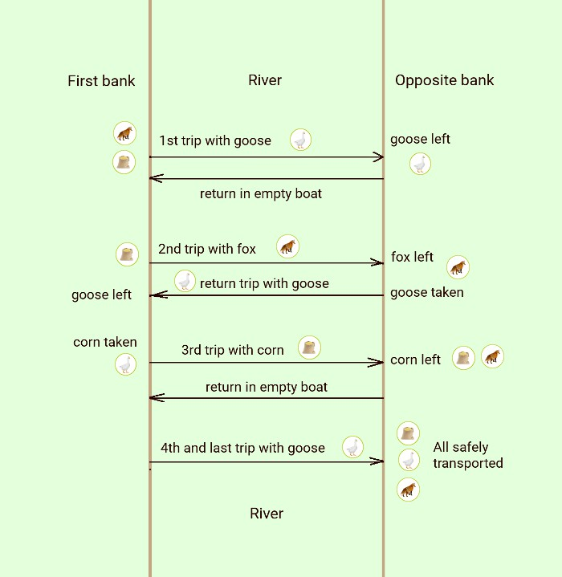

Slide 9
Course Plan
Search problems
Markov decision processes
Adversarial games
Constraint satisfaction problems
Bayesian networks
Reflex
States
Variables
Logic
Low Level Intelligence
High Level Intelligence
Artificial Intelligence

Slide 10
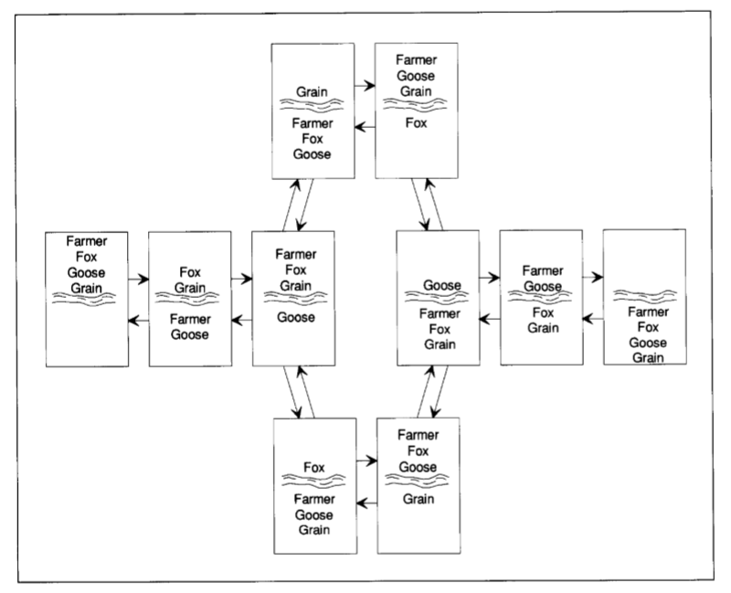

Slide 11
How many possibilities are there?
2^4 = 16
Safe?
10
Not safe
6

Slide 12
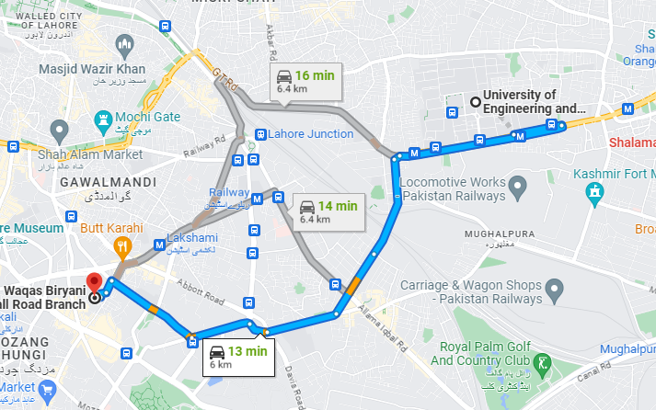
Route finding
Objective: shortest? fastest? most scenic?
Actions: go straight, turn left, turn right
Notes:
Route finding is perhaps the most canonical example of a search problem. We are given as input
map
source point
destination point.
Goal: output a sequence of actions (e.g., go straight, turn left, or turn right) that will take us from the source to the destination.
We might evaluate action sequences based on an objective (distance, time, or pleasantness).

Slide 13
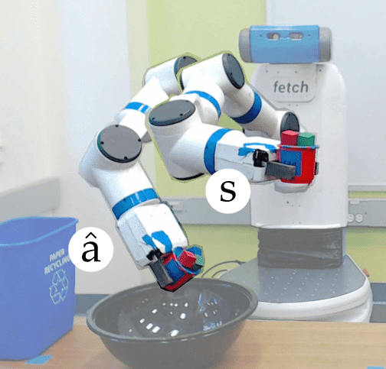
Robot Motion Planning
Objective: fastest? most energy efficient? safest? most expressive?
Actions: translate and rotate joints
Notes:
In robot motion planning, the goal is get a robot to move from one position/pose to another.
The desired output trajectory consists of individual actions, each action corresponding to moving or rotating the joints by a small amount.
Again, we might evaluate action sequences based on various resources like time or energy.

Slide 14
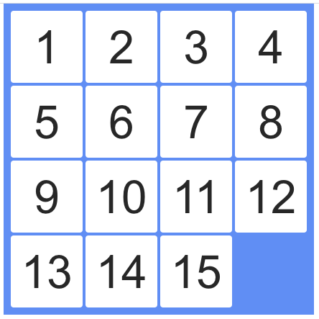
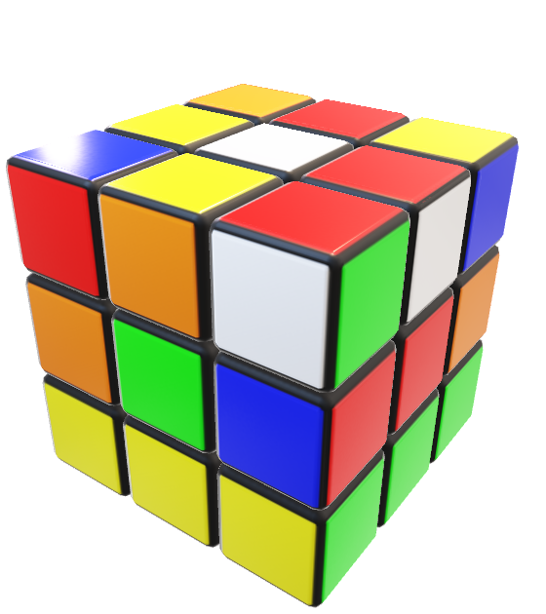
Solving Puzzles
Objective: reach a certain configuration
Actions: move pieces (e.g., Move12Down)
Notes:
Solution can be represented by a sequence of individual actions.
In the Rubik’s cube, an action is rotating one slice of the cube.
In the 15-puzzle, an action is moving one square to an adjacent free square.
In puzzles, even finding one solution might be an accomplishment. The more ambitious might want to find the best solution (say, minimize the number of moves).

Slide 15
Application: machine translation
Objective: fluent English and preserves meaning
Actions: append single words (e.g., the)
la maison bleue
the blue house

Slide 16
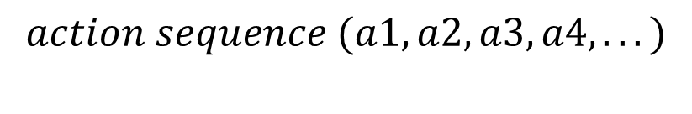

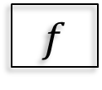


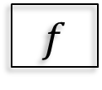
Beyond reflex
Classifier (reflex-based models):
$$x$$
$$f$$
$$single action y ∈\{+1,−1\}$$
Search problem (state-based models):
$$x$$
$$f$$
$$action sequence (a1, a2, a3, a4, . . . )$$
Key: need to consider future consequences of an action!
Notes:
Last week, we finished our tour of machine learning of reflex-based models (e.g., linear predictors and neural networks) that output either a +1 or −1 (for binary classification) or a real number (for regression).
While reflex-based models were appropriate for some applications such as sentiment classification or spam filtering, the applications we will look at today, such as solving puzzles, demand more.
To tackle these new problems, we will introduce search problems, our first instance of a state-based model.
In a search problem, in a sense, we are still building a predictor f which takes an input x, but f will now
return an entire action sequence, not just a single action. Of course you should object: can’t I just apply a reflex model iteratively to generate a sequence? While that is true, the search problems that we’re trying to solve importantly require reasoning about the consequences of the entire action sequence, and cannot be tackled by myopically predicting one action at a time.
Tangent: Of course, saying ”cannot” is a bit strong, since sometimes a search problem can be solved by a reflex-based model. You could have a massive lookup table that told you what the best action was for any given situation. It is interesting to think of this as a time/memory tradeoff where reflex-based models are performing an implicit kind of caching. Going on a further tangent, one can even imagine compiling a state-based model into a reflex-based model; if you’re walking around Stanford for the first time, you might have to really plan things out, but eventually it kind of becomes reflex.
We have looked at many real-world examples of this paradigm. For each example, the key is to decompose
the output solution into a sequence of primitive actions. In addition, we need to think about how to evaluate different possible outputs.

Slide 17
Roadmap
Tree search
Dynamic programming
Uniform cost search

Slide 18
Boat Crossing Problem
Farmer
Corn
Actions:
Goose
Fd FCd FGd FWd
Fa FCa FGa FWa
Wolf
Approach: build a search tree (”what if?”)

Slide 19
Farmer Crosses River Problem
For this problem, we have eight possible actions, which will be denoted by a concise set of symbols.
For example, the action
FGd means that the farmer will take the goose across to the right bank
Fa means that the farmer is coming back to the left bank alone.

Slide 20
FCGWǁ
FCd:1
FGd:1
FWd:1
GWǁ FC
CWǁFG
CGǁFW
Fa:1 FCWǁG
FCd:1
FWd:1
WǁFCG
CǁFGW
Fa:1 FGa:1
Fa:1 FGa:1
FWǁCG
FGWǁC
FCǁGW
FCGǁW
FWd:1
FCd:1
GǁFCW
GǁFCW
Fa:1
Fa:1
FGǁCW
FGǁCW
FGd:1
FGd:1
ǁFCGW
ǁFCGW

Slide 21
FCGWǁ
Search problem
FCd:1
FGd:1
FWd:1
GWǁFC
CWǁFG
CGǁFW
Definition: search problem
sstart: starting state
Actions(s): possible actions
Cost(s,a): action cost
Succ(s,a): successor
IsEnd(s): reached end state?
Fa:1 FCWǁG
FCd:1
FWd:1
WǁFCG
CǁFGW
Fa:1 FGa:1 FWǁCG FGWǁC
Fa:1 FGa:1 FCǁGW FCGǁW
FWd:1
FCd:1
GǁFCW
GǁFCW
Fa:1
Fa:1
FGǁCW
FGǁCW
FGd:1
FGd:1
ǁFCGW
ǁFCGW
Notes:
The search process involves creating a search tree with start and end states, where nodes represent states and edges correspond to possible actions with associated costs.
Each path from the root to a leaf in the search tree represents a potential action sequence, and the sum of edge costs on the path is the total cost.
The objective is to identify the lowest-cost root-to-leaf path that reaches a valid end state.
The search tree serves as a visualization tool for understanding search algorithms and the problem's structure in code.
In the boat crossing example, actions have a unit cost of 1, actions leading back to previous states are disallowed, and valid solutions are determined by end states in the search tree.

Slide 22
Transportation example
Street with blocks numbered 1 to n.
Walking from s to s + 1 takes 1 minute.
Taking a magic tram from s to 2s takes 2 minutes.
How to travel from 1 to n in the least time?
Notes:
Specifying precisely what the states, actions, goals, costs, and successors are.
To avoid the ambiguity of natural language, we will do this directly in code, where we define a SearchProblem class and implement the methods: startState, isEnd and succAndCost.

