Slide 1
CS 371
Artificial Intelligence
Samyan Qayyum Wahla
Fall 2023
Course Credits: Stanford-CS221

Slide 2


Slide 3
Week 3 – Lecture 2

Slide 4
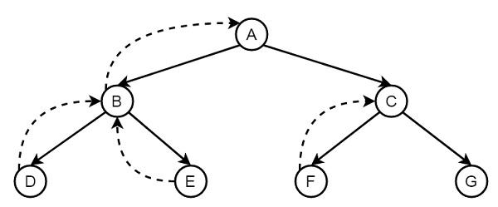
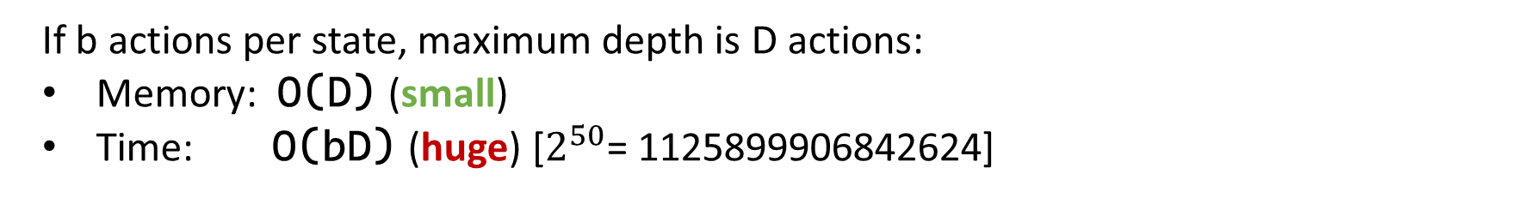
Backtracking search
If b actions per state, maximum depth is D actions:
Memory: O(D) (small)
Time: O(bD) (huge) [$2^{50}$= 1125899906842624]
Notes:
Backtracking search, the simplest algorithm which just tries all paths. The algorithm is called recursively on the current state s and the path leading up to that state.
If we have reached a goal, then we can update the minimum cost path with the current path. Otherwise, we consider all possible actions a from state s, and recursively search each of the possibilities.
Graphically, backtracking search performs a depth-first traversal of the search tree.
What is the time and memory complexity of this algorithm?
To get a simple characterization, assume that the search tree has maximum depth D (each path consists of D actions/edges) and that there are b available actions per state (the branching factor is b).
The running time is proportional to the number of nodes in the tree, since the algorithm needs to check each of them.
The number of nodes is:

Slide 5
Backtracking search
Algorithm: backtracking search
def backtrackingSearch(s, path):
If IsEnd(s): update minimum cost path
For each action a ∈ Actions(s):
  Extend path with Succ(s, a) and Cost(s, a) Call backtrackingSearch(Succ(s, a), path)
Return minimum cost path

Slide 6
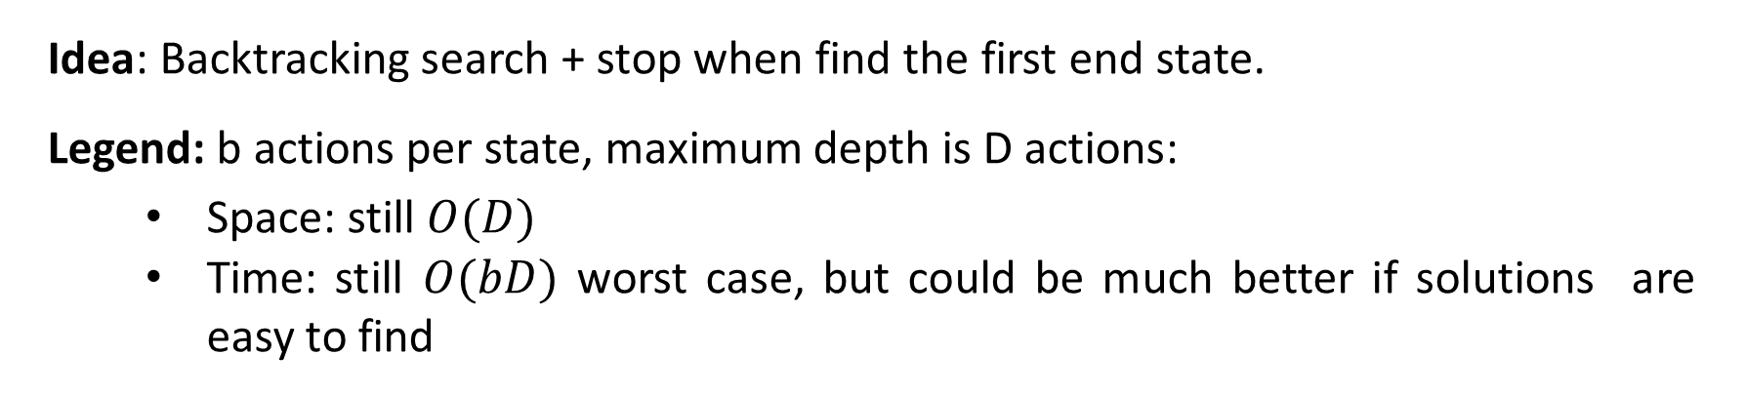
Depth-first search
Idea: Backtracking search + stop when find the first end state.
Legend: b actions per state, maximum depth is D actions:
  Space: still $O(D)$
  Time: still $O(bD)$ worst case, but could be much better if solutions are easy to find
Note: Assume action costs Cost(s, a) = 0.
Notes:
Backtracking search will always work (i.e., find a minimum cost path), but there are cases where we can do it faster. But in order to do that, we need some additional assumptions — there is no free lunch.
Suppose we make the assumption that all the action costs are zero. In other words, all we care about is finding a valid action sequence that reaches the goal. Any such sequence will have the minimum cost: zero.
In this case, we can just modify backtracking search to not keep track of costs and then stop searching as
soon as we reach a goal. The resulting algorithm is depth-first search (DFS), which should be familiar to you. The worst time and space complexity are of the same order as backtracking search. In particular, if there is no path to an end state, then we have to search the entire tree.
However, if there are many ways to reach the end state, then we can stop much earlier without exhausting the search tree. So DFS is great when there are an abundance of solutions.

Slide 7
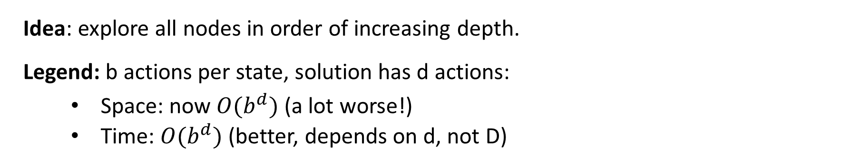
Breadth-first search
Idea: explore all nodes in order of increasing depth.
Legend: b actions per state, solution has d actions:
  Space: now $O(b^{d})$ (a lot worse!)
  Time: $O(b^{d})$ (better, depends on d, not D)
Note: Assume action costs Cost(s, a) = c for some c ≥ 0.
Notes:
Breadth-first search (BFS), which should also be familiar, makes a less stringent assumption, that all the action costs are the same non-negative number. This effectively means that all the paths of a given length have the same cost.
BFS maintains a queue of states to be explored. It pops a state off the queue, then pushes its successors back on the queue.
BFS will search all the paths consisting of one edge, two edges, three edges, etc., until it finds a path
that reaches a end state. So if the solution has d actions, then we only need to explore O(b^{d}) nodes, thus taking that much time.
However, a potential show-stopper is that BFS also requires O(b^{d}) space since the queue must contain all the nodes of a given level of the search tree. Can we do better?

Slide 8
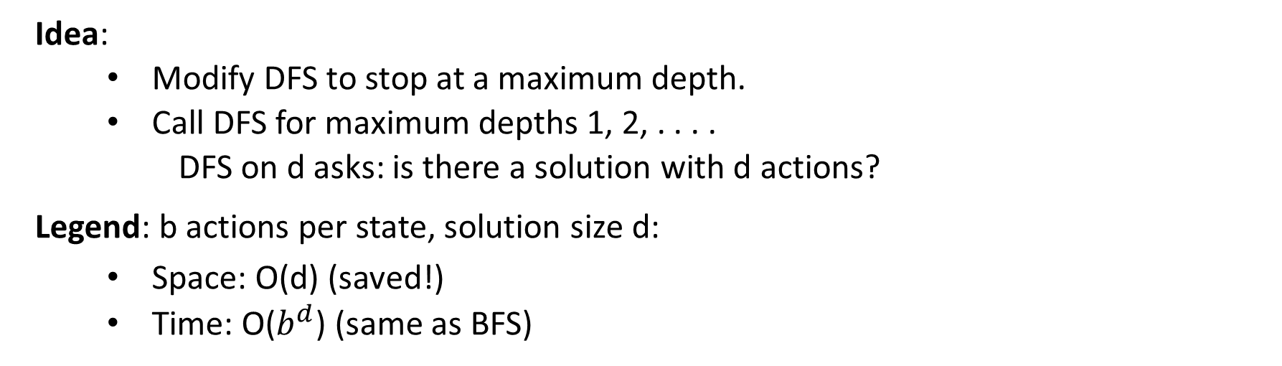
DFS with iterative deepening
Idea:
  Modify DFS to stop at a maximum depth.
  Call DFS for maximum depths 1, 2, . . . .
    DFS on d asks: is there a solution with d actions?
Legend: b actions per state, solution size d:
  Space: O(d) (saved!)
  Time: O($b^{d}$) (same as BFS)
Note: Assume action costs Cost(s, a) = c for some c ≥ 0.
Notes:
Yes, we can do better with a trick called iterative deepening. The idea is to modify DFS to make it stop after reaching a certain depth. Therefore, we can invoke this modified DFS to find whether a valid path exists with at most d edges, which as discussed earlier takes O(d) space and O(b^{d}) time.
Now the trick is simply to invoke this modified DFS with cutoff depths of 1, 2, 3, . . . until we find a solution or give up. This algorithm is called DFS with iterative deepening (DFS-ID). In this manner, we are guaranteed optimality when all action costs are equal (like BFS), but we enjoy the parsimonious space requirements of DFS.
One might worry that we are doing a lot of work, searching some nodes many times. However, keep in mind that both the number of leaves and the number of nodes in a search tree is O(b^{d}) so asymptotically DFS with iterative deepening is the same time complexity as BFS.

Slide 9
Tree search algorithms
Legend: $b$ actions/state, solution depth d, maximum depth D
Algorithm | Action Costs | Space | Time
Backtracking | any | O(D) | O($b^{D})$
DFS | Zero | O(D) | O(𝑏^𝐷)
BFS | constant ≥ 0 | O($b^{d}$) | O($b^{d}$)
DFS-ID | constant ≥ 0 | O(d) | O($b^{d}$)
Always exponential time
Avoid exponential space with DFS-ID
Notes:
Here is a summary of all the tree search algorithms, the assumptions on the action costs, and the space and time complexities.
The take-away is that we can’t avoid the exponential time complexity, but we can certainly have linear space complexity. Space is in some sense the more critical dimension in search problems. Memory cannot magically grow, whereas time ”grows” just by running an algorithm for a longer period of time, or even by parallelizing it across multiple machines (e.g., where each processor gets its own subtree to search).

Slide 10
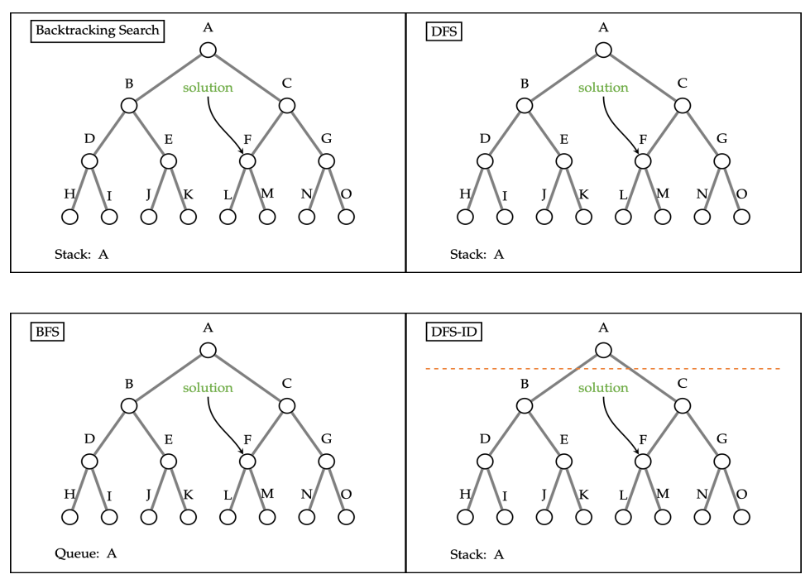
Tree Search Review

