Slide 1
CS 371
Artificial Intelligence
Samyan Qayyum Wahla
Fall 2023
Course Credits: Stanford-CS221

Slide 2


Slide 3

Week 4 Lecture 1

Slide 4


Definition: search problem
s_{start}: starting state
Actions(s): possible actions from state s
Cost(s, a): action cost
transition(s, a): Find Next State given current State and Action
IsGoal(s): reached goal state?
Objective
find the minimum cost path from s_{start} to an s satisfying that we have reached on the goal state i.e. isGoal(s) is true.

Slide 5

Key idea: state
A state is a summary of all the past actions sufficient to choose future actions optimally.

Slide 6
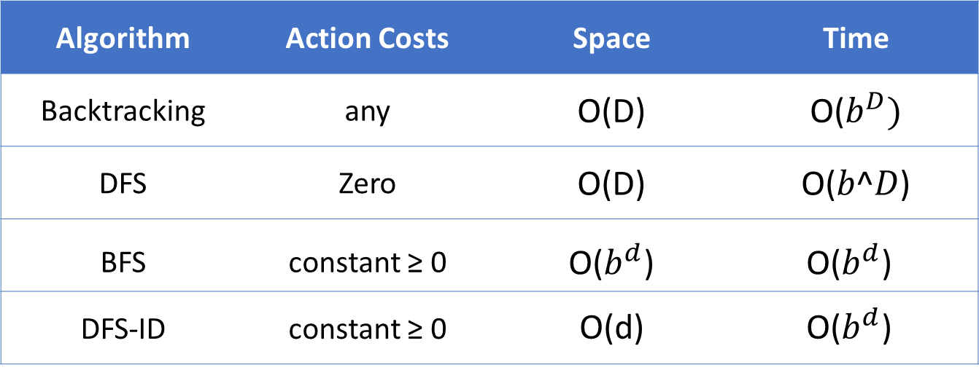
Tree search algorithms
Legend: $b$ actions/state, solution depth d, maximum depth D
Algorithm | Action Costs | Space | Time
Backtracking | any | O(D) | O($b^{D})$
DFS | Zero | O(D) | O(𝑏^𝐷)
BFS | constant ≥ 0 | O($b^{d}$) | O($b^{d}$)
DFS-ID | constant ≥ 0 | O(d) | O($b^{d}$)
Always exponential time
Avoid exponential space with DFS-ID
Notes:
Here is a summary of all the tree search algorithms, the assumptions on the action costs, and the space and time complexities.
The take-away is that we can’t avoid the exponential time complexity, but we can certainly have linear space complexity. Space is in some sense the more critical dimension in search problems. Memory cannot magically grow, whereas time ”grows” just by running an algorithm for a longer period of time, or even by parallelizing it across multiple machines (e.g., where each processor gets its own subtree to search).

Slide 7
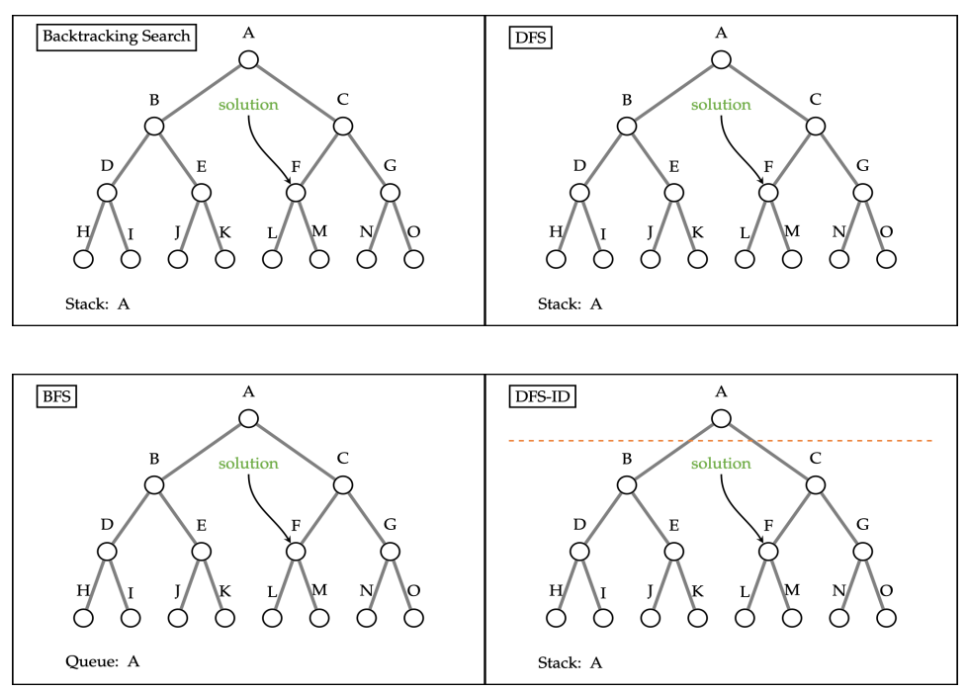
Tree Search Review

Slide 8
Definition: Transportation Example
Move from state 1 to n moving forward
Start state: 1
Walk action: from s to s + 1 (cost: 1)
Tram action: from s to 2s (cost: 2)
End state: n
State:
current city

Slide 9
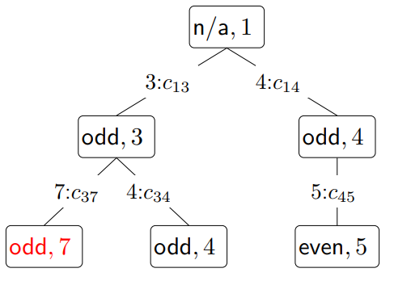

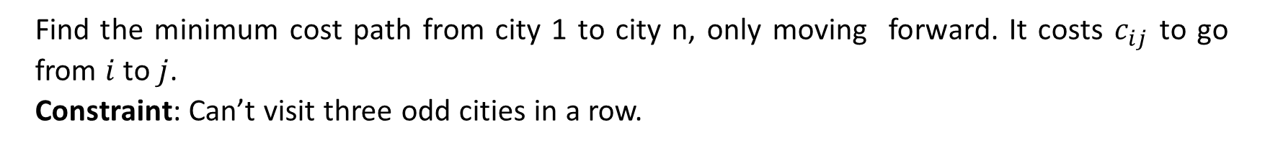
Handling additional constraints
Example: Route finding
Find the minimum cost path from city 1 to city n, only moving forward. It costs $c_{ij}$ to go from $i$ to $j$.
Constraint: Can’t visit three odd cities in a row.
What will the state definition?
How many Minimum states are possible?
State: (whether previous city was odd,
current city)
Notes:
Let’s add a constraint that says we can’t visit three odd cities in a row. If we only keep track of the current city, and we try to move to a next city, we cannot enforce this constraint because we don’t know what the previous city was. So let’s add the previous city into the state.
This will work, but we can actually make the state smaller. We only need to keep track of whether the previous city was an odd numbered city to enforce this constraint.
Note that in doing so, we have 2n states rather than n² states, which is a substantial savings. So the lesson is to pay attention to what information you actually need in the state.

Slide 10

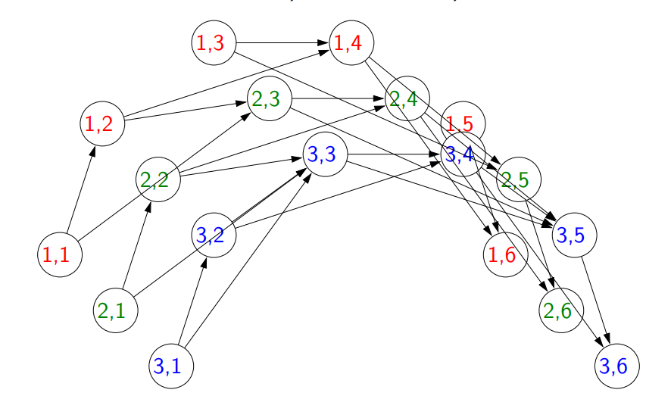
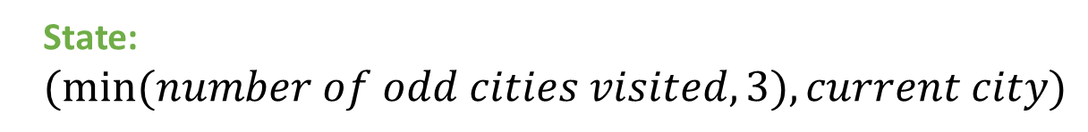
Activity
Objective
travel from city 1 to city n, visiting at least 3 odd cities. What is the minimal state?
State: $(min⁡(number of odd cities visited, 3), current city)$

Slide 11

Exercise
Objective
travel from city 1 to city n, visiting more odd than even cities. What is the minimal state?

Slide 12
Take Away
State: summary of past actions sufficient to choose future actions optimally
Dynamic programming: backtracking search with memorization — potentially exponential savings
Dynamic programming only works for
acyclic graphs. what if there are cycles?

Slide 13
Uniform Cost Search

Slide 14
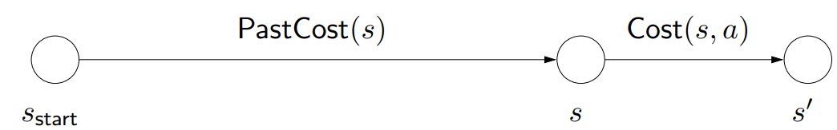
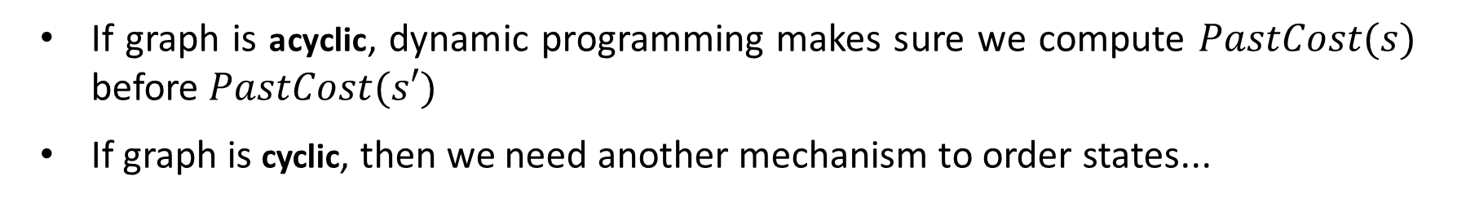
Ordering the states
Observation: prefixes of optimal path are optimal
If graph is acyclic, dynamic programming makes sure we compute $PastCost(s)$ before $PastCost(s′)$
If graph is cyclic, then we need another mechanism to order states...
Notes:
Recall that we used dynamic programming to compute the future cost of each state s, the cost of the minimum cost path from s to a end state.
We can analogously define PastCost(s), the cost of the minimum cost path from the start state to s. If instead of having access to the successors via Succ(s, a), we had access to predecessors (think of reversing the edges in the state graph), then we could define a dynamic program to compute all the PastCost(s).
Dynamic programming relies on the absence of cycles, so that there is always a clear order in which to compute all the past costs. If the past costs of all the predecessors of a state s are computed, then we could compute the past cost of s by taking the minimum.
Note that PastCost(s) will always be computed before PastCost(s′) if there is an edge from s to s′. In essence, the past costs will be computed according to a topological ordering of the nodes.
However, when there are cycles, no topological ordering exists, so we need another way to order the states.

Slide 15
Intuition from Dijkstra Algorithm
Aside

Slide 16
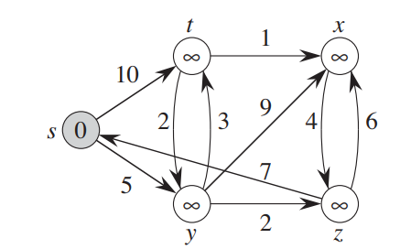
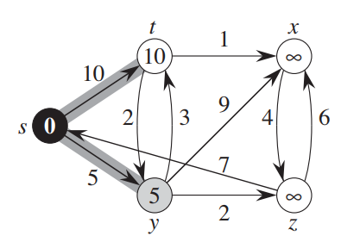
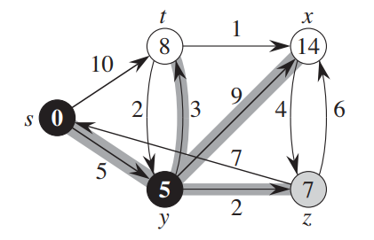

Slide 17
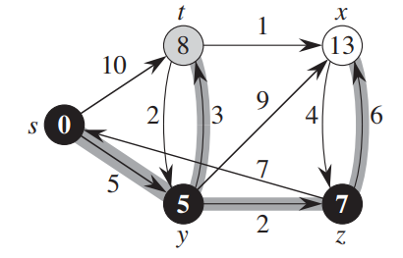
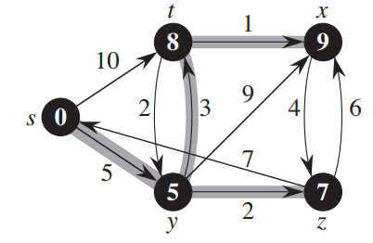
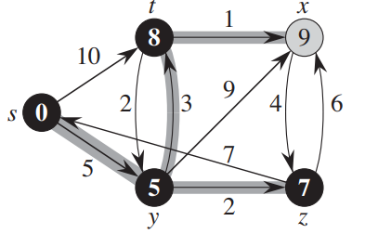

Slide 18
End Aside
Dijkstra
Stop on Goal
Uniform Cost Search

Slide 19
Uniform cost search (UCS)
Key idea: state ordering
UCS enumerates states in order of increasing past cost.
Assumption: non-negativity
All action costs are non-negative: Cost(s, a) ≥ 0.
Notes:
The key idea that uniform cost search (UCS) uses is to compute the past costs in order of increasing past cost. To make this efficient, we need to make an important assumption that all action costs are non-negative.
This assumption is reasonable in many cases, but doesn’t allow us to handle cases where actions have payoff. To handle negative costs (positive payoffs), we need the Bellman-Ford algorithm. When we talk about value iteration for MDPs, we will see a form of this algorithm.
Note: those of you who have studied algorithms should immediately recognize UCS as Dijkstra’s algorithm.
Logically, the two are indeed equivalent. There is an important implementation difference: UCS takes as input a search problem, which implicitly defines a large and even infinite graph, whereas Dijkstra’s algorithm (in the typical exposition) takes as input a fully concrete graph. The implicitness is important in practice because we might be working with an enormous graph (a detailed map of world) but only need to find the path between two close by points (Stanford to Palo Alto).
Another difference is that Dijkstra’s algorithm is usually thought of as finding the shortest path from the start state to every other node, whereas UCS is explicitly about finding the shortest path to an end state. This difference is sharpened when we look at the A* algorithm next time, where knowing that we’re trying to get to the goal can yield a much faster algorithm. The name uniform cost search refers to the fact that we are exploring states of the same past cost uniformly (the video makes this visually clear); in contrast, A* will explore states which are biased towards the end state.

Slide 20
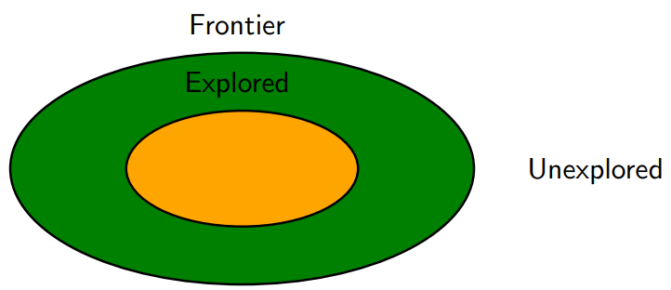
High-level strategy
Explored(Black): states we’ve found the optimal path to
Frontier(grey): states we’ve seen, still figuring out how to get there cheaply
Unexplored(white): states we haven’t seen
Notes:
The general strategy of UCS is to maintain three sets of nodes: explored, frontier, and unexplored. Throughout the course of the algorithm, we will move states from unexplored to frontier, and from frontier to explored.
The key invariant is that we have computed the minimum cost paths to all the nodes in the explored set. So when the end state moves into the explored set, then we are done.

Slide 21
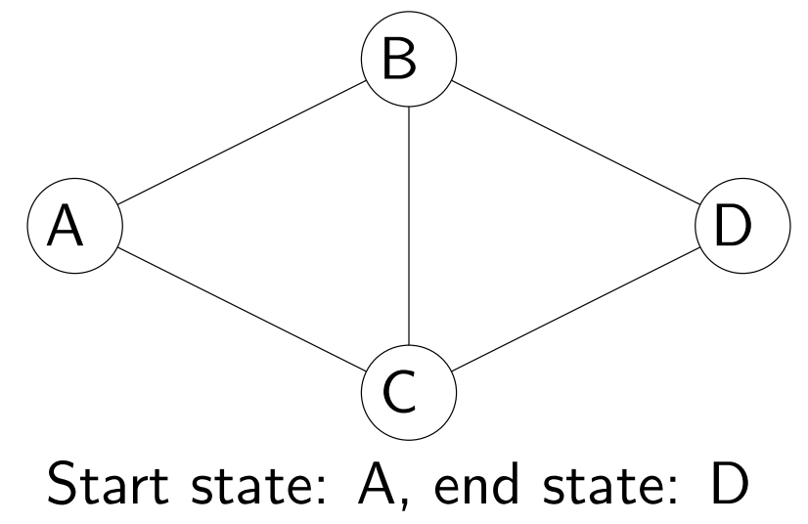
Uniform cost search example
Example: UCS example
Minimum cost path:
$$A → B → C → D with cost 3$$
Notes:
Before we present the full algorithm, let’s walk through a concrete example.
Initially, we put A on the frontier. We then take A off the frontier and mark it as explored. We add B and C to the frontier with past costs 1 and 100, respectively.
Next, we remove from the frontier the state with the minimum past cost (priority), which is B. We mark B as explored and consider successors A, C, D. We ignore A since it’s already explored. The past cost of C gets updated from 100 to 2. We add D to the frontier with initial past cost 101.
Next, we remove C from the frontier; its successors are A, B, D. A and B are already explored, so we only update D’s past cost from 101 to 3.
Finally, we pop D off the frontier, find that it’s a end state, and terminate the search.

Slide 22
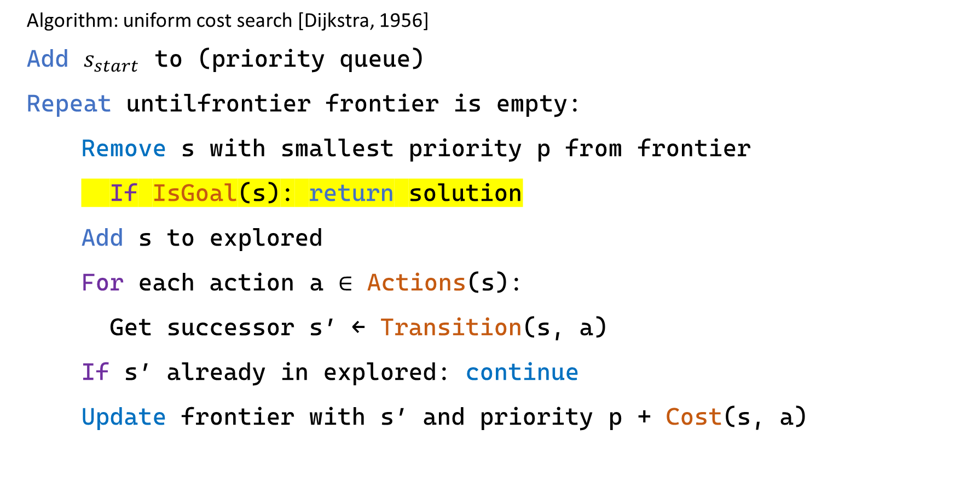
Uniform cost search (UCS)
Algorithm: uniform cost search [Dijkstra, 1956]
Add $s_{start}$ to (priority queue)
Repeat untilfrontier frontier is empty:
  Remove s with smallest priority p from frontier
  If IsGoal(s): return solution
  Add s to explored
  For each action a ∈ Actions(s):
  Get successor s′ ← Transition(s, a)
  If s′ already in explored: continue
  Update frontier with s′ and priority p + Cost(s, a)
Notes:
Implementation note: we use util.PriorityQueue which supports removeMin and update. Note that frontier.update(state, pastCost) returns whether pastCost improves the existing estimate of the past cost of state.

Slide 23
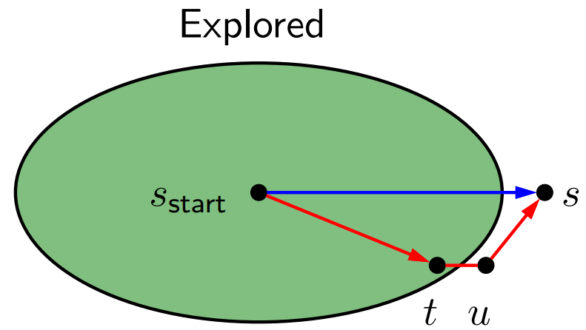
Analysis of uniform cost search
Theorem: correctness
When a state $s$ is popped from the frontier and moved to explored, its priority is $PastCost(s)$, the minimum cost to $s$.
Proof:
Notes:
Let p_{s} be the priority of s when s is popped off the frontier. Since all costs are non-negative, p_{s} increases over the course of the algorithm.
Suppose we pop s off the frontier. Let the blue path denote the path with cost p_{s}.
Consider any alternative red path from the start state to s. The red path must leave the explored region at some point; let t and u = Succ(t, a) be the first pair of states straddling the boundary. We want to show that the red path cannot be cheaper than the blue path via a string of inequalities.
First, by definition of PastCost(t) and non-negativity of edge costs, the cost of the red path is at least the cost of the part leading to u, which is PastCost(t) + Cost(t, a) = p_{t} + Cost(t, a), where the last equality is by the inductive hypothesis.
Second, we have p_{t} + Cost(t, a) ≥ p_{u} since we updated the frontier based on (t, a).
Third, we have that p_{u} ≥ p_{s} because s was the minimum cost state on the frontier.
Note that p_{s} is the cost of the blue path.

Slide 24
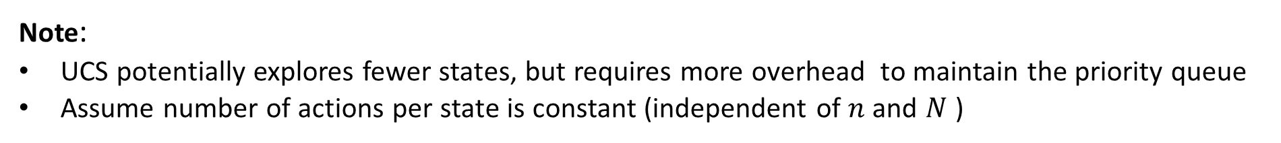
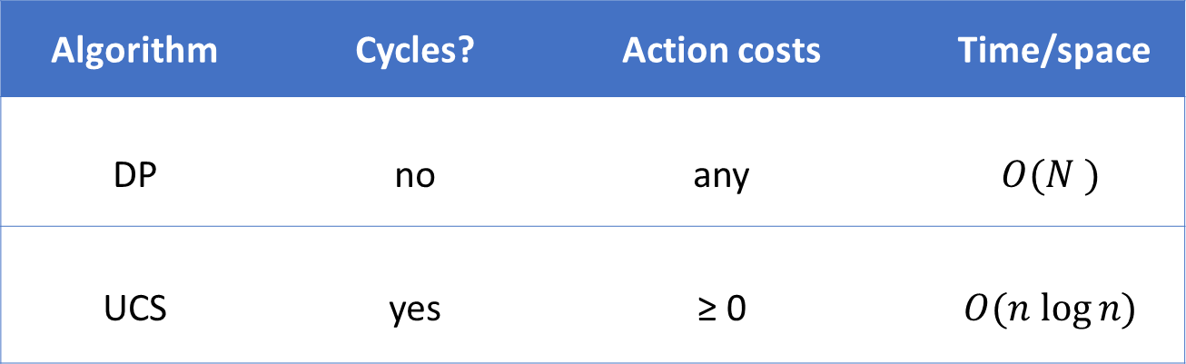
DP versus UCS
$N$ total states, $n$ of which are closer than end state
Algorithm | Cycles? | Action costs | Time/space
DP | no | any | $$O(N )$$
UCS | yes | ≥ 0 | $$O(n log⁡n)$$
Note:
UCS potentially explores fewer states, but requires more overhead to maintain the priority queue
Assume number of actions per state is constant (independent of $n$ and $N$ )
Notes:
DP and UCS have complementary strengths and weaknesses; neither dominates the other.
DP can handle negative action costs, but is restricted to acyclic graphs. It also explores all N reachable states from s_{start}, which is inefficient. This is unavoidable due to negative action costs.
UCS can handle cyclic graphs, but is restricted to non-negative action costs. An advantage is that it only needs to explore n states, where n is the number of states which are cheaper to get to than any end state. However, there is an overhead with maintaining the priority queue.
One might find it unsatisfying that UCS can only deal with non-negative action costs. Can we just add a
large positive constant to each action cost to make them all non-negative? It turns out this doesn’t work because it penalizes longer paths more than shorter paths, so we would end up solving a different problem.

Slide 25
Activity
Question
Suppose we want to travel from city 1 to city n (going only forward) and back to city 1 (only going backward).It costs c_{ij} ≥ 0 to go from i to
j. Which of the following algorithms can be used to find the minimum cost path (select all that apply)?
Depth First Search
Breadth First Search
Dynamic Programming
Uniform Cost Search

Slide 26
1
2
3
4
5
6
7
8
…
n
What will be the state here
1
2
3
4
…
n
…
4
3
2
1

