Slide 1
CS 371
Artificial Intelligence
Samyan Qayyum Wahla
Fall 2023
Course Credits: Stanford-CS221

Slide 2


Slide 3

Week 4 Lecture 2

Slide 4
Paradigm
Review
Major Pillars
Modeling
Learning
Inference

Slide 5
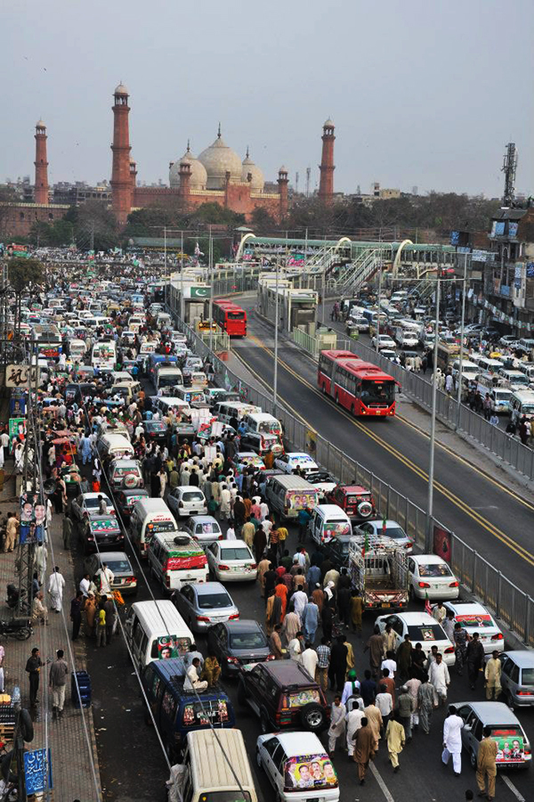
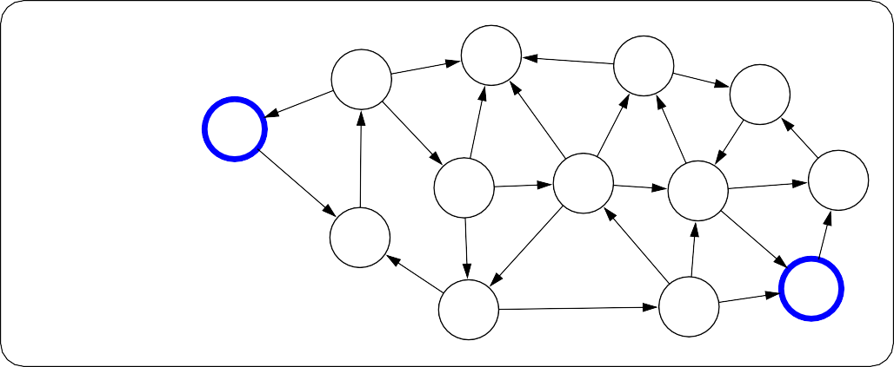
Paradigm
Modeling
Review
Real world
6
7
4
5
5
5
3
1
Model
0
8
6
3
8
8
1
1
7
2
3
6
7
2
4
8
6
Notes:
The first pillar is modeling. Modeling takes messy real world problems and packages them into neat formal mathematical objects called models, which can be subject to rigorous analysis and can be operated on by computers. However, modeling is lossy: not all of the richness of the real world can be captured, and therefore there is an art of modeling: what does one keep versus ignore? (An exception to this are games such as Chess, Go or Sodoku, where the real world is identical to the model.)
As an example, suppose we’re trying to have an AI that can navigate through a busy city. We might formulate this as a graph where nodes represent points in the city, edges represent the roads, and the cost of an edge represents the traffic on that road.

Slide 6

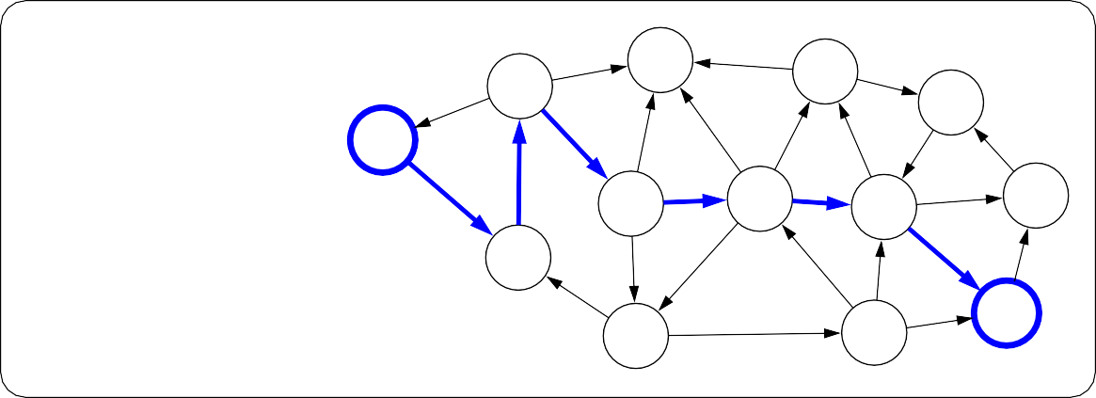
Review
Paradigm
Inference
6
7
4
5
5
5
3
1
Model
0
8
6
3
8
8
1
1
7
2
3
6
7
2
4
8
6
Inference
6
7
4
5
8
5
5
3
1
Predictions
0
6
3
8
8
1
1
7
2
3
6
7
2
4
8
6
Notes:
The second pillar is inference. Given a model, the task of inference is to answer questions with respect to the model. For example, given the model of the city, one could ask questions such as: what is the shortest path? what is the cheapest path?
The focus of inference is usually on efficient algorithms that can answer these questions. For some models, computational complexity can be a concern (games such as Go), and usually approximations are needed.

Slide 7
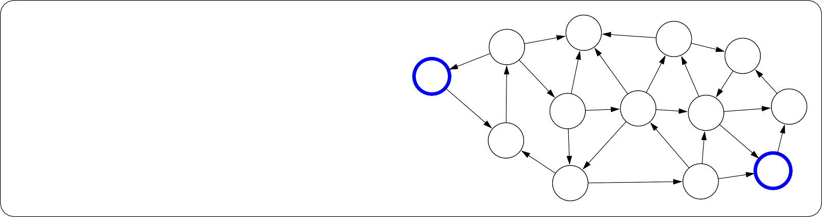
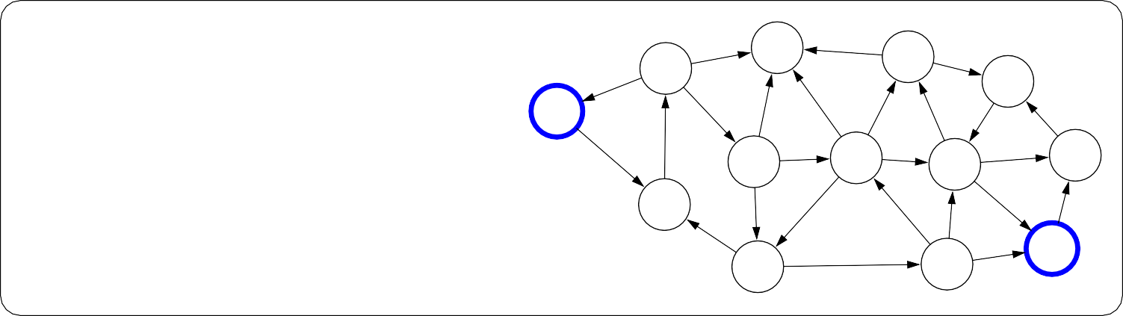
Review
Paradigm
Learning
?
?
?
?
?
?
?
?
Model without parameters
?
?
?
?
+ Data
?
?
?
?
?
?
?
?
?
?
?
?
?
Learning
6
7
4
5
5
5
3
1
Model with parameters
0
8
6
3
8
8
1
1
7
2
3
6
7
2
4
8
6
Notes:
But where does the model come from? Remember that the real world is rich, so if the model is to be faithful, the model has to be rich as well. But we can’t possibly write down such a rich model manually.
The idea behind (machine) learning is to instead get it from data. Instead of constructing a model, one constructs a skeleton of a model (more precisely, a model family), which is a model without parameters. And then if we have the right type of data, we can run a machine learning algorithm to tune the parameters of the model.
Note that learning here is not tied to a particular approach (e.g., neural networks), but more of a philosophy.
This general paradigm will allow us to bridge the gap between logic-based AI and statistical AI.

Slide 8
Learning Costs

Slide 9


Search Problem
Transportation Example
Move from state 1 to n moving forward
Start state: 1
Walk action: from s to s + 1 (cost: 1)
Tram action: from s to 2s (cost: 2)
End state: n
State:
current city
search algorithm
walk walk tram tram tram walk tram tram
(minimum cost path)

Slide 10
Learning Problem
Transportation Example
Move from state 1 to n moving forward
Start state: 1
Walk action: from s to s + 1 (cost: 1)
Tram action: from s to 2s (cost: 2)
End state: n
State:
current city
Learning algorithm
walk cost: 1 tram cost: 2
Notes:
Now suppose we don’t know what the costs are, but we observe someone getting from 1 to n via some sequence of walking and tram-taking. Can we figure out what the costs are? This is the goal of learning.

Slide 11
Learning as an inverse problem
Predictor
Forward problem (search):
Input
Search Problem
(cost of each action)
Output
Sequence of
Actions towards
optimal path
Cost(s, a)
(a₁, . . . , a_{k})
Inverse problem (learning):
Data
Examples containing
Optimal paths
(might contain some noise)
Learner
(a₁, . . . , a_{k})
Cost(s, a)
Predictor
Notes:
More generally, so far we have thought about search as a ”forward” problem: given costs, finding the optimal sequence of actions.
Learning concerns the ”inverse” problem: given the desired sequence of actions, reverse engineer the costs.

Slide 12
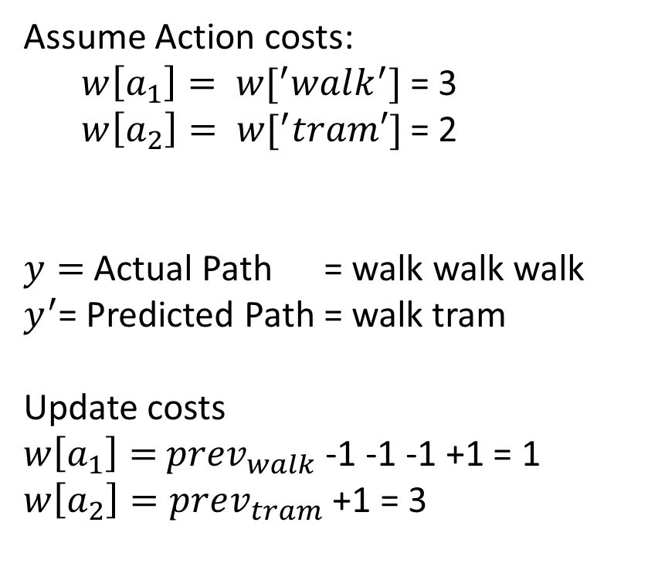
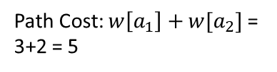
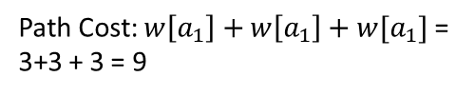
Learning as an inverse problem
Assume Action costs:
$w\left[a_{1}\right]= w[^{′}walk^{′}]$ = 3
$w\left[a_{2}\right]= w[^{′}tram′]$ = 2
$y=$Actual Path = walk walk walk
$y^{′}$= Predicted Path = walk tram
Update costs
$w\left[a_{1}\right]=$ $prev_{walk}$ -1 -1 -1 +1 = 1
$w\left[a_{2}\right]=prev_{tram}$ +1 = 3
Input x: search problem without costs
1
walk:?
2
walk:? tram:?
3
walk:?
4
4
Path Cost: $w\left[a_{1}\right]+w[a_{2}]$ =
3+2 = 5
Path Cost: $w\left[a_{1}\right]+w\left[a_{1}\right]+w[a_{1}]$ =
3+3 + 3 = 9
Output y: solution path
walk walk walk
Notes:
Let’s cast the problem as predicting an output y given an input x. Here, the input x is the search problem (visualized as a search tree) without the costs provided. The output y is the desired solution path. The question is what the costs should be set to so that y is actually the minimum cost path of the resulting search problem.

Slide 13
Costs: {walk:1, tram:3}
Minimum cost path:
1
walk:1
2
Costs: {walk:3, tram:2}
Minimum cost path:
1
walk:3
2
walk:3 tram:2
3
walk:3 4
Tweaking costs
walk:1 tram:3
3
walk:1
4
4
4
Notes:
Suppose the walk cost is 3 and the tram cost is 2. Then, we would obviously predict the [walk, tram] path, which has lower cost.
But this is not our desired output, because we actually saw the person walk all the way from 1 to 4. How can we update the action costs so that the minimum cost path is walking?
Intuitively, we want the tram cost to be more and the walk cost to be less. Specifically, let’s increase the
cost of every action on the predicted path and decrease the cost of every action on the true path. Now, the predicted path coincides with the true observed path. Is this a good strategy in general?

Slide 14
Modeling costs (simplified)
Assume costs depend only on the action:
Cost(s, a) = w[a]
Candidate output path:
y:
a₁ : w[a₁]
a₂ : w[a₂]
a₃ : w[a₃]
s₀
s₁
s₂
s₃
Path cost:
Cost(y) = w[a₁] + w[a₂] + w[a₃]
Notes:
For each action a, we define a weight w[a] representing the cost of action a. Without loss of generality, let us assume that the cost of the action does not depend on the state s.
Then the cost of a path y is simply the sum of the weights of the actions on the path. Every path has some cost, and recall that the search algorithm will return the minimum cost path.

Slide 15

Learning algorithm
Algorithm: Structured Perceptron
For each action: w[a] ← 0
For each iteration t = 1, . . . T :
  For each training example (x, y) ∈ D_{train}:
    Compute the minimum cost path y^{j} given w
    For each action a ∈ y: w[a] ← w[a] − 1
    For each action a ∈ y^{j}: w[a] ← w[a] + 1
Try to decrease cost of true y (from training data)
Try to increase cost of predicted y^{j} (from search)

Slide 16
Applications
Part-of-speech tagging
Fruit flies like a banana.
Noun Noun Verb Det Noun
Machine translation
la maison bleue
the blue house
Notes:
The structured Perceptron was first used for natural language processing tasks. Given it’s simplicity, the Perceptron works reasonably well. With a few minor tweaks, you get state-of-the-art algorithms for structured prediction, which can be applied to many tasks such as machine translation, gene prediction, information extraction, etc.
On a historical note, the structured Perceptron merges two relatively classic communities. The first
is search algorithms (uniform cost search was developed by Dijkstra in 1956). The second is machine learning (Perceptron was developed by Rosenblatt in 1957). It was only over 40 years later that the two met.

Slide 17
Transportation Problem
class TranportationProblem(object):
def __init__(self, N):
self.N = N
def startState(self):
return 1
def isGoal(self, state):
return state == self.N
def actions(self, state):
actions=[]
if(state+ 1 <= self.N):
actions.append('walk')
if(state *2<= self.N):
actions.append('tram')
return actions
def transition(self, state, action):
new_state = 0
if(action == 'walk'):
new_state = state + 1
elif(action =='tram'):
new_state = state *2
return new_state
def cost(self, action):
cost_val = 0
if(action == 'walk'):
cost_val = 1
elif(action =='tram'):
cost_val = 2
return cost_val

Slide 18
Transportation Problem
class TranportationProblem(object):
def __init__(self, N, weights):
self.N = N
self.weights = weights
def startState(self):
return 1
def isGoal(self, state):
return state == self.N
def actions(self, state):
actions=[]
if(state+ 1 <= self.N):
actions.append('walk')
if(state *2<= self.N):
actions.append('tram')
return actions
def transition(self, state, action):
new_state = 0
if(action == 'walk'):
new_state = state + 1
elif(action =='tram'):
new_state = state *2
return new_state
def cost(self, action):
cost_val = 0
if(action == 'walk'):
cost_val = self.weights['walk']
elif(action =='tram'):
cost_val = self.weights['tram']
return cost_val

Slide 19

Learning Problem in Action
Learning requires the correct examples against the output from the environment.
How we get these examples?

Slide 20

Generate the Data from the Environment
Data Generator
(knows the mechanism to do work)
Costs are hidden inside
N = 1: w
N= 2: w, t
N =3: w, w, w
…
…
N = 10: w, t, t, w
Observer

Slide 21
Data Generator in Action
def predict(N, weights):
# f(x)
# Input (x): N (number of blocks)
# Output (y): path (sequence of actions)
problem = TransportationProblem(N, weights)
totalCost, history = dynamicProgramming(problem)
return [action for action, newState, cost in history]
def generateExamples():
trueWeights = {'walk': 1, 'tram’: 2}
return [(N, predict(N, trueWeights)) for N in range(1, 10)]

Slide 22
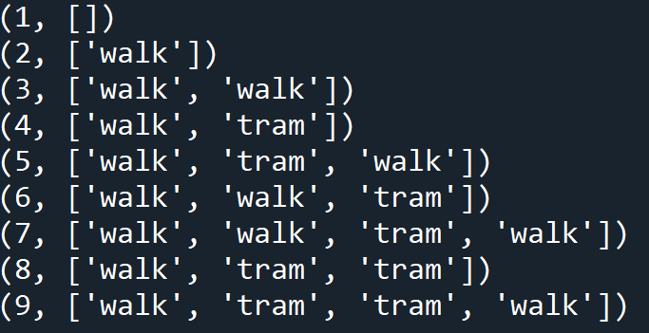
Data Generator for Transportation Problem (N = 10)
Walk: 1, Tram: 2

Slide 23
Structured Perceptron (Learning Algorithm)
def structuredPerceptron(examples):
weights = {'walk': 0, 'tram': 0}
for t in range(100):
numMistakes = 0
for N, trueActions in examples:
# Make a prediction
predActions = predict(N, weights)
if predActions != trueActions:
numMistakes += 1
# Update weights
for action in trueActions:
weights[action] -= 1
for action in predActions:
weights[action] += 1
print('Iteration {}, numMistakes = {}, weights = {}'.format(t, numMistakes, weights))
if numMistakes == 0:
break

Slide 24
Learning Transportation Problem (N = 10)
Walk: 1, Tram: 2

Slide 25
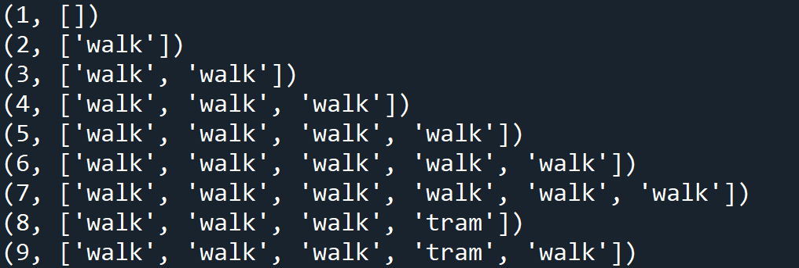
Learning Transportation Problem (N = 10)
Walk: 2, Tram: 4

Slide 26
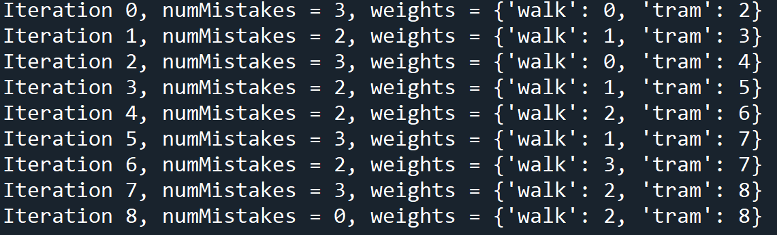
Learning Transportation Problem (N = 10)

Slide 27
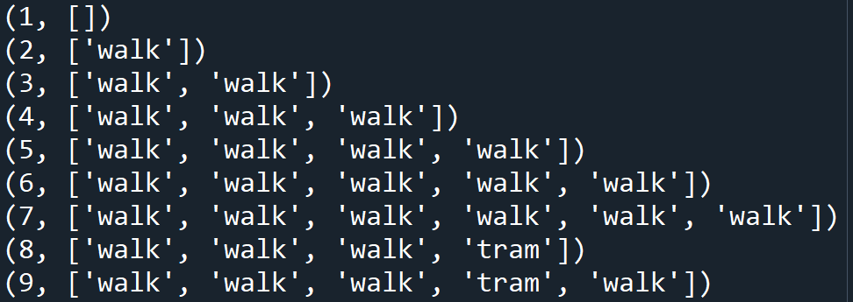
Learning Transportation Problem (N = 10)
Walk: 2, Tram: 5

Slide 28
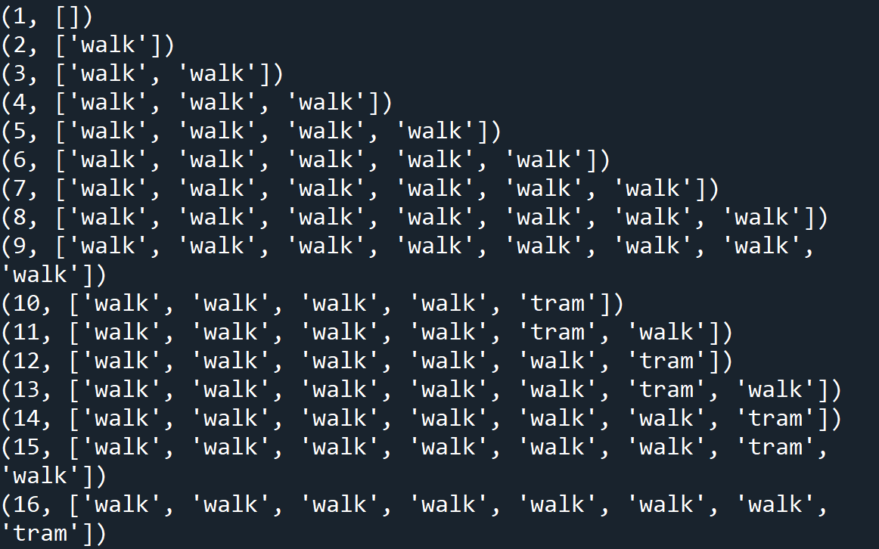

Slide 29
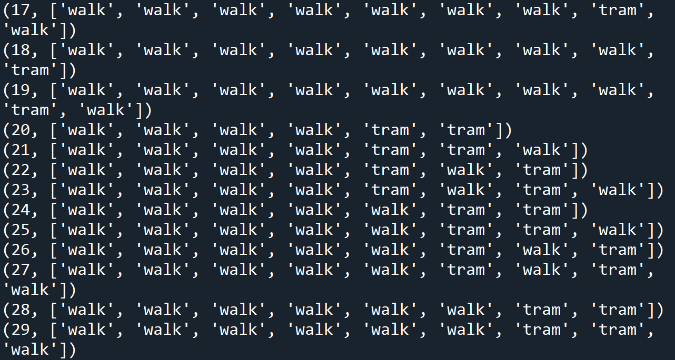

Slide 30
Learning on N= 30

