Slide 1
The Open Systems Interconnection Model (OSI)
The OSI Model: Understanding the Seven Layers of Computer Networks
Notes:
The Open Systems Interconnection (OSI) model began as a reference model, but has since been implemented. It was created by the International Organization for Standardization (ISO) to provide a logical framework for how data communication processes should interact across networks. There are 7 layers in the OSI model. Each layer is responsible for a particular aspect of data

Slide 2
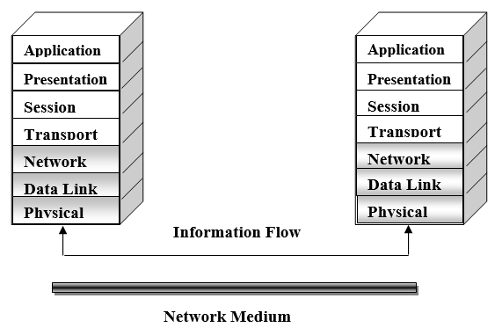
OSI Model
Notes:
Hint: StandUp
S- session
T- Transport
A- application
N- network
D- data link
U-’’
P- physical, presentation

Slide 3
OSI Model
The OSI model attempts to define rules that apply to the following issues:
How network devices contact each other and, if they have different languages, how they communicate with each other.
Methods by which a device on a network knows when to transmit data and when not to.
How the physical transmission media are arranged and connected.
How to ensure that network devices maintain a proper rate of data flow.
How bits are represented on the network media.
Application
Presentation
Session
Transport
Network
Data Link
Physical

Slide 4
(1) Physical Layer
The following items are addressed at the physical layer:
Network connection types, including multipoint, point-to-point or multi-homed connections.
Physical topologies, which are physical layouts of networks, such as bus, star.
Analog and digital, which include several methods for encoding data.
Multiplexing, which involves combining several data channels into one.
Termination, which prevents signals from reflecting back through the cable and causing signal and packets errors.
Application
Presentation
Session
Transport
Network
Data Link
Physical
Notes:
Hint: tap-man
T- termination
A- analog & digital
P- physical topologies
M- multiplexing
A- ‘’
N- network connection types

Slide 5
(2) Data Link Layer
Allows a device to access the network to send and receive messages
Offers a physical address so a device’s data can be sent on the network
Works with a device’s networking software when sending and receiving messages
Provides error-detection capability
Application
Presentation
Session
Transport
Network
Data Link
Physical
Notes:
Hint: pase
P- physical address
A- access control
S- software corporation
E- error detection
Access Control: Allows a device to access the network to send and receive messages
Physical Address: It assigns a unique physical address to each device so data can be sent to the right place.
Software Cooperation: Works with a device’s networking software when sending and receiving messages
Error Detection: Provides error-detection capability

Slide 6
(3) Network Layer
This layer is concerned with the following:
Network addressing.
Circuit, message, and packet switching.
Route discovery, and rout selection.
Gateway services.
Application
Presentation
Session
Transport
Network
Data Link
Physical
Notes:
Hint: singer = snger
S- switching methods (circuit switching, message switching and packet switching)
I- ‘’
N- Network addressing
G- Gateway services
E-’’
R- Route discovery, route selection

Slide 7
(4) Transport Layer
Some of the functions offered by the transport layer include:
Application identification
Client-side entity identification
Confirmation that the entire message arrived intact
Segmentation of data for network transport
Control of data flow to prevent memory overruns
Establishment and maintenance of both ends of virtual circuits
Transmission-error detection
Multiplexing or sharing of multiple sessions over a single physical link
Application
Presentation
Session
Transport
Network
Data Link
Physical
Notes:
Hint: m-advices
M- multiplexing
A- application identification
D- data flow control: Control of data flow to prevent memory overruns
V- Virtual Circuit Establishment and Maintenance: Establishment and maintenance of both ends of virtual circuits
I- ‘’
C- Client-side Entity Identification
E- transmission error detection
S- segmentation of data

Slide 8
(5) Session Layer
Session layer functionality includes:
Virtual connection between application entities
Synchronization of data flow
Creation of dialog units
Connection parameter negotiations
Partitioning of services into functional groups
Acknowledgements of data received during a session
Retransmission of data if it is not received by a device
Application
Presentation
Session
Transport
Network
Data Link
Physical
Notes:
Hint: cards
C- Connection parameter negotiations: Connection parameter negotiations
A- Acknowledgements: Acknowledgements of data received during a session
R- retransmission: Retransmission of data if it is not received by a device
D- dialog units: Creation of dialog units
S- synchronization(Synchronization of data flow), service partitioning(Partitioning of services into functional groups)
Virtual connection

Slide 9
(6) Presentation Layer
The following items are addressed at the presentation layer:
Encryption and decryption of a message for security
Compression and expansion of a message so that it travels efficiently
Graphics formatting
Content translation
System-specific translation
Application
Presentation
Session
Transport
Network
Data Link
Physical
Notes:
Hint: CE G CS
C- Compression and expansion: Compression and expansion of a message so that it travels efficiently
E- Encryption and decryption: Encryption and decryption of a message for security
G- Graphics formatting
C- Content translation
S- System-specific translation

Slide 10
(7) Application Layer
database access
e-mail
support for file transfers
ability to print on a network
browsing the World Wide Web
Application
Presentation
Session
Transport
Network
Data Link
Physical
Notes:
Hint: beds
B- Browsing the World Wide Web
E- email
D- database access
S- support of file transfer
Printing on a Network

Slide 11
OSI in Action
IBM
Host computer
DEC
Host computer
Application
Application
Presentation
Presentation
Session
Session
Transport
Transport
Network
Network
Data Link
Data Link
Physical
Physical

Slide 12
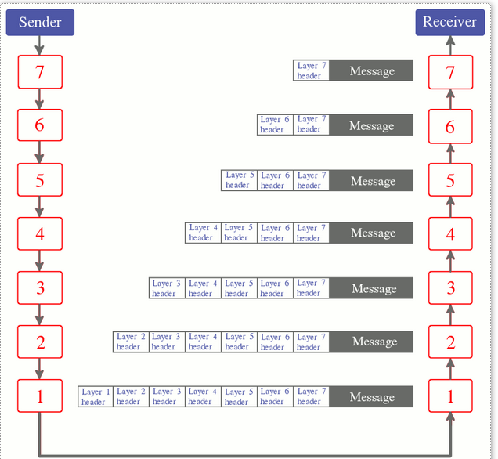
OSI in Action

Slide 13
OSI in Action - What if an error had occurred?
IBM
Host computer
DEC
Host computer
Application
Application
Presentation
Presentation
Session
Session
Transport
Transport
Network
Network
Data Link
Data Link
Physical
Physical

Slide 14
OSI in Action
Host computer
Host computer
Application
Application
Presentation
Presentation
Session
Session
Transport
(Intermediate Node)
Transport
Network
Network
Network
Data Link
Data Link
Data Link
Physical
Physical
Physical
San Francisco
(Source Node)
New York
(Destination Node)
Chicago

