Slide 1
Resume writing strategies
Conducted By:
Umm e Farwa [Team Leader]
Muhammad Yaqoob [Researcher]
Ahmed Raza [Presenter]

Slide 2

Agenda
Importance of a well-crafted resume.
Distinction between a resume and curriculum vitae.
Detailed guidelines for each section of a resume.
Hands-on activities for resume creation.

Slide 3
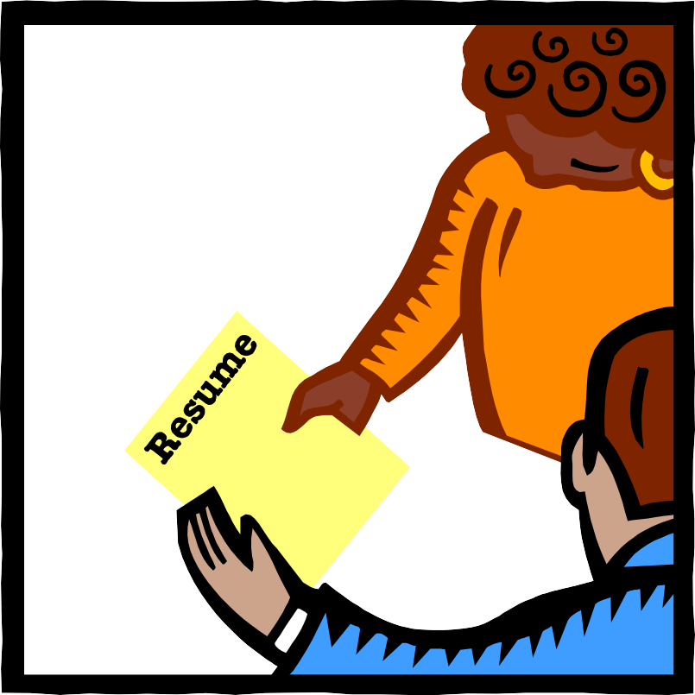
Reason for choosing
After graduation, students that are going to apply for a job ,they definitely need resume for this purpose.
Connection of an individual’s skills, experience and potential with opportunities.

Slide 4
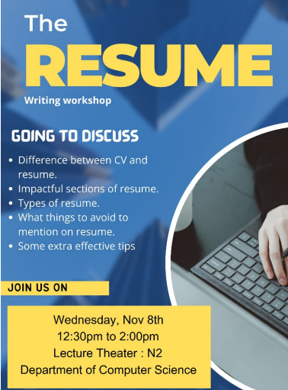
Procedure Followed
Distribution of posters
Announcements to all sessions within the Computer Science department
Shared with the class representatives of other departments.

Slide 5

Procedure Followed
Research:
Research Paper: The Resume Research Literature: Where Have We Been and Where Should We Go Next?
References:
A Collection of Quality Resumes by Professional Resume Writers
The Complete Idiot’s Guide to The Perfect Resume
100 Winning Resumes for $100,000+ Jobs: Resumes that Can Change Your Life.

Slide 6

Problem Analysis
Typos and Grammatical Errors
Attempted the "One–Size–Fits–All" Approach
No action words
Leaving Off Important Information
Incorrect Contact Information
Notes:
Make sure ap kei resume grammatically perfect ho. Agr to ap kei resume grammatically perfect nie hei to employ yhi conclude kry ga keh “This person can’t write” or “This person doesn’t care”
Jb hm aik Generic resume banatay hein It will most end up with something employers will toss in the recycle bin. They expect you to clearly show how and why you fit the position in a specific organization.
No action words: Avoid using phrases like "responsible for.“ Instead use action words for work experience. Like Implemented this, Designed this.
Leaving off important information: The soft skills you've gained from these experiences (e.g., work ethic, time management) are more important to employers than you might think.
Moral of the story: Double-check even the most minute, taken-for-granted details sooner rather than later.

Slide 7
Workshop Feedback
Following the successful conclusion of the workshop, we distributed a feedback form among the participants, receiving a total of 26 responses.

Slide 8
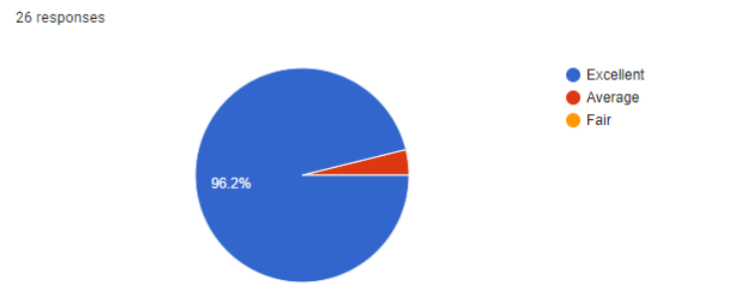
. How do you feel about the workshop overall?
Participants expressed an overwhelmingly positive sentiment, with 96% indicating that they found the workshop excellent.

Slide 9
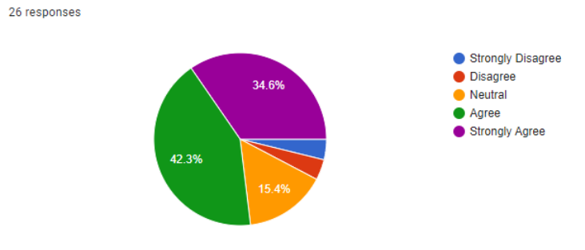
Prior to this workshop,did you feel you had an understanding of how to create a resume?
Prior to this workshop, they were not enough confident.

Slide 10
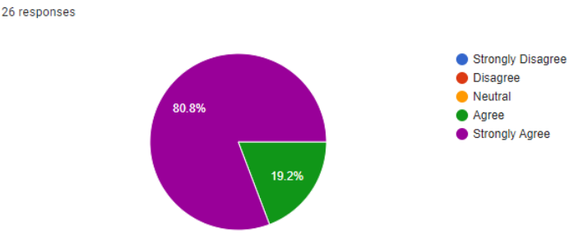
After taking this workshop,do you feel understand how to create a resume?
After the workshop, they were much more confident

Slide 11
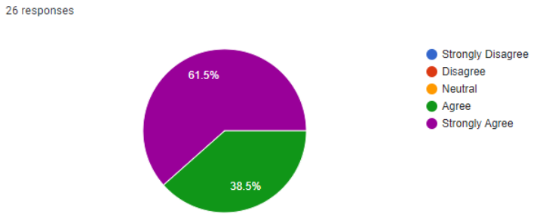
From what you learned this workshop,do you now understand the different types of resume formats?
: They had the better understanding of resume formats..

Slide 12
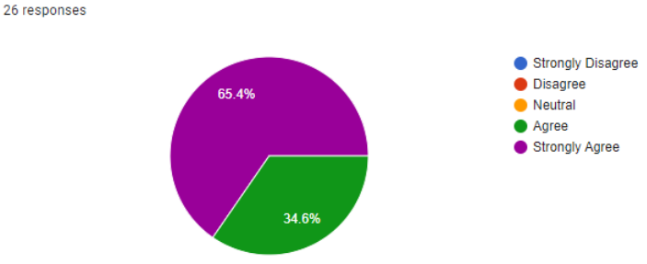
After participating in this workshop,do you understand some of the different ways to organize a resume?
: They had the better understanding of resume formats.

Slide 13

Feedback comments
It was a great seminar. I understood each and everything about resumes.
It was a really informative session, looking forward to further sessions.
Thank you for organizing the resume workshop! It was incredibly informative and practical. The tips provided will certainly enhance my resume. The interactive format and the opportunity to ask questions were much appreciated.
It was a valuable experience, got to learn great new things

Slide 14



Conclusion
Successful conclusion of the workshop.
Valuable feedback gathered from participants.
A resume speaks for you when you’re not present
Job-specific resumes are crucial for job hunters.
Additionally, a good cover letter is essential as it complements your resume.

Slide 15
Thank You
Please contact me at 2021cs118@student.uet.edu.pk
for more information or to schedule a resume critique.

