Slide 1
Resume Workshop
Umm e Farwa
Muhammad Yaqoob
Ahmed Raza

Slide 2

What is a resume?
●
An advertisement of you.
●
A snapshot of who you are and your personal, professional, educational and work qualifications.
●
It is about your future, NOT your past.

Slide 3

Why do we need a resume?
●
To get an interview, not a job!
●
Interest the employer in your abilities.
●
Give a positive first impression of you in 10-20 seconds.

Slide 4
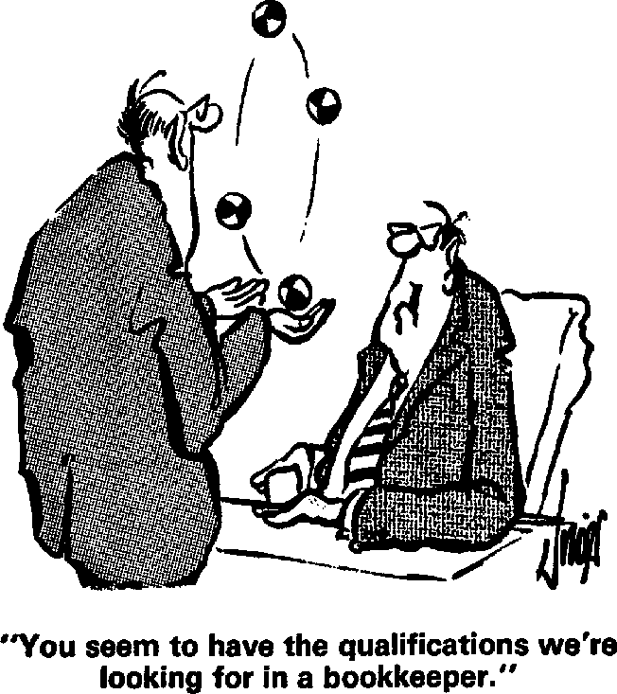
What is it NOT?
●
Not an autobiography or a confessional.
●
You do not have to tell all
– only what is marketable and relevant to the position.
●
It is NOT going to get you a job (only an interview!).

Slide 5

Resume Formatting
Which type of resume is best for you?
●
Chronological
●
Functional/Skills- Based
●
Combination

Slide 6
Chronological Resumes
●
●
Most traditional format.
Lists work experience by dates in reverse chronological order (most recent first).
Does not highlight main skills and qualifications. Useful when:
You have consistent work history with growth and achievements.
No gaps in employment and staying in the same field.
●
●

Slide 7
Functional or Skills-Based Resumes
●
●
Groups your qualifications around skill headings.
Highlights major areas of accomplishment, strengths, and abilities in order of importance to this particular job/employer.
Actual work history is minimized. Useful when:
Changing careers or reentering job market.
Gaps in employment.
Variety of different jobs.
●

Slide 8

Combination Resumes
Combines the best of chronological and functional.
Includes qualifications section and may highlight key strengths.
Work history section may emphasize results instead of job duties.

Slide 9

Resume Components
Heading
Job Objective
Summary of Qualifications
Work Experience
Education
Skills and Abilities
Other

Slide 10


Resume Components
Heading
●
●
●
●
Name Address
Phone number(s) Email address
Be sure to check your phone and email messages periodically!

Slide 11

Resume Components
Job Objective
A short statement that tells the employer what specific position you’re applying for.
Directly reflects the position applying for.
Should be concise and specific.

Slide 12
Resume Components
Summary of Qualifications
What makes you the best candidate for this job? (ie: qualifications, skills, abilities, years of experience, work ethic and values, accomplishments, etc.)
Must reflect what is required in the job description. One paragraph or 3-5 bulleted statements.
Most important part of your resume; catches and keeps the reader’s attention.
●
●
●

Slide 13

Resume Components
Work Experience
Reverse chronological order; 10 years.
Required: Position title, name of company, dates of employment (month & year)
Extra: City and state, specific responsibilities, description of job, accomplishments.
Better than a list of job duties – list accomplishments/results. Give specific $ amounts, years, %, etc.
Show your value and success.
●
●

Slide 14


Resume Components
Education
●
●
Reverse chronological order.
Required: Degree, major, school, year of graduation.
Extra: GPA (if over 3.0), minors, honors, specific related courses.
Professional training may also be listed either under Education or Training
●
●

Slide 15


Resume Components
Skills and Abilities
Listed as a separate section (functional or combination resume).
Divide in categories that are related to the job.
Examples: Computer Skills, Manufacturing Skills, Leadership Skills, Customer Service, Patient Care, etc.
●
●

Slide 16



Resume Components
Additional Resume Components
Any of these can be added if they are relevant to the position you are applying for:
●
●
●
●
●
●
●
Activities
Honors Certifications Achievements Awards Licenses
Professional Affiliations

Slide 17

Resume Components
Some “Don’ts”
Don’t list interests and hobbies unless directly related to the position.
Don’t write “References available upon request.”
Don’t use personal pronouns (I, me, my) in your resume.
Don't include your height, weight, age, date of birth, place of birth, marital status, sex, ethnicity/race, health, social security number, reasons for leaving previous job, picture of yourself, religion, or political affiliations.
Don’t ever lie on your resume.
●
●
●
●

Slide 18

Resume Layout and Appearance
●
●
●
White or off-white paper. Usually 1 page (1-2).
Font at 12 pt. (no smaller than 11).
Be consistent with the layout, underlining, capitalizing, bold, etc.
Use white space, good margins, and tabs.
Use bullets.
Spell and grammar check!
●
●
●
●

Slide 19

Wording
●
●
Use action verbs.
Use phrases that focus on your successes and accomplishments.
Only include what is relevant and marketable.
Use bulleted lists instead of paragraphs.
Use past tense for work in the past.
BE HONEST!
●
●
●
●

Slide 20

Where to begin?
●
●
Get it on paper.
Make a list of all your work experience, education, skills, abilities, interests, talents, etc.
If making a career change, remember transferable skills.
Layout basic resume format. Fill in the blanks.
●
●
●

Slide 21

Where to end?
●
●
Write and re-write/edit.
Ask at least 2 other people to give you feedback.
Be open to feedback.
Re-write based on each job you’re applying for.
Remember that it is NEVER finished!
●
●
●

Slide 22
Thank You
Please contact me at 2021cs118@student.uet.edu.pk
for more information or to schedule a resume critique.

