Slide 1
Professional Practices Organizations and Team Structures

Slide 2
Contents
Team
Becoming a team
Organization and team structures
Dispersed and virtual teams
Leadership

Slide 3
Team
By team, we usually mean group of people who are working together in the same space at the same location.
The term project team is used to refer all the people working on a common project who may sit in different work groups at some distance from each other.

Slide 4
Becoming a Team
Just throwing people together will not immediately enable them to work together as a team.
Teams go through five basic stages of development.

Slide 5
Becoming a Team
Forming: members of a group get to know each other and try to set up some ground rules about behavior.
Storming: conflict arise as various members of the group try to exert leadership.
Norming: conflicts are largely settled and a feeling of group identity emerges.
Performing: the emphasis is now on the tasks at hand.
Adjourning: the group disbands.

Slide 6
Organization and Team structures
Large software development companies are usually organized into departments.
Each department usually handles several projects at any time, and each project is assigned to a separate team of developers.
Working of any organization is significantly affected by its department structure and team structure.

Slide 7
Organization and Team structures
Department structure: how a department is organized into teams. Two ways are
Functional Format
Project Format
Team structure: how individual teams are structured. Two ways are
Chief programmer team
Democratic team

Slide 8
Functional Format
Developers are divided into functional groups based on their specialization or experience.
For example different functional groups of an organization might specialize in areas such as database, networking, requirement analysis, design, testing and so on.
Every developer in organization would belong to some functional group depending on his expertise.
For carrying out specific activities, different projects borrow developers from different functional groups

Slide 9
Functional Format
Upon the completion of their activities, the developers are returned to their respective functional groups.
The partially completed product passes from one team to another and evolves due to the work done on it by several teams.
A functional team working on a project does not physically meet the members of other functional teams who have carried out other parts of the project.

Slide 10
Functional Format
A team understands the work done by other team solely by studying the documents produced by them.
Teams working subsequently on the project will find it difficult to understand the work already completed if good quality documents are not produced.

Slide 11
Project Format
In the project format, a set of developers are assigned to a project at its start.
It is assumed that, the assigned members can carry out various activities required for project completion.
The developers remain with the project till the completion of the project, thus the same team carries out all the project activities.
Functional vs. project format.

Slide 12
Activity
Despite of several important advantages of the functional format, it is rarely adopted by the industry. Can you think about some reasons?

Slide 13
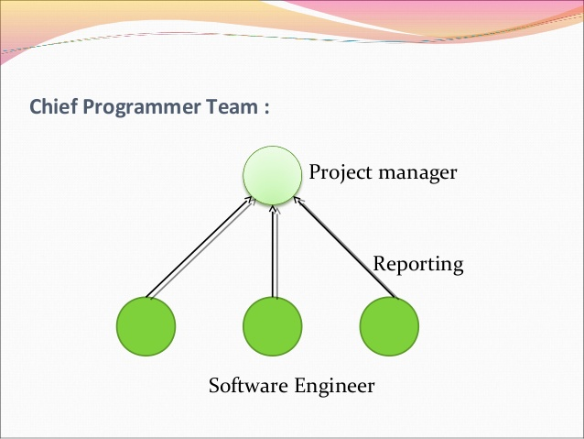
Chief Programmer Team

Slide 14
Chief Programmer Team
A senior member provides the technical leadership and is designated as the chief programmer.
The chief programmer defines the specification and constructs the high level design.
He then partitions the remaining tasks such as detail design, coding, testing and documentation into many smaller tasks and assigns the to the team members.
He also verifies and integrates the work completed by different team members.

Slide 15
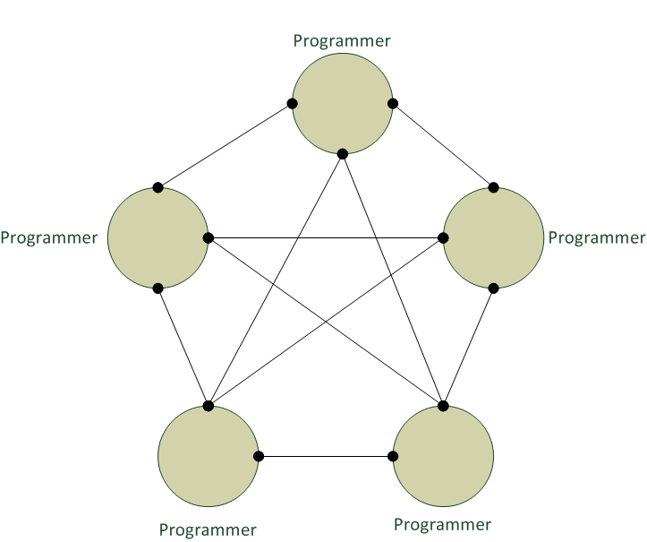
Democratic Team

Slide 16
Democratic Team
Democratic team structure does not enforce any formal team hierarchy.
Decisions are taken on the base of discussions, where any member is free to discuss with any other member.
A manager provides the administrative leadership.
Different members of the team provide technical leadership at different times.
A lot of debate and discussions take place among team members, a significant overhead is experienced for large teams.

Slide 17
Dispersed and Virtual Teams
Virtual teams are the group of individuals spread across different time zones, cultures and languages which are united by a common goal.
These are the groups of geographically, organizationally and/or time dispersed workers brought together by information and telecommunication technologies to accomplish one or more organizational tasks.
Notes:
History

Slide 18
Dispersed and Virtual Teams
Some advantages are
A reduction in staff cost.
The flexible use of staff.
Use of specialist staff for specific jobs.
Some disadvantages are
Coordination of dispersed workers can be difficult.
Different time zones can cause communication and coordination problems.
Social isolation.

Slide 19
Leadership
Leadership is the ability to influence others in a group to act in a particular way to achieve group goals.
Some common characteristics of a good leader are
They have a greater need for power and achievement.
They have more self control
They have more self confidence

Slide 20
Leadership
Leadership is based on the idea of authority or power.
Power can either be
Position power
Personal power
A leader should know that when he must be authoritative and insist on things and when he must be flexible and tolerant.
Notes:
Leadership:
Position power: Like HOD
Personal power: natural qualities or characteristics

Slide 21
Leadership
Leadership styles are measured on two axes: directive vs. permissive and autocratic vs. democratic.
Directive autocrat: makes decisions alone, close supervision of implementation.
Permissive autocrat: makes decisions alone, subordinates have liberty in implementation.
Directive democrat: makes decisions participatively, close supervision of implementation.
Permissive democrat: makes decisions participatively, subordinates have liberty in implementation.
Notes:
Directive autocrat: decisions just leader leta hei.
Permissive autocrat: decisions leader alone lei ga but workers kei pass liberty hoti hei.(leader choose team. But team decides which technology stack they will use.)
Directive democrat: sb kei mrzi sai decision lia jata hei. And leader just monitor krta hei.
Permissive democrat: full freedom. Decision mei be pocha jai ga. And implementation mei be liberty hoti.(HOD curriculum goals set krny kei liay meeting krta hei. And implementation kei liay teachers pai force bei nie kia jata. Full freedom hei. Decision mei be pocha ja rha)

