Slide 1
Professional Practices
“Finance and Accounting”

Slide 2
Contents
The need for capital
Sources of funds
Budgeting and monitoring
Sales and order intake
Costing
Pricing
Annual statements
Capital and its maintenance
Auditing

Slide 3
Finance and Accounting
Any organization can not be successful unless its finances are soundly managed.
In this chapter, those aspects of finance and accounting with which the newly graduated software engineer is most likely to come into contact are emphasized.
Notes:
What is finance and accounting?

Slide 4
The need for capital
It is not uncommon for recent graduates in computing to start their own company that provide software services.
Contract hire services
Develop packages
They will be in need of some money to start the venture.
Notes:
Invoices are issued at the end of the month.

Slide 5
The need for capital
Capital will be needed for
Salaries
Rents and bills
Equipments
Costs of advertising
Miscellaneous expenses
Interests on any money borrowed
Notes:
Money will require some time to come.

Slide 6
The need for capital
Present a business plan to potential funders. This plan should include
Description of what the company will be doing, together with information to show that it is technically feasible and founders of the company have the necessary expertise.
Assessment of the size of market and competition
Prediction of financial performane of the campany
Notes:
How to raise money?

Slide 7
Sources of Funds
Sources of Funds
Grant
Loan
Sale of Equity

Slide 8
Sources of Funds
A grant is a sum of money given to the company.
Company is obliged to demonstrate that it has been used for the purposes for which it was intended.
Grant is never paid back to the organization who gave it.
Notes:
Grant - Khirat

Slide 9
Sources of Funds
A loan is a sum of money lent to the company.
Interest is payable on it, at a rate that may be fixed or variable.
Loan is usually for a fixed period.
The company is liable to pay back the loan, and if company dissolves, the lender is entitled to recover the loan from the sale of company’s assets.
Notes:
Association between loan and assets

Slide 10
Sources of Funds
Equity capital is money paid to the company in exchange for a share in the ownership of the company.
Advantge/ disadvantage

Slide 11
Budgeting and monitoring
A budget is a financial plan for a defined period of time, usually a year.
It is an estimation of revenue and expenses over a specified future period of time; it is compiled and re-evaluated on a periodic basis.
Budgets can be made for a person, a family, a group of people, a business, a government, a country, a multinational organization or just about anything else that makes and spends money.

Slide 12
Budgeting and monitoring
A budget is a prediction of the future financial position of an organization covering usually the current or the next financial year.
A complete budget includes prediction for all of the annual financial statments, but the most concerned aspect of budgeting is income and expenditure budget.

Slide 13
Budgeting and monitoring
Budgeting is an iterative process.
First version of the budget is likely to show expenditure exceeding income.
Adjustment are made repeatedly until a situation is reached where sales exceed expenditure with a reasonable profit margin.
Notes:
Why?

Slide 14
Budgeting and monitoring
Budget is mostly used as a basis for monitoring the organization’s performance.
The figures in the budget are split into monthly or weekly figures.
When the actual figures of a month become available, they are compared with the budgeted figures.
If real expenditure of any field exceeds the budgeted value, reason is determined quickly and remedial action is taken.
Notes:
Two remedial actions.

Slide 15
Sales and Order Intake
A sale is a transaction between two parties where the buyer receives goods, services, and assets in exchange for money.
Order intake is a measure of company production in terms of customer offers to buy products or services, it refers to receiving or processing a customer's order.

Slide 16
Sales and Order Intake
A company’s cost, its pricing and the level of overheads that it can afford, all depends critically on the level of sales.
Monitoring the level of sales is therefore a very important managerial activity.
Notes:
Examples, small items, bespoke software.

Slide 17
Costing
The price at which an organization decides to sell a product or a service depends on
The cost of producing and providing it
Market conditions
Price and availablity of competing products
Elasticity of demand

Slide 18
Costing
COST
Raw materials and bought-in items
Cost of equipment
Direct labour cost
overheads

Slide 19
Costing
Materials which are bought by a campany and processed as part of the campany’s manufacturing process are called raw materials.
Brought-in items are those items that are bought by a company and incorporated into their products, as it is (unchanged).
Notes:
Examples of both
Method of estimation sale price.

Slide 20
Costing
The cost of equipment for a company is simply how much the company paid for the equipment.
The cost of labour is the sum of all wages paid to employees.

Slide 21
Costing
Overheads are the costs that cannot be directly associated with specific products or services but must still be covered by the total revenue.
Examples are marketing costs, manager’s costs and costs related to preparation of bids.

Slide 22
Costing
Departmental overheads are associated with specific parts of the organization and should be covered by the revenue earned by those parts.
Corporate overheads are associated with the whole organization.
Notes:
Examples, how to allocate?

Slide 23
Pricing
Pricing is the method of determining the value a producer will get in the exchange of goods and services. Simply, pricing method is used to set the price of producer’s offerings relevant to both the producer and the customer.
The price that a company charges for its products and services is constrained by the fact that revenue must exceed the cost of those products.
Notes:
Breaking this rule can be bearable for 1 or 2 year but not more than that.

Slide 24
Pricing
Software companies are typically faced with pricing in three contexts
Pricing a bid to provide services, such as consultancy, design or programming, with payment based on the effort supplied.
Pricing a bid for a contract to supply bespoke software at a fixed price.
Pricing a software product which they have developed.
Notes:
explain

Slide 25
Annual Statements
All limited companies are required to produce annual accounts and to give a copy of them to the registrar of companies for filing.
Company accounts should include
The balance sheet
A profit and loss account
Notes:
SECP

Slide 26
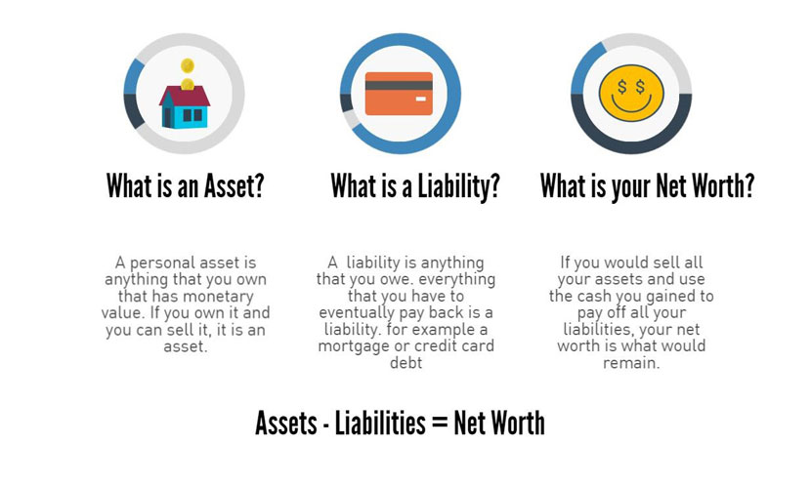
Annual Statements

Slide 27
Annual Statements
A balance sheet is a snapshot of financial state of an organization at a single instant, normally at the end of an organization’s financial year.
It shows the values of organization’s assets and its liabilities.
Normally a balance sheet also shows the twelve months previously position for comparison purpose.

Slide 28
Annual Statements
As the name suggests....a balance sheet must balance: the total assets and total liabilities should be equal.
To acieve this a balancing item is added on one side or the other.

Slide 29
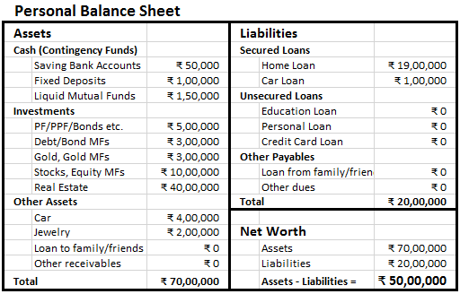
Annual Statements

Slide 30
Annual Statements
A profit and loss account records the money received and money spend.
It is also called an income and expenditure account in case of non-profit making organization.

Slide 31
Annual Statements
INCOME
Contribution from Parents | 1,000.00
Income from Summer Job | 1,851.35
Total Income | 2,851.35
EXPENDITURE
Course Fees | 1,025.00
Hall Fees | 1,980.00
Transport | 125.78
Food | 1,203.40
Entertainment | 1,261.33
Depreciation | 30.00
Total Expenditure | 5,600.51
EXCESS OF EXPENDITURE OVER INCOME | (2,749.16)

Slide 32
Capital and its Maintenance
The concept of capital maintenance has important practical consequences.
The capital of a company is usually taken as a gurantee that the company will be able to meet its obligations.
A lender also takes into account a campany’s capital, when deciding whether or not to give a loan.

Slide 33
Capital and its Maintenance
To maintain capital
A company is not allowed to issue shares at a discounted value.
A company cannot pay back to the shareholders any of their original contributions.

Slide 34
Auditing
Financial auditing is the process of examining an organization's financial records to determine if they are accurate and in accordance with any applicable rules , regulations, and laws.
The company accounts should be accompanied by an auditor’s report.
Purpose of the report is to provide members of the company and public with an assurance that accounts give a “true and fair view” of the state of the affairs of the company.

Slide 35
Auditing
It is not practicable for auditors to check every financial transaction.
They work by
Examimining the adequacy of the company’s financial procedures
Making detiled checks on a small sample of transactions and assets.

Slide 36
Auditing
The primary resposibility for preventing and detecting fraud lies with the directors of the company, not with the auditors.
However auditors are also expected of finding anything seriously misleading in the financial statements.
If they find evidence of fraud , they have a duty to report it to directors.

