Slide 1
ORGANIZATIONAL BEHAVIOR (Managing People in Working Environments)

Slide 2
Contents
Introduction
Organizational Behaviors: A Background
Staff selection
Staff development
Staff motivation
Continued well being of staff during a project (Stress Management )

Slide 3
Introduction
People with practical experience of projects consider the handling of people a very important aspect of project management.
The way in which human beings behave in their work places is termed as organizational behavior (OB).
The discipline of OB has evolved theories that try to explain people’s behavior.

Slide 4
Organizational Behaviors: A Background
The roots of studies in OB can be traced back to work done in the late 19th and early 20th centuries by Fredrick Taylor.
He attempted to analyze the most productive way of doing manual tasks.
Taylor had three basic objectives
To select the best people for job.
To instruct them in the best methods.
To give incentives in the form of higher wages to the best workers.

Slide 5
Staff Selection
Right selection of employees is a challenging task as the mistake of selecting an eligible candidate who is not in fact a suitable one occurs frequently.
Eligible candidates have a CV which shows the right experience and right paper qualifications.
Suitable candidates can actually do the job well.
It is suggested that we should try to assess actual skills rather than past experience and provide training to make good minor gaps in expertise.
Notes:
Discussion….

Slide 6
Staff Selection
A general procedure for a recruitment process includes following steps
create a job specification
Create a job holder profile
Obtain applicants
Examine CVs
Tests, interviews etc.
Other procedures

Slide 7
Staff Development
When new members of the team are recruited, the team leader will need to plan their induction into the team very carefully.
The team leaders should regularly assess the training needs of their team members.
Training can either be provided by
Commercial training companies
A team member having expertise in a specific software tool demonstrate it to other colleagues

Slide 8
Staff Motivation
Some models of motivation are
Maslow’s hierarchy of needs
Expectancy theory of motivation

Slide 9
Maslow’s hierarchy of needs
Abraham Maslow suggested a hierarchy of needs.
According to him, when a lower level of needs is satisfied then gradually a higher level of needs emerges.
If these are satisfied, then another level will emerge.

Slide 10
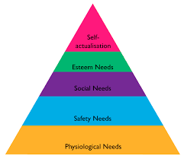
Maslow’s hierarchy of needs
Notes:
A desire to become everything one is capable of becoming.

Slide 11
Maslow’s hierarchy of needs
In practice, people are motivated by different things at different stages of life.
For example, salary increases probably have less impact on more mature employee who is already relatively well paid than on a less paid trainee.
Older team members might place more value on qualities of the job, such as being given autonomy, which show respect for their judgment and sense of responsibility.

Slide 12
Expectancy theory of motivation
Another model of motivation developed by Vroom and his colleagues illustrate that day to day ups and downs of system development affect motivation.
They identifies three influences on motivation
Expectancy: the belief that working harder will lead to a better performance.
Instrumentality: the belief that better performance will be rewarded.
Perceived value: of the resulting reward

Slide 13
Expectancy theory of motivation
Vroom’s expectancy theory can be given by the following expressions
Motivation = Expectancy * Instrumentality * Perceived value
EXAMPLE

Slide 14
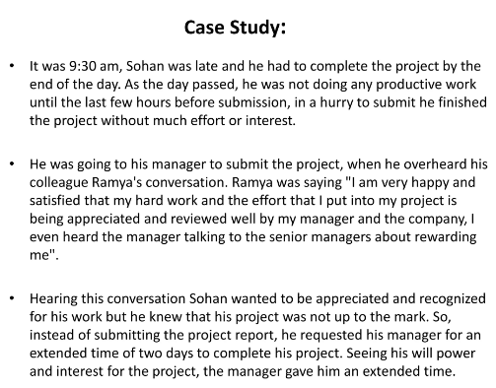

Slide 15
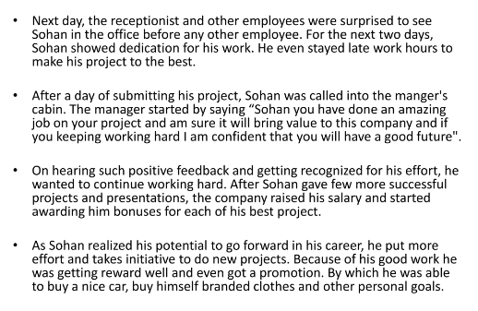

Slide 16
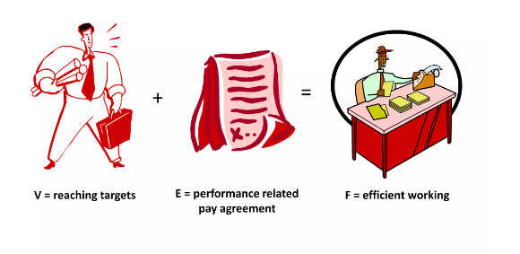

Slide 17
Stress
Projects are about overcoming obstacles and achieving objectives.
Almost by definition, both the project manager and team members will be under pressure.
Some pressure is actually healthy.
Boredom can make many jobs soul-destroying.
But beyond a certain level of pressure, the quality of work can decrease and health can be affected.

Slide 18
Stress
It is sometimes necessary to put in extra effort to overcome some temporary obstacle or to deal with an emergency.
But if overtime working becomes a way of life then there will be longer term problems.
There is a good evidence that productivity and the quality of output go down when more than about 40 hours a week are worked.

Slide 19
Stress
Stress can be caused by
Role ambiguity: staff do not have a clear idea of the objectives that their work is supposed to be fulfilling, what is expected of them by others and the precise scope of their responsibilities.
Role conflict: a person is torn between the demands of two different roles.

Slide 20
Stress Management
Stress is a routine part of almost every one’s life and it is usually agreed that some amount of stress can be beneficial by making an individual focused and more productive.
However when the level of stress becomes burdensome, there is a drop in performance due to cognitive, emotional and physical strains.

Slide 21
Stress Management
Cognitive strains may manifest in many forms such as worrying, forgetting and lacking concentration.
Emotional strains can lead to anxiety, restlessness, panic, irritability and anger.
Physical strains may manifest itself in the form of shallow breathing, nausea, fatigue, headache, shoulder and back pain.

Slide 22
Stress Management
Project managers and software developers are involved in intellectual work, meeting customer expectations and team work.
Each of these can be source of stress, and when the stress level of an individual exceeds some threshold, suitable stress management technique should be deployed.

Slide 23
Stress Management
Stress management techniques are divided in three important categories
Imagery, relaxation and meditation: These techniques rely on deep breathing, relaxation, physical exercise and guided imagery.
Cognitive behavioral approaches: These techniques involve self monitoring of stress intensity, thought record keeping and rewriting, time management and increase social interactions.
Systemic approaches: These focus on altering the factors which contribute to stress e.g. a switch of job role.
Notes:
Through guided imagery you can learn to use your imagination to "create the state you want”.

