Slide 1
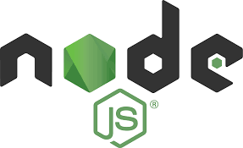
Node A to Z
By Laeeq Khan Niazi

Slide 2

Learning Objective
Students should be able to develop a backend services (APIs)
Student should be able to manage project directory structure for scalable projects
Student should be able to write manageable code
Students should be able to store the data in the database using APIs

Slide 3

Prerequisites
Programming
Java Script Syntax
Database

Slide 4
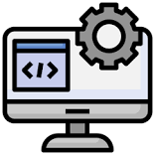
Software's Required
Node (Server that run JS code)
NPM (Package Manager)
MongoDb (No SQL Database)
MongoDbCompass (Software to visualize the database data)
VS Code (Text Editor)
Postman (Software for testing APIs)

Slide 5

What is node?
Node.js is an open-source, cross-platform runtime environment built on Chrome’s V8 Engine.
It is used to develop highly scalable backend as well as server-side applications.
Node.js uses a single-threaded event loop architecture.

Slide 6

Check version
Check Node Version
node –v make sure you have minimum 16 version installed
Check NPM Version
npm –v 8 or higher must be installed

Slide 7

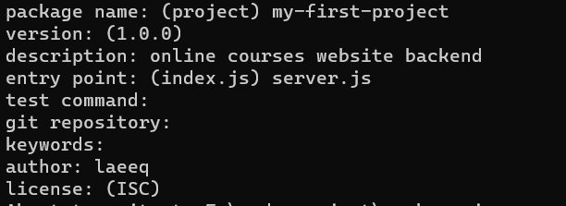
Create your node project
Navigate to your required destination where you want to create your node project
Use npm init command to create a new project
It will create a project and ask you to enter some project details

Slide 8

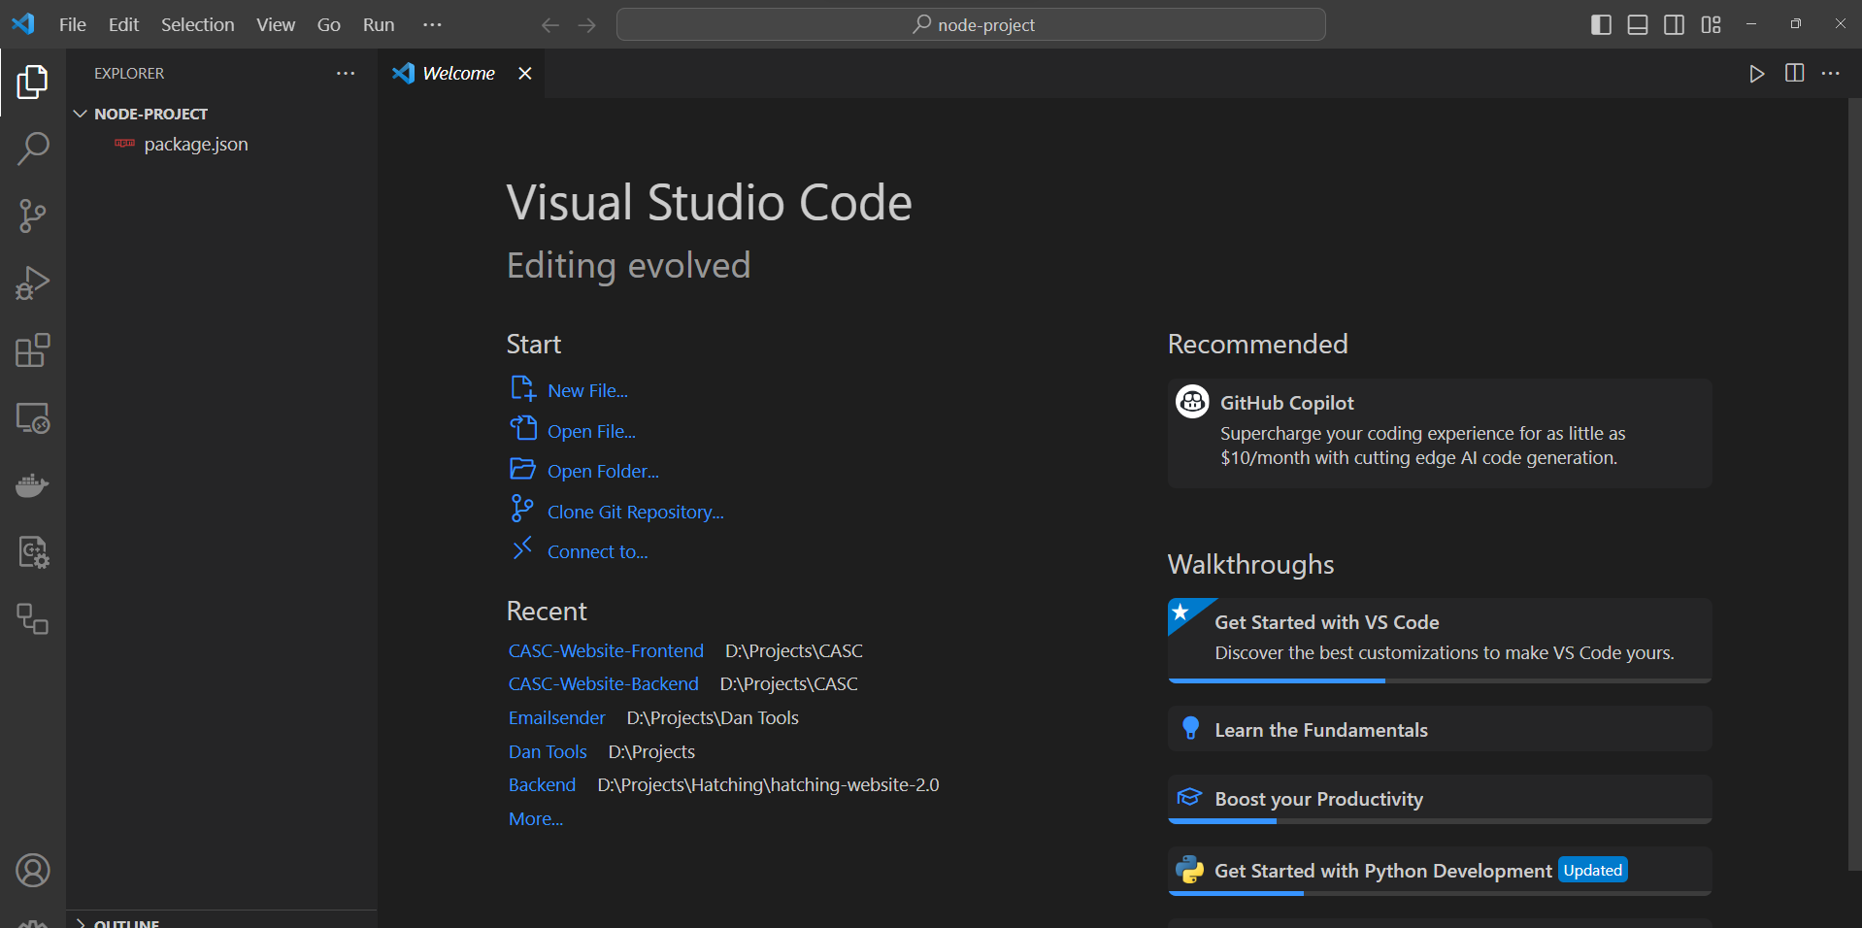
Open your project
Use code . Command to open your code into your default editor or first open VS Code and then from the file use open folder option to open the project

Slide 9
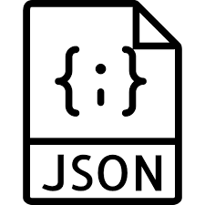
Package.json
This file is used as a manifest, storing information about applications, modules, packages, and more.
Major roles of Package.json file
Dependency Management : It contains the packages
Script Definitions : npm run or other custom commands for start and test and build
Project Metadata: contains metadata about your project, including its name, description, version, author, and license information
Project Configuration: such as the entry point for your application, environment variables, and other project-specific settings.

Slide 10
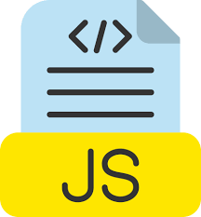
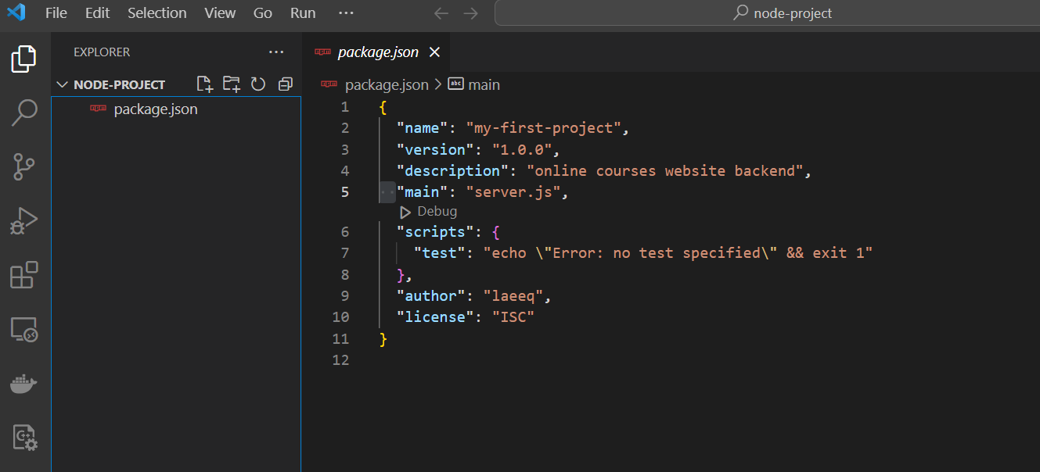
Let's create your first js file
Create the file with same name that is available in package.json file with main key

Slide 11

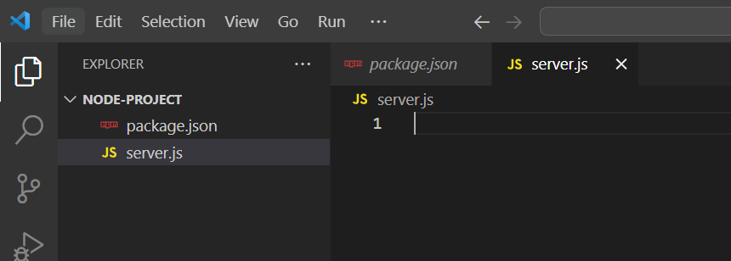
Project
Make sure your project directory structure looks like this

Slide 12
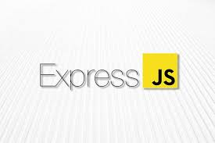
Now install your first library express.js
We can certainly write the node server in pure JavaScript, but it can be a bit challenging and may not offer the flexibility we need. Therefore, we've opted to utilize Express.js for developing our APIs, as it provides a more streamlined and adaptable approach.
Here is command to install the express in your node project

Slide 13
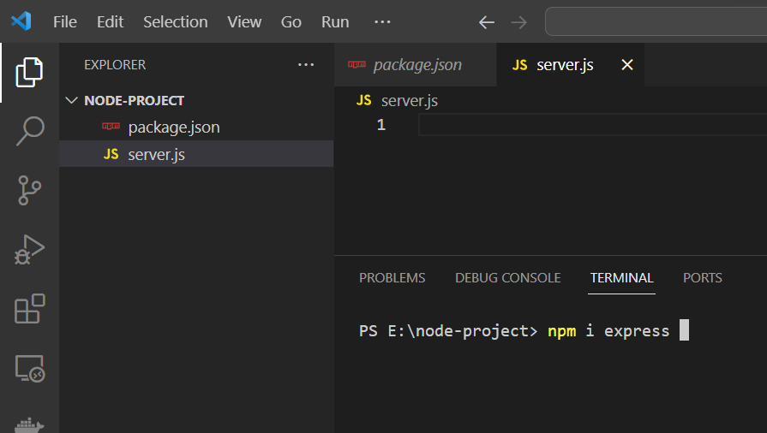
Make sure you run this command in your node project folder

Slide 14
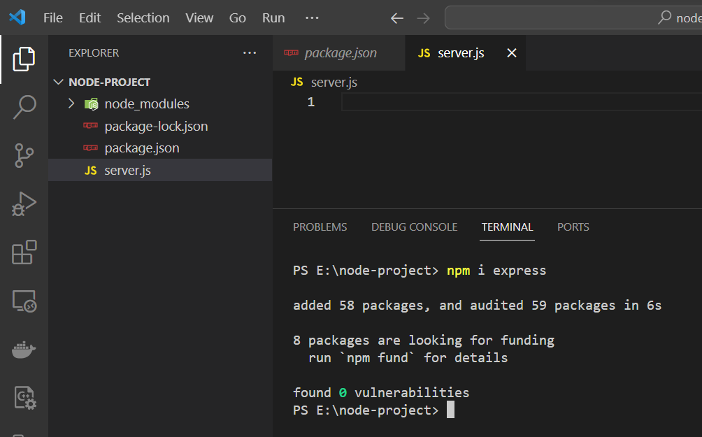
This command will create some file and folder to store the package files and information

Slide 15
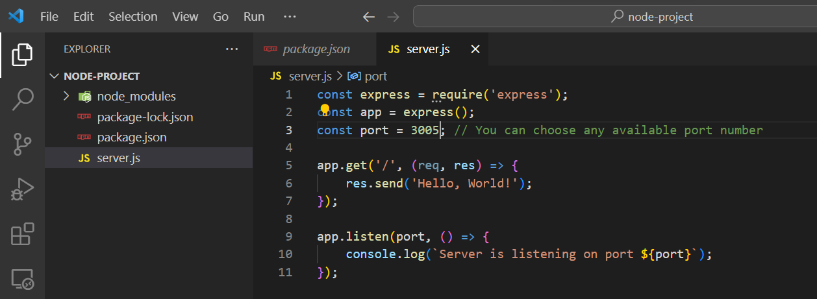
Express hello word write, run and see

Slide 16
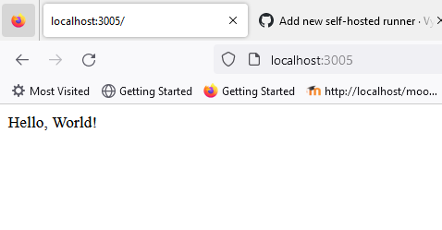
In your browser type the localhost with your project port number and you will see the result of your application

Slide 17
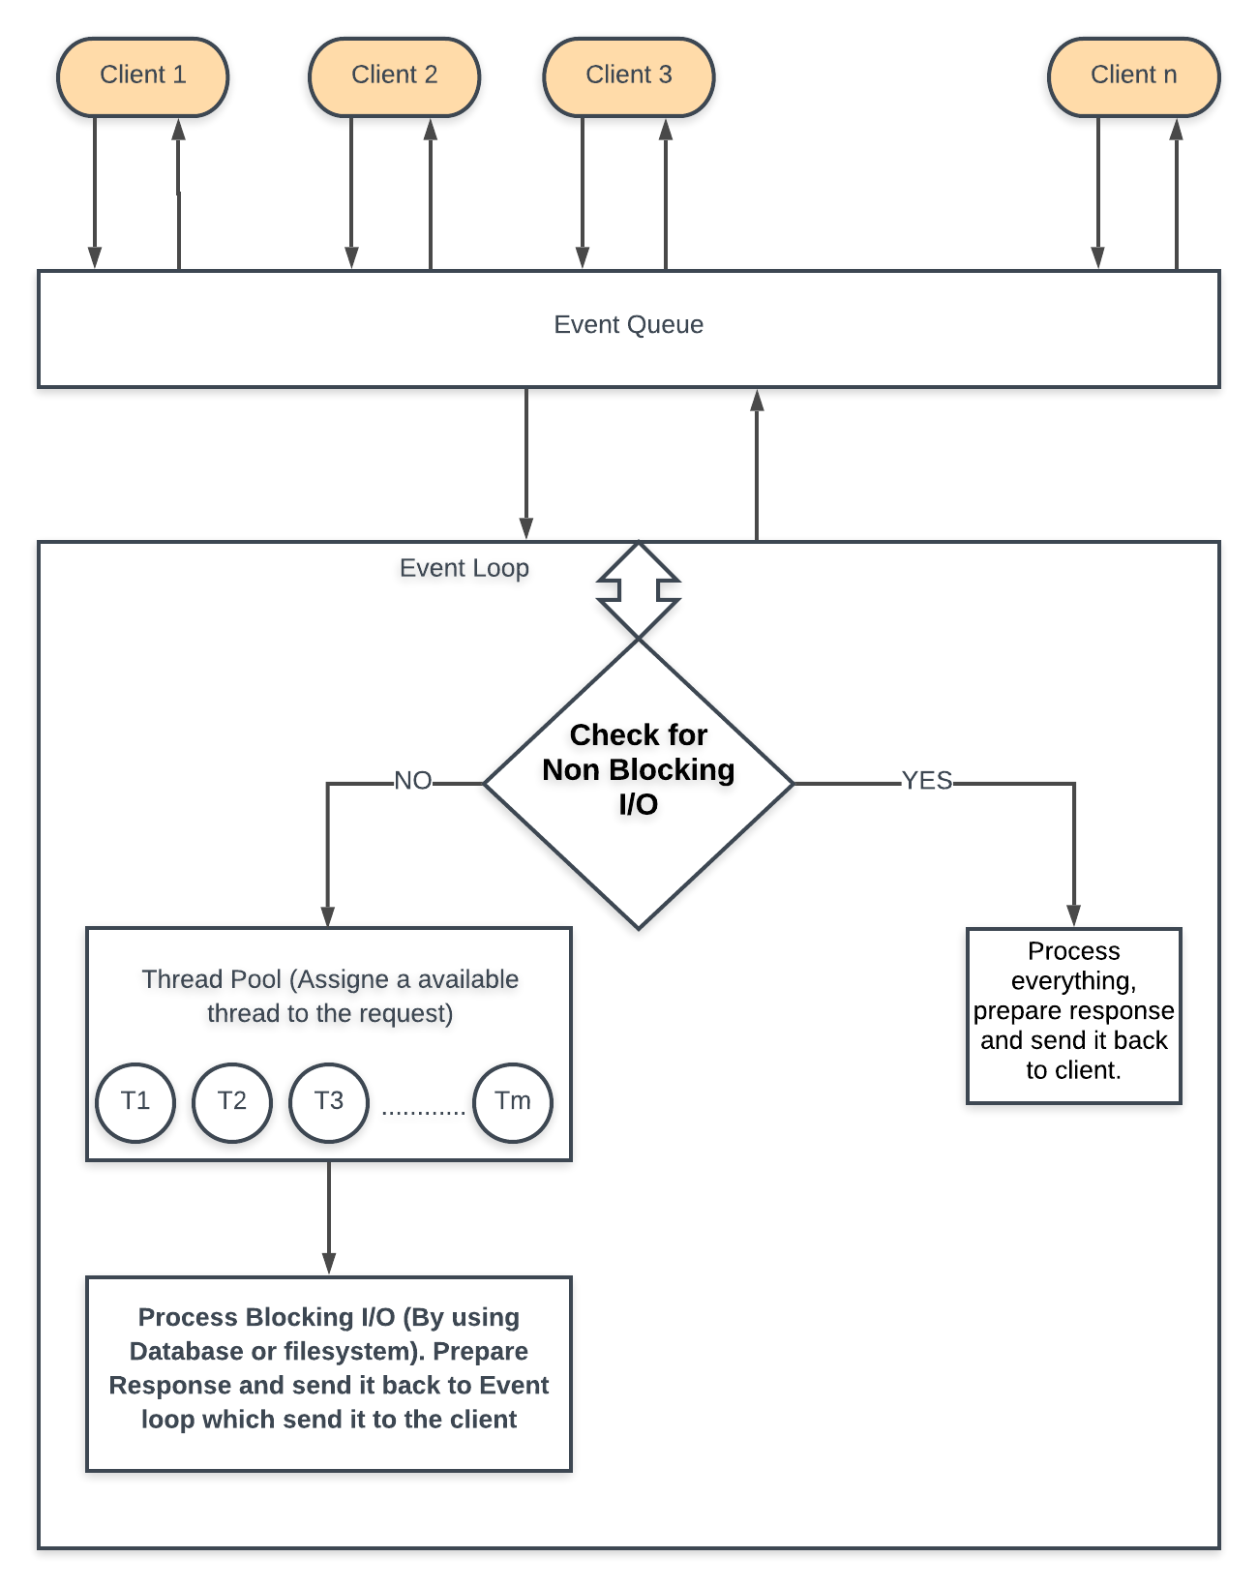
What is happening?

Slide 18

Class Task
Make another API /welcome
If you hit localhost:3000/welcome it in browser it send you response like Welcome yourname

Slide 19

Discussion
This was a simple hello word API example
But if we have 20 or 50 or 100 API we will make all the APIs in the server.js file????
How we can do it or we can manage large projects??

Slide 20

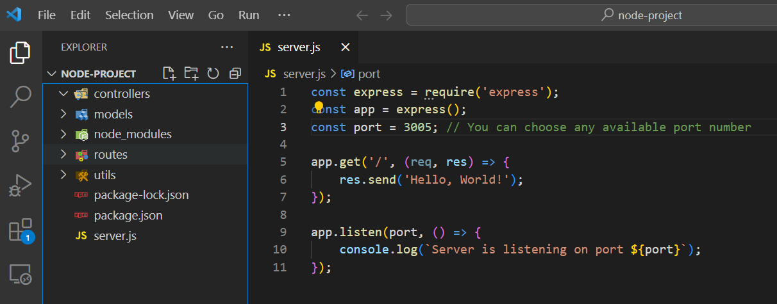
For Professional Web Development
We make following directors mostly but still its your choice you can chose any other design pattern to complete project

Slide 21
Controllers
Controllers handle the application's logic and act as intermediaries between the routes (HTTP endpoints) and the models (data layer). They contain functions that define how the application responds to different HTTP requests.
Example: userController.js, productController.js, etc.
Typical Responsibilities:
Parsing and validating request data.
Calling appropriate functions from the models.
Formatting and sending responses to the client.

Slide 22
Models
Models represent the data structures and database interactions of your application. They encapsulate the data schema, database queries, and business logic related to data.
Example: userModel.js, productModel.js, etc.
Typical Responsibilities:
Defining the data schema using Object-Relational Mapping (ORM) or database libraries (e.g., Mongoose for MongoDB, Sequelize for SQL databases).
Executing database queries and transactions.
Enforcing data validation and business rules.

Slide 23
Routes:
Routes define the HTTP endpoints and map them to specific controller functions. They determine how incoming requests are routed to the appropriate controller methods.
Example: userRoutes.js, productRoutes.js, etc.
Typical Responsibilities:
Defining the URL routes and HTTP methods (GET, POST, PUT, DELETE).
Binding route handlers (controller functions) to specific routes and methods.

Slide 24
Utils (Utilities)
The "utils" folder typically contains utility functions or modules that can be used throughout the application. These utilities are not directly related to models, controllers, or routes but provide general-purpose functionality.
Example: helper.js, validation.js, auth.js, etc.
Typical Responsibilities:
Reusable functions such as date formatting, string manipulation, or encryption.
Custom validation functions.
Authentication and authorization middleware.

Slide 25
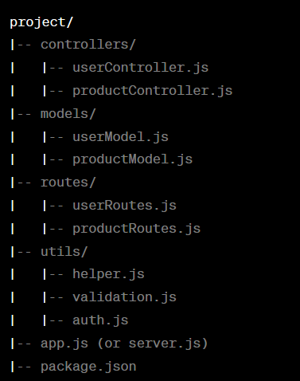
Directory Structure Example

Slide 26
Lets install some dependences
npm i mongoose body-parser
mongooes is used to mongodb operations
The body-parser middleware plays a crucial role in your Node.js application when dealing with HTTP requests that have a request body, such as POST and PUT requests. Its primary purpose is to parse the request body and make it available under req.body in a more convenient format, such as JSON or URL-encoded data, for your route handlers to work with.

Slide 27
Middleware??
Middleware in Express.js is a fundamental concept that refers to functions that are executed during the request-response cycle. These functions have access to the request (req) and response (res) objects and can perform various tasks or modifications to the request or response or even terminate the request-response cycle.

Slide 28
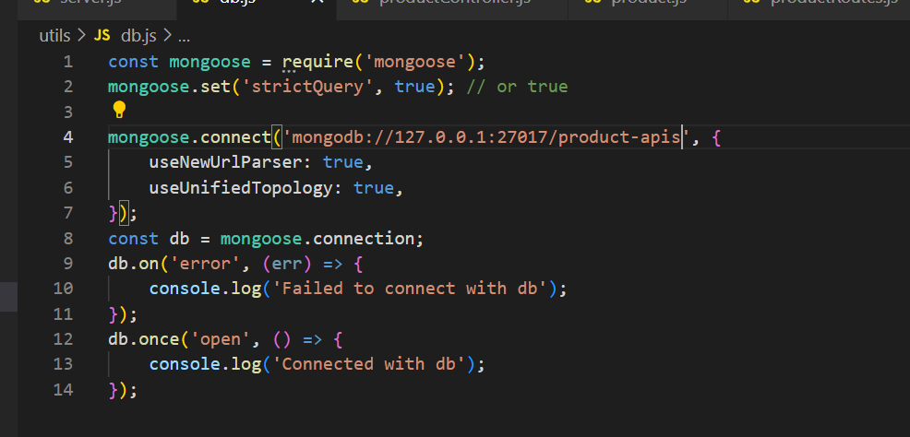
Your database connection code

Slide 29
Use following library and middleware call in your server.js file
const bodyParser = require('body-parser’);
app.use(bodyParser.json());

Slide 30
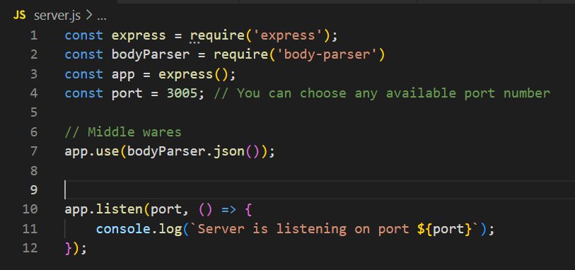
Server.js file should look like that

Slide 31
We are going to develop API for Products
We will be working with product name, description and price

Slide 32
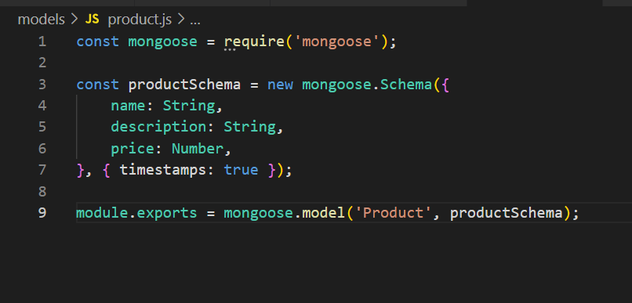
Create product model in model's directory

Slide 33
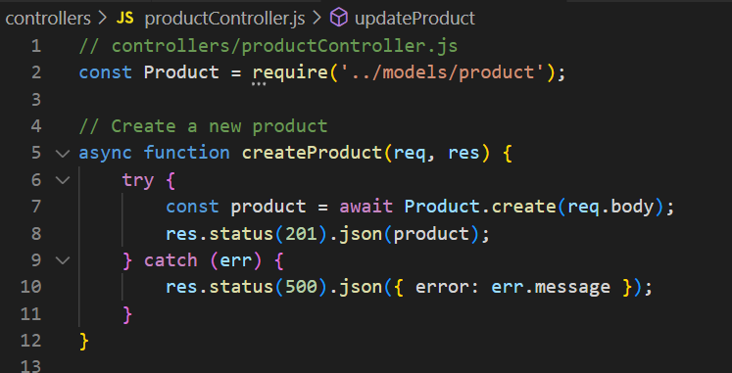
Create your productController.js file
This function will take the product data from the API and store into the database

Slide 34
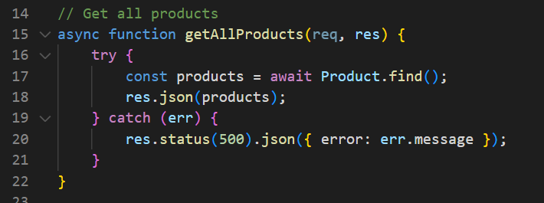
Get all products

Slide 35
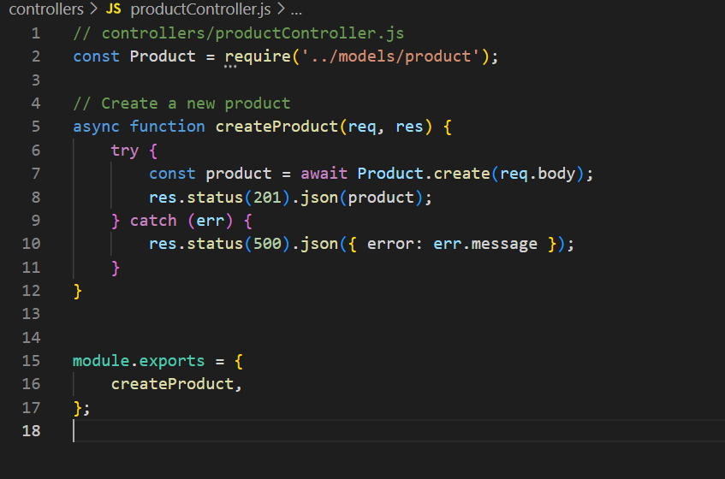
Export the function to make it visible to other js files

Slide 36
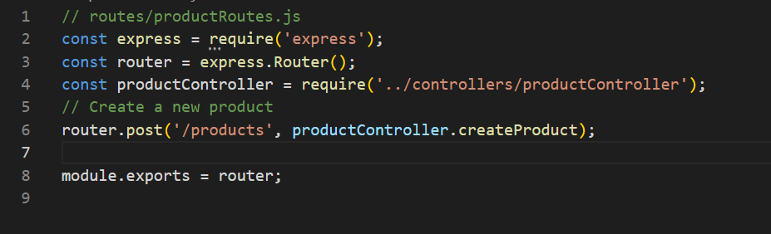
Create the router file and map your function API end point

Slide 37
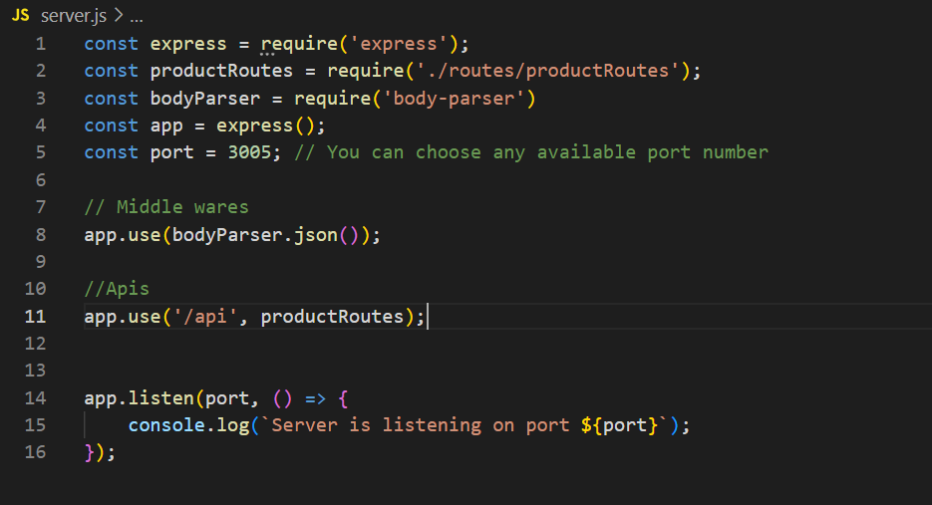
Here use the middle where and pass the route and the routers

Slide 38
Use postman to test the API
Open postman
Create your workspace
Setup the global variable to store the base URL
Create your post request and pass the data to API get the response and check the data into the mongodb database.

Slide 39
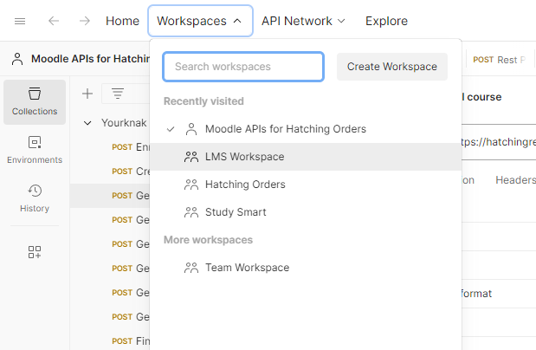

Slide 40
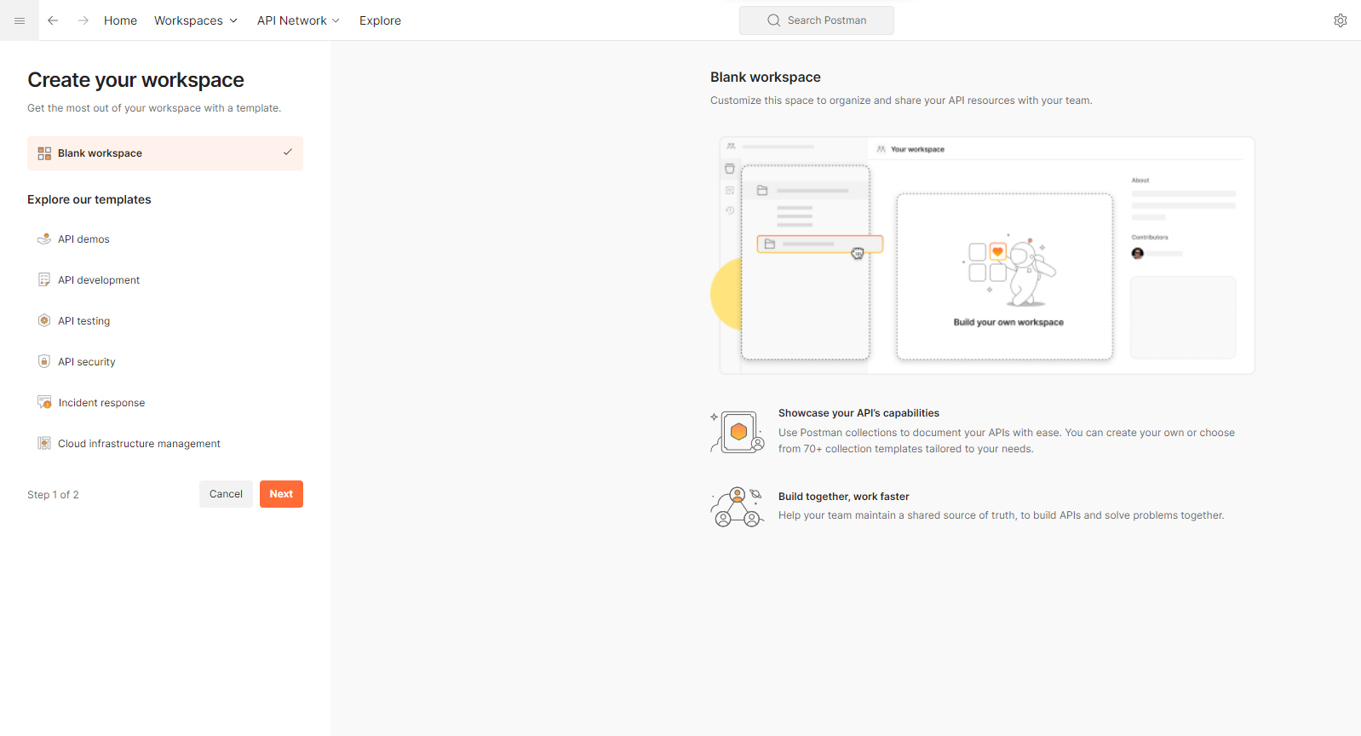

Slide 41
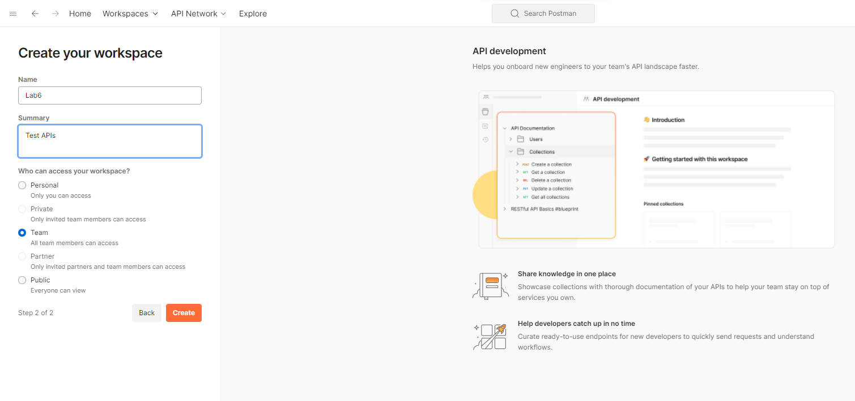

Slide 42
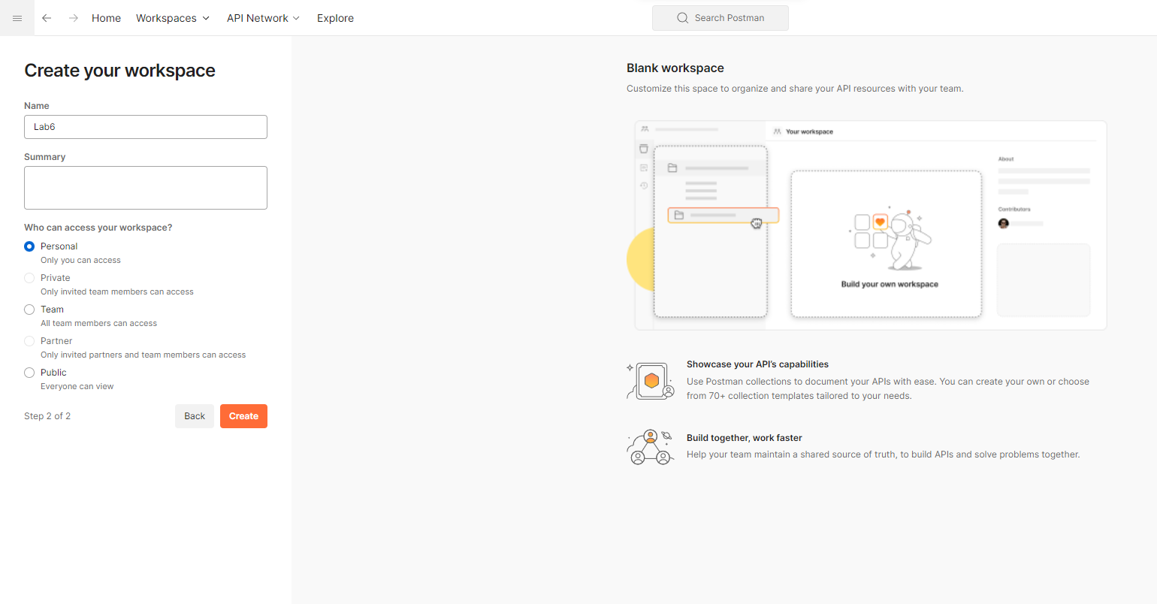

Slide 43
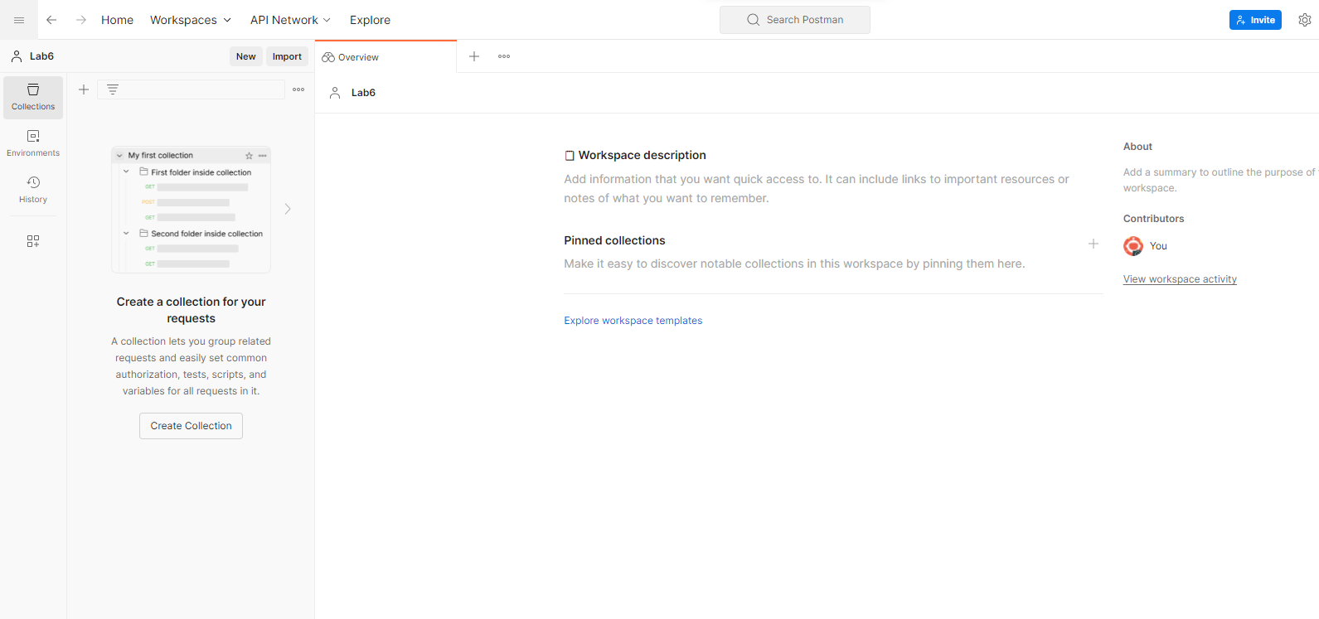
Create

Slide 44
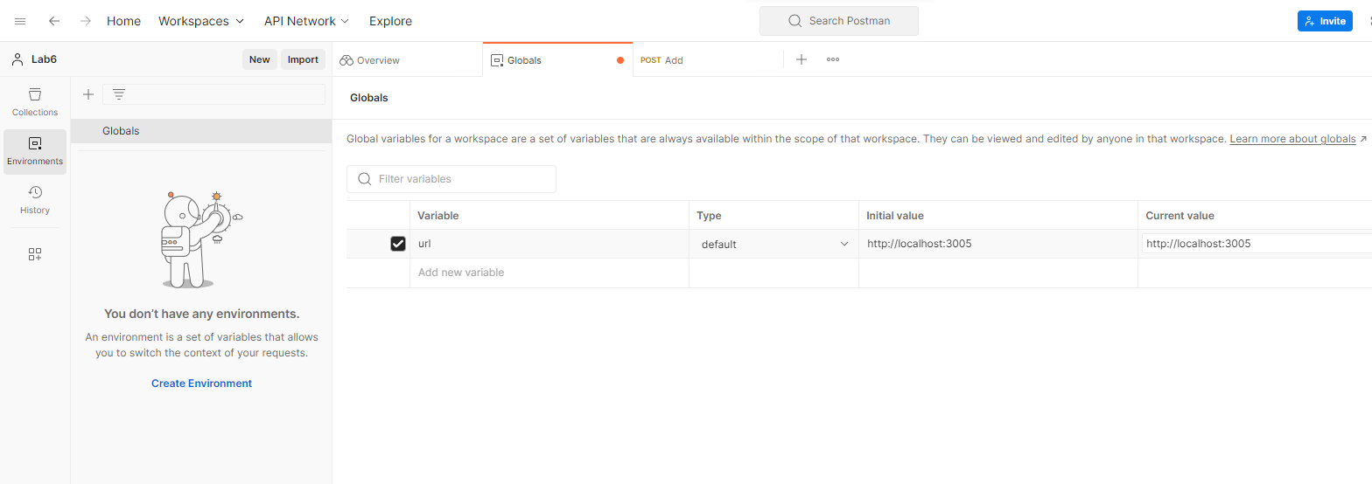
Setup the URL as global variable

Slide 45
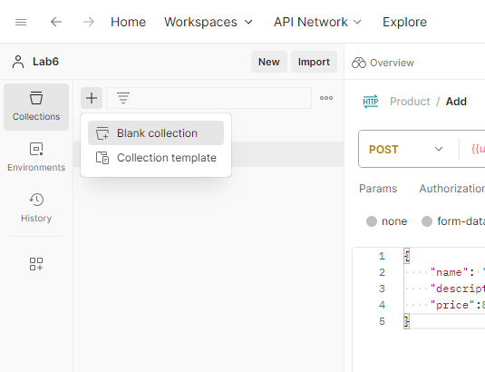
Create a collection and add a request in the collection

Slide 46
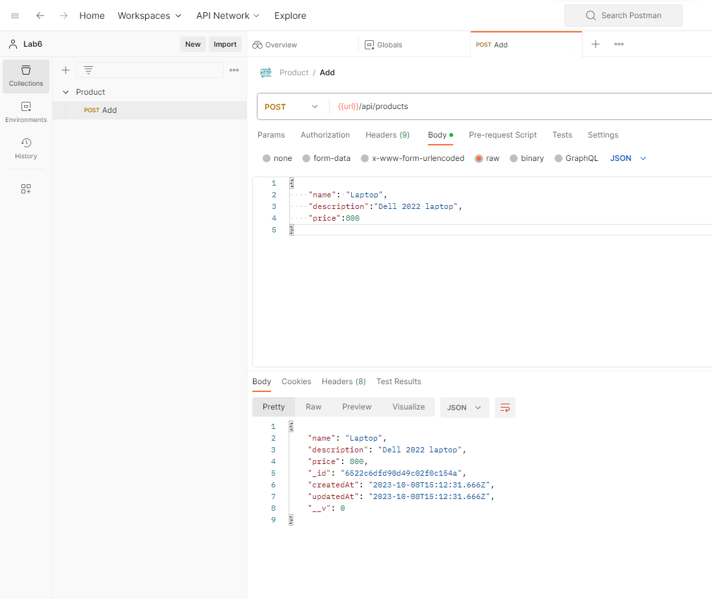
Send the API request and check response

Slide 47
Install cors module and use it as middleware
npm i cors
What is cors?
CORS stands for Cross-Origin Resource Sharing. It is a security feature implemented by web browsers that controls and restricts web pages' ability to make requests to a different domain (origin) than the one that served the web page. CORS is an important security measure to prevent cross-origin attacks, like Cross-Site Request Forgery (CSRF) and Cross-Site Scripting (XSS).

Slide 48
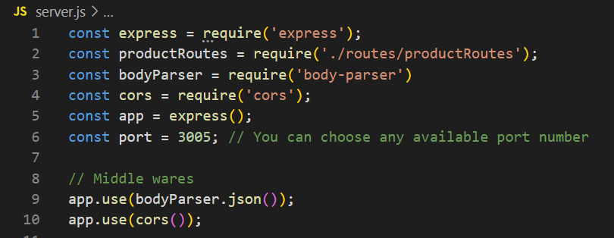
Server.js code will look like that

Slide 49
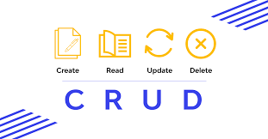
Let's make all APIs for product
Update
Delete
Get All

Slide 50
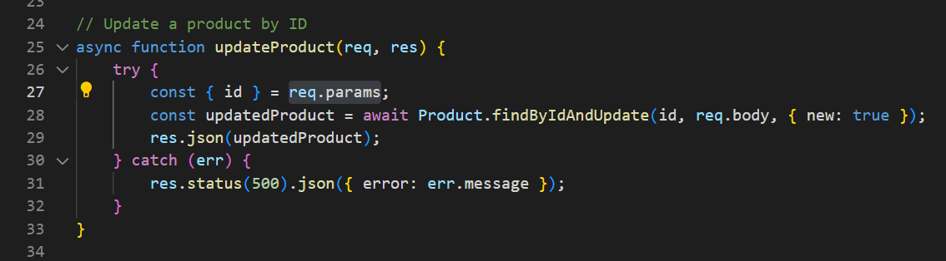
Update product by Id

Slide 51
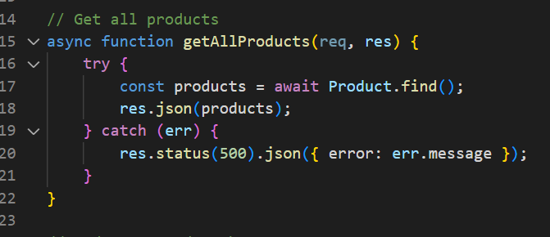
Get All Products

Slide 52
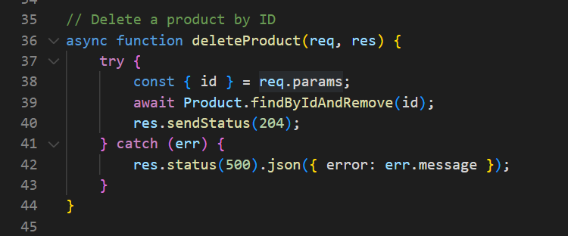
Delete product by Id

Slide 53
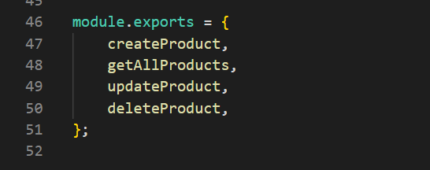
Export modules

Slide 54
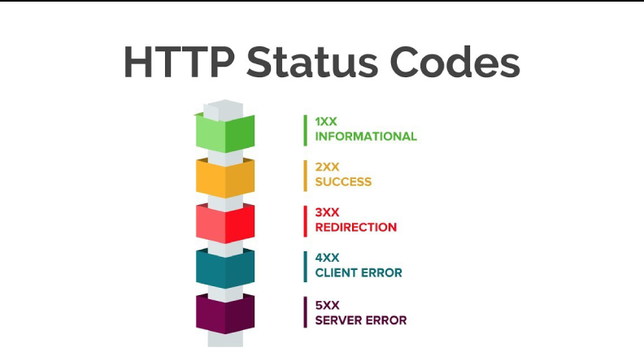
Status Codes

Slide 55
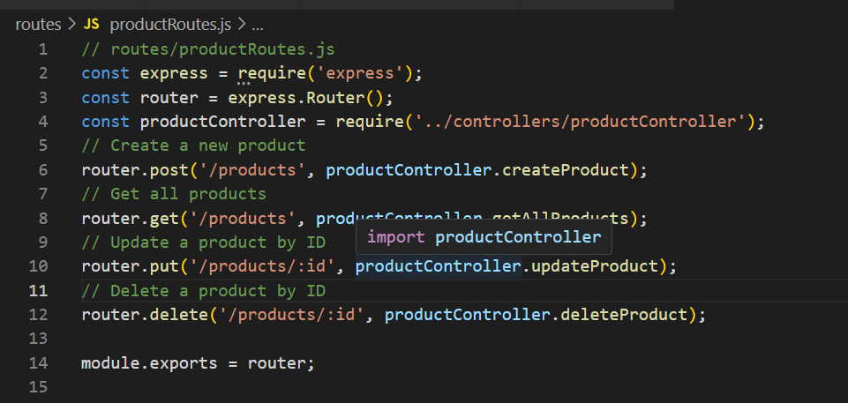
Create productRoutes File in Routes directory

Slide 56
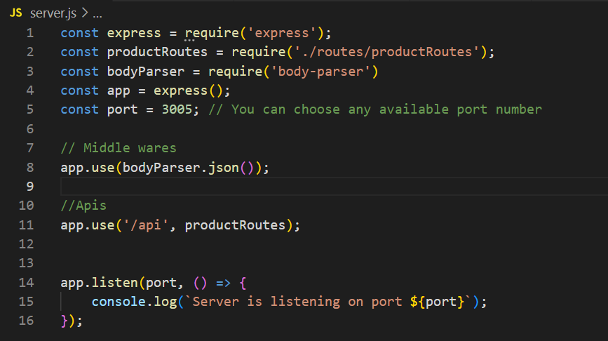
Server.js file

Slide 57
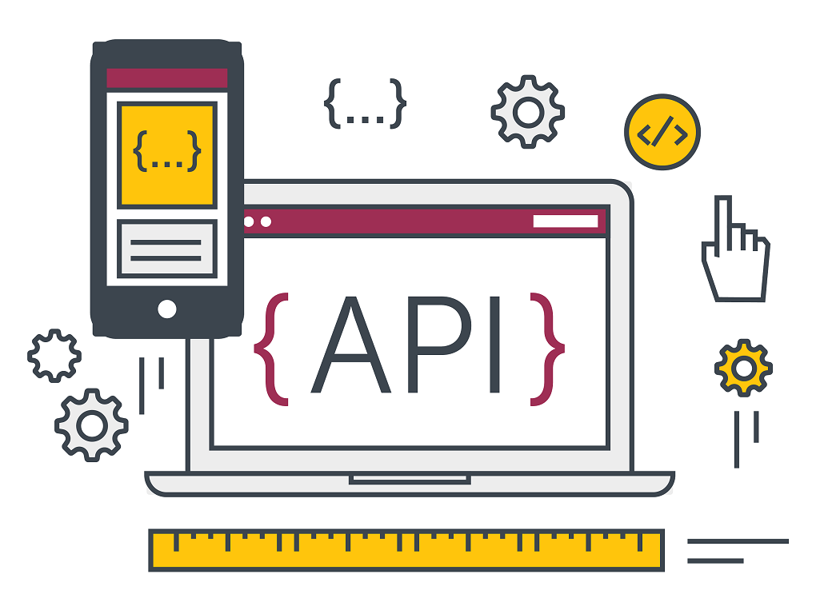
Test your all APIs

Slide 58

Your task
Create 4 APIs for Student with data student name, registration no, father name, date of birth and contact

Slide 59
Let’s make your life easier
Install nodemon and it will help you to restart your application on every save.
npm install --save-dev nodemon
It will install the nodemon as development library it will not work in production because we don’t need it in production.

Slide 60
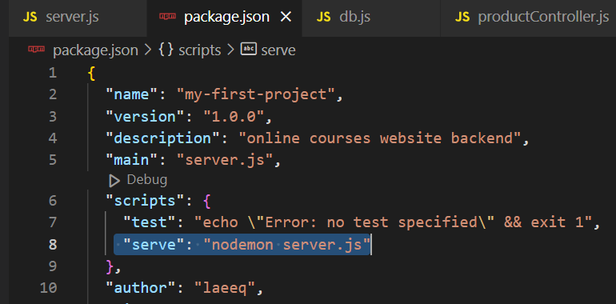
Add following line in your package.json

Slide 61
Use following command to run the application
npm run serve
Now when you will save your file you don’t need to restart the node server it will restart automatically and help you to speed up your development process

