Slide 1


Node JWT Middleware
By Laeeq Khan Niazi

Slide 2

Task
Create a Create API store following information of the Card
Cart type (Debit/Credit)
Card Bank
Card Holder Name
Card Number
Card Expiry
Card CVC

Slide 3

Learning Objective
Student should be able to write and implement the middleware's in express
Students should be able to protect the APIs using JWT base token

Slide 4

Create Signup API
Create an API to store username and password in the database using API

Slide 5
Install Package
npm install jsonwebtoken

Slide 6
Create Signup API
async function login(req, res, next) => {
const { email, password } = req.body;
try {
const user = await User.findOne({ email });
if (!user) return res.status(404).json({ error: 'User not found' });
return res.status(200).json({
message: 'Logged in successfully',
email: email,
fullname: user.fullname,
userid: user.id,
});
} catch (err) {
return res.status(500).json({ message: err });
}
};

Slide 7
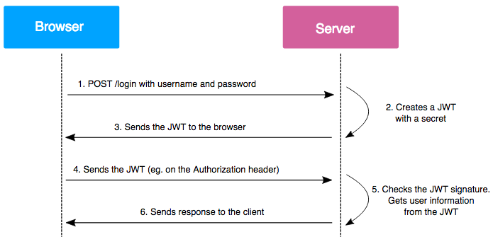
How JWT Works

Slide 8
Now let's get the token on the login
function GenerateToken(user) => {
const payload = {
role: user.role,
id: user._id,
};
const token = jwt.sign(payload, process.env.ACCESS_TOKEN_SECRET);
return token;
};

Slide 9
Send back the token to the Login Response
async function login (req, res, next) {
const { email, password } = req.body;
try {
const user = await User.findOne({ email });
if (!user) return res.status(404).json({ error: 'User not found' });
if (!isMatch) return res.status(401).json({ error: 'Invalid credentials' });
var token = generteLoginToken(user);
return res.status(200).json({
message: 'Logged in successfully',
email: email,
fullname: user.fullname,
userid: user.id,
token: token,
});
} catch (err) {
return res.status(500).json({ message: err });
}
};

Slide 10
Make middleware to verify the token
Create a middleware file in the Utils folder

Slide 11
Middleware Function
asyc function SecureAPI(req, res, next) => {
const token = req.body.token;
if (!token) {
return res
.status(401)
.json({ message: 'Access denied. Please login to access these pages' });
}
const secritkey = process.env.ACCESS_TOKEN_SECRET;
try {
const decoded = jwt.verify(token, secritkey);
req.body.role = decoded.role;
req.body.userid = decoded.id;
next();
} catch (ex) {
return res.status(400).json({ message: 'Invalid token.' });
}
};
module.exports = { SecureAPI };

Slide 12
Include that middleware in Routes
const { SecureAPI } = require('../utils/authorization_middleware');

Slide 13
Call middleware function as 2nd argument in your routes calling function like
myRouter.post('/admin', SecureAPI, controller.admindasbhard);

