Slide 1


Node JWT Middleware
By Laeeq Khan Niazi

Slide 2

Task
Create a Create API store following information of the Card
Cart type (Debit/Credit)
Card Bank
Card Holder Name
Card Number
Card Expiry
Card CVC

Slide 3

Learning Objective
Student should be able to write and implement the middleware's in express
Students should be able to protect the APIs using JWT base token

Slide 4

Create Signup API
Create an API to store username and password in the database using API

Slide 5
Install Package
npm install jsonwebtoken

Slide 6

What JWT?
JWT stands for "JSON Web Token." It is a compact, self-contained way to represent and transmit information between two parties in the form of a JSON object. JWTs are often used for authentication and authorization in web applications and APIs. They are commonly used in scenarios where it is necessary to verify the identity of a user or the authenticity of data

Slide 7
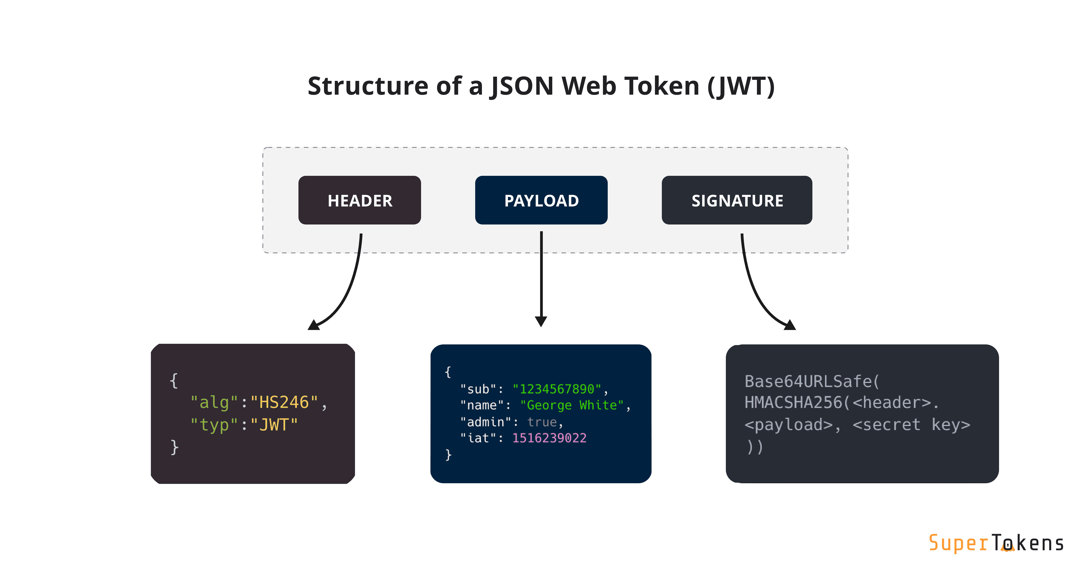
JWT Parts
A JWT typically consists of three parts:
Header → The header typically consists of two parts: the type of the token, which is JWT, and the signing algorithm being used, such as HMAC SHA256 or RSA
Payload
Signature → To create the signature part, you take the encoded header, encoded payload, a secret, and the algorithm specified in the header and sign that with the secret. The signature is used to verify that the sender of the JWT is who it says it is and to ensure that the message wasn't changed along the way.

Slide 8
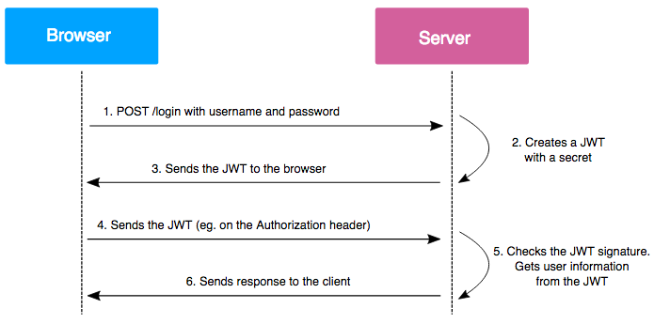
How JWT Works

Slide 9
Create Signin API
async function login(req, res){
const { email, password } = req.body;
try {
const user = await User.findOne({ email });
if (!user) return res.status(404).json({ error: 'User not found' });
if(user.password != password ) return res.status(401).json({error: ‘Invalid credentails '});
return res.status(200).json({
message: 'Logged in successfully',
email: email,
fullname: user.fullname,
userid: user.id,
});
} catch (err) {
return res.status(500).json({ message: err });
}
};

Slide 10

Now let's get the token on the login
const jwt = require('jsonwebtoken'); // Import the jwt library
function GenerateToken(user) {
const payload = {
role: user.role,
id: user._id,
};
const token = jwt.sign(payload, ‘adsfasdfjkh$#asdfasdf.adsfxc’);
return token;
};

Slide 11
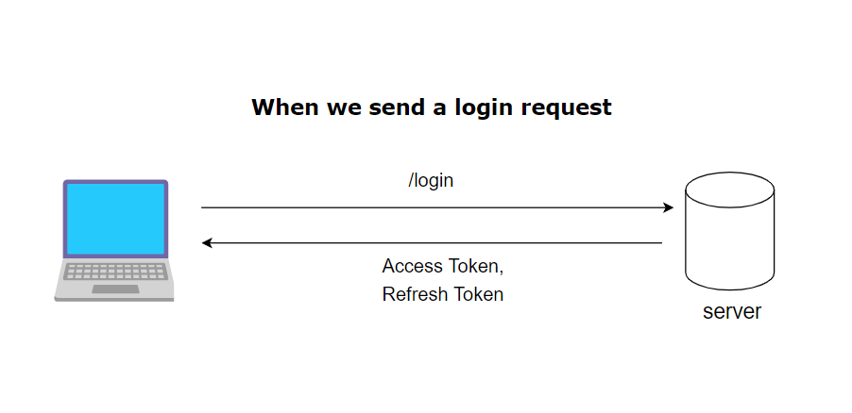
Send back the token to the Login Response
async function login (req, res) {
const { email, password } = req.body;
try {
const user = await User.findOne({ email});
if (!user) return res.status(404).json({ error: 'User not found' });
if (user.password != password) return res.status(401).json({ error: 'Invalid credentials' });
var token = generteLoginToken(user);
return res.status(200).json({
message: 'Logged in successfully',
email: email,
fullname: user.fullname,
userid: user._id,
token: token,
});
} catch (err) {
return res.status(500).json({ message: err });
}
};

Slide 12

Make middleware to verify the token
Create a middleware file in the Utils folder

Slide 13
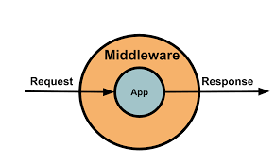
Middleware Function
const jwt = require('jsonwebtoken'); // Middleware function to validate JWT tokens
function validateToken(req, res, next) {
var token = req.headers.authorization
if (!token) {
return res.status(401).json({ message: 'No token provided' });
}
token = token.split(' ')[1]; //it is good to write such codes in try catch to handle proper exceptions jwt.verify(token, ‘adsfasdfjkh$#asdfasdf.adsfxc’, (err, decoded) => {
if (err) {
return res.status(403).json({ message: 'Failed to authenticate token' });
}
// If the token is valid, save the decoded information for later use
req.user = decoded;
next();
});
}
module.exports = validateToken;

Slide 14
Include that middleware in Routes
const validateToken = require('../utils/authorization_middleware');

Slide 15
Call middleware function as 2nd argument in your routes calling function like
myRouter.post('/admin', validateToken, controller.admindasbhard);

Slide 16

Multiple middleware's on the API
You can also call multiple middlewares for the same API endpoint in Express.js
app.get('/api/endpoint', middleware1, middleware2, (req, res) => {
console.log('API endpoint handler');
res.send('API response');
});

Slide 17

Role base Authorization
function requireRoles(roles) {
return (req, res, next) => {
const userRole = req.user.role; // Assuming you saved the user's role in req.user
if (roles.includes(userRole)) {
// User has one of the required roles, so allow access
next();
} else {
// User does not have any of the required roles, so send a forbidden response
res.status(403).json({ message: 'Permission denied' });
}
};
}

Slide 18

Calling multiple middleware's
app.get('/shared', requireRoles(['admin', 'user']), (req, res) => {
res.json({ message: 'Shared endpoint' });
});

