Slide 1
Cs-381 Software Engineering
Course Instructor: Dr. Shazia Arshad
Notes:
Welcome to all of you in this course. I am Dr. Shazia Arshad. I will be your instructor for this course.

Slide 2
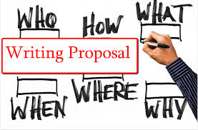
What is proposal?
Notes:
What is proposal writing???
Software engineering proposal is a document that a software developer submits to a business customer for acceptance.
A project proposal is a document that outlines everything stakeholders need to know to initiate a project. It’s a necessary first step towards getting a project off the ground.
Differentiate between PROJECT PROPOSAL and OTHER DOCUMENTS (Idea Document or any other)?
Proposal is the first document / confirmed agreement between client and Project Manager.
Proposal gives insight of all the aspects of the project. It does NOT includes only one part.
It clearly highlights WHAT the Client needs?
HOW the project will be developed?
WHY there is a need to develop project??
WHERE the project will be used after completion (e.g in school, in imanufacturing industry, in offices, in security departments.)
WHO will used the project??
WHEN the project will be completed (a rough estimate)??
Software engineering proposal is a document that a software developer submits to a business customer for acceptance.
Firstly, the BUSINESS STAKEHOLDERS posted their requirements for project.
What they want in their project??
Then, the PROJECT MANAGER / TEAM LEADER put their proposal for PROJECT WINNING.
It covers questions like:
What are the client requirements??
Which tools and technologies client want to use in your project??
What the developer need to develop??

Slide 3
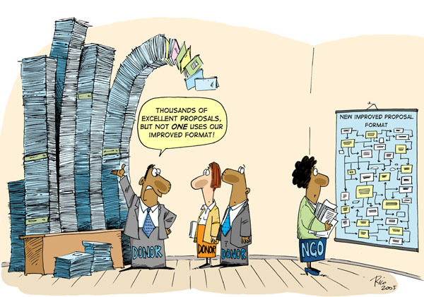
Why proposal writing is important?
Notes:
Can a Project Manager win projects without proposal?
Why proposal writing is important???
Thousand proposals in response to a client need.
How the client choose the Best proposal and award project to PROJECT MANAGER??
What makes your proposal EFFECTIVE, UNIQUE and DISTINGUISED IT FROM OTHERS??

Slide 4

HOW TO WRITE PROPOSAL??
DIAGNOSE PROBLEM
==>
PRESCRIBE TREATMENT
==>
DESCRIBE PLAN OF WORK
Notes:
The most important thing about a software engineering proposal is that the proposal is about the problem domain, not about programming.
The purpose of a software development proposal is to convey a solution that will be read by business people,
so keep it simple and to the point;
stay away from technical terms as much as possible.
Use Simple language.
Avoid Irrelevant details.
The proposal should clearly describe the motivation for the proposed work and the proposed solution along with its expected business value.
Proposal Length:
It is important to keep in mind that the people that you are going to present the proposal to don’t have a lot of time to read a lengthy document.

Slide 5
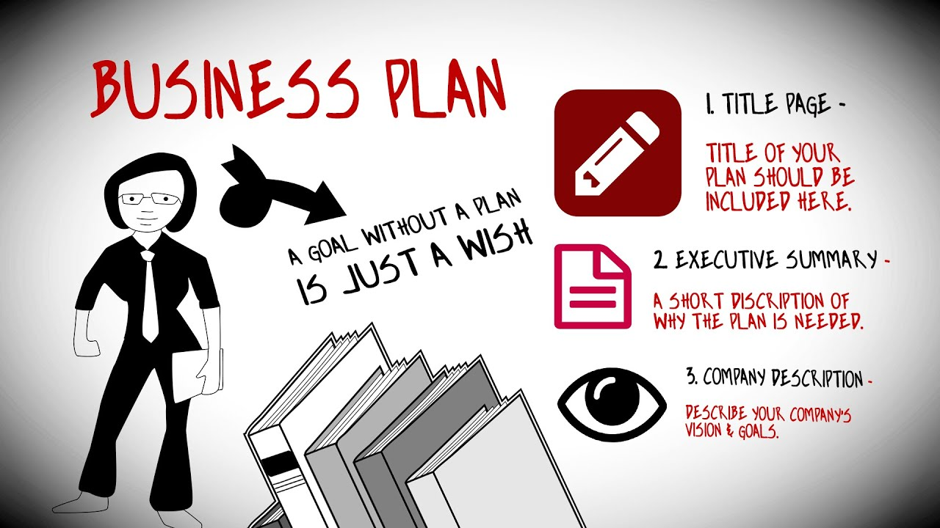
Elements of proposal??
Project Details
Business Case
Benefits
Technology
Notes:
Note that there is NO FIXED TEMPLATE for a proposal writing.
You can follow any template but the key elements (listed above) should be completed.
The key elements for proposal writing (shown in slide) are further divided into following categories:
Project Details:
Proposed Project Title
Executive Summary
Business Case:
Outline the business need for the project
Motivation for Project
Description of the project objective(s)
State the level of impact expected should the project proceed and implications of not proceeding
Functional Requirements
Benefits:
What benefits are expected/ anticipated?
Technology:
Programming Language
Platform

Slide 6
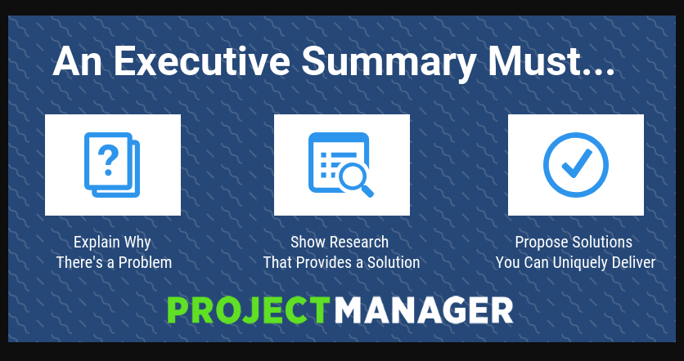
Proposal Detail: Executive Summary
Notes:
First step is to write EXECUTIVE SUMMARY.
The executive summary captures the attention of your audience. The goal is to get them excited about the project you’re proposing. It should motivate the client.
It includes the following:
What is the project about?
Addresses how your proposed project intends to solve the problem
A clear description of the project.
At least 300 words long.
The executive summary should cover the points like:
Brief Introduction of project (2 –3 lines)
Existing Projects (1 line)
CLEARLY HIGHLIGHT PROBLEM STATEMENT (2 lines)
Methodology you adopt (1-2 line)
Technology Used (1-2)

Slide 7
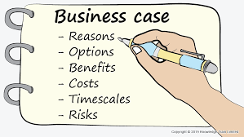
Business Case
Notes:
Second element is writing Business Case:
Business Need of Project:
This section to contain a clear articulation of the business need in the form of a statement that addresses the problem or opportunity. This statement should be no more than three or four sentences.
Motivation for Project:
This section to contain a clear statement of motivation which drives you to this project.
Description of the project objective(s):
Identify the key objectives of the project.
Level of Impact Expected:
State whether the implementation would have an impact at an operational level and/or strategic level and state the impact(s) in 2-3 lines.
Functional Requirements:
State list of features/services that you are going to offer. List should not be less than 8 features.

Slide 8

Benefits
Notes:
Highlight the benefits achieved by completing your project.
Try to discuss
Social
Academic
Economical
Time Saving
Industrial Benefit

Slide 9
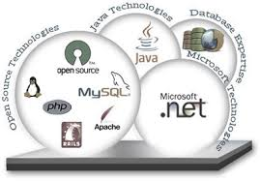
Technology
Notes:
In this part, you need to state the TECHNOLOGY you are going to use in your project.
Programming Language:
Which programming language you are going to use and state reason why this is best suited for project.
Platform:
Desktop / web / Mobile

Slide 10

Notes:
Project Proposal Example

