Slide 1
Cs-381 Software Engineering
Course Instructor: Dr. Shazia Arshad
Notes:
Welcome to all of you in this course. I am Dr. Shazia Arshad. I will be your instructor for this course.

Slide 2
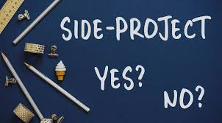
Share your Experience of Previous Projects
Notes:
This is your turn to share your experience.
What type of projects you have completed in the past??
How do you start your project??
Have the project completed on time??
What are the MISSING features of the project??
Why you were NOT able to complete project on time??
Which methodology / steps you have taken to complete your project??
What do you think how the project can be improved??

Slide 3

How to Take a start?
Notes:
The figure shows example of a TEAM MANAGER who is in confused state.
He have a BIG project to complete.
He is NEW is MANAGING a project for FIRST time.
He is VERY CONFUSED and don't know HOW TO START A PROJECT??
What do you think how he should TAKE START??
Which modules or task should he completes first??
Should he start developing project using EXISTING knowledge or should he WAITS for COMPLETE REQUIREMENTS??
How he is sure that the requirements discussed by client is FULL AND FINALIZED?
Is he CONFIDENT that the client needs are TECHNICALLY, ECONOMICALLY FEASIBLE?

Slide 4
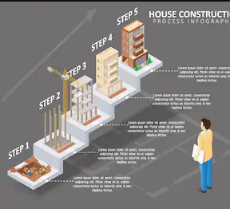
BUILDING A HOUSE
Notes:
To know the answers of previous questions, lets take an example and see how the people from other engineering disciplines take start?
let's take a look at a process that you might be familiar with, like building a house.
Constructing a house requires steps which is followed in sequential manner.
Like firstly, user buys a piece of land,
then approaches builder for construction.
Discuss your requirements with builder (you'll probably reach out to a builder and tell about your needs, like, I need two bedrooms, I need a bigger great room, I need a room on the basement etc etc.)
Builders may give you some options.
Then you will have to do some analysis, and come back with your choice.
At last, you end up with the final design of house.
Then, builder is going to go back, and going to create a floor plan.
And then, he's going to show it to you the floor plan, and you might make some adjustment.
Once that is done, builder is going to create a detailed map or detailed plan about where the foundation is going to be,
where the electricity is going to be,
where the plugs are going to be,
where the plumbing is going to be,
and then, they're going to start building the home. And, as they are building the home, they're going to call the inspection people to come, and inspect the house. For example, let's say the foundation is done, they're going to get the foundation approved. When the plumbing is done, they can get the plumbing approved.
And once the house is ready, he's going to call you to say whether, you like the house,
Is it what you expected?
And then, once you approve it, then you're going to start, staying in that house or living in that house and,
of course, there comes the maintenance of the house.

Slide 5
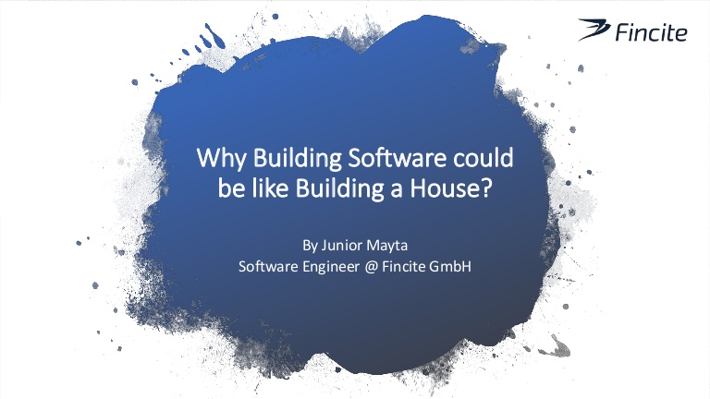
Notes:
Is building a software is like building a house?
So any idea??? Map the previous example of building a house to building a software. You will find the solution.
So, when you're building a software, similar to building a house, you're looking at requirements or you're looking at what exactly you need to build??
you will do analysis of different options or you might do a prototype and show it to your customer, and just say, "Is this what you're looking for?"
But at the end of this phase, you have exactly what you're looking to build.

Slide 6
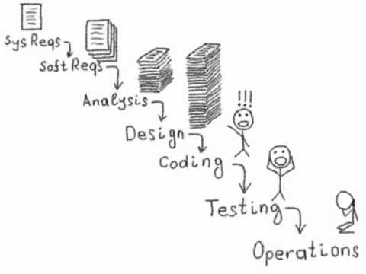
SOFTWARE DEVELOPMENT LIFECYCLE
Notes:
The steps pf SDLC or Software Development Lifecycle includes the following shown above.
These steps should be followed in a sequential manner for developing a good software.

Slide 7

Requirement Gathering phase
GOAL:
Collecting client requirements
OUTCOME:
Requirement Gathering Document
Notes:
This phase involves collecting requirements from clients related to project.
Requirement Gathering involves detailed understanding of each part of the project, with focus on each and every minor detail.
During this phase, the customer states the expectations of the project including who will use the product, how the customer will use the product, and the specific information included with any special customer requirements related to the software.
The business must communicate with IT teams to convey their requirements for new development and enhancement. The requirements phase gathers these requirements from business stakeholders and Subject Matter Experts (SMEs.)
Architects, Development teams, and Product Managers work with the SMEs to document the business processes that need to be automated through software.

Slide 8

ANALYSIS phase
GOAL:
Answers the questions of who will use the system, what the system will do, and where and when it will be used.
OUTCOME:
Feasibility Report
Notes:
This involves carefully monitoring the requirements collected from the previous step. It includes analyzing each step to find out whether the development of project is Technically, Economically feasible.
This may include:
Resource allocation (both human and materials)
Capacity planning
Project scheduling
Cost estimation

Slide 9
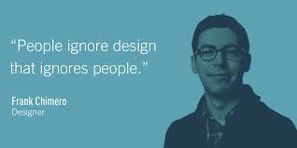
Design phase
GOAL:
Transformation of all requirements into detailed specifications covering all aspects of the system.
OUTCOME:
Detailed Design Document
Notes:
After getting requirements from clients and analysis, there is Design Phase.
Here comes the architects and the software developers. They're going to design the system, they're going to architect the system, and answer questions like,
What are the different components that they need to build?
And how they're going to work together?
The importance of design phase is illustrated by a designer Frank. The one who ignores design will end up in a messy situation as they are NOT CLEAR what they intended to develop.
Unless a person is not clear in his thoughts, he cannot give satisfactory responses and can't help others.
It specifies the construction details of the system, each system component’s interaction with other components and external systems, and the interface that allows end users to operate the system and its functions.
The outcome of design phase includes the following:
Detailed Design Document including CLASS , ERD, DATABASE, DATAFLOW, SEQUENCE, ACTIVITY diagram.

Slide 10
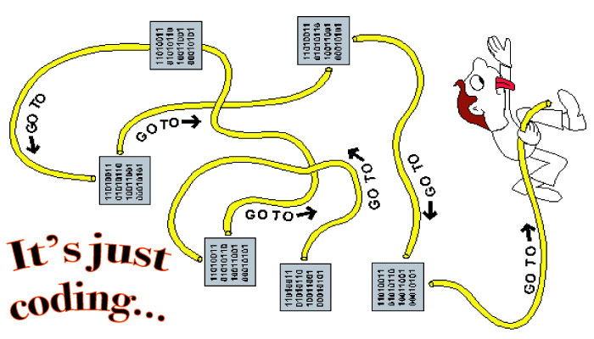
CODING phase
GOAL:
Implement the project
OUTCOME:
Complete Product
Notes:
Once the design is done, next step is CODING.
Here the developers play their role to develop the product.
Suitable tools and language is chosen for development.

Slide 11

TESTING phase
GOAL:
Test your product
OUTCOME:
Test Cases and Project Testing Backlog
Notes:
From the figure, it can be infer that unless you touch raindrops, or hear the sound of rain, you can’t have idea of how raindrops feel when it touches hand.
Or if you do not use your umbrella, you can’t say whether it is okay or have defects (means having holes)
Similarly, if you do not test your software, you cannot see its defects.
Software testing involves finding errors, defects or bugs.
It can be UNIT testing or INTEGRATION testing or FUNCTIONAL testing.

Slide 12
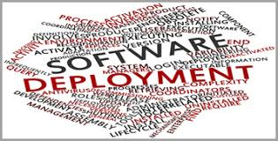
Deployment phase
GOAL:
To successfully deploy the project
OUTCOME:
Deployment Completed
Notes:
Deployment can happen in stages, where you release only the parts of your product that are ready and workable. You can also deploy a beta version and limit access to select testers to get feedback and make improvements before releasing the full product to a wider population.
This is the part where your final product meets real-world use.

Slide 13
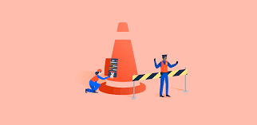
OPERATION AND Maintenance phase
GOAL:
To regularly maintain and update your project
OUTCOME:
Updated version of software
Notes:
It’s important to note that your job as a software developer doesn’t end after the final deadline or after the product launches.
As with other engineering projects, every product requires updation and maintenance with time.
Software must be monitored constantly to ensure proper operation.
Maintenance is a never-ending process of updating your system periodically, improving it for more efficient use, and fixing bugs as they occur. And without improvements or updates, your product will deteriorate over time.

Slide 14

TIME TO THINK
Can we skip any phase of SDLC and state reason to justify your answer ????
Notes:
So, its time to check if you are active or not???

