Slide 1

CS411-Compiler Construction
Syntax Analysis - Introduction
Talha Waheed, Dept. of CS, UET, Lahore, Pakistan.

Slide 2
Course Learning Objectives
CLO2 → PLO1 (Cognitive Domain, Domain Level: 2 Understand)
CLO2: Understand the working principles of various phases of a compiler and how they are integrated to produce a working compiler
PLO1 (Engineering Knowledge): An ability to apply knowledge of mathematics, science, engineering fundamentals and an engineering specialization to the solution of complex engineering problems

Slide 3
Quick Review 1/3 - What is a Compiler?
A compiler is a program that takes a program written in a source language (usually a High Level Programming Language) and translates it into an equivalent program in a target language (usually an Intermediate Code, Machine Code or Relocatable Object File).
COMPILER
Source Program
Target Program
Error Messages

Slide 4
Quick Review 2/3 - Phases of Compilation
source program
front end
(source)
lexical analyzer
syntax analyzer
semantic analyzer
symbol table
manager
error handler
intermediate
code generator
code optimizer
code generator
back end
(target)
target program
Each phase transforms the source program from one representation
into another representation.

Slide 5
Quick Review 3/3 - Lexical Analyzer
Error Handler
source
program
token
Parser
Scanner (Double Buffering)
Lexical Analyzer
GetNextToken()
Symbol
Table
Keyword Handler (Hash based)
Notes:
Scanner – Double Buffering using Multithreading
How to specify and recognize tokens for a lexical analyzer using Regular Expression, Regular Grammars and Finite Automata.
Then We implemented Lexical Analyzer that are based on Finite Automata by 1) maintaining a State variable, 2) without state variables 3) Transition Table Based and 4) Compressed Transition Table based
Error Handler How to Handle different types of lexical errors using various actions like delete, insert, replace, transpose, we have also implemented panic mode error handling
Removal of White Space and Comments
5 Different Techniques for Keywords Handling, we have implemented hash table based technique

Slide 6
Parser Introduction

Slide 7
Syntax of Programming Languages
In pascal or C, for example
a program is made out of blocks,
a block out of statements,
a statement out of expressions,
an expression out of tokens,
and token out of characters.
Inherently recursive structures of a programming language are defined by a Context Free Grammar (CFG) or in BNF (Backus Naur Form) notation.

Slide 8
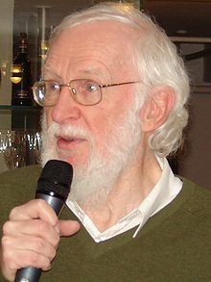
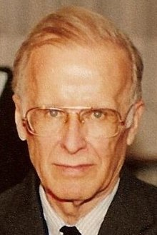
Pioneers of Syntax of Programming Languages
Peter Naur (1928-2016)
Danish Computer Scientist
John W. Backus (1924-2007)
American Computer Scientist
Inventor of Fortan, Algol60
ACM-Turing Award for defining Algol60 syntax using BNF

Slide 9
Advantages of Grammars
gives a precise syntactic specification of a programming language.
the design of the grammar is an initial phase of the design of a compiler.
a grammar can be directly converted into a parser manually or by using some automated tools.
New constructs can be added easily in a language when existing implementation is based on a grammatical description

Slide 10
What is Parsing?
Parsing, syntax analysis, or syntactic analysis is the process of analyzing a string of symbols, either in natural language, computer languages or data structures, conforming to the rules of a formal grammar.
(Definition from Wikipedia)

Slide 11
Context of Parser
Input: a stream of tokens.
Output: Generates a Parse Tree
Purpose: To check validity of an input statement, otherwise generates error
The smallest item is a token.
Error Handler
source
program
Lexical Analyzer
Stream of tokens
Parser
Rest of the Front end
Parse Tree
Intermediate
code
GetNextToken()
Symbol Table

Slide 12
Role of the Parser
To determine if the stream of tokens provided by the lexical analyzer is a valid string in the language
To report syntax errors (if invalid)
To recover from errors (if possible) so that all syntactical errors can be reported at once.
To collect some information about tokens into symbol table.

Slide 13
Parser
The syntax of a programming language is typically described by a CFG or in (BNF Notation) .
Parser checks whether a given input from a source program satisfies the syntactic rules implied by a CFG or not.
If it satisfies, the parser creates the parse tree of that program.
Otherwise the parser gives the error messages.

Slide 14
Types of Parsers - Overview

Slide 15
Types of Parsers
Parsers
Universal Parsers
Top Down Parsers
Bottom Up Parsers (Shift reduce)
Hybrid Parsers
Operator Precedence
Backtracking TDP
LR Parsers
Non Backtracking TDP
Earley’s Algorithm
LR(0)
Bruteforce
Method
Simple LR(1)
Canonical LR(1)
Recursive Descent
Predictive Parsers
Cocke Younger Kasomi (CYK)
Look Ahead LR(1)
Recursive Predictive
Non Recursive Predictive LL(1)
(Table-based)

Slide 16
Universal Parsers
Usually for Natural language parsers where backtracking support is required,
backtracking is rarely required in Programming Language grammars.
Earley’s Algorithm
CYK is a dynamic programming (recall from algorithm design) technique, based upon n*n tabular methods.
Pros
Can parse any type of CFG grammar
Cons
Worst case time complexity is O(n3)
inefficient in production compilers

Slide 17
Top Down and Bottom up Parsers
Hybrid Parsers uses both top down and bottom up parsing at the same time.
Efficient top-down and bottom-up parsers can be implemented only for sub-classes of CFGs. E.g.
LL(1) for top-down parsing
LR for bottom-up parsing
LL and LR detect errors as soon as possible

Slide 18
Top Down Parsers
Start building parse tree from top (root) towards bottom (leaves) in preorder
LL(1) first L stands for Left to Right scan, second L stands for Left most derivation, while looking ahead 1 symbol)
Pros
Efficient parsers can be easily implemented manually
From LL(1) grammar a non-recursive predictive parser can be constructed automatically. (We will see it later)
Cons
Limited and restricted types of grammars.
E.g. for nondeterministic grammars predictive parsers can’t be build.

Slide 19
Bottom Up Parsers
Start building parse tree from bottom (leaves) towards top (root).
Operator Precedence can parse ambiguous grammars
Pros, it is easy to implement.
LR parsing is more general method, used by automated software tools like yacc,
However for a small class of LR grammars (operator grammars) we can construct shift reduce parsers by hand.
Cons
Shift reduce can handle a large class of LR grammars and translation schemes

Slide 20
LR Parsers
LR(k) L is for left to right scan of input, whereas R is for constructing a rightmost derivation in reverse., k for number of input symbols of lookahead that are used for making a parsing decision.
Pros
Can be constructed to recognize all PL constructs for which CFG exists
The most general non-backtracking shift-reduce parsing method
As Efficient as other shift-reduce methods
Class of LR grammars is a proper superset of predictive parser grammars
LR parser can detect a syntax error as soon as possible
Cons
Manual implementation requires too much work.
Automatic tools can identify ambiguities or non-parsable constructs in grammars.

Slide 21
Sub Types of LR parsers
SLR – Simple LR is easiest to implement, but least powerful
May fail to produce parsing tables for certain grammars
LALR - Lookahead LR is intermediate in power and cost.
CLR - Canonical LR is most powerful but most expensive

Slide 22
Syntax Error Handling

Slide 23
Syntax Error Handling
If a compiler had to process only correct programs its design and implementation would be greatly simplified.
Good compiler should assist the programmer in identifying and locating errors. And even in automatically correcting them.
4 Levels of Error
Lexical – Misspelling of an id, keyword or operator e.g. 9ad, ::=, “hello world
Syntax – Unbalanced parenthesis in an arithmetic expression e.g. (a + b))
Semantic – Using incompatible operator e.g. “abc” * “def” (overloading creates errors?), void function() {return 100; };
Logical – Infinite loop (while (1>0) {…}), infinite recursion or incorrect operator if (a=0)
Much of Error Detection and Recovery occurs in Parsing
Semantic and Logical errors detection at compile time is a difficult task (type mismatch can be detected at semantic level.)
Goals of Error Handler in Parser
Report the error clearly and accurately
Recover from error quickly
Not slow down the processing of correct programs

Slide 24
Typical Errors Frequency
(An old report, about student’s Pascal programs)
60% of small programs are syntactically and semantically correct (Not the case for large-scale industrial software applications)
Out of Erroneous programs
80% Have only one error
13% Have two errors
90% Were single token errors

Slide 25
Typical Statistical Classification of Errors
(An old report, about student Pascal programs)
60% Punctuation Errors
Mostly semicolon missing as line terminator, cout << “Hi”;
Use of comma instead of semicolon ( for (int a = 0, a < 5; a++) {…})
Use of semicolon after while expression (while(a>0); {…} ) or else ( if (a>0){…} else; {…})
Q: Why so many semicolon errors?
20% Operator and Operand Errors
Instead of a:= b using a=b (if you are a C++ programmer , := is assignment operator in Pascal)
Unbalanced parenthesis in expressions (a + b)) or misplaced braces { } in a block statement.
15% Keyword Errors (use of else if instead of elsif, or writing wrteln insteas of writeln (pascal output statement))
5% All Other kind of Errors

Slide 26
Error Recovery in Predictive Parsing
What should parser do in case of an error?
The parser should be able to give an error message (informative, understandable diagnostic error message) with place of error (actual occur may occurred before that).
Not adequate to quit parsing at detection of first error. It should recover from that error, and it should be able to continue the parsing with the rest of the input. (Some max errors limit should be there. E.g. 200)
Broadly applicable strategies to address error recovery, no universal solution.
Extensive error-recovery is not cost-effective, trend is to help programmer by powerful IDE to avoid common lexical and syntax errors, e.g. use of colors for different constructs of a program, auto-format of code, auto-insertion of pair of brackets and auto-completion of data members of a class, variable info display in a baloon.

Slide 27
Error Recovery Technique 1 – Panic Mode
While parsing, skipping the input symbols until an unambiguous and clear synchronizing token is found.
Some popular synch tokens are delimiters (semicolon, }), operators (assignment) or reserve words (if, while, for etc.)
Compare Panic mode implementation in interpreter and compiler
Pros
Simplest and mostly used.
Guaranteed not to go in infinite loop.
Cons
Often skips a considerable amount of input without checking for further errors.
Not useful where multiple errors in a single statement are there.

Slide 28
Error Recovery Technique 2 – Phrase Level
Parser may perform local correction (in phrase??) in an input statement. It may replace the prefix of erroneous input that allows the parser to continue.
(viable prefix property of LL grammar, error detected as soon as they see a prefix of input that cannot be completed to form a string in the language)
To replace a comma by a semicolon. ( for (int a = 0, a < 5; a++) {…})
Delete or insert a missing semicolon (while(a>0); {…} ).
The choice of local correction is left to the compiler designer.
However, careful replacements are required to avoid infinite loops or avalanche of errors, not intended by programmers.
E.g. if we always insert something on the input ahead of the current symbol.
Sometimes syntactic corrections may introduce semantic errors. e.g.
declaration of a variable num is skipped by parser,
later it is encountered in an assignment statement a = (num+3);
there is nothing syntactically wrong in this statement,
but symbol table entry of num is missing, so it is undefined.
Cons
Difficult to cope with the situation if actual error has occurred before its point of detection, now prefix cannot be corrected, and needs trace-out before that.

Slide 29
Error Recovery Technique 3- Error Productions
If we have a good idea of the common errors that might be encountered, we can augment the grammar with error productions that generate erroneous constructs.
E.g. Compare following rules, and Identify the error?
DECL_STMT → DATATYPE ID OPT_INIT SEMICOLON (Correct)
DECL_STMT_E → DATATYPE ID OPT_INIT IF_STMT (Error Production)
When input statement is parsed by an error production, we exactly diagnosed the error in it and how to correct it.
Cons
Large number of error productions are difficult to write and make grammar heavy.
Almost impossible to know all types of errors that can be made by programmers
This is less practical for new languages and works on well-established languages with large scale error studies.

Slide 30
Error Recovery Technique 4 – Global Correction
Ideally, a compiler needs to introduce minimal changes in correcting input.
For this we have to globally analyze the changes in input and its implications.
There are algorithms for choosing a minimal sequence of changes to obtain a globally least-cost correction.
Given an input string x and a Grammar G, these algo will find a parse tree for a related string x’ such that the number of changes (insertions, deletions, swapping) in tokens required to transform x into x’ is minimal.
Cons
Expensive in terms of time and space. Difficult to implement.
So these techniques are mostly theoretical.
Issue: A closest correct program may not be what the programmer had in mind.
Least-cost correction does not provide a yardstick for evaluating error recovery techniques
It is useful for finding optimal replacements in phrase-level error recovery.
Which one of four option will you choose and why?

Slide 31
Context Free Grammar (CFG)

Slide 32
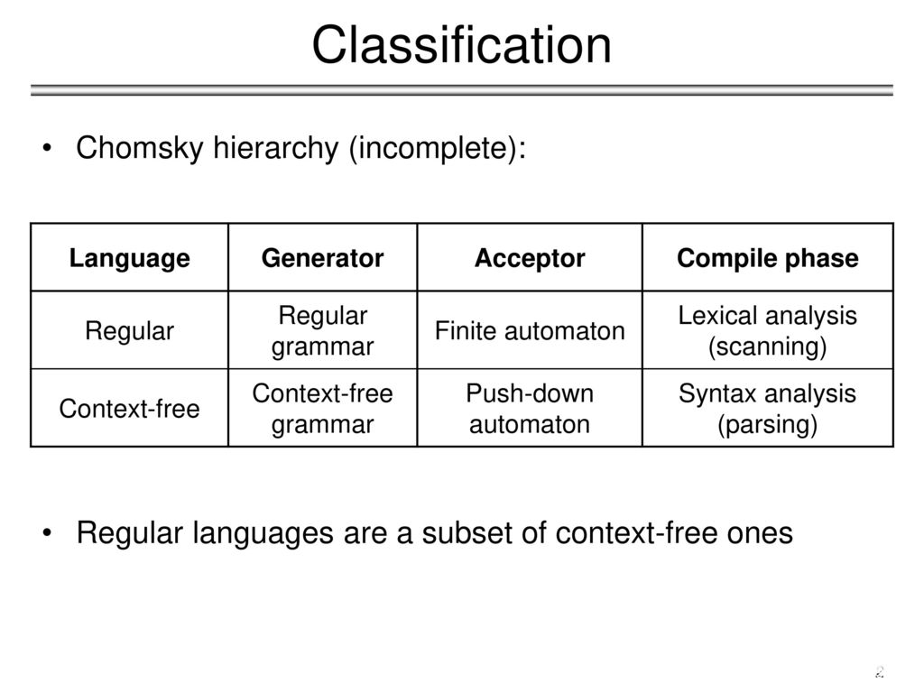
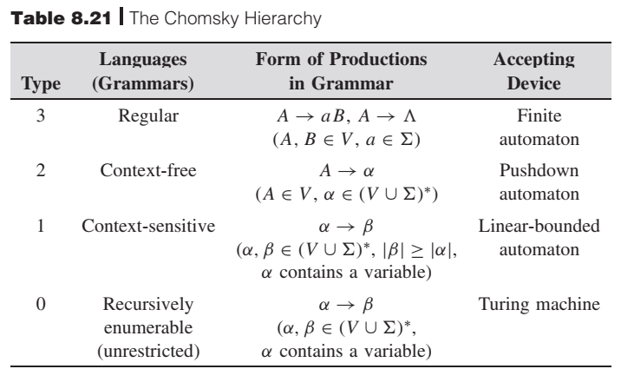
Context-Free Grammars
A finite set of terminals (in our case, this will be the set of tokens)
A finite set of non-terminals (syntactic-variables)
A finite set of production rules in the given form A → α (where A is a non-terminal, and α is a string of terminals and non-terminals including empty string)
A starting rule (one of the production rules).
Recall the restrictions between different grammars
(courtesy: Introduction to Languages and the Theory of Computation by John C. Martin, p282,)
Type 0 ⸧ Type 1 ⸧ Type 2 ⸧ Type 3

Slide 33
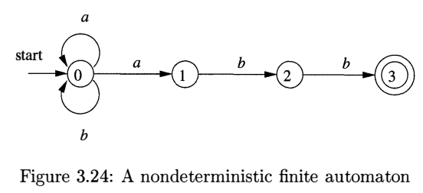
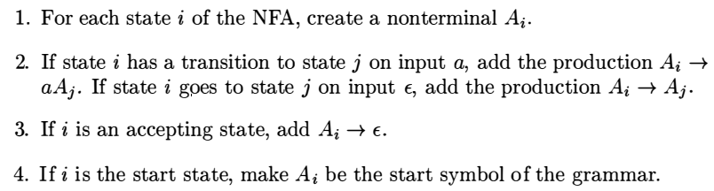
CFG vs Regular Grammar
The regular grammar for the regular expression (a+b)* abb of the given NFA can be generated systematically
Regular Grammar: A₀ → aA₀ | bA₀ | aA₁ A₁ → bA₂ A₂ → bA₃ A₃ → ε
CFG is more powerful than Regular Grammar (no restrictions on RHS of rule)
So everything that can be represented by a Regular Grammar/ Finite Automata can also be represented by a CFG, but not vice versa.
The language L = {a^{n}b^{n} | n>=1} or (^{n}) ^{n} can be described by a CFG (S → aSb | ab), but not by a Regular Grammar/ Finite Automata (recall pumping lemma).
Note that a*b* is a regular language with a CFG {S→aS | C C → bC | ε}.

Slide 34
CFG vs Context-Sensitive Grammar
Few syntax of programming languages can’t be described by any CFG even.
How to write a CFG for “declare an identifier before its usage” in a program.
Its abstraction can be represented by language L = {wcw, | w is in (a+b)*} where first w represents the declaration of an identifier w, c represents an intervening program fragment, and the second w represents the use of the identifier.
e.g. for the input string aabcaab, w is aab (wcw = aab c aab)
Identify w and c in this code? int rate; cout << “hi”; rate = 3;
If wcw can’t have a CFG then why and how wcw^{r} can be written by a CFG?
wcw^{r} is a Palindrome with a CFG {S→ aSa | bSb | C C → aC | bC | ε}
int f(void) { return n + 1; } its syntax is ok but n is not in the scope
So, C and Java are context-sensitive languages, they require identifier declaration before their usage, and they allow identifiers of any length.
For this reason, C and Java grammars doesn’t distinguish among identifiers of different character strings. Instead, same token of id is used everywhere.
In their compiler, semantic analyzer (with the help of symbol entry) checks the context of identifiers (are they declared before their usage or not).

Slide 35
CFG vs Context-Sensitive Grammar
“Match No. of formal parameters in function declaration with the No. of actual parameters in function usage” is also context-sensitive.
Its abstraction can be represented by language L = {a^{n}b^{m}c^{n}d^{m} | n, m >= 0}
Here a^{n} and b^{m} could represents the formal parameter lists of two functions declared to have n and m arguments, respectively while c^{n} and d^{m} represents the actual parameter lists in calls to these two functions.
Identify a^{n}, b^{m} , c^{n} and d^{m} in? f1(int a); f2(char b, char c); … f1(5); f2(d, e);
a^{n}b^{m}c^{n}d^{m} can’t be written by a CFG but in a different order b^{m}a^{n}c^{n}d^{m} have a CFG (S→ bSd | A A → aAc | ε)
In the following a C-language like rule for function call, function declaration and its usage does not count the number of parameters.
stmt → fun_id (exprList) exprList → exprList, expr | expr expr → expr + expr | expr - expr | (expr) | id | digit
So matching the No. of parameters in a function call with its declaration is done in semantic analysis (mild context-sensitivity added with the help of its symbol table entry).

Slide 36
CFG - Terminology
A sentence of L(G) is a string of terminal symbols of G.
L(G) is the language of G (the set of sentences generated by Grammar G).
If S is the start symbol of G then
ω is a sentence of L(G) iff S ⇒ ω (where ω is a string of terminals of G).
If G is a context-free grammar (CFG), L(G) is a context-free language.
Two grammars are equivalent if they produce the same language.
+

Slide 37
Example – A CFG for Arithmetic Expression
Grammar:
E → E + E | E – E | E * E | E / E | - E | ( E ) | id | digit
Input string: id + digit
Derivation: E ⇒ E + E ⇒ id + E ⇒ id + digit
Step-by-step replacements of non-terminals with their rules is called a derivation of input id+id from start symbol E.
α₁ ⇒ α₂ ⇒ ... ⇒ α_{n} (α_{n} derives from α₁ or α₁ derives α_{n} )
⇒ : derives in one step
⇒ : derives in zero or more steps
⇒ : derives in one or more steps
In general a derivation step is αAβ ⇒ αγβ
(if there is a production rule A→γ in our grammar
where α and β are arbitrary strings of terminal and non-terminal)
*
+

Slide 38
CFG – Terminology – Sentinal Form vs Sentences
*
S ⇒ α
If α contains non-terminals, it is called as a sentential form of G (intermediate form).
If α does not contain non-terminals, it is called as a sentence of G (final form).

Slide 39
Derivation
At each derivation step, we can choose any of the non-terminal in the sentential form of G for the replacement.
If we always choose the left-most non-terminal in each derivation step, this derivation is called as left-most derivation.
If we always choose the right-most non-terminal in each derivation step, this derivation is called as right-most derivation.

Slide 40
Left-most vs Right-most Derivation
Context Free Grammar for Arithmetic Expression:
Prod No: (1) (2) (3) (4) (5) (6) (7) (8)
E → E + E | E – E | E * E | E / E | - E | ( E ) | id | digit
Input String: -(id₁ + digit * id₂)
Left-Most Derivation
Prod No: 5 6 1 7 3 8 7
E ⇒ -E ⇒ -(E) ⇒ -(E + E) ⇒ -(id₁ + E) ⇒ -(id₁ + E * E) ⇒ -(id₁ + digit * E) ⇒ -(id₁ + digit * id₂)
Right-Most Derivation
Prod No: 5 6 1 3 7 8 7
E ⇒ -E ⇒ -(E) ⇒ -(E + E) ⇒ -(E + E * E) ⇒ -(E + E * id₂) ⇒ -(E + digit * id₂) ⇒ -(id₁ + digit * id₂)
(Note: Start and End are same, intermediate path is different)

Slide 41
Parse Tree vs Derivations
Inner nodes of a parse tree are non-terminal symbols.
The leaves of a parse tree are terminal symbols.
A parse tree can be seen as a hierarchical representation of a derivation. whereas derivation provides a linear order of replacement.
e.g. a step-by-step expansion of left-most derivation parse-tree for -(id + digit)
E ⇒ -E
⇒ -(E)
⇒ -(E + E)
⇒ -(id + E)
⇒ -(id + digit)
E
E
E
E
E
-
E
-
E
-
E
-
E
-
E
(
E
)
(
E
)
(
E
)
(
E
)
E
+
E
E
+
E
E
+
E
id
id
digit

Slide 42
Parsing and Left-Most and Right-Most Derivations
We will see that the top-down parsers try to find the left-most derivation of the given source program.
We will see that the bottom-up parsers try to find the right-most derivation of the given source program in the reverse order.

Slide 43
Problems in Grammar

Slide 44
Ambiguity
A grammar is ambiguous if it produces more than one parse tree / more than one left-most derivation/ more than one right-most derivation for a sentence.
Prod No: (1) (2) (3) (4) (5) (6) (7) (8)
E → E + E | E – E | E * E | E / E | - E | ( E ) | id | digit
Leftmost derivation 1
1 8 3 8 8
E ⇒ E + E ⇒ digit + E ⇒ digit + E * E ⇒ digit + digit * E ⇒ digit + digit * digit
e.g. 3 + 5 * 2 = 13 (here * is applied first)
Leftmost derivation 2
3 1 8 8 8
E ⇒ E * E ⇒ E + E * E ⇒ digit + E * E ⇒ digit + digit * E ⇒ digit + digit * digit
e.g. 3 + 5 * 2 = 16 (here + is applied first)
E
E
E
+
E
E
*
E
digit
E
*
E
E
+
E
digit
digit
digit
3
digit
digit
2
5
2
3
5
Parse Tree for Leftmost derivation 1
Parse Tree for Leftmost derivation 2

Slide 45
Ambiguity in Grammars
For the most parsers, unambiguous grammar is required.
So we must eliminate the ambiguity in the grammar during the design phase of the compiler.
An unambiguous grammar provides ➔ unique selection of the parse tree for any sentence.
Either we have to prefer one of the parse trees of a sentence (generated by an ambiguous grammar) to disambiguate that grammar to restrict to this choice.
Or an ambiguous grammar should be rewritten to eliminate the ambiguity.

Slide 46
Ambiguity – Operator Precedence
Ambiguous grammars (because of ambiguous operators) can be disambiguated according to the precedence and associativity rules.
E.g. for the given grammar:
E → E + E | E * E | E ^ E | id | (E)
disambiguate it according to following precedence (associativity in brackets)
^ (right to left)
* (left to right)
+ (left to right)
Revised grammar
E → E + T | T
T → T * F | F
F → G ^ F | G
G → id | (E)
⇓

Slide 47
Ambiguity in If-else Statement 1/2
Grammar:
stmt → if expr then stmt | if expr then stmt else stmt | otherstmts
Input:
if E₁ then if E₂ then S₁ else S₂
What does it mean?
Case 1: if E₁ then {if E₂ then S₁} else S₂ (else associated with farthest if)
Case 2: if E₁ then {if E₂ then S₁ else S₂} (else associated with closest if)
stmt
if expr then stmt else stmt
E₁ if expr then stmt S₂
E₂ S₁
stmt
if expr then stmt
E₁ if expr then stmt else stmt
E₂ S₁ S₂
Case 1:
Case 2:

Slide 48
Ambiguity in If-else Statement 2/2
Either we prefer the second parse tree (where else matches with closest if).
Or, we have to rewrite following grammar to reflect this choice.
stmt → if expr then stmt | if expr then stmt else stmt | otherstmts
The unambiguous grammar for this is:
stmt → matchedstmt | unmatchedstmt
matchedstmt → if expr then matchedstmt else matchedstmt | otherstmts
unmatchedstmt → if expr then stmt |
if expr then matchedstmt else unmatchedstmt

Slide 49
Eliminating Ambiguity from a Grammar
By Introducing Some Precedence/ Convention / Rule (like which else to consider with closest if or farthest if)
By modifying Grammar (No universal algorithm exist)
By introducing Brackets, punctuation marks (as we did in if-else)
By introducing different Keywords. (like elsif)
Note: Usually ambiguity is property of grammar, but sometimes language constructs itself are ambiguous. In that case we only can specify some rule.

Slide 50
Left Factoring

Slide 51
Left Factoring
Recall Algebraic Factoring of Secondary School (xa + xb) ➔ x (a + b)
Example 1
A → aX | aY X → b Y → c | d
Input string: ac (current symbol is a)
On the righthand side of both productions of A, a is common
Grammar after doing left Factoring:
A → aA’ A’ → X | Y X → b Y → c | d
Example 2
stmt → if expr then stmt else stmt | if expr then stmt
On the righthand side of both productions, if expr then stmt is common.
Grammar after doing left Factoring:
stmt → if expr then stmt stmt’ stmt’ → else stmt | ε

Slide 52
Left-Factoring and Parsing
A top-down predictive parser (without backtracking) insists that the grammar must be left-factored.
Solution
Write a new equivalent grammar without left factoring that is suitable for predictive parsing

Slide 53
Left-Factoring Algorithm
If, A → αβ₁ | αβ₂ (where α is non-empty prefix and the first symbols of β₁ and β₂ (if they have one) are different)
when processing α we don’t know whether to choose production A → αβ₁ or A → αβ₂
But, if we re-write the grammar as follows by factoring α (taking it common in both productions, like in elementary algebra)
A → αA’ A’ → β₁ | β₂ we can immediately expand A to αA’
General Algorithm: For each non-terminal A with two or more production rules with a common non-empty prefix α, let say
A → αβ₁ | ... | αβ_{n} | γ₁ | ... | γ_{m}
convert it into
A → αA’ | γ₁ | ... | γ_{m} A’ → β₁ | ... | β_{n}

Slide 54
Left-Factoring – Example1
A → abB | aB | cdg | cdeB | cdfB
⇓ (Remove First Left Factoring)
A → aA’ | cdg | cdeB | cdfB
A’ → bB | B
⇓ (Remove Second Left Factoring)
A → aA’ | cdA’’
A’ → bB | B
A’’ → g | eB | fB

Slide 55
Left-Factoring – Example2
A → ad | a | ab | abc | b
⇓ (Remove First Left Factoring)
A → aA’ | b
A’ → d | ε | b | bc
⇓ (Remove Second Left Factoring)
A → aA’ | b
A’ → d | ε | bA’’
A’’ → ε | c

Slide 56
Left Recursion

Slide 57
Left Recursion
A grammar is left recursive if it has a production of the form A → Aα (where A is a non-terminal) or that causes a derivation A ⇒ Aα for some string α
The left-recursion may appear in
a single step of the derivation like in above case (direct left-recursion) or
in more than one steps of the derivation (in-direct left-recursion e.g. in 2 steps).
Top-down parsing cannot handle left-recursive grammars. E.g. if we replace A at stack top with Aα, it will cause infinite recursion
So, grammar needs to be converted to equivalent non-left-recursive grammar.
+

Slide 58
Direct Left-Recursion in 1 Rule - Algorithm
A → A α | β where β does not start with A
⇓ eliminate direct left recursion by
A → β A’
A’ → α A’ | ε rearranging an equivalent grammar
Direct Left-Recursion in N Rules - General Algorithm
A → A α₁ | ... | A α_{n} | β₁ | ... | β_{m} where β₁ ... β_{m} do not start with A
⇓ eliminate direct left recursion by
A → β₁ A’ | ... | β_{m} A’
A’ → α₁ A’ | ... | α_{n} A’ | ε rearranging an equivalent grammar
(Alternatively, we can left-factor all productions of A, and then can remove left-recursions from resulting Grammar)

Slide 59
Direct Left-Recursion - Example
A → A α | β where β does not start with A
⇓ eliminate direct left recursion by
A → β A’
A’ → α A’ | ε rearranging an equivalent grammar
Grammar:
E → E + T | T
T → T * F | F
F → id | (E)
⇓ eliminate direct left recursion
1.1) E → T E’
1.2) E’ → +T E’ | ε After removing left recursion in above production 1
2.1) T → F T’
2.2) T’ → *F T’ | ε After removing left recursion in above production 2
3) F → id | (E) No Left Recursion in above production 3

Slide 60
Indirect Left-Recursion (in 2 Steps) - Problem
Sometimes even after eliminating the direct left-recursion, we may get a grammar which still has left-recursion.
E.g. The given grammar:
S → Aa | b A → Ac | Sd | f
is not directly left-recursive, it is indirectly left-recursive (in 2 steps).
The derivation causes to a left-recursion
S ⇒ Aa ⇒ Sda ⇒…
All kinds of left-recursions need to be removed from the grammar for topdown parsing

Slide 61
Eliminate Indirect Left-Recursion - Algorithm
1. Arrange non-terminals in some order: A₁ ... A_{n}
2. for i = 1 to n //where n is number of non-terminals, do for all productions
{
for j = 1 to i-1 // if there are more than one non-terminals to be replaced
2.1 { replace A_{j} in each production A_{i} → A_{j} γ (with its rules A_{j} → α₁ | ... | α_{k} so it becomes A_{i} → α₁ γ | ... | α_{k} γ ) }
2.2 eliminate direct left-recursions (if any) in A_{i} productions
}

Slide 62
Indirect Left-Recursion (in 2 Steps) – Example 1/3
Grammar: S → Aa | b A → Ac | Sd | f
Algo step 1: Order of non-terminals: S, A
Algo Step 2: for S
Algo step 2.1: we do not enter the inner loop of production A.
Algo step 2.2: there is no direct left recursion in S.
Algo for indirect left recursion removal
1. Arrange non-terminals in some order: A₁ ... A_{n}
2. for i = 1 to n //where n is number of non-terminals, do for all productions
{ for j = 1 to i-1 // if there are more than one non-terminals to be replaced
2.1 { replace A_{j} in each production A_{i} → A_{j} γ (with its rules A_{j} → α₁ | ... | α_{k} so it becomes A_{i} → α₁ γ | ... | α_{k} γ ) }
2.2 eliminate direct left-recursions (if any) in A_{i} productions }

Slide 63
Indirect Left-Recursion (in 2 Steps) – Example 2/3
Grammar: S → Aa | b A → Ac | Sd | f
Algo Step 1: Order of non-terminals: S, A
Algo Step 2: for A
Algo Step 2.1
Replace S with its productions one by one (like in Gaussian Elimination)
Replace S→ Aa in A → Sd so it becomes A→ Aad
Then Replace S→b in A → Sd so it becomes A→ bd
Modified grammar: S → Aa | b A → Ac | Aad | bd | f
Algo for indirect left recursion removal
1. Arrange non-terminals in some order: A₁ ... A_{n}
2. for i = 1 to n //where n is number of non-terminals, do for all productions
{ for j = 1 to i-1 // if there are more than one non-terminals to be replaced
2.1 { replace A_{j} in each production A_{i} → A_{j} γ (with its rules A_{j} → α₁ | ... | α_{k} so it becomes A_{i} → α₁ γ | ... | α_{k} γ ) }
2.2 eliminate direct left-recursions (if any) in A_{i} productions }

Slide 64
Indirect Left-Recursion (in 2 Steps) – Example 3/3
Grammar After Replacing S with its Productions
S → Aa | b A → Ac | Aad | bd | f
Algo Step 2.2 eliminate direct left-recursion in A, New Grammar is
S → Aa | b A → bdA’ | fA’ A’ → cA’ | adA’ | ε
No left-recursion in Grammar remained.
A → A α₁ | ... | A α_{n} | β₁ | ... | β_{m} where β₁ ... β_{m} do not start with A
⇓ eliminate direct left recursion by
A → β₁ A’ | ... | β_{m} A’
A’ → α₁ A’ | ... | α_{n} A’ | ε rearranging an equivalent grammar

Slide 65
Indirect Left-Recursion (in 2 Steps) – Example – If order is reversed
Original Grammar: S → Aa | b A → Ac | Sd | f
Algo Step 1: Order of non-terminals A, S (Previously Order was S, A)
Algo Step 2: for A
Algo step 2.1: We do not enter the inner loop for S.
Algo step 2.2: Eliminate direct left-recursion in A
A → SdA’ | fA’ A’ → cA’ | ε
Algo Step 2: for S
Algo Step 2.1: Replace A in S → Aa | b with A → SdA’ | fA’
So, we will have S → SdA’ a | fA’ a | b
Algo Step 2.2: Eliminate direct left-recursion in S
S → fA’aS’ | bS’ S’ → dA’aS’ | ε
So, the resultant grammar without left-recursion is:
S → fA’aS’ | bS’ S’ → dA’aS’ | ε A → SdA’ | fA’ A’ → cA’ | ε
Q: Are both the Grammars / Languages Same? (If Yes) How can we confirm?

Slide 66
Making Grammar Problems Free for Topdown Parsing
Reduce Ambiguity
Eliminate Left Factoring
Remove Left Recursion
The resulting grammar is called LL(1), where
first L stands for Left to Right scan,
second L stands for Left most derivation,
while looking ahead 1 input symbol
Now Grammar is ready to be used for predictive topdown parsing.

