Slide 1
Modern Web Development Architecture of Asynchronous REST Framework
Aatif Hussain Warraich
Credit: Darryl Nelson

Slide 2
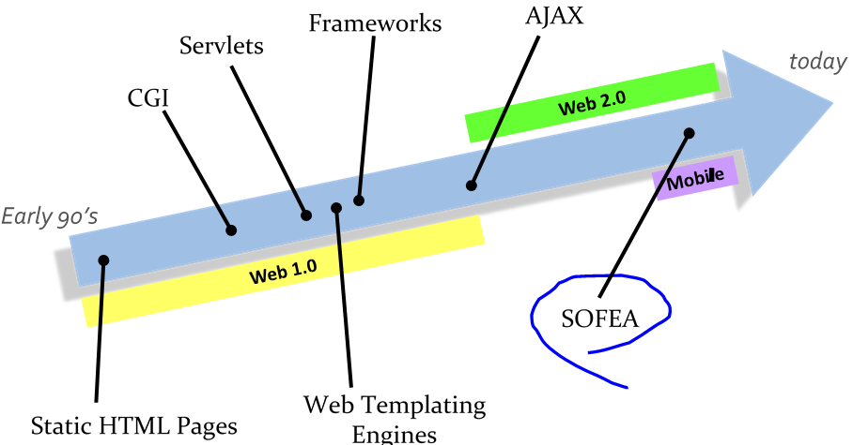

Slide 3
What Today?
Service Oriented Development
Clouds
Serverless Architectures
Internet of Things
Semantic Web
Web of Things
Progressive Web
Low-Code Development
Role of AI in Web Development

Slide 4
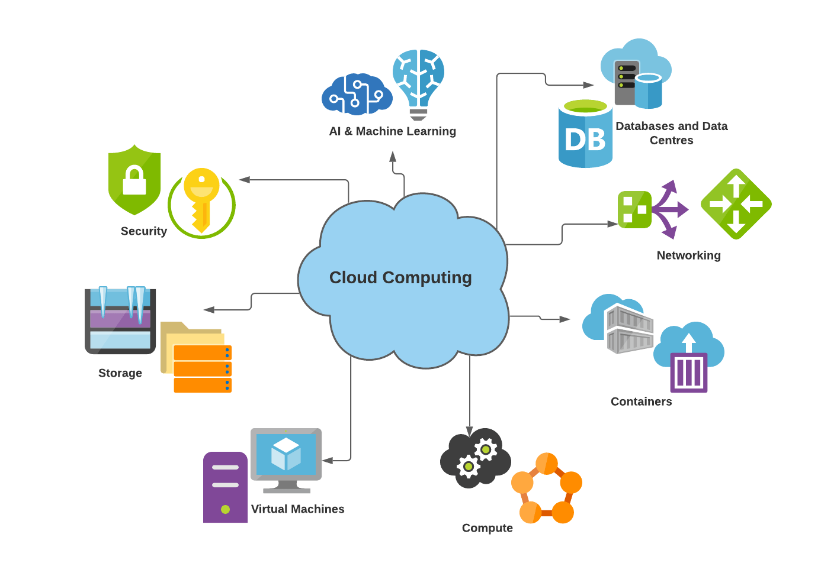
Cloud Computing

Slide 5
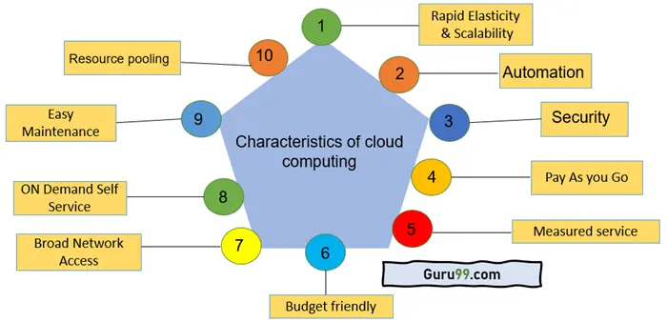

Slide 6
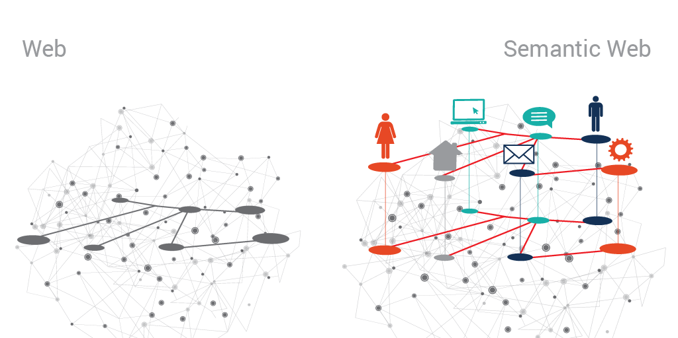
Semantic Web

Slide 7
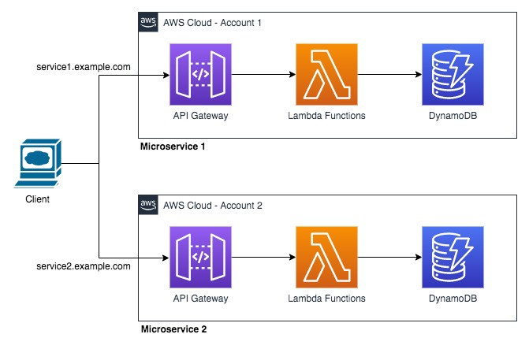
Serverless Architecture

Slide 8
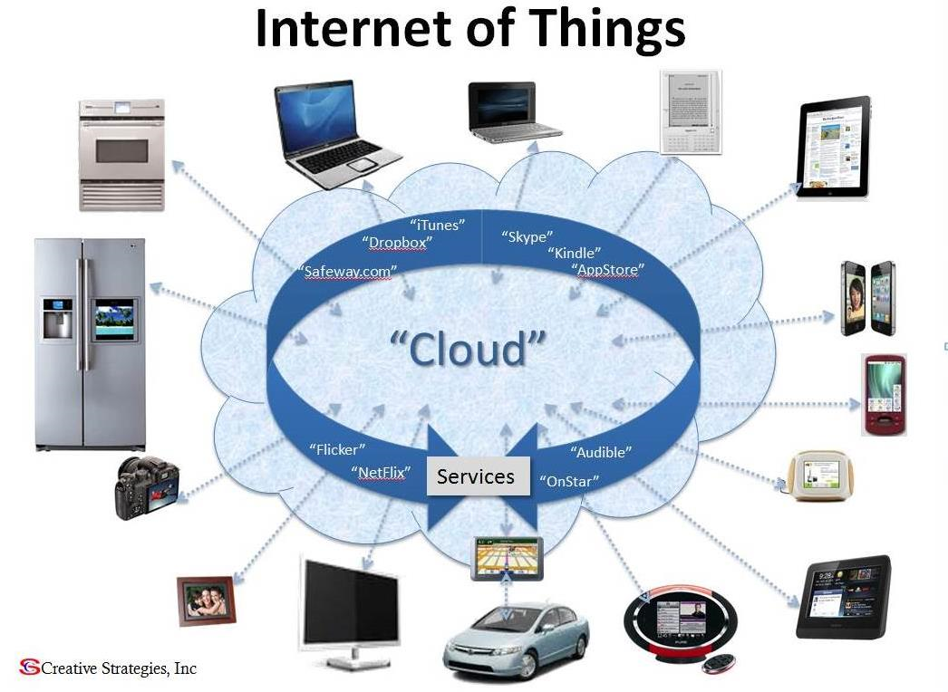
Internet of Things

Slide 9
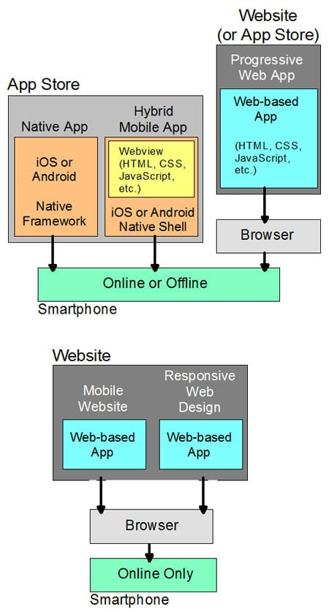
Progressive Web

Slide 10
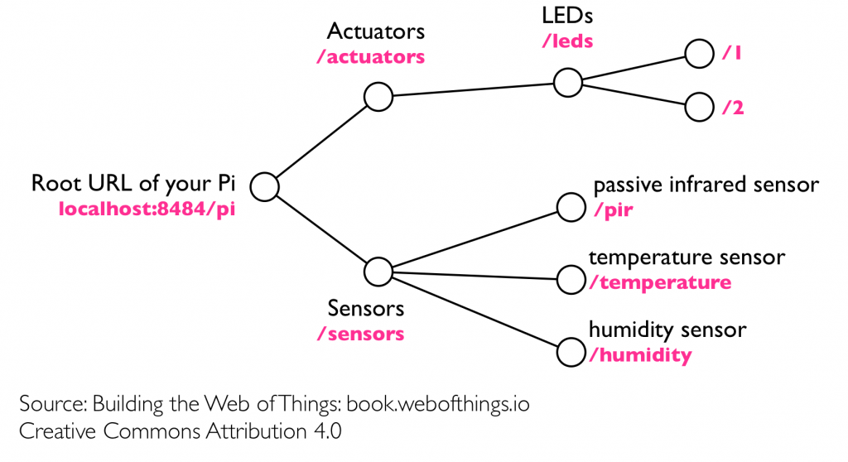
Web of Things

Slide 11
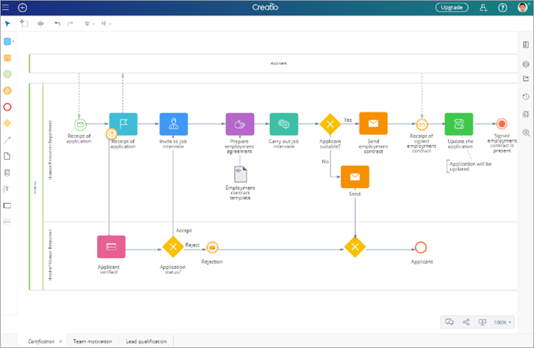
Low Code

Slide 12
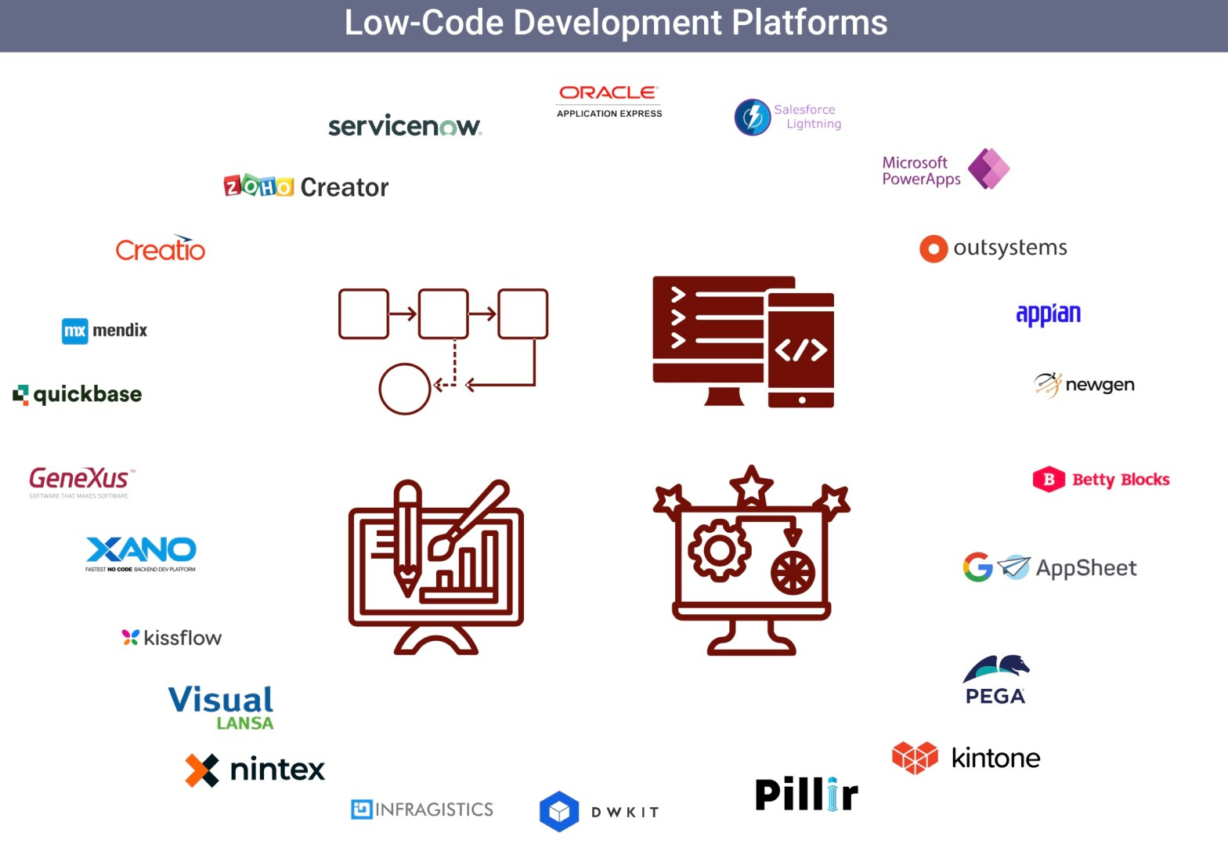
Low Code Platforms

Slide 13
Service Oriented Architecture

Slide 14
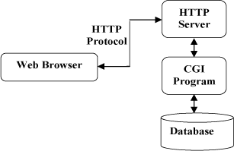
Common Gateway Interface

Slide 15
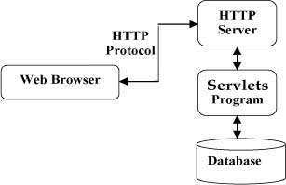
Servlets

Slide 16

Web Templating Engine
Embedded code within static HTML elements
Mix of static and dynamic HTML
"Model 1" Architecture
Examples – Java Server Pages (JSP) – PHP – Active Server Pages (ASP)

Slide 17
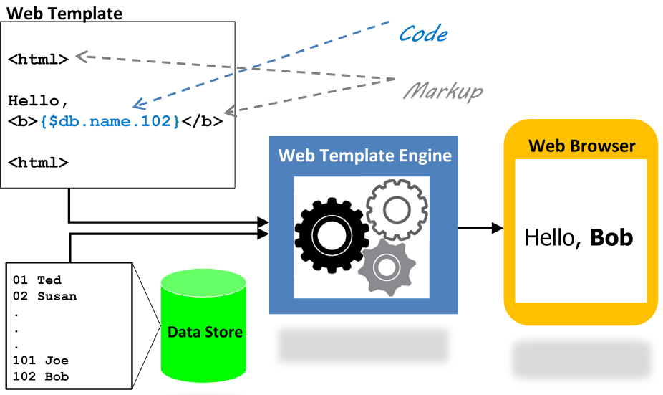
Web Templating Engines

Slide 18
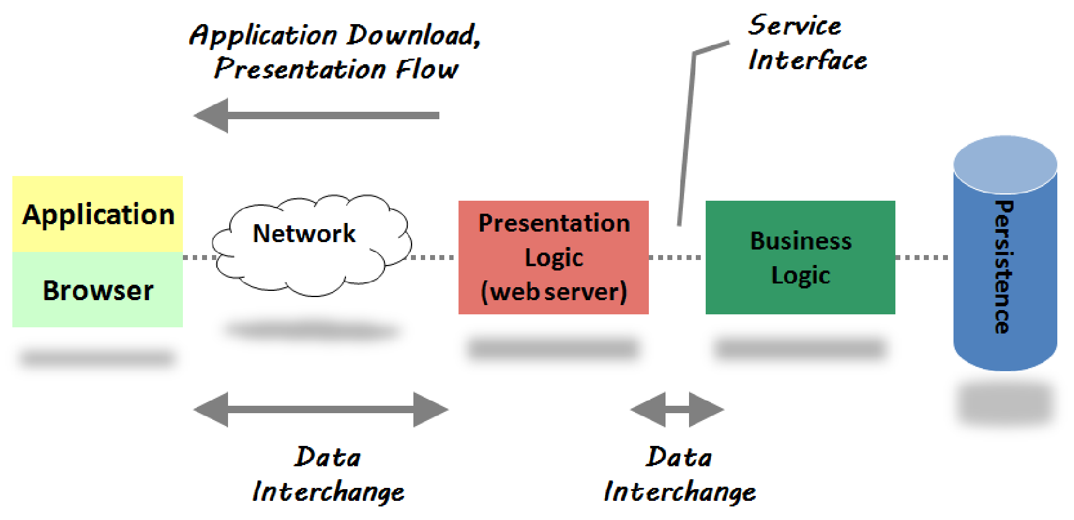
Process Allocation for Web Templating Engines

Slide 19
Frameworks
Model View Controller pattern
Server side framework
“Model 2” Architecture
Examples
ASP.NET MVC Framework (.Net)
Struts, Spring MVC (Java)
Ruby on Rails (Ruby)
Django (Python)
Zend, Symfony, Laravel, Codeignitor (PHP)

Slide 20
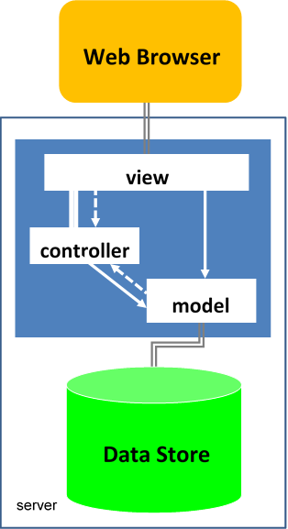
MVC Frameworks
Model
Represents the application data
View
Defines the user interface of the app
Controller
Process incoming requests, handle user input and interactions, and execute appropriate application logic

Slide 21

Frameworks
Other Architectural Patterns
MOVE (Models, Operations, Views, and Events)
HMVC (Hierarchical model–view–controller)

Slide 22

Ajax
Asynchronous JavaScript And XML
Dynamic content changes without reloading the entire page
Interactive and dynamic web apps approaching rich client capability
HTML/CSS + DOM + XmlHttpRequest Object + JavaScript + JSON/XML

Slide 23
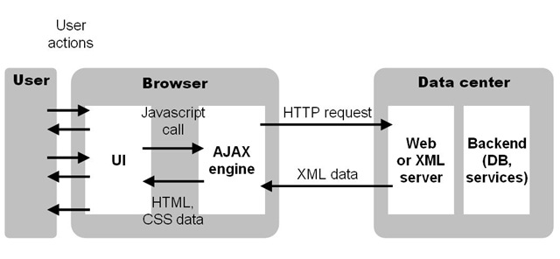
AJAX

Slide 24
Three Processes of Web Applications
Application Download
Mobile code (JavaScript, HTML, Applets, Flash) download to the client (web browser)
Presentation Flow
Dynamic visual rendering of the UI (screen changes, new screens, etc) in response to user input and data state changes
Data Interchange
The exchange of data between two software components or tiers (search, updates, retrieval, etc)

Slide 25
Process Allocation for Web Templating Engines Frameworks

Slide 26
Characteristics of Web Templating Engines and MVC Frameworks
Tight coupling between presentation flow and data interchange (both in the web server)
Triggering a Presentation Flow in a web application always initiates a Data Interchange operation
Every Data Interchange operation results in a Presentation Flow operation
Presentation flow and data interchange are orthogonal concerns that should be decoupled
Separate concerns

Slide 27
Today (Not Today)
Server Centric Frameworks
web templating engines + MVC frameworks + a sprinkling of Ajax
Zend Framework, Symfony, Laravel, Codeignitor

Slide 28
Problems with server-centric frameworks
Poor distribution of processing
High user response latency
Difficult programming model
Heavy state management on the servers
Offline Difficulties
Reduced opportunity for interoperability

Slide 29
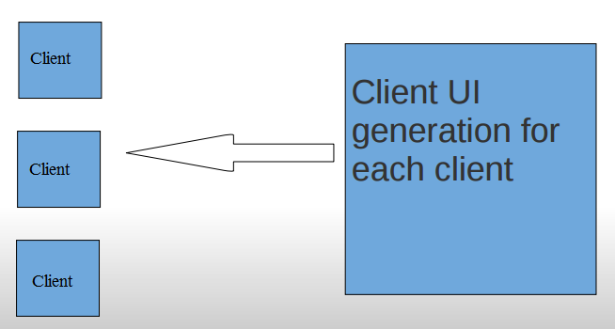
Poor distribution of processing
With a large number of clients, doing all the processing on the server is inefficient.

Slide 30
High user response latency
Traditional web applications are not responsive enough.
High quality user interaction is very sensitive to latency, and very fast response is essential.
Server
Client
Response Latency

Slide 31
Difficult programming model
Client interface is prepared in pieces on the server.
JavaScript logic is hidden and/or mapped to server-side logic.
Additional complexity in mapping debugging.
HTML needs massage to become server-side template.
Risk of high coupling between view logic and business logic.
Even if view and business logic is cleanly separated on server, the server is not the client.

Slide 32
Heavy state management on the servers
Client user interface state is maintained by the server.
This requires a significant increase in resource utilization as server side sessions must be maintained with potentially large object structures within them.
Usually these resources can’t be released until a session times out, which is often 30 minutes after a user actually leaves the web site.

Slide 33
Offline Difficulties
Adding offline capabilities to a web application can be a tremendous project when user interface code is mainly on the server.
The user interface code must be ported to run on the client in offline situations.

Slide 34
Reduced opportunity for interoperability
Client/server communication is hidden by framework.
Integration (vendor/customer system) projects must start from scratch.
Risk of reinventing wheel.
Changes in web application code might not match changes in integration code.

Slide 35
Modern Asynchronous REST API framework
All functionality that possibly can be implemented on the client side should be implemented on the client side.
All communication with the application server should be using services (REST, SOAP, domain-specific)
No part of the client should be evoked, generated or templated from the server-side. This rules out in-line conditional HTML in JSP, ASP, PHP, et.c.
The logic in the server will only implement the Security, Business logic functionality.

Slide 36
Benefits
Scalability
Immediate user response
Organized programming model
Client side state management
Offline applications
Interoperability

Slide 37
Scalability
The more clients that use an application, the more client machines that are available.
Any presentation logic that can be moved to the client scales 1:1 with the number of clients.

Slide 38
Immediate User Response
Client side code can immediately react to user input, rather than waiting for network transfers.
If you need data on the server, you need data on the server. There's no way around that.
At least we don't have to load THE WHOLE PAGE again, just to get an updated list of items.

Slide 39
Organized Programming Model
Client and server are explicitly modeled and no 'mapping' is required.
Neither side needs to be 'pretended' on the other side.
Each side implement its own logic, completely separated from the other, leading to less risk of complication.
When debugging, the messages and object being inspected are 'real'.
Less complexity.
Asynchronous development.

Slide 40
Client Side State Management
Transient session state information on the client reduces the memory load on the server.
The client decides what to show, cache and request from the server.
The server manages security, not widget state.

Slide 41
Offline Applications
Having a clean separation between client and server makes it simpler to implement offline modes.
Certain toolkits have client-side data abstractions which can switch to offline stores transparently, when needed.

Slide 42
Interoperability
Using structured data with minimal APIs for interaction, makes it easier to connect additional consumers and producers to interact with existing systems.
By exposing explicit and secure data-interchange interfaces on the server, we get interoperability for free.

Slide 43
More
Server-side developers nothing to do with UI logic.
Front-end developers don’t need to participate in server internals
The Designers: Normal files makes for simpler mockups and simpler changes. Just ordinary HTML/CSS/Images
The Front-end developers: Normal files makes for simpler mockups and simpler changes. Just ordinary HTML/JS
The Back-end developers: No UI logic makes a simpler server. Can focus on _only_ business logic/database stuff
More Front-End goodness: Mock servers/services: Creating the contract and developing asynchronously

Slide 44
Legacy Enterprise Web Architecture
Client
Server
Web Page Construction
Business Logic and persistence
Web Browser
JSP, ASP, PHP, ROR

Slide 45
Move Web Page Construction Logic to Client
Client
Server
Web Page Construction Logic
Business Logic And Persistence
Web Browser

Slide 46
Only Business Login on the Server side
Client
Server
Services
Business Logic And Persistence
Web Browser

Slide 47
REST Framework Architecture Process Allocation
Presentation Flow
Application Download (One Time)
Presentation Logic
Services
Business Logic And Persistence
DB
Network
Application
Browser
Data Interchange

Slide 48
Cont'd.
Application Download
Download Server
Presentation Flow
Services
Business Logic And Persistence
Web Browser
Data Interchange
Service Interface

Slide 49
One time download Application
One time Download
Presentation code
HTML / Javascript
Web Browser
Download Server

Slide 50




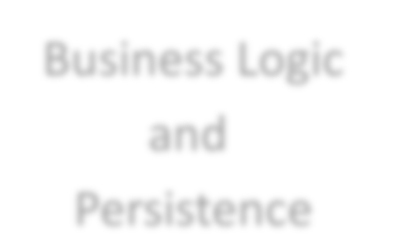

Data Only from server
Data Only
Business Logic
SERVICES
Web Browser
and
Persistence
Copyright©(
2013)

Slide 51
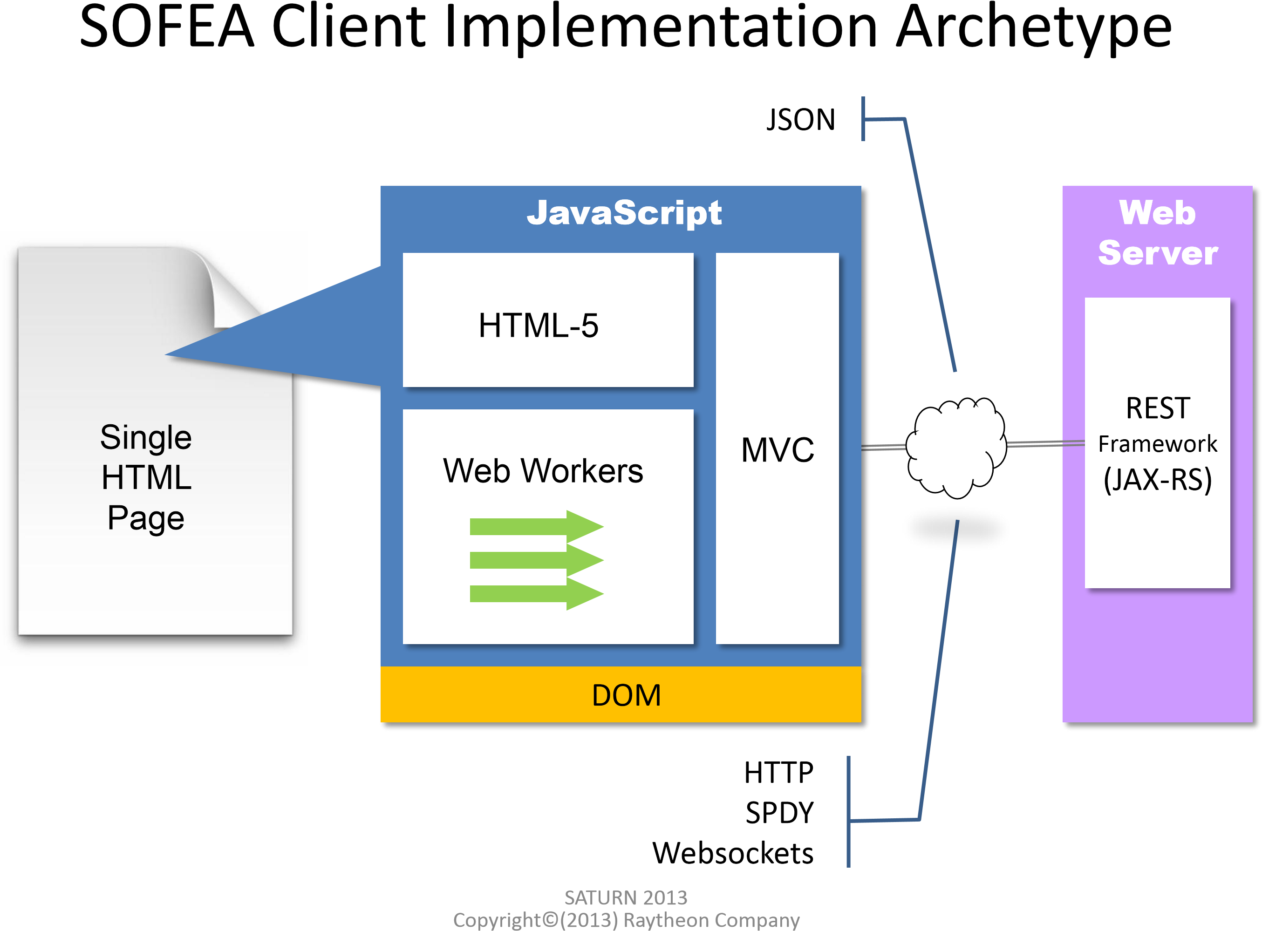
MVC at the client side

Slide 52
MVC At Client Side
Presentation Flow
Application Download (One Time)
JAVASCRIPT
HTML5
Services
REST Framework
DB
Network
MVC
Browser
Data Interchange

Slide 53
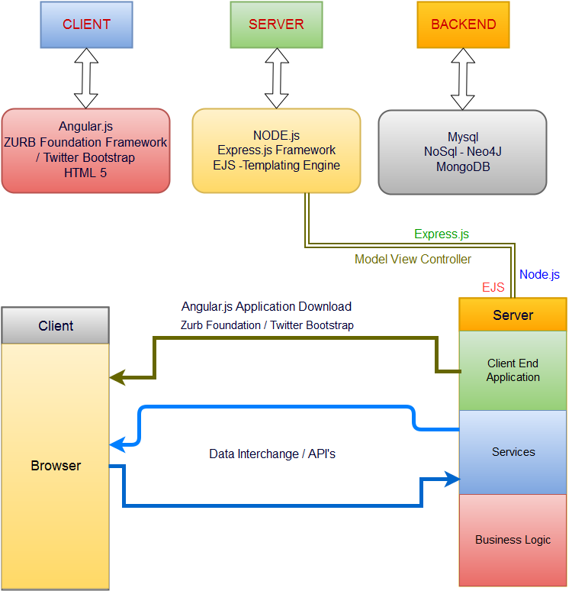

Slide 54
Service Oriented Front End Architecture
Synonymous with “Single Page” Web Applications
Life above the Service Tier
How to Build Application Front-ends in a Service-Oriented World
Ganesh Prasad, Rajat Taneja, Vikrant Todankar
Architectural Style – Not an implementation
Prasad, et al propose that the SOA revolution has left behind application front ends/UI’s

