Slide 1

Principles of Information Security,
Fourth Edition
Chapter 6
Security Technology: Wireless, VPNs, and Firewalls
If you think technology can solve your security problems, then you don’t understand the problems and you don’t understand the technology.
BRUCE SCHNEIER, AMERICAN CRYPTOGRAPHER,
COMPUTER SECURITY SPECIALIST, AND WRITER

Slide 2
Learning Objectives
Upon completion of this material, you should be able to:
  Recognize the important role of access control in computerized information systems, and identify and discuss widely-used authentication factors
  Describe firewall technology and the various approaches to firewall implementation
  Identify the various approaches to control remote and dial-up access by means of the authentication and authorization of users
Principles of Information Security, Fourth Edition

Slide 3
Learning Objectives (cont’d.)
  Discuss content filtering technology
  Describe the technology that enables the use of virtual private networks
Principles of Information Security, Fourth Edition

Slide 4
Introduction
Technical controls are essential in enforcing policy for many IT functions that do not involve direct human control
Technical control solutions improve an organization’s ability to balance making information readily available against increasing information’s levels of confidentiality and integrity
Principles of Information Security, Fourth Edition

Slide 5
Access Control
Access control: method by which systems determine whether and how to admit a user into a trusted area of the organization
Mandatory access controls (MACs): use data classification schemes
Nondiscretionary controls: strictly-enforced version of MACs that are managed by a central authority
Discretionary access controls (DACs): implemented at the discretion or option of the data user
Principles of Information Security, Fourth Edition
Notes:
By Ali Ahmed:
Access Control: It's about regulating who can access what resources in a system or a network. There are different types of access control, such as:
Mandatory Access Control (MAC): Think of this as strict rules enforced by the system itself. For example, in a military setting, a top-secret document can only be accessed by individuals with the highest clearance.
Discretionary Access Control (DAC): Here, the owner of a resource decides who gets access and what level of access they have. It's like when you share a Google Doc and set permissions for who can view or edit it.
Role-Based Access Control (RBAC): Access is based on the role of the user within an organization. For instance, an employee might have access to certain financial data because they're in the accounting department.

Slide 6
Identification
Identification: mechanism whereby an unverified entity that seeks access to a resource proposes a label by which they are known to the system
Supplicant: entity that seeks a resource
Identifiers can be composite identifiers, concatenating elements-department codes, random numbers, or special characters to make them unique
Some organizations generate random numbers
Principles of Information Security, Fourth Edition
Notes:
By Ali Ahmed:
Identification: Identification is simply stating who you are. Imagine going to the library and showing your student ID card to borrow a book. That's identification. In the digital world, it could be your username, email address, or employee ID.

Slide 7
Authentication
Authentication: the process of validating a supplicant’s purported identity
Authentication factors
  Something a supplicant knows
    Password: a private word or combination of characters that only the user should know
    Passphrase: a series of characters, typically longer than a password, from which a virtual password is derived
Principles of Information Security, Fourth Edition
Notes:
Authentication: Authentication is proving that you are who you say you are. Continuing with the library analogy, this is like entering your password or using a fingerprint scanner along with showing your ID card. There are various ways to authenticate, such as:
Something you know: Like a password or a PIN.
Something you have: Such as an ID card, a phone with an authenticator app, or a hardware token.
Something you are: This could be biometric data like fingerprints, facial recognition, or iris scans.

Slide 8
Authentication (cont’d.)
Authentication factors (cont’d.)
  Something a supplicant has
    Smart card: contains a computer chip that can verify and validate information
    Synchronous tokens
    Asynchronous tokens
  Something a supplicant is
    Relies upon individual characteristics
    Strong authentication
Principles of Information Security, Fourth Edition

Slide 9
Authorization
Authorization: the matching of an authenticated entity to a list of information assets and corresponding access levels
Authorization can be handled in one of three ways
  Authorization for each authenticated user
  Authorization for members of a group
  Authorization across multiple systems
Authorization tickets
Principles of Information Security, Fourth Edition
Notes:
By Ali Ahmed:
Authorization: Authorization comes after authentication and determines what actions a user is allowed to perform. It's like once you've proven you're a library member, the librarian decides whether you can borrow one book or five, or if you can access the restricted section. For example, after logging into your bank account, authorization determines whether you can only view your balance or also transfer money to another account.

Slide 10
Accountability
Accountability (auditability): ensures that all actions on a system—authorized or unauthorized—can be attributed to an authenticated identity
Most often accomplished by means of system logs and database journals, and the auditing of these records
Systems logs record specific information
Logs have many uses
Principles of Information Security, Fourth Edition
Notes:
By Ali Ahmed:
Accountability: Accountability is like CCTV cameras in a store. It ensures that actions can be traced back to the individuals who performed them. In the digital world, this means keeping logs of who accessed what, when, and what they did. This is crucial for security investigations and audits.

Slide 11
Firewalls
Prevent specific types of information from moving between the outside world (untrusted network) and the inside world (trusted network)
May be:
  Separate computer system
  Software service running on existing router or server
  Separate network containing supporting devices
Principles of Information Security, Fourth Edition
Notes:
Firewalls
A firewall prevents specific types of information from moving between the outside world, known as the untrusted network, and the inside world, known as the trusted network.
The firewall may be a separate computer system, a software service running on an existing router or server, or a separate network containing a number of supporting devices.
Ali Ahmed:
Firewalls: Think of a firewall as a security guard for your network. It sits between your internal network and the outside world, filtering incoming and outgoing traffic based on a set of rules. Imagine your network as a house, and the firewall as a gatekeeper who decides which visitors are allowed in and which are kept out. Firewalls can be:
Packet Filtering: Examines each packet of data and decides whether to let it through based on predefined rules.
Stateful Inspection: Keeps track of the state of active connections and makes decisions based on the context of the traffic.
Proxy Firewalls: Acts as an intermediary between internal and external systems, inspecting and filtering traffic at the application level.

Slide 12
Firewalls Processing Modes
Five processing modes by which firewalls can be categorized:
  Packet filtering
  Application gateways
  Circuit gateways
  MAC layer firewalls
  Hybrids
Principles of Information Security, Fourth Edition
Notes:
Firewall Categorization Methods
Firewalls can be categorized by:
Processing mode
Development era
Intended structure

Slide 13
Firewalls Processing Modes (cont’d.)
Packet filtering firewalls examine header information of data packets
Most often based on combination of:
  Internet Protocol (IP) source and destination address
  Direction (inbound or outbound)
  Transmission Control Protocol (TCP) or User Datagram Protocol (UDP) source and destination port requests
Simple firewall models enforce rules designed to prohibit packets with certain addresses or partial addresses
Principles of Information Security, Fourth Edition
Notes:
Packet Filtering
Packet filtering firewalls examine the header information of data packets that come into a network.
The restrictions most commonly implemented are based on a combination of:
Internet Protocol (IP) source and destination address
Direction (inbound or outbound)
Transmission Control Protocol (TCP) or User Datagram Protocol (UDP) source and destination port requests
Simple firewall models examine one aspect of the packet header: the destination and source address. They enforce address restrictions, rules designed to prohibit packets with certain addresses or partial addresses from passing through the device.
They accomplish this through access control lists (ACLs), which are created and modified by the firewall administrators.
There are three subsets of packet filtering firewalls:
Static filtering
Dynamic filtering
Stateful inspection
Static filtering requires that the filtering rules governing how the firewall decides which packets are allowed and which are denied are developed and installed.
Dynamic filtering allows the firewall to react to an emergent event and update or create rules to deal with the event.
While static filtering firewalls allow entire sets of one type of packet to enter in response to authorized requests, the dynamic packet filtering firewall allows only a particular packet with a particular source, destination, and port address to enter through the firewall.
Stateful inspection firewalls, or stateful firewalls, keep track of each network connection between internal and external systems using a state table, which tracks the state and context of each packet in the conversation by recording which station sent what packet and when.
Whereas simple packet filtering firewalls only allow or deny certain packets based on their address, a stateful firewall can block incoming packets that are not responses to internal requests.
The primary disadvantage of this type of firewall is the additional processing required to manage and verify packets against the state table, which can leave the system vulnerable to a DoS or DDoS attack.
By Umair Shahid
Packet Filtering Firewalls: These firewalls inspect the header information of data packets (like the source and destination IP addresses and ports) and either allow or block them based on predefined rules. They're relatively simple and fast, but they don't look at the actual content of the packets.

Slide 14
Firewalls Processing Modes (cont’d.)
Three subsets of packet filtering firewalls:
  Static filtering: requires that filtering rules governing how the firewall decides which packets are allowed and which are denied are developed and installed
  Dynamic filtering: allows firewall to react to emergent event and update or create rules to deal with event
  Stateful inspection: firewalls that keep track of each network connection between internal and external systems using a state table
Principles of Information Security, Fourth Edition
Notes:
By …Ali
Static filtering: Static filtering involves the creation and installation of filtering rules that govern how the firewall decides which packets are allowed and which are denied. These rules are established by firewall administrators based on predefined criteria such as source and destination IP addresses, port numbers, and protocols.
Dynamic filtering: Dynamic filtering allows the firewall to react to emergent events and update or create rules dynamically to deal with these events.
Stateful inspection: Stateful inspection firewalls, also known as stateful firewalls, keep track of each network connection between internal and external systems using a state table.

Slide 15
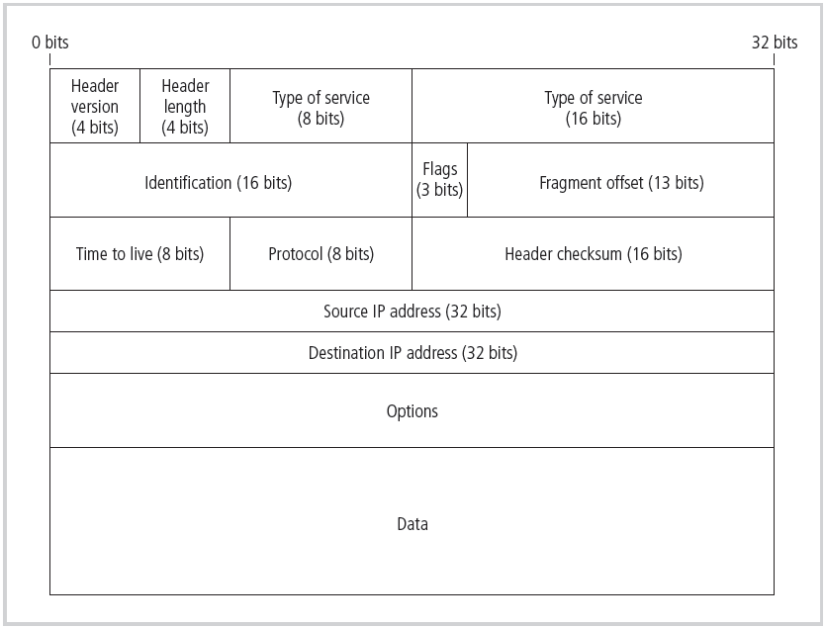
Figure 6-2 IP Packet Structure
Principles of Information Security, Fourth Edition

Slide 16
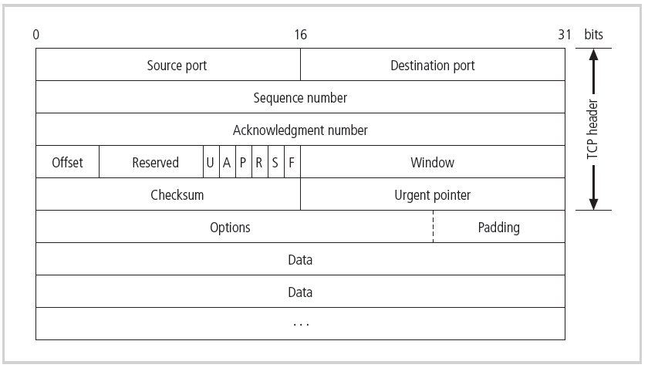
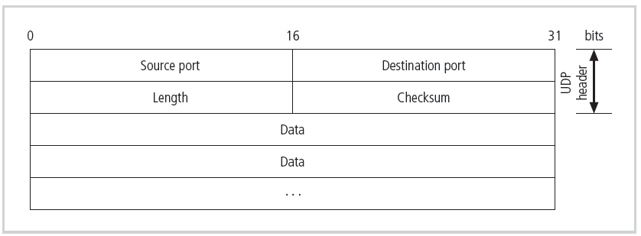
Figure 6-3 TCP Packet Structure
Figure 6-4 UDP Datagram Structure
Principles of Information Security, Fourth Edition

Slide 17
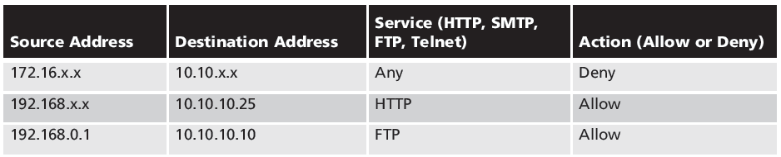
Table 6-1 Sample Firewall Rule and Format
Principles of Information Security, Fourth Edition

Slide 18
Firewalls Processing Modes (cont’d.)
Application gateways
  Frequently installed on a dedicated computer; also known as a proxy server
  Since proxy server is often placed in unsecured area of the network (e.g., DMZ), it is exposed to higher levels of risk from less trusted networks
  Additional filtering routers can be implemented behind the proxy server, further protecting internal systems
Principles of Information Security, Fourth Edition
Notes:
Application Gateways
The application gateway, application-level firewall, or application firewall is frequently installed on a dedicated computer, separate from the filtering router, but it is commonly used in conjunction with a filtering router.
The application firewall is also known as a proxy server, since it runs special software that acts as a proxy for a service request.
Since the proxy server is often placed in an unsecured area of the network or is placed in the DMZ, it, rather than the Web server, is exposed to the higher levels of risk from the less trusted networks.
Additional filtering routers can be implemented behind the proxy server, limiting access to the more secure internal system and thereby further protecting internal systems.
By …Ali
Application Gateways: Application Gateways are a type of firewall that operates at the application layer (Layer 7) of the OSI model. They act as intermediaries between client applications and servers, providing security by inspecting and filtering traffic at the application level.
Application Gateways often function as proxy servers
When a client sends a request to access a service or resource, the application gateway intercepts the request, processes it on behalf of the client, and forwards it to the appropriate destination server.
This proxying capability allows the application gateway to perform deep packet inspection and enforce security policies

Slide 19
Firewalls Processing Modes (cont’d.)
Circuit gateway firewall
  Operates at transport layer
  Like filtering firewalls, do not usually look at data traffic flowing between two networks, but prevent direct connections between one network and another
  Accomplished by creating tunnels connecting specific processes or systems on each side of the firewall, and allow only authorized traffic in the tunnels
Principles of Information Security, Fourth Edition
Notes:
Circuit Gateways
The circuit gateway firewall operates at the transport layer.
Connections are authorized based on addresses.
Like filtering firewalls, circuit gateway firewalls do not usually look at data traffic flowing between one network and another, but they do prevent direct connections between one network and another.
They accomplish this by creating tunnels connecting specific processes or systems on each side of the firewall, and then they allow only authorized traffic, such as a specific type of TCP connection for only authorized users, in these tunnels.
By …Ali
Circuit Gateways: Circuit Gateways, also known as Circuit-Level Gateways, function at the transport layer (Layer 4) of the OSI model. Unlike application gateways that inspect and filter traffic at the application layer, circuit gateways focus on managing connections based on network addresses.
Circuit gateways prevent direct connections between networks by creating tunnels between authorized systems or processes.
These tunnels serve as secure channels for authorized traffic to traverse the firewall while blocking unauthorized connection attempts
Circuit gateways create tunnels or virtual circuits connecting specific endpoints on each side of the firewall.
Only authorized traffic is allowed to pass through these tunnels.

Slide 20
Firewalls Processing Modes (cont’d.)
MAC layer firewalls
  Designed to operate at the media access control layer of OSI network model
  Able to consider specific host computer’s identity in its filtering decisions
  MAC addresses of specific host computers are linked to access control list (ACL) entries that identify specific types of packets that can be sent to each host; all other traffic is blocked
Principles of Information Security, Fourth Edition
Notes:
MAC Layer Firewalls
While not as well known or widely referenced as the firewall approaches above, MAC layer firewalls are designed to operate at the media access control layer of the OSI network model.
This gives these firewalls the ability to consider the specific host computer’s identity in its filtering decisions.
Using this approach, the MAC addresses of specific host computers are linked to ACL entries that identify the specific types of packets that can be sent to each host, and all other traffic is blocked.
By …Ali
MAC layer firewalls: MAC Layer Firewalls operate at the Media Access Control (MAC) layer of the OSI network model, which is Layer 2(Data Link Layer). Unlike traditional firewalls that focus on IP addresses and port numbers, MAC Layer Firewalls consider the specific MAC addresses of host computers in their filtering decisions.
By Ali Ahmed
MAC Layer Firewalls:
Technical Explanation: MAC layer firewalls operate at the data link layer (Layer 2) of the OSI model, where MAC addresses reside. They filter traffic based on MAC addresses, controlling which devices can communicate at a very granular level. This type of firewall is often used in wireless networks.
Non-technical Example: Think of a MAC layer firewall as a security guard at the entrance of a gated community. Each resident is issued a unique access card (MAC address). The guard only allows entry to those with valid access cards, denying entry to unauthorized individuals, regardless of who they claim to be.
By Umair Shahid:
MAC Layer Firewalls
These firewalls operate at the Media Access Control (MAC) layer and can filter traffic based on the unique hardware addresses (MAC addresses) of devices on the network. They're useful for controlling access at a very granular level, but they can be complex to configure and manage, especially in large networks.

Slide 21
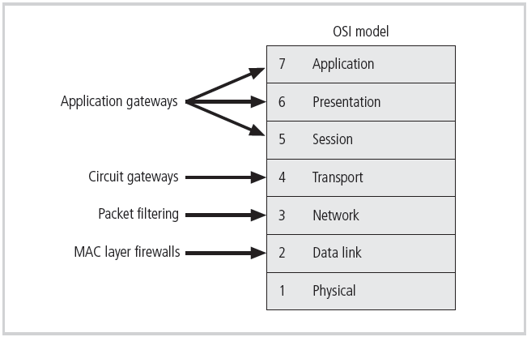
Figure 6-6 Firewall Types and the OSI Model
Principles of Information Security, Fourth Edition

Slide 22
Firewalls Processing Modes (cont’d.)
Hybrid firewalls
  Combine elements of other types of firewalls; i.e., elements of packet filtering and proxy services, or of packet filtering and circuit gateways
  Alternately, may consist of two separate firewall devices; each a separate firewall system, but connected to work in tandem
Principles of Information Security, Fourth Edition
Notes:
Hybrid Firewalls
Hybrid firewalls combine the elements of other types of firewalls—that is, the elements of packet filtering and proxy services or of packet filtering and circuit gateways.
Alternately, a hybrid firewall system may actually consist of two separate firewall devices; each is a separate firewall system, but they are connected so that they work in tandem.
By Ali Ahmed:
Hybrids:
Technical Explanation: Hybrid firewalls combine features of multiple types of firewalls, such as packet filtering, application gateways, and circuit gateways, to provide more robust security. They leverage the strengths of each type to create a comprehensive defense strategy.
Non-technical Example: Imagine a superhero team. Each member has their own unique powers and strengths. Individually, they're formidable, but when they combine forces, they become even more powerful, able to handle a wider range of threats. Similarly, hybrid firewalls combine different firewall technologies to create a stronger defense against various cyber threats.
By Umair Shahid:
Hybrid Firewalls
As the name suggests, hybrid firewalls combine two or more of the above techniques. For example, a hybrid firewall might use packet filtering for basic traffic control and an application gateway for more in-depth inspection of specific types of traffic.

Slide 23
Firewalls Categorized by Generation
First generation: static packet filtering firewalls
Second generation: application-level firewalls or proxy servers
Third generation: stateful inspection firewalls
Fourth generation: dynamic packet filtering firewalls; allow only packets with particular source, destination, and port addresses to enter
Fifth generation: kernel proxies; specialized form working under kernel of Windows NT
Principles of Information Security, Fourth Edition
Notes:
First generation firewalls are static packet filtering firewalls—simple networking devices that filter packets according to their headers as the packets travel to and from the organization’s networks.
Second generation firewalls are application-level firewalls or proxy servers— dedicated systems that are separate from the filtering router and that provide intermediate services for requestors.
Third generation firewalls are stateful inspection firewalls and monitor network connections between internal and external systems using state tables.
Fourth generation firewalls are dynamic packet filtering firewalls and allow only a particular packet with a particular source, destination, and port address to enter.
Fifth generation firewalls are kernel proxy and are a specialized form that works under the Windows NT Executive, which is the kernel of Windows NT.
By Umair Shahid:
Firewalls can also be categorized based on their generation or level of sophistication:
1st Generation: Static packet filtering firewalls.
2nd Generation: Application-level firewalls or proxy servers.
3rd Generation: Stateful inspection firewalls (track connections and maintain state tables).
4th Generation: Dynamic packet filtering firewalls (adapt rules based on events).
5th Generation: Kernel proxies (specialized form working within the operating system kernel).

Slide 24

Table 6-2 State Table Entries
Principles of Information Security, Fourth Edition

Slide 25
Firewalls Categorized by Structure
Most firewalls are appliances: stand-alone, self-contained systems
Commercial-grade firewall system
Small office/home office (SOHO) firewall appliances
Residential-grade firewall software
Principles of Information Security, Fourth Edition
Notes:
By Umair Shahid:
Firewalls Categorized by Structure:
Firewalls can be implemented as standalone appliances (dedicated hardware devices) or software solutions running on servers or routers. Common examples include commercial-grade firewall systems, small office/home office (SOHO) firewall appliances, and residential-grade firewall software.

Slide 26
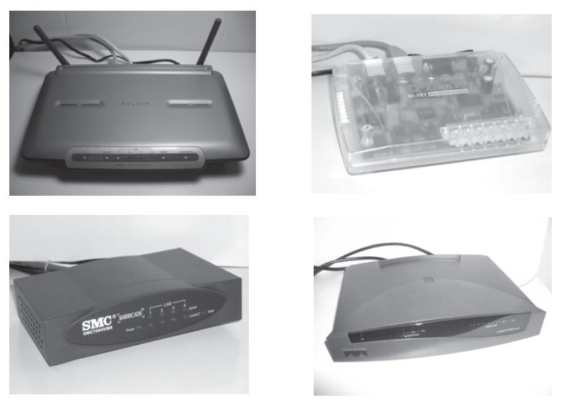
Figure 6-7 SOHO Firewall Devices
Principles of Information Security, Fourth Edition

Slide 27
Software vs. Hardware: the SOHO Firewall Debate
Which firewall type should the residential user implement?
Where would you rather defend against a hacker?
With the software option, hacker is inside your computer
With the hardware device, even if hacker manages to crash firewall system, computer and information are still safely behind the now disabled connection
Principles of Information Security, Fourth Edition
Notes:
Software vs. Hardware: The SOHO Firewall Debate
So which type of firewall should the residential user implement?
Where would you rather defend against a hacker?
With the software option, the hacker is inside your computer, battling with a piece of software that may not have been correctly installed, configured, patched, upgraded, or designed. If the software happens to have a known vulnerability, the hacker could bypass it and then have unrestricted access to your system. With the hardware device, even if the hacker manages to crash the firewall system, your computer and information are still safely behind the now disabled connection, which is assigned a nonroutable IP address, making it virtually impossible to reach from the outside.
By Umair Shahid:
Software vs. Hardware: The SOHO Firewall Debate:
When it comes to small office or home environments, there's a debate over whether a software-based firewall (running on a computer) or a dedicated hardware firewall appliance is more secure. While software firewalls are less expensive, if compromised, the attacker gains access to the computer itself. Hardware firewalls, even if disabled, still provide an additional layer of protection between the attacker and the computer or network.

Slide 28
Firewall Architectures
Firewall devices can be configured in a number of network connection architectures
Best configuration depends on three factors:
  Objectives of the network
  Organization’s ability to develop and implement architectures
  Budget available for function
Four common architectural implementations of firewalls: packet filtering routers, screened host firewalls, dual-homed firewalls, screened subnet firewalls
Principles of Information Security, Fourth Edition
Notes:
Firewall Architectures
Each of the firewall devices noted earlier can be configured in a number of network connection architectures.
The firewall configuration that works best for a particular organization depends on three factors: the objectives of the network, the organization’s ability to develop and implement the architectures, and the budget available for the function.
Although literally hundreds of variations exist, there are four common architectural implementations of firewalls:
Packet filtering routers
Screened host firewalls
Dual-homed firewalls
Screened subnet firewalls

Slide 29
Firewall Architectures (cont’d.)
Packet filtering routers
  Most organizations with Internet connection have a router serving as interface to Internet
  Many of these routers can be configured to reject packets that organization does not allow into network
  Drawbacks include a lack of auditing and strong authentication
Principles of Information Security, Fourth Edition
Notes:
Packet Filtering Routers
Most organizations with an Internet connection have a router as the interface to the Internet at the perimeter. Many of these routers can be configured to reject packets that the organization does not allow into the network.
The drawbacks to this type of system include a lack of auditing and strong authentication, and the complexity of the access control lists used to filter the packets can grow and degrade network performance.
By Umair Shahid:
Packet Filtering Routers: These are basic routers with packet filtering capabilities, often used as a first line of defense.
Non-tech example: A security guard at the entrance gate for a quick bag/ID check before permitting entry into a secured compound.
Tech example: An internet router applying a set of packet filtering rules to traffic entering/leaving the network.

Slide 30
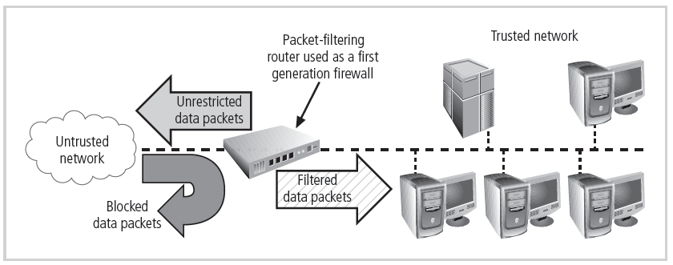
Figure 6-5 Packet-Filtering Router
Principles of Information Security, Fourth Edition

Slide 31
Firewall Architectures (cont’d.)
Screened host firewalls
  Combines packet filtering router with separate, dedicated firewall such as an application proxy server
  Allows router to prescreen packets to minimize traffic/load on internal proxy
  Separate host is often referred to as bastion host
    Can be rich target for external attacks and should be very thoroughly secured
    Also known as a sacrificial host
Principles of Information Security, Fourth Edition
Notes:
Screened Host Firewalls
This architecture combines the packet filtering router with a separate, dedicated firewall, such as an application proxy server, allowing the router to prescreen packets to minimize the network traffic and load on the internal proxy.
The application proxy examines an application layer protocol and performs the proxy services.
This separate host is often referred to as a bastion host or sacrificial host; it can be a rich target for external attacks and should be very thoroughly secured.
By Umair Shahid:
Screened Host Firewalls: These combine a packet filtering router with a separate, dedicated firewall host (like a proxy server) for more advanced filtering.
Non-tech example: After an entrance gate, there is a security checkpoint for more thorough checks before permitting access to internal buildings.
Tech example: Internal hosts/servers are isolated behind a bastion host that proxies all incoming traffic after basic filtering at perimeter router.

Slide 32
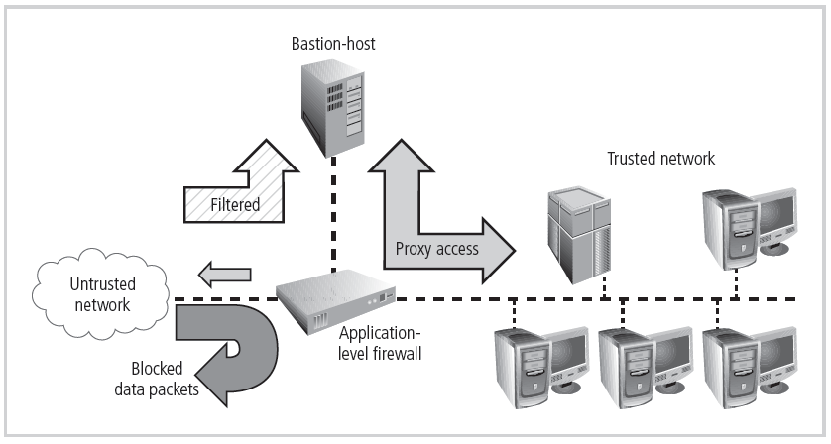
Figure 6-12 Screened Host Firewall
Principles of Information Security, Fourth Edition

Slide 33
Firewall Architectures (cont’d.)
Dual-homed host firewalls
  Bastion host contains two network interface cards (NICs): one connected to external network, one connected to internal network
  Implementation of this architecture often makes use of network address translation (NAT), creating another barrier to intrusion from external attackers
Principles of Information Security, Fourth Edition
Notes:
Dual-Homed Host Firewalls
With this approach, the bastion host contains two NICs: one connected to the external network and one connected to the internal network, providing an additional layer of protection by requiring all traffic to go through the firewall to move between the internal and external networks.
Implementation of this architecture often makes use of NAT mapping—assigned IP addresses to special ranges of nonroutable internal IP addresses, creating yet another barrier to intrusion from external attackers.
By Umair Shahid:
Dual-Homed Host Firewalls: These have two network interfaces, one connected to the internal network and one to the external network, acting as a bastion host.
Non-tech example: A security guard sits between the entrance driveway and internal compound, validating people/vehicles at both ends.
Tech example: A firewall with one NIC on external network and another on internal network acting as an Application Gateway.

Slide 34
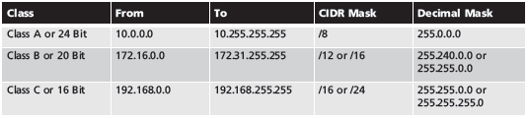
Table 6-4 Reserved Nonroutable Address Ranges
Principles of Information Security, Fourth Edition

Slide 35
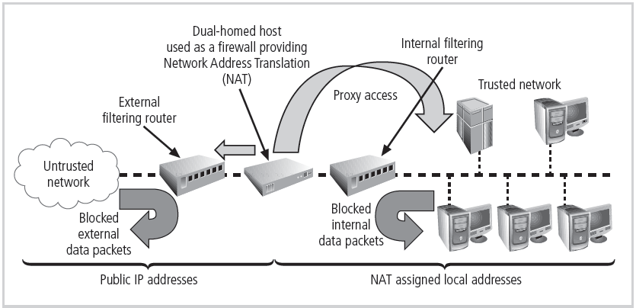
Figure 6-13 Dual-Homed Host Firewall
Principles of Information Security, Fourth Edition

Slide 36
Firewall Architectures (cont’d.)
Screened subnet firewall is the dominant architecture used today
Commonly consists of two or more internal bastion hosts behind packet filtering router, with each host protecting trusted network:
  Connections from outside (untrusted network) routed through external filtering router
  Connections from outside (untrusted network) are routed into and out of routing firewall to separate network segment known as DMZ
  Connections into trusted internal network allowed only from DMZ bastion host servers
Principles of Information Security, Fourth Edition
Notes:
Screened Subnet Firewalls (with DMZ)
The dominant architecture used today, the screened subnet firewall, provides a DMZ, which can be a dedicated port on the firewall device linking a single bastion host or it can be connected to a screened subnet.
A common arrangement finds the subnet firewall consisting of two or more internal bastion hosts behind a packet filtering router, with each host protecting the trusted network:
Connections from the outside or untrusted network are routed through an external filtering router.
Connections from the outside or untrusted network are routed into—and then out of—a routing firewall to the separate network segment known as the DMZ.
Connections into the trusted internal network are allowed only from the DMZ bastion host servers.
The screened subnet is an entire network segment that performs two functions:
It protects the DMZ systems and information from outside threats by providing a network of intermediate security.
It protects the internal networks by limiting how external connections can gain access to internal systems.
DMZs can also create extranets—segments of the DMZ where additional authentication and authorization controls are put into place to provide services that are not available to the general public.
By Umair Shahid:
Screened Subnet Firewalls: This is a popular architecture that uses multiple firewalls and a demilitarized zone (DMZ) to separate the internal network from the external network and any publicly accessible servers
Non-tech example: A secure compound with an outer perimeter fence, then a barricaded holding area for verifying visitors before they can access internal areas.
Tech example: Internet traffic first traverses an external screening router, entering a DMZ segment with bastion hosts/servers that control access to internal network segments.

Slide 37
Firewall Architectures (cont’d.)
Screened subnet performs two functions:
  Protects DMZ systems and information from outside threats
  Protects the internal networks by limiting how external connections can gain access to internal systems
Another facet of DMZs: extranets
Principles of Information Security, Fourth Edition

Slide 38
Firewall Architectures (cont’d.)
SOCKS servers
  SOCKS is the protocol for handling TCP traffic via a proxy server
  A proprietary circuit-level proxy server that places special SOCKS client-side agents on each workstation
  A SOCKS system can require support and management resources beyond those of traditional firewalls
Principles of Information Security, Fourth Edition

Slide 39
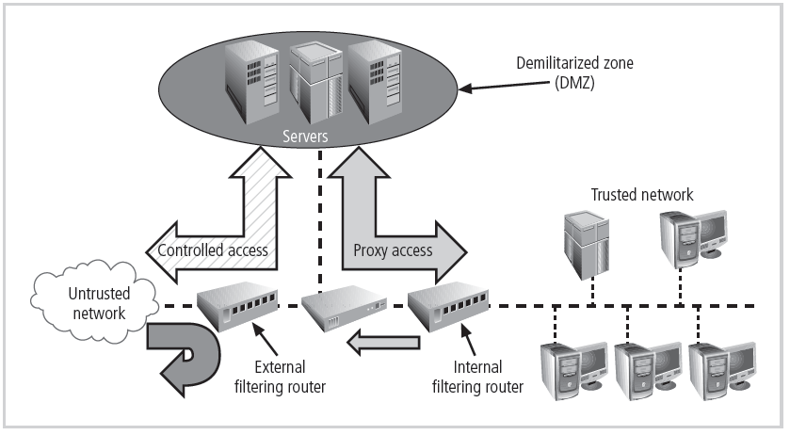
Figure 6-14 Screened Subnet (DMZ)
Principles of Information Security, Fourth Edition

Slide 40
Selecting the Right Firewall
When selecting firewall, consider a number of factors:
  What firewall offers right balance between protection and cost for needs of organization?
  Which features are included in base price and which are not?
  Ease of setup and configuration? How accessible are staff technicians who can configure the firewall?
  Can firewall adapt to organization’s growing network?
Second most important issue is cost
Principles of Information Security, Fourth Edition
Notes:
Selecting the Right Firewall
When selecting the best firewall for an organization, you should consider a number of factors. The most important of these is the extent to which the firewall design provides the desired protection:
What type of firewall technology offers the right balance between protection and cost for the needs of the organization?
What features are included in the base price? What features are available at extra cost? Are all cost factors known?
How easy is it to set up and configure the firewall? How accessible are the staff technicians who can competently configure the firewall?
Can the candidate firewall adapt to the growing network in the target organization?
The second most important issue is cost.

Slide 41
Configuring and Managing Firewalls
Each firewall device must have own set of configuration rules regulating its actions
Firewall policy configuration is usually complex and difficult
Configuring firewall policies is both an art and a science
When security rules conflict with the performance of business, security often loses
Principles of Information Security, Fourth Edition
Notes:
Configuring and Managing Firewalls
Good policy and practice dictates that each firewall device, whether a filtering router, bastion host, or other firewall implementation, must have its own set of configuration rules that regulate its actions.
The configuration of firewall policies can be complex and difficult.
Configuring firewall policies is as much an art as a science. Each configuration rule must be carefully crafted, debugged, tested, and sorted.
When configuring firewalls, keep one thing in mind: when security rules conflict with the performance of business, security often loses.
By Umair Shahid:
Configuring and Managing Firewalls:
Firewalls must be properly configured with a set of rules (rule base or firewall logic) that govern their actions. These rules are based on examining packet header information and applying predefined logic to allow or deny traffic. Firewall configuration is complex and requires careful planning and maintenance to balance security with business needs. Best practices include allowing outbound traffic from the trusted network, denying direct access to the firewall from public networks, and selectively allowing or denying specific protocols and services.

Slide 42
Configuring and Managing Firewalls (cont’d.)
Best practices for firewalls
  All traffic from trusted network is allowed out
  Firewall device never directly accessed from public network
  Simple Mail Transport Protocol (SMTP) data allowed to pass through firewall
  Internet Control Message Protocol (ICMP) data denied
  Telnet access to internal servers should be blocked
  When Web services offered outside firewall, HTTP traffic should be denied from reaching internal networks
Principles of Information Security, Fourth Edition
Notes:
Best Practices for Firewalls
All traffic from the trusted network is allowed out.
The firewall device is never directly accessible from the public network.
SMTP data is allowed to pass through the firewall but should be routed to a well-configured SMTP gateway to filter and route messaging traffic securely.
All ICMP data should be denied.
Telnet access to all internal servers from the public networks should be blocked.
When Web services are offered outside the firewall, HTTP traffic should be denied from reaching your internal networks through the use of some form of proxy access or DMZ architecture.

Slide 43
Configuring and Managing Firewalls (cont’d.)
Firewall rules
  Operate by examining data packets and performing comparison with predetermined logical rules
  Logic based on set of guidelines most commonly referred to as firewall rules, rule base, or firewall logic
  Most firewalls use packet header information to determine whether specific packet should be allowed or denied
Principles of Information Security, Fourth Edition
Notes:
Firewall Rules
Firewalls operate by examining a data packet and performing a comparison with some predetermined logical rules.
This logical set is most commonly referred to as firewall rules, rule base, or firewall logic.
Most firewalls use packet header information to determine whether a specific packet should be allowed to pass through or should be dropped.

Slide 44
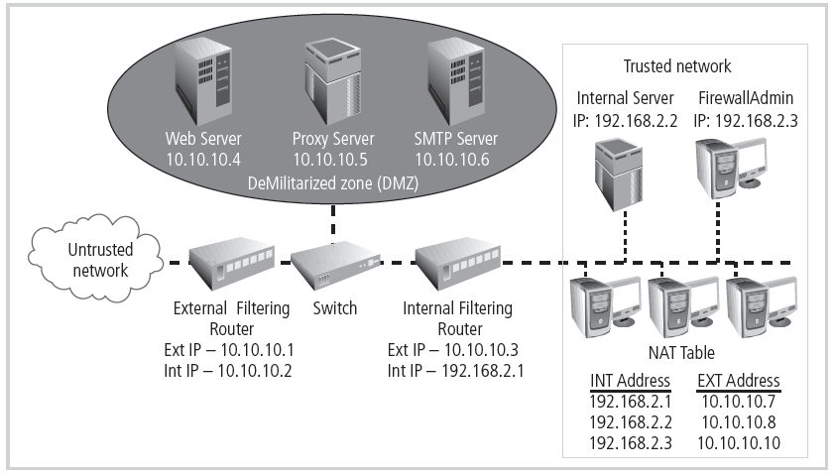
Figure 6-15 Example Network Configuration
Principles of Information Security, Fourth Edition

Slide 45
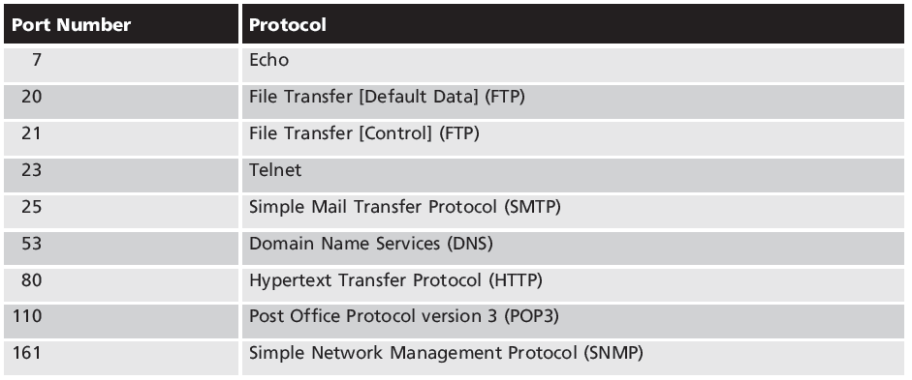
Table 6-5 Select Well-Known Port Numbers
Principles of Information Security, Fourth Edition

Slide 46
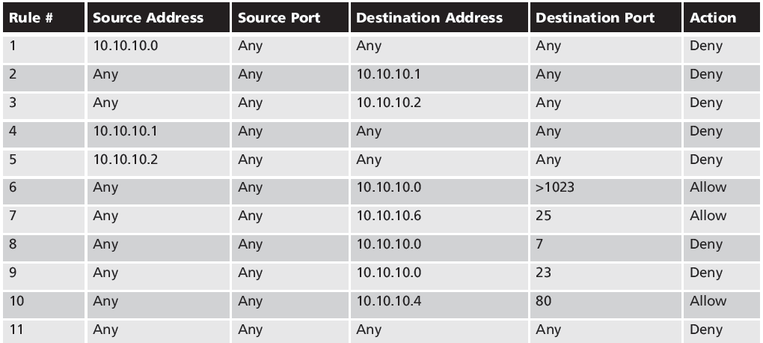
Table 6-16 External Filtering Firewall Inbound Interface Rule Set
Principles of Information Security, Fourth Edition
Notes:
Note that the rule allowing responses to internal communications comes first (appearing in Table 6-16 as Rule #1), followed by the four rules prohibiting direct communications to or from the firewall (Rules #2 through 5 in Table 6-16). After this comes the rule stating that all outgoing internal communications are allowed, followed by the rules governing access to the SMTP server and denial of Ping, Telnet access, and access to the HTTP server. If heavy traffic to the HTTP server is expected, move the HTTP server rule closer to the top (for example, into the position of Rule #2), which would expedite rule processing for external communications. The final rule in Table 6-16 denies any other types of communications.

Slide 47
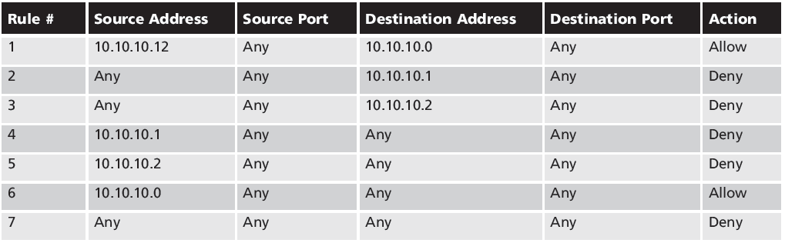
Table 6-17 External Filtering Firewall Outbound Interface Rule Set
Principles of Information Security, Fourth Edition
Notes:
Note the similarities and differences in the two rule sets. The internal filtering router/firewall rule set, shown in Table 6-17, has to both protect against traffic and allow traffic from the internal network (192.168.2.0). Most of the rules in Table 6-17 are similar to those in Table 6-16: allowing responses to internal communications (Rule #1); denying communications to/from the firewall itself (Rules #2 through 5); and allowing all outbound internal traffic (Rule #6). Note that there is no permissible traffic from the DMZ systems, except as in Rule #1. Why isn’t there a comparable rule for the 192.168.2.1 subnet? Because this is an unrouteable network, external communications are handled by the NAT server, which maps internal (192.168.2.0) addresses to external (10.10.10.0) addresses. This prevents a hacker from compromising one of the internal boxes and accessing the internal network with it. The exception is the proxy server (Rule #7 in Table 6-17), which should be very carefully configured. If the organization does not need the proxy server, as in cases where all externally accessible services are provided from machines in the DMZ, then Rule #7 is not needed. Note that there are no Ping and Telnet rules in Table 6-17. This is because the external firewall filters these external requests out. The last rule, Rule #8, provides cleanup.

Slide 48
Content Filters
Software filter—not a firewall—that allows administrators to restrict content access from within network
Essentially a set of scripts or programs restricting user access to certain networking protocols/Internet locations
Primary focus to restrict internal access to external material
Most common content filters restrict users from accessing non-business Web sites or deny incoming span
Principles of Information Security, Fourth Edition
Notes:
Content Filters
A content filter is a software filter—technically not a firewall—that allows administrators to restrict access to content from within a network.
It is essentially a set of scripts or programs that restricts user access to certain networking protocols and Internet locations or restricts users from receiving general types or specific examples of Internet content. Some refer to content filters as reverse firewalls, as their primary focus is to restrict internal access to external material.
In most common implementation models, the content filter has two components: rating and filtering.
The rating is like a set of firewall rules for Web sites and is common in residential content filters.
The filtering is a method used to restrict specific access requests to the identified resources, which may be Web sites, servers, or whatever resources the content filter administrator configures.
The most common content filters restrict users from accessing Web sites with obvious non-business related material, such as pornography, or deny incoming spam e-mail.

Slide 49
Protecting Remote Connections
Installing Internetwork connections requires leased lines or other data channels; these connections are usually secured under requirements of formal service agreement
When individuals seek to connect to organization’s network, more flexible option must be provided
Options such as virtual private networks (VPNs) have become more popular due to spread of Internet
Principles of Information Security, Fourth Edition
Notes:
Protecting Remote Connections
Installing Internetwork connections requires using leased lines or other data channels provided by common carriers, and therefore these connections are usually permanent and secured under the requirements of a formal service agreement.
In the past, organizations provided remote connections exclusively through dial-up services like Remote Authentication Service (RAS).
Since the Internet has become more widespread in recent years, other options such as virtual private networks (VPNs) have become more popular.

Slide 50
Remote Access
Unsecured, dial-up connection points represent a substantial exposure to attack
Attacker can use device called a war dialer to locate connection points
War dialer: automatic phone-dialing program that dials every number in a configured range and records number if modem picks up
Some technologies (RADIUS systems; TACACS; CHAP password systems) have improved authentication process
Principles of Information Security, Fourth Edition
Notes:
Dial-Up
It is a widely held view that these unsecured, dial-up connection points represent a substantial exposure to attack.
An attacker who suspects that an organization has dial-up lines can use a device called a war dialer to locate the connection points.
A war dialer is an automatic phone-dialing program that dials every number in a configured range and checks to see if a person, answering machine, or modem picks up.
Some technologies, such as RADIUS systems, TACACS, and CHAP password systems, have improved the authentication process.

Slide 51
Remote Access (cont’d.)
RADIUS, TACACS, and Diameter
  Systems that authenticate user credentials for those trying to access an organization’s network via dial-up
  Remote Authentication Dial-In User Service (RADIUS): centralizes management of user authentication system in a central RADIUS server
  Diameter: emerging alternative derived from RADIUS
  Terminal Access Controller Access Control System (TACACS): validates user’s credentials at centralized server (like RADIUS); based on client/server configuration
Principles of Information Security, Fourth Edition
Notes:
RADIUS, TACACS, and Diameter
RADIUS and TACACS are systems that authenticate the credentials of users who are trying to access an organization’s network via a dial-up connection.
The Remote Authentication Dial-In User Service system places the responsibility for authenticating each user in the central RADIUS server. When a remote access server receives a request for a network connection from a dial-up client, it passes the request along with the user’s credentials to the RADIUS server, which then validates the credentials and passes the resulting decision (accept or deny) back to the accepting RAS.
Similar in function to the RADIUS system is the Terminal Access Controller Access Control System (TACACS). TACACS, like RADIUS, is a centralized database and validates the user’s credentials at this TACACS server.
Diameter is an emerging alternative derived from RADIUS

Slide 52
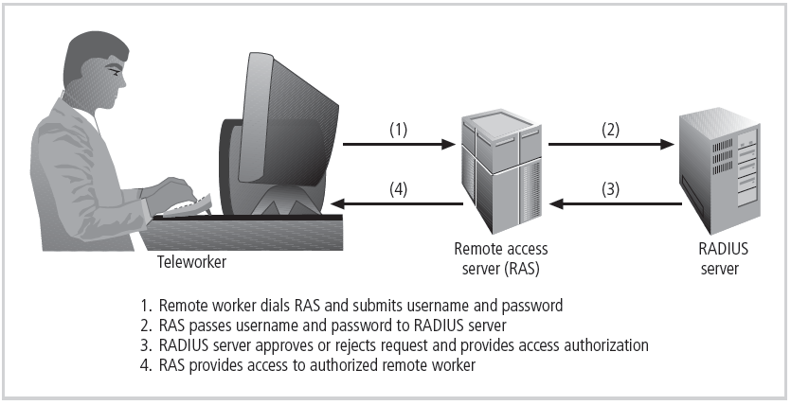
Figure 6-16 RADIUS Configuration
Principles of Information Security, Fourth Edition

Slide 53
Remote Access (cont’d.)
Securing authentication with Kerberos
  Provides secure third-party authentication
  Uses symmetric key encryption to validate individual user to various network resources
  Keeps database containing private keys of clients/servers
  Consists of three interacting services:
    Authentication server (AS)
    Key Distribution Center (KDC)
    Kerberos ticket granting service (TGS)
Principles of Information Security, Fourth Edition
Notes:
Securing Authentication with Kerberos
Kerberos uses symmetric key encryption to validate an individual user to various network resources. Kerberos keeps a database containing the private keys of clients and servers—in the case of a client, this key is simply the client’s encrypted password.
The Kerberos system knows these private keys and can authenticate one network node (client or server) to another.
Kerberos consists of three interacting services, all of which use a database library:
1. Authentication server (AS), which is a Kerberos server that authenticates clients and servers.
2. Key Distribution Center (KDC), which generates and issues session keys.
3. Kerberos ticket granting service (TGS), which provides tickets to clients who request services.
In Kerberos, a ticket is an identification card for a particular client that verifies to the server that the client is requesting services and that the client is a valid member of the Kerberos system and therefore authorized to receive services.
The ticket consists of the client’s name and network address, a ticket validation starting and ending time, and the session key, all encrypted in the private key of the server from which the client is requesting services.

Slide 54
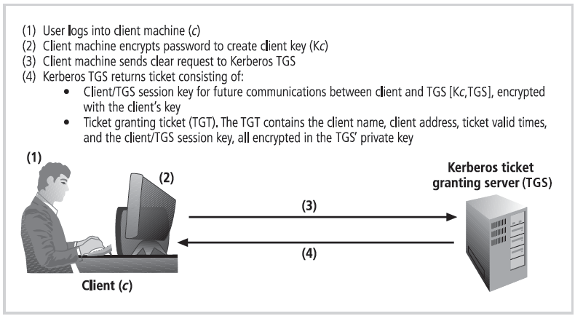
Figure 6-17 Kerberos Login
Principles of Information Security, Fourth Edition

Slide 55
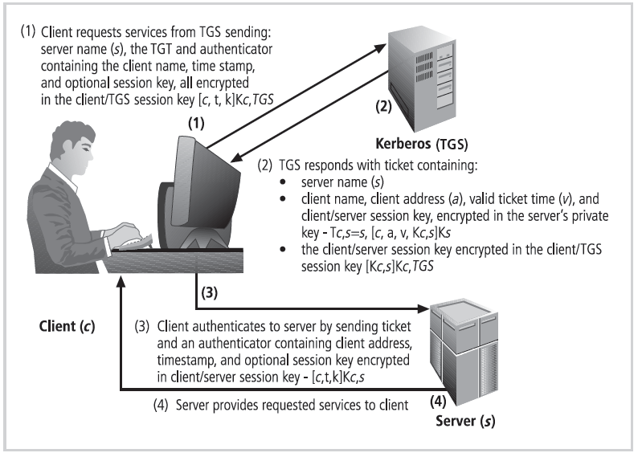
Figure 6-18 Kerberos Request for Services
Principles of Information Security, Fourth Edition

Slide 56
Remote Access (cont’d.)
Sesame
  Secure European System for Applications in a Multivendor Environment (SESAME) is similar to Kerberos
    User is first authenticated to authentication server and receives token
    Token then presented to privilege attribute server as proof of identity to gain privilege attribute certificate
    Uses public key encryption; adds additional and more sophisticated access control features; more scalable encryption systems; improved manageability; auditing features; delegation of responsibility for allowing access
Principles of Information Security, Fourth Edition
Notes:
SESAME
The Secure European System for Applications in a Multivendor Environment (SESAME) is similar to Kerberos in that the user is first authenticated to an authentication server and receives a token.
The token is then presented to a privilege attribute server (instead of a ticket granting service as in Kerberos) as proof of identity to gain a privilege attribute certificate (PAC).
SESAME also builds on the Kerberos model by adding additional and more sophisticated access control features, more scalable encryption systems, as well as improved manageability, auditing features, and the delegation of responsibility for allowing access.

Slide 57
Virtual Private Networks (VPNs)
Private and secure network connection between systems; uses data communication capability of unsecured and public network
Securely extends organization’s internal network connections to remote locations beyond trusted network
Three VPN technologies defined:
  Trusted VPN
  Secure VPN
  Hybrid VPN (combines trusted and secure)
Principles of Information Security, Fourth Edition
Notes:
Virtual Private Networks (VPNs)
A VPN is a private and secure network connection between systems that uses the data communication capability of an unsecured and public network.
VPNs are commonly used to extend securely an organization’s internal network connections to remote locations beyond the trusted network.
The VPNC defines three VPN technologies:
A trusted VPN, or VPN, uses leased circuits from a service provider and conducts packet switching over these leased circuits.
Secure VPNs use security protocols and encrypt traffic transmitted across unsecured public networks like the Internet.
A hybrid VPN combines the two, providing encrypted transmissions (as in secure VPN) over some or all of a trusted VPN network.
A VPN that proposes to offer a secure and reliable capability while relying on public networks must address:
Encapsulation of incoming and outgoing data, wherein the native protocol of the client is embedded within the frames of a protocol that can be routed over the public network, as well as be usable by the server network environment.
Encryption of incoming and outgoing data to keep the data contents private while in transit over the public network but usable by the client and server computers and/or the local networks on both ends of the VPN connection.
Authentication of the remote computer and, perhaps, the remote user as well. Authentication and the subsequent authorization of the user to perform specific actions are predicated on accurate and reliable identification of the remote system and/or user.

Slide 58
Virtual Private Networks (VPNs) (cont’d.)
VPN must accomplish:
  Encapsulation of incoming and outgoing data
  Encryption of incoming and outgoing data
  Authentication of remote computer and (perhaps) remote user as well
Principles of Information Security, Fourth Edition
Notes:
Virtual Private Networks (VPNs) (continued)
A VPN is a private and secure network connection between systems that uses the data communication capability of an unsecured and public network.
VPNs are commonly used to extend securely an organization’s internal network connections to remote locations beyond the trusted network.
The VPNC defines three VPN technologies:
A trusted VPN, or VPN, uses leased circuits from a service provider and conducts packet switching over these leased circuits.
Secure VPNs use security protocols and encrypt traffic transmitted across unsecured public networks like the Internet.
A hybrid VPN combines the two, providing encrypted transmissions (as in secure VPN) over some or all of a trusted VPN network.
A VPN that proposes to offer a secure and reliable capability while relying on public networks must address:
Encapsulation of incoming and outgoing data, wherein the native protocol of the client is embedded within the frames of a protocol that can be routed over the public network, as well as be usable by the server network environment.
Encryption of incoming and outgoing data to keep the data contents private while in transit over the public network but usable by the client and server computers and/or the local networks on both ends of the VPN connection.
Authentication of the remote computer and, perhaps, the remote user as well. Authentication and the subsequent authorization of the user to perform specific actions are predicated on accurate and reliable identification of the remote system and/or user.

Slide 59
Virtual Private Networks (VPNs) (cont’d.)
Transport mode
  Data within IP packet is encrypted, but header information is not
  Allows user to establish secure link directly with remote host, encrypting only data contents of packet
  Two popular uses:
    End-to-end transport of encrypted data
    Remote access worker connects to office network over Internet by connecting to a VPN server on the perimeter
Principles of Information Security, Fourth Edition
Notes:
Transport Mode
In transport mode, the data within an IP packet is encrypted, but the header information is not. This allows the user to establish a secure link directly with the remote host, encrypting only the data contents of the packet.
There are two popular uses for transport mode VPNs.
The end-to-end transport of encrypted data. In this model, two end users can communicate directly, encrypting and decrypting their communications as needed. Each machine acts as the end node VPN server and client.
A remote access worker or teleworker connects to an office network over the Internet by connecting to a VPN server on the perimeter.

Slide 60
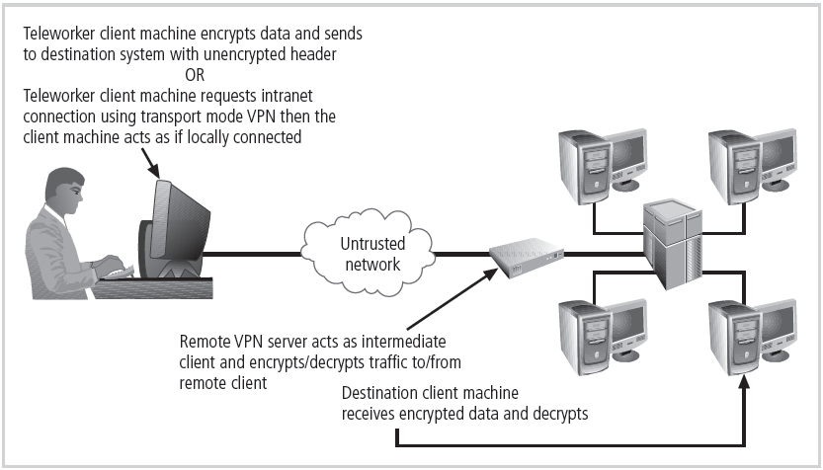
Figure 6-19 Transport Mode VPN
Principles of Information Security, Fourth Edition

Slide 61
Virtual Private Networks (VPNs) (cont’d.)
Tunnel mode
  Organization establishes two perimeter tunnel servers
  These servers act as encryption points, encrypting all traffic that will traverse unsecured network
  Primary benefit to this model is that an intercepted packet reveals nothing about true destination system
  Example of tunnel mode VPN: Microsoft’s Internet Security and Acceleration (ISA) Server
Principles of Information Security, Fourth Edition
Notes:
Tunnel Mode
In tunnel mode, the organization establishes two perimeter tunnel servers. These servers serve as the encryption points, encrypting all traffic that will traverse an unsecured network.
In tunnel mode, the entire client packet is encrypted and added as the data portion of a packet addressed from one tunneling server and to another. The receiving server decrypts the packet and sends it to the final address.
The primary benefit to this model is that an intercepted packet reveals nothing about the true destination system.

Slide 62
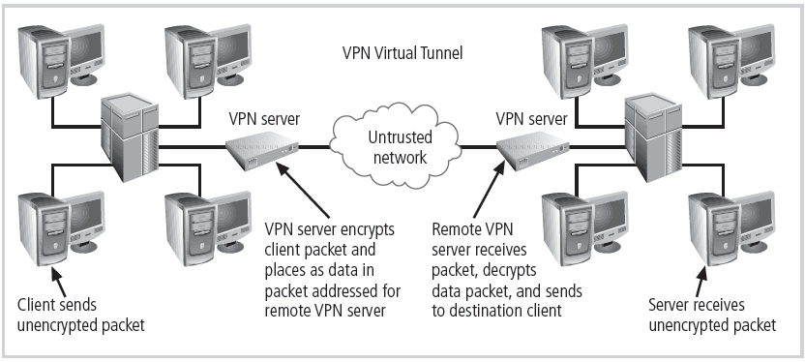
Figure 6-20 Tunnel Mode VPN
Principles of Information Security, Fourth Edition

Slide 63
Summary
Firewalls
  Technology from packet filtering to dynamic stateful inspection
  Architectures vary with the needs of the network
Various approaches to remote and dial-up access protection
  RADIUS and TACACS
Content filtering technology
Virtual private networks
  Encryption between networks over the Internet
Principles of Information Security, Fourth Edition

