Slide 1

Principles of Information Security,
Fourth Edition
Chapter 7
Security Technology: Prevention Systems, Intrusion Detection, and Other Security Tools
Do not wait; the time will never be just right. Start where you stand and work with whatever tools you may have at your command, and better tools will be found as you go along.
NAPOLEON HILL (1883–1970) FOUNDER OF THE SCIENCE of SUCCESS

Slide 2
Learning Objectives
Upon completion of this material, you should be able to:
  Identify and describe the categories and operating models of intrusion detection and prevention systems
  Define and describe honeypots, honeynets, and padded cell systems
  List and define the major categories of scanning and analysis tools, and describe the specific tools used within each of these categories
  Explain the various methods of access control, including the use of biometric access mechanisms
Principles of Information Security, Fourth Edition
Notes:
Upon completion of this material, you should be able to:
Identify and describe the categories and operating models of intrusion detection and prevention systems
Define and describe honeypots, honeynets, and padded cell systems
List and define the major categories of scanning and analysis tools, and describe the specific tools used within each of these categories
Explain the various methods of access control, including the use of biometric access mechanisms

Slide 3
Introduction
Protection of organizations assets depend as much on people as technical controls
Technical solutions, guided by policy and properly implemented are essential to an information security program
Advanced technologies can be used to enhance the security of information assets
Principles of Information Security, Fourth Edition

Slide 4
Intrusion Detection and Prevention Systems
Intrusion: occurs when an attacker attempts to gain entry into or disrupt the normal operations of an information system, almost always with the intent to do harm
Intrusion prevention: consists of activities that seek to deter an intrusion from occurring
Principles of Information Security, Fourth Edition
Notes:
Introduction
An intrusion is a type of attack on information assets in which the instigator attempts to gain entry into a system or disrupt the normal operations of a system with, almost always, the intent to do malicious harm.
Incident response is the identification of, classification of, response to, and recovery from an incident, and is frequently discussed in terms of prevention, detection, reaction, and correction.
Intrusion prevention consists of activities that seek to deter an intrusion from occurring.
Intrusion detection consists of procedures and systems that are created and operated to detect system intrusions.
Intrusion reaction encompasses the actions an organization undertakes when an intrusion event is detected.
Intrusion correction activities finalize the restoration of operations to a normal state, and by seeking to identify the source and method of the intrusion in order to ensure that the same type of attack cannot occur again, they return to intrusion prevention—thus closing the incident response loop.

Slide 5
Intrusion Detection and Prevention Systems (cont’d.)
Intrusion detection: consists of procedures and systems created and operated to detect system intrusions
Intrusion reaction: encompasses actions an organization undertakes when intrusion event is detected
Intrusion correction activities: finalize restoration of operations to a normal state
Principles of Information Security, Fourth Edition

Slide 6
Intrusion Detection and Prevention Systems (cont’d.)
Detect a violation of its configuration and activate alarm
Many IDSs enable administrators to configure systems to notify them directly of trouble via e-mail or pagers
Systems can also be configured to notify an external security service organization of a “break-in”
Principles of Information Security, Fourth Edition
Notes:
Intrusion Detection Systems (IDSs)
An IDS detects a violation of its configuration and activates an alarm. System administrators can choose the configuration of the various alerts and the associated alarm levels for each type of alert.
Many IDSs enable administrators to configure the systems to notify them directly of trouble via e-mail or pagers.
The systems can also be configured to notify an external security service organization of a “break-in.”

Slide 7
IDPS Terminology
Site policy awareness
Tuning
True attack stimulus
Confidence value
Alarm filtering
Alarm clustering and compaction
Alert or alarm
Evasion
False attack stimulus
False negative and false positive
Noise
Site policy
Principles of Information Security, Fourth Edition
Notes:
IDS Terminology
Alert or Alarm: An indication that a system has just been attacked and/or continues to be under attack.
False Attack Stimulus: An event that triggers alarms and causes a false positive when no actual attacks are in progress.
False Negative: The failure of an IDS system to react to an actual attack event.
False Positive: An alarm or alert that indicates that an attack is in progress or that an attack has successfully occurred when in fact there was no such attack.
Noise: The ongoing activity from alarm events that are accurate and noteworthy but not necessarily significant as potentially successful attacks.
Site Policy: The rules and configuration guidelines governing the implementation and operation of IDSs within the organization.
Site Policy Awareness: An IDS’s ability to dynamically modify its site policies in reaction or response to environmental activity.
True Attack Stimulus: An event that triggers alarms and causes an IDS to react as if a real attack is in progress.
Confidence Value: A value associated with an IDS’s ability to detect and identify an attack correctly.
Alarm Filtering: The process of classifying the attack alerts that an IDS produces in order to distinguish/sort false positives from actual attacks more efficiently.
Alarm clustering and compaction: A process of grouping almost identical alarms that happen at close to the same time into a single higher-level alarm.

Slide 8
Why Use an IDPS?
Prevent problem behaviors by increasing the perceived risk of discovery and punishment
Detect attacks and other security violations
Detect and deal with preambles to attacks
Document existing threat to an organization
Act as quality control for security design and administration, especially of large and complex enterprises
Provide useful information about intrusions that take place
Principles of Information Security, Fourth Edition
Notes:
Why Use an IDS?
To prevent problem behaviors by increasing the perceived risk of discovery and punishment for those who would attack or otherwise abuse the system
To detect attacks and other security violations that are not prevented by other security measures
To detect and deal with the preambles to attacks
To document the existing threat to an organization
To act as quality control for security design and administration, especially of large and complex enterprises
To provide useful information about intrusions that do take place, allowing improved diagnosis, recovery, and correction of causative factors

Slide 9
Types of IDPS
IDSs operate as network-based or host-based
Network-based IDPS is focused on protecting network information assets
  Wireless IDPS: focuses on wireless networks
  Network behavior analysis IDPS: examines traffic flow on a network in an attempt to recognize abnormal patterns
Principles of Information Security, Fourth Edition
Notes:
Types of IDSs and Detection Methods
IDSs operate as network-based, host-based, or application-based systems.
A network-based IDS is focused on protecting network information assets.
A host-based version is focused on protecting the server or host’s information assets.
The application-based model works on one or more host systems that support a single application and is oriented to defend that specific application from special forms of attack.

Slide 10
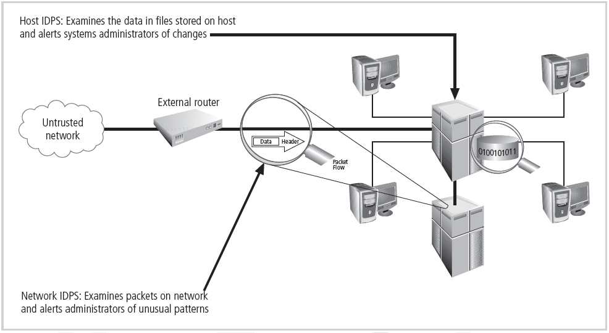
Figure 7-1 Intrusion Detection and Prevention Systems
Principles of Information Security, Fourth Edition

Slide 11
Types of IDPS (cont’d.)
Network-based IDPS
  Resides on computer or appliance connected to segment of an organization’s network; looks for signs of attacks
  When examining packets, a NIDPS looks for attack patterns
  Installed at specific place in the network where it can watch traffic going into and out of particular network segment
Principles of Information Security, Fourth Edition
Notes:
Network-Based IDS
A network-based IDS resides on a computer or appliance connected to a segment of an organization’s network and monitors network traffic on that network segment, looking for indications of ongoing or successful attacks.
When a situation occurs that the network-based IDS is programmed to recognize as an attack, it responds by sending notifications to administrators.
When examining the packets transmitted through an organization’s networks, a NIDS looks for attack patterns within network traffic such as large collections of related items that are of a certain type, which could indicate that a denial-of-service attack is underway, or the exchange of a series of related packets in a certain pattern, which could indicate that a port scan is in progress.
NIDSs are installed at a specific place in the network (such as on the inside of an edge router) from where it is possible to watch the traffic going into and out of a particular network segment.
The NIDS can be deployed to watch a specific grouping of host computers on a specific network segment, or it may be installed to monitor all traffic between the systems that make up an entire network.

Slide 12
Types of IDPS (cont’d.)
NIDPS signature matching
  To detect an attack, NIDPSs look for attack patterns
  Done by using special implementation of TCP/IP stack:
    In process of protocol stack verification, NIDPSs look for invalid data packets
    In application protocol verification, higher-order protocols are examined for unexpected packet behavior or improper use
Principles of Information Security, Fourth Edition
Notes:
NIDS Signature Matching
To determine whether or not an attack has occurred or may be underway, NIDSs look for attack patterns by comparing measured activity to known signatures in their knowledge base.
They do this by comparing captured network traffic using a special implementation of the TCP/IP stack that reassembles the packets and applies protocol stack or application protocol verification:
In the process of protocol stack verification, the NIDSs look for invalid data packets.
In application protocol verification, the higher-order protocols are examined for unexpected packet behavior or improper use.

Slide 13
Types of IDPS (cont’d.)
Advantages of NIDPSs
  Good network design and placement of NIDPS can enable organization to use a few devices to monitor large network
  NIDPSs are usually passive and can be deployed into existing networks with little disruption to normal network operations
  NIDPSs not usually susceptible to direct attack and may not be detectable by attackers
Principles of Information Security, Fourth Edition
Notes:
Advantages of NIDSs
Good network design and placement of NIDS devices can enable an organization to use a few devices to monitor a large network.
NIDSs are usually passive devices and can be deployed into existing networks with little or no disruption to normal network operations.
NIDSs are not usually susceptible to direct attack and, in fact, may not be detectable by attackers.

Slide 14
Types of IDPS (cont’d.)
Disadvantages of NIDPSs
  Can become overwhelmed by network volume and fail to recognize attacks
  Require access to all traffic to be monitored
  Cannot analyze encrypted packets
  Cannot reliably ascertain if attack was successful or not
  Some forms of attack are not easily discerned by NIDPSs, specifically those involving fragmented packets
Principles of Information Security, Fourth Edition
Notes:
Disadvantages of NIDSs
A NIDS can become overwhelmed by network volume and fail to recognize attacks it might otherwise have detected.
NIDSs require access to all traffic to be monitored.
NIDSs cannot analyze encrypted packets, making some of the network traffic invisible to the process.
NIDSs cannot reliably ascertain if an attack was successful or not.
Some forms of attack are not easily discerned by NIDSs, specifically those involving fragmented packets.

Slide 15
Types of IDPS (cont’d.)
Wireless NIDPS
  Monitors and analyzes wireless network traffic
  Issues associated with it include physical security, sensor range, access point and wireless switch locations, wired network connections, cost
Network behavior analysis systems
  Examine network traffic in order to identify problems related to the flow of traffic
  Types of events commonly detected include DoS attacks, scanning, worms, unexpected application services, policy violations
Principles of Information Security, Fourth Edition

Slide 16
Types of IDPS (cont’d.)
Host-based IDPS
  Resides on a particular computer or server and monitors activity only on that system
  Benchmark and monitor the status of key system files and detect when intruder creates, modifies, or deletes files
  Most HIDPSs work on the principle of configuration or change management
  Advantage over NIDPS: can usually be installed so that it can access information encrypted when traveling over network
Principles of Information Security, Fourth Edition
Notes:
Host-Based IDS
A host-based IDS resides on a particular computer or server, known as the host, and monitors activity only on that system.
HIDSs are also known as system integrity verifiers, as they benchmark and monitor the status of key system files and detect when an intruder creates, modifies, or deletes monitored files.
Most HIDSs work on the principle of configuration or change management, which means they record the sizes, locations, and other attributes of system files.
The HIDS then triggers an alert when one of the following changes occurs: file attributes change, new files are created, or existing files are deleted.
A HIDS has an advantage over NIDS in that it can usually be installed in such a way that it can access information that is encrypted when traveling over the network.
A HIDS relies on the classification of files into various categories and then applies various notification actions, depending on the rules in the HIDS configuration.
Managed HIDSs can monitor multiple computers simultaneously by creating a configuration file on each monitored host and by making each HIDS report back to a master console system, which is usually located on the system administrator’s computer.

Slide 17
Types of IDPS (cont’d.)
Advantages of HIDPSs
  Can detect local events on host systems and detect attacks that may elude a network-based IDPS
  Functions on host system, where encrypted traffic will have been decrypted and is available for processing
  Not affected by use of switched network protocols
  Can detect inconsistencies in how applications and systems programs were used by examining records stored in audit logs
Principles of Information Security, Fourth Edition
Notes:
Advantages of HIDSs
A HIDS can detect local events on host systems and also detect attacks that may elude a network-based IDS.
A HIDS functions on the host system, where encrypted traffic will have been decrypted and is available for processing.
The use of switched network protocols does not affect a HIDS.
A HIDS can detect inconsistencies in how applications and systems programs were used by examining the records stored in audit logs.

Slide 18
Types of IDPS (cont’d.)
Disadvantages of HIDPSs
  Pose more management issues
  Vulnerable both to direct attacks and attacks against host operating system
  Does not detect multi-host scanning, nor scanning of non-host network devices
  Susceptible to some denial-of-service attacks
  Can use large amounts of disk space
  Can inflict a performance overhead on its host systems
Principles of Information Security, Fourth Edition
Notes:
Disadvantages of HIDS
HIDSs pose more management issues since they are configured and managed on each monitored host.
A HIDS is vulnerable both to direct attacks and to attacks against the host operating system.
A HIDS is not optimized to detect multi-host scanning, nor is it able to detect the scanning of non-host network devices, such as routers or switches.
A HIDS is susceptible to some denial-of-service attacks.
A HIDS can use large amounts of disk space to retain the host OS audit logs; to function properly, it may require disk capacity to be added to the system.
A HIDS can inflict a performance overhead on its host systems, and in some cases may reduce system performance below acceptable levels.

Slide 19
IDPS Detection Methods
Signature-based IDPS
  Examine data traffic in search of patterns that match known signatures
  Widely used because many attacks have clear and distinct signatures
  Problem with this approach is that as new attack strategies are identified, the IDPS’s database of signatures must be continually updated
Principles of Information Security, Fourth Edition
Notes:
Signature-Based IDS
A signature-based IDS (or knowledge-based IDS) examines data traffic in search of patterns that match known signatures—preconfigured, predetermined attack patterns.
Signature-based IDS technology is widely used because many attacks have clear and distinct signatures.
The problem with the signature-based approach is that as new attack strategies are identified, the IDS’s database of signatures must be continually updated.

Slide 20
IDPS Detection Methods (cont’d.)
Statistical anomaly-based IDPS
  The statistical anomaly-based IDPS (stat IDPS) or behavior-based IDPS sample network activity to compare to traffic that is known to be normal
  When measured activity is outside baseline parameters or clipping level, IDPS will trigger an alert
  IDPS can detect new types of attacks
  Requires much more overhead and processing capacity than signature-based
  May generate many false positives
Principles of Information Security, Fourth Edition
Notes:
Statistical Anomaly-Based IDS
The statistical anomaly-based IDS (stat IDS) or behavior-based IDS periodically sample network activity, and, using statistical methods, compare the sampled network activity to traffic that is known to be normal (performance baseline).
When the measured activity is outside the baseline parameters or clipping level, the IDS will trigger an alert to notify the administrator.
The data that is measured from the normal traffic and is used to prepare the baseline can include variables such as host memory or CPU usage, network packet types, and packet quantities.
The advantage of the statistical anomaly-based approach is that the IDS can detect new types of attacks, for it is looking for abnormal activity of any type.
Unfortunately, however, these systems require much more overhead and processing capacity than signature-based ones, as they must constantly compare patterns of activity against the baseline.
Another drawback is that these systems may not detect minor changes to system variables and may generate many false positives.

Slide 21
IDPS Detection Methods (cont’d.)
Stateful protocol analysis IDPS
  SPA: process of comparing predetermined profiles of definitions of benign activity for each protocol state against observed events to identify deviations
  Stores and uses relevant data detected in a session to identify intrusions involving multiple requests/responses; allows IDPS to better detect specialized, multisession attacks
  Drawbacks: analytical complexity; processing overhead; may fail to detect unless protocol violates fundamental behavior; may cause problems with protocol it’s examining
Principles of Information Security, Fourth Edition

Slide 22
IDPS Detection Methods (cont’d.)
Log file monitors
  Log file monitor (LFM) similar to NIDPS
  Reviews log files generated by servers, network devices, and even other IDPSs for patterns and signatures
  Patterns that signify attack may be much easier to identify when entire network and its systems are viewed holistically
  Requires allocation of considerable resources since it will involve the collection, movement, storage, and analysis of large quantities of log data
Principles of Information Security, Fourth Edition
Notes:
Log File Monitors
A log file monitor (LFM) is similar to a NIDS and reviews the log files generated by servers, network devices, and even other IDSs for patterns and signatures in the log files that may indicate that an attack or intrusion is in process or has already succeeded.
The patterns that signify an attack can be subtle and hard to distinguish when one system is examined in isolation, but they may be much easier to identify when the entire network and its systems are viewed holistically.
Of course, this approach will require the allocation of considerable resources since it will involve the collection, movement, storage, and analysis of very large quantities of log data.

Slide 23
IDPS Response Behavior
Once IDPS detects an anomalous network situation, it has a number of options
IDPS responses can be classified as active or passive
  Active response: collecting additional information about the intrusion, modifying the network environment, taking action against the intrusion
  Passive response: setting off alarms or notifications, collecting passive data through SNMP traps
Principles of Information Security, Fourth Edition
Notes:
IDS Response Behavior
Once an IDS detects an anomalous network situation, it has a number of options, depending on the policy and objectives of the organization that has configured it as well as the capabilities of the organization’s system.
IDS responses can be classified as active or passive. An active response is one in which a definitive action is initiated when certain types of alerts are triggered. IDSs with passive response options simply report the information they have already collected and wait for the administrator to take actions.
Audible / visual alarm
SNMP traps and plug-ins
E-mail message
Page or phone message
Log entry
Evidentiary packet dump
Take action against the intruder
Launch program
Reconfigure firewall
Terminate session
Terminate connection

Slide 24
Selecting IDPS Approaches and Products
Technical and policy considerations
  What is your systems environment?
  What are your security goals and objectives?
  What is your existing security policy?
Organizational requirements and constraints
  What are requirements that are levied from outside the organization?
  What are your organization’s resource constraints?
Principles of Information Security, Fourth Edition
Notes:
Selecting IDS Approaches and Products
The wide array of intrusion detection products available today addresses a broad range of organizational security goals and considerations.
Given that range of products and features, the process of selecting products that represent the best fit for any specific organization’s needs is challenging. The following questions may be useful when preparing a specification for acquiring and deploying an intrusion detection product
Organizational Requirements & Constraints
What are requirements that are levied from outside the org?
Is your org subject to oversight or review by another org?
Are there requirements for public access to information on your org’s systems?
Are there other security-specific requirements levied by law?
Are there internal audit requirements for security best practices or due diligence?
Is the system subject to accreditation?
Are there requirements for law enforcement investigation and resolution of security incidents?
What are your organization’s resource constraints?
What is the budget for acquisition and life cycle support of intrusion detection hardware, software, and infrastructure?
Is there sufficient existing staff to monitor an IDS full time?
Does your org have authority to instigate changes based on the findings of an IDS?

Slide 25
Selecting IDPS Approaches and Products (cont’d.)
IDPSs product features and quality
  Is the product sufficiently scalable for your environment?
  How has the product been tested?
  What is the user level of expertise targeted by the product?
  Is the product designed to evolve as the organization grows?
  What are the support provisions for the product?
Principles of Information Security, Fourth Edition
Notes:
IDSs Product Features & Quality
Is the product sufficiently scalable for your environment?
How has the product been tested?
Has the product been tested against functional requirements?
Has the product been tested against attack? Ask vendors for details of the security testing to which its products have been subjected.
What is the user level of expertise targeted by the product?
Is the product designed to evolve as the organization grows?
Can the product adapt to growth in user expertise?
Can the product adapt to growth and change of the organization’s systems infrastructure?
Can the product adapt to growth and change of the security threat environment?
What are the support provisions for the product?
What are commitments for product installation and configuration support?
What are commitments for ongoing product support?
Are subscriptions to signature updates included?
How often are subscriptions updated?
How quickly after a new attack is made public will the vendor ship a new signature?
Are software updates included?
How quickly will software updates and patches be issued after a problem is reported to the vendor?
Are technical support services included?
What are the contact provisions for contacting technical support?
Are there any guarantees associated with the IDS?
What training resources does the vendor provide as part of the product?
What additional training resources are available from the vendor and at what cost?

Slide 26
Strengths and Limitations of IDPSs
IDPSs perform the following functions well:
  Monitoring and analysis of system events and user behaviors
  Testing security states of system configurations
  Baselining security state of system and tracking changes
  Recognizing system event patterns matching known attacks
  Recognizing activity patterns that vary from normal activity
Principles of Information Security, Fourth Edition

Slide 27
Strengths and Limitations of IDPSs (cont’d.)
IDPSs perform the following functions well: (cont’d.)
  Managing OS audit and logging mechanisms and data they generate
  Alerting appropriate staff when attacks are detected
  Measuring enforcement of security policies encoded in analysis engine
  Providing default information security policies
  Allowing non-security experts to perform important security monitoring functions
Principles of Information Security, Fourth Edition

Slide 28
Strengths and Limitations of IDPSs (cont’d.)
IDPSs cannot perform the following functions:
  Compensating for weak/missing security mechanisms in protection infrastructure
  Instantaneously detecting, reporting, responding to attack when there is heavy network or processing load
  Detecting new attacks or variants of existing attacks
  Effectively responding to attacks by sophisticated attackers
  Investigating attacks without human intervention
Principles of Information Security, Fourth Edition

Slide 29
Strengths and Limitations of IDPSs (cont’d.)
IDPSs cannot perform the following functions (cont’d.):
  Resisting attacks intended to defeat or circumvent them
  Compensating for problems with fidelity of data sources
  Dealing effectively with switched networks
Principles of Information Security, Fourth Edition

Slide 30
Deployment and Implementation of an IDPS
An IDPS can be implemented via one of three basic control strategies
  Centralized: all IDPS control functions are implemented and managed in a central location
  Fully distributed: all control functions are applied at the physical location of each IDPS component
  Partially distributed: combines the two; while individual agents can still analyze and respond to local threats, they report to a hierarchical central facility to enable organization to detect widespread attacks
Principles of Information Security, Fourth Edition
Notes:
IDS Control Strategies
An IDS can be implemented via one of three basic control strategies.
A control strategy determines how an organization exerts influence and maintains the configuration of an IDS.
The three commonly utilized control strategies are:
Centralized IDS control strategy—All IDS control functions are implemented and managed in a central location.
Fully distributed IDS control strategy—Control functions are applied at the physical location of each IDS component.
Partially distributed IDS control strategy—Combines the two: While the individual agents can still analyze and respond to local threats, they report to a hierarchical central facility to enable the organization to detect widespread attacks.

Slide 31
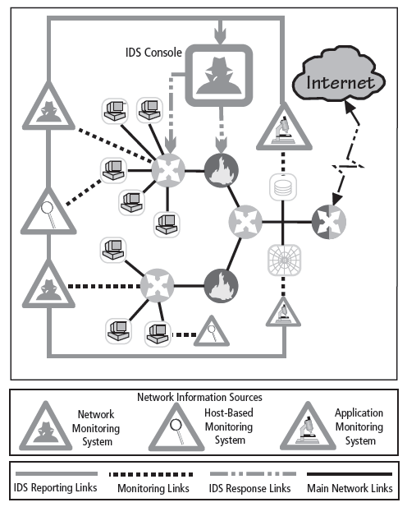
Figure 7-4 Centralized IDPS Control¹³
Principles of Information Security, Fourth Edition

Slide 32
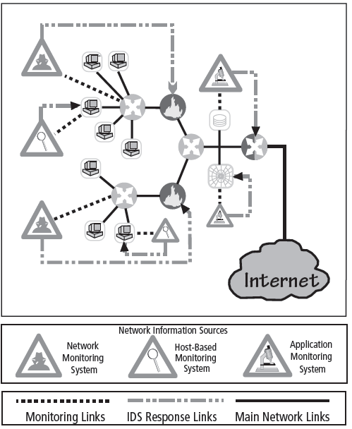
Figure 7-5 Fully Distributed IDPS Control¹⁴
Principles of Information Security, Fourth Edition

Slide 33
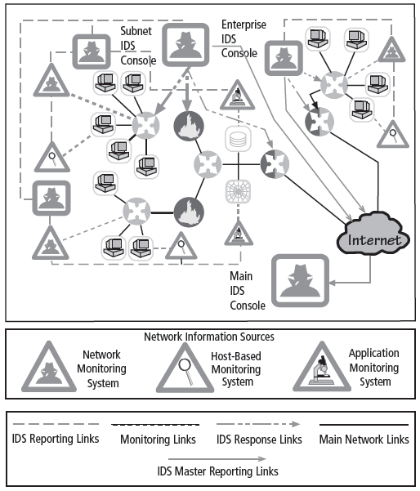
Figure 7-6 Partially Distributed IDPS Control¹⁵
Principles of Information Security, Fourth Edition

Slide 34
Deployment and Implementation of an IDPS (cont’d.)
IDPS deployment
  Like decision regarding control strategies, decision about where to locate elements of intrusion detection systems can be art in itself
  Planners must select deployment strategy that is based on careful analysis of organization’s information security requirements but, at the same time, causes minimal impact
  NIDPS and HIDPS can be used in tandem to cover both individual systems that connect to an organization’s networks and networks themselves
Principles of Information Security, Fourth Edition
Notes:
IDS Deployment Overview
Like the decision regarding control strategies, the decision about where to locate the elements of the intrusion detection systems can be an art in itself.
As an organization selects an IDS and prepares for implementation, planners must select a deployment strategy that is based on a careful analysis of the organization’s information security requirements and integrates with the organization’s existing IT infrastructure but, at the same time, causes minimal impact.
NIDS and HIDS can be used in tandem to cover both the individual systems that connect to an organization’s networks and the networks themselves.

Slide 35
Deployment and Implementation of an IDPS (cont’d.)
Deploying network-based IDPSs
  NIST recommends four locations for NIDPS sensors
    Location 1: Behind each external firewall, in the network DMZ
    Location 2: Outside an external firewall
    Location 3: On major network backbones
    Location 4: On critical subnets
Principles of Information Security, Fourth Edition
Notes:
Deploying Network-Based IDSs
NIST recommends four locations for NIDS sensors:
Location 1: Behind each external firewall, in the network DMZ
IDS sees attacks that originate from the outside world and may penetrate the network’s perimeter defenses.
IDS can identify problems with the network firewall policy or performance.
IDS sees attacks that might target the Web server or ftp server, both of which commonly reside in this DMZ.
Even if the incoming attack is not detected, the IDS can sometimes recognize, in the outgoing traffic, patterns that suggest that the server has been compromised.
Location 2: Outside an external firewall
IDS documents the number of attacks originating on the Internet that target the network.
IDS documents the types of attacks originating on the Internet that target the network.
Location 3: On major network backbones
IDS monitors a large amount of a network’s traffic, thus increasing its chances of spotting attacks.
IDS detects unauthorized activity by authorized users within the organization’s security perimeter.
Location 4: On critical subnets
IDS detects attacks targeting critical systems and resources.
Location allows organizations with limited resources to focus these resources on the network assets considered of greatest value.

Slide 36
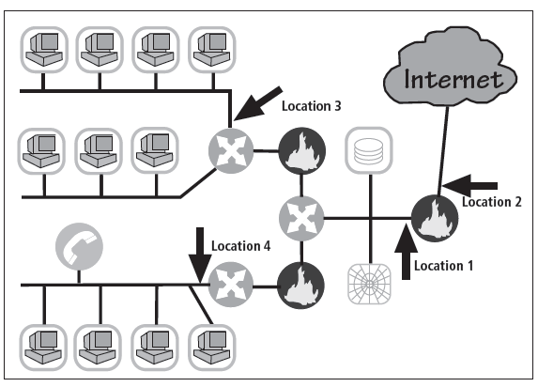
Figure 7-7 Network IDPS Sensor Locations¹⁷
Principles of Information Security, Fourth Edition

Slide 37
Deployment and Implementation of an IDPS (cont’d.)
Deploying host-based IDPSs
  Proper implementation of HIDPSs can be a painstaking and time-consuming task
  Deployment begins with implementing most critical systems first
  Installation continues until either all systems are installed or the organization reaches planned degree of coverage it is willing to live with
Principles of Information Security, Fourth Edition
Notes:
Deploying Host-Based IDSs
The proper implementation of HIDSs can be a painstaking and time-consuming task, as each HIDS must be custom configured to its host systems.
Deployment begins with implementing the most critical systems first.
Installation continues until either all systems are installed or the organization reaches the planned degree of coverage it is willing to live with, with regard to the number of systems or percentage of network traffic.
Just as technicians can install the HIDS in off-line systems to develop expertise and identify potential problems, users and managers can gain expertise and understanding of the operation of the HIDS by using a test facility.

Slide 38
Measuring the Effectiveness of IDPSs
IDPSs are evaluated using four dominant metrics: thresholds, blacklists and whitelists, alert settings, and code viewing and editing
Evaluation of IDPS might read: at 100 Mb/s, IDS was able to detect 97% of directed attacks
Since developing this collection can be tedious, most IDPS vendors provide testing mechanisms that verify systems are performing as expected
Principles of Information Security, Fourth Edition
Notes:
Measuring IDSs’ Effectiveness
IDSs are evaluated using two dominant metrics:
Administrators evaluate the number of attacks detected in a known collection of probes.
Administrators examine the level of use, commonly measured in megabits per second of network traffic, at which the IDSs fail.
An evaluation of an IDS might read something like this: at 100 Mb/s, the IDS was able to detect 97% of directed attacks.
Since developing this collection can be tedious, most IDS vendors provide testing mechanisms that verify that their systems are performing as expected.
Some of these testing processes will enable the administrator to:
Record and retransmit packets from a real virus or worm scan
Record and retransmit packets from a real virus or worm scan with incomplete TCP/IP session connections (missing SYN packets)
Conduct a real virus or worm scan against an invulnerable system

Slide 39
Measuring the Effectiveness of IDPSs (cont’d.)
Some of these testing processes will enable the administrator to:
  Record and retransmit packets from real virus or worm scan
  Record and retransmit packets from a real virus or worm scan with incomplete TCP/IP session connections (missing SYN packets)
  Conduct a real virus or worm scan against an invulnerable system
Principles of Information Security, Fourth Edition
Notes:
Measuring IDSs’ Effectiveness (continued)
IDSs are evaluated using two dominant metrics:
Administrators evaluate the number of attacks detected in a known collection of probes.
Administrators examine the level of use, commonly measured in megabits per second of network traffic, at which the IDSs fail.
An evaluation of an IDS might read something like this: at 100 Mb/s, the IDS was able to detect 97% of directed attacks.
Since developing this collection can be tedious, most IDS vendors provide testing mechanisms that verify that their systems are performing as expected.
Some of these testing processes will enable the administrator to:
Record and retransmit packets from a real virus or worm scan
Record and retransmit packets from a real virus or worm scan with incomplete TCP/IP session connections (missing SYN packets)
Conduct a real virus or worm scan against an invulnerable system

Slide 40
Honeypots, Honeynets, and Padded Cell Systems
Honeypots: decoy systems designed to lure potential attackers away from critical systems and encourage attacks against the themselves
Honeynets: collection of honeypots connecting several honey pot systems on a subnet
Honeypots designed to:
  Divert attacker from accessing critical systems
  Collect information about attacker’s activity
  Encourage attacker to stay on system long enough for administrators to document event and, perhaps, respond
Principles of Information Security, Fourth Edition
Notes:
Honey Pots & Honey Nets
Honey pots are decoy systems designed to lure potential attackers away from critical systems and encourage attacks against themselves.
Honey nets are a collection of honey pots connecting several honey pot systems on a subnet.
Honey pots are designed to:
Divert an attacker from accessing critical systems
Collect information about the attacker’s activity
Encourage the attacker to stay on the system long enough for administrators to document the event and, perhaps, respond

Slide 41
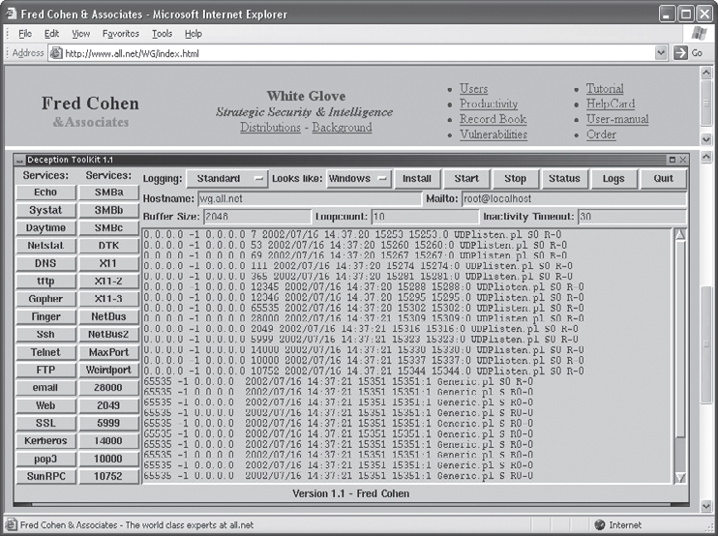
Figure 7-8 Deception Toolkit
Principles of Information Security, Fourth Edition

Slide 42
Honeypots, Honeynets, and Padded Cell Systems (cont’d.)
Padded cell: honeypot that has been protected so it cannot be easily compromised
In addition to attracting attackers with tempting data, a padded cell operates in tandem with a traditional IDS
When the IDS detects attackers, it seamlessly transfers them to a special simulated environment where they can cause no harm—the nature of this host environment is what gives approach the name padded cell
Principles of Information Security, Fourth Edition
Notes:
Padded Cell Systems
A padded cell is a honey pot that has been protected so that that it cannot be easily compromised.
In addition to attracting attackers with tempting data, a padded cell operates in tandem with a traditional IDS.
When the IDS detects attackers, it seamlessly transfers them to a special simulated environment where they can cause no harm—the nature of this host environment is what gives the approach its name, padded cell.

Slide 43
Honeypots, Honeynets, and Padded Cell Systems (cont’d.)
Advantages
  Attackers can be diverted to targets they cannot damage
  Administrators have time to decide how to respond to attacker
  Attackers’ actions can be easily and more extensively monitored, and records can be used to refine threat models and improve system protections
  Honey pots may be effective at catching insiders who are snooping around a network
Principles of Information Security, Fourth Edition
Notes:
Honey Pots, Honey Nets, and Padded Cell Systems
Advantages:
Attackers can be diverted to targets that they cannot damage.
Administrators have time to decide how to respond to an attacker.
Attackers’ actions can be easily and more extensively monitored, and the records can be used to refine threat models and improve system protections.
Honey pots may be effective at catching insiders who are snooping around a network.
Disadvantages:
The legal implications of using such devices are not well defined.
Honey pots and padded cells have not yet been shown to be generally useful security technologies.
An expert attacker, once diverted into a decoy system, may become angry and launch a more hostile attack against an organization’s systems.
Administrators and security managers will need a high level of expertise to use these systems.

Slide 44
Honeypots, Honeynets, and Padded Cell Systems (cont’d.)
Disadvantages
  Legal implications of using such devices are not well defined
  Honeypots and padded cells have not yet been shown to be generally useful security technologies
  Expert attacker, once diverted into a decoy system, may become angry and launch a more hostile attack against an organization’s systems
  Administrators and security managers will need a high level of expertise to use these systems
Principles of Information Security, Fourth Edition
Notes:
Honey Pots, Honey Nets, and Padded Cell Systems (continued)
Advantages:
Attackers can be diverted to targets that they cannot damage.
Administrators have time to decide how to respond to an attacker.
Attackers’ actions can be easily and more extensively monitored, and the records can be used to refine threat models and improve system protections.
Honey pots may be effective at catching insiders who are snooping around a network.
Disadvantages:
The legal implications of using such devices are not well defined.
Honey pots and padded cells have not yet been shown to be generally useful security technologies.
An expert attacker, once diverted into a decoy system, may become angry and launch a more hostile attack against an organization’s systems.
Administrators and security managers will need a high level of expertise to use these systems.

Slide 45
Trap and Trace Systems
Use combination of techniques to detect an intrusion and trace it back to its source
Trap usually consists of honeypot or padded cell and alarm
Legal drawbacks to trap and trace
  Enticement: process of attracting attention to system by placing tantalizing bits of information in key locations
  Entrapment: action of luring an individual into committing a crime to get a conviction
  Enticement is legal and ethical, entrapment is not
Principles of Information Security, Fourth Edition
Notes:
Trap and Trace Systems
Trap and trace systems use a combination of techniques to detect an intrusion and then to trace incidents back to their sources.
The trap usually consists of a honey pot or padded cell and an alarm. While the intruders are distracted, or trapped, by what they perceive to be successful intrusions, the system notifies the administrator of their presence.
The trace feature is a process by which the organization attempts to determine the identity of someone discovered in unauthorized areas of the network or systems.
If the individual is outside the security perimeter of the organization, then numerous legal issues arise.
There are more legal drawbacks to trap and trace.
The trap portion frequently involves the use of honey pots or honey nets.
When using honey pots and honey nets, administrators should be careful not to cross the line between enticement and entrapment.
Enticement is the process of attracting attention to a system by placing tantalizing bits of information in key locations.
Entrapment is the action of luring an individual into committing a crime to get a conviction.
Enticement is legal and ethical, whereas entrapment is not.

Slide 46
Active Intrusion Prevention
Some organizations implement active countermeasures to stop attacks
One tool (LaBrea) takes up unused IP address space to pretend to be a computer and allow attackers to complete a connection request, but then holds connection open
Principles of Information Security, Fourth Edition
Notes:
Active Intrusion Prevention
Some organizations implement active countermeasures to stop attacks. One tool that provides active intrusion prevention works by taking up the unused IP address space within a network.
If an address is not currently being used by a real computer or network device, LaBrea will pretend to be a computer at that IP address and allow the attacker to complete the connection request but then hold the connection open but inactive, allowing the system time to notify administrators about the anomalous behavior on the network.

Slide 47
Scanning and Analysis Tools
Typically used to collect information that attacker would need to launch successful attack
Attack protocol is series of steps or processes used by an attacker, in a logical sequence, to launch attack against a target system or network
Footprinting: the organized research of Internet addresses owned or controlled by a target organization
Principles of Information Security, Fourth Edition
Notes:
Scanning and Analysis Tools
Scanning tools are typically used as part of an attack protocol to collect information that an attacker would need to launch a successful attack.
The attack protocol is a series of steps or processes used by an attacker, in a logical sequence, to launch an attack against a target system or network.

Slide 48
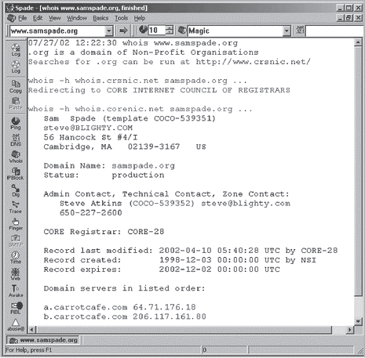
Figure 7-9 Sam Spade
Principles of Information Security, Fourth Edition

Slide 49
Scanning and Analysis Tools (cont’d.)
Fingerprinting: systematic survey of all of target organization’s Internet addresses collected during the footprinting phase
Fingerprinting reveals useful information about internal structure and operational nature of target system or network for anticipated attack
These tools are valuable to network defender since they can quickly pinpoint the parts of the systems or network that need a prompt repair to close the vulnerability
Principles of Information Security, Fourth Edition
Notes:
Scanning and Analysis Tools (continued)
The next phase of the attack is a second intelligence or data-gathering process called fingerprinting—a systematic survey of all of the target organization’s Internet addresses collected during the footprinting phase, to ascertain the network services offered by the hosts in that range.
Fingerprinting reveals useful information about the internal structure and operational nature of the target system or network for the anticipated attack.
Since these tools were created to find vulnerabilities in systems and networks, they are valuable for the network defender since they can quickly pinpoint the parts of the systems or network that need a prompt repair to close the vulnerability.

Slide 50
Port Scanners
Tools used by both attackers and defenders to identify computers active on a network and other useful information
Can scan for specific types of computers, protocols, or resources, or their scans can be generic
The more specific the scanner is, the better it can give attackers and defenders useful information
Principles of Information Security, Fourth Edition
Notes:
Port Scanners
Port scanning utilities (or port scanners) are tools used by both attackers and defenders to identify (or fingerprint) the computers that are active on a network, as well as the ports and services active on those computers, the functions and roles the machines are fulfilling, and other useful information.
These tools can scan for specific types of computers, protocols, or resources, or their scans can be generic.
The more specific the scanner is, the better it can give attackers and defenders information that is detailed and will be useful later. However, it is also recommended that you keep a generic, broad-based scanner in your toolbox as well.

Slide 51
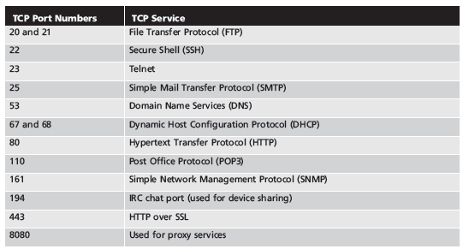
Table 7-1 Select Commonly Used Port Numbers
Principles of Information Security, Fourth Edition

Slide 52
Firewall Analysis Tools
Several tools automate remote discovery of firewall rules and assist the administrator in analyzing them
Administrators who feel wary of using the same tools that attackers use should remember:
  It is intent of user that will dictate how information gathered will be used
  In order to defend a computer or network well, it is necessary to understand ways it can be attacked
A tool that can help close up an open or poorly configured firewall will help network defender minimize risk from attack
Principles of Information Security, Fourth Edition
Notes:
Firewall Analysis Tools
There are several tools that automate the remote discovery of firewall rules and assist the administrator in analyzing the rules to determine exactly what they allow and what they reject.
Incidentally, administrators who feel wary of using the same tools that attackers use should remember:
Regardless of the nature of the tool that is used to validate or analyze a firewall’s configuration, it is the intent of the user that will dictate how the information gathered will be used.
In order to defend a computer or network well, it is necessary to understand the ways it can be attacked.
Thus, a tool that can help close up an open or poorly configured firewall will help the network defender minimize the risk from attack.

Slide 53
Operating System Detection Tools
Detecting a target computer’s operating system (OS) is very valuable to an attacker
There are many tools that use networking protocols to determine a remote computer’s OS
Principles of Information Security, Fourth Edition
Notes:
Operating System Detection Tools
Detecting a target computer’s OS is very valuable to an attacker, because once the OS is known, all of the vulnerabilities to which it is susceptible can easily be determined. There are many tools that use networking protocols to determine a remote computer’s OS.
As most OSs have a unique way of responding to ICMP requests, these tools are very reliable in finding matches and thus detecting the OSs of remote computers.
System and network administrators should take note of this and plan to restrict the use of ICMP through their organization’s firewalls and, when possible, within its internal networks.

Slide 54
Vulnerability Scanners
Active vulnerability scanners scan networks for highly detailed information; initiate traffic to determine holes
Passive vulnerability scanners listen in on network and determine vulnerable versions of both server and client software
Passive vulnerability scanners have ability to find client-side vulnerabilities typically not found in active scanners
Principles of Information Security, Fourth Edition
Notes:
Vulnerability Scanners
An “active” vulnerability scanner is one that initiates traffic on the network in order to determine security holes.
As a class, this type of scanner identifies exposed usernames and groups, shows open network shares, and exposes configuration problems and other vulnerabilities in servers.
A passive vulnerability scanner is one that listens in on the network and determines vulnerable versions of both server and client software.
Passive scanners are advantageous in that they do not require vulnerability analysts to get approval prior for testing.
These tools simply monitor the network connections to and from a server to gain a list of vulnerable applications.
Furthermore, passive vulnerability scanners have the ability to find client-side vulnerabilities that are typically not found in active scanners.

Slide 55
Packet Sniffers
Network tool that collects copies of packets from network and analyzes them
Can provide network administrator with valuable information for diagnosing and resolving networking issues
In the wrong hands, a sniffer can be used to eavesdrop on network traffic
To use packet sniffer legally, administrator must be on network that organization owns, be under direct authorization of owners of network, and have knowledge and consent of the content creators
Principles of Information Security, Fourth Edition
Notes:
Packet Sniffers
A packet sniffer or network protocol analyzer is a network tool that collects copies of packets from the network and analyzes them.
It can provide a network administrator with valuable information for diagnosing and resolving networking issues.
In the wrong hands, a sniffer can be used to eavesdrop on network traffic.
Typically, to use these types of programs most effectively, the user must be connected to a network from a central location.
To use a packet sniffer legally, the administrator must:
Be on a network that the organization owns
Be under direct authorization of the owners of the network
Have knowledge and consent of the content creators

Slide 56
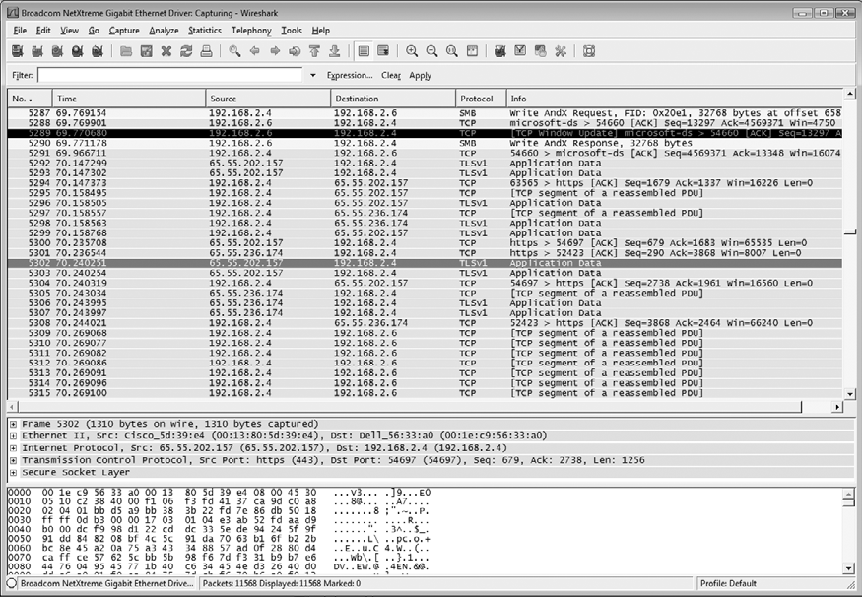
Figure 7-17 Wireshark
Principles of Information Security, Fourth Edition

Slide 57
Wireless Security Tools
Organization that spends its time securing wired network and leaves wireless networks to operate in any manner is opening itself up for security breach
Security professional must assess risk of wireless networks
A wireless security toolkit should include the ability to sniff wireless traffic, scan wireless hosts, and assess level of privacy or confidentiality afforded on the wireless network
Principles of Information Security, Fourth Edition
Notes:
Wireless Security Tools
An organization that spends all of its time securing the wired network and leaves wireless networks to operate in any manner is opening itself up for a security breach.
As a security professional, you must assess the risk of wireless networks.
A wireless security toolkit should include the ability to sniff wireless traffic, scan wireless hosts, and assess the level of privacy or confidentiality afforded on the wireless network.

Slide 58
Biometric Access Control
Based on the use of some measurable human characteristic or trait to authenticate the identity of a proposed systems user (a supplicant)
Relies upon recognition
Includes fingerprint comparison, palm print comparison, hand geometry, facial recognition using a photographic id card or digital camera, retinal print, iris pattern
Characteristics considered truly unique: fingerprints, retina of the eye, iris of the eye
Principles of Information Security, Fourth Edition

Slide 59

Figure 7-20 Biometric Recognition Characteristics
Principles of Information Security, Fourth Edition

Slide 60
Effectiveness of Biometrics
Biometric technologies evaluated on three basic criteria:
  False reject rate: the rejection of legitimate users
  False accept rate: the acceptance of unknown users
  Crossover error rate (CER): the point where false reject and false accept rates cross when graphed
Principles of Information Security, Fourth Edition
Notes:
Effectiveness of Biometrics
Biometric technologies are evaluated on three basic criteria:
The false reject rate: The rate at which supplicants who are authentic users are denied or prevented access to authorized areas as a result of a failure in the biometric device (Type I error).
The false accept rate: The rate at which supplicants who are not legitimate users are allowed access to systems or areas as a result of a failure in the biometric device (Type II error).
The crossover error rate (CER): The level at which the number of false rejections equals the false acceptances (Equal error rate). This is the most common and important overall measure of the accuracy of a biometric system.

Slide 61
Acceptability of Biometrics
Balance must be struck between how acceptable security system is to users and its effectiveness in maintaining security
Many biometric systems that are highly reliable and effective are considered intrusive
As a result, many information security professionals, in an effort to avoid confrontation and possible user boycott of biometric controls, don’t implement them
Principles of Information Security, Fourth Edition
Notes:
Acceptability of Biometrics
A balance must be struck between how acceptable a security system is to its users and how effective it is in maintaining security.
Many of the biometric systems that are highly reliable and effective are considered somewhat intrusive to users.
As a result, many information security professionals, in an effort to avoid confrontation and possible user boycott of the biometric controls, don’t implement them.

Slide 62
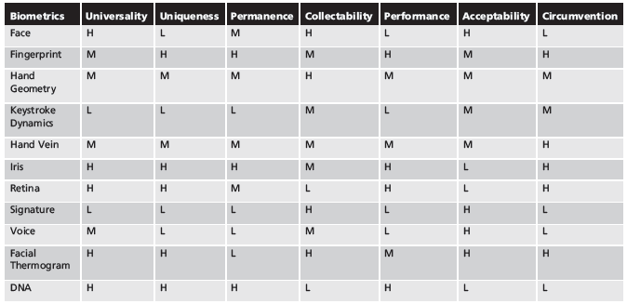
Table 7-3 Ranking of Biometric Effectiveness and Acceptance
H=High, M=Medium, L=Low
Reproduced from The ‘123’ of Biometric Technology, 2003, by Yun, Yau Wei²²
Principles of Information Security, Fourth Edition

Slide 63
Summary
Intrusion detection system (IDPS) detects violation of its configuration and activates alarm
Network-based IDPS (NIDPS) vs. host-based IDPS (HIDPS)
Selecting IDPS products that best fit organization’s needs is challenging and complex
Honey pots are decoy systems; two variations are known as honey nets and padded cell systems
Principles of Information Security, Fourth Edition

Slide 64
Summary (cont’d.)
Scanning and analysis tools are used to pinpoint vulnerabilities in systems, holes in security components, and unsecured aspects of network
Authentication is validation of prospective user’s (supplicant’s) identity
Principals of Information Security, Fourth Edition

