Slide 1


Principles of Information Security,
Fourth Edition
Chapter 8
Using Encryption

Slide 2
Learning Objectives
Upon completion of this material, you should be able to:
  Chronicle the most significant events and discoveries in the history of cryptology
  Explain the basic principles of cryptography
  Describe the operating principles of the most popular cryptographic tools
  List and explicate the major protocols used for secure communications
  Discuss the nature and execution of the dominant methods of attack used against cryptosystems
Principles of Information Security, Fourth Edition
Notes:
Upon completion of this chapter you should be able to:
Define and identify the various types of firewalls
Discuss the approaches to firewall implementation
Discuss the approaches to dial-up access and protection
Identify and describe the two categories of intrusion detection systems
Discuss the two strategies behind intrusion detection systems
Discuss the process of encryption and define key terms
Identify and discuss common approaches to cryptography
Compare and contrast symmetric and asymmetric encryption
Discuss various approaches to biometric access control

Slide 3
Introduction
Cryptology: science of encryption; combines cryptography and cryptanalysis
Cryptography: process of making and using codes to secure transmission of information
Cryptanalysis: process of obtaining original message from encrypted message without knowing algorithms
Encryption: converting original message into a form unreadable by unauthorized individuals
Decryption: the process of converting the ciphertext message back into plaintext
Principles of Information Security, Fourth Edition
Notes:
Cryptography and Encryption-Based Solutions
Although not a specific application or security tool, encryption represents a sophisticated approach to security that is implemented in many security systems.
In fact, many security-related tools use embedded encryption technologies to protect sensitive information handled by the application.
Encryption is the process of converting an original message into a form that is unreadable by unauthorized individuals, that is, anyone without the tools to convert the encrypted message back to its original format.
The science of encryption, known as cryptology, encompasses cryptography, from the Greek words kryptos, meaning hidden; graphein, meaning to write; and cryptanalysis, the process of obtaining the original message (or plaintext) from an encrypted message (or ciphertext), without the knowledge of the algorithms and keys used to perform the encryption.

Slide 4
Foundations of Cryptology
Cryptology has a long and multicultural history
With emergence of technology, need for encryption in information technology environment greatly increased
All popular Web browsers use built-in encryption features for secure e-commerce applications
Principles of Information Security, Fourth Edition
Notes:
Encryption Definitions
Algorithm: The mathematical formula used to convert an unencrypted message into an encrypted message.
Cipher: The transformation of the individual components (characters, bytes, or bits) of an unencrypted message into encrypted components.
Ciphertext or cryptogram: The unintelligible encrypted or encoded message resulting from an encryption.
Code: The transformation of the larger components (words or phrases) of an unencrypted message into encrypted components.
Cryptosystem: The set of transformations necessary to convert an unencrypted message into an encrypted message.
Decipher: To decrypt or convert ciphertext to plaintext.
Encipher: To encrypt or convert plaintext to ciphertext.
Key or cryptovariable: The information used in conjunction with the algorithm to create ciphertext from plaintext.
Keyspace: The entire range of values that can possibly be used to construct an individual key.
Link encryption: A series of encryptions and decryptions between a number of systems, whereby each node decrypts the message sent to it and then reencrypts it using different keys and sends it to the next neighbor, until it reaches the final destination.
Plaintext: The original unencrypted message that is encrypted and results from successful decryption.
Steganography: The process of hiding messages in a picture or graphic.
Work factor: The amount of effort (usually in hours) required to perform cryptanalysis on an encoded message.

Slide 5
Cipher Methods
Plaintext can be encrypted through bit stream or block cipher method
Bit stream: each plaintext bit transformed into cipher bit one bit at a time
Block cipher: message divided into blocks (e.g., sets of 8- or 16-bit blocks) and each is transformed into encrypted block of cipher bits using algorithm and key
Principles of Information Security, Fourth Edition
Notes:
Cryptography and Encryption-Based Solutions
The notation used to describe the encryption process differs depending on the source.
The first uses the letters M to represent the original message, C to represent the ending ciphertext, and E to represent the encryption process: E(M) = C.
This formula represents the application of encryption to a message to create ciphertext. D represents the decryption or deciphering process, thus D[E(M)]=M.
K is used to represent the key, thus E(M, K) = C, or encrypting the message with the key results in the ciphertext.
Now look at a simple form of encryption based on two concepts: the block cipher and the exclusive OR operation.
With the block cipher method, the message is divided into blocks, i.e., 8- or 16-bit blocks, and then each block is transformed using the algorithm and key.
The exclusive OR operation (XOR) is a function of Boolean algebra whereby two bits are compared, and if the two bits are identical, the result is a binary 0. If the two bits are NOT the same, the result is a binary 1.

Slide 6
Monoalphabetic Ciphers
The ciphers for which, once a key is chosen, each alphabetic character is mapped to a unique alphabetic character
Examples of monoalphabetic ciphers include Shift cipher, Substitution Cipher and Affine cipher

Slide 7
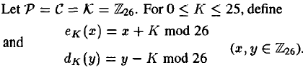
1. Shift Cipher
Let plaintext (p) = wewillmeetatmidnight
We first convert the plaintext string into integers. The rule is:
a<->0, b<->1, c<->2, d<->3, e<->4, f<->5, g<->6, h<->7, i<->8, j<->9, k<->10, l<->11, m<->12,n<->13, o<->14, p<->15,q<->16, r<->17, s<->18, t<->19, u<->20, v<->21, w<->22, x<->23, y<->24, z<->25
w | e | w | i | l | l | m | e | e | t | a | t | m | i | d | n | i | g | h | t
22 | 4 | 22 | 8 | 11 | 11 | 12 | 4 | 4 | 19 | 0 | 19 | 12 | 8 | 3 | 13 | 8 | 6 | 7 | 19
Let K=11, we add 11 to each value, reducing each sum modulo 26, we get ciphertext
7 | 15 | 7 | 19 | 22 | 22 | 23 | 15 | 15 | 4 | 11 | 4 | 23 | 19 | 14 | 24 | 19 | 17 | 18 | 4
H | P | T | T | W | W | X | P | P | E | L | E | X | T | O | Y | T | R | S | E

Slide 8
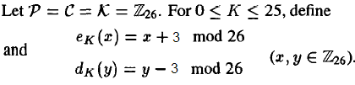
1. Shift Cipher
For a particular Key k=3, the cryptosystem is often called the
Caesar Cipher (Roman Empire, 2000 years ago )
  0123456...
  Plain: abcdefghijklmnopqrstuvwxyz
  Cipher: DEFGHIJKLMNOPQRSTUVWXYZABC
  3456789...
  Plain: meet me after the toga party
  Cipher: PHHW PH DIWHU WKH WRJD SDUWB

Slide 9
2-Substitution Cipher
Substitute one value for another
Monoalphabetic substitution: uses only one alphabet
Polyalphabetic substitution: more advanced; uses two or more alphabets
Vigenère cipher: advanced cipher type that uses simple polyalphabetic code; made up of 26 distinct cipher alphabets
Principles of Information Security, Fourth Edition
Notes:
Encryption Operations
In encryption, the most commonly used algorithms include two functions: substitution and transposition.
In a substitution cipher, you substitute one value for another.
This is a simple enough method by itself but very powerful if combined with other operations. This type of substitution is based on a monoalphabetic substitution, since it only uses one alphabet.
More advanced substitution ciphers use two or more alphabets and are referred to as polyalphabetic substitutions.
Caesar reportedly used a three-value shift to the right, giving that particular substitution cipher his name–the “Caesar Cipher.”
Just like the substitution operation, the transposition cipher is simple to understand but can be complex to decipher if properly used.
Unlike the substitution cipher, the transposition cipher (or permutation cipher) simply rearranges the values within a block to create the ciphertext.
This can be done at the bit level or at the byte (character) level.
Transposition ciphers move these bits or bytes to another location in the block, so that bit 1 becomes bit 4, bit 2 becomes bit 7, etc.

Slide 10

Table 8-2 The Vigenère Square
Principles of Information Security, Fourth Edition

Slide 11
Polyalphabetic Ciphers
The simple substitution cipher is weak because the attacker can exploit the fact that:
  The letter frequency distribution of the ciphertext will match the letter frequency distribution of the plaintext
  These will generally follow the letter frequency distribution of the plaintext language
A simple way to defeat frequency analysis is to encipher each plaintext letter with a different substitution alphabet
The use of multiple substitution alphabets will mean that a plaintext letter can encrypt to different ciphertext letters, thus causing the letter frequency distribution to appear “flatter” (the individual letter frequencies are averaged out)
A cipher that uses multiple substitution alphabets is called a polyalphabetic substitution cipher. The Vigenere Cipher and Hill Cipher are examples of alphabetic ciphers

Slide 12
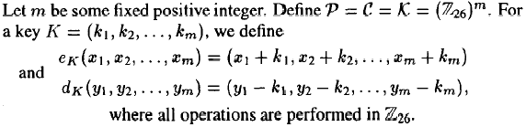
1. The Viginere Cipher
Suppose key length (m)=6
Key word (K) = C I P H E R = (2,8,15,7,4,17)
Plaintext (P) = thiscryptosystemisnotsecure
Possible keys= 26^{m}
P | t | h | i | s | c | r |  | y | p | t | o | s | y
 | 19 | 7 | 8 | 18 | 2 | 17 |  | 24 | 15 | 19 | 14 | 18 | 24
K | 2 | 8 | 15 | 7 | 4 | 17 |  | 2 | 8 | 15 | 7 | 4 | 17
 | 21 | 15 | 23 | 25 | 6 | 8 |  | 0 | 23 | 8 | 21 | 22 | 15
C | V | P | X | Z | G | I |  | A | X | I | V | W | P
P | s | t | e | m | i | s |  | n | o | t | s | e | c
 | 18 | 19 | 4 | 12 | 8 | 18 |  | 13 | 14 | 19 | 18 | 4 | 2
K | 2 | 8 | 15 | 7 | 4 | 17 |  | 2 | 8 | 15 | 7 | 4 | 17
 | 20 | 1 | 19 | 19 | 12 | 9 |  | 15 | 22 | 8 | 25 | 8 | 19
C | U | B | T | T | M | J |  | P | W | I | Z | I | T
u | R | e
20 | 17 | 4
2 | 8 | 15
22 | 25 | 19
W | Z | T
Ciphertext (C) = VPXZGIAXIVWPUBTTMJPWIZITWZI

Slide 13
1. The Viginere Tableau
A B C D E F G H I J K L M N O P Q R S T U V W X Y Z
B C D E F G H I J K L M N O P Q R S T U V W X Y Z A
C D E F G H I J K L M N O P Q R S T U V W X Y Z A B
D E F G H I J K L M N O P Q R S T U V W X Y Z A B C
E F G H I J K L M N O P Q R S T U V W X Y Z A B C D
F G H I J K L M N O P Q R S T U V W X Y Z A B C D E
G H I J K L M N O P Q R S T U V W X Y Z A B C D E F
H I J K L M N O P Q R S T U V W X Y Z A B C D E F G
I J K L M N O P Q R S T U V W X Y Z A B C D E F G H
J K L M N O P Q R S T U V W X Y Z A B C D E F G H I
K L M N O P Q R S T U V W X Y Z A B C D E F G H I J
L M N O P Q R S T U V W X Y Z A B C D E F G H I J K
M N O P Q R S T U V W X Y Z A B C D E F G H I J K L
N O P Q R S T U V W X Y Z A B C D E F G H I J K L M
O P Q R S T U V W X Y Z A B C D E F G H I J K L M N
P Q R S T U V W X Y Z A B C D E F G H I J K L M N O
Q R S T U V W X Y Z A B C D E F G H I J K L M N O P
R S T U V W X Y Z A B C D E F G H I J K L M N O P Q
S T U V W X Y Z A B C D E F G H I J K L M N O P Q R
T U V W X Y Z A B C D E F G H I J K L M N O P Q R S
U V W X Y Z A B C D E F G H I J K L M N O P Q R S T
V W X Y Z A B C D E F G H I J K L M N O P Q R S T U
W X Y Z A B C D E F G H I J K L M N O P Q R S T U V
X Y Z A B C D E F G H I J K L M N O P Q R S T U V W
Y Z A B C D E F G H I J K L M N O P Q R S T U V W X
Z A B C D E F G H I J K L M N O P Q R S T U V W X Y

Slide 14
The RSA Algorithm
“It is not what it is, but what it seems to be”
W. Shakespeare
The RSA algorithm was invented by Rivest, Shamir and Adleman in 1977.
Let p and q be two distinct large random primes. The modulus n is the product of these two primes, n=pq
Euler’s totient function of n is given by
Φ(n)=(p-1)(q-1)
Now, let us select a number 1<e< Φ(n) such that
gcd(e, Φ(n))=1
and compute d with
d=e⁻¹(mod Φ(n))
using the extended Euclid's algorithm. Under this scheme, e is the public exponent and d is the private exponent. Usually, one selects a small public exponent (e.g., e=2¹⁶+1).
The modulus n and the public exponent e are published. The value of d and the prime numbers p and q are kept secret.

Slide 15
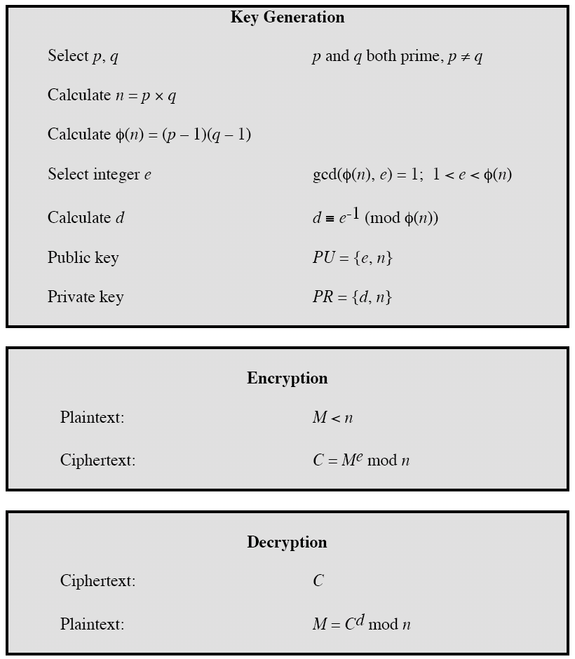
RSA Algorithm

Slide 16

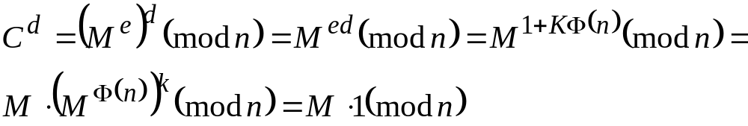
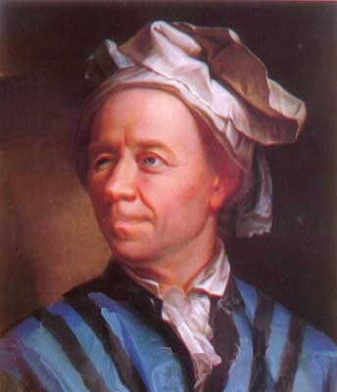
The RSA Algorithm
The correctness of the RSA algorithm follows from Euler's theorem, which in turn is an extension of Fermat's little theorem,
Euler’s Theorem: Let n and a be positive, relatively prime integers.
Then
Proof: Since we have ed=1mod Φ(n), we can write ed=1+K Φ(n), for some
integer K . Hence,
provided that gcd(M,n)=1.

Slide 17
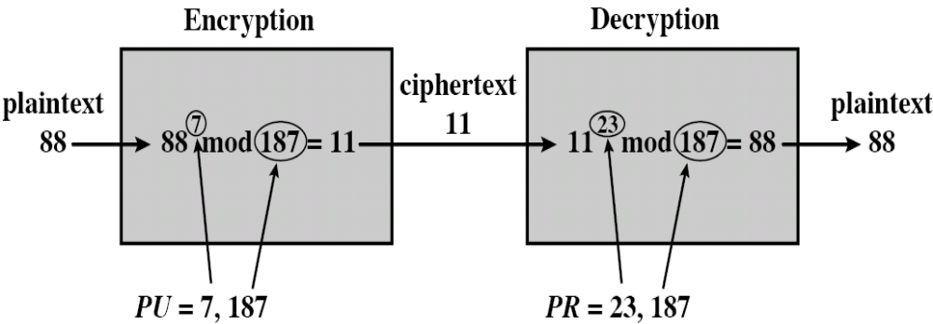
RSA Example
Select two primes, p = 17 and q = 11
Calculate n = pq = 17 × 11 = 187
Calculate φ(n) = (p-1)(q-1) = 16 × 10 = 160
Select e s.t. e is relatively prime to φ(n) and less than φ(n); in this case, e = 7
Determine d s.t. de ≡ 1 mod 160 and d < 160. The correct value is d = 23 (7 × 23 = 161 = 160 + 1)
PU = {7, 187}, PR = {23, 187}

Slide 18
Transposition Cipher
Easy to understand, but if properly used, produces ciphertext that is difficult to decipher
Rearranges values within a block to create ciphertext
Can be done at the bit level or at the byte (character) level
To make the encryption even stronger, the keys and block sizes can be made much larger
Principles of Information Security, Fourth Edition
Notes:
Transposition Cipher Method
The transposition cipher (or permutation cipher) simply rearranges the values within a block to create the ciphertext
This can be done at the bit level or at the byte (character) level. Transposition ciphers move these bits or bytes to another location in the block, so that bit 1 becomes bit 4, bit 2 becomes bit, 7 etc.

Slide 19
Exclusive OR (XOR)
Function of Boolean algebra; two bits are compared
  If two bits are identical, result is binary 0
  If two bits not identical, result is binary 1
A very simple symmetric cipher that is used in many applications where security is not a defined requirement
Principles of Information Security, Fourth Edition

Slide 20

Table 8-3 XOR Truth Table
Principles of Information Security, Fourth Edition

Slide 21
Vernam Cipher
Developed at AT&T
Uses set of characters once per encryption process
To perform:
  The pad values are added to numeric values that represent the plaintext that needs to be encrypted
  Each character of the plaintext is turned into a number and a pad value for that position is added
  The resulting sum for that character is then converted back to a ciphertext letter for transmission
  If the sum of the two values exceeds 26, then 26 is subtracted from the total
Principles of Information Security, Fourth Edition
Notes:
Vernam Cipher
Also known as the one-time pad, the Vernam cipher was developed at AT&T and uses a one-use set of characters, the value of which is added to the block of text.
The resulting sum is then converted to text.
When the two are added, if the values exceed 26, 26 is subtracted from the total (Modulo 26). The corresponding results are then converted back to text.

Slide 22
Book or Running Key Cipher
Uses text in book as key to decrypt a message
Ciphertext contains codes representing page, line, and word numbers
Algorithm is the mechanical process of:
  Looking up the references from the ciphertext
  Converting each reference to a word by using the ciphertext’s value and the key
Typical sources are dictionaries and thesauruses
Principles of Information Security, Fourth Edition

Slide 23
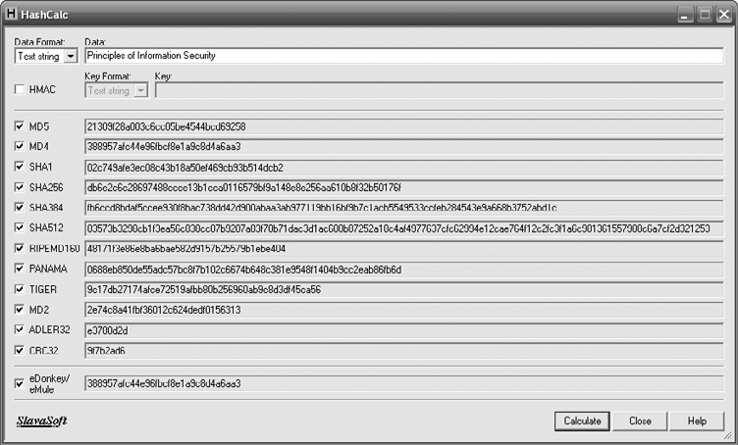
Figure 8-4 Various Hash Values
Principles of Information Security, Fourth Edition

Slide 24
Hash Functions
Mathematical algorithms that generate message summary/digest to confirm message identity and confirm no content has changed
Hash algorithms: publicly known functions that create hash value
Use of keys not required
  Message authentication code (MAC), however, may be attached to a message
Used in password verification systems to confirm identity of user
Principles of Information Security, Fourth Edition
Notes:
Hash Functions
Hash algorithms are publicly known functions that create a hash value, also known as a message digest, by converting variable-length messages into a single fixed-length value.
The message digest is a fingerprint of the author’s message that is to be compared with the receiver’s locally calculated hash of the same message.
Hashing functions do not require the use of keys, but a message authentication code (MAC), which is essentially a one-way hash value that is encrypted with a symmetric key. The recipients must possess the key to access the message digest and to confirm message integrity.

Slide 25
Cryptographic Algorithms
Often grouped into two broad categories, symmetric and asymmetric
  Today’s popular cryptosystems use hybrid combination of symmetric and asymmetric algorithms
Symmetric and asymmetric algorithms distinguished by types of keys used for encryption and decryption operations
Principles of Information Security, Fourth Edition
Notes:
Cryptographic Algorithms
In general, cryptographic algorithms are often grouped into two broad categories—symmetric and asymmetric—but in practice, today’s popular cryptosystems use a hybrid combination of symmetric and asymmetric algorithms.
Symmetric and asymmetric algorithms can be distinguished by the types of keys they use for encryption and decryption operations.

Slide 26
Symmetric Encryption
Uses same “secret key” to encipher and decipher message
  Encryption methods can be extremely efficient, requiring minimal processing
  Both sender and receiver must possess encryption key
  If either copy of key is compromised, an intermediate can decrypt and read messages
Principles of Information Security, Fourth Edition
Notes:
Symmetric Encryption
Symmetric encryption indicates that the same key, also known as a secret key, is used to conduct both the encryption and decryption of the message.
Symmetric encryption methods can be extremely efficient, requiring minimal processing to either encrypt or decrypt the message.
The problem is that both the sender and the receiver must own the encryption key.
If either copy of the key is compromised, an intermediate can decrypt and read the messages.
One of the challenges of symmetric key encryption is getting a copy of the key to the receiver, a process that must be conducted out-of-band to avoid interception.

Slide 27
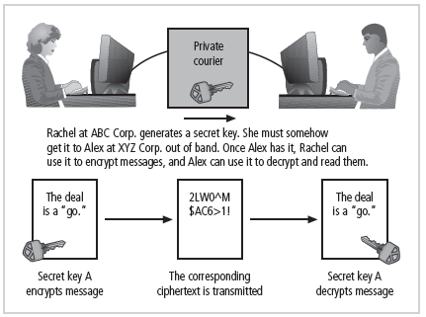
Figure 8-5 Example of Symmetric Encryption
Principles of Information Security, Fourth Edition

Slide 28
Symmetric Encryption (cont’d.)
Data Encryption Standard (DES): one of most popular symmetric encryption cryptosystems
  64-bit block size; 56-bit key
  Adopted by NIST in 1976 as federal standard for encrypting non-classified information
Triple DES (3DES): created to provide security far beyond DES
Advanced Encryption Standard (AES): developed to replace both DES and 3DES
Principles of Information Security, Fourth Edition
Notes:
There are a number of popular symmetric encryption cryptosystems.
One of the most familiar is Data Encryption Standard (DES), developed in 1977 by IBM and based on the Data Encryption Algorithm (DEA).
DEA uses a 64-bit block size and a 56-bit key. The algorithm begins by adding parity bits to the key (resulting in 64 bits) and then apples the key in 16 rounds of XOR, substitution, and transposition operations.
With a 56-bit key, the algorithm has 256 possible keys to choose from (over 72 quadrillion).
DES is a federally approved standard for non-classified data. DES was cracked in 1997 when Rivest-Shamir-Aldeman (RSA) put a bounty on the algorithm.
RSA offered a $10,000 reward for the first person or team to crack the algorithm. Fourteen thousand users collaborated over the Internet to finally break the encryption.

Slide 29
Asymmetric Encryption
Also known as public-key encryption
Uses two different but related keys
  Either key can encrypt or decrypt message
  If Key A encrypts message, only Key B can decrypt
  Highest value when one key serves as private key and the other serves as public key
RSA algorithm
Principles of Information Security, Fourth Edition
Notes:
Asymmetric Encryption
Another category of encryption techniques is asymmetric encryption, also known as public-key encryption.
Whereas the symmetric encryption systems are based on a single key to both encrypt and decrypt a message, asymmetric encryption uses two different keys.
Either key can be used to encrypt or decrypt the message. However, if Key A is used to encrypt the message, only Key B can decrypt, and if Key B is used to encrypt a message, only Key A can decrypt it.
The public key is stored in a public location, where anyone can use it.
The private key, as its name suggests, is a secret known only to the owner of the key pair.
The problem with asymmetric encryption is that it requires four keys to hold a single conversation between two parties.
Asymmetric encryption is not as efficient as symmetric encryptions in terms of CPU computations.
As a result, the hybrid system described in the section on Public Key Infrastructure is more commonly used, instead of a pure asymmetric system.

Slide 30
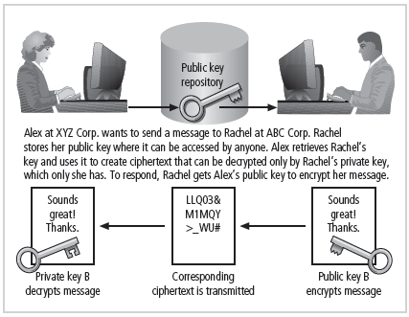
Figure 8-6 Example of Asymmetric Encryption
Principles of Information Security, Fourth Edition

Slide 31
Encryption Key Size
When using ciphers, size of cryptovariable or key is very important
Strength of many encryption applications and cryptosystems measured by key size
For cryptosystems, security of encrypted data is not dependent on keeping encrypting algorithm secret
Cryptosystem security depends on keeping some or all of elements of cryptovariable(s) or key(s) secret
Principles of Information Security, Fourth Edition
Notes:
Encryption Key Size
When using ciphers, one of the decisions that has to be made is the size of the cryptovariable or key. The strength of many encryption applications and cryptosystems is measured by key size.
When it comes to cryptosystems, the security of encrypted data is not dependent on keeping the encrypting algorithm secret; in fact, algorithms are often published, so that research to uncover their weaknesses can be done.
The security of any cryptosystem depends on keeping some or all of the elements of the cryptovariable(s) or key(s) secret.

Slide 32
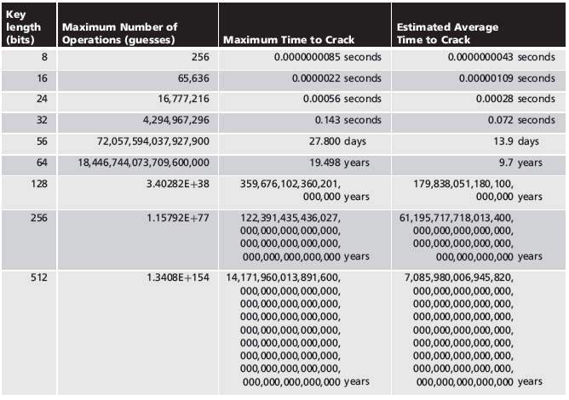
Table 8-7 Encryption Key Power
Principles of Information Security, Fourth Edition

Slide 33
Cryptographic Tools
Potential areas of use include:
  Ability to conceal the contents of sensitive messages
  Verify the contents of messages and the identities of their senders
Tools must embody cryptographic capabilities so that they can be applied to the everyday world of computing
Principles of Information Security, Fourth Edition

Slide 34
Public-Key Infrastructure (PKI)
Integrated system of software, encryption methodologies, protocols, legal agreements, and third-party services enabling users to communicate securely
PKI systems based on public-key cryptosystems
PKI protects information assets in several ways:
  Authentication
  Integrity
  Privacy
  Authorization
  Nonrepudiation
Principles of Information Security, Fourth Edition
Notes:
Cryptography Tools
Public Key Infrastructure (PKI) is an integrated system of software, encryption methodologies, protocols, legal agreements, and third-party services that enables users to communicate securely.
PKI systems are based on public-key cryptosystems and include digital certificates and certificate authorities (CAs).
PKI Protects Information Assets in Several Ways:
Authentication. Digital certificates in a PKI system permit parties to validate the identity of other parties in an Internet transaction.
Integrity. A digital certificate demonstrates that the content signed by the certificate has not been altered while being moved from server to client.
Privacy. Digital certificates keep information from being intercepted during transmission over the Internet.
Authorization. Digital certificates issued in a PKI environment can replace user IDs and passwords, enhance security, and reduce some of the overhead required for authorization processes and controlling access privileges.
Nonrepudiation. Digital certificates can validate actions, making it less likely that customers or partners can later repudiate a digitally signed transaction.

Slide 35
Public-Key Infrastructure (PKI) (cont’d.)
Typical PKI solution protects the transmission and reception of secure information by integrating:
  A certificate authority (CA)
  A registration authority (RA)
  Certificate directories
  Management protocols
  Policies and procedures
Principles of Information Security, Fourth Edition

Slide 36
Digital Signatures
Created in response to rising need to verify information transferred using electronic systems
Asymmetric encryption processes used to create digital signatures
Nonrepudiation: the process that verifies the message was sent by the sender and thus cannot be refuted
Digital Signature Standard (DSS)
Principles of Information Security, Fourth Edition
Notes:
Digital Signatures
An interesting thing happens when the asymmetric process is reversed, that is, the private key is used to encrypt a short message.
The public key can be used to decrypt it, and the fact that the message was sent by the organization that owns the private key cannot be refuted.
This is known as nonrepudiation, which is the foundation of digital signatures.
Digital signatures are encrypted messages that are independently verified by a central facility (registry) as authentic.

Slide 37
Digital Certificates
Electronic document containing key value and identifying information about entity that controls key
Digital signature attached to certificate’s container file to certify file is from entity it claims to be from
Different client-server applications use different types of digital certificates to accomplish their assigned functions
Distinguished name (DN): uniquely identifies a certificate entity
Principles of Information Security, Fourth Edition
Notes:
Digital Certificates and Certificate Authorities
As alluded to earlier, a digital certificate is an electronic document, similar to a digital signature, attached to a file certifying that this file is from the organization it claims to be from and has not been modified from the originating format.
A certificate authority is an agency that manages the issuance of certificates and serves as the electronic notary public to verify their worth and integrity.

Slide 38
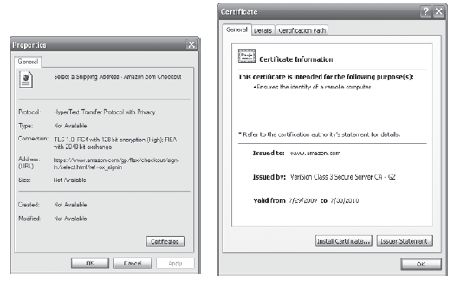
Figure 8-8 Digital Certificate
Principles of Information Security, Fourth Edition

Slide 39
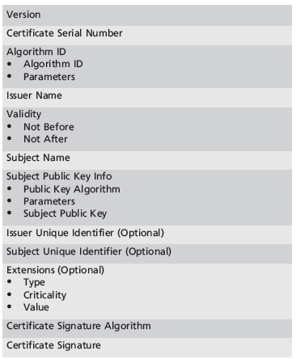
Table 8-8 X.509 v3 Certificate Structure¹¹
Principles of Information Security, Fourth Edition

Slide 40
Hybrid Cryptography Systems
Except with digital certificates, pure asymmetric key encryption not widely used
Asymmetric encryption more often used with symmetric key encryption, creating hybrid system
Diffie-Hellman Key Exchange method:
  Most common hybrid system
  Provided foundation for subsequent developments in public-key encryption
Principles of Information Security, Fourth Edition
Notes:
Hybrid Systems
In practice, asymmetric key encryption is not widely used except in the area of certificates. Instead, it is more often used in conjunction with symmetric key encryption creating a hybrid system.
The current process is based on the Diffie-Hellman Key Exchange method, which is a way to exchange private keys without exposure to any third parties using public key encryption.
With this method, asymmetric encryption is used as a method to exchange symmetric keys so that two organizations can conduct quick, efficient, secure communications based on symmetric encryption.
Diffie-Hellman provided the foundation for subsequent developments in public key encryption.

Slide 41
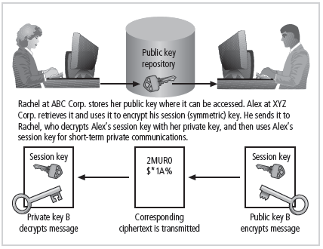
Figure 8-9 Example of Hybrid Encryption
Principles of Information Security, Fourth Edition

Slide 42
Steganography
Process of hiding information
Has been in use for a long time
Most popular modern version hides information within files appearing to contain digital pictures or other images
Some applications hide messages in .bmp, .wav, .mp3, and .au files, as well as in unused space on CDs and DVDs
Principles of Information Security, Fourth Edition
Notes:
Steganography
Steganography is a process of hiding information and has been in use for a long time.
The word “steganography” is derived from the Greek words steganos meaning “covered” and graphein meaning “to write.”
The most popular modern version of steganography involves hiding information within files that appear to contain digital pictures or other images.
Most computer graphics standards use a combination of three color values (red, blue, and green (RGB)) to represent a picture element, or pixel.
Each of the three color values usually requires an 8-bit code for that color’s intensity (e.g., 00000000 for no red and 11111111 for maximum red).
This inability to perceive difference on the part of humans provides the steganographer with one bit per color (or three bits per pixel) to use for encoding data into an image file.
Some applications are capable of hiding messages in .bmp, .wav, .mp3, and .au files, as well as in unused storage space on CDs and DVDs.

Slide 43
Protocols for Secure Communications
Much of the software currently used to protect the confidentiality of information are not true cryptosystems
They are applications to which cryptographic protocols have been added
Particularly true of Internet protocols
As the number of threats to the Internet grew, so did the need for additional security measures
Principles of Information Security, Fourth Edition

Slide 44
Securing Internet Communication with S-HTTP and SSL
Secure Socket Layer (SSL) protocol: uses public key encryption to secure channel over public Internet
Secure Hypertext Transfer Protocol (S-HTTP): extended version of Hypertext Transfer Protocol; provides for encryption of individual messages between client and server across Internet
S-HTTP is the application of SSL over HTTP
  Allows encryption of information passing between computers through protected and secure virtual connection
Principles of Information Security, Fourth Edition
Notes:
Securing the Web
Secure Electronic Transactions (SET) was developed by MasterCard and Visa in 1997 to provide protection from electronic payment fraud.
SET works by encrypting the credit card transfers with DES for encryption and RSA for key exchange, much as other algorithms do.
SET provides the security for both Internet-based credit card transactions and the encryption of swipe systems of those credit cards in retail stores.
Secure Socket Layer was developed by Netscape in 1994 to provide security in online electronic commerce transactions.
It uses a number of algorithms but mainly relies on RSA for key transfer and IDEA, DES, or 3DES for encrypted symmetric key-based data transfer.
Secure Hypertext Transfer Protocol (SHTTP) is an encrypted solution to the unsecured version of HTTP.
It provides an alternative to the aforementioned protocols and can provide secure e-commerce transactions as well as encrypted Web pages for secure data transfer over the Web, using a number of different algorithms.
Secure Shell (SSH) provides security over remote access connections using tunneling. It provides authentication services between a client and server.
IP Security (IPSec) is the cryptographic authentication and encryption product of the IETF’s IP Protocol Security Working Group, defined in RFC 1825, 1826 and 1827.
IP Security (IPSec) is used to create virtual private networks (VPNs) and is an open framework for security development within the TCP/IP family of protocol standards.

Slide 45
Securing e-mail with S/MIME, PEM, and PGP
Secure Multipurpose Internet Mail Extensions (S/MIME): builds on Multipurpose Internet Mail Extensions (MIME) encoding format by adding encryption and authentication
Privacy Enhanced Mail (PEM): proposed as standard to function with public-key cryptosystems; uses 3DES symmetric key encryption
Pretty Good Privacy (PGP): uses IDEA Cipher for message encoding
Principles of Information Security, Fourth Edition
Notes:
Securing E-mail
A number of encryption cryptosystems have been adapted in an attempt to inject some degree of security into e-mail, a notoriously unsecured medium.
S/MIME builds on the Multipurpose Internet Mail Extensions (MIME) encoding format by adding encryption and authentication through digital signatures based on public key cryptosystems.
Privacy Enhanced Mail (PEM) was proposed by the Internet Engineering Task Force (IETF) as a standard to function with the public-key cryptosystems.
PEM uses 3DES symmetric key encryption and RSA for key exchanges and digital signatures.
Pretty Good Privacy (PGP) was developed by Phil Zimmerman and uses the IDEA Cipher, a 128-bit symmetric key block encryption algorithm with 64-bit blocks for message encoding.
IDEA performs eight rounds on 16-bit sub-blocks using algebraic calculations.
PGP also uses RSA for symmetric key exchange and for digital signatures.

Slide 46
Securing Web transactions with SET, SSL, and S-HTTP
Secure Electronic Transactions (SET): developed by MasterCard and VISA in 1997 to provide protection from electronic payment fraud
Uses DES to encrypt credit card information transfers
Provides security for both Internet-based credit card transactions and credit card swipe systems in retail stores
Principles of Information Security, Fourth Edition
Notes:
Securing Web Transactions with SET, SSL, and S-HTTP
Just as PGP, PEM, and S/MIME work to secure e-mail operations, a number of related protocols work to secure Web browsers, especially at electronic commerce sites.
Among these are Secure Electronic Transactions (SET), Secure Socket Layer (SSL), Secure Hypertext Transfer Protocol (S-HTTP), Secure Shell (SSH-2), and IP Security (IPSec).
Secure Electronic Transactions (SET) was developed by MasterCard and VISA in 1997 to provide protection from electronic payment fraud.
SET uses DES to encrypt credit card information transfers and RSA for key exchange. SET provides the security for both Internet-based credit card transactions and credit card swipe systems in retail stores.

Slide 47
Securing Wireless Networks with WEP and WPA
Wired Equivalent Privacy (WEP): early attempt to provide security with the 8002.11 network protocol
Wi-Fi Protected Access (WPA and WPA2): created to resolve issues with WEP
Next Generation Wireless Protocols: Robust Secure Networks (RSN), AES – Counter Mode Encapsulation, AES – Offset Codebook Encapsulation
Bluetooth: can be exploited by anyone within approximately 30 foot range, unless suitable security controls are implemented
Principles of Information Security, Fourth Edition

Slide 48
Protocols for Secure Communications (continued)
Securing TCP/IP with IPSec
  Internet Protocol Security (IPSec): open source protocol to secure communications across any IP-based network
  IPSec designed to protect data integrity, user confidentiality, and authenticity at IP packet level
  IPSec combines several different cryptosystems: Diffie-Hellman; public key cryptography; bulk encryption algorithms; digital certificates
  In IPSec, IP layer security obtained by use of application header (AH) protocol or encapsulating security payload (ESP) protocol
Principles of Information Security, Fourth Edition
Notes:
IPSec
IPSec combines several different cryptosystems including:
Diffie-Hellman key exchange for deriving key material between peers on a public network
Public-key cryptography for signing the Diffie-Hellman exchanges to guarantee the identity of the two parties
Bulk encryption algorithms, such as DES, for encrypting the data
Digital certificates signed by a certificate authority to act as digital ID cards.
IPSec includes:
1) The IP Security Protocol itself, which defines the information to add to an IP packet, as well as how to encrypt packet data
2) The Internet Key Exchange, which uses asymmetric-based key exchange and negotiates the security associations.

Slide 49
Securing TCP/IP with IPSec and PGP
Internet Protocol Security (IPSec): an open-source protocol framework for security development within the TCP/IP family of protocol standards
IPSec uses several different cryptosystems
  Diffie-Hellman key exchange for deriving key material between peers on a public network
  Public key cryptography for signing the Diffie-Hellman exchanges to guarantees identity
  Bulk encryption algorithms for encrypting the data
  Digital certificates signed by a certificate authority to act as digital ID cards
Principles of Information Security, Fourth Edition

Slide 50
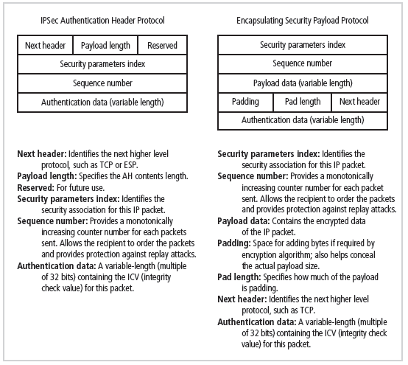
Figure 8-10 IPSec Headers
Principles of Information Security, Fourth Edition

Slide 51
Securing TCP/IP with IPSec and PGP (cont’d.)
Pretty Good Privacy (PGP): hybrid cryptosystem designed in 1991 by Phil Zimmermann
  Combined best available cryptographic algorithms to become open source de facto standard for encryption and authentication of e-mail and file storage applications
  Freeware and low-cost commercial PGP versions are available for many platforms
  PGP security solution provides six services: authentication by digital signatures; message encryption; compression; e-mail compatibility; segmentation; key management
Principles of Information Security, Fourth Edition
Notes:
PGP
Pretty Good Privacy (PGP) is a hybrid cryptosystem originally designed in 1991 by Phil Zimmermann.
PGP combined some of the best available cryptographic algorithms to become the open source de facto standard for encryption and authentication of e-mail and file storage applications.
Both freeware and low-cost commercial versions of PGP are available for a wide variety of platforms.
The PGP security solution provides six services: authentication by digital signatures, message encryption, compression, e-mail compatibility, segmentation, and key management.

Slide 52
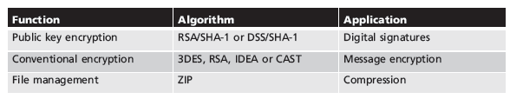
Table 8-12 PGP Functions²⁴
Principles of Information Security, Fourth Edition

Slide 53
Attacks on Cryptosystems
Attempts to gain unauthorized access to secure communications have used brute force attacks (ciphertext attacks)
Attacker may alternatively conduct known-plaintext attack or selected-plaintext attach schemes
Principles of Information Security, Fourth Edition
Notes:
Attacks on Cryptosystems
Historically, attempts to gain unauthorized access to secure communications have used brute force attacks.
Ciphertext attacks involve a hacker searching for a common text structure, wording, or syntax in the encrypted message that can enable him or her to calculate the number of each type of letter used in the message.
Frequency analysis can be used along with published frequency of occurrence patterns of various languages and can allow an experienced attacker to crack almost any code quickly if the individual has a large enough sample of the encoded text.
To protect against this, modern algorithms attempt to remove the repetitive and predictable sequences of characters from the ciphertext.
Occasionally, an attacker may obtain duplicate texts, one in ciphertext and one in plaintext, which enable the individual to reverse-engineer the encryption algorithm in a known-plaintext attack scheme.
Alternatively, an attacker may conduct a selected-plaintext attack by sending the potential victim a specific text that they are sure the victim will forward on to others.

Slide 54
Man-in-the-Middle Attack
Designed to intercept transmission of public key or insert known key structure in place of requested public key
From victim’s perspective, encrypted communication appears to be occurring normally, but in fact, attacker receives each encrypted message, decodes, encrypts, and sends to originally intended recipient
Establishment of public keys with digital signatures can prevent traditional man-in-the-middle attack
Principles of Information Security, Fourth Edition
Notes:
Man-in-the-Middle Attack
A man-in-the-middle attack is designed to intercept the transmission of a public key or even to insert a known key structure in place of the requested public key.
From the perspective of the victims of such attacks, their encrypted communication appears to be occurring normally, but in fact the attacker is receiving each encrypted message and decoding it and then encrypting and sending it to the originally intended recipient.
Establishment of public keys with digital signatures can prevent the traditional man-in-the-middle attack, as the attacker cannot duplicate the signatures.

Slide 55
Correlation Attacks
Collection of brute-force methods that attempt to deduce statistical relationships between structure of unknown key and ciphertext
Differential and linear cryptanalysis have been used to mount successful attacks
Only defense is selection of strong cryptosystems, thorough key management, and strict adherence to best practices of cryptography in frequency of changing keys
Principles of Information Security, Fourth Edition
Notes:
Correlation Attacks
Correlation attacks are a collection of brute-force methods that attempt to deduce statistical relationships between the structure of the unknown key and the ciphertext that is the output of the cryptosystem.
Differential and linear cryptanalysis, both of which are advanced methods of breaking codes, have been used to mount successful attacks on block cipher encryptions such as DES.
The only defense against this kind of attack is the selection of strong cryptosystems that have stood the test of time, thorough key management, and strict adherence to the best practices of cryptography in the frequency of changing keys.

Slide 56
Dictionary Attacks
Attacker encrypts every word in a dictionary using same cryptosystem used by target
Dictionary attacks can be successful when the ciphertext consists of relatively few characters (e.g., usernames, passwords)
Principles of Information Security, Fourth Edition
Notes:
Dictionary Attacks
In a dictionary attack, the attacker encrypts every word in a dictionary using the same cryptosystem as used by the target.
Dictionary attacks can be successful when the ciphertext consists of relatively few characters, as for example files that contain encrypted usernames and passwords.
After a match is located, the attacker has essentially identified a potential valid password for the system under attack.

Slide 57
Timing Attacks
Attacker eavesdrops during victim’s session
  Uses statistical analysis of user’s typing patterns and inter-keystroke timings to discern sensitive session information
Can be used to gain information about encryption key and possibly cryptosystem in use
Once encryption successfully broken, attacker may launch a replay attack (an attempt to resubmit recording of deciphered authentication to gain entry into secure source)
Principles of Information Security, Fourth Edition
Notes:
Timing Attacks
In a timing attack, the attacker eavesdrops during the victim’s session and uses statistical analysis of the user’s typing patterns and inter-keystroke timings to discern sensitive session information.
While timing analysis may not directly result in the decryption of sensitive data, it can be used to gain information about the encryption key and perhaps the cryptosystem in use.
Once the attacker has successfully broken an encryption, he or she may launch a replay attack, which is an attempt to resubmit a recording of the deciphered authentication to gain entry into a secure source.

Slide 58
Defending Against Attacks
No matter how sophisticated encryption and cryptosystems have become, if key is discovered, message can be determined
Key management is not so much management of technology but rather management of people
Principles of Information Security, Fourth Edition
Notes:
Defending From Attacks
No matter how sophisticated encryption and cryptosystems have become, however, they have retained the same flaw that the first systems contained thousands of years ago: if you discover the key, you can determine the message.
Thus, key management is not so much the management of technology but rather the management of people.

Slide 59
Summary
Cryptography and encryption provide sophisticated approach to security
  Many security-related tools use embedded encryption technologies
  Encryption converts a message into a form that is unreadable by the unauthorized
Many tools are available and can be classified as symmetric or asymmetric, each having advantages and special capabilities
Principles of Information Security, Fourth Edition

Slide 60
Summary (cont’d.)
Strength of encryption tool is dependent on key size but even more dependent on following good management practices
Cryptography is used to secure most aspects of Internet and Web uses that require it, drawing on extensive set of protocols and tools designed for that purpose
Cryptosystems are subject to attack in many ways
Principles of Information Security, Fourth Edition

