Slide 1
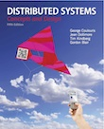
Slides for Chapter 1
Characterization of Distributed Systems
From Coulouris, Dollimore, Kindberg and Blair
Distributed Systems:
Concepts and Design
Edition 5, © Addison-Wesley 2015

Slide 2
Distributed Systems (Introduction)
Definition: A distributed system is one in which components (software/hardware) located at networked computers communicate and coordinate their actions only by-passing messages. [Coulouris]
Definition: It is a collection of autonomous computers linked by a computer networks and equipped with distributed systems software (middleware).
Definition: A distributed system is a collection of independent computers that appear to the users of the system as a single computer. [Andrew Tanenbaum]
Definition: A distributed system is several computers doing something together. Thus, a distributed system has three primary characteristics: multiple computers, interconnections, and shared state. [Michael Schroeder]

Slide 3
Distributed Systems (Introduction)
e.g., the Internet and the associated World Wide Web, web search, online gaming, financial trading systems, email, social networks, eCommerce, etc.
The sharing of resources is a main motivation for constructing D.S. Resources may be managed by servers & accessed by clients or they may be encapsulated as objects and accessed by other client objects.

Slide 4
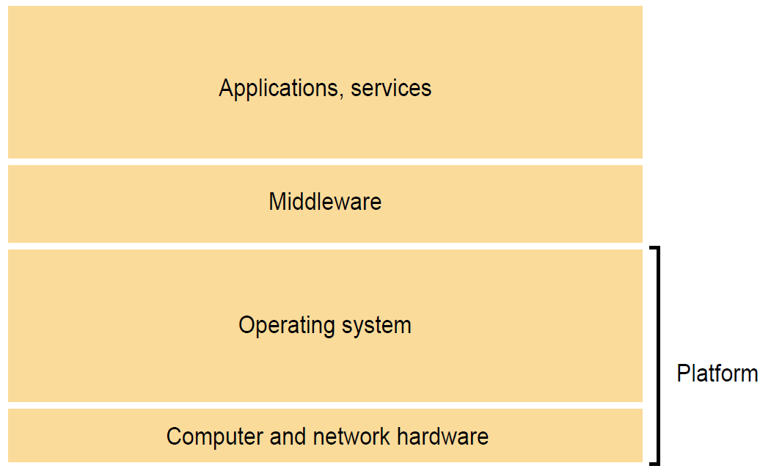
Figure 2.7
Software and hardware service layers in distributed systems
To solving the problems of heterogeneity, middleware provides a uniform computational model for use by the programmers of servers and distributed applications. The term middleware applies to a software layer that provides a programming abstraction as well as masking the heterogeneity of the underlying networks, hardware, operating systems and programming languages. The Common Object Request Broker (CORBA), Java RMI etc.

Slide 5
Distributed Systems (Introduction)
The challenges arising from the construction of distributed systems are the heterogeneity (variety & differences) of their components, openness (which allows components to be added or replaced), security, scalability – the ability to work well when the load or the number of users increases – failure handling, concurrency of components, transparency and providing quality of service.
Heterogeneity – networks, computer hardware, OS, PL, implementations by different developers

Slide 6
Fig. 1.1 (see book for the full text) Uses of Distributed Systems Technology:
Selected application domains and associated networked applications
Finance and commerce | eCommerce e.g. Amazon and eBay, PayPal, online banking and trading
The information society | Web information and search engines, ebooks, Wikipedia; social networking: Facebook and MySpace.
Creative industries and entertainment | online gaming, music and film in the home, user-generated content, e.g. YouTube, Flickr
Healthcare | health informatics, on online patient records, monitoring patients
Education | e-learning, virtual learning environments; distance learning
Transport and logistics | GPS in route finding systems, map services: Google Maps, Google Earth
Science | The Grid as an enabling technology for collaboration between scientists
Environmental management | sensor technology to monitor earthquakes, floods or tsunamis

Slide 7
Distributed Systems - Challenges
Heterogeneity: Heterogeneity (that is, variety and difference) applies to all of the following:
• networks
• computer hardware
• operating systems
• programming languages
• implementations by different developers
Notes:
Networks: For example, a computer attached to an Ethernet has an implementation of the Internet protocols over the Ethernet, whereas a computer on a different sort of network will need an implementation of the Internet protocols for that network (i.e., Token Ring).
Computer Hardware: Data types such as integers may be represented in different ways on different sorts of hardware
OS: Unix or Windows
PL: Different programming languages use different representations for characters and data structures such as arrays and records.

Slide 8
Distributed Systems - Challenges
Openness: that determines whether the system can be extended and reimplemented in various ways
new resource-sharing services can be added and be made available for use by a variety of client programs
needs specification and documentation of the key software interfaces of the components of a system are made available to software developers
a uniform communication mechanism and published interfaces for access to shared resources.
Notes:
By Ali Ahmed:
Resource Sharing: new services can be added and used by different programs
Documentation: software interfaces need clear documentation for developers
Communication: communication mechanism

Slide 9
Distributed Systems - Challenges
Security: Security for information resources has three components: confidentiality (protection against disclosure to unauthorized individuals), integrity (protection against alteration or corruption), and availability (protection against
interference with the means to access the resources - fairness).
Denial of service attacks: Another security problem is that a user may wish to disrupt a service for some reason. A large number of pointless requests that the serious users are unable to use it
Security of mobile code: Mobile code needs to be handled with care. An executable program as email attachment - the possible effects of running the program are unpredictable, it may seem to display an interesting picture but in reality it may access local resources
Notes:
By Ali Ahmed:
Components of Security: CIA
Confidentiality: Confidentiality ensures that only authorized individuals have access.
Integrity: Integrity protects information resources from being altered or corrupted.
Availability: It’s like making sure everyone gets a fair chance to use them.
DoS attack:

Slide 10
Distributed Systems - Challenges
Scalability: A system is described as scalable if it will remain effective when there is a significant increase in the number of resources and the number of users. The number of computers and servers in the Internet has increased dramatically.
Controlling the cost of physical resources
Controlling the performance loss
Preventing software resources running out: An example of lack of scalability is shown by the numbers used as Internet (IP) addresses (32bit to 128bit)

Slide 11
Figure 1.6: Growth of the Internet (computers and web servers)
Date
Computers
Web servers
Percentage
1993, July
1,776,000
130
0.008
1995, July
6,642,000
23,500
0.4
1997, July
19,540,000
1,203,096
6
1999, July
56,218,000
6,598,697
12
2001, July
125,888,197
31,299,592
25
2003, July
~200,000,000
42,298,371
21
2005, July
353,284,187
67,571,581
19

Slide 12
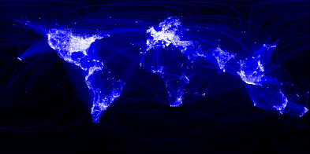
Which is a Distributed System – (A) or (B)?
(A)
(A) Facebook Social Network Graph among humans
Source: https://www.facebook.com/note.php?note_id=469716398919

Slide 13
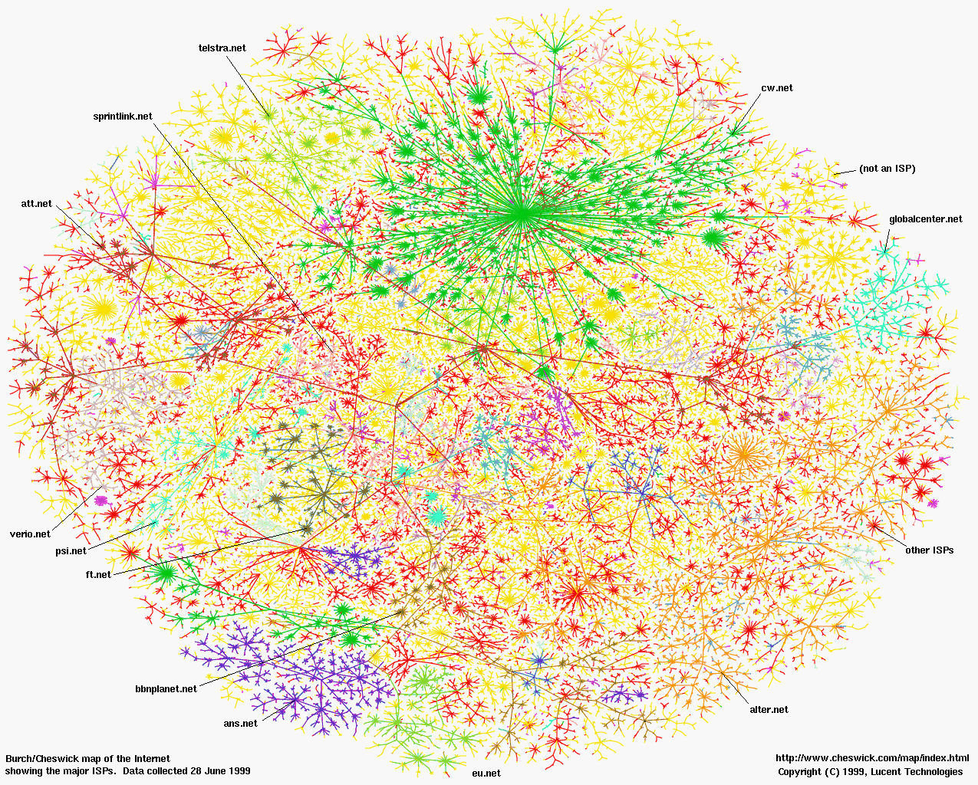
(B)
(B) The Internet (Internet Mapping Project, color coded by ISPs)

Slide 14
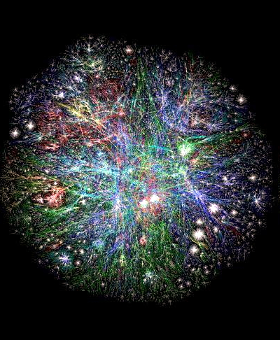
Distributed System Example – Web domains
What are the “entities”
(nodes)?
What is the
communication medium
(links)?
Source: http://www.vlib.us/web/worldwideweb3d.html

Slide 15
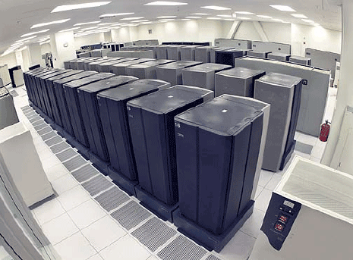
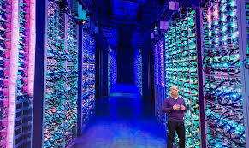
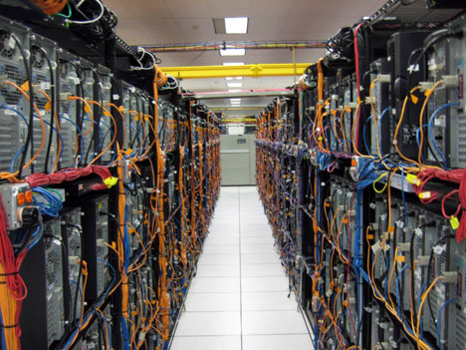
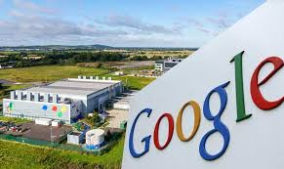
Distributed System Example – A Datacenter

Slide 16
Distributed Systems - Challenges
Failure Handling: Computer systems sometimes fail. When faults occur in hardware or software, programs may produce incorrect results or may stop before they have completed the intended computation.
Detecting failures: Some failures can be detected. For example, checksums can be used to detect corrupted data in a message or a file
Masking failures: i) Messages can be retransmitted when they fail to arrive, ii) File data can be written to a pair of disks so that if one is corrupted, the other may still be correct
Recovery from failures: Recovery involves the design of software so that the state of permanent data can be recovered or ‘rolled back’ after a server has crashed
Redundancy: Services can be made to tolerate failures by the use of redundant components; i) Two different routes between any two routers in the Internet; ii) In the DNS, every name table is replicated in at least two different servers; iii) A database may be replicated in several servers to ensure that the data remains accessible after the failure of any single server

Slide 17
Distributed Systems - Challenges
Concurrency: Both services and applications provide resources that can be shared by clients in a distributed system. The services and applications generally allow multiple client requests to be processed concurrently.
There is therefore a possibility that several clients will attempt to access a shared resource at the same time.
For an object to be safe in a concurrent environment, its operations must be synchronized in such a way that its data remains consistent. Therefore, concurrency is another challenges, however, it is useful in multicore, multiprocessor and distributed computer systems:
Increased performance from true parallelism
Increased reliability (fault tolerance)
Specialized processors (graphics, communication, encryption ...)
Some applications, like email, are inherently distributed

Slide 18
Distributed Systems - Challenges
Transparency:
It means that any form of distributed system should hide its distributed nature from its users, appearing and functioning as a normal centralized system.
Transparency is defined as the concealment (hiding) from the user and the application programmer of the separation of components in a distributed system, so that the system is perceived as a whole rather than as a collection of independent components.
The two most important transparencies are access and location transparency; their presence or absence most strongly affects the utilization of distributed resources.

Slide 19
Distributed Systems - Challenges
Access transparency: enables local & remote resources to be accessed using identical operations (GUI with folders, which is same whether the files inside the folder are local or remote)
Location transparency: enables resources to be accessed without knowledge of their physical or network location (for example, which building or IP address).
Concurrency transparency: enables several processes to operate concurrently using shared resources without interference between them.
Replication transparency: enables multiple instances of resources to be used to increase reliability and performance without knowledge of the replicas by users or application programmers.
Failure transparency: enables the concealment of faults, allowing users and application programs to complete their tasks despite the failure of hardware or software components.
Mobility transparency: allows the movement of resources and clients within a system without affecting the operation of users or programs.
Performance transparency: allows the system to be reconfigured to improve performance as loads vary.
Scaling transparency: allows the system and applications to expand in scale without change to the system structure or the application algorithms.
Notes:
By Ali Ahmed:
Access transparency ensures that we can access both local and remote resources using identical operations (like opening folders).
Location transparency allows us to access resources without knowing their physical or network location.
Concurrency transparency allows several processes to operate concurrently using shared resources without interfering with one another.
Replication transparency ensures that multiple instances of resources (like databases) exist for improved reliability and performance.
Failure transparency conceals faults (hardware or software failures) from users and applications.
Mobility transparency allows resources and clients to move within a system without affecting users or programs.
Performance transparency allows the system to reconfigure itself to improve performance as loads vary.
Scaling transparency allows the system and applications to grow in scale (handle more users or data) without changing the fundamental system design or application algorithms

Slide 20
Distributed Systems - Challenges
We use the term service for a distinct part of a computer system that manages a collection of related resources and presents their functionality to users and applications, e.g., we access shared files through a file service; we send documents to printers through a printing service; we buy goods through an electronic payment service.
The only access we have to the service is via the set of operations that it exports. e.g., a file service provides read, write and delete operations on files.
The term server is probably familiar to most readers. It refers to a running program (a process) on a networked computer that accepts requests from programs running on other computers to perform a service and responds appropriately. The requesting processes are referred to as clients, and the overall approach is known as client-server computing.
In this approach, requests are sent in messages from clients to a server and replies are sent in messages from the server to the clients. When the client sends a request for an operation to be carried out, we say that the client invokes an operation upon the server. A complete interaction between a client and a server, from the point when the client sends its request to when it receives the server’s response, is called a remote invocation.

Slide 21
Characteristics of Distributed Systems (cont.)
No global clock: When programs need to cooperate, they coordinate their actions by exchanging messages. Close coordination often depends on a shared idea of the time at which the programs’ actions occur. But it turns out that there are limits to the accuracy with which the computers in a network can synchronize their clocks – there is no single global notion of the correct time. This is a direct consequence of the fact that the only communication is by sending messages through a network.

Slide 22
Distributed Systems (Examples & Trends)
We now look at more specific examples of distributed systems to further illustrate the diversity and indeed complexity of distributed systems provision today:
Web Search
Pervasive networking and the modern Internet
Mobile and ubiquitous computing
Massively multiplayer online games (MMOGs)
Financial Trading
Notes:
Pervasive: Universal or Ubiqoutious

Slide 23
Distributed Systems (Examples)
Web Search: has emerged as a major growth industry in the last decade and global number of searches has risen to over 10 billion per calendar month
task of a web search engine is to index the entire contents of the World Wide Web, web pages, multimedia sources, books etc
Google, the market leader in web search technology has put significant effort into the design of a sophisticated distributed system infrastructure to support search (and Google Earth)
very large numbers of networked computers located at data centres all around the world
very large parallel and distributed computations/storage system that offers fast access to very large datasets

Slide 24
Distributed System Example – A Datacenter

Slide 25
Distributed Systems (Examples)
Pervasive networking and the modern Internet
The modern Internet is a vast interconnected collection of computer networks of many different types - WiFi, WiMAX, Bluetooth and 3G/4G mobile phone networks.
Programs running on the Computers connected to it interact by passing messages, employing a common means of communication.
Internet enables users, wherever they are, to make use of services such as the www, email and file transfer.
Intranets – subnetworks operated by companies and other organizations and typically protected by firewalls (preventing unauthorized messages from leaving or entering).
The intranets are linked together by backbones. A backbone is a network link with a high transmission capacity, employing satellite connections, fibre optic cables and other high-bandwidth circuits.
Notes:
Pervasive: Universal or Ubiquitous

Slide 26
Figure 1.3: A typical portion of the Internet
intranet
☎
ISP
☎
☎
☎
backbone
satellite link
desktop computer:
server:
network link:

Slide 27
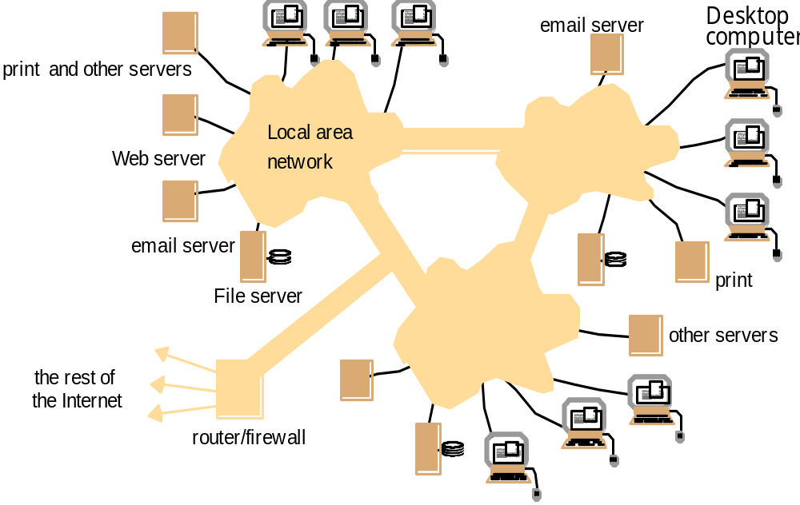
An Intranet and a distributed system over it
Running over this Intranet is a distributed file system
What are the “entities”
(nodes) in it?
What is the
communication medium?
Police, military and other security and law enforcement agencies
prevents unauthorized messages from leaving/entering;
implemented by filtering incoming and outgoing messages

Slide 28
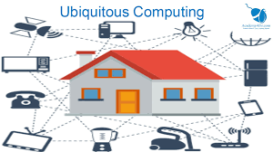
Distributed Systems (Examples)
Mobile and ubiquitous computing: Ubiquitous computing - connecting the many small, cheap computational devices that are present in users’ physical environments, including the home, office etc. a concept where computing is made to appear anytime & everywhere, in contrast to desktop computing it can occur using any device/any location/any format.
Laptop computers, Handheld devices - including mobile phones, smart phones, GPS-enabled devices, pagers, personal digital assistants (PDAs), video/digital cameras & smart watches.
Devices embedded in appliances such
as washing machines, hi-fi systems,
cars and refrigerators

Slide 29
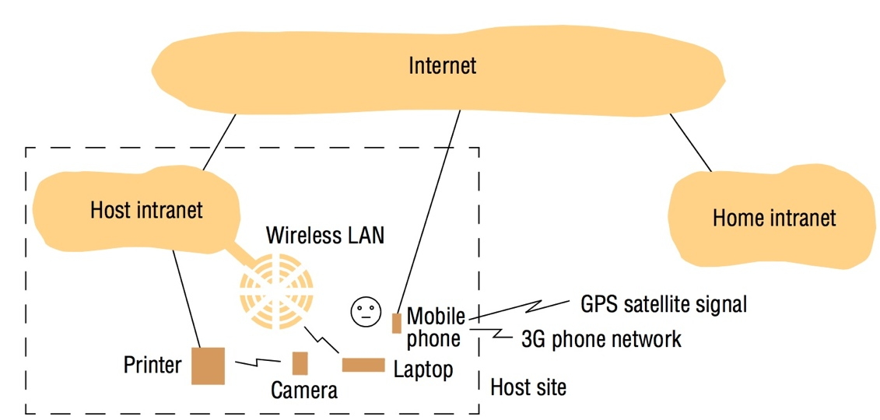
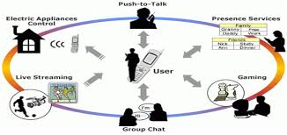
Figure 1.4: Portable and handheld devices in a distributed system
User visiting a host organization - user’s home intranet and
the host intranet at the site that the user
is visiting. Both intranets are connected to the rest of the Internet.
access to three forms of wireless connection
Notes:
The user has access to three forms of wireless connection. Their laptop has a means of connecting to the host’s wireless LAN. This network provides coverage of a few hundred metres (a floor of a building, say). It connects to the rest of the host intranet via a gateway or access point.
The user also has a mobile (cellular) telephone, which is connected to the Internet. The phone gives access to the Web and other Internet services.
Also the user carries a digital camera, which can communicate over a personal area wireless network (with range up to about 10m) with a device such as a printer.

Slide 30
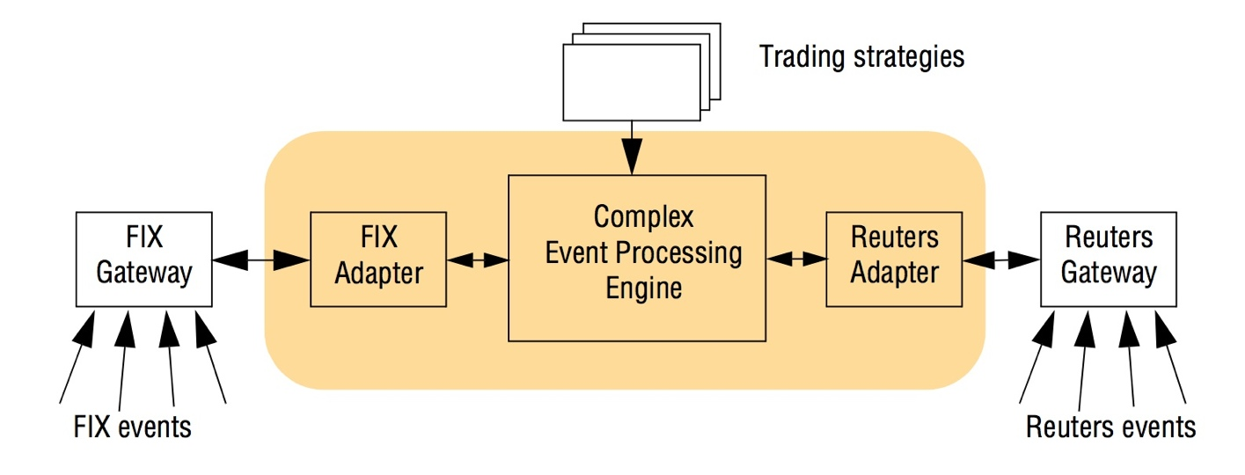
Distributed Systems (Examples)
Financial Trading
the sources are typically in a variety of formats, such as Reuters market data events and FIX events (events following the specific format of
the Financial Information eXchange protocol)
use of adapters which translate heterogeneous formats into a common internal format
Fig. 1.2: An example financial trading system

Slide 31
Distributed Systems are layered over networks
Application
layer protocol
smtp [RFC 821]
telnet [RFC 854]
http [RFC 2068]
ftp [RFC 959]
proprietary
(e.g. RealNetworks)
NFS-network file system
proprietary
(e.g., Skype)
Underlying
transport protocol
TCP
TCP
TCP
TCP
TCP or UDP
TCP or UDP
typically UDP
Application
e-mail
remote terminal access
Web
file transfer
streaming multimedia
remote file server
Internet telephony
TCP=Transmission Control Protocol
UDP=User Datagram Protocol
Distributed System Protocols!
e.g. SMTP- Simple Mail Transfer Protocol
Networking Protocols

Slide 32

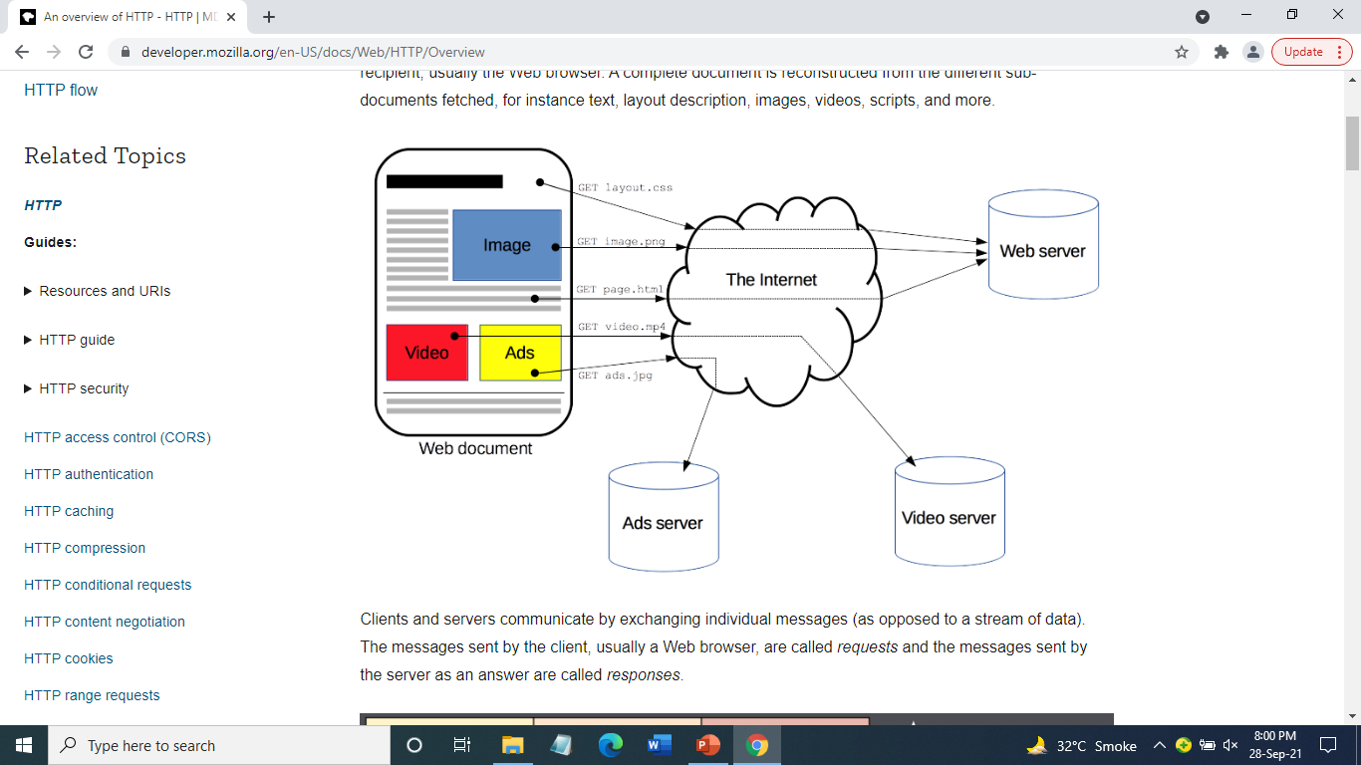
The Secret of the World Wide Web: the HTTP Standard
http request
HTTP: hypertext transfer protocol
WWW’s application layer protocol
client/server model
  client: browser that requests, receives, and “displays” WWW objects
  server: WWW server, which is storing the website, sends objects in response to requests
http1.0: RFC 1945
http1.1: RFC 2068
  Leverages same connection to download images, scripts, etc.
PC running
Explorer
http response
http request
Server
Running
Apache
Web
server
Mac running
Safari
http response

Slide 33
The HTTP Protocol: More
http: TCP transport service:
client initiates a TCP connection (creates socket) to server, port 80
server accepts the TCP connection from client
http messages (application-layer protocol messages) exchanged between browser (http client) and WWW server (http server)
TCP connection closed
http is “stateless”
server maintains no information about past client requests
Why?
Protocols that maintain session “state” are complex!
past history (state) must be maintained and updated.
if server/client crashes, their views of “state” may be inconsistent, and hence must be reconciled.
RESTful protocols are stateless.

Slide 34
HTTP Example
Suppose user enters URL www.cs.uiuc.edu/
(contains text,
references to 10
jpeg images)
1a. http client initiates a TCP connection to http server (process) at www.cs.uiuc.edu. Port 80 is default for http server.
1b. http server at host www.cs.uiuc.edu waiting for a TCP connection at port 80. “accepts” connection, notifying client
2. http client sends a http request message (containing URL) into TCP connection socket
3. http server receives request messages, forms a response message containing requested object (index.html), sends message into socket
time

Slide 35
HTTP Example (cont.)
4. http server closes the TCP connection (if necessary).
5. http client receives a response message containing html file, displays html, Parses html file, finds 10 referenced jpeg objects
6. Steps 1-5 are then repeated for each of 10 jpeg objects
time
For fetching referenced objects, have 2 options:
non-persistent connection: only one object fetched per TCP connection
  some browsers create multiple TCP connections simultaneously - one per object
persistent connection: multiple objects transferred within one TCP connection

Slide 36
A human as a browser (Client Side)
1. Telnet to your favorite WWW server:
telnet www.google.com 80
Opens TCP connection to port 80
(default http server port) at www.google.com
Anything typed in sent
to port 80 at www.google.com
2. Type in a GET http request:
GET /index.html
Or
GET /index.html HTTP/1.0
By typing this in (may need to hit
return twice), you send
this minimal (but complete)
GET request to http server
3. Look at response message sent by http server!
What do you think the response is?

Slide 37
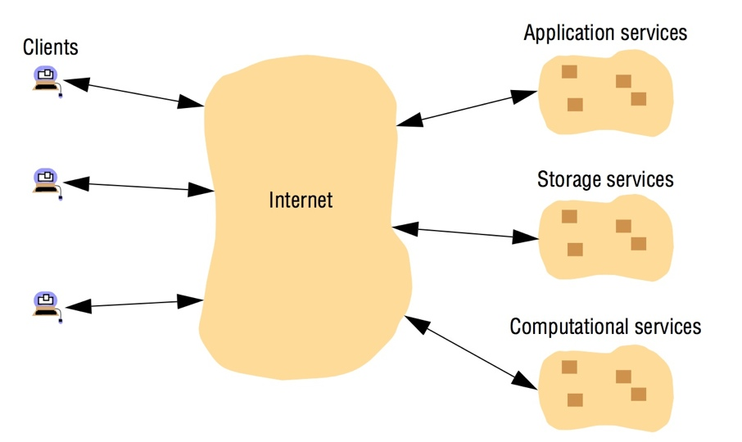
Distributed computing as a utility – Cloud Computing
The term cloud computing is used to capture this vision of computing as a utility. A cloud is defined as a set of Internet-based application, storage and computing services sufficient to support most users’ needs, thus enabling them to largely or totally distribute with local data storage and application software.

Slide 38
What is cloud computing, in simple terms?
Cloud computing is the delivery of on-demand computing services -- from applications to storage and processing power -- typically over the internet and on a pay-as-you-go basis
Rather than owning their own computing infrastructure or data centers, companies can rent access to anything from applications to storage from a cloud service provider
One benefit of using cloud computing services is that firms can avoid the upfront cost and complexity of owning and maintaining their own IT infrastructure, and instead simply pay for what they use, when they use it
In turn, providers of cloud computing services can benefit from significant economies of scale by delivering the same services to a wide range of customers, which includes consumer services like Gmail or the cloud back-up of the photos on your smartphone

Slide 39
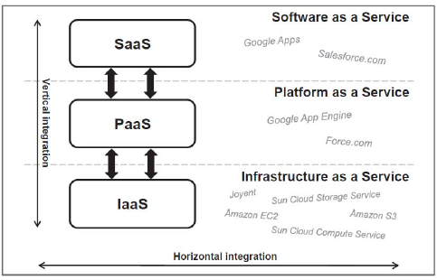
Services Models – Cloud Computing
SaaS is a way in which a software is carried as on demand application over Internet. Instead of installing it on the computer it can be accessed and utilized over Internet makes us free from Complex software
PaaS provides an environment for development as a service & used by users to run and deploy application. Different providers make their own tools which are used by other users to develop their own program. These programs are provided to the users through internet
IaaS provides infrastructure which is used by client (it can be storage, Network and firewalls). IaaS provides multiple resources like load balancer, virtual Local area network, IP address and software bundles
Notes:
Users don’t need worry about how much memory is used for the execution of software.
It provides a complete platform to develop software.

Slide 40
Figure 7: Web servers and web browsers
Web servers
Browsers
http://www.google.comlsearch?q=obama
www.google.com
www.cdk5.net
Internet
http://www.cdk5.net/
www.w3c.org
File system of
http://www.w3.org/standards/faq.html#conformance
www.w3c.org
standards
faq.html

