Slide 1

Slides for Chapter 2:
System Models - Architectural Models…
From Coulouris, Dollimore, Kindberg and Blair
Distributed Systems:
Concepts and Design
Edition 5, © Addison-Wesley 2015

Slide 2
System Models
The design of distributed systems can usefully be described/discussed in terms of 3-Modles:
Physical Model –Physical models consider the types of computers and devices that constitute a system and their interconnectivity, without details of specific technologies.
Architectural Model –An architectural model of a DS is concerned with the placement of its parts & relationships b/w them. It describe a system in terms of the computational and communication tasks performed by its computational elements; the computational elements being individual computers or aggregates of them supported by appropriate network interconnections. Client-server and peer-to-peer are two of the most commonly used forms of architectural model for DS.
Fundamental Model –take an abstract perspective in order to examine individual aspects of a DS: interaction models - which consider the structure and sequencing of the communication b/w the elements of system; failure models - which consider the ways in which a system may fail to operate correctly; security models - which consider how system is protected against attempts to interfere with its correct operation or to steal its data.
Notes:
Fundamental Model – basic issues for any network or system basic requirements, fundamentals things like performance, security, failure or Error
By Ali Ahmed
Physical Model: Physical model focuses on the types of computers and devices in the system and how they’re connected.
Architectural Model: Architectural Model describes how parts of the DS are placed and interact. It’s like arranging furniture in a room. Commonly used architectural model for DS:
Client Server
Peer to peer
Fundamental Model: Fundamental Model is the abstract perspective. It’s like looking at DS from a distance.
Interaction Models: How elements communicate.
Failure Models: What can go wrong.
Security Models: Protecting against bad guys.

Slide 3
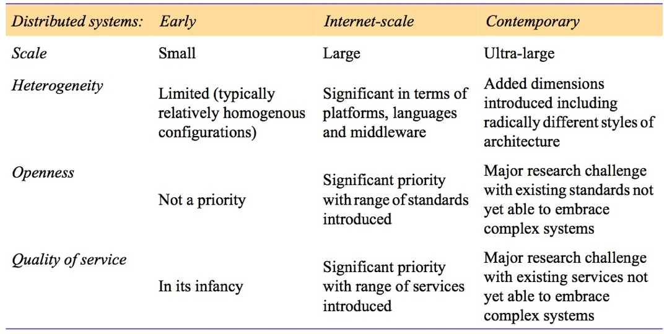
Figure 2.1: Generations of distributed systems
This table highlighting the significant challenges associated with contemporary (modern) distributed systems in terms of managing the levels of heterogeneity and providing key properties such as openness and quality of service
Notes:
Embrace: to accept

Slide 4
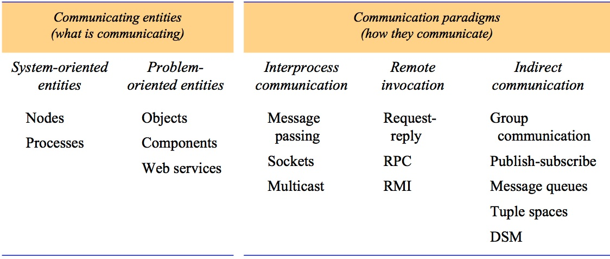
Figure 2.2: Communicating entities and communication paradigms
Architectural Elements: to understand building blocks of a DS - What are the entities that are communicating in the DS? How do they communicate or what communication paradigm is used? What roles and responsibilities do they have in the overall architecture?
Communicating entities - the entities that communicate in a DS are typically processes or nodes
use of object-oriented approaches in DS, objects are introduced; or components or Web services
Communication Paradigms - how entities communicate in DS

Slide 5
Communication Paradigms – how they communicate?
Inter-process Communication– refers to the relatively low-level support for communication b/w processes in DS, including message-passing primitives, direct access to the API offered by Internet protocols (socket programming) and support for multicast communication.
Remote Invocation– the calling of a remote operation, procedure or method; as request-reply using http (client-server); Remote procedure calls; Java RMI - a calling object can invoke a method in a remote object.
Indirect Communication– group communication is delivery of messages to a set of recipients and hence is a multiparty communication paradigm supporting one-to-many communication; Distributed shared memory (DSM) provide a concept for sharing data b/w processes that do not share physical memory.
Notes:
Indirect Communication: like what’s up group communication, while forwarding/sharing the docs or Data
By Ali Ahmed
Inter-process communication: Inter-process communication includes message passing, sockets, multicast communication.
Remote Invocation: the calling of a remote operation, procedure or method as:
HTTP Request-Reply
Java RMI (Its like asking a friend to do something for you)

Slide 6
Client Server Architecture
Client-Server– This is the architecture that is most often cited when DS are discussed, historically the most important, most widely employed
Simple structure in which processes take on the roles of being clients or servers
Client processes interact with individual server processes to access the shared resources
Servers may in turn be clients of other servers
Web server is often a client of local file server that manages files
Web servers & most other Internet services are clients of the DNS service (also search engines - summaries of information available on web pages at sites throughout the Internet; called web crawlers)
Search engine is both a server & a client: it responds to queries from browser clients and it runs web crawlers that act as clients of other web servers
Notes:
Fundamental Model – basic issues for any network or system basic requirements, fundamentals things like performance, security, failure or Error

Slide 7
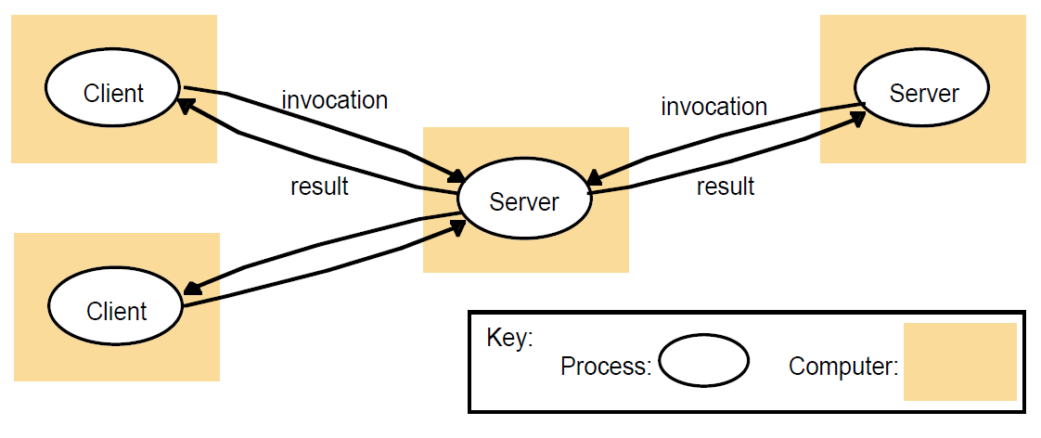
Figure 2.3
Clients invoke individual servers

Slide 8
Peer-to-Peer Architecture
Peer-to-Peer– all of the processes involved in a task/activity play similar roles, interacting cooperatively as peers without any distinction b/w client & server processes.
As client-server model offers a direct and relatively simple approach to sharing of data and other resources, but p2p scales poorly.
A large number of data objects are shared, an individual computer holds only a small part of the application database & storage, processing & comm. loads for access to objects are distributed across many computers and network links.
Each object is replicated in several computers to further distribute load & to provide resilience in the event of disconnection of individual computers.
Placing individual objects & retrieve them & to maintain replicas amongst many computers, thus more complex than client-server architecture.
Notes:
In P2P, every process (like a friend) plays similar roles. There’s no boss (central server) telling them what to do.
Cooperative Interaction: All nodes (computers) collaborate without distinctions.
No Central Server: No one’s in charge; they work together as equals.
Resource Sharing: They share data and services directly.
Independence: Each node can keep working even if others stop.
Scaling Challenges:
P2P doesn’t scale well for large-scale systems.

Slide 9
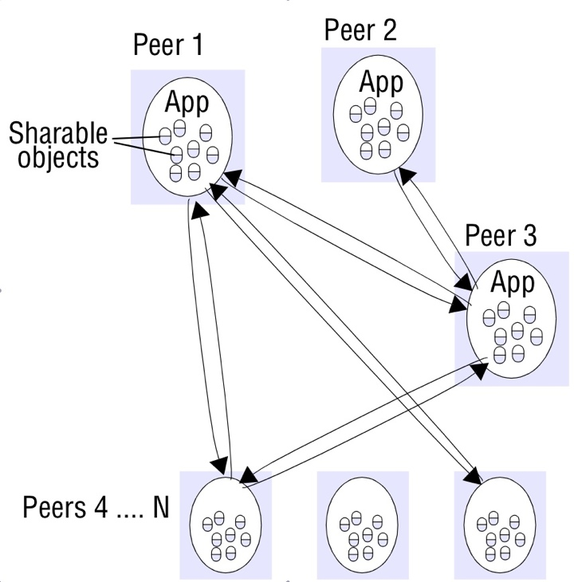
Figure 2.4a
Peer-to-peer architecture

Slide 10
Mapping of services to multiple servers
Mapping of services to multiple servers–
Services may be implemented as several server processes in separate host computers interacting as necessary to provide a service to client processes.
The servers may partition the set of objects on which the service is based and distribute those objects between themselves, or they may maintain replicated copies of them on several hosts.
The Web provides a common example of partitioned data in which each web server manages its own set of resources. A user can employ a browser to access a resource at any one of the servers.

Slide 11
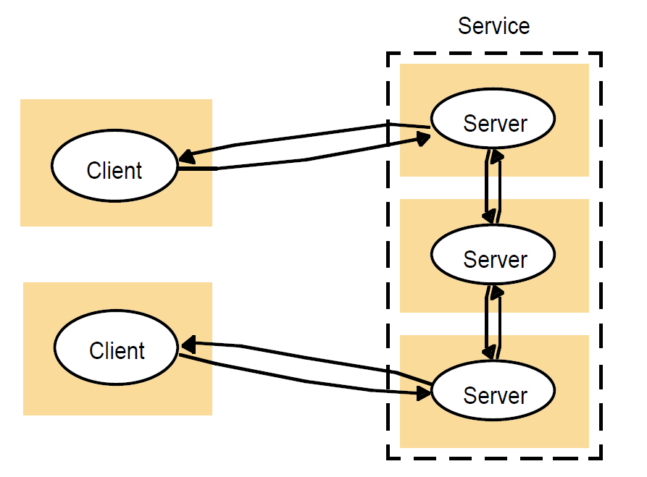
Figure 2.4b
A service provided by multiple servers

Slide 12
Caching - Web proxy server
Caching– A cache is a store of recently used data objects that is closer to one client.
When an object is needed by a client process, the caching service first checks the cache & supplies the object from there if an up-to-date copy is available. If not, an up-to-date copy is fetched
Caches may be co-located with each client or they may be located in a proxy server that can be shared by several clients
The purpose of proxy servers is to increase the availability and performance of the service by reducing the load on the WAN and web servers.
Proxy servers may be used to access remote web servers through a firewall
Notes:
e.g., Web browsers maintain a cache of recently visited web pages/web resources in the client’s local file system, using
a special HTTP request to check with the original server that cached pages are up-to date before displaying them.

Slide 13
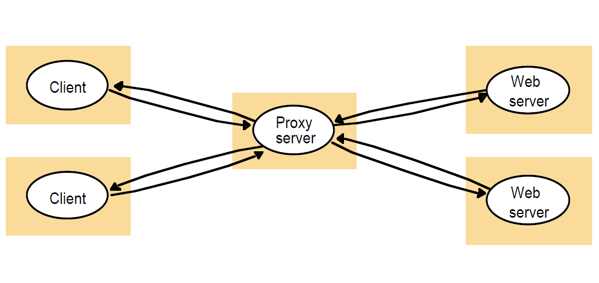
Figure 2.5
Web proxy server

Slide 14
Web Applets – Mobile code & Mobile agents
Web Applets– Applets are a well-known and widely used example of mobile code – the user running a browser selects a link to an applet whose code is stored on a web server; the code is downloaded to the browser and runs there (locally) –
give good interactive response since it doesn't suffer from the delays or variability of bandwidth associated with network communication
Each customer would have to download a special applet that receives updates from the broker’s server, displays them to the user
Mobile code is a potential security threat to the local resources in the destination computer; therefore, browsers give applets limited access to local resources
Notes:
e.g., calculator, live weather info/stockbroker; server updates the client-browser when any change occurs

Slide 15
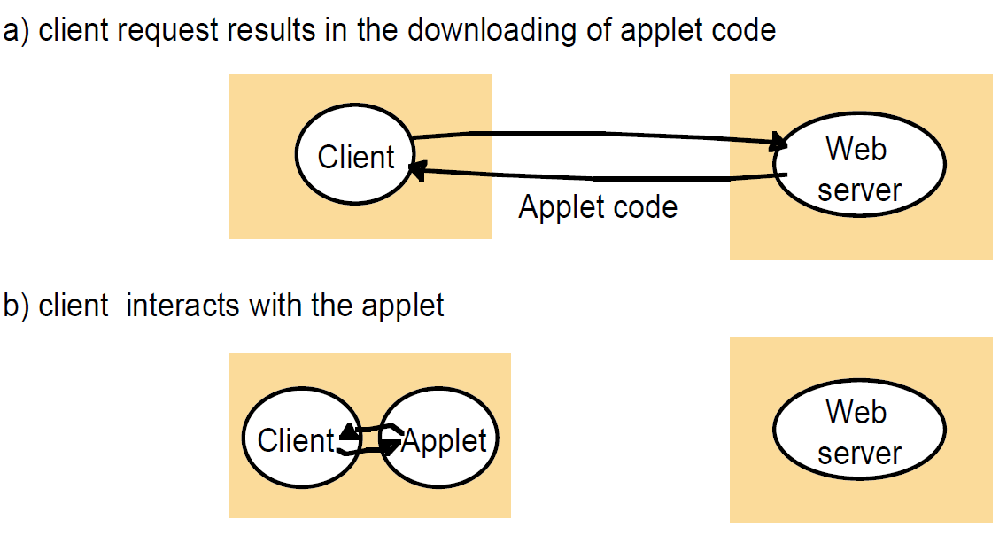
Figure 2.6
Web applets

Slide 16
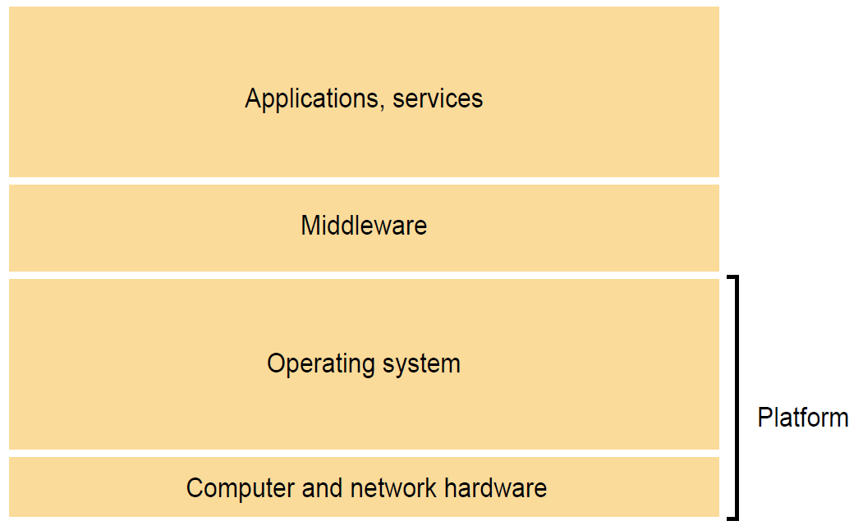
Figure 2.7
Software and hardware service layers in distributed systems
Instructor’s Guide for Coulouris, Dollimore, Kindberg and Blair, Distributed Systems: Concepts and Design Edn. 5
© Pearson Education 2012

Slide 17
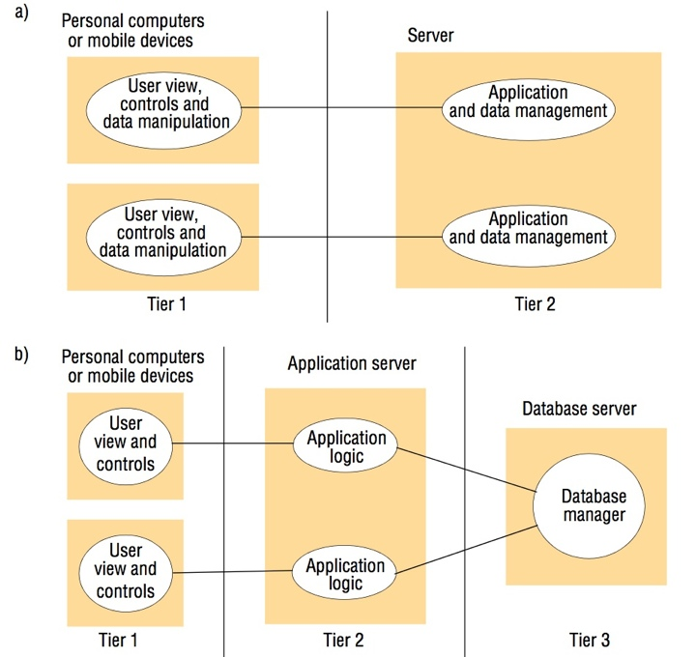
Figure 2.8
Two-tier and three-tier architectures
Instructor’s Guide for Coulouris, Dollimore, Kindberg and Blair, Distributed Systems: Concepts and Design Edn. 5
© Pearson Education 2012

Slide 18
Figure 2.9
AJAX example: soccer score updates
new Ajax.Request('scores.php?
game=Arsenal:Liverpool’,
{onSuccess: updateScore});
function updateScore(request) {
.....
( request contains the state of the Ajax request including the returned result.
The result is parsed to obtain some text giving the score, which is used to update the relevant portion of the current page.)
.....
}
Instructor’s Guide for Coulouris, Dollimore, Kindberg and Blair, Distributed Systems: Concepts and Design Edn. 5
© Pearson Education 2012

Slide 19
Figure 2.10
Thin clients and compute servers
Compute server
Network computer or PC
Thin
network
Application
Client
Process
Instructor’s Guide for Coulouris, Dollimore, Kindberg and Blair, Distributed Systems: Concepts and Design Edn. 5
© Pearson Education 2012

Slide 20
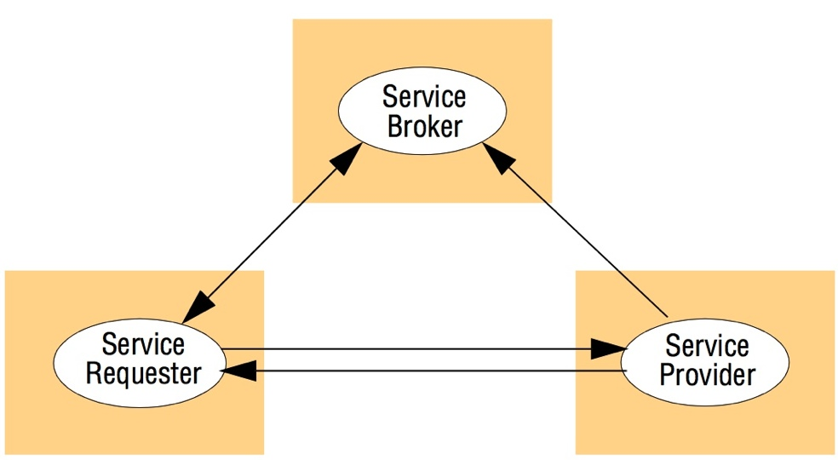
Figure 2.11
The web service architectural pattern
Instructor’s Guide for Coulouris, Dollimore, Kindberg and Blair, Distributed Systems: Concepts and Design Edn. 5
© Pearson Education 2012

Slide 21
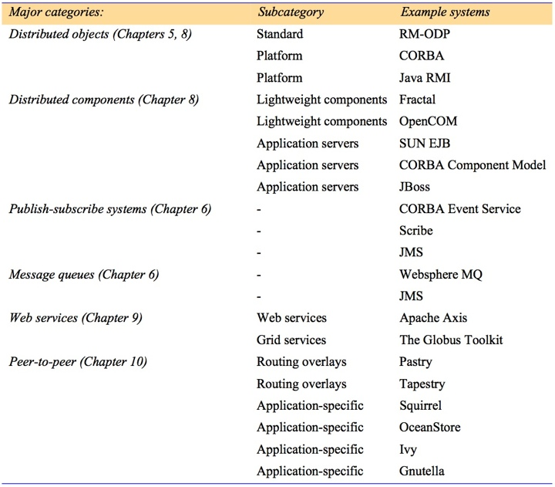
Figure 2.12
Categories of middleware
Instructor’s Guide for Coulouris, Dollimore, Kindberg and Blair, Distributed Systems: Concepts and Design Edn. 5
© Pearson Education 2012

Slide 22
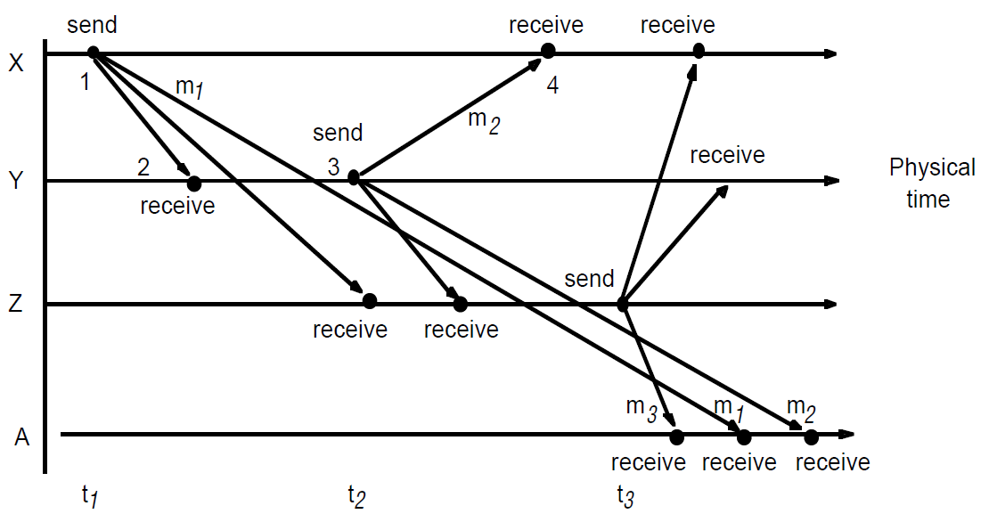
Figure 2.13
Real-time ordering of events
Instructor’s Guide for Coulouris, Dollimore, Kindberg and Blair, Distributed Systems: Concepts and Design Edn. 5
© Pearson Education 2012

Slide 23
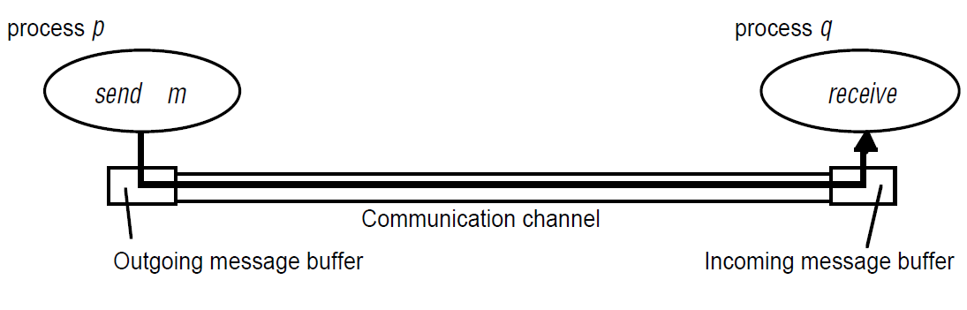
Figure 2.14
Processes and channels
Instructor’s Guide for Coulouris, Dollimore, Kindberg and Blair, Distributed Systems: Concepts and Design Edn. 5
© Pearson Education 2012

Slide 24
Figure 2.15
Omission and arbitrary failures
Class of failure
Affects
Description
Fail-stop
Process
Process halts and remains halted. Other processes may
detect this state.
Crash
Process
Process halts and remains halted. Other processes may
not be able to detect this state.
Omission
Channel
A message inserted in an outgoing message buffer never
arrives at the other end’s incoming message buffer.
Send-omission
Process
A process completes a
send,
but the message is not put
in its outgoing message buffer.
Receive-omission
Process
A message is put in a process’s incoming message
buffer, but that process does not receive it.
Arbitrary
Process or
Process/channel exhibits arbitrary behaviour: it may
(Byzantine)
channel
send/transmit arbitrary messages at arbitrary times,
commit omissions; a process may stop or take an
incorrect step.
Instructor’s Guide for Coulouris, Dollimore, Kindberg and Blair, Distributed Systems: Concepts and Design Edn. 5
© Pearson Education 2012

Slide 25
Figure 2.11
Timing failures
Class of Failure
Affects
Description
Clock
Process
Process’s local clock exceeds the bounds on its
rate of drift from real time.
Performance
Process
Process exceeds the bounds on the interval
between two steps.
Performance
Channel
A message’s transmission takes longer than the
stated bound.
Instructor’s Guide for Coulouris, Dollimore, Kindberg and Blair, Distributed Systems: Concepts and Design Edn. 5
© Pearson Education 2012

Slide 26
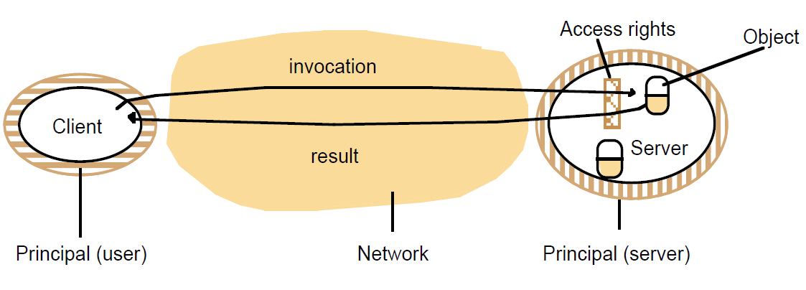
Figure 2.17
Objects and principals
Instructor’s Guide for Coulouris, Dollimore, Kindberg and Blair, Distributed Systems: Concepts and Design Edn. 5
© Pearson Education 2012

Slide 27
Figure 2.18
The enemy
Copy of
m
The enemy
m’
Process
p
m
Process
q
Communication channel
Instructor’s Guide for Coulouris, Dollimore, Kindberg and Blair, Distributed Systems: Concepts and Design Edn. 5
© Pearson Education 2012

Slide 28
Figure 2.19
Secure channels
Principal
A
Principal
B
Process
p
Secure channel
Process
q
Instructor’s Guide for Coulouris, Dollimore, Kindberg and Blair, Distributed Systems: Concepts and Design Edn. 5
© Pearson Education 2012

