Slide 1


Web Development
#6
Flask Scaffolding

Slide 2
Training Outline
Flask Security - Authorization
Flask Scaffolding

Slide 3
Flask Security - Authorization
1. Flask Security - Register & Logot User
2. Flask Security - Change & Reset Password
3. Flask Security - Restrict Access View to Specific Role
4. User & Role Management

Slide 4
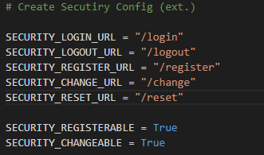
Flask Security - Registration
To enable Registration in Flask Security, we need to put REGISTERABLE= True
pertemuan_6\1_Flask_Security_Registration\config.py
Flask-Security Documentation :
Flask-Security Config : https://pythonhosted.org/Flask-Security/configuration.html
Flask-Security Customization : https://pythonhosted.org/Flask-Security/customizing.html

Slide 5
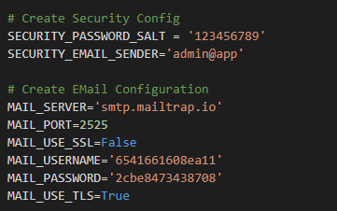
Flask Security - Registration
Then we need to enable several configuration in instance/config.py related to Email Config for Registration Notification and several SECURITY_EMAIL_SENDER
Then eachtime user register into app, there will be email sent to that account automatically by Flask-Mail under the hood.
For testing purpose, we can use fake SMTP server from https://mailtrap.io/ for our mail setting.
pertemuan_6\1_Flask_Security_Registration\instance\config.py

Slide 6
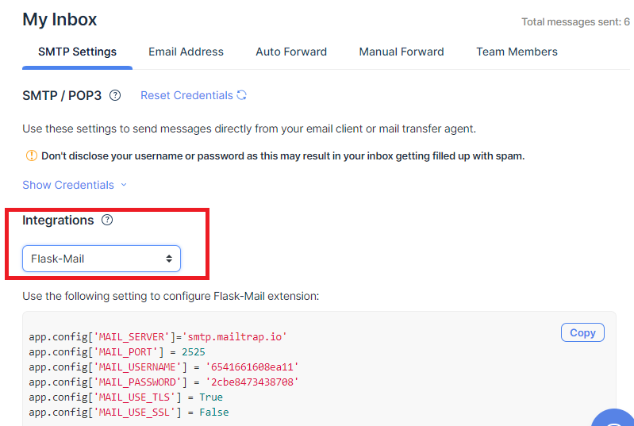
Flask Security - Registration
Just sign up in https://mailtrap.io/register/signup then Open SMTP Setting > Flask Mail,
Coppy that configuration, into our instance/config.py

Slide 7
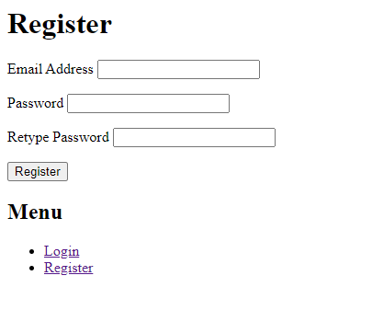
Flask Security - Registration
Invoke the pertemuan_6\1_Flask_Security_Registration\run.py and open URL http://localhost:5000/register
This is default registration form from Flask Security.

Slide 8
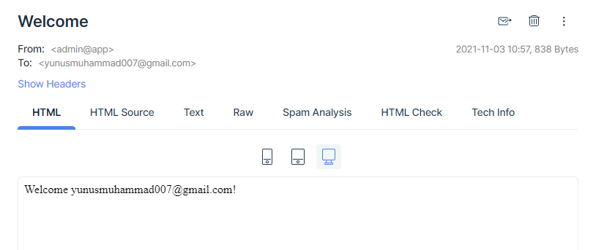
Flask Security - Registration
Email notification for registration complete, in https://mailtrap.io console,
Also this email template is default format from Flask Security, we can modifying it if we want.

Slide 9
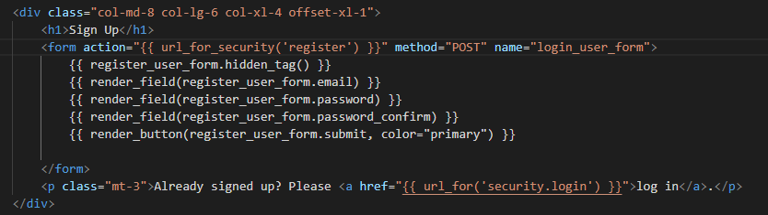
Flask Security - Registration (Custom Template)
Now we will modifying Registration form using our custom template,
Template for registration form by default need to exist in templates/security/register_user.html
Then inside this template, we can access registration form field & button under registration_user_form WTForm object.
NOTE : Dont forget to setup Flask-Mail configuration in instance/config.py
pertemuan_6\2_Flask_Security_Registration_Custom\app\templates\security\register_user.html

Slide 10
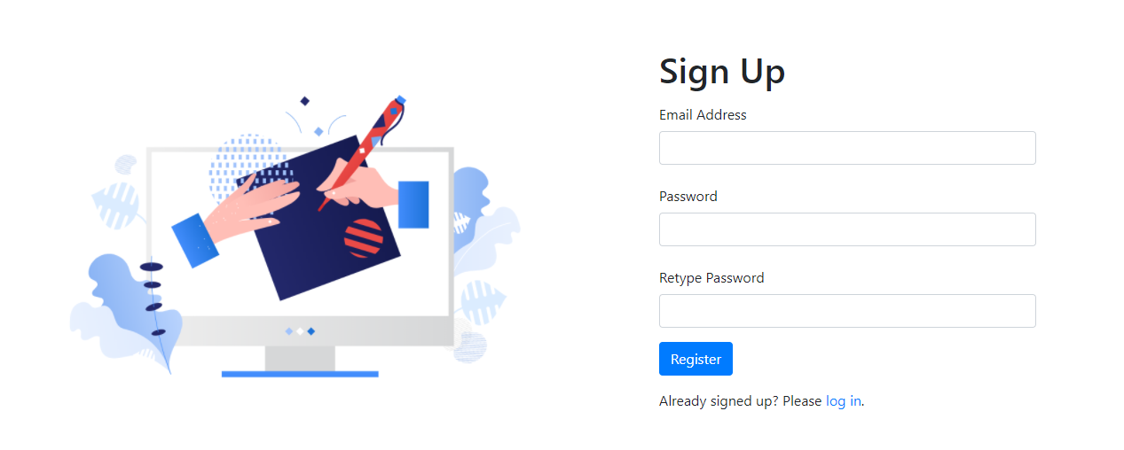
Flask Security - Registration
Invoke the pertemuan_6\2_Flask_Security_Registration_Custom\run.py
and open URL http://localhost:5000/register
This is default registration should be replaced with our custom template.

Slide 11
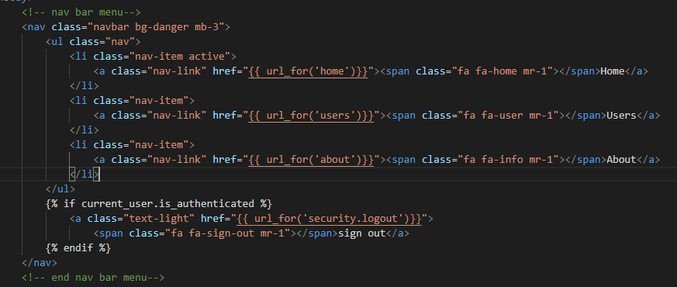
Flask Security - Logout
To add a button Logout in App, we just add a link with destinantion (href) into security.logout route.
Since the logout is only exist for loggedin user, it’s make sense to only show the logout button if current user is authenticated.
pertemuan_6\3_Flask_Security_Logout\app\templates\_layout.html

Slide 12
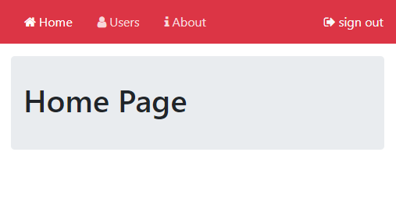
Flask Security - Logout
Invoke the pertemuan_6\3_Flask_Security_Logout\run.py
Then login to URL http://localhost:5000 , afther logged in, there should a logout link on the top right corner nav-bar like below.

Slide 13
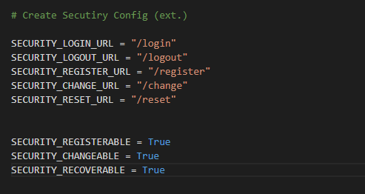
Flask Security - Change & Forgot Password (Custom)
To enable Change password for authenticated user ,
we need to add config SECURITY_CHANGEABLE = True in config.py
To enable Reset password for unauthenticated user ,
we need to add config SECURITY_RECOVERABLE = True in config.py
pertemuan_6\4_Flask_Security_Reset_Change_Password\config.py

Slide 14
Flask Security - Change & Forgot Password (Custom)
Now we will modifying Change Password form using our custom template,
Template for Change Password form by default need to exist in templates/security/change_password.html
Template for Forgot Password form by default need to exist in templates/security/forgot_password.html
Template for Reset Password form by default need to exist in templates/security/reset_password.html
Then inside this template, we can access registration form field & button under change_password_form, forgot_password_form & reset_password_form WTForm object.
Email Reset Password
Forgot Password (put Email)
Reset Password (put New Password)

Slide 15
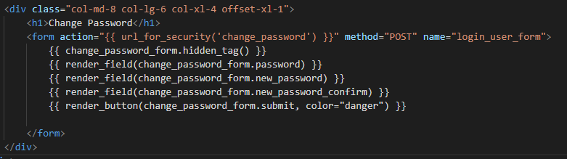
Flask Security - Change & Forgot Password (Custom)
Change Password Template :
pertemuan_6\4_Flask_Security_Reset_Change_Password\app\templates\security\change_password.html

Slide 16
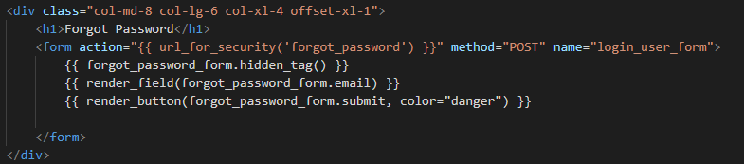
Flask Security - Change & Forgot Password (Custom)
Forgot Password Template :
pertemuan_6\4_Flask_Security_Reset_Change_Password\app\templates\security\forgot_password.html

Slide 17
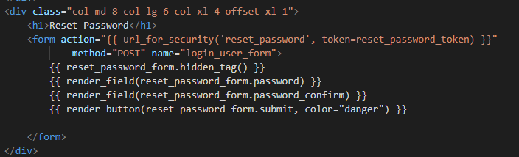
Flask Security - Change & Forgot Password (Custom)
Reset Password Template :
pertemuan_6\4_Flask_Security_Reset_Change_Password\app\templates\security\forgot_password.html

Slide 18
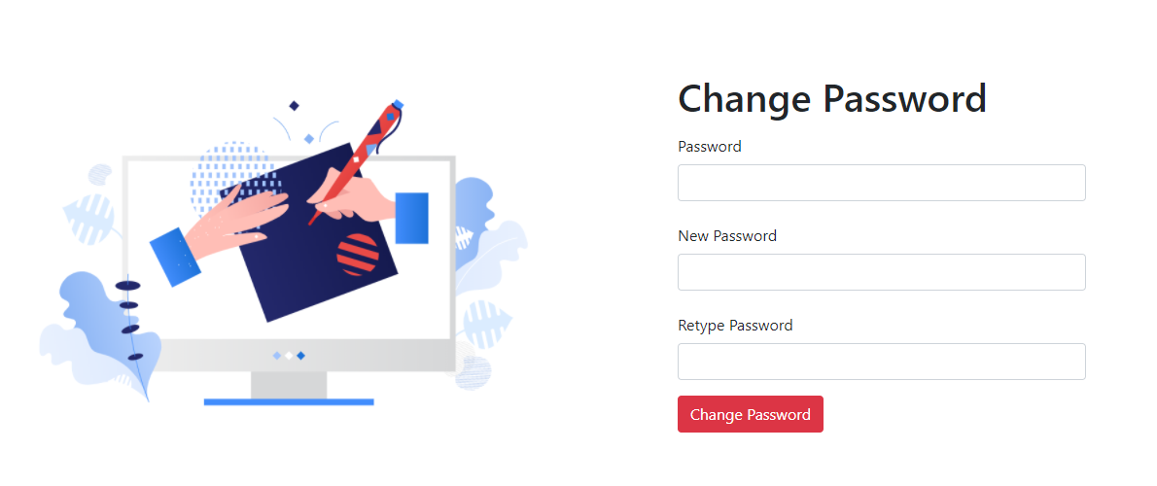
Flask Security - Change & Forgot Password (Custom)
Invoke the pertemuan_6\4_Flask_Security_Reset_Change_Password\run.py
Then login to URL http://localhost:5000 ,
Then open http://localhost:5000/change to change password, try it.

Slide 19
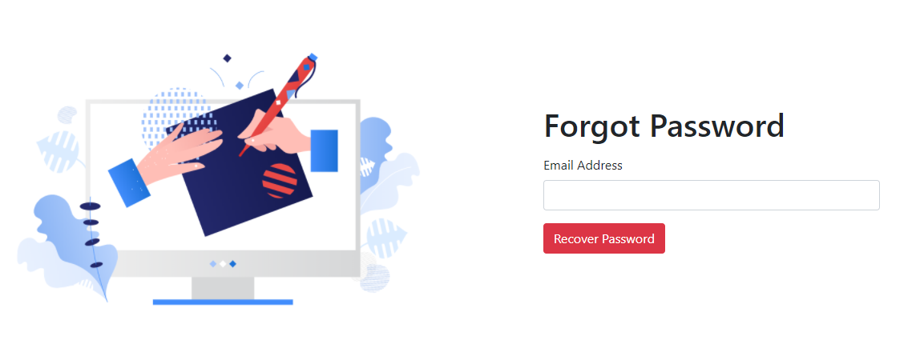
Flask Security - Change & Forgot Password (Custom)
To do a reset password, you need to Logout First,
Then open http://localhost:5000/reet to reset password, then put the email account john@mail.com.

Slide 20
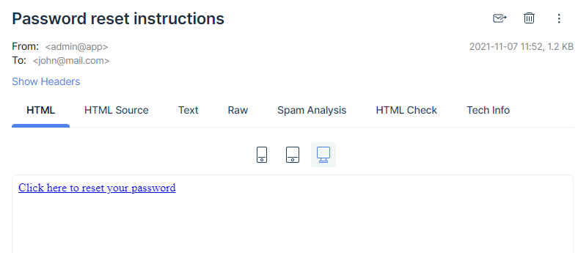
Flask Security - Change & Forgot Password (Custom)
Just open in https://mailtrap.io to access email reset password link.
The reset password email is should look like this, Just click it, to open reset password form
this email template can be customized also.

Slide 21
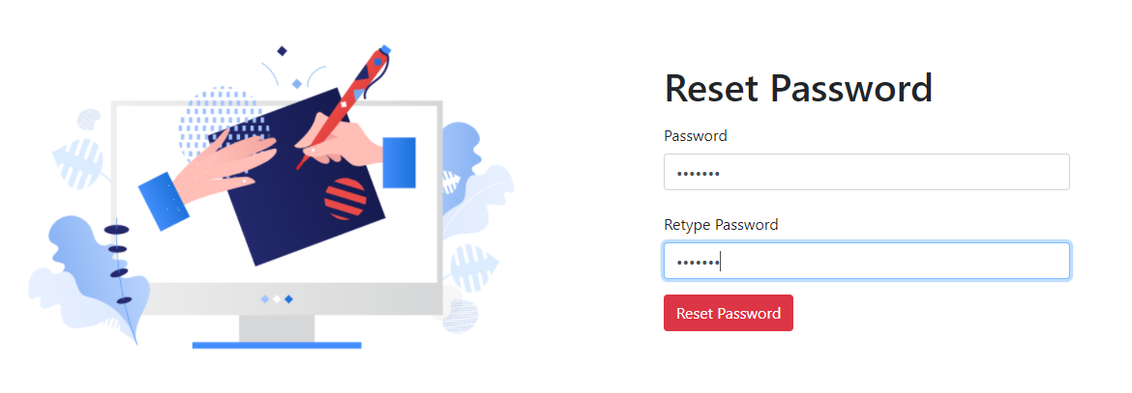
Flask Security - Change & Forgot Password (Custom)
The reset password form should lok like this,
Just put a new Password there,

Slide 22
Flask Security - Restrict Access View to Specific Role
Now we will learn how to restrict access View into specific Role that granted to the registered user.
This is important to limiting user access into sensitif data or make sure the user own the relevant data.
In this simple case, for all view that we have now, we will put the restriction access like below.
View | Anonymous | Authenticated
 |  | User | Admin
Login | ✓ | ✓ | ✓
Register | ✓ | ✓ | ✓
Reset Password | ✓ | ✓ | ✓
Change Password |  | ✓ | ✓
About | ✓ | ✓ | ✓
Home |  | ✓ | ✓
View Users |  | ✓ | ✓
Delete & Update User |  |  | ✓

Slide 23
Flask Security - Restrict Access View to Specific Role
To limiting access into view, we can use builtin decorator under Flask Security
This is a list of availabel decorator :
Decorator | Descripition
@login_required | If you decorate a view with this, it will ensure that the current user is logged in and authenticated before calling the actual view. previously we use current_user.is_authenticated to hide logout button for unauthenticated user, using this property, we can limiting access in element level like a button, field, etc.
@roles_required('admin', 'user') | Decorator which specifies that a user must have all the specified roles. The role it self is created in Role model that registered into SQLAlchemyUserDatastore
@roles_accepted('editor', 'user') | Decorator which specifies that a user must have at least one of the specified roles.
More detail about Flask Security Decorator : https://pythonhosted.org/Flask-Security/api.html

Slide 24
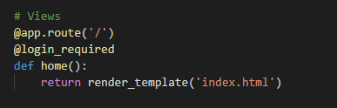

Flask Security - Restrict Access View to Specific Role
This is how we apply @login_required into home() view.
since about() view is accessible for all user & anonymouse, leave it as is,
pertemuan_6\5_Role_Based_Access\app\views.py

Slide 25
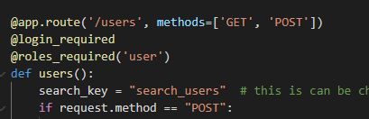
Flask Security - Restrict Access View to Specific Role
This is how we apply @login_required into users() view.
And also we can put extra restriction by applying @roles_required(‘user’) ino users() view to ensure only user with role ‘user’ that can access this view.
pertemuan_6\5_Role_Based_Access\app\views.py

Slide 26
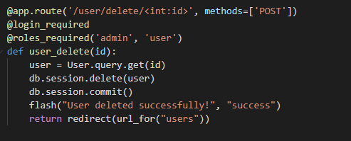
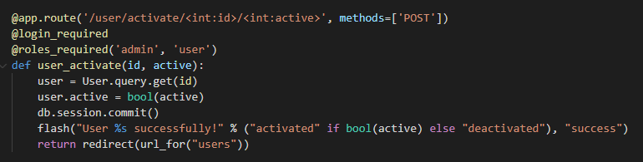
Flask Security - Restrict Access View to Specific Role
Additinal view is added to handle user deletion & user activation.
since delete user is crucial part, we want to restrict it into user granted role ‘admin’ and ‘user’ .
pertemuan_6\5_Role_Based_Access\app\views.py

Slide 27
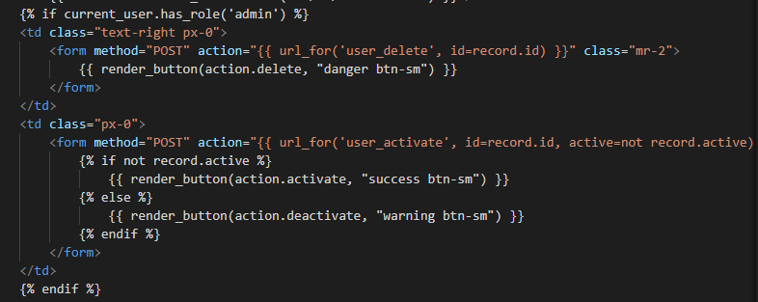
Flask Security - Restrict Access View to Specific Role
To access view user deletion & user activation. we can add a button on each row of user list data.
This button is rendered by ActionForm.
pertemuan_6\5_Role_Based_Access\app\templates\user_list.html

Slide 28
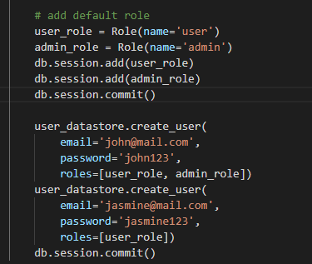
Flask Security - Restrict Access View to Specific Role
After we can restrict access to a user with associated role,
Then, how we create Role and granted role into user?
Since a Role itself is creating iour data model, we can use Flask-SQLAlchemy style to creating Role.
We can put this part on run.py like this side.
pertemuan_6\5_Role_Based_Access\run.py

Slide 29
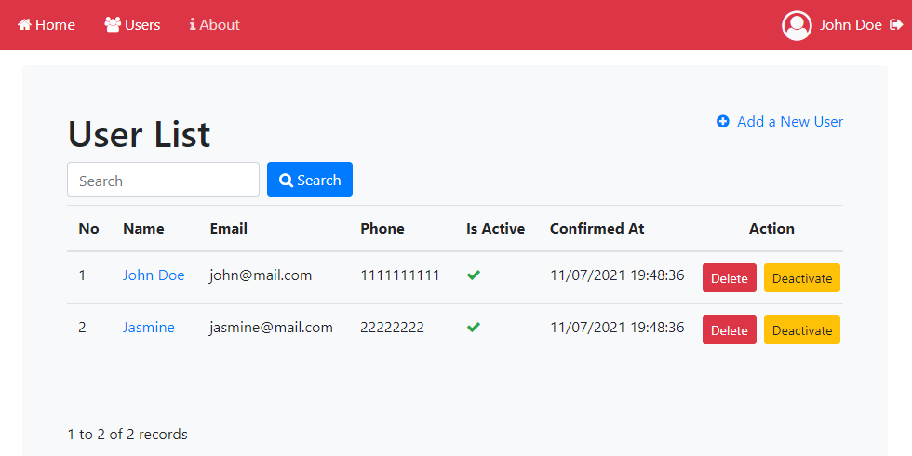
Flask Security - Restrict Access View to Specific Role
Invoking the app by running pertemuan_6\5_Role_Based_Access\run.py
Then check if a view we have is restricted following our role matrix.
Logged in as John Doe (granted with admin & user Role)

Slide 30
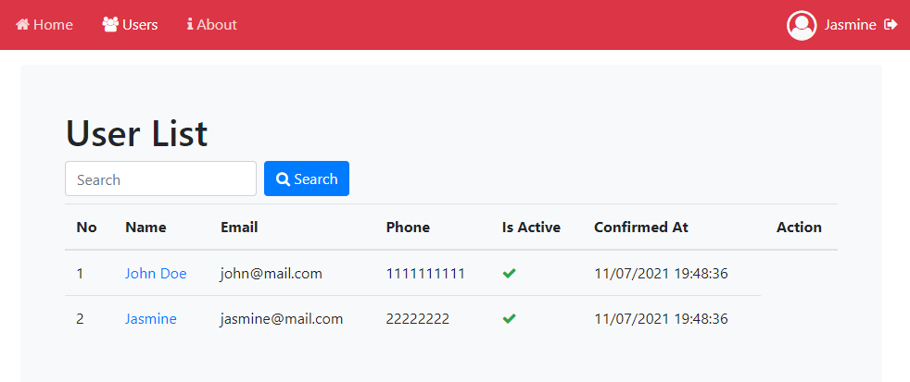
Flask Security - Restrict Access View to Specific Role
Logged in as Jasmine (granted with only user Role)

Slide 31
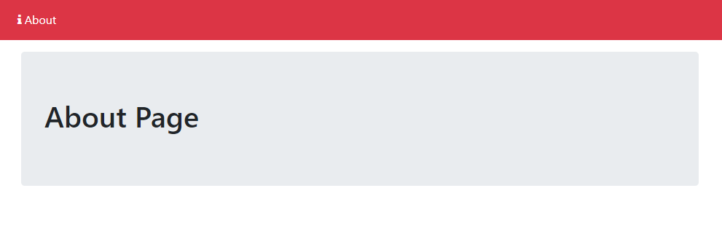
Flask Security - Restrict Access View to Specific Role
Unauthenticated User (Anonymous)

Slide 32
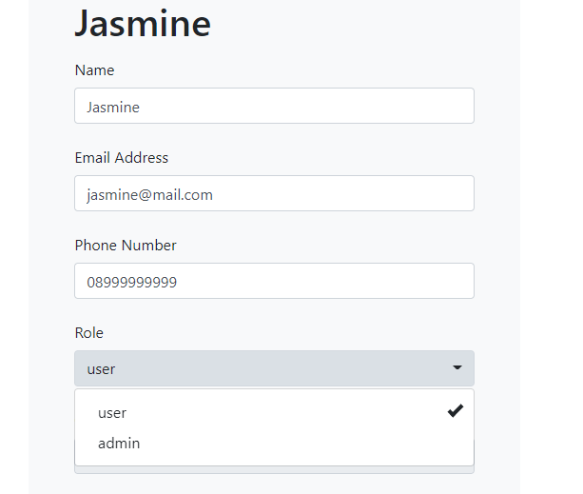
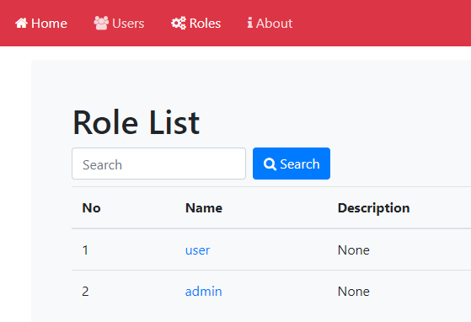
User & Role Management
After we successfully restrict access views to a specific user eith associated role.
Now we will try to create Role Menu in apps and Multi Select Role in User Form, so we can manage User Role in runtime.
Role Menu
Multi Select Role in User Form

Slide 33
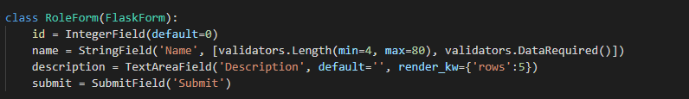
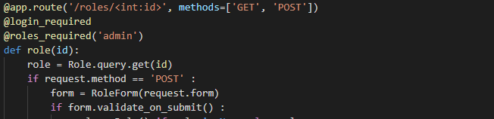
User & Role Management
To create Role Menu, we need to create Form and Views for Role Menu.
pertemuan_6\6_Role_Management\app\forms.py
pertemuan_6\6_Role_Management\app\views.py

Slide 34
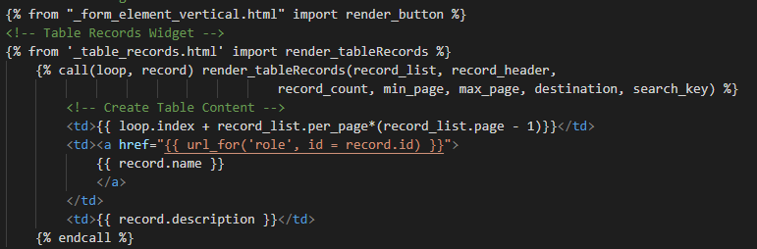
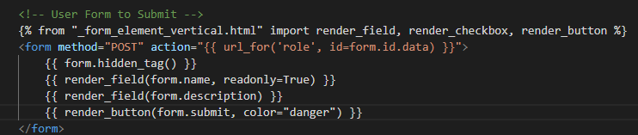
User & Role Management
Dont forget to create Jinja2 template for Role List & Role Detail
pertemuan_6\6_Role_Management\app\templates\role_list.html
pertemuan_6\6_Role_Management\app\templates\role.html

Slide 35
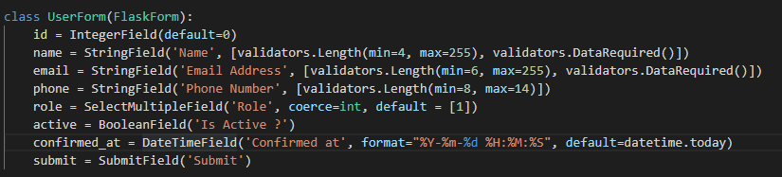
User & Role Management
To add Multi Select Role in UserForm we can use SelectMultipleField() method from Flask-WTForm.
pertemuan_6\6_Role_Management\app\forms.py

Slide 36
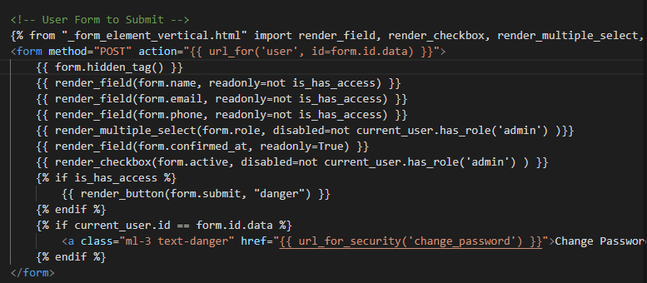
User & Role Management
Then, to show Multi Select Role in template (user.html) we can use render_multiple_select() macro from _form_element_vertical.html widget.
pertemuan_6\6_Role_Management\app\templates\user.html

Slide 37
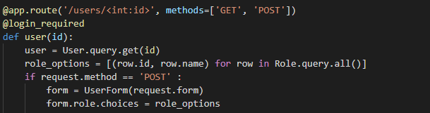
User & Role Management
To set list option for Multiple Select Role, we can creating an list with structure :
[(value, label), (value, label), (value, label)]
Then assign it into Role field in UserForm
pertemuan_6\6_Role_Management\app\views.py

Slide 38
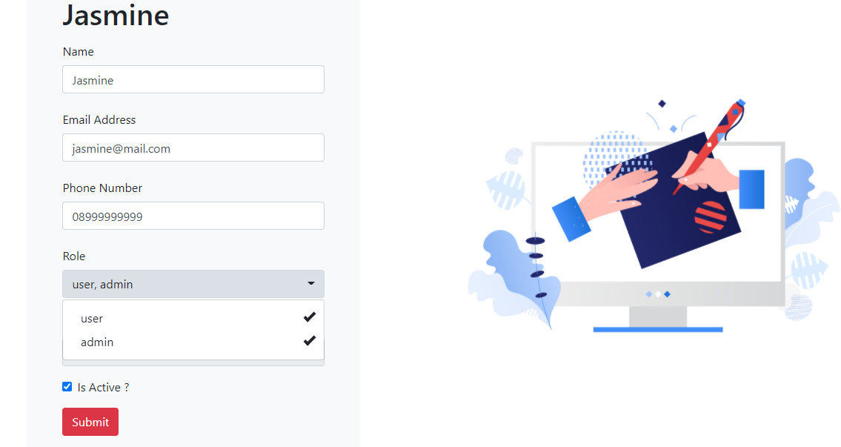
User & Role Management
Invoking the app by running pertemuan_6\6_Role_Management\run.py
Then try to open User Form and grant Role “Admin” to Jasmine
Then Jasmine shoud be able to access screen with Admin resticted role.

Slide 39
Flask Scaffolding

Slide 40
Flask Scaffolding
Scaffolding is a technique supported by some model–view–controller frameworks, in which the programmer can specify how the application database may be used. [Wikipedia]
Scaffolding was made popular by the Ruby on Rails framework. It has been adapted to other software frameworks, including OutSystems Platform, Express Framework, Blitz.js, Play framework, Django, web2py, MonoRail, Brail, Symfony, Laravel, CodeIgniter, Yii, CakePHP, Phalcon PHP, Model-Glue, PRADO, Grails, Catalyst, Mojolicious, Seam Framework, Spring Roo, JHipster, ASP.NET Dynamic Data, KumbiaPHP and ASP.NET MVC framework's Metadata Template Helpers.

Slide 41
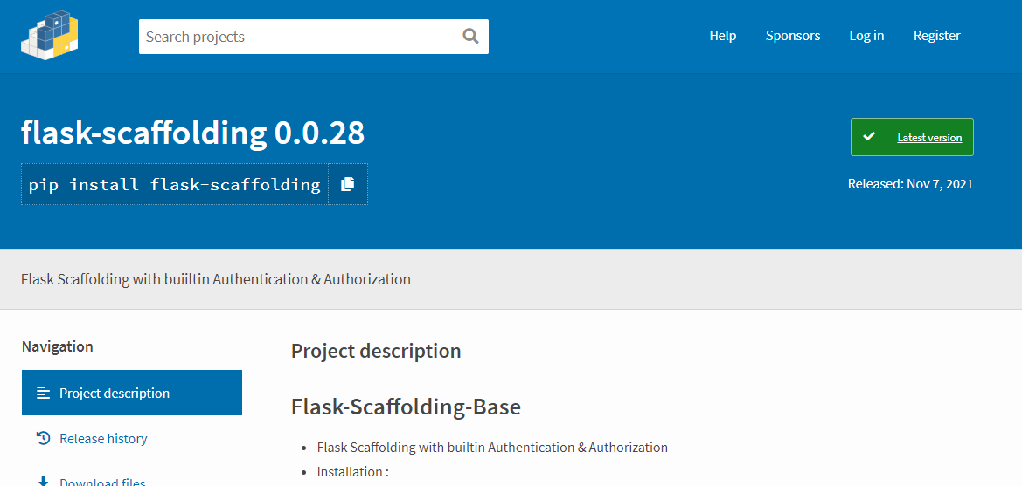
Flask Scaffolding
https://pypi.org/project/flask-scaffolding/

Slide 42
Flask Scaffolding
Installation :
pip install flask-scaffolding
Run to create a new flask app with the given name and destination path.
python -m scaffold.web <YOUR_APP_NAME> <path/to/destination>
Add your custom model into <YOUR_APP_NAME>/app/models/,
Run to add a new screen UI on created app above,
python -m scaffold.ui <MODEL_NAME> <path/to/model/file/location>

Slide 43
The End

