Slide 1


Web Development
#3
Data Model & ORM

Slide 2
Training Outline
Flask - SQL Alchemy (Configuration)
Flask - SQL Alchemy (Model Relationship)
Flask - SQL Alchemy (Insert & Select)
Create User Form & Save into Database
Create User Table & Pagination

Slide 3
Flask - SQL Alchemy (Configuration)
1. ORM using Flask - SQL Alchemy
2. Configure Flask - SQL Alchemy
3. Using SQLTool VS Code Extension

Slide 4
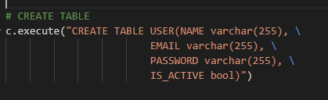
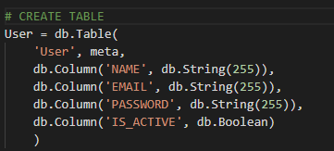
ORM using Flask - SQL Alchemy
Object–relational mapping (ORM, O/RM, and O/R mapping tool) in computer science is a programming technique for converting data between incompatible type systems using object-oriented programming languages. [Wikipedia]
CREATE TABLE - RAW SQL in Python
CREATE TABLE - ORM in Python
pertemuan_3\1_ORM\1_Raw_SQL.py
pertemuan_3\1_ORM\2_ORM.py
ORM advantages :
Accessibility & Maintainability
Prevent for SQL Injection & sanitation
Improve SQL formation
Using OOP (ability to extend & inherit Model)

Slide 5

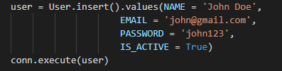
ORM using Flask - SQL Alchemy
INSERT - RAW SQL in Python
pertemuan_3\1_ORM\1_Raw_SQL.py
INSERT - ORM in Python
pertemuan_3\1_ORM\2_ORM.py

Slide 6
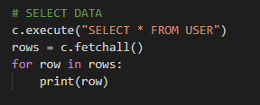

ORM using Flask - SQL Alchemy
SELECT - RAW SQL in Python
pertemuan_3\1_ORM\1_Raw_SQL.py
SELECT - ORM in Python
pertemuan_3\1_ORM\2_ORM.py

Slide 7

Configure Flask - SQL Alchemy
Flask-SQLAlchemy is an extension for Flask that adds support for SQLAlchemy to your application.
It aims to simplify using SQLAlchemy with Flask by providing useful defaults and extra helpers that make it easier to accomplish common tasks. [Flask-SQLAlchemy].
For simple case, let’s create config.py and model.py :
config.py
config.py is where we keep our configuration like a database connection, etc.
model.py is where we create data model for our App.
This two file, will be imported by app.py
model.py
app.py

Slide 8
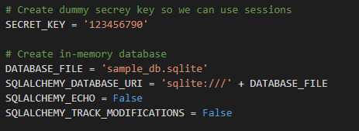
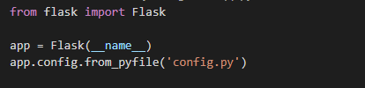
Configure Flask - SQL Alchemy
Put the following config inside config.py
Then, inside app.py, we just load config.py using add app.config.from_pyfile() method after creating app object.
pertemuan_3\2_Flask_SQLAlchemy_config\config.py
We can put all Flask configuration inside this file, not only for database connection.
On this part we pu SQLite configuretion with database file sample_db.sqlite
In the next part we will learn more about Flask Configureation.
pertemuan_3\2_Flask_SQLAlchemy_config\config.py

Slide 9
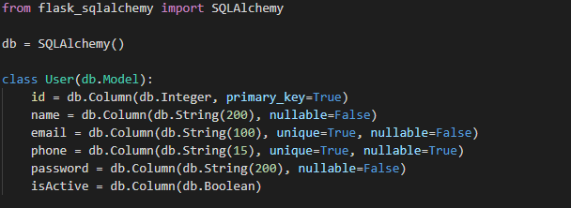
Configure Flask - SQL Alchemy
After configuration loaded inside app.py
Now, we need to define atlease one model inside model.py
Creating a model User that inherit from Model Class SQLAlchemy, then define a field like below :
More detail about Model and it’s relationship will be explained in the next slide.

Slide 10
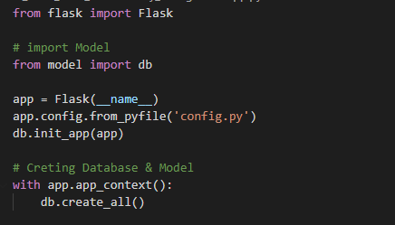
Configure Flask - SQL Alchemy
The important part is, wee need to import above db object into our app.py
after that we can use app.init_app(db) to attach db object into the Flask app context.
After that we just simply (for this case) just directly use db.create_all() to create Model and Database that previously defined inside model.py
The purpose app.app_context() is to push an application context when creating the tables, we need to do this since this part is outside our views/route.

Slide 11
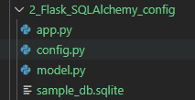
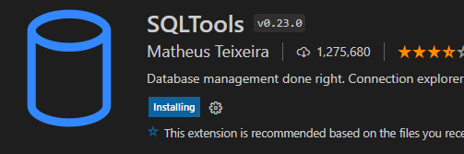
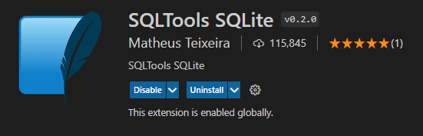
Using SQLTool VS Code Extension
After executing app.py, database file sample_db.sqlite will be creating to hold model definition in model.py
To view that database file, just install SQLTools & SQLTools SQLite extension in VS Code,

Slide 12
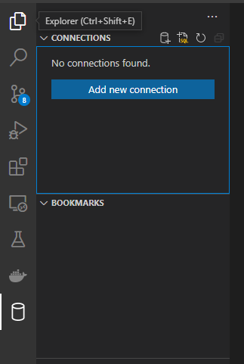
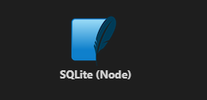
Using SQLTool VS Code Extension
3
2
Open SQLTool and create a new connection.
1

Slide 13
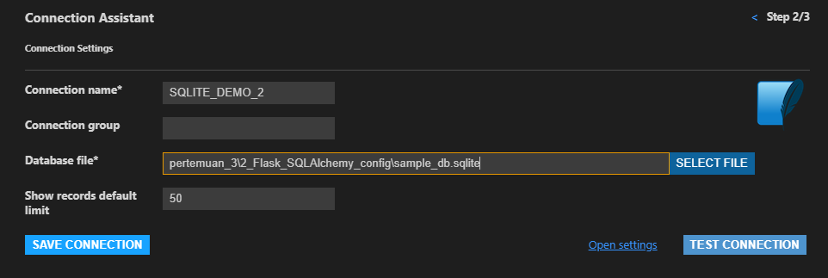
Using SQLTool VS Code Extension
Create database connection into our sample_db.sqlite in pertemuan_3\2_Flask_SQLAlchemy_config\sample_db.sqlite
Then click TEST CONNECTION
xxx

Slide 14
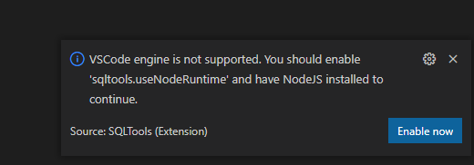
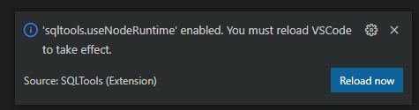
Using SQLTool VS Code Extension
If you get an error relater to enable sqltool.useNodeRuntime, just click Enable Now,
After that, click Reload Now

Slide 15
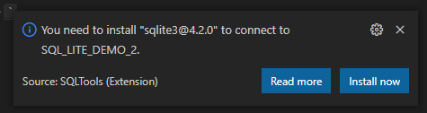
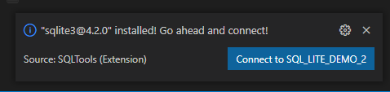
Using SQLTool VS Code Extension
If after reload, VS Code asking for install SQLite dependency, Just click Install Now,
Then, we can connect using our database connection,

Slide 16
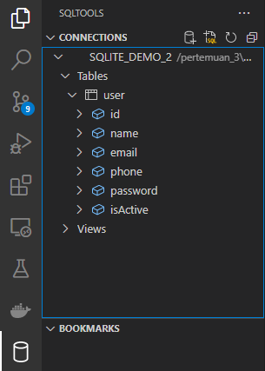
Using SQLTool VS Code Extension
If we can see the User table structure like below, that’s mean we are successfully connected to sample_db.sqlite

Slide 17
Flask - SQL Alchemy (Model Relationship)
1. Creating Model
2. Model Relationship (1 to many)

Slide 18
Creating Model
In configuration part, we use below file structure to manage our Data Model and Configuration.
Previously we are also able to build User model inside model.py and save taht definition inside sample_db.sqllite
config.py
Now we will learn deep more about creating Data Model using Flask-SQLAlchemy.
More about Declaring Model Flask-SQLAlchemy
model.py
app.py

Slide 19
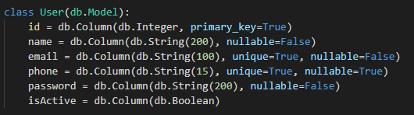
Creating Model
The baseclass for all your models is called db.Model.
It’s stored on the SQLAlchemy instance you have to create.
Use db.Column to define a column. The name of the column is the name you assign it to.
If you want to use a different name in the table you can provide an optional first argument :
username = db.Column(“USERNAME”, db.String(80), unique=True, nullable=False)
Primary keys are marked with primary_key=True.
Primary Key is a field in Table which uniquely identifies each row/record. [Primary-Key]
pertemuan_3\3_Model_n_Relationship\model.py

Slide 20
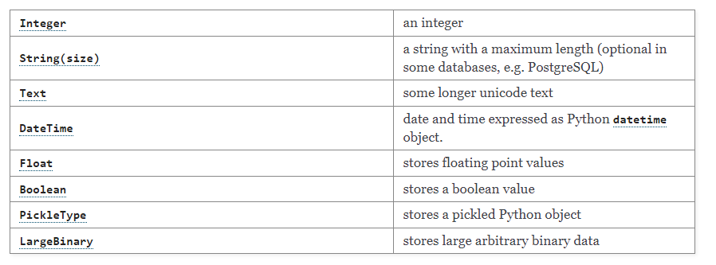
Creating Model
Supported Column Type :
in db.Column() we are also able to set is nullable or unique by assigning them to True or False.

Slide 21
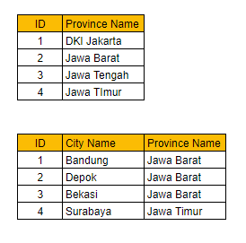
Model Relationship (1 to many)
1 to Many : When one row in our Data Model is linked with relationship to other Data Model row data.
Province is 1-to-Many into City Data Model,
So 1 row in Province has a many relation into multiple row in City Data Model.
PK : Primary Key
FK : Foreign Key
Province
City
Id (PK)
Id (PK)
ProvinceId (FK)
A FOREIGN KEY is a field (or collection of fields) in one table, that refers to the PRIMARY KEY in another table. [W3school - Foreign Key]

Slide 22
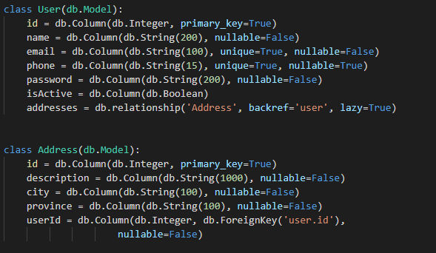
Model Relationship (1 to many)
Let’s create a new Data Model called Address and add forein key userId by specifing db.ForeignKey(‘user.id’) with type Integer.
So what the purpose of addresses field inside User ?
That field is relationship field defined by db.relationship() into Address data model.
With this we can retrieve related address into that user.
So what do backref and lazy mean?
to declare new property in Address Class , so we can retrieve a User data from adress object like my_address.user
lazy defines when SQLAlchemy will load the data from the database
pertemuan_3\3_Model_n_Relationship\model.py

Slide 23
Flask - SQL Alchemy (Insert & Update)
1. Flask - SQL Alchemy (Insert Statement)
2. Flask - SQL Alchemy (Update Statement)

Slide 24
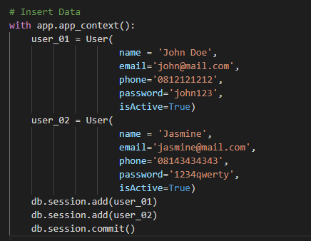
Flask - SQL Alchemy (Insert Statement)
Now that you have declared models it’s time to query the data from the database.
pertemuan_3\4_Insert_Statement\app.py
To insert into User we need to create an object derived from User class with value field difined.
Use db.session.add(object) will issue an INSERT statement into database.
Then db.session.commit() will make an inserted data presited in database.

Slide 25
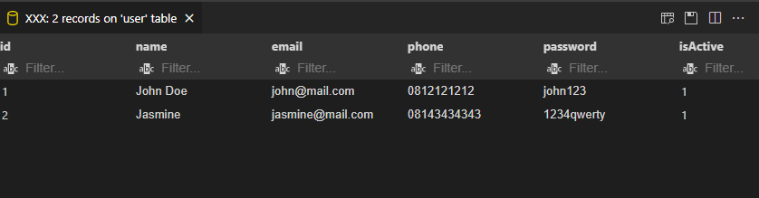
Flask - SQL Alchemy (Insert Statement)
Just connect using SQLTool to check if data is exist in database (pertemuan_3\4_Insert_Statement\sample_db.sqlite)

Slide 26
Flask - SQL Alchemy (Select Statement)
So how do we get data back out of our database?
Flask-SQLAlchemy provides a query attribute on your Model class.
When you access it you will get back a new query object over all records.
You can then use methods like filter() and filter_by() to filter the records.
before you fire the select with all() or first().
If you want to go by primary key you can also use get()
also you will be able to order the data using order_by()
and you can use limiting expression to limit number of row retrieved using limit()

Slide 27
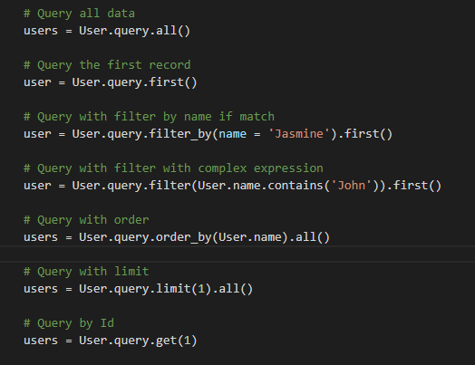
Flask - SQL Alchemy (Select Statement)
pertemuan_3\5_Update_Statement\app.py
More detail abour Query property and Method :
SQLAlchemy Query

Slide 28
Flask - SQL Alchemy (Select Statement)
Another method iside query object is :
count() : Return a count of rows this the SQL formed by this Query would return.
distinct() : Apply a DISTINCT to the query and return the newly resulting Query.
group_by() : Apply one or more GROUP BY criterion to the query and return the newly resulting Query.
join() : Create a SQL JOIN against this Query object’s criterion and apply generatively, returning the newly resulting Query.
subquery() : Return the full SELECT statement represented by this Query, embedded within an Alias.
union() : Produce a UNION of this Query against one or more queries.
More Detail : https://docs.sqlalchemy.org/en/14/orm/query.html#sqlalchemy.orm.Query.join

Slide 29
Create User Form & Save into Database
1. Handle Submit on Save Button

Slide 30
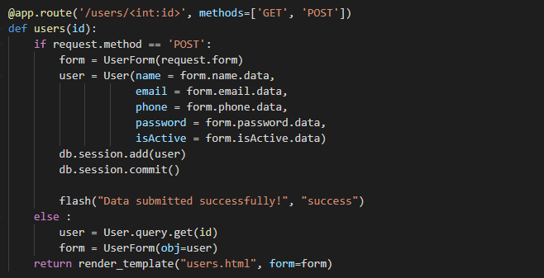
Handle Submit on Save Button
Now, we will interact with form created by WTForm with Model created using SQLAlchemy.
pertemuan_3\6_Interation_with_From\app.py
To handle submit button (POST) and store submitted data into database, we need assign WTForm field into User Model.
To handle GET we just select into the database and assign the result to WTForm object.

Slide 31
Handle Submit on Save Button
Then check the data using SQL Tool Extension to ensure data exist in database.

Slide 32
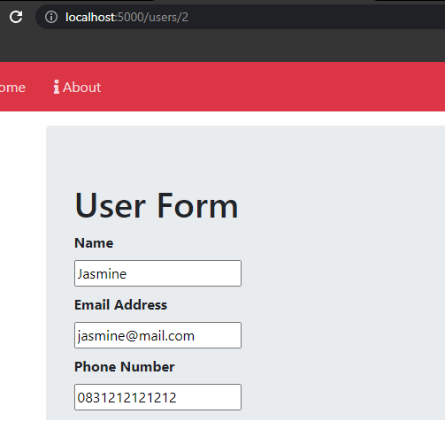
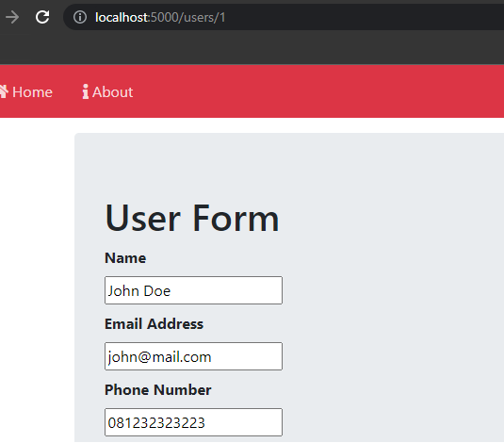
Handle Submit on Save Button
Try submitting the data using User form in http://localhost:5000/users/0, after that view the submitted data by specifying Id of the Record.

Slide 33
Create User Table & Pagination
1. Create Table Record & Link
2. Create Tabel Filter -> Move to the next part
3. Create Pagination & Line Counter -> Move to the next part
4. Create Delete & Update Button -> Move to the next part

Slide 34
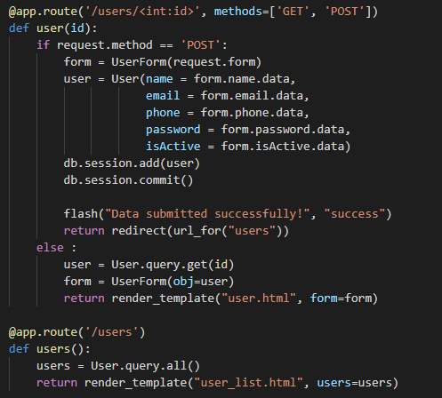
Create Table Record
change function users into user
and change also return that function using Flask redirect to redirect into users view (list of users).
we need to import that redirect function at the top app.py
Then create a new view to handle user_list.html template in path http://localhost:5000/users called as users()
Query all users data and return that result into user_list.html

Slide 35
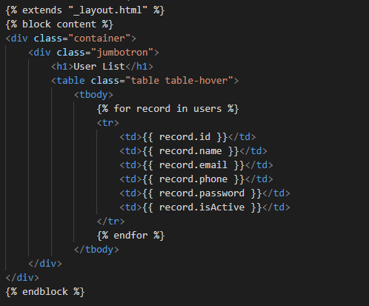
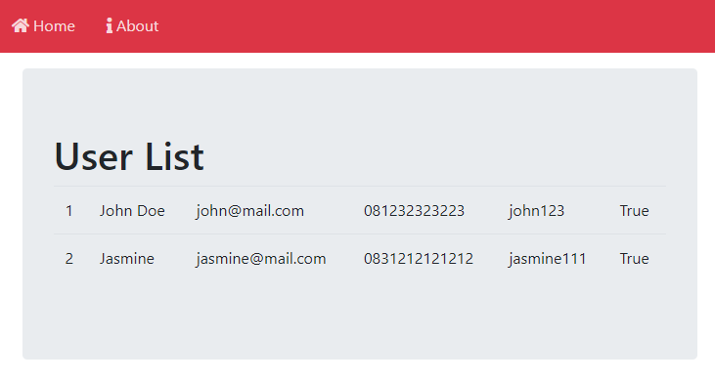
Create Table Record
Then inside user_list.html template just put the following content to render users data into html table record.
Since the users data is multiple record as list, we can do a jinja loop on each table row <tr> , then accessing each element one by one inside table cell<td>

Slide 36
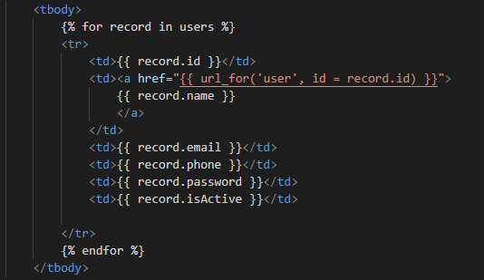
Create Table Record Link
To add link into our Table Record, just put tag <a> than set href into user form URL using url_for() function.
Navigate into User Form in
http://localhost:5000/users/<id>

Slide 37
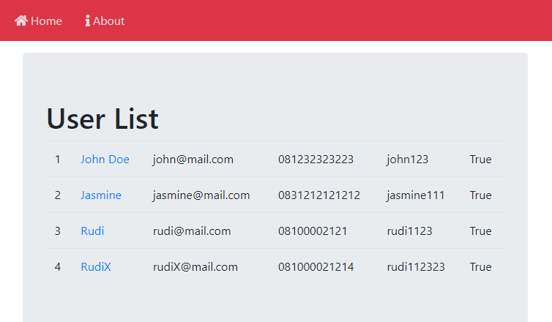
Create Table Record Link
Then now, the Table Record inside User List has URL navigate into user form.
Just try to click that link.

Slide 38
The End

