Slide 1


Web Development
#4
Project Structure

Slide 2
Training Outline
Project Structure
Template Widget
Flask - View/Routing Part 2 (Advance Routing) -> move to the next part
Static Files & Upload -> move to the next part

Slide 3
Organization patterns
1. Organizing Project
2. Organization patterns

Slide 4
Organizing Project
Repository VS Package VS Module
Repository - This is the base folder where your applications sits. This term traditionally refers to version control systems, which you should be using.
Package - This refers to a Python package that contains your application’s code.
Module - A module is a single Python file that can be imported by other Python files. A package is essentially multiple modules packaged together.
README.md
.gitignore
env
.git
LICENSE
app/
app.py
model.py
template/
https://exploreflask.com/en/latest/organizing.html

Slide 5

Organizing Project
Package Structure
app/
Inside Python Package Folder at lease there is an __init__.py exist to tell Python that this folder is package.
We can leave it blank or can put anything Python Code that we want to start on Package imported.
Then outside this package, we can import them by :
__init__.py
model.py
form.py
view.py

Slide 6
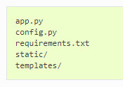
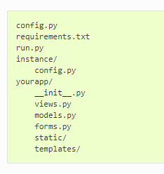
Organization Pattern
Single module
Package
keep all of the code in a single file (app.py).
This is great for quick projects (tutorial).
Just need to serve a few routes.
Less than a few hundred lines of application code.
Project that’s a little more complex,
You’ll need to define classes for models and forms,
The, serve as a package is solution.
https://exploreflask.com/en/latest/organizing.html

Slide 7
Organization Pattern
Package
run.py | This is the file that is invoked to start up a development server.
requirements.txt | This file lists all of the Python packages that your app depends on.
config.py | This file contains most of the configuration variables that your app needs.
/instance/config.py | This file contains configuration variables that shouldn’t be in version control. Like API keys and database URIs containing passwords. This also contains variables that are specific to this particular instance of your app.
/yourapp/ | This is the package that contains your application.
/yourapp/__init__.py | This file initializes your application and brings together all of the various components.
/yourapp/views.py | This is where the routes are defined. It may be split into a package of its own (yourapp/views/)
/yourapp/models.py | This is where you define the models of your application. This may be split into several modules in the same way as views.py.
/yourapp/static/ | This directory contains the public CSS, JavaScript, images and other files. It is accessible from yourapp.com/static/ by default (Public).
/yourapp/templates/ | This is where you’ll put the Jinja2 templates for your app.
Organizing Pattern

Slide 8
Organization Pattern
Package
repository/
run.py
app/
app/
__init__.py
app/
views.py
config.py
instance/
config.py
app/
models.py
app/
forms.py
app/
template/
app/
static/
Organizing Pattern

Slide 9
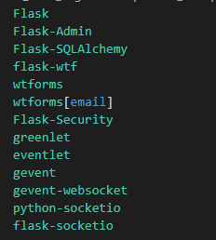
Organization Pattern
requirements.txt
This file lists all of the Python packages that your app depends on.
We can use it to install the package needed by the application.
Using pip :
pip install -r requirements.txt
Using Conda :
conda install --file requirements.txt -c conda-forge
pertemuan_4\1_Organization_patterns_example\requirements.txt

Slide 10

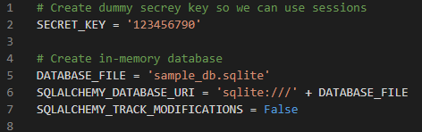
Organization Pattern
config.py VS instance/config.py
pertemuan_4\1_Organization_patterns_example\config.py
pertemuan_4\1_Organization_patterns_example\instance\config.py
common configuration
config.py can be override by instance/config.py
configuration variables that contain sensitive information
hiding secrets like database passwords and API keys
defining variables specific to a given machine/environment.
to hide instance/ folder from version control, we need to add this path in .gitignore of the repository.

Slide 11

Organization Pattern
Importing config.py and instance/config.py to our app
pertemuan_4\1_Organization_patterns_example\app\__init__.py
When defining Flask app object, we need to set parameter instance_relative_config to True
Then we can use :
app.config.from_object(‘config’) : to load config.py
app.config.from_pyfile(‘config.py’) : to load instance/config.py
Remember :
If we put the same configuration variable inside config.py and instance/config.py, when it loaded the evective value will be used from instance/config.py

Slide 12
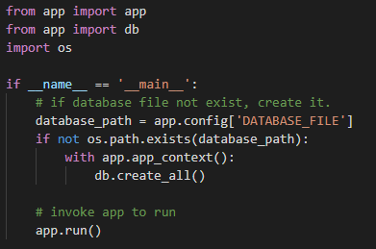
Organization Pattern
run.py
This is the file that is invoked to start up a development server.
It’s also can be used to ORM for database & model creation.
run.py use app and db object imported from app/ package.
pertemuan_4\1_Organization_patterns_example\run.py

Slide 13
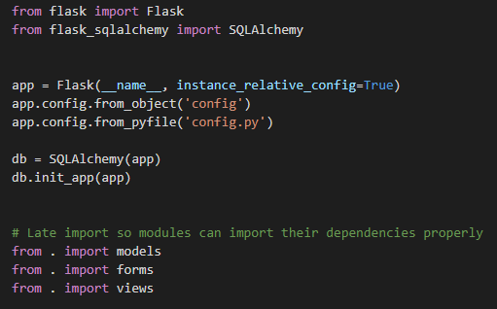
Organization Pattern
app/__init__.py
This file initializes your application and brings together all of the various components.
In this file, we can define Flask app object and SQLAlchemy db object that can be used in other file to be imported (models.py, views.py).
After that we need to do a late import for models, forms and views module,
this is important to keep importing that module after app and db object creation, to ensure dependencies loaded properly.
pertemuan_4\1_Organization_patterns_example\app\__init__.py

Slide 14
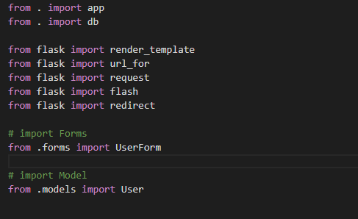
Organization Pattern
app/views.py
This is where the routes are defined.
We can import app and db object using relative import into __init__.py,
from . import app
from . import db
More about Relative Import in Python.
After that we can import necessary module.
Then also we can put all our flask route inside this views.py.
pertemuan_4\1_Organization_patterns_example\app\views.py

Slide 15
Organization Pattern
app/forms.py
app/models.py
app/templates/
app/static/
Above part is same as our previous implementation.
Jus try to run pertemuan_4\1_Organization_patterns_example\run.py to check that all everything remain the same.

Slide 16
Template Widget
1. Form Element Widget
2. Table Record Widget with Header
3. Line Counter Widget
4. Pagination Widget
5. Search & Filter Widget -> Move to the next part

Slide 17
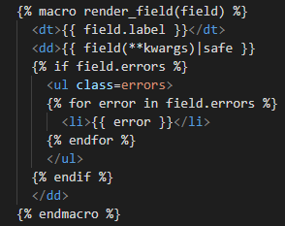
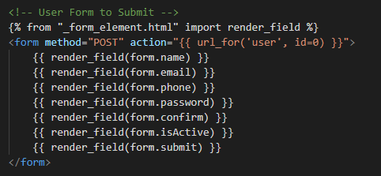
Form Element Widget
Previously we are implementing form element generation by wrapping it into _form_element.html as a Jinja2 macro.
Then inside our consumer template (e.g user.html), able to use that macro like below.
_form_element.html
user.html

Slide 18
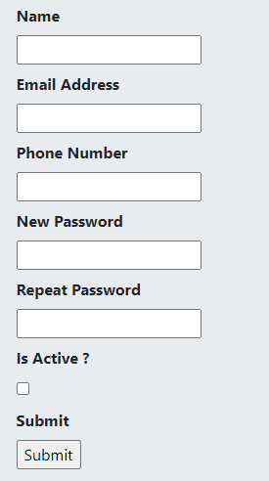
Form Element Widget (Previous Implementation)
_form_element.html
But bootstrap style is not applied yet into the template.
How we can manage this?

Slide 19
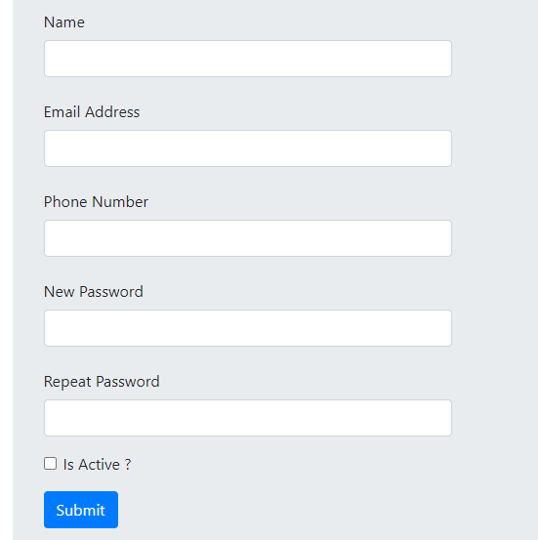
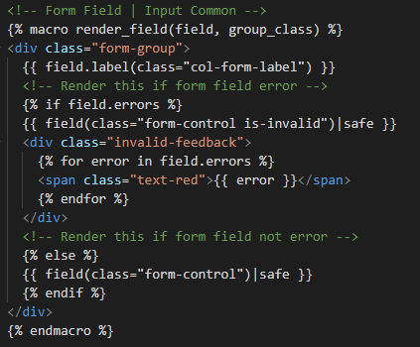
Form Element Widget (Vertical)
Now we will customizing _form_element.html to add a bootstrap style and there is and field option verticaly or horizontaly.
This is customization for Vertical Input Field.
_form_element_vertical.html

Slide 20
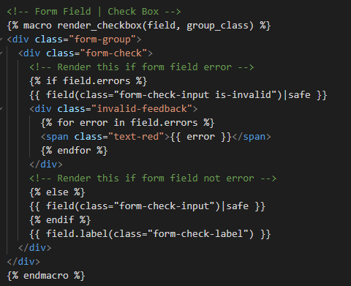
Form Element Widget (Vertical)
Now we will customizing _form_element.html to add a bootstrap style and there is and field option verticaly or horizontaly.
This is customization for Vertical Input Checkbox.
_form_element_vertical.html

Slide 21

Form Element Widget (Vertical)
Now we will customizing _form_element.html to add a bootstrap style and there is and field option verticaly or horizontaly.
This is customization for Vertical Submit Button.
_form_element_vertical.html

Slide 22
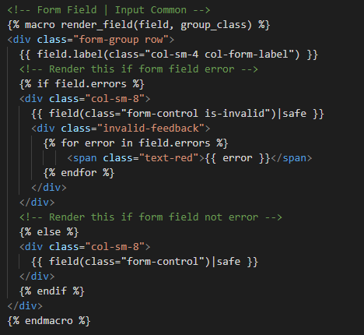
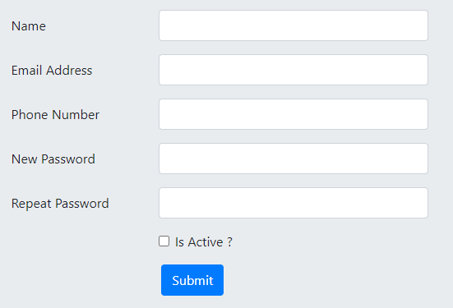
Form Element Widget (Horizontal)
Now we will customizing _form_element.html to add a bootstrap style and there is and field option verticaly or horizontaly.
This is customization for Horizontal Input Field.
_form_element_horizontal.html

Slide 23
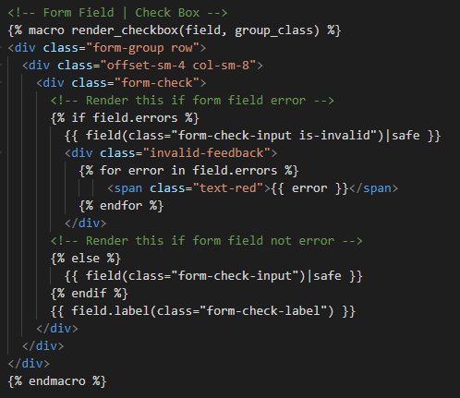
Form Element Widget (Horizontal)
This is customization for Horizontal Input Checkbox.
_form_element_horizontal.html

Slide 24
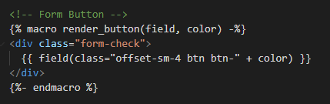
Form Element Widget (Horizontal)
This is customization for Horizontal Button Submit.
_form_element_horizontal.html

Slide 25
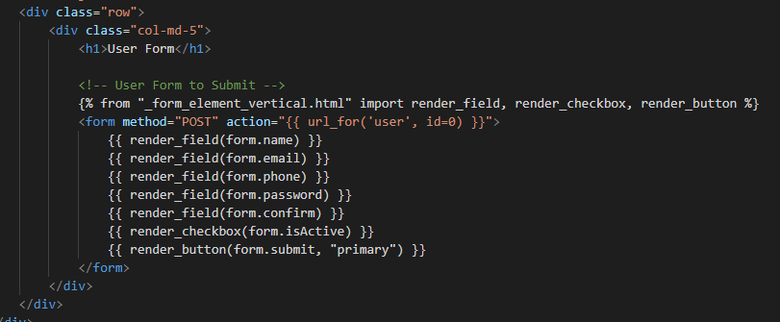
Form Element Widget
Then we can use macro inside _form_element_horizontal.html into consumer template (e.g user.html) like below,
We can import multiple macro inside _form_element_horizontal.html using above implementation,
pertemuan_4\2_Form_Element_Widget\app\templates\user.html

Slide 26
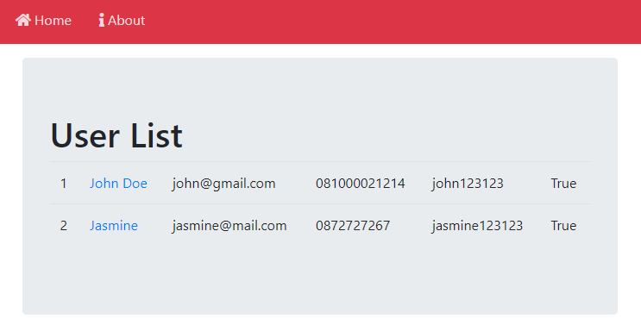
Table Record Widget with Header
In our previous implementation for Table Records, there still missing on Table header and Button to Add a new data.
Now we will try to add that feature in below Table Records

Slide 27
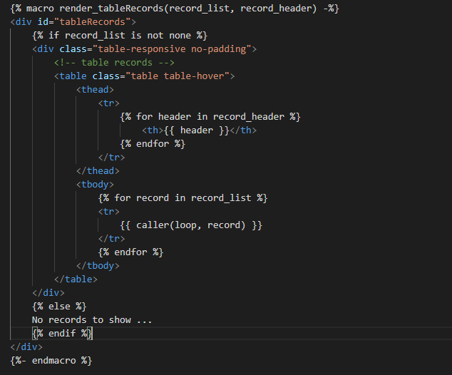
Table Record Widget with Header
Create a new widget called as _table_records.html
Inside this widget, we can put HTML <table> rendering with Header included.
Put the macro name as render_tableRecords() with input variable record_list and record_header
We also introduce other Jinja2 feature called as caller()
caller() is actualy usefull if we wan to put macro inside another macro.

Slide 28
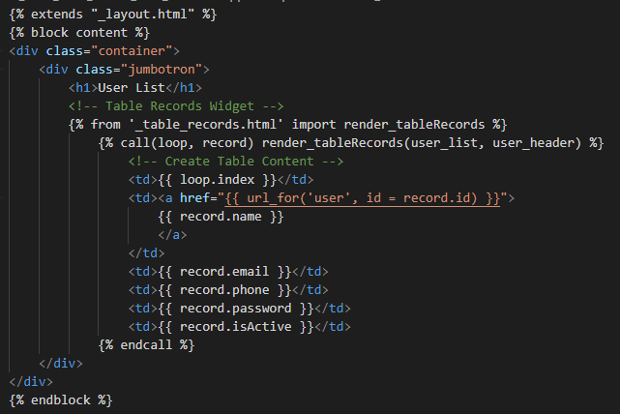
Table Record Widget with Header
Load render_TableRecords() inside consumer template (e.g user_list.html)
In this example the render_tableRecord() macro will be rendered inside consumer template.
Then each row table will be defined in Consumer template and rendered inside render_tableRecord()
More about Jinja2 Call
<th> render
call()
endcall
<td> render
<td>
_table_records.html
user_list.html

Slide 29
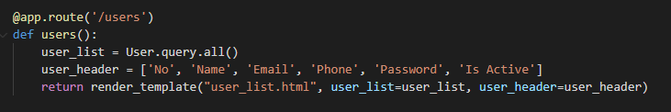
Table Record Widget with Header
Inside views.html in /users route, we can modifyto be like this,

Slide 30
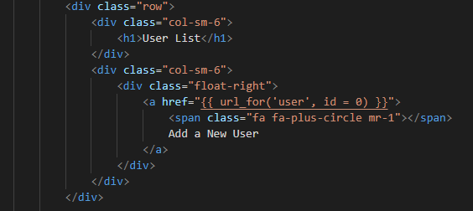
Table Record Widget with Header
The last, we an put Link to add a new data, like below,
pertemuan_4\3_Table_Record_With_Header\app\templates\user_list.html

Slide 31
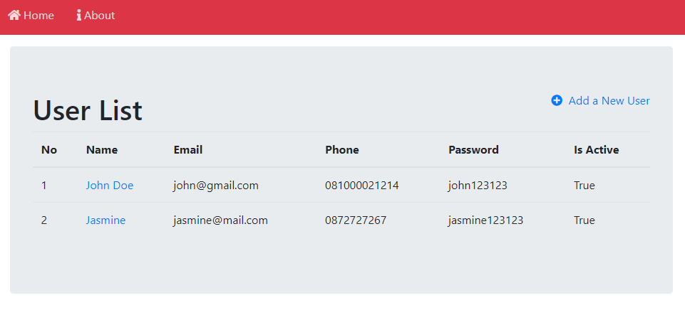
Table Record Widget with Header
Then result shoul look like this,

Slide 32
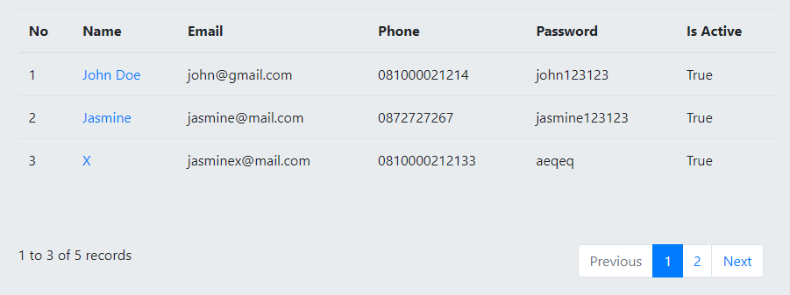
Line Counter & Pagination Widget
Line Counter & Pagination is part of how we dislaying a Table Record.
Flask support Pagination that we can find more in Flask Pagination

Slide 33
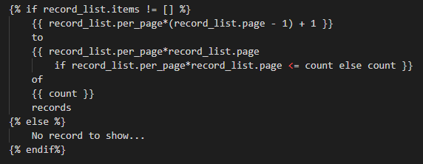

Line Counter Widget
Line Counter is Common element in Table Record, to show how many data shown in curren page relative to total data.
To do this, we need to create a new widget in _line_counter.html to be used as line counter.
pertemuan_4\4_Line_Counter_n_Pagination\app\templates\_line_counter.html
pertemuan_4\4_Line_Counter_n_Pagination\app\templates\_line_counter.html

Slide 34
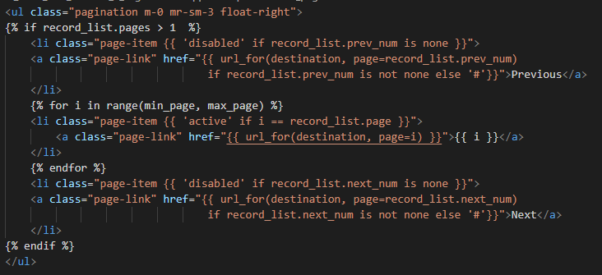

Pagination Widget
Pagination is Common element in Table Record, to navigate the table record across available page.
To do this, we need to create a new widget in _pagination.html to be used as line counter.
pertemuan_4\4_Line_Counter_n_Pagination\app\templates\_pagination.html

Slide 35
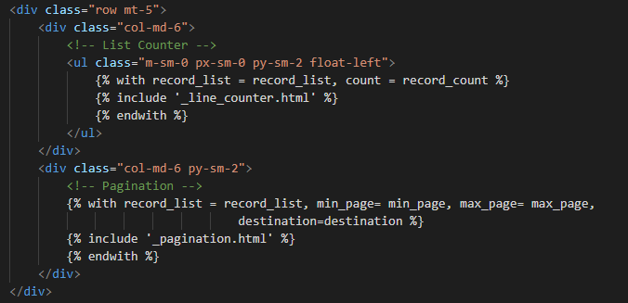
Line Counter & Pagination Widget
Then we can put _pagination.html and _line_counter.html inside _table_records.html,
pertemuan_4\4_Line_Counter_n_Pagination\app\templates\_table_records.html

Slide 36
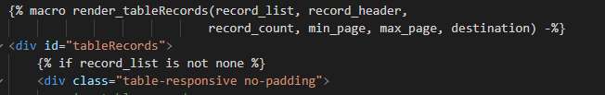
Line Counter & Pagination Widget
Since the pagination and line_counter need extra variable like min_page, max_page, destination and record_count, we need add this variable as input for render_tabelRecords() macro inside _table_records.html
pertemuan_4\4_Line_Counter_n_Pagination\app\templates\_table_records.html

Slide 37
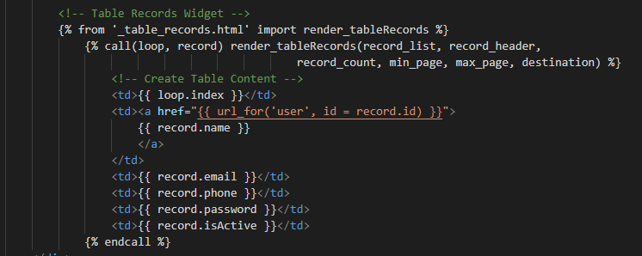
Line Counter & Pagination Widget
Then inside consumer template (e.g user_list.html), we can put like below,
The difference is only in part render_tableRecords() that need extra variable min_page, max_page, destination and record_count
pertemuan_4\4_Line_Counter_n_Pagination\app\templates\user_list.html

Slide 38
Line Counter & Pagination Widget
So, What is actualy extra variable min_page, max_page, destination and record_count ?
How we can produce them?
min_page : is page number minimum showed in table record.
max_page : is page number maximum showed in table record.
destination : is destination route when pagination elemen clicked.
That will be : users, or another route destination in views.html
record_count : is number of data retrieved in server.
That can be from : User.query.count()
min_page
max_page

Slide 39
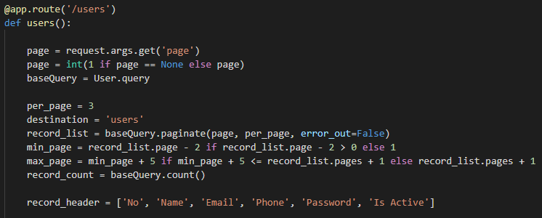
Line Counter & Pagination Widget
For above purpose, so we need to add some modification in users route inside views.html
by default, we pass page=1 when loaded a table record,
if we click another page (e.g 2), pagination widget will put page=2
http://localhost:5000/users?page=1

Slide 40
Line Counter & Pagination Widget
For above purpose, so we need to add some modification in users route inside viesw.html
base query is used to apply Flask .paginate() and .count() using a same query basis.

Slide 41
Line Counter & Pagination Widget
For above purpose, so we need to add some modification in users route inside viesw.html
per_page is actually number of record showed on each page in Table Record, we can change is as prefered.
destination is route in our views.html as a destination on pagiantion clicked.

Slide 42
Line Counter & Pagination Widget
For above purpose, so we need to add some modification in users route inside viesw.html
Flask .paginate() help us to select a data within a page and per_page parameter.
So for example we can choose to select page 2 to show 3 record.

Slide 43
Line Counter & Pagination Widget
For above purpose, so we need to add some modification in users route inside viesw.html
This is how actually we define min_page and max_page. by referring to number of page in Pagination result.

Slide 44
Line Counter & Pagination Widget
For above purpose, so we need to add some modification in users route inside viesw.html
then we can supply record_count by using Flask .count()

Slide 45
The End

