Slide 1


Web Development
#1
Layout & Theme

Slide 2
Training Outline
Programming, library, tools & debugging
Flask - Minimum App
Flask - Debug Mode
Flask - Template (HTML element) part 1
Basic Widget
Menu
Flask - Bootstrap & JQuery

Slide 3
Programming, library, tools & debugging

Slide 4


Programming, library, tools & debugging
1. Install Anaconda, Create Conda Environment & Install Library
https://www.anaconda.com/products/individual

Slide 5
Create Coda Environment & Install Library
Double click create_env_n_install_library.bat inside pertemuan_1/ directory, to automaticaly creating Conda Environment and installing necessary libraries.
Double click remove_env.bat inside pertemuan_1/ directory, to automaticaly remove Conda Environment and uninstall libraries.

Slide 6

Programming, library, tools & debugging
2. Install Visual Studio Code
https://code.visualstudio.com/

Slide 7
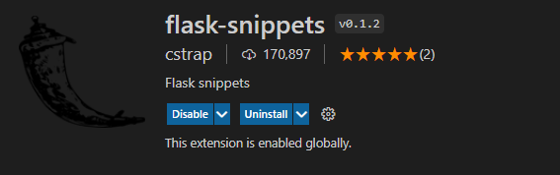
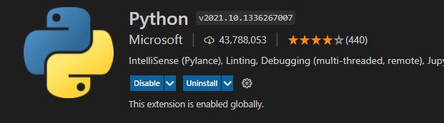
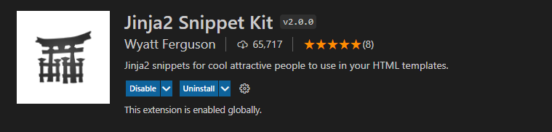
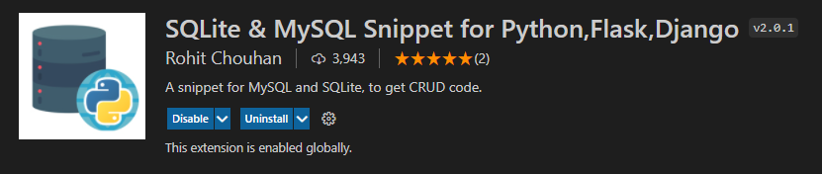
Programming, library, tools & debugging
3. Install Python Extension

Slide 8
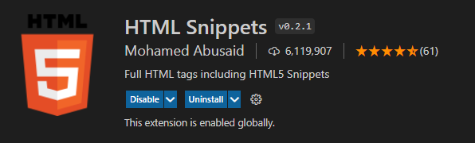
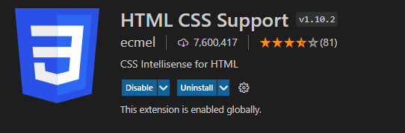
Programming, library, tools & debugging

Slide 9
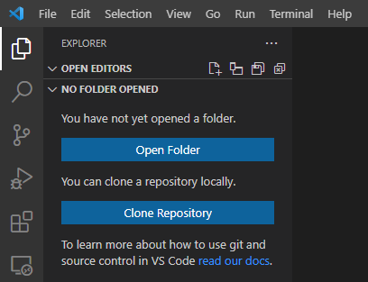
Programming, library, tools & debugging
4. Open Workspace Folder pertemuan_1/

Slide 10

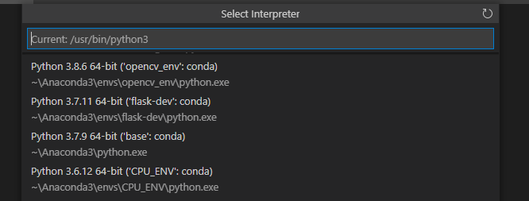
Programming, library, tools & debugging
5. Select a Python interpreter flask-dev

Slide 11
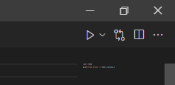
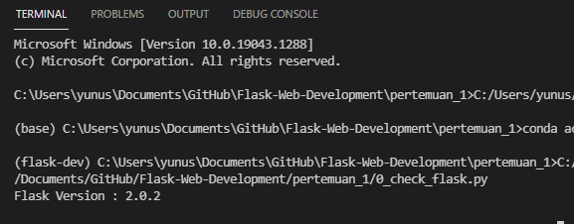
Programming, library, tools & debugging
6. Open and run Python program 0_check_flask.py by clicking play button at the to-right corner.
result should look like this,

Slide 12
Flask - Minimum App

Slide 13
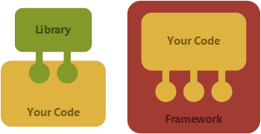
Flask
Flask is a lightweight WSGI web application framework.
It is designed to make getting started quick and easy, with the ability to scale up to complex applications.
It began as a simple wrapper around Werkzeug and Jinja and has become one of the most popular Python web application frameworks. [Github]
WSGI is the Web Server Gateway Interface.
It is a specification that describes :
how a web server communicates with web applications, and
how web applications can be chained together to process one request. [WSGI]
WSGI promote web application portability across a variety of web servers. [PEP 3333]
Framework vs Library

Slide 14




Flask vs XAMPP
Question : is Flask a substitute for XAMPP ?
XAMPP is an abbreviation for cross-platform, Apache, MySQL, PHP and Perl, and it allows you to build WordPress site offline, on a local web server on your computer. [XAMPP]

Slide 15
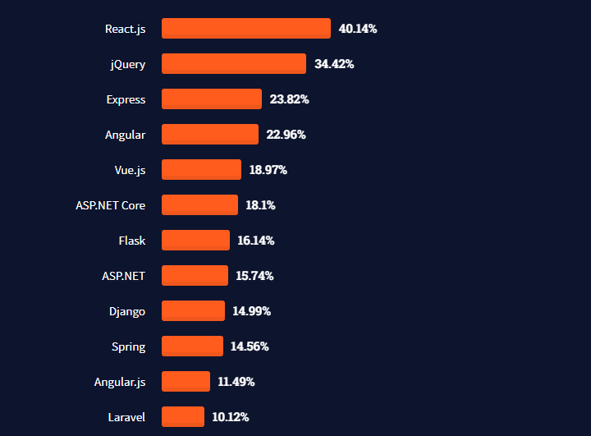
Flask
Stack Overflow - Web frameworks Survey 2021
https://insights.stackoverflow.com/survey/2021?_ga=2.246165380.1881375990.1634542895-135957014.1634542895

Slide 16
Flask
Flask Documentation :
https://flask.palletsprojects.com/en/2.0.x/
Flask on Youtube by Corey Schafer:
https://www.youtube.com/watch?v=MwZwr5Tvyxo&list=PL-osiE80TeTs4UjLw5MM6OjgkjFeUxCYH

Slide 17
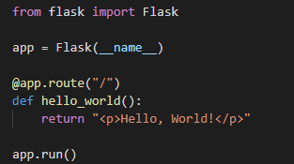
Flask - Minimum App
A minimal Flask application looks something like this (we can find it inside 1_hello.py) :
Flask is a class inside flask module as WSGI application
create an instance of this class with name app
The first argument is the name of the application’s module or package,
__name__ is a convenient shortcut for this that is appropriate for most cases.
This is needed so that Flask knows where to look for resources such as templates and static files.
use the route() decorator to tell Flask what URL should trigger our function.
function returns the message we want to display in the user’s browser (The default content type is HTML).
app.run() will start run the application
https://flask.palletsprojects.com/en/2.0.x/quickstart/#a-minimal-application

Slide 18
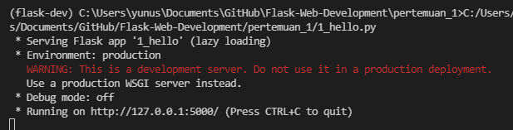
Flask - Minimum App
Open and run Python program 1_hello.py by clicking play button at the to-right corner.
Then Application will be starting,

Slide 19
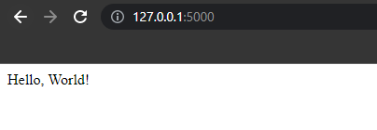
Flask - Minimum App
Open bowser and paste URL http://127.0.0.1:5000/
Then try to change the Hello World text inside 1_hello.py, then reload the web page. Is text changed?

Slide 20
Flask - Debug Mode

Slide 21
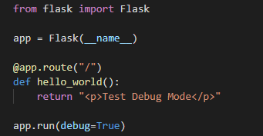
Flask - Debug Mode
By enabling debug mode, the server will automatically reload if code changes, and
will show an interactive debugger in the browser if an error occurs during a request.
debug=True on app.run() will entering Flask into debug mode.
Run the app, then try to change text inside return expression above without exiting the app,
View on the browser, the text shold be changed.

Slide 22
Flask - Template (Part 1)

Slide 23
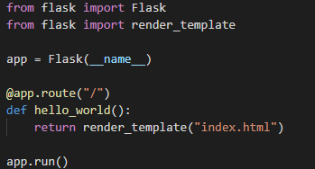

Flask - Intro to Template
A minimal Flask application with Template (we can find it inside 3_simple_flask_template.py):
To render a template you can use the render_template() method.
All you have to do is provide the name of the template and the variables you want to pass to the template engine as keyword arguments.
By default, Flask will look for templates in the templates/ folder.

Slide 24
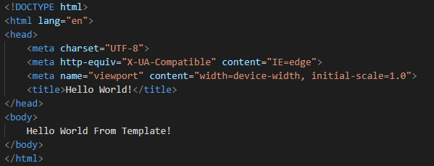
Flask - Intro to Template
HTML Template (index.html)

Slide 25
Flask - Intro to Template
If previously we are installing HTML snippets Extension, we can just type html:5 to help us creating basic html page

Slide 26
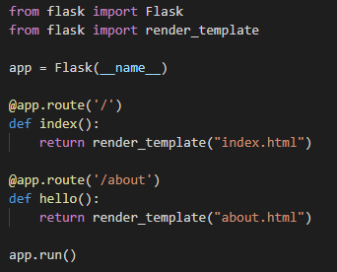
Flask - Handle multiple Template
we can use multiple app.route() to render multiple template like below (we can find it inside 4_multiple_flask_template.py)
http://127.0.0.1:5000/
http://127.0.0.1:5000/about
Advance usage Route will be explained in the next part (Flask - Route)

Slide 27
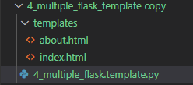
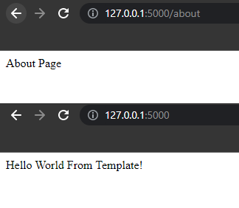
Flask - Handle multiple Template
Generated web page

Slide 28
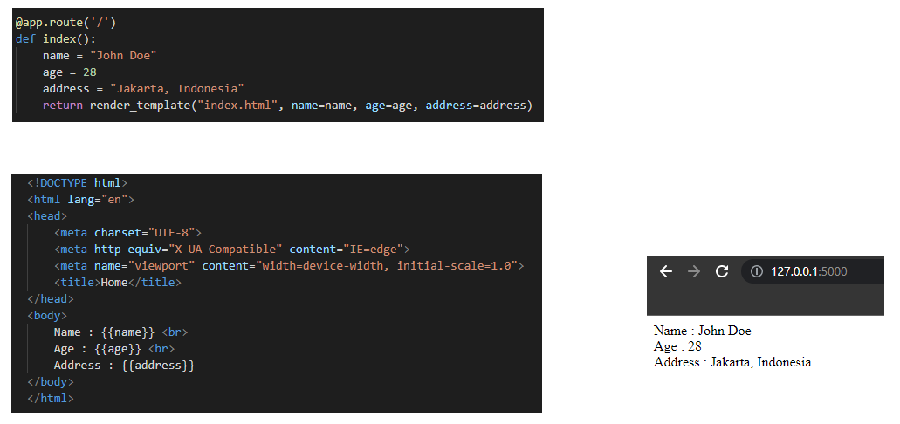
Flask - Template Parameter
We can send a variable from Flask context into rendered template via template parameter
(we can find it inside 5_template_parameter.py)
Flask using Jinja2 as a template engine that can help us to render HTML in Python
{{ ... }} is start and end string for print statement in Jinja2

Slide 29
Flask - Template Parameter
Jinja2 initialization parameter
block_start_string : The string marking the beginning of a block. Defaults to '{%'.
block_end_string : The string marking the end of a block. Defaults to '%}'.
variable_start_string : The string marking the beginning of a print statement. Defaults to '{{'.
variable_end_string : The string marking the end of a print statement. Defaults to '}}'.
comment_start_string : The string marking the beginning of a comment. Defaults to '{#'.
comment_end_string : The string marking the end of a comment. Defaults to '#}'.

Slide 30
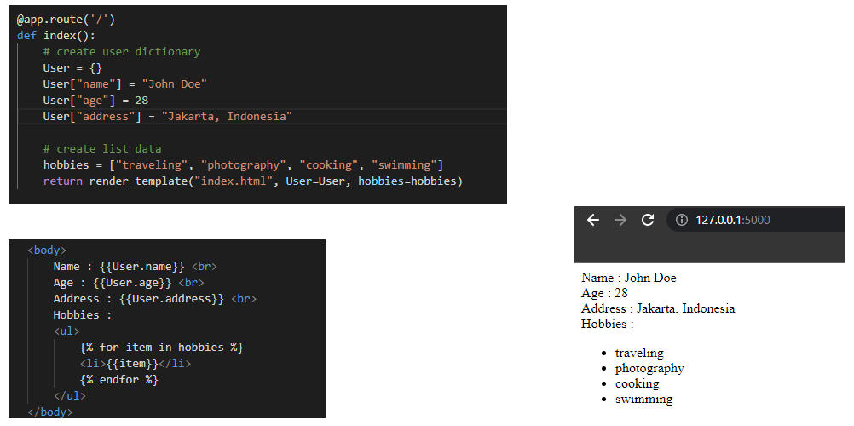
Flask - Template Parameter (continue...)
In the previous implementation we are able send simple python variable int rendered template
How about List, Dictionary or custom Object?
(we can find it inside 6_template_parameter_part2.py)
{% for item in list %} is expression to do a for loop in Jinja
{% enfor %} is expression to end a loop in Jinja

Slide 31
Flask - Template Parameter (continue...)
Jinja For Loop structure
Jinja Comparison Operator
{% for item in list %}
{{item}} {% endfor %}
{% if varX == varY %}
{% if varX != varY %}
{% if varX > varY %}
{% if varX < varY %}
{% if varX >= varY %}
{% if varX <= varY %}
Jinja If-else structure
{% if name in list %}
... do something
{% elif name == “John Doe”%}
... do something
{% else %}
.... do something {% endif %}
Jinja Membership Operator
{% if item in list %}
{% if item not in list %}
Jinja Identity Operator
{% if objectA is objectB %}
{% if objectA is not none %}

Slide 32
Flask - Link & Button

Slide 33
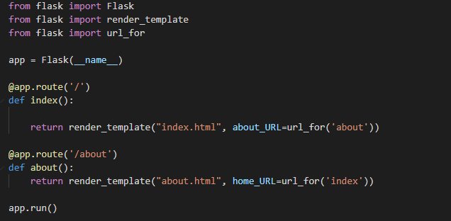
Flask - Link & Button
Link in html need a target URL to be used, we can use url_for(func_name) method to get URL for that function.
Below we have function index() that use root path / and function about() that use /about path
(we can find it inside 7_button_n_link.py)

Slide 34
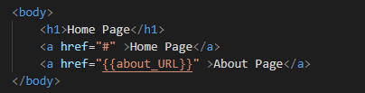
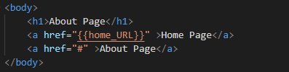
Flask - Link & Button
index.html
about.html
HTML tag for link :
<a href=”DESTINATION_URL” >label </a>

Slide 35
Flask - Bootstrap & JQuery in Base Template

Slide 36
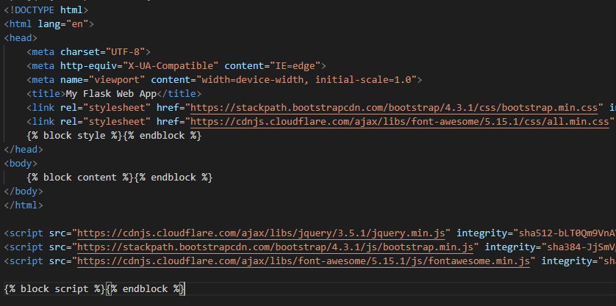
Flask - Bootstrap & JQuery in Base Template
This is simple base layout (_layout.html) inside templates/ directory,
The idea behind why we need base layout is to reduce code typing for common element, like menu, footer, etc.
(we can find it inside 8_bootstrap_n_jquery/templates/_layput.html)
{% block name %} {%endblock%} is help us sparating common area and custom element.
Load bootstrap & JQuery css from CDN
Load bootstrap, font-awesome & JQuery script from CDN

Slide 37
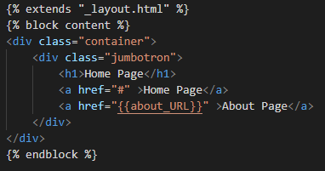
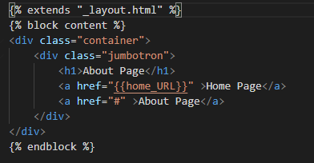
Flask - Bootstrap & JQuery in Base Template
{% extends "_layout.html" %} will include _layout.html in to that template.
_layout.html
index.html
about.html

Slide 38
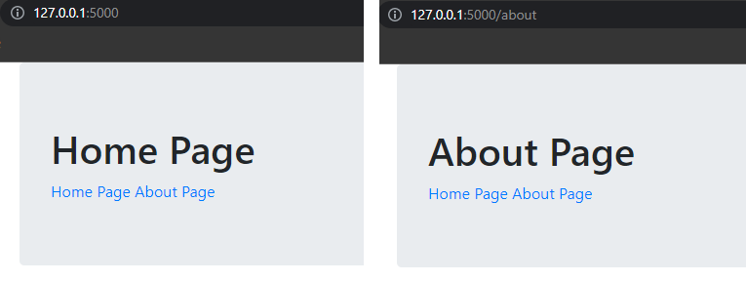
Flask - Bootstrap & JQuery in Base Template
class=”container”
and
class=”jumbotron”
is Bootstrap class to organize content
index.html
about.html

Slide 39
Flask - Bootstrap & JQuery in Base Template
Bootstrap Documentation : https://getbootstrap.com/docs/4.3/getting-started/introduction/
JQuery Documentation : https://api.jquery.com/category/version/3.5/

Slide 40
Flask - Navigation Menu

Slide 41
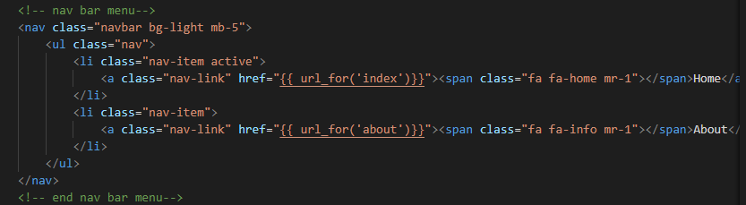
Flask - Navigation Menu
add navigation element into _layout.html
Bootstrap Navbar Documentation :
https://getbootstrap.com/docs/4.3/components/navbar/
We can use url_for(name) method inside Jinja2 template,
bg-xxx is bootstrap background color class
mb-x is bootstrap margin bottom class with size x
mr-x is bootstrap margin right class with size x
fa fa-xxx is font awesome class to display icon

Slide 42
Flask - Navigation Menu
Bootstrap Documentation (Background Color)
https://getbootstrap.com/docs/4.3/utilities/colors/#background-color
Bootstrap Documentation (Spacing, Margin, Padding)
https://getbootstrap.com/docs/4.3/utilities/spacing/
Fontawesome Documentation
https://www.w3schools.com/icons/fontawesome_icons_webapp.asp

Slide 43
The End

