Slide 1


Web Development
#7
Chart.Js & SocketIO

Slide 2
Training Outline
Flask Socket IO
Admin LTE Template
ChartJS

Slide 3
Flask - Socket IO (Part 1)
1. Emit On Connet
2. Ping Pong
3. Connnect & Disconnect
4. Disconnect Serverside

Slide 4

Flask SocketIO
Socket.IO
Bidirectional and low-latency communication for every platform.
The connection will be established with WebSocket, providing a low-overhead communication channel between the server and the client.
In case the WebSocket connection is not possible, it will fall back to HTTP long-polling. And if the connection is lost, the client will automatically try to reconnect. [https://socket.io/]
client
server

Slide 5
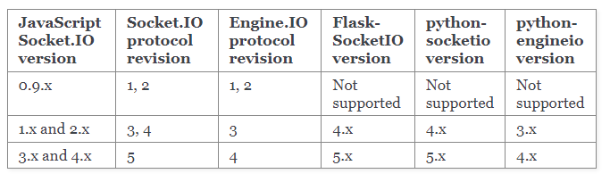
Flask SocketIO
Install Library :
pip install flask-socketio
Version compatibility

Slide 6
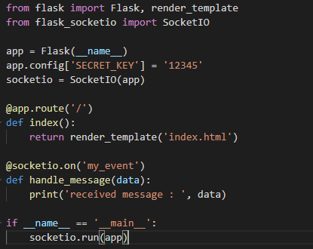
Flask SocketIO - Emit On Connect
Minimal implementation of Flask-SocketIO is look like below,
We can use decorator @socketio.on(‘my_event’) to listen and handle event with namne ‘my_event’
On the function handler, we can grab the message sent by the client.
To Invoke Flask SocketIO , we just run socketio.run(app).
This method similar to app.run() which user Flask dev web server.
There is also route in root path “/” as entry point of web app in client side.

Slide 7
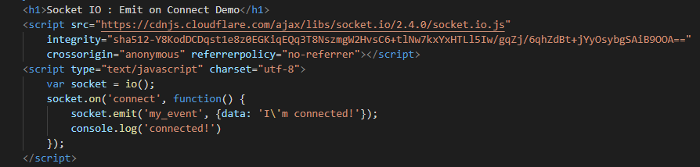
Flask SocketIO - Emit On Connect
Now in index.html (routed by root path “/”), we can put the following content,
remember : use compatible socket.io.js version with our Flask SocketIO.
The socketIO implementation in clinet side writen in Javascript.
socket.io(‘connect’, fn_callback) is method to listed if clinet connected, then the call back funtion will be executed.
Then we can use method socket.io(‘my_event’, mg) to emit / send message from client to server with event name ‘my_event’

Slide 8
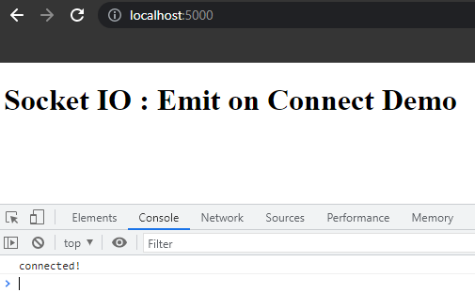
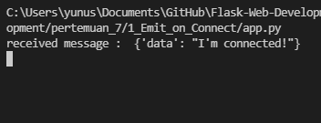
Flask SocketIO - Emit On Connect
Invoking the app by running pertemuan_7\1_Emit_on_Connect\app.py ,
Then open URL http://localhost:5000
See in the browser console and python console, there should look like this,
python console
since we print everything message sent by the client on the serverside, when client connected, the server will receive this message
browser console

Slide 9
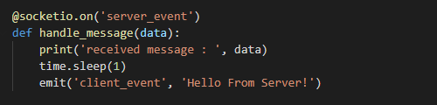
Flask SocketIO - Ping Pong
After previously we are able to emiting message from client to server in specific event,
Now we will do in both side, so the client and server will continue to send and receive a message from each other.
To do that, in server side, we need to add extra line to do emit() message from server to client in specific event.
So each time, client send the message, the the server will print that message and replaying with the server message.
Don’tforget to import emit() method from flask_socketio

Slide 10
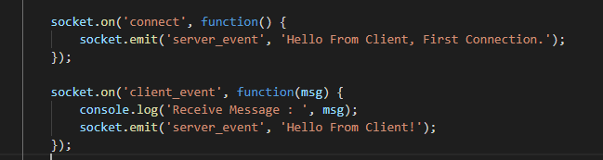
Flask SocketIO - Ping Pong
And in the client side, we can put this two SocketIO listener,
One is to listen when client connected, then emiting first message to server.
Second is to listen the client_event sended by the server,
Then we just print out that sever message in browser console, after that replaying message into the server.
client
emit on connect (first)
server
replay from server
replay from client

Slide 11
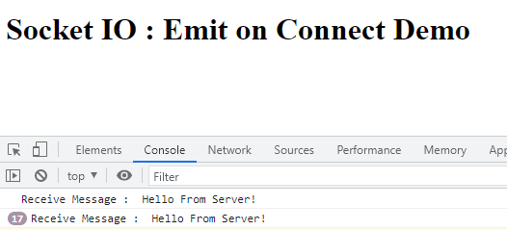
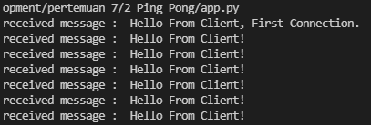
Flask SocketIO - Ping Pong
Invoking the app by running pertemuan_7\2_Ping_Pong\app.py ,
Then open URL http://localhost:5000
See in the browser console and python console, there should look like this,
python console
we can se the client and server continue to send and receive message from each other.
browser console

Slide 12
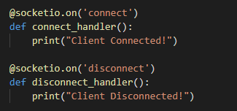
Flask SocketIO - Connect & Disconnect
After we understand the basic idea behind sending and receiving message between the client and server using SocketIO,
Now we will explore capability to do a Connect and Disconnect mechanism from the client side.
On the serverside, there is also listener when client connected or disconnected via event ‘connect’ and ‘disconnect’, by this capability, we can using it to handle anything we need when client connected and disconnected in serverside.

Slide 13

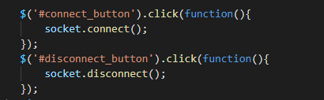
Flask SocketIO - Connect & Disconnect
On the client side, we will create two button (Connect and Disconnect) to help ups triggering SocketIO connection and disconnection.
After that, we can use JQuery method to listed when button clicked, to call socketio.connect() and socketio.disconnect()

Slide 14
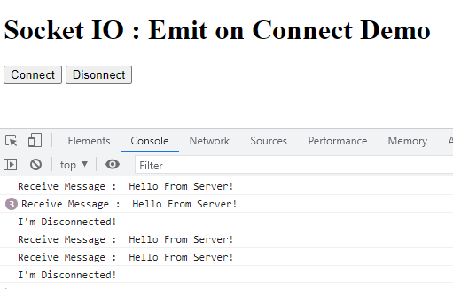
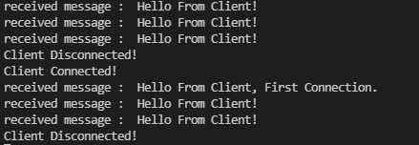
Flask SocketIO - Connect & Disconnect
Invoking the app by running pertemuan_7\3_Connect_n_Disconnect\app.py ,
Then open URL http://localhost:5000
See in the browser console and python console, there should look like this,
python console
with this capabillity, the client can decide to disconnect connection from the server if needed.
browser console

Slide 15
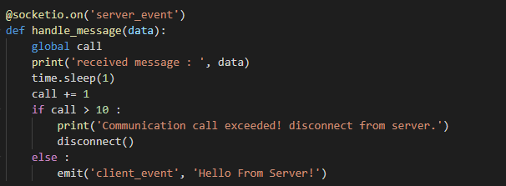
Flask SocketIO - Disconnect Serverside
Disconnecting client is possible also through the server, it’s important if we want to do something like connection rejection if client is not authenticated to the resources, or just limiting number of communication call from client to the server.
To do this, we can use method disconnect() from flask_socketio.
In this example we can using it to limiting number of communication call from client to the server,

Slide 16
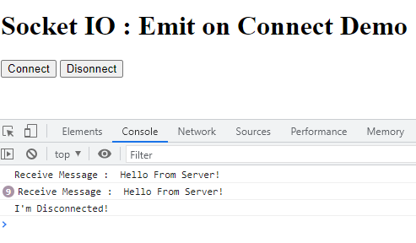
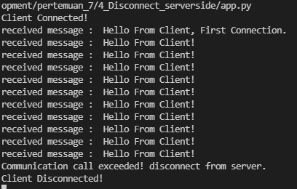
Flask SocketIO - Disconnect Serverside
In the client side (Javascript) , the implementation remaining same like previouse,
Now, we just invoking app in pertemuan_7\4_Disconnect_serverside\app.py
After that open URL http://localhost:5000
See in the browser console and python console, there should look like this,
browser console
python console
we can see, comunication is diconnected from the serverside when maximum call exceeded.

Slide 17
Admin LTE
1. AdminLTE Base Template (IoT Platform)
2. Add view into Admin LTE Template

Slide 18
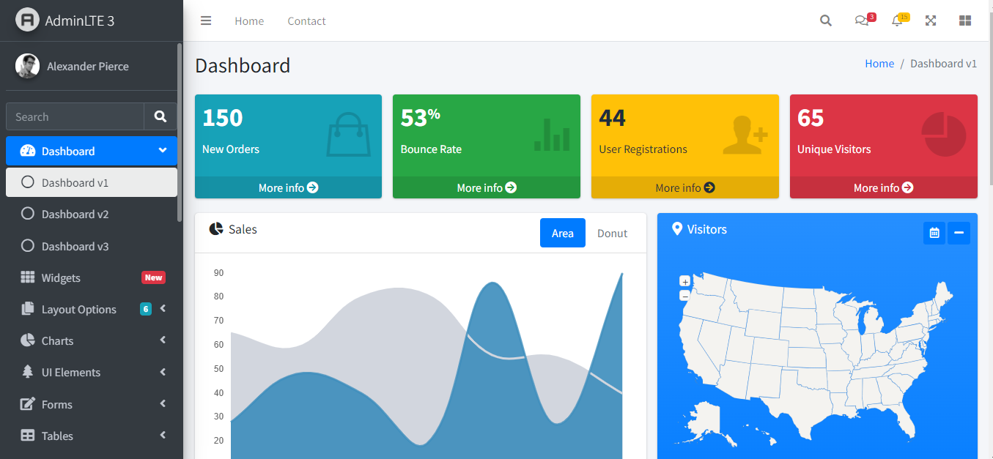
Admin LTE
AdminLTE Bootstrap Admin Dashboard Template
Best open source admin dashboard & control panel theme. Built on top of Bootstrap, AdminLTE provides a range of responsive, reusable, and commonly used components.
Preview https://adminlte.io/themes/v3/
Home Page https://adminlte.io/
Documentation https://adminlte.io/docs/3.1/

Slide 19
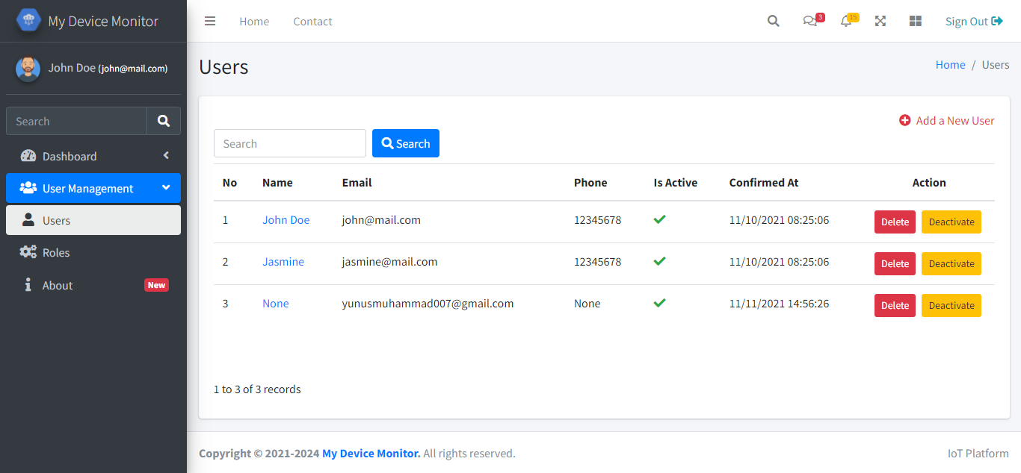
Admin LTE Base Template (IoT Platform)
All the serverside code remain the same like previouse tmplate, the different is in the template side.

Slide 20
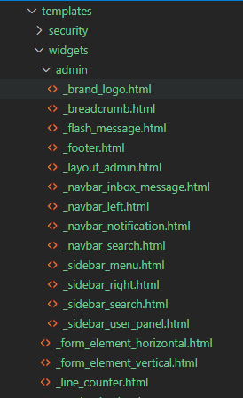
Admin LTE Base Template (IoT Platform)
We are organizing new template structure into like this,
templates/
security/
_layout_security.html
login_user.html
etc.
widgets/
admin/
_layout_admin.html
_brand_logo.html
_sidebar_user_panel.html
etc.
_form_element_vertical.html
_table_records.html
etc.
index.html
user.html
base layout in login/register/reset/change
base layout common

Slide 21
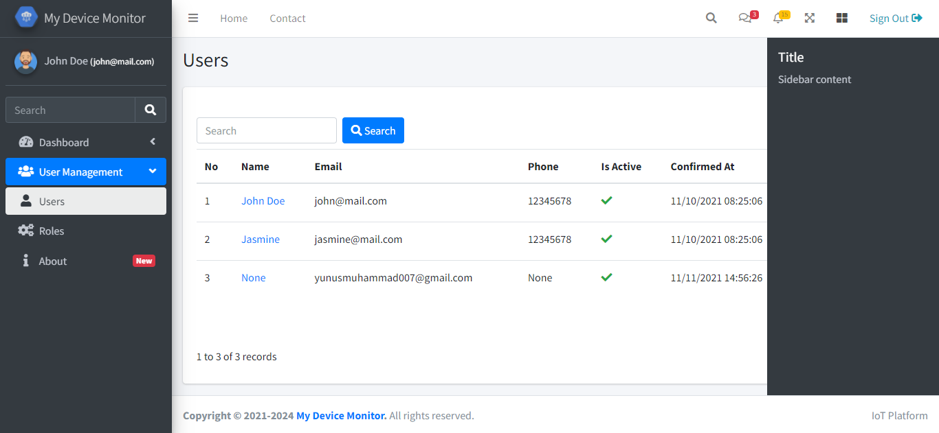
Admin LTE Base Template (IoT Platform)
_navbar_search.html
_navbar_inbox_message.html
_navbar_notification.html
_brand_logo.html
_navbar_left.html
_sidebar_user_panel.html
_sidebar_search.html
_sidebar_menu.html
_footer.html
_sidebar_right.html

Slide 22
Admin LTE Base Template (IoT Platform)
Invoking the app by running pertemuan_7\5_Admin_LTE_Base\run.py
Then open http://localhost:5000
All funtionality remaining same, register/change/reset/login/user management

Slide 23
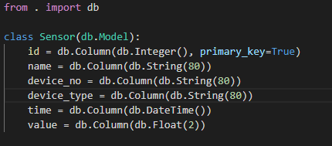
Add view into Admin LTE Template
Creating a new Model called Sensor in sensor.py under the models/ folder

Slide 24
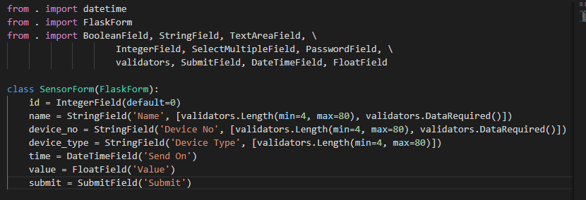
Add view into Admin LTE Template
Creating a new Form called SensorForm in sensor.py under the forms/ folder

Slide 25
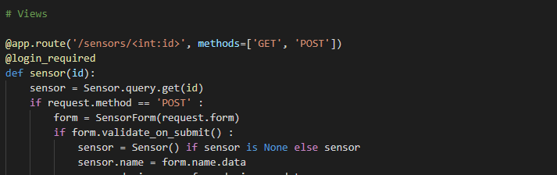
Add view into Admin LTE Template
Creating a new View in sensor.py under the views/ folder to handle Sensor List route & Sensor Detail Route.

Slide 26
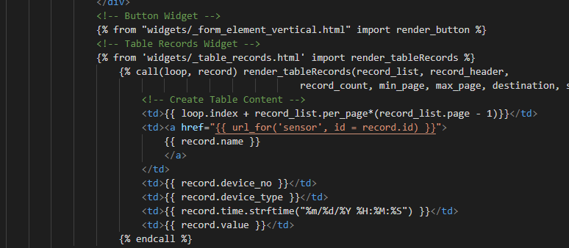
Add view into Admin LTE Template
Creating a new Template called sensor_list.html under templates/ folder to render Sensor Data List Page.

Slide 27
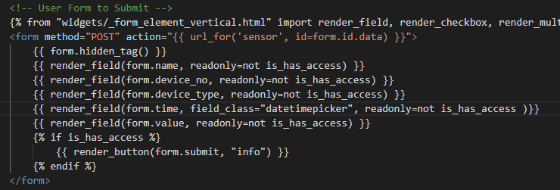
Add view into Admin LTE Template
Creating a new Template called sensor.html under templates/ folder to render Sensor Form (Detail) Page.
Since the form.time field is WTForm DatetimeField, we need to show it as datetimepicker, set the field_class=”datetimepicker”.

Slide 28
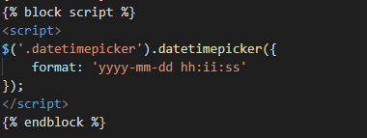

Add view into Admin LTE Template
Then at the scriptblock we can put this datetimepicker() widget method handler, to control datetimepicker configuration, etc.
This Datetimepicker using smalot-bootstrap-datetimepicker (https://cdnjs.com/libraries/smalot-bootstrap-datetimepicker), that already imported in _layout_admin.html template

Slide 29
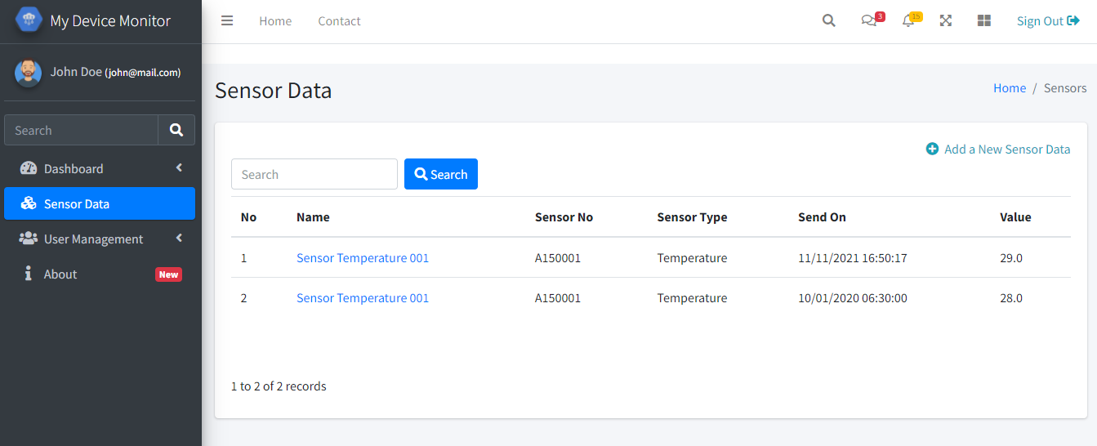
Admin LTE Base Template (IoT Platform)
Invoking the app by running pertemuan_7\6_Add_Menu_Sensor_Data\run.py
Then open http://localhost:5000
Now we have a new view to save a Sensor Data

Slide 30
Chart JS
1. ChartJS Simple
2. ChartJS Styling
3. AdminLTE Chart JS
4. ChartJS SQLAlchemy

Slide 31
ChartJS
Chart.js | Open source HTML5 Charts for your website
https://www.chartjs.org
Simple, clean and engaging HTML5 based JavaScript charts. Chart.js is an easy way to include animated, interactive graphs on your website for free.

Slide 32

ChartJS Simple
To useChartJS in our website, we need to load Chart.css and Chart.js ,
We can choose anothe version in here : https://cdnjs.com/libraries/Chart.js/

Slide 33

ChartJS Simple
Then creating <canvas> tag, this is important, since ChartJS will rendering element in canvas.
Also dont forget to put id property for that <canvas> tag.

Slide 34
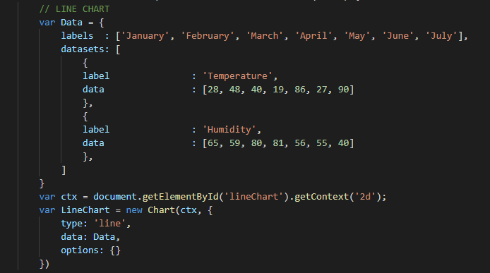
ChartJS Simple
Now, to draw, a simple line chart, just apllying this script,
If we want to create line chart, we need to create a list of labels (that will be printed in x-axis)
Then also we need to create a list object datasets, that hold our actual data with specific label. this label is different from above, since this part is important to group the data in chart if you have a mutiple series.
Then call new Chart(ctx, {}) class to draw line chart in canvas.

Slide 35
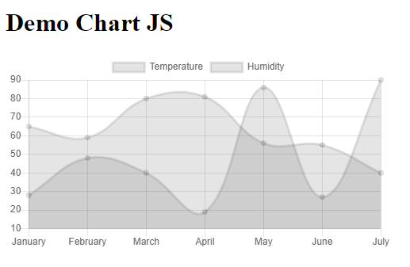
ChartJS Simple
Invoking the app by running pertemuan_7\7_ChartJS_Simple\app.py

Slide 36
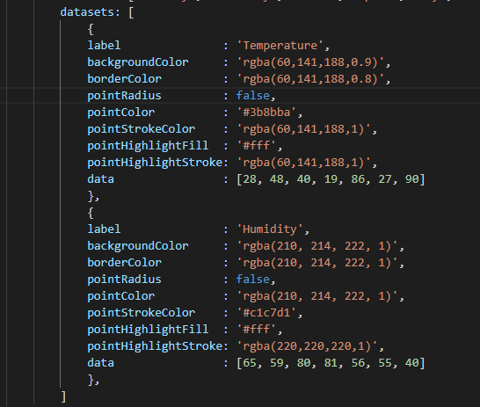
ChartJS Styling
Next, we will learn how to add a color to our series and necassary styling to make chart look better,
Change the Datasets part into something like this,
This should help us to change/modify color series/point/etc.
Wecan put hex standar code like #FFCC00 or using rgba(xxx,xxx,xxx,x) format

Slide 37
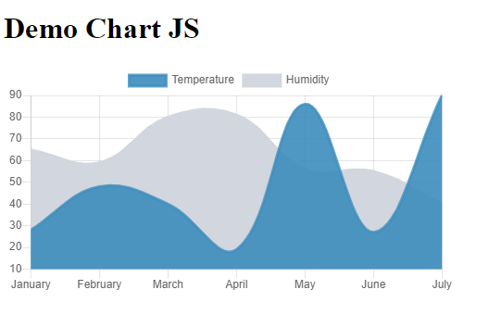
ChartJS Styling
Invoking the app by running pertemuan_7\8_ChartJS_Styling\app.py
Before
After

Slide 38
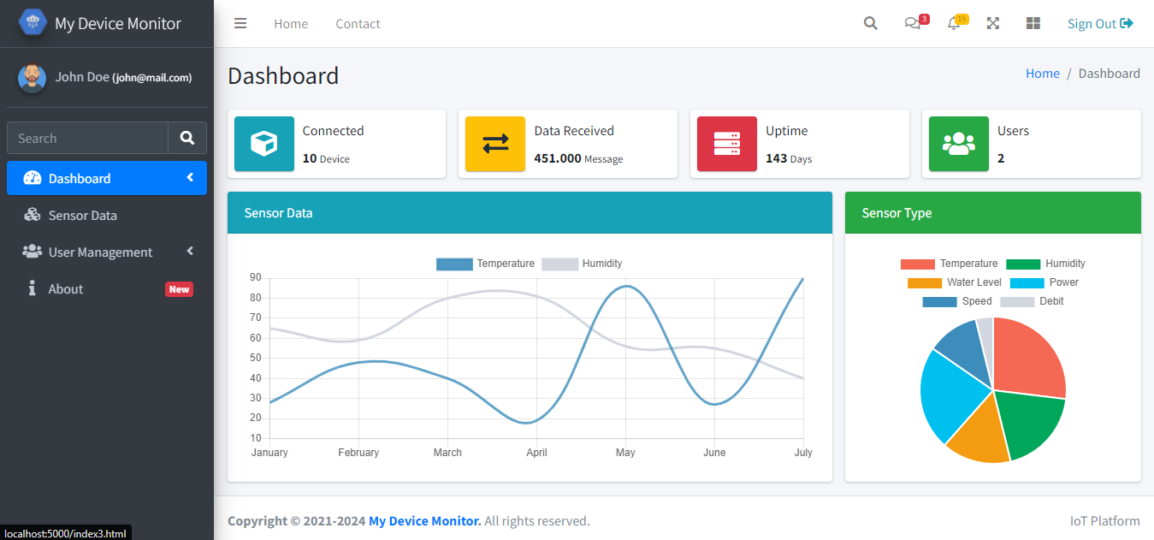
AdminLTE ChartJS

Slide 39
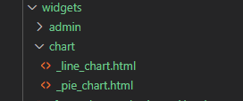
AdminLTE ChartJS
To help us creating Chart quick, we will you a chart template laced under widgets/chart/ folder
For now, there is only two template available (line chart & pie chart),

Slide 40
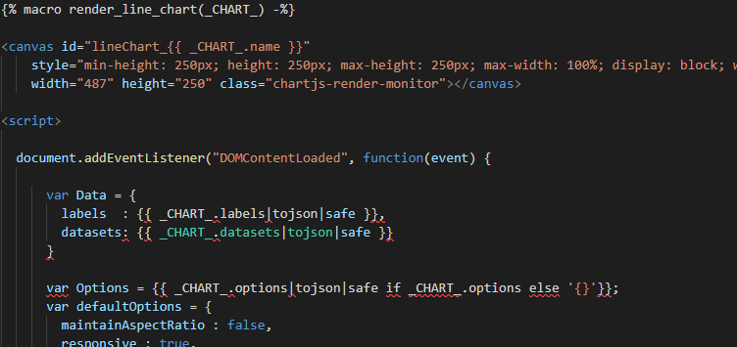
AdminLTE ChartJS
Inside _line_chart.html there is a macro called render_line_chart() that can help us generating chart in consumer template.
The variable that we pass throuh the macro is _CHART_ object that hold chart data like labels and datasets

Slide 41
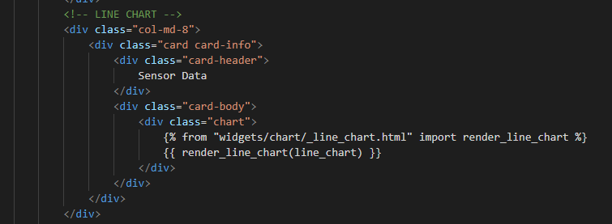
AdminLTE ChartJS
Then we will rendering chart in index.html template using this way,
Using the template is much more clean and easy to use than the previouse implementation.
In index.html we feed line_chart object into the macro render_line_chart() then next will be used by _CHART_ object inside that macro.
So what is the data that we need to put in line_chart object ?

Slide 42
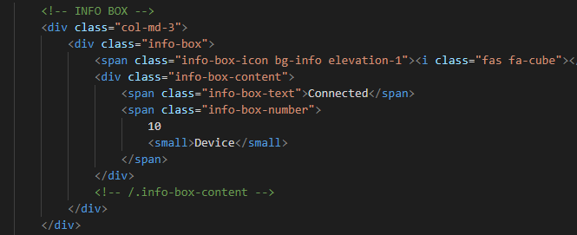
AdminLTE ChartJS
The info-box part is just a dmmy element, in the future, we will updating this part using real data.

Slide 43
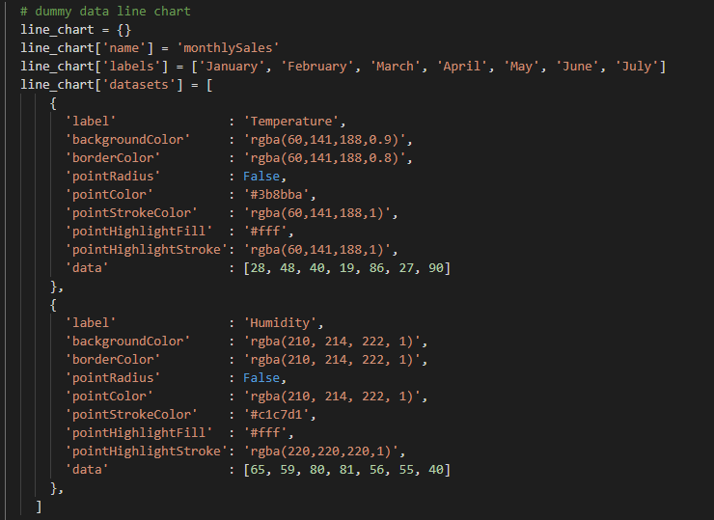
AdminLTE ChartJS
We done this part in views/home.py , just creating a disctionaly like a jeson data and configuration needed in the previouse implementation,
line_chart object is the object that we will feed into the index.html via render_template() at the end funtion route.
line_chart object containing necassary list and dictionary needed by the chart like labels, datasets, and configuration (optional).

Slide 44
ChartJS Styling
Invoking the app by running pertemuan_7\9_Admin_LTE_ChartJs\run.py

Slide 45
ChartJS SQLAlchemy
In the previouse implementation we are successfully wrapping Chartjs into the template,
Then able to feed the dummy data from the server side (flask)
Now we will use a real data from Sensor model that have an time and value taht will be interesting if we can plot it into the line chart.
To do this, we need to query all the Sensor data and sorting them by time as DESC.

Slide 46
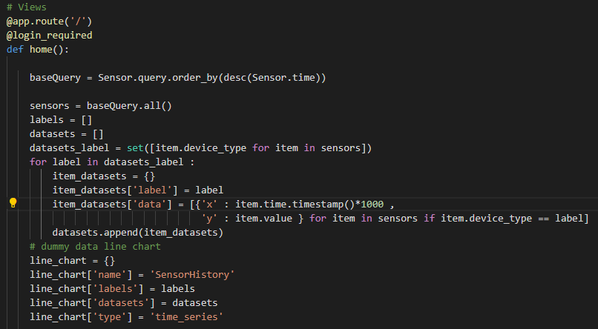
ChartJS SQLAlchemy

Slide 47
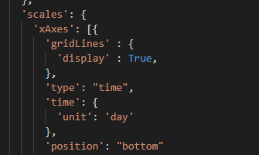
ChartJS SQLAlchemy
Since this is a little different from the tipical line chart data that we are using previously,
Now we use a timeseries data, wichis need to pe plot into the correct time position in the chart
To do this the we doesn’t need to put the labels anwe just generating the datasets object with the following structure :
[{ ‘x’ : timestamp(), ‘y’ : value},
{ ‘x’ : timestamp(), ‘y’ : value},
{ ‘x’ : timestamp(), ‘y’ : value}]
Then we also need to add extra config into xAxis to do
a specific time formating,
more config can be found in
https://www.chartjs.org/docs/2.8.0/axes/cartesian/time.html

Slide 48
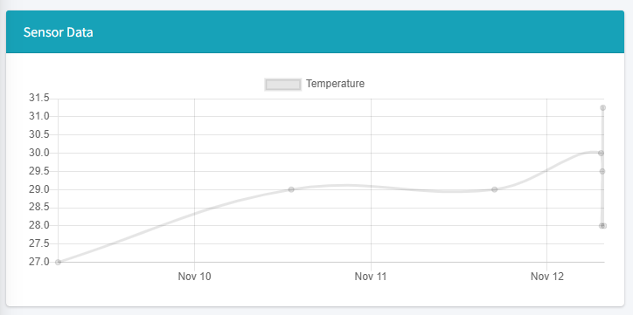
ChartJS SQLAlchemy
Then invoking the app in pertemuan_7\10_ChartJs_SQLAlchemy\run.py
Then try to imput several data into Sensor Data menu, then we can see the chart is updated with that data.

Slide 49
The End

