Slide 1


Web Development
#8
Chart.Js & SocketIO Part II

Slide 2
Training Outline
ChartJS & SocketIO
HTTP API Integration

Slide 3
ChartJs & SocketIO
1. All ChartJS Chart Sample
2. Update Chart JS data using SocketIO
3. Using Two Data Series
4. Unified Chart Control
5. Integrate with SQL Alchemy
6. Presistent Message

Slide 4
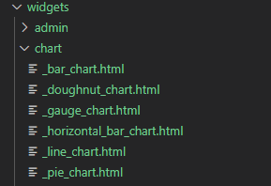
All ChartJS Chart Sample
Open : pertemuan_8\1_All_ChartJs_Sample
We have several supported ChartJS Template for speedup Chart creation under templates/widgets/chart
Here are the following template :

Slide 5
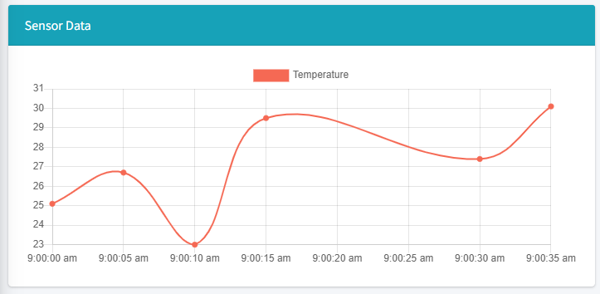
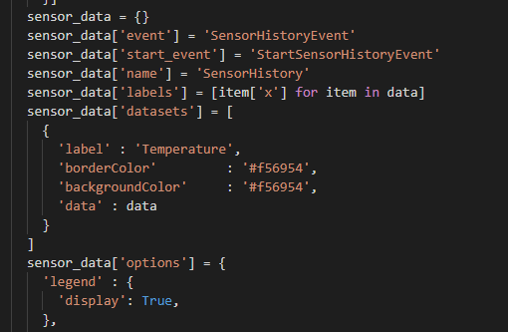
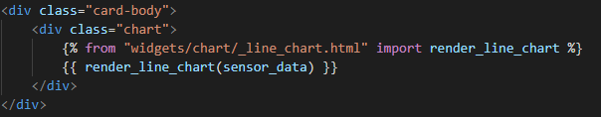
All ChartJS Chart Sample
Time Series Line Chart
Chart data inside views :
pertemuan_8\1_All_ChartJs_Sample\app\views\home.py
Render Chart in templates :
pertemuan_8\1_All_ChartJs_Sample\app\templates\index.html

Slide 6
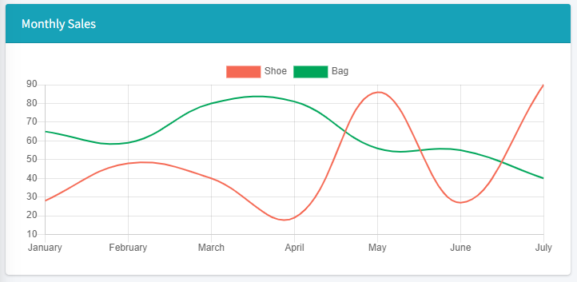
All ChartJS Chart Sample

Slide 7
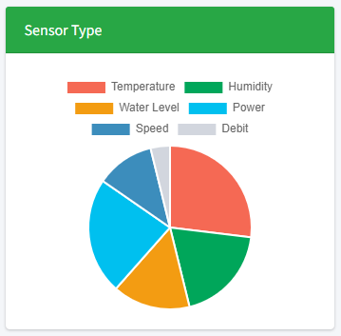
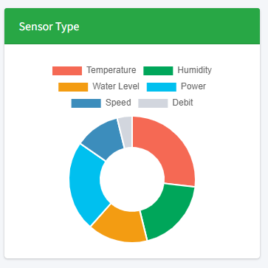
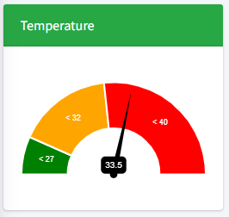
All ChartJS Chart Sample

Slide 8
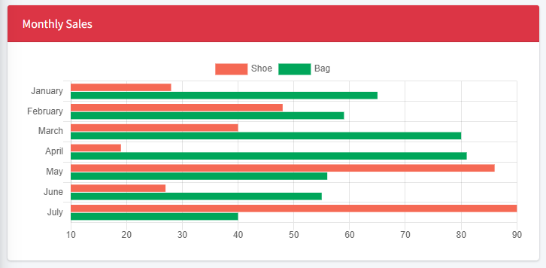
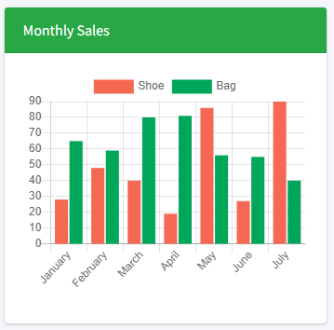
All ChartJS Chart Sample

Slide 9
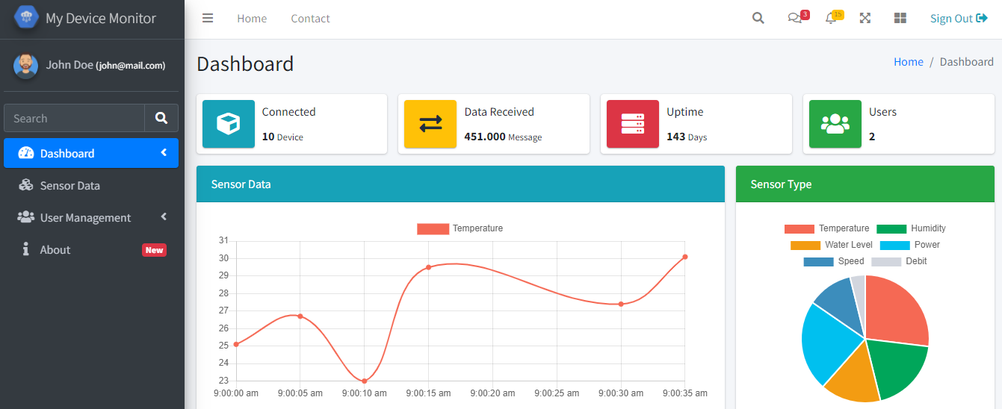
All ChartJS Chart Sample
Invoking app by run pertemuan_8\1_All_ChartJs_Sample\run.py
Open localhost:5000 in browser
See the result,

Slide 10
Update Chart JS data using SocketIO
Views (home.py)
Templates (index.html)
start Button
receive start/update event
emit start event
emit data
receive data
emit update event
pertemuan_8\2_ChartJs_SocketIO

Slide 11
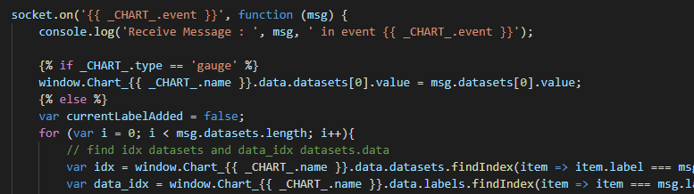
Update Chart JS data using SocketIO
We can update ChartJS data using SocketIO in Javascript
Inserting new data point into ChartsJS datasets.data and labels
Then call .update() method into our ChartJs Object.
To make it easy to use, we can put all of that funtionaliti inside a template called with _chart_control.html
pertemuan_8\2_ChartJs_SocketIO\app\templates\widgets\chart\_chart_control.html

Slide 12
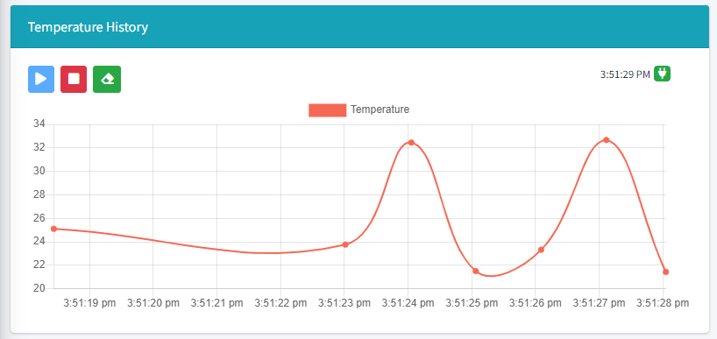
Update Chart JS data using SocketIO
_chart_control.html
pertemuan_8\2_ChartJs_SocketIO\app\templates\widgets\chart\_chart_control.html
_chart_control.html template will be rendered to be look like bellow.
We can see there is a button Start, Stop and Clear Data.
And also we have last received time and icon socketio connected/disconnected

Slide 13
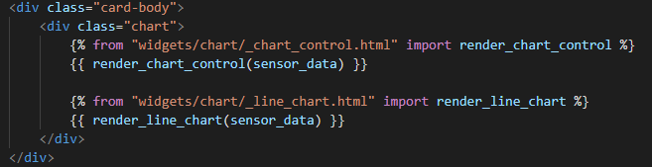
Update Chart JS data using SocketIO
To use that in our index.html template, jus call the macro render_chart_control() from _chart_control.html widgets
pertemuan_8\2_ChartJs_SocketIO\app\templates\index.html

Slide 14
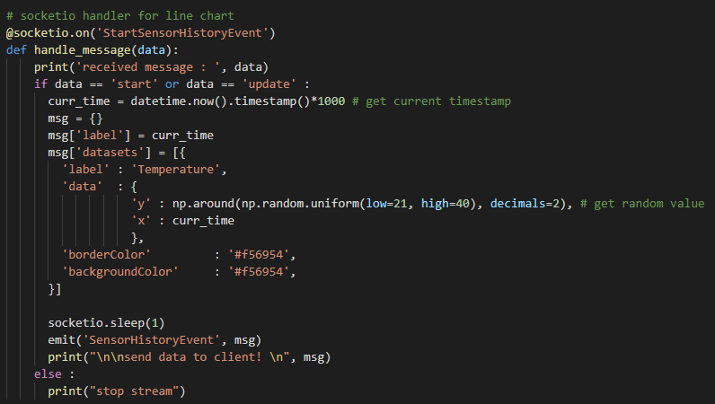
Update Chart JS data using SocketIO
Socketio Handler in Views (home.py)
Then we should add socketio event handler in serverside to receive emit message from cllient on start and update data.
We just use a simple random generator just to simulating data supertemuan_8\2_ChartJs_SocketIO\app\views\home.py.
pertemuan_8\2_ChartJs_SocketIO\app\views\home.py

Slide 15
Update Chart JS data using SocketIO
Invoking app by run pertemuan_8\2_ChartJs_SocketIO\run.py
Open localhost:5000 in browser
Then there should be a chart control exist on above our Chart,

Slide 16
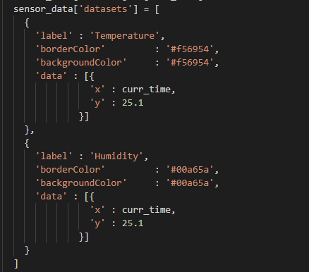
Using Two Data Series
If we want to add more than one data series in one chart, we can do the following step,
Create a List of Dictionary for ChartJs datasets.
Each dictionary item, will be rendered as a different series if we put a different label.
Then we can pass the data point on each series with pairs x,y.
Series 1
Series 2
pertemuan_8\3_Two_Data_Series\app\views\home.py

Slide 17
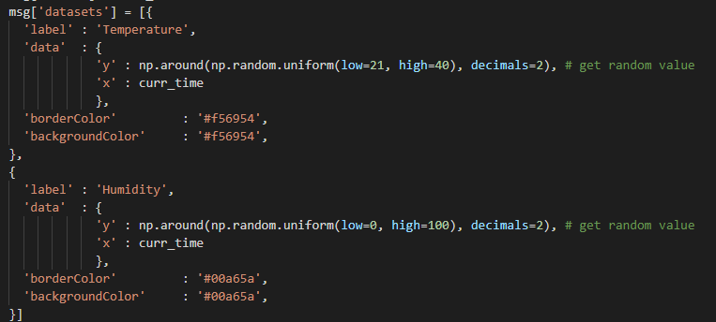
Using Two Data Series
Also for socketio event handler in serverside need to update for taht two series
Series 1
Series 2
pertemuan_8\3_Two_Data_Series\app\views\home.py

Slide 18
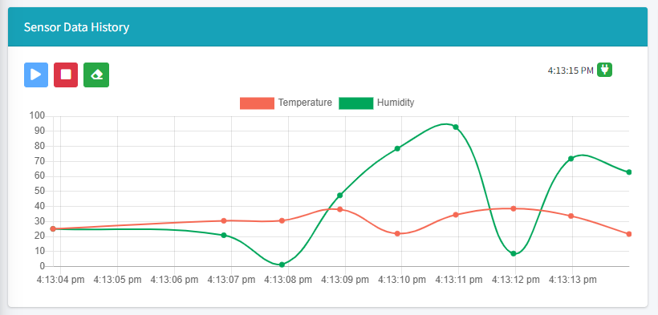
Using Two Data Series
Invoking app by run pertemuan_8\3_Two_Data_Series\run.py
Open localhost:5000 in browser
Then there should be a two data series rendered and updated by socketio

Slide 19
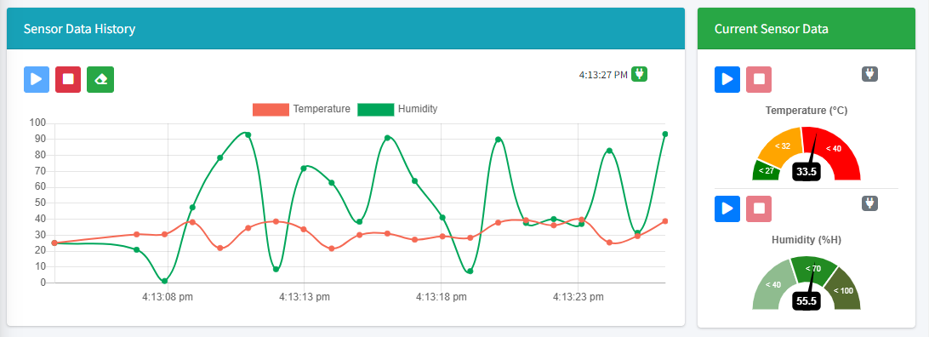
Unified Chart Control
Previously we see that each chart has own chart control to start and stop update data
But if we have multiple chart element, then we want to update it automatically by SocketIO,
Using chart control per chart is hard to use.

Slide 20
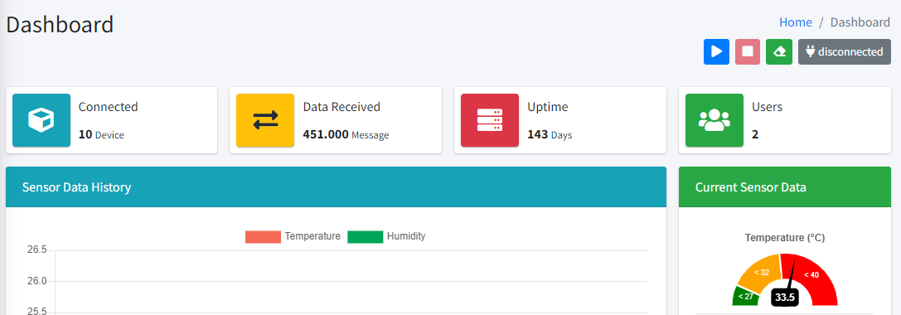
Unified Chart Control
So, now we will create a new way to render chart control that can help us to start and stop update data for all chart in our template,
To do this, we need use a different chart control widget called _unified_chart_control.html,
This _unified_chart_control.html will be rendered like below,

Slide 21
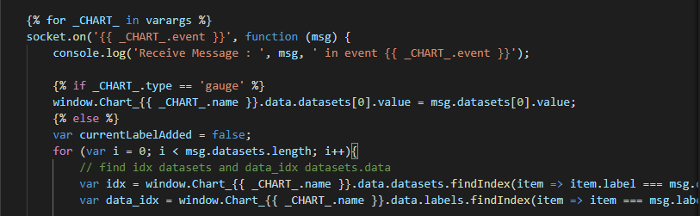
Unified Chart Control
Basicly , inside _unified_chart_control.html there is a marco render_chart_control() that can do an update data to all chart object in our template.
pertemuan_8\4_Unified_Chart_Control\app\templates\widgets\chart\_unified_chart_control.html

Slide 22

Unified Chart Control
To use this widget in our template, just put under the breadcrum section,
The important things is, to make _unified_chart_control.html able to update all series in our template we need to assign all chart object into the macro render_unified_chart_control().
All everything in serverside (Views) is remaining the same.
pertemuan_8\4_Unified_Chart_Control\app\templates\index.html
pertemuan_8\4_Unified_Chart_Control\app\templates\index.html

Slide 23
Unified Chart Control
Invoking app by run pertemuan_8\4_Unified_Chart_Control\run.py
Open localhost:5000 in browser
Then there will be an unified chart control rendered

Slide 24
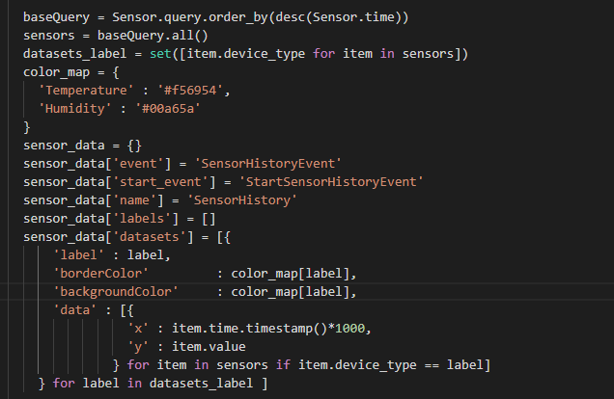
Integrate with SQL Alchemy
Previously, we are using a dummy data for our case,
Now we will query into Sensor Model to retrieve a sensor data direcly from database than used it into our chart,
To do this, we just create a Query object into Sensor model, dan inserting that result into chartjs datasets data,
pertemuan_8\5_Integrate_With_SQLAlchemy\app\views\home.py

Slide 25
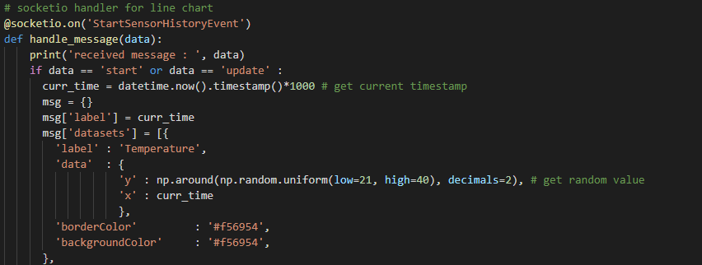
Integrate with SQL Alchemy
For the socketio event handler for start and update data in serverside, we are still use a rundom value like below,
pertemuan_8\5_Integrate_With_SQLAlchemy\app\views\home.py

Slide 26
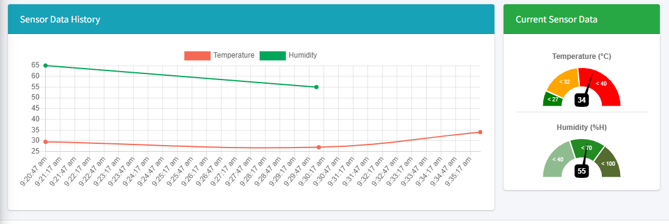
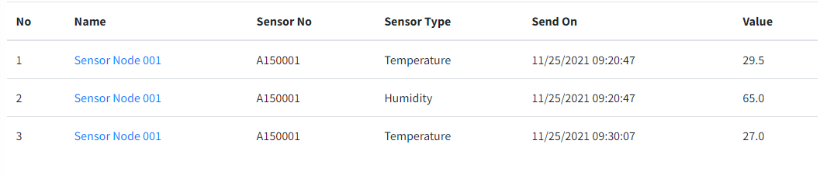
Integrate with SQL Alchemy
Invoking app by run pertemuan_8\5_Integrate_With_SQLAlchemy\run.py
Open localhost:5000 in browser
Then the first data will retrieved from Sensor Model.

Slide 27
Presistent Message
Previously we see that our random data sended by socketio from server into the client is not saved presistent in teh database,
So if we reload the page, we will loss all of that received data in our chart,
To solve this issue, we need to save the data each time socketio send that to the client.
Views (home.py)
Templates (index.html)
receive start/update event
start Button
save data
emit start event
load data
receive data
emit data
emit update event

Slide 28
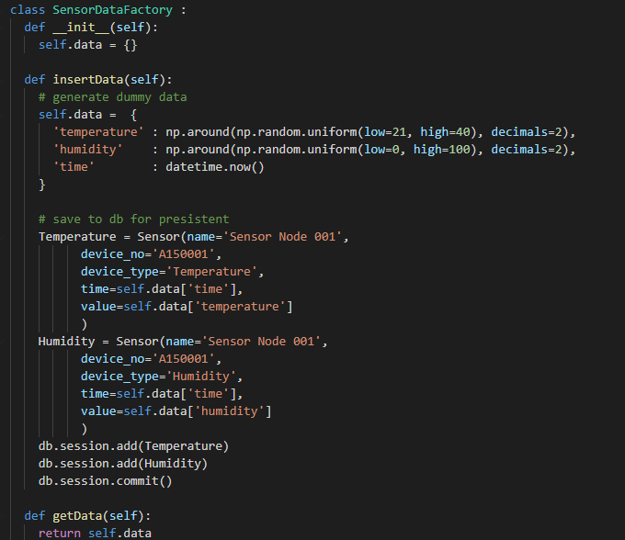
Presistent Message
To help us generating the data and inserting to database then distributing to all socketio event handler, we need to create a new class called with SensorDataFactory,
Then we just call the method .insertData() one time to insert data into database,
And we can use .getData() method in all socketio event handler to retrieve the latest data availabel.
pertemuan_8\6_Presistent_Message\app\views\home.py

Slide 29

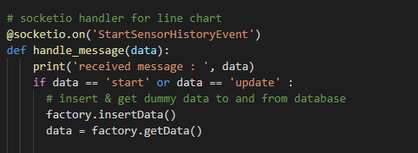
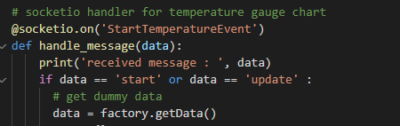
Presistent Message
To use SensorDataFactory class, we need to instantiat the class into object called factory,
Then we can call the method
factory.insertData()
factory.getData()
in our socketio event handler for linechart
Then in socketio event handler for other chart like the temperature gauge, we just call factory.getData() method, since the data is already inserted in linechart event handler,
*) if we call factory.insertData() twice, then the data will be inserted twice.
pertemuan_8\6_Presistent_Message\app\views\home.py

Slide 30
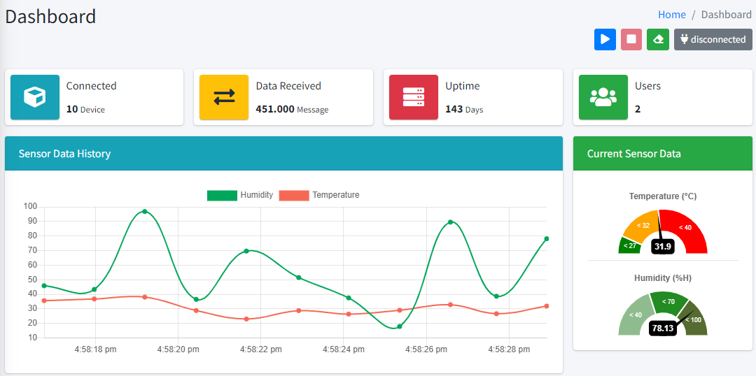
Presistent Message
Invoking app by run pertemuan_8\6_Presistent_Message\run.py
Open localhost:5000 in browser
Then try to start and stop socketio data stream, the reload the page,
The data should be loaded without lossing it.

Slide 31
HTTP API Integration
1. Create HTTP API to receive Sensor Data
2. POST Data using Postman

Slide 32

Create HTTP API to receive Sensor Data
HTTP API is used to do integration from the external into the systems (Flask Webapp)
Templates
API
Views
Forms
Model

Slide 33
Create HTTP API to receive Sensor Data
HTTP API is like a simple Flask Route but the returned object is a simple json message,
Views (api.py)
Views (home.py)
Templates (index.html)
start Button
[POST] /api/v1/sensor/post
receive start/update event
emit start event
save data
load data
receive data
response message
emit data
emit update event
success 200

Slide 34
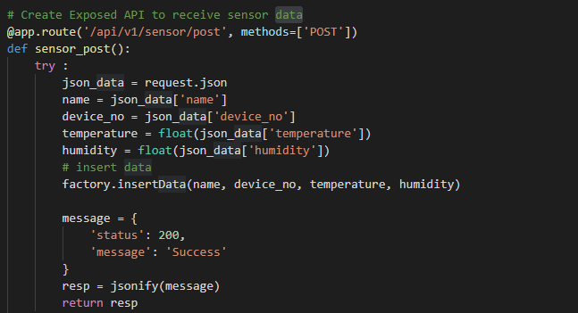
Create HTTP API to receive Sensor Data
Create a new views fle called api.py,
On gthis api.py, we can create a new route with path /api/v1/sensor/post using method POST to receive json message,
Then we can inderting that data into database using factory.insertData(),
Then we just returning a success message to the API consumer with status code 200,
pertemuan_8\7_HTTP_API_With_Sensor\app\views\api.py

Slide 35
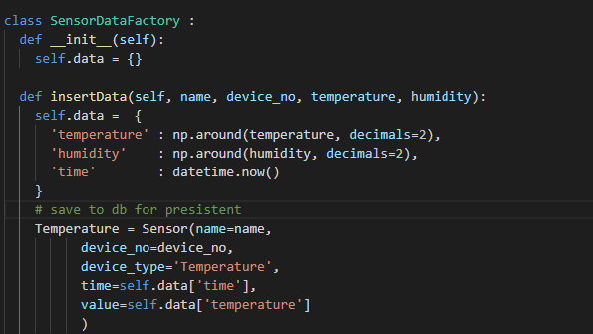
Create HTTP API to receive Sensor Data
To make the code more cleaner, we just sparate the SensorDataFactory class previously located under home.py into a new view file called with sensor_utils.py,
pertemuan_8\7_HTTP_API_With_Sensor\app\views\sensor_utils.py

Slide 36

Create HTTP API to receive Sensor Data
Then to instantiate a object factory from SensorDataFactory class, we need to put it into views/__init__.py file,
The reason is, we need to make a factory object accesible in home.py to be used for get data (factory.getData())
And inside api.py to do insert data (factory.insertData()) when API /api/v1/sensor/post called by consumer.
pertemuan_8\7_HTTP_API_With_Sensor\app\views\__init__.py

Slide 37
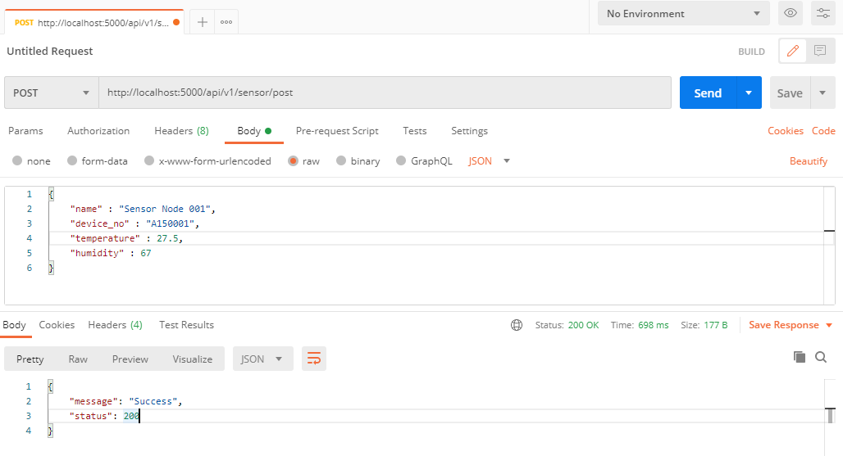
POST Data using Postman

Slide 38
The End

