Slide 1





Web Development
#9
Deployment Flask App With Gunicorn & NGINX

Slide 2
Training Outline
ChartJS - Chart Date Filter
Flask Integration - MQTT
Flask SQLAlchemy - Change Database from SQLite to MySQL
Deployment
Create AWS EC2 Instance
Deploy Flask App to EC2 AWS Instance
Add Inbound & Outpbound Rule in AWS Security Group
Serve Flask App using Gunicorn
Run Flask as daemon using Systemd
Use NGINX as Reverse Proxy Server for Gunicorn
Point Domain to EC2 Instance
Configuring SSL using Let’s Encrypt & Certbot

Slide 3
ChartJS - Chart Date Filter

Slide 4
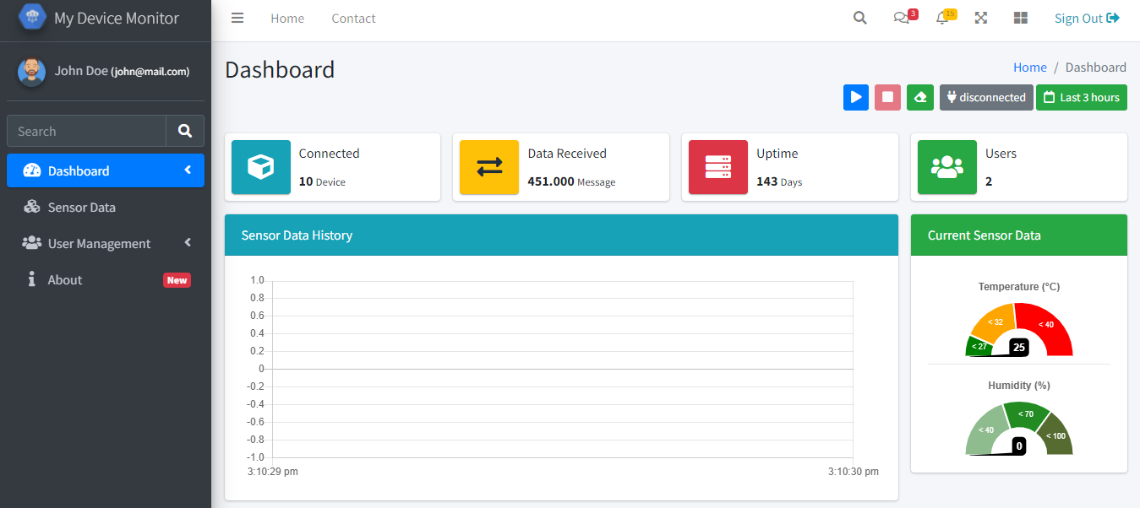
ChartJS - Chart Date Filter

Slide 5
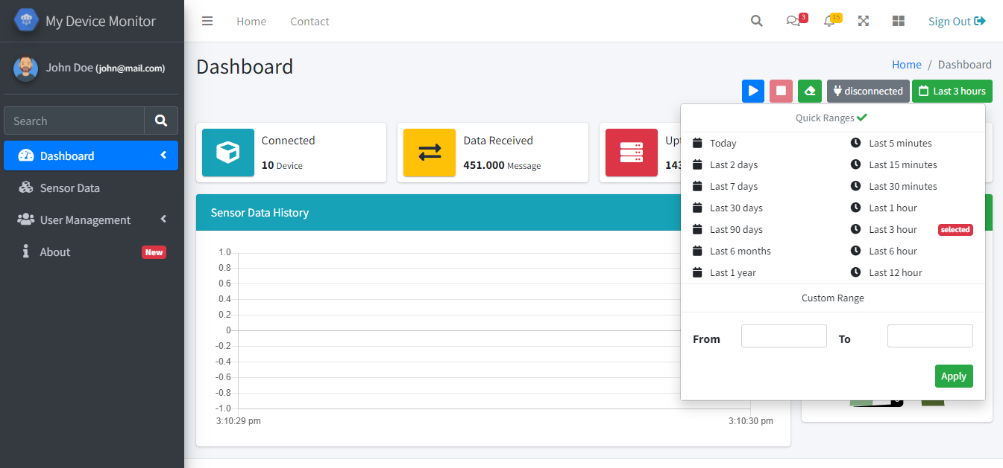
ChartJS - Chart Date Filter

Slide 6
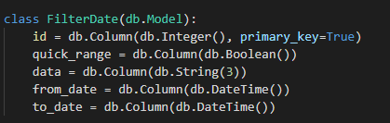
ChartJS - Chart Date Filter
To make Date Filter presistent in database,
We need to create a new model called FilterDate
pertemuan_9\1_Filter_Date_Range\app\models\filter_date.py

Slide 7
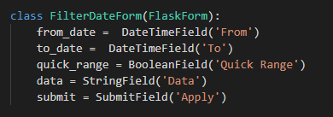
ChartJS - Chart Date Filter
Since in the Date Filter widget, there is a form to submit date range data, we also need to define a WTForm for that,
We called that with FilterDateForm,
pertemuan_9\1_Filter_Date_Range\app\forms\_action.py

Slide 8
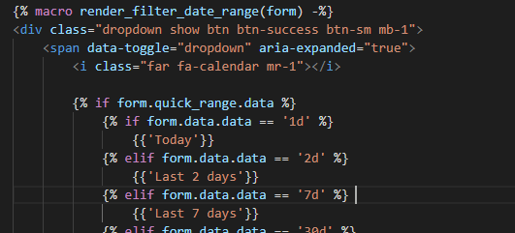
ChartJS - Chart Date Filter
To add that Date Filter into our dashboard, we just put the macro render_filter_date_range() in widgets/chart/_filter_date_range.html into our dashboard template (index.html).
This macro need input parameter form from FilterDateForm,
pertemuan_9\1_Filter_Date_Range\app\templates\widgets\chart\_filter_date_range.html

Slide 9
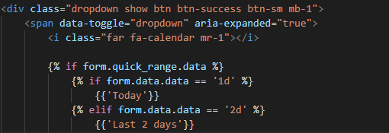
ChartJS - Chart Date Filter
The filter button text is dynamicly changes, depending on the filter type selected,
This is when we choose Quick Ranges options,

Slide 10
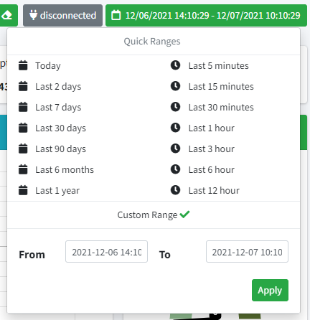

ChartJS - Chart Date Filter
This is when we choose Custom Ranges options,

Slide 11
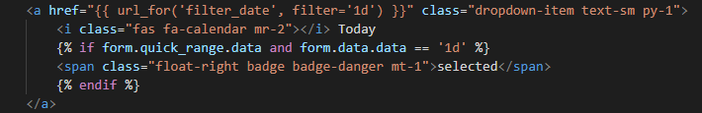
ChartJS - Chart Date Filter
Quick Range Options item is a link that can update a FilterDate datamodel with the following detail :
FilterDate.quick_range = True
FilterDate.data=’3h’
‘3h’ that means get the last 3 hours data.

Slide 12
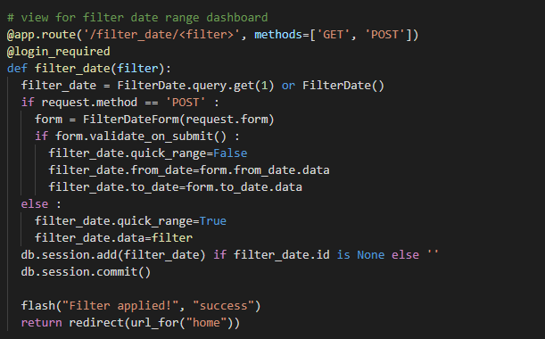
ChartJS - Chart Date Filter
Route handler for Quick Range Options in View
pertemuan_9\1_Filter_Date_Range\app\views\home.py

Slide 13
ChartJS - Chart Date Filter
Custom Range Form is a WTForm that can update a FilterDate datamodel with the following detail :
FilterDate.quick_range = True
FilterDate.from_date = <datetime>
FilterDate.to_date = <datetime>
The submit form in handled in View
pertemuan_9\1_Filter_Date_Range\app\views\home.py

Slide 14
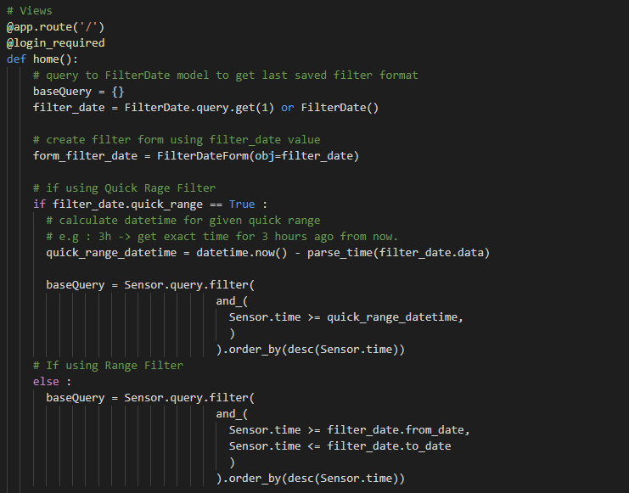
ChartJS - Chart Date Filter
pertemuan_9\1_Filter_Date_Range\app\views\home.py
To apply FilterDate data into Dashboard, we need to modify baseQuery for our Sensor model in View home.py.

Slide 15
ChartJS - Chart Date Filter
Invoking app by running pertemuan_9\1_Filter_Date_Range\run.py
Then open the browser http://localhost:5000
The result should look like this.

Slide 16
Flask Integration - MQTT

Slide 17
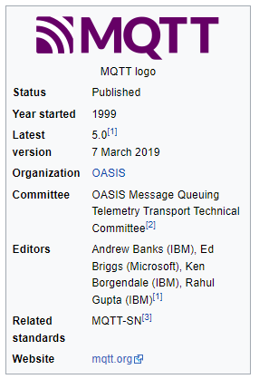
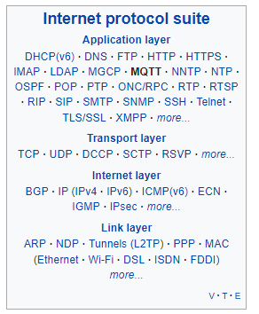
Flask Integration - MQTT
MQTT is a lightweight, publish-subscribe network protocol that transports messages between devices. The protocol usually runs over TCP/IP, however, any network protocol that provides ordered, lossless, bi-directional connections can support MQTT.[Wikipedia]

Slide 18
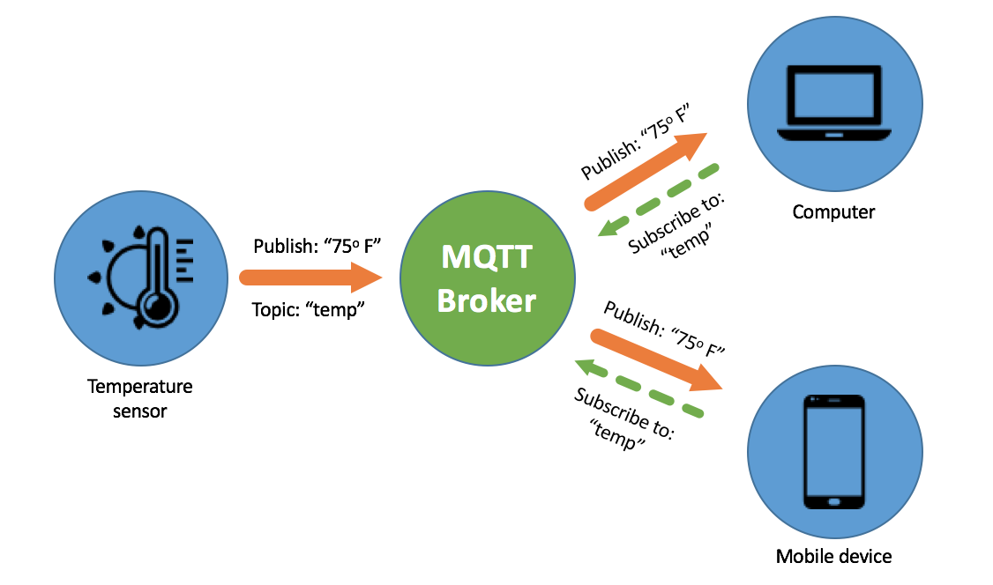
Flask Integration - MQTT
Diagram interkoneksi MQTT.
Sumber [https://medium.com/pujanggateknologi/berkenalan-dengan-teknologi-mqtt-7e63cab9d00d]

Slide 19
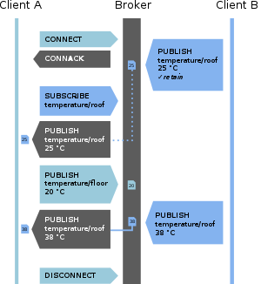
Flask Integration - MQTT
Example of an MQTT connection (QoS 0) with connect, publish/subscribe, and disconnect.
The first message from client B is stored due to the retain flag.

Slide 20
Flask Integration - MQTT
Install Flask MQTT package,
pip install Flask-MQTT
Flask MQTT Official Documentations,
https://flask-mqtt.readthedocs.io/en/latest/

Slide 21
Flask Integration - MQTT
Previous implementation using HTTP API, for integration.
Views (api.py)
Views (home.py)
Templates (index.html)
start Button
[POST] /api/v1/sensor/post
receive start/update event
emit start event
save data
load data
receive data
response message
emit data
emit update event
success 200

Slide 22
Flask Integration - MQTT
MQTT Integration flow diagrams,
Views (home.py)
do nothing.
Views (mqtt_sub.py)
Views (sensor_utils.py)
Templates (index.html)
start Button
Topic dashboard/sensor
.insertData() called
emit start event
factory.insertData()
Insert into Sensor Model
emit data
receive data

Slide 23
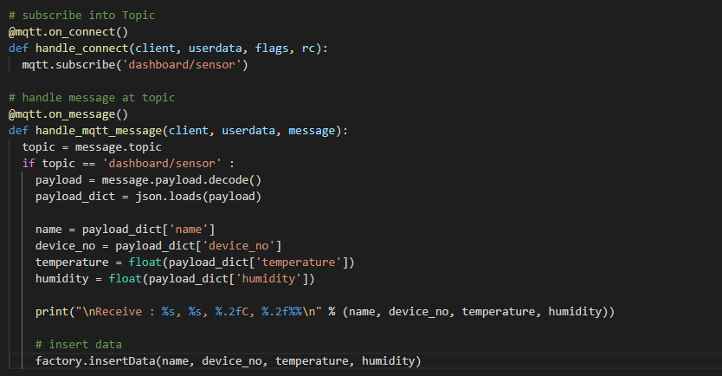
Flask Integration - MQTT
Event handler when Flask MQTT Connected into the Broker
Event handler when message received to the Flask MQTT
pertemuan_9\2_MQTT_Integration\app\views\mqtt_sub.py

Slide 24
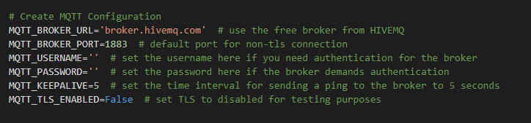
Flask Integration - MQTT
Flask MQTT configuration,
We can use free broker like above, or using the Commercial Broker Services like,
HiveMQ (https://www.hivemq.com)
VerneMQ (https://vernemq.com)
Or self managed by installing it into our server using OpenSource Broker like,
Eclipse Mosquitto (https://mosquitto.org)
pertemuan_9\2_MQTT_Integration\instance\config.py

Slide 25
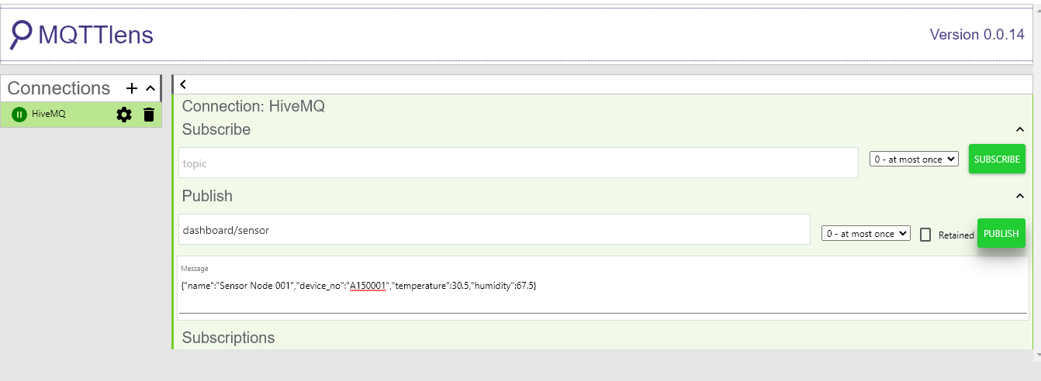
ChartJS - Chart Date Filter
Invoking app by running pertemuan_9\2_MQTT_Integration\run.py
Then open the browser http://localhost:5000
The try to subscribe into the Topic dashboard/sensor using MQTT Lens Chrome Extension.
Then the data should be emited to the dashboard.

Slide 26
Flask SQLAlchemy - Change Database from SQLite to MySQL

Slide 27
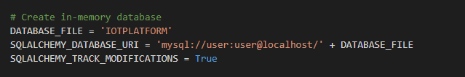
Change Database from SQLite to MySQL
To change Database from SQLite into MySQL in SQLAlchemy, we just need to change the SQLALCHEMY_DATABASE_URI in instance/config.py into connection string for MySQL.
We also neet to put DATABASE_FILE as the Database name exist in MySQL Server.
Database URI Format for MySQL :
mysql://<username>:<password>@localhost/<database>
On above configuration, we should create a Database IOTPLATFORM in MySQL Database.
We also need to install extra package to help SQLAlchemy to connect into MySQL , just installing it via pip,
pip install mysqlclient
pertemuan_9\3_Change_To_MySQL_Db\instance\config.py

Slide 28
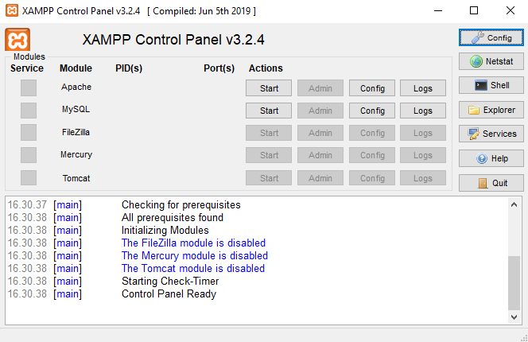
Change Database from SQLite to MySQL
The easies way to install MySQL Database in Local Computer is using XAMPP.
Since we just need MySQL Database only for this case, we doen’s need to install any other optional service like FileZilla, Tomzat, etc. profided by the XAMPP.
Download XAMPP : https://www.apachefriends.org/download.html
Install and opening it,
Then klik Start for MySQL Database.
After MySQL Running, click the shell button to access cli mode of XAMPP.

Slide 29
Change Database from SQLite to MySQL
Create a New MySQL User
Access MySQL Console using below command, (default password is blank, just hit enter)
$ sudo mysql -u root -p
Then, we need to create a new user using below command, just change the ‘mypassword’ with the password that our preferred,
> CREATE USER 'user'@'localhost' IDENTIFIED BY 'mypassword';
grant privileges into that new user,
> GRANT ALL PRIVILEGES ON * . * TO 'user'@'localhost';
Reload privileges,
> FLUSH PRIVILEGES;

Slide 30
Change Database from SQLite to MySQL
Create a Database for Our Flask Application
Now, try to access MySQL console using a new user created
$ mysql -u user -p
Create a New Databas IOTPLATFORM using that user,
> CREATE DATABASE IOTPLATFORM ;
Don’t forget to change SQLALCHEMY_DATABASE_URI in instance/config.py into connection string into the New User Created and New Database Created Above.
mysql://<username>:<password>@localhost/<database>

Slide 31
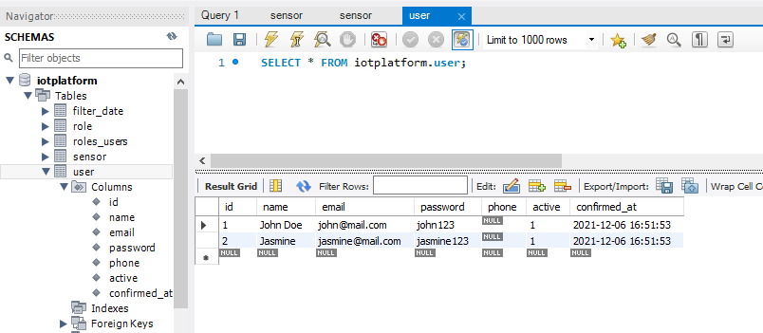
Change Database from SQLite to MySQL
Invoking app by running pertemuan_9\3_Change_To_MySQL_Db\run.py
Then open the browser http://localhost:5000
Then check the MySQL database using XAMPP shell or MySQL Workbench
The table should be created automatically into the MySQL database.
MySQL Workbench

Slide 32
Deployment
Create AWS EC2 Instance
Deploy Flask App to EC2 AWS Instance
Add Inbound & Outpbound Rule in AWS Security Group
Serve Flask App using Gunicorn
Run Flask as daemon using Systemd
Use NGINX as Reverse Proxy Server for Gunicorn
Point Domain to EC2 Instance
Configuring SSL using Let’s Encrypt & Certbot

Slide 33
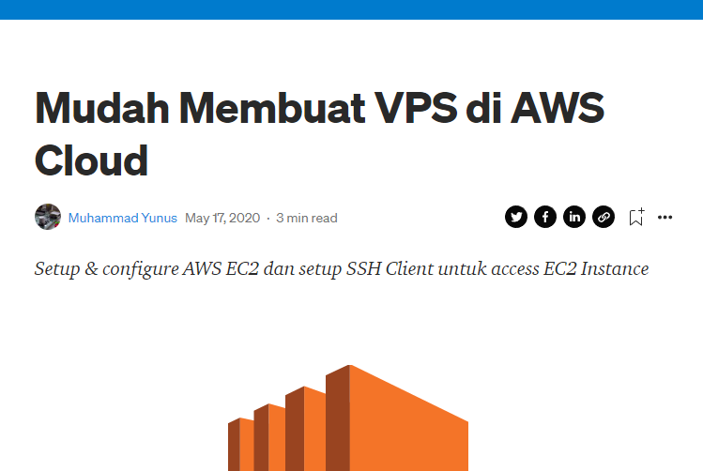
Create AWS EC2 Instance
To create AWS EC2 Instance, just refer into this tutorial : https://yunusmuhammad007.medium.com/mudah-membuat-vps-di-aws-cloud-f1d9c0071fdf

Slide 34
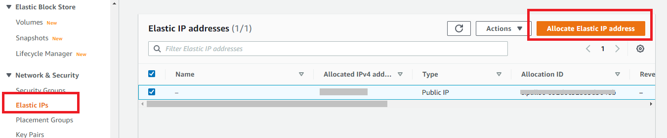
Create AWS EC2 Instance
Add Elastic IP into EC2 Instance
Open the Amazon EC2 console at https://console.aws.amazon.com/ec2/.
In the navigation pane, choose Network & Security, Elastic IPs.
To add Elastic IP into our EC2 Instance, click Allocate Elastic IP Address
https://docs.aws.amazon.com/AWSEC2/latest/UserGuide/elastic-ip-addresses-eip.html

Slide 35
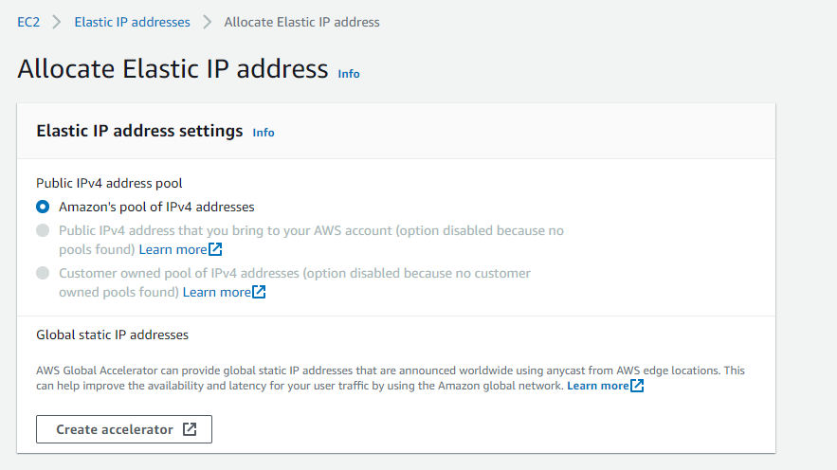
Create AWS EC2 Instance
Add Elastic IP into EC2 Instance
Then in the next page, just click Create Accelerator,
https://docs.aws.amazon.com/AWSEC2/latest/UserGuide/elastic-ip-addresses-eip.html

Slide 36
Create AWS EC2 Instance
Associate Elastic IP into EC2 instance
Open the Amazon EC2 console at https://console.aws.amazon.com/ec2/.
In the navigation pane, choose Elastic IPs.
Select the Elastic IP address to associate and choose Actions, Associate Elastic IP address.
For Resource type, choose Instance.
Choose the instance with which to associate the Elastic IP address.
https://docs.aws.amazon.com/AWSEC2/latest/UserGuide/elastic-ip-addresses-eip.html

Slide 37
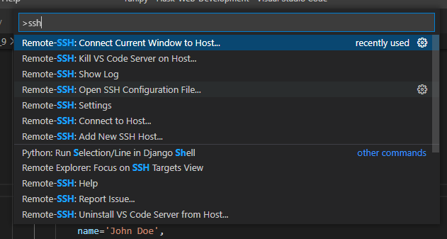
Create AWS EC2 Instance
Remote SSH EC2 Instance via VS Code Remote SSH
Open SSH Configuration, press F1 in VS Code, then type ssh,
Then select Remote-SSH: Open SSH Configuration File...

Slide 38
Create AWS EC2 Instance
Remote SSH EC2 Instance via VS Code Remote SSH
Open SSH Configuration, press F1 in VS Code, then type ssh,
Then select Remote-SSH: Open SSH Configuration File...
Add new configuration bya add the folloing line at the end of file,
Host <enter hostname>
HostName <enter hostname>
User ubuntu
IdentityFile /location/to/my.pem
Then try to connect using VS Code Remote as usual,

Slide 39
Deploy Flask App to EC2 AWS Instance
To simplify the deployment, we just creating the Software Repositories for Our Flask App.
The Structure is following the best practices in “Pertemuan 4 (Project Structure)”
https://github.com/Muhammad-Yunus/Simple-IOT-Server
Just Clone the whole repository into the EC2 Instance via git command,
git clone https://github.com/Muhammad-Yunus/Simple-IOT-Server

Slide 40
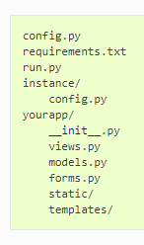
Organization Pattern (Flashback...)
Package
repository/
run.py
app/
app/
__init__.py
app/
views.py
config.py
instance/
config.py
app/
models.py
app/
forms.py
app/
template/
app/
static/
Organizing Pattern

Slide 41
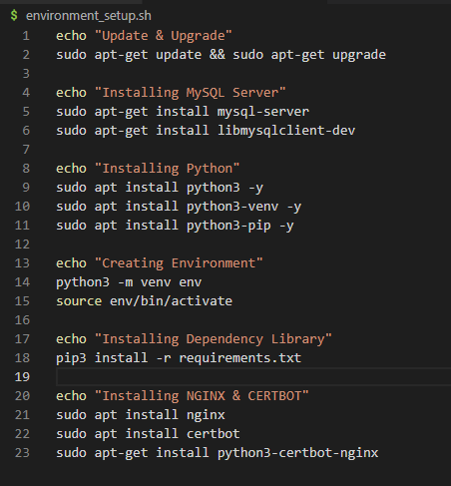
Deploy Flask App to EC2 AWS Instance
The first this we need to do in EC2 instance is like,
Update upgrade the software,
Installing necassary library,
Configuring Environment,
etc.
To make this step much more simple, we just using script environment_setup.sh inside the cloned repository,
To execute the script, just running,
sudo chmod +x environment_setup.sh
./environment_setup.sh

Slide 42
Deploy Flask App to EC2 AWS Instance
Create a New MySQL User in MySQL Server (EC2)
Access MySQL Console using below command, (default password is blank, just hit enter)
$ sudo mysql -u root -p
Then, we need to create a new user using below command, just change the ‘mypassword’ with the password that our preferred,
> CREATE USER 'user'@'localhost' IDENTIFIED BY 'mypassword';
grant privileges into that new user,
> GRANT ALL PRIVILEGES ON * . * TO 'user'@'localhost';
Reload privileges,
> FLUSH PRIVILEGES;

Slide 43
Deploy Flask App to EC2 AWS Instance
Create a Database for Our Flask Application in MySQL Server (EC2)
Now, try to access MySQL console using a new user created
$ mysql -u user -p
Create a New Databas IOTPLATFORM using that user,
> CREATE DATABASE IOTPLATFORM ;
Don’t forget to change SQLALCHEMY_DATABASE_URI in instance/config.py into connection string into the New User Created and New Database Created Above.
mysql://<username>:<password>@localhost/<database>

Slide 44
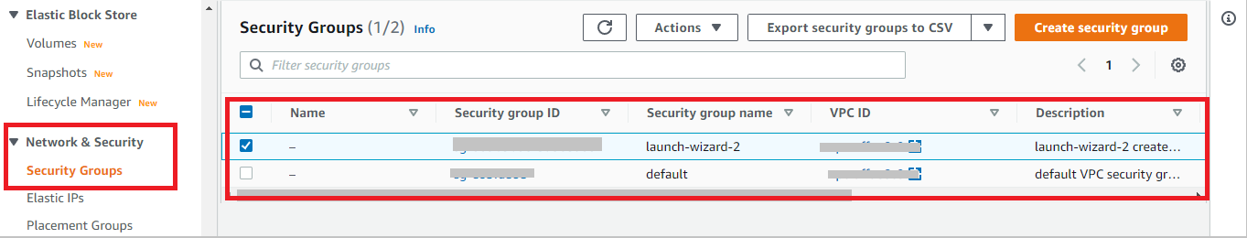
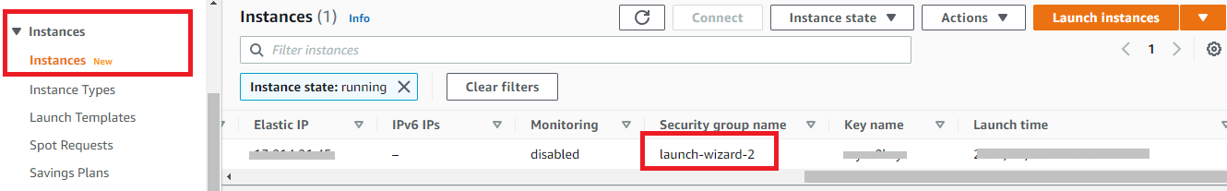
Add Inbound & Outpbound Rule in AWS Security Group
Since in EC2 instance by default only open PORT 22 to public, we need to add Rule for another PORT like in 5000 used in our Flask App in AWS Services called with AWS Security Group
Just ensure we choose the correct Security Group Name used by ours EC2 instance

Slide 45
Add Inbound & Outpbound Rule in AWS Security Group
Click in correct Security Group Name used by ours EC2 instance,
Then Open the Inbound Rules tab and Outbound Rules tab,
Just add Custom TCP inport 5000 with Source Anywhere-IPv4,
Rememmber to do this twice ( Inbound Rule & Outbound Rule)

Slide 46
Add Inbound & Outpbound Rule in AWS Security Group
Run Flask App using development WSGI server.
Since the port is already opened, we can try to test run our Flask App in EC2 instance.
Invoking the app by running below command,
Then open the browser using Public IP that attached into EC2 instance.
source env/bin/activate
cd ~/Simple-IOT-Server
python3 Simple-IoT-Server/run.py

Slide 47

Serve Flask App using Gunicorn
Gunicorn 'Green Unicorn' is a Python WSGI HTTP Server for UNIX. It's a pre-fork worker model. The Gunicorn server is broadly compatible with various web frameworks, simply implemented, light on server resources, and fairly speedy.[https://gunicorn.org/]
Server

Slide 48
Serve Flask App using Gunicorn
Run Flask App using Gunicorn.
Invoking the app by running below command,
Then open the browser using Public IP that attached into EC2 instance.
Above comand is a simple gunicorn start command that can bind the into machine IP Address, and chose eventlet as worker-class (since we using SocketIO) and we can specify the worker number -w 1 (1 worker),
Then since the entry point of our app in run.py, we can used it also ingunicorn in format <module>:<app_instance>
cd ~/Simple-IOT-Server/Simple-IoT-Server
gunicorn --bind 0.0.0.0:5000 --worker-class eventlet -w 1 run:app

Slide 49
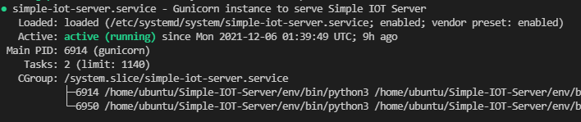
Run Flask as daemon using Systemd
Now we will run the Flask App as Daemon using Systemd,
The Systemd script is already prepared in cloned repository with name simple-iot-server.service
To Start the service, just executing below command,
Then the Flask App will run automatically in background,
Just open the browser to chek the App still working.
sudo systemctl start simple-iot-server.service
sudo systemctl enable simple-iot-server.service
sudo systemctl status simple-iot-server.service

Slide 50
Use NGINX as Reverse Proxy Server for Gunicorn
Nginx (pronounced "engine X") is a web server that can also be used as a reverse proxy, load balancer, mail proxy and HTTP cache. A large fraction of web servers use NGINX, often as a load balancer. [Wikipedia]
NGINX as Loadbalancer

Slide 51
Use NGINX as Reverse Proxy Server for Gunicorn
Nginx (pronounced "engine X") is a web server that can also be used as a reverse proxy, load balancer, mail proxy and HTTP cache. A large fraction of web servers use NGINX, often as a load balancer. [Wikipedia]
NGINX as Reverse Proxy Server
https://<Domain>/home
http://<machine_ip>:5000/home
HTTP Reverse Proxy
SocketIO WSS://
PORT 5000
PORT 80
SocketIO WSS:// : WSS (Web Socket Secure) or Websocket over HTTPS.

Slide 52
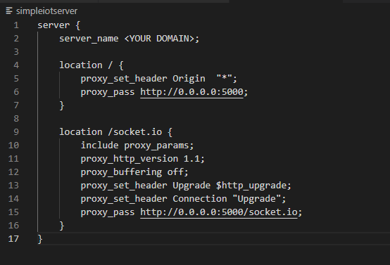
Use NGINX as Reverse Proxy Server for Gunicorn
Now we will configure NGINX as Reverse Proxy Server for Gunicorn.
To do this simply just modifying the simpleiotserver file that already prepared in cloned repository,
The important thing, we need a valid Domain Name inside this configuration.
So, please buy a new one for this. After that, just change <YOUR DOMAIN> into our domain.

Slide 53
Use NGINX as Reverse Proxy Server for Gunicorn
To apply the NGINX configuration inside simpleiotserver file,
Just run below command,
Then check if configuration is valid by executing,
If everything is looks good, just restart NGINX to load the new configuration,
sudo unlink /etc/nginx/sites-enabled/default
sudo cp ~/Simple-IOT-Server/simpleiotserver /etc/nginx/sites-available/
sudo ln -s /etc/nginx/sites-available/simpleiotserver /etc/nginx/sites-enabled/simpleiotserver
sudo nginx -t
sudo systemctl restart nginx

Slide 54
Point Domain to EC2 Instance
To point The domain to EC2 instance using A Record in our Domain Provider,
A Clear step if using Niagahoster (Indonesia Local DomainProvider)
https://www.niagahoster.co.id/kb/cara-menghubungkan-domain-ke-vps#menghubungkan-domain-ke-vps-dengan-a-record

Slide 55
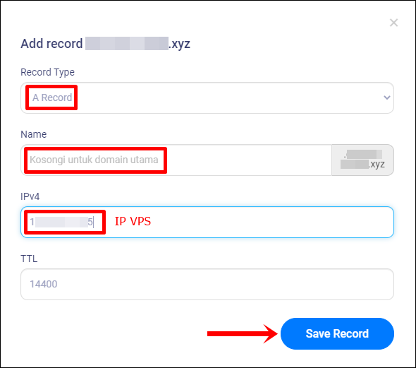
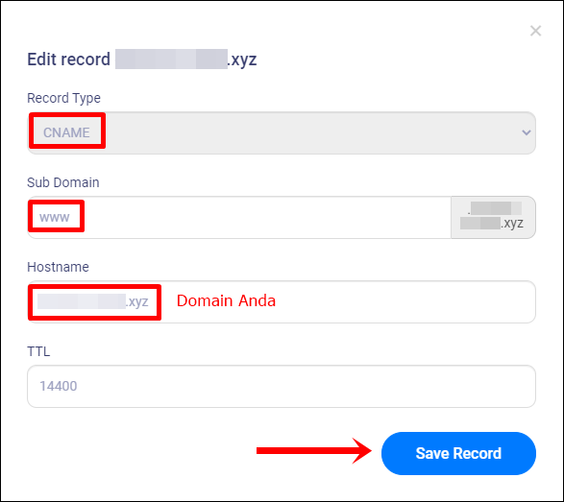
Point Domain to EC2 Instance
Ada dua record yang perlu ditambahkan, antara lain:
A Record: Record untuk menghubungkan domain dengan VPS.
CNAME: Record agar domain dapat diakses dengan subdomain www.

Slide 56
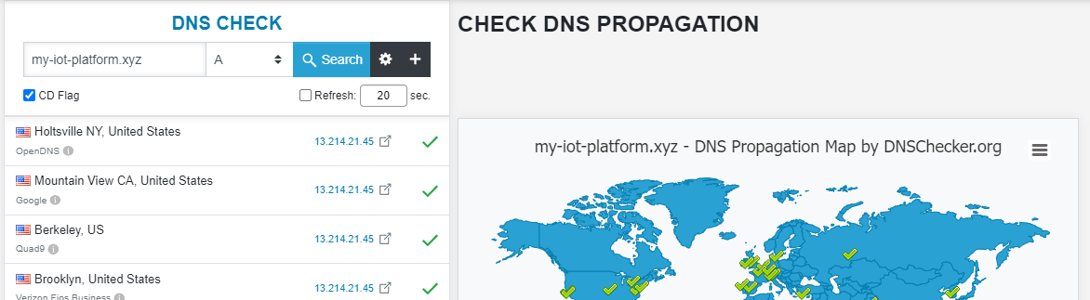
Point Domain to EC2 Instance
After we add A Record and CNAME in Domain Provider web panel ,
We need to wait untill DNS Propagation is completed.
Usually DNS changes will propagate within a few hours, but it can take up to 48 hours for everything to propagate across the Internet.
Many things affect propagation time, including your TTL, your ISP and your domain's registry. [source]
To monitor the progress of Proagation time, just chek using https://dnschecker.org/

Slide 57
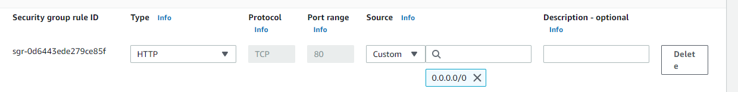
Point Domain to EC2 Instance
After propagation time is completed,
We can access the Flask App using the domain just by entering http://<your domain>/
But dont forget to add extra Inbound and Outbound Rule in AWS Security Group for HTTP Port 80.

Slide 58
Configuring SSL using Let’s Encrypt & Certbot
Previously we are successfully use NGINX as Proxy Server for Gunicorn in HTTP Port 80.
We can securing our app by add SSL into it, so instead HTTP we will use HTTPS in port 443 for this case.
To do this, we will use Let’s Encrypt with Certbot that actualy the easiest way to do this.
Run below command,
sudo certbot --nginx -d <YOUR DOMAIN>
This runs certbot with the --nginx plugin, using -d to specify the names you’d like the certificate to be valid for.
If this is your first time running certbot, you will be prompted to enter an email address and agree to the terms of service.
After doing so, certbot will communicate with the Let’s Encrypt server to request a certificate for your domain.

Slide 59
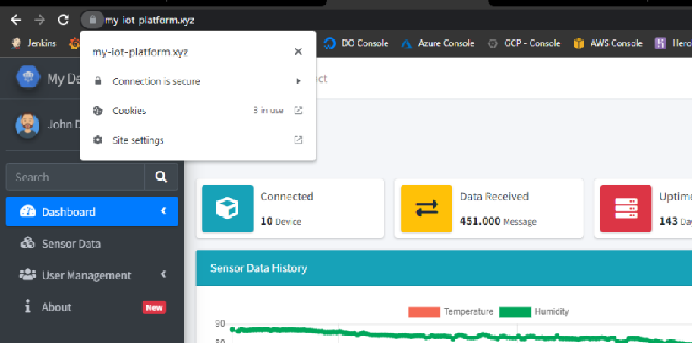
Configuring SSL using Let’s Encrypt & Certbot
After finish, we can open the app in browser using https://<YOUR DOMAIN>/
Now our App is already securing by SSL.

Slide 60
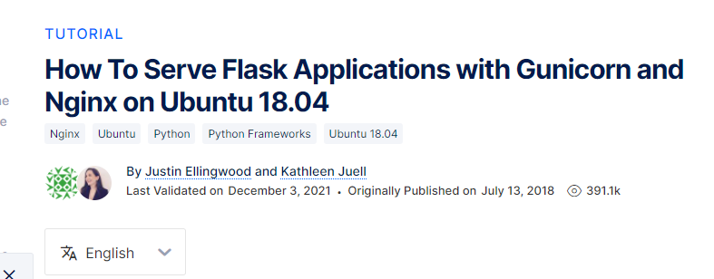
Note
All the deployment step is inspired to this tutorial : https://www.digitalocean.com/community/tutorials/how-to-serve-flask-applications-with-gunicorn-and-nginx-on-ubuntu-18-04

Slide 61
The End

