Slide 1


Web Development
#5
Session, Authentication & Authorization

Slide 2
Training Outline
Flask - Session
Flask - Authentication
Flask - Authorization

Slide 3
Flask - Session
1. Cookies & Session
2. Flask - Create & Use Session
3. Flask - Session Configuration
4. Use Session in Search Input Table Record

Slide 4
Cookies & Session
Stateless applications
Web application servers are generally "stateless"
Each HTTP request is independent;
Server can't tell if 2 requests came from the same browser or user.
Web server applications maintain no information in memory from request to request.
https://web.stanford.edu/~ouster/cgi-bin/cs142-fall10/lecture.php?topic=cookie

Slide 5
Cookies & Session
Browser cookies
Cookies is contained by name-value pair,
Cookies is stored in a client side (browser),
Data size limited by browsers (typically < 4 KB),
A server can define multiple cookies with different names,
But browsers limit the number of cookies per server (around 50),
Expiration date: browser can delete old cookies.
How Cookies Created ?
The first time a browser connects with a particular server, there are no cookies,
When the server responds it includes a Set-Cookie: header that defines a cookie.
Cookies have an expiry datetime set, example using HTTP headers:
Set-Cookie: name1=value1; Expires=Wed, 24 Oct 2021 21:00:00 GMT
https://web.stanford.edu/~ouster/cgi-bin/cs142-fall10/lecture.php?topic=cookie

Slide 6
Cookies & Session
Session
Cookies are used by the server to implement sessions.
If Session started in Server-side, and there is web request into the server,
Then the cookies from the server set to keep identifier for that session (session id).
When we do the next request into the server, this session id will be included,
Each user (browser) has a different session id (unique)
server
first request
Session.start()
session_id
Set-Cookie : session_id
session_id
next request
do something with session
https://web.stanford.edu/~ouster/cgi-bin/cs142-fall10/lecture.php?topic=cookie

Slide 7
Cookies & Session
Session
Session purpose is to store temporary value in the server side,
Session is key-value pair like Cookies,
Session value is tie up with the session id,
Session will be expired on Browser Closed or User Logout.
session_id
user_1
value_1 = mongkey
session_id
user_2
value_2 = horse
session_id
user_3
value_3 = cat
server
https://web.stanford.edu/~ouster/cgi-bin/cs142-fall10/lecture.php?topic=cookie

Slide 8
Flask - Create & Use Session
Install Flask Session :
Open Anaconda Prompt,
activate flask-dev environment,
conda activate flask-dev
Install Flask Session via pip,
pip install Flask-Session

Slide 9
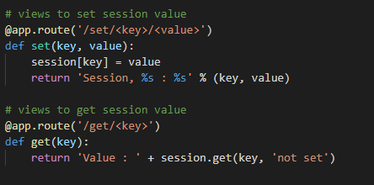
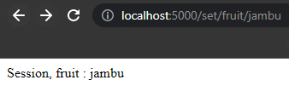
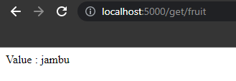
Flask - Create & Use Session
Now we will try to implement simple session to store a data in a serverside with a specific key.
On route /set/<key>/<values> we can supply the key-value pair to be added into Flask session.
Then we can retrieve that value using route /get/<key>.
pertemuan_5\1_Create_n_Use_Session\app.py

Slide 10
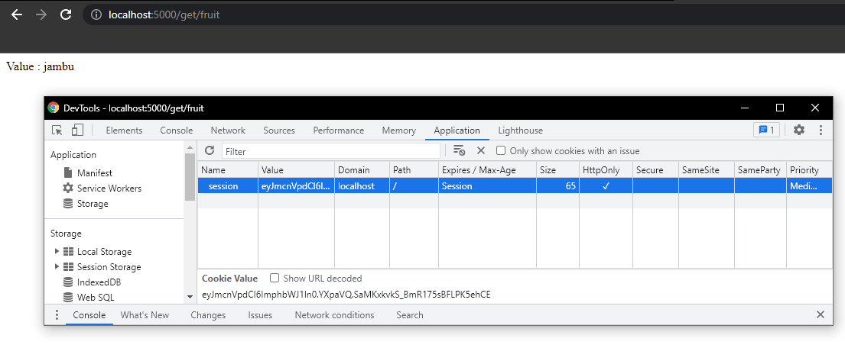
Flask - Create & Use Session
Since the session id is keep on the client side by cookies, we can view that value inside Application Tab on Chrome Developer Tool, Just remember, this Id will be added on each request,

Slide 11
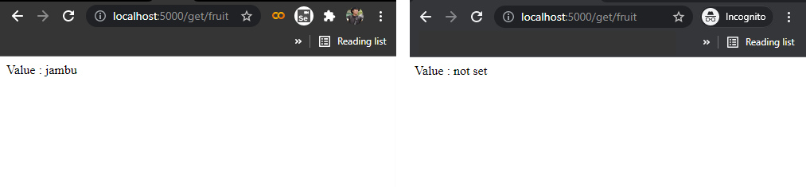
Flask - Create & Use Session
What happend if we open the route /get/<key> with key = fruit in previouse example in Chrome Incognito ?
Same Browser
Another Browser (Incognito)
Same brower when we set the session using /set/<key><value>
with key = fruit and value = jambu
Using another browser / Chrome Incognito, since in this browser using different session_id and we doesn’t set te value for key fruit, then the server cannot find that value.

Slide 12
Flask - Session Configuration
The following configuration values exist for Flask-Session,
Flask-Session loads these values from your Flask application config (config.py or instance/config.py),
SESSION_COOKIE_NAME | the name of the session cookie
SESSION_COOKIE_DOMAIN | the domain for the session cookie. If this is not set, the cookie will be valid for all subdomains of SERVER_NAME.
SESSION_COOKIE_HTTPONLY | controls if the cookie should be set with the httponly flag. Defaults to True.
SESSION_COOKIE_SECURE | controls if the cookie should be set with the secure flag. Defaults to False.
PERMANENT_SESSION_LIFETIME | the lifetime of a permanent session as datetime.timedelta object. Starting with Flask 0.8 this can also be an integer representing seconds.

Slide 13
Flask - Session Configuration
Another configuration,
SESSION_TYPE | Specifies which type of session interface to use. Built-in session types: null : NullSessionInterface (default) redis : RedisSessionInterface memcached: MemcachedSessionInterface filesystem: FileSystemSessionInterface mongodb: MongoDBSessionInterface sqlalchemy: SqlAlchemySessionInterface
SESSION_SQLALCHEMY | A flask.ext.sqlalchemy.SQLAlchemy instance whose database connection URI is configured using the SQLALCHEMY_DATABASE_URI parameter
SESSION_SQLALCHEMY_TABLE | The name of the SQL table you want to use, default “sessions”
More Detail for Flask Session Configuration

Slide 14
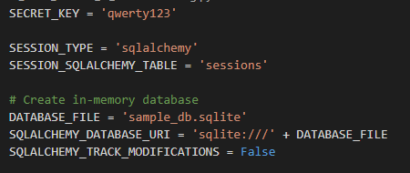
Flask - Session Configuration
Now we will try to use SQLAlchemy Interface for our flask session,
To do that, put the following config inside config.py,
pertemuan_5\2_Session_in_DB\config.py

Slide 15
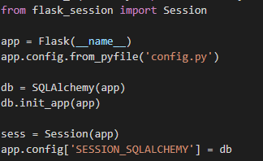
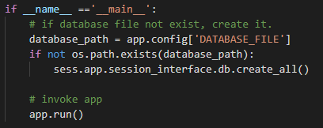
Flask - Session Configuration
The minimal implementation is look like below,
we need to import Session class from flask_session module to create sess object,
Then we can set the SESSION_SQLALCHEMY config with db object like above,
After that, to make SQLAlchemy populate that sessions table we need use,
sess.app.session_interface.db.create_all()
pertemuan_5\2_Session_in_DB\app.py

Slide 16
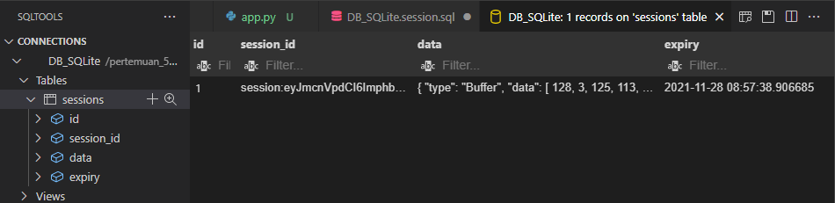
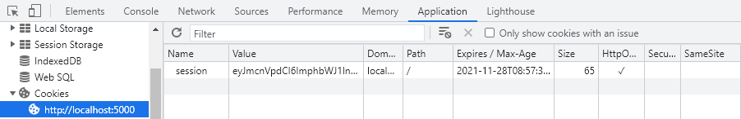
Flask - Session Configuration
Then Sessions tables will be created in SQLite db_sample.sqlite like below,
Session in browser,

Slide 17
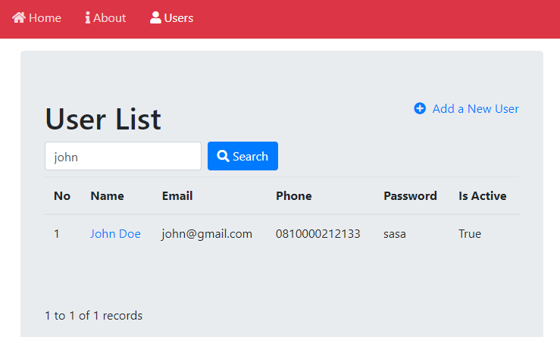
Use Session in Search Input Table Record
After previously we are understand what is session and used, now we will apply that session to hold value a search field in Table Record like below,
The benefit using session in search field on Table Record is we can still have filter applied even though we are moving to other page.

Slide 18
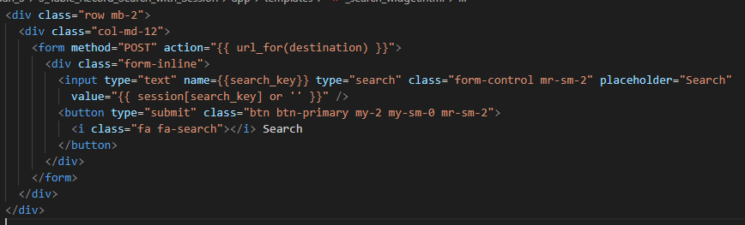


Use Session in Search Input Table Record
To do this, we need to create _search_widget.html to hold input and button search wrapped by form,
This form will make a POST request into the /users route, so we need to handle it later,
The interesting part is we can accessng session value inside Jinja2 template using session[key]
pertemuan_5\3_Table_Record_Search_with_Session\app\templates\_search_widget.html
pertemuan_5\3_Table_Record_Search_with_Session\app\templates\_table_records.html

Slide 19
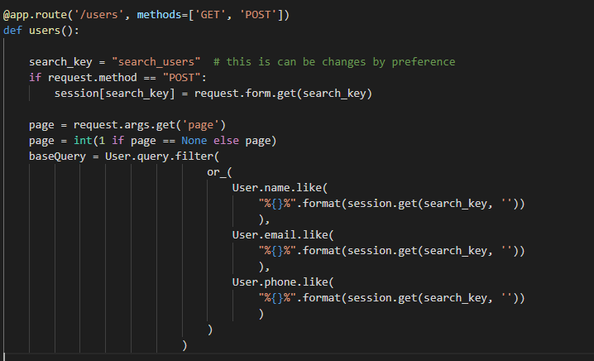
Use Session in Search Input Table Record
we add POST method in /users route on views.html
Then if request method is POST, just assign search value into the session with search_key = “search_user”
Then we can apply that into .filter() in baseQuery
.filter() can accept OR SQL clause by using or_() funtion
then just put
.like(“%value%”) statement inside or_() funtion.
pertemuan_5\3_Table_Record_Search_with_Session\app\views.py

Slide 20
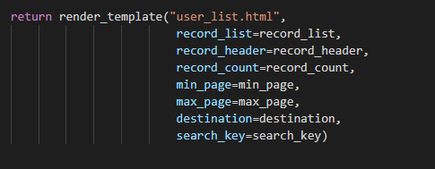

Use Session in Search Input Table Record
Then don’t forget to send back the search_key into the template in render part,
And import or_() funtion from sqlaclhemy module,
pertemuan_5\3_Table_Record_Search_with_Session\app\views.py

Slide 21
Flask - Authentication & Authorization
1. Authentication
2. Session Based Authentication
3. Login Page Modification
4. Role/Identity Based Access -> Move to the next part

Slide 22
Flask - Authentication & Authorization
Install Flask Security:
Open Anaconda Prompt,
activate flask-dev environment,
conda activate flask-dev
Install Flask Secrity via pip,
pip install Flask-Security

Slide 23
Authentication
Authentication is the process of determining whether someone or something is, in fact, who or what it says it is.
Authentication enables organizations to keep their networks secure by permitting only authenticated users or processes to gain access to their protected resources.
[Search-Security]

Slide 24
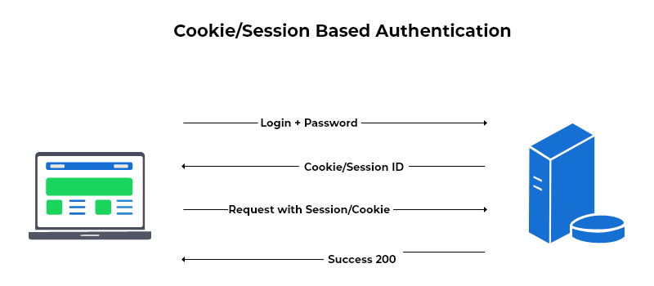
Session Based Authentication
A session identifier (session ID) is created at server-side to uniquely identify each user login.
While the user is logged in, the cookie will be sent along with each subsequent request.
https://beaglesecurity.com/blog/article/session-security.html

Slide 25
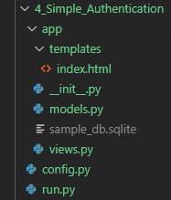
Session Based Authentication
The minimum implementation for Flask Security Authentication is like below,
views.py contain route to / (root) that only accessible when user authenticated.
models.py contain data model for User & Role.
index.html is template rendered in / (root) route.
config.py contain configuration into catabase & Security
run.py part to invoke app to run.

Slide 26
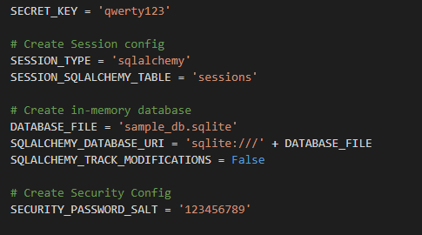
Session Based Authentication
config.py
SECURITY_PASSWORD_SALT
Specifies the HMAC salt.
HMAC (Hash-Based Message Authentication Codes)
This is only used if the password hash type is set to something other than plain text.
Defaults to None.
We can just put anything into this, or using same value used in SECRET_KEY
This config is used to be combined with unique salt generated for each password that gets created.
Latter on this combination will be used to salt the password when it gets hashed.
We can explain this in the next part.
More on Flask Security Configuration :
https://pythonhosted.org/Flask-Security/configuration.html

Slide 27
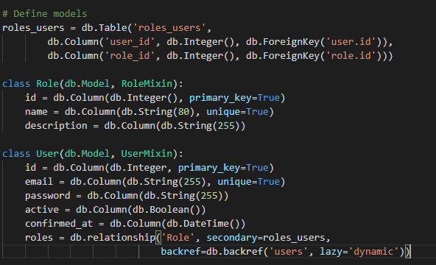
Session Based Authentication
app/models.py
pertemuan_5\4_Simple_Authentication\app\models.py
models.py contain data model for User, Role and roles_users.
The common relationship for this data model is using many-to-many relationship.
FK User
FK Role
Id
roles_users
Id
User
Role

Slide 28
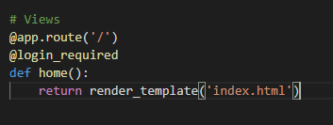
Session Based Authentication
app/views.py
Inside views.py we can use @login_required decorator together with route.
Then when someone try to access that page, he need to authenticated firs (do login).
pertemuan_5\4_Simple_Authentication\app\views.py

Slide 29
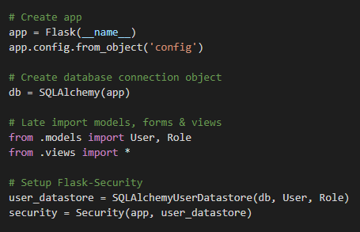
Session Based Authentication
app/__init__.py
Inside this __init__.py file, we can do a setup for Flask-Security
We need to use SQLAlchemyUserDatastore() to help us handle all User related funtion like :
activate_user()
add_role_to_User()
create_role()
create_user()
deactivate_user()
delete_user()
remove_role_from_user()
etc.
More about SQLAlchemy User DataStore
pertemuan_5\4_Simple_Authentication\app\__init__.py

Slide 30
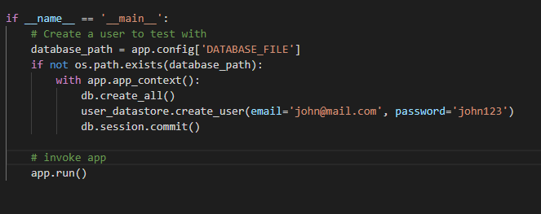
Session Based Authentication
run.py
pertemuan_5\4_Simple_Authentication\run.py
Then using run.py we can use function create_user() on user_datastrore created inside app/__init__.py.
Above example will automatically creating user with email john@mail.com and password john123

Slide 31
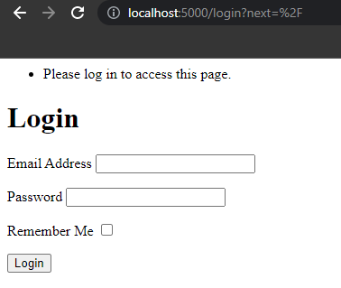
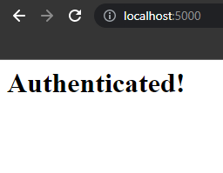
Session Based Authentication
Result
Open http://127.0.0.1:5000/ in the browser,
Since the / (root) path is attached with @login_requred decorator,
When we still Un-authenticated, we will redirected to Login Page (http://localhost:5000/login)
This Login Page is default route & template from Flask-Security, that can be modified latter.
Try to login, using user email and password created before,
Then you should authenticated,
and able to access the web .

Slide 32
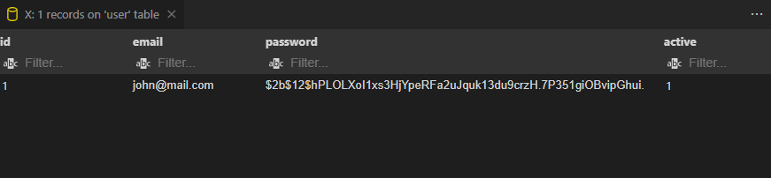
Session Based Authentication
When we check into User datamodel, we can see the password is encrypted.
This encryiption is handle by SQLAlchemyUserDataStore created in app/__init__.py

Slide 33
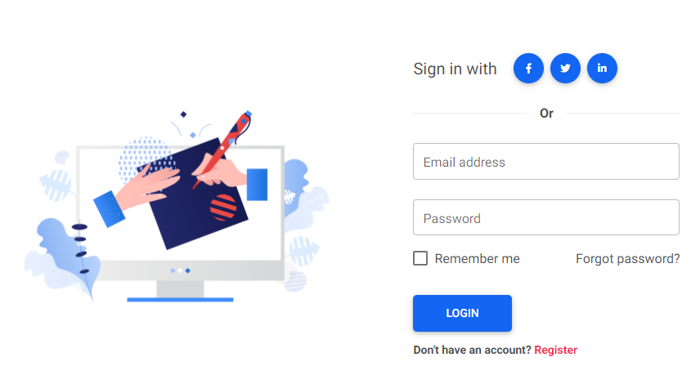
Login Page Modification
We can try to pt Login Page example in https://mdbootstrap.com/docs/standard/extended/login/
Into Our Flask login page,

Slide 34
Login Page Modification
Flask-Security is packaged with a default template for each view it presents to a user.
Templates are located within a subfolder named security.
The following is a list of view templates :
security/forgot_password.html
security/login_user.html
security/register_user.html
security/reset_password.html
security/change_password.html
security/send_confirmation.html
security/send_login.html
https://pythonhosted.org/Flask-Security/customizing.html

Slide 35
Login Page Modification
Overriding these templates is simple:
Create a folder named security/ within your application’s templates/ folder.
For example we try to overide login_user.html, create that template,
Then we acess WTForm login_user_form object inside that template, There are field like :
login_user_form.email (input text field)
login_user_form.password (input text field)
login_user_form.remember (checkbox field)
login_user_form.submit (button submit)
https://pythonhosted.org/Flask-Security/customizing.html

Slide 36
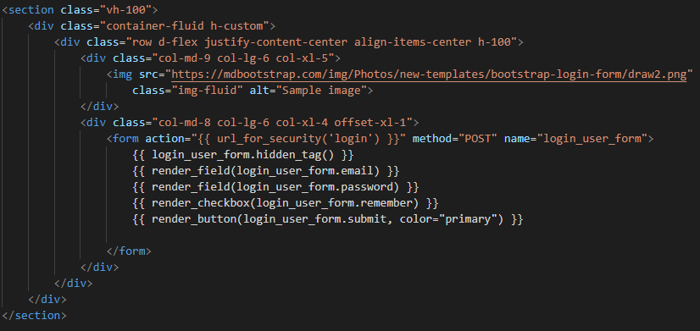
Login Page Modification
Then Just apply like this,
form action should be url_for_security(‘login’) that will handel redirection user when it authenticated.
pertemuan_5\5_Custom_Login_Template\app\templates\security\login_user.html

Slide 37
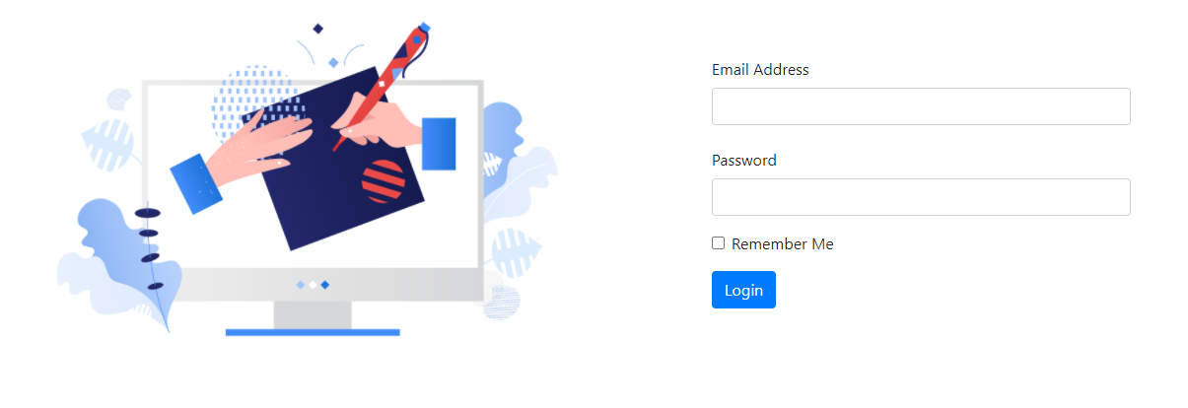
Login Page Modification
Result
Try to login, using user email and password created before,
Then you should authenticated and able to access the web .

Slide 38
The End

