Slide 1


Web Development
#2
View & Form

Slide 2
Training Outline
Flask - View / Routing (part 1)
Flask - Template (part 2)
Flask - Form & User Input
Flask - SQL Alchemy (ORM) & Database -> move to the next part
Flask - CRUD part 1 -> move to the next part

Slide 3
Flask - View / Routing (Part 1)
1. Route & Function Decorator
2. URL Converter
3. URL Structure
4. HTTP Methods (GET & POST)

Slide 4
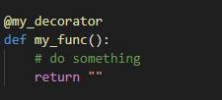
Route & Function Decorator
By definition, a decorator is a function that takes another function and extends the behavior of the latter function without explicitly modifying it. [real-python]
decorators use @ symbol called the “pie” syntax
decorators wrap a function, modifying its behavior
Why we need decorator?

Slide 5
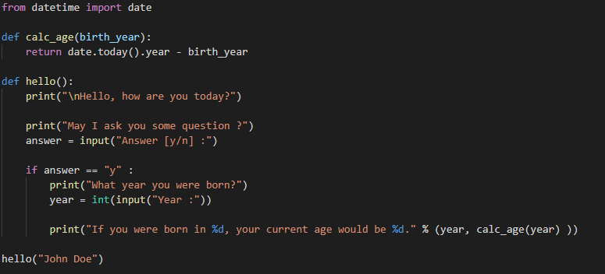
Route & Function Decorator
Take a look this a simple program to ask your age.
1_Function_Decorator\1_hello_func_part1.py
Look’s great, we don’t have a problem with this.

Slide 6
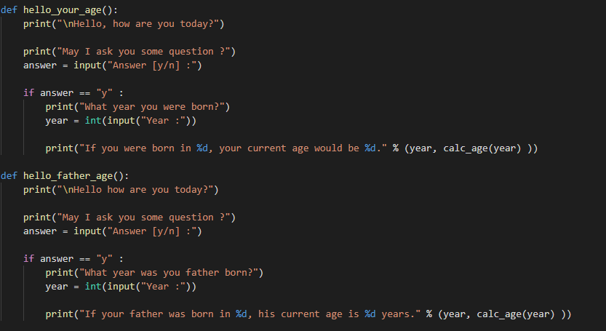
Route & Function Decorator
Let’s create another function to ask your father age with same behaviour.
1_Function_Decorator\2_hello_func_part2.py
We're writing redundant parts here, but we need it and also this doesn't look good.

Slide 7
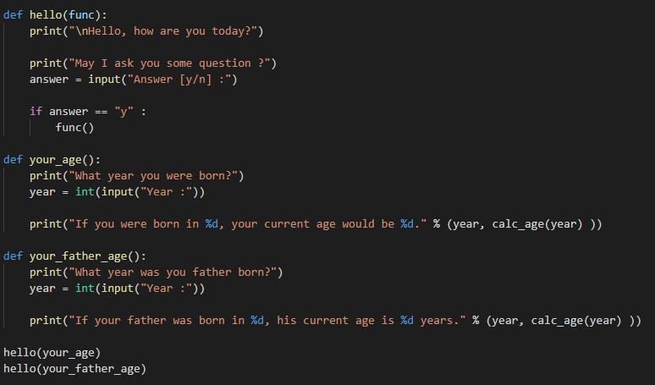
Route & Function Decorator
Let’s change it into a simple decorator
1_Function_Decorator\3_simple_decorator.py
This implementation acceptable, but we need call a functin in a different way.

Slide 8
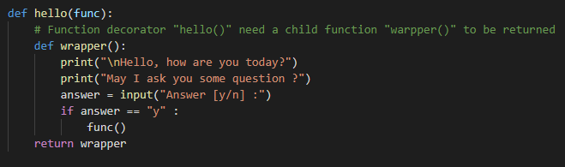
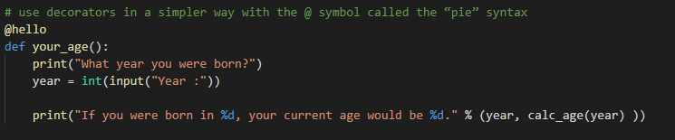

Route & Function Decorator
Call it using decorator style
1_Function_Decorator\4_python_decorator.py
Your wrapper function (common part)
Your actual function (wrapped by decorator “@hello”)
call a function as usual.

Slide 9
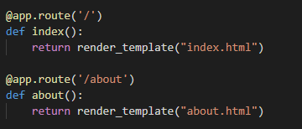
Route & Function Decorator
pertemuan_2\2_Flask_Route\app.py
Flask @app.route() is a function decorator for our function,
It’s wrap our function with ability to handle request from and to web browser.
Beside that, Flask has others decorator.
Login Required Decorator (@login_required)
Caching Decorator (@cache)
Templating Decorator (@templating)
etc.
View for more detail in Flask - Decorator

Slide 10
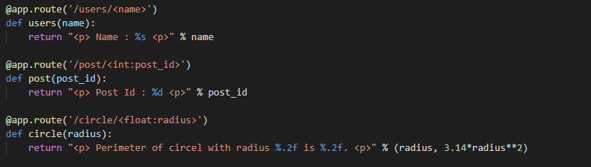
URL Converter
Inside @app.route(), You can add variable sections to a URL by marking sections with <variable_name>.
Your function then receives the <variable_name> as a keyword argument.
Optionally, you can use a converter to specify the type of the argument like <converter:variable_name>.
pertemuan_2\3_URL_Converter\app.py
http://localhost:5000/users/Jasmine
http://localhost:5000/post/23
http://localhost:5000/post/23
http://localhost:5000/circle/10.5

Slide 11
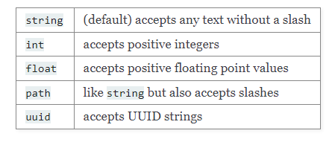
URL Converter
List of available Converter types [Flask - Doc] :
If converter is specified (e.g int), then the inputted variable use a different format (e.g string) ,
It will give you HTTP error, since Flask can’t find a correct path for that request.

Slide 12
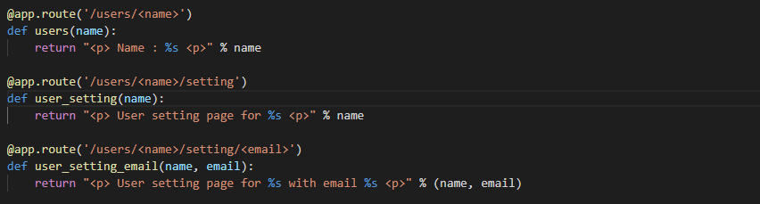
URL Structure
we can build more readable URL using @app.route() in Flask, by defining undestandable path into your funtion.
pertemuan_2\4_URL_Structure\app.py
http://localhost:5000/users/Jasmine
http://localhost:5000/users/Jasmine/setting
http://localhost:5000/users/Jasmine/setting/jasmine@mail.com

Slide 13
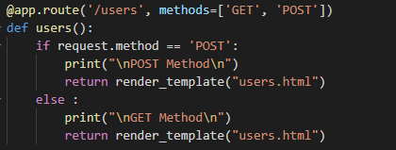
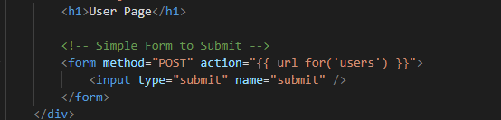
HTTP Method
we can also define HTTP method inside @app.route(),
Below example we have /users endpoint that accept GET and POST method
We also put a simple form with submit button with method POST and action into /users
pertemuan_2\5_HTTP_Method\app.py
Click submit button in http://localhost:5000/users
Just open URL http://localhost:5000/users
pertemuan_2\5_HTTP_Method\templates\users.html

Slide 14
Flask - Template (Part 2)
1. Custom Style (css)
2. Add Script (Js)
3. Flash Message

Slide 15
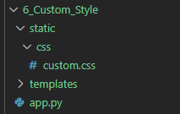

Custom Style (CSS)
We can put a custom style into our application by creating custom.css file inside directory static/css/
Let’s try to add some custom style into our app
Previously we see that our menu navigation link have colors that don't match
Because that link use a default color (blue)
In my opinion, it’s better to make a link to be a white color.
We also need to put white transpared color if link is hovered or menu is active.
How we can do that?

Slide 16
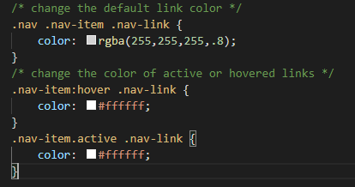
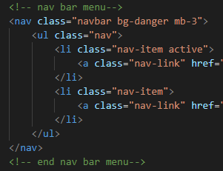
Custom Style (CSS)
Put below style inside custom.css file,
What we have done above is inherit Bootstrap CSS style (.nav, .nav-item, .nav-link) by our preferred style. [CSS Inheritance]
The way we inherit is by using CSS class selector (.), decendant combinator (“ “). [CSS selector]
on above we try to inherit class .nav_link decendent decendent from .nav-item and .nav
pertemuan_2\6_Custom_Style\static\css\custom.css
pertemuan_2\6_Custom_Style\templates\_layout.html

Slide 17
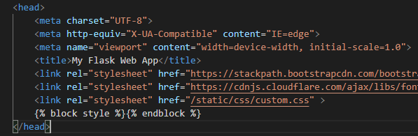

Custom Style (CSS)
Then don’t forget we need to put the link into that custom.css from our _layput.html
Result,
Try to hover on that menu link, the color should changed.
But when we click the link, active link is not changed. why ?
pertemuan_2\6_Custom_Style\templates\_layout.html

Slide 18
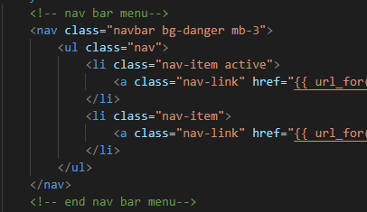
Add Script (Js)
Previously, we see that menu active not changed when clicked to another menu link.
We can solve this problem by applying jQuery script (Js) to update color active link.
pertemuan_2\7_Add_Script\templates\_layout.html
active menu specified by add active class inside menu element (<li> tag)
But, when we click other menu link, this class is not automatically moved.
So, we need add a small script to help us move active class from one menu item to other.

Slide 19
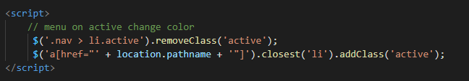
Add Script (Js)
Put the following script at the script section in our _layout.html,
Above script is using jQuery to remove active class inside tag <li> with active class,
Then add active class into closest <li> element with tag <a> use location.pathname.
$(...) is a jQuery selector to help us manipulating html element in our template.
Then check the result, menu active should be changed when it clicked.
More about JQuery : https://api.jquery.com/category/version/3.5/

Slide 20
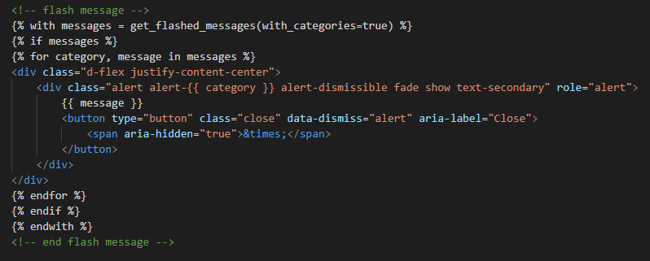
Flash Message
Flash message help us give some feedback meesage from server into web browser.
It’s probably give a success message, or inform if something goes wrong.
To enable flash message in our application, put below Jinja2 template for get and show flash message inside _layput.html
pertemuan_2\7_Flash_Message\templates\_layout.html

Slide 21
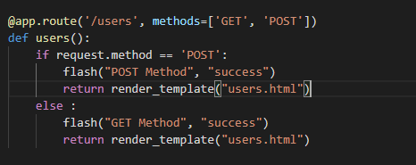

Flash Message
Then inside route function, we can call the flash message with syntax, flash(“message”, “type” )
type shouldbe :
success
danger
info
etc. (follow Bootstrap color class)
pertemuan_2\7_Flash_Message\app.py
Also we need to put app.config SECRET_KEY to make flash message to work.
It’s because flash message use Session to work.
We can learn more aboute session, in the next part.

Slide 22
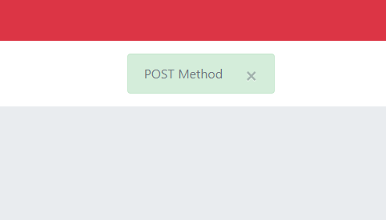
Flash Message
When you click submit button, it will give you flash message like below,

Slide 23
Flask - Form & User Input
User Input (Input Text, Number, Checkbox)
WTForm (Form Rendering & Validation)
Form Handling (Submit)

Slide 24
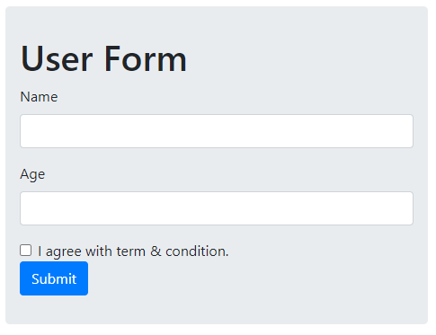
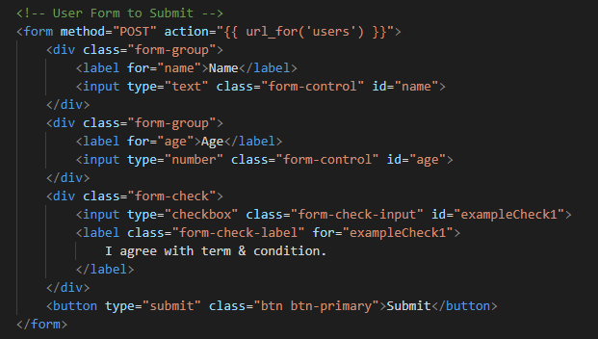
User Input (Input Text, Number, Checkbox)
Now, we will put some User Input element like Input Text, Number and Checkbox.
pertemuan_2\8_User_Input_Part1\templates\users.html
Then, how we can receive all submitted data in server side (Flask) ?

Slide 25
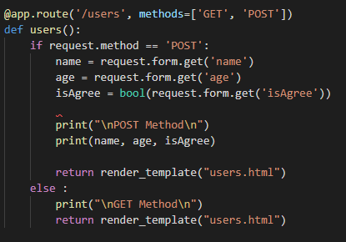
User Input (Input Text, Number, Checkbox)
We can receive submitted form by accessing request.form() object inside flask route function.
use request.form.get(“key”) is more convinient than using request.form[“key”] ,
Because pyhon will evaluate, if that key doesn’t exist in that object, it will not give you error.
More about Flask Request

Slide 26
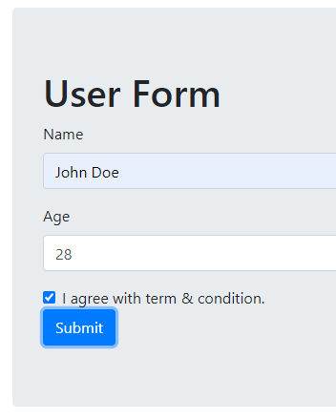
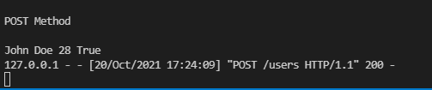
User Input (Input Text, Number, Checkbox)
Result,
http://127.0.0.1:5000/users
view in VSCode console

Slide 27
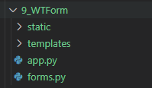
WTForm
WTForms is a flexible forms validation and rendering library for Python web development.
It supports data validation, CSRF protection, internationalization (I18N), and more.
How to put Flask WTForm inside our app?
For simple case, we just put form definition inside forms.py
form.py
app.py
templates/

Slide 28
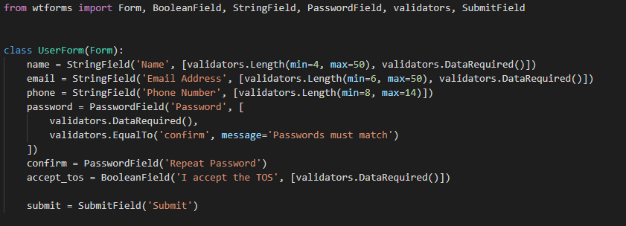
WTForm
Let’s define a User Form inside forms.html, with filed (name, email, phone, password and accept ToC), then add several validation inside that,
Class UserForm is inherited from WTForm Form Class,
Inside that calss we can put form field like StringField (Input Text), PasswordField (Password Input), BooleanField (Checkbox Input) and SubmitField (button Submit)
With validators obect that can help up do a data validation like data input length, required field, and etc.
pertemuan_2\9_WTForm\forms.py

Slide 29

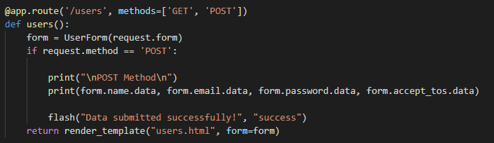
WTForm
Then import UserForm class inside app.py
After that, create form object from UserForm class and give request.form as input
pertemuan_2\9_WTForm\app.py

Slide 30
WTForm
Then import UserForm class inside app.py
After that, create form object from UserForm class and give request.form as input
pertemuan_2\9_WTForm\app.py

Slide 31
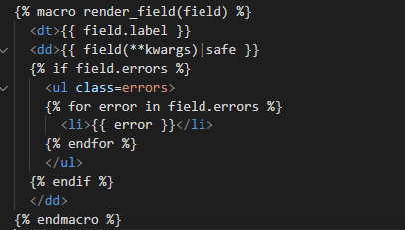
WTForm
We will create a new layout to render form element , we call it _form_element.html
This layput will help us render form element like input text, checkbox, password field, and submit button.
we use Jinja2 macro to wrapping an form element to be callable like a function in consumer template (users.html)
we set the name of macro to render_field with input parameter field that will be filled by WTForm object in prev slide.,
More about Jinja2 Macro
pertemuan_2\9_WTForm\templates\_form_element.html

Slide 32
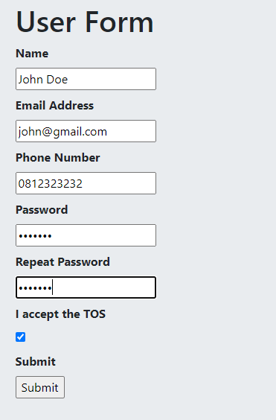
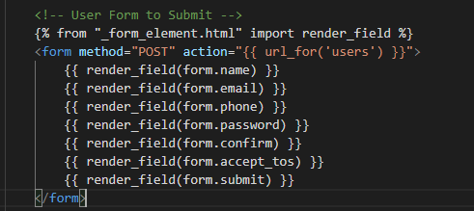
WTForm
Then we can render the form using render_field() macro inside _form_element.html
If we he alot of form, this mechanism much more cleans and easy to maintain if form specification (style, etc.) changes.
In the next part we will learn how to add Bootstrap class inside our rendered field.
pertemuan_2\9_WTForm\templates\users.html

Slide 33
The End

