Slide 1
Cloud To Edge
Cloud computing
Edge computing

Slide 2
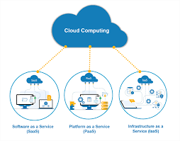
Cloud computing
Cloud computing is a model for delivering IT services in which resources, such as computing power, storage, and applications, are made available over the internet on a pay-per-use basis. Instead of owning and maintaining their own physical servers and equipment, organizations can access these services remotely, scaling them up or down as needed.

Slide 3
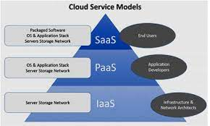
Cloud computing services
Infrastructure as a Service (IaaS): This type of service provides access to computing resources, such as servers, storage, and networking, over the internet.
Platform as a Service (PaaS): This type of service provides a platform for developing, testing, and deploying software applications, often including the underlying infrastructure and middleware.
Software as a Service (SaaS): This type of service provides access to software applications, such as email, customer relationship management (CRM), and enterprise resource planning (ERP), over the internet.

Slide 4
Cloud computing benefits
Cost Savings
Scalability
Improved collaboration
Security
Privacy
Regulatory compliance
Automatic software updates
Greater Innovation
Increased data storage

Slide 5
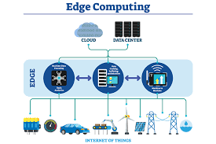
Edge computing
Edge computing refers to the practice of processing data closer to the source of data, rather than sending all data to a centralized location for processing. This can be done using edge devices such as routers, gateways, or specialized edge servers. Edge computing can help reduce the latency and bandwidth requirements of sending data to a distant central location, as well as increase the efficiency and security of data processing.

Slide 6
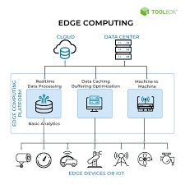
Edge computing services
Data collection and pre-processing: Edge devices can collect data from sensors and other sources, and perform initial processing such as filtering, compression, and encryption.
Data analytics: Edge devices can perform real-time analytics on the data they collect, such as pattern recognition, anomaly detection, and machine learning.
Edge content delivery: Edge devices can store and serve content, such as software updates, images, and videos, to nearby devices, reducing the need for data to be sent to a central location.
Edge security: Edge devices can monitor and secure the network by inspecting and filtering traffic, and providing security services such as firewalls, intrusion detection, and VPNs.

Slide 7
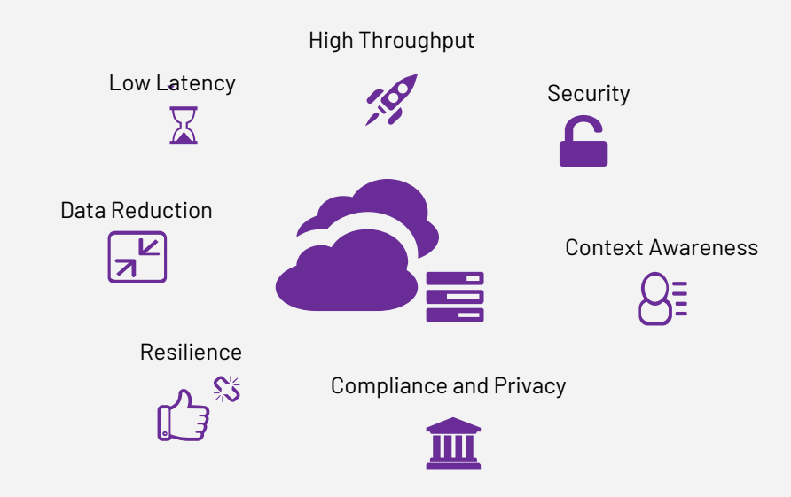
Edge computing benefits
Low Latency
Increased Efficiency
Improved Security
Cost Savings
Offline Capabilities
Better Scalability
Real-time insights
Low power consumption

Slide 8
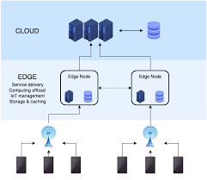
Cloud to edge computing
A "cloud to edge" presentation typically refers to a discussion or demonstration of how data and computing resources can be distributed across a network, with some elements stored and processed in the cloud (i.e., remote servers accessed over the internet) and others located closer to the device or "edge" where they are used. This architecture can help improve performance, reduce latency, and increase security, among other benefits. Depending on the context, a "cloud to edge" presentation may focus on specific technologies or solutions that enable this type of deployment, such as edge computing, IoT devices, and 5G networks.

Slide 9
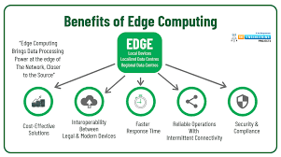
Cloud to edge computing benefits
Reduced Latency
Improved Security
Increased Reliability
Cost Savings
Improved Privacy
Better Scalability
Better Performance
.

Slide 10
Cloud to edge computing conculsion
In conclusion, cloud to edge computing is a distributed computing architecture that combines the benefits of cloud computing with those of edge computing. It allows organizations to process data closer to the source, reducing latency and improving security, reliability, and privacy. It also enables organizations to scale their IT infrastructure more easily and efficiently, and make real-time decisions and actions. Cloud to edge computing can be especially useful for real-time applications such as autonomous vehicles, industrial internet of things (IIoT) systems, retail and healthcare. However, organizations must carefully consider the trade-offs and costs of using this architecture, particularly when it comes to security, data management, and regulatory compliance.

