Slide 1
.Net
WEB ENGINEERING

Slide 2
Week 4 - Day 20

Slide 3
Recap Assignment (10 marks)(Time: 1 hr)
Students will Work in pairs and perform a Simple
Crud Operation Using ADO.NET
They may take help from this video to complete the project.

Slide 4

ASP.NET Web Application

Slide 5

Learning Objectives
By the end of this session, the students will have developed an understanding of:
Types of Relationship
Implementing One to One Relationship
Implementing One to Many Relationship
Implementing Many to Many Relationship

Slide 6
Types of Relationships
One of the most important things in databases is to understand the types of relations in the databases. That stands for both – a process of designing a database model as well as when you’re analyzing your data. Understanding these relations is somehow natural and not so complex but is still essential in the database theory (and practice).
There are 3 different types of relations in the database:
one-to-one
one-to-many, and
many-to-many
Notes:
for further details and explanation:https://www.sqlshack.com/learn-sql-types-of-relations/#:~:text=There%20are%203%20different%20types,many%2Dto%2Dmany

Slide 7
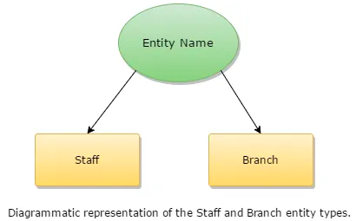
Entity Relationship Model
ER-Diagram is a pictorial representation of data that describes how data is communicated and related to each other. Any object, such as entities, attributes of an entity, sets of relationship, and other attributes of relationship, can be characterized with the help of the ER diagram.
Notes:
for further details and explanation:https://www.sqlshack.com/learn-sql-types-of-relations/#:~:text=There%20are%203%20different%20types,many%2Dto%2Dmany

Slide 8
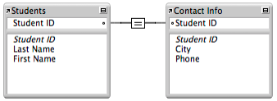
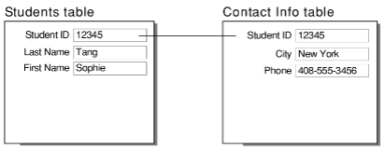
One to One Relationship
In a one-to-one relationship, one record in a table is associated with one and only one record in another table. For example, in a school database, each student has only one student ID, and each student ID is assigned to only one person.
Notes:
for further details and explanation:https://fmhelp.filemaker.com/help/18/fmp/en/index.html#page/FMP_Help%2Fone-to-many-relationships.html%23

Slide 9
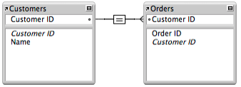
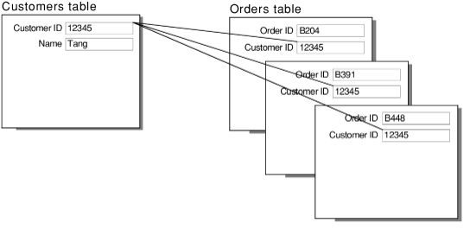
One to Many Relationship
In a one-to-many relationship, one record in a table can be associated with one or more records in another table. For example, each customer can have many sales orders.
Notes:
for further details and explanation: https://fmhelp.filemaker.com/help/18/fmp/en/index.html#page/FMP_Help%2Fone-to-many-relationships.html%23

Slide 10
Many to Many Relationship
A many-to-many relationship occurs when multiple records in a table are associated with multiple records in another table. For example, a many-to-many relationship exists between customers and products: customers can purchase various products, and products can be purchased by many customers.
Relational database systems usually don't allow you to implement a direct many-to-many relationship between two tables. Consider the example of keeping track of invoices. If there were many invoices with the same invoice number and one of your customers inquired about that invoice number, you wouldn't know which number they were referring to. This is one reason for assigning a unique value to each invoice.
To avoid this problem, you can break the many-to-many relationship into two one-to-many relationships by using a third table, called a join table. Each record in a join table includes a match field that contains the value of the primary keys of the two tables it joins. (In the join table, these match fields are foreign keys.) These foreign key fields are populated with data as records in the join table are created from either table it joins.
Notes:
for further details and explanation: https://fmhelp.filemaker.com/help/18/fmp/en/index.html#page/FMP_Help%2Fone-to-many-relationships.html%23

Slide 11
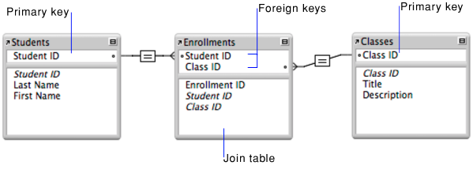
Many to Many Relationship (Example)
A typical example of a many-to many relationship is one between students and classes. A student can register for many classes, and a class can include many students.
The following example includes a Students table, which contains a record for each student, and a Classes table, which contains a record for each class. A join table, Enrollments, creates two one-to-many relationships—one between each of the two tables.
The primary key Student ID uniquely identifies each student in the Students table. The primary key Class ID uniquely identifies each class in the Classes table. The Enrollments table contains the foreign keys Student ID and Class ID.
Notes:
for further details and explanation: https://fmhelp.filemaker.com/help/18/fmp/en/index.html#page/FMP_Help%2Fone-to-many-relationships.html%23

Slide 12
Exercise
To set up a join table for a many-to-many relationship:
1.Using the example above, create a table named Enrollments. This will be the join table.
2.In the Enrollments table, create a Student ID field and a Class ID field.
Join tables typically hold fields that might not make sense to have in any other table. You can add fields to the Enrollments table, such as a Date field to keep track of when someone started a class, and a Cost field to track how much a student paid to take a class.
3.Create a relationship between the two Student ID fields in the tables. Then create a relationship between the two Class ID fields in the tables.
Using this design, if a student registers for three classes, that student will have one record in the Students table and three records in the Enrollments table—one record for each class the student enrolled in.
For help click here
Notes:
for further details and explanation: https://fmhelp.filemaker.com/help/18/fmp/en/index.html#page/FMP_Help%2Fone-to-many-relationships.html%23

Slide 13

Web Engineering > .Net
Learning Objectives
By the end of this session, the students have practised
Types of Relationship
Implementing One to One Relationship
Implementing One to Many Relationship
Implementing Many to Many Relationship
‹#›
Notes:
for further details and explanation:https://www.w3schools.blog/nosql-databases-types-advantages

Slide 14
Conclusion & Q/A
See you tomorrow!

