Slide 1

AI-Driven Disease Risk Tracker For Post-Flood Areas
Group Members
Syed Afaq Haider (P20-0178)
Muhammad Muzammil (P21-8328)
Project Supervisor
Dr. Muhammad Amin

Slide 2
Introduction
Developing a disease risk tracker with following key features:
Risk Prediction of Diseases
Temporal Trend Analysis (Lagged Disease Spikes)
Explainable AI Justification (SHAP)

Slide 3
Problem Statement
Floods in Pakistan frequently lead to outbreaks of waterborne and vector-borne diseases. However, no AI-based system exists that integrates flood data, disease history, and environmental indicators to predict post-flood health risks with transparency. This lack of predictive capacity delays medical response and worsens the humanitarian crisis.

Slide 4
Problem Solution
Develop an AI-powered predictive model that integrates historical flood indicators, and socio-economic vulnerability factors to forecast the risk level of priority waterborne and vector-borne disease outbreaks (AD, Malaria, Typhoid) in flood-affected districts of Pakistan. The system will use Explainable AI (XAI) to provide transparent, action-oriented reports for public health officials

Slide 5
Identified Gap
Challenge: Public health response is often reactive and delayed, relying on confirmed case reports after an outbreak has started.
Current Solutions: Epidemiological studies provide statistical association but lack predictive, location-specific forecasting models that integrate environmental features with high accuracy.
Safety Limitations: Existing flood models focus on flood hazard mapping but fail to couple this directly with health vulnerability and transparent risk justification.

Slide 6
Literature Review
Paper Title | Year | Limitation | Improvement
A Comparative Review of Predictive Models for Waterborne Disease Outbreaks [14] | 2025 | Models often face issues with data inconsistency, missing information, and lacking interpretability/trust among public health actors. | Directly addresses the "lack of interpretability" gap by integrating the SHAP Engine
Flood Risk Analysis in Sindh, Pakistan: Predicting the Most Affected Tehsil Using Statistical and Machine Learning Models [10] | 2025 | Focus is on physical/demographic impact (displacement), not health outcome | Shifts the prediction target from displacement to the risk of disease outbreak
Data-Driven Innovations in Flood Hazard Assessment with Machine Learning [11] | 2025 | Highlights the variability of ML model performance across different regions and environments | Uses SHAP to identify the most significant regional features, providing local interpretability
A Climate Change Calamity: Assessing The Impact Of Flooding On Waterborne Disease Burden In Pakistan [3] | 2024 | Due to limited data availability and small sample sizes, the study relied on less powerful non-parametric statistical tests | We move beyond statistical association to predictive modeling for stronger inference.
Deep learning rapid flood risk predictions for climate resilience planning [6] | 2024 | Deep Learning models generally lack easy interpretability | Our FYP specifically utilizes SHAP delivering the required explainability for public health decision-makers.

Slide 7
Literature Review
Paper Title | Year | Limitation | Improvement
Machine Learning and Prediction of Infectious Diseases: A Systematic Review [13] | 2023 | High-quality, comprehensive data is often incomplete or biased. Predictions lack probabilistic interpretations in some ML models. | We focus on integrating multiple data sources (meteorological, GIS, socio-economic) to create a more comprehensive feature set.
Machine learning based efficient prediction of positive cases of waterborne diseases [4] | 2023 | The study is limited to patient-centric features. | Our FYP integrates environmental, flood, and geospatial data with disease data, addressing the root causes of the outbreak.
Leptospirosis modelling using hydrometeorological indices and random forest machine learning [5] | 2023 | The study is limited to one disease and a purely hydro-meteorological feature set. | Our FYP applies a generalized flood-disease model to three key diseases.
Prediction of dengue annual incidence using seasonal climate variability in Bangladesh [12] | 2022 | Focuses on seasonal dengue in an endemic region; models may not generalize well to extreme, sudden, non-seasonal flood events. | Fuses Seasonal with Event Data: Integrates both seasonal features (Week_Index) and extreme flood event features

Slide 8
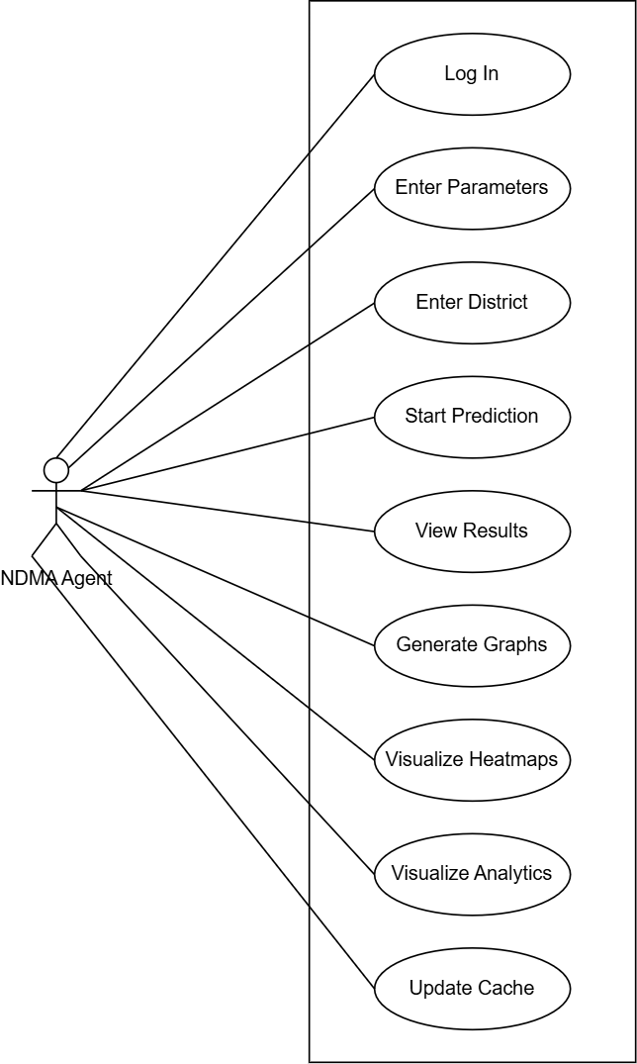


Use Case Diagram

Slide 9
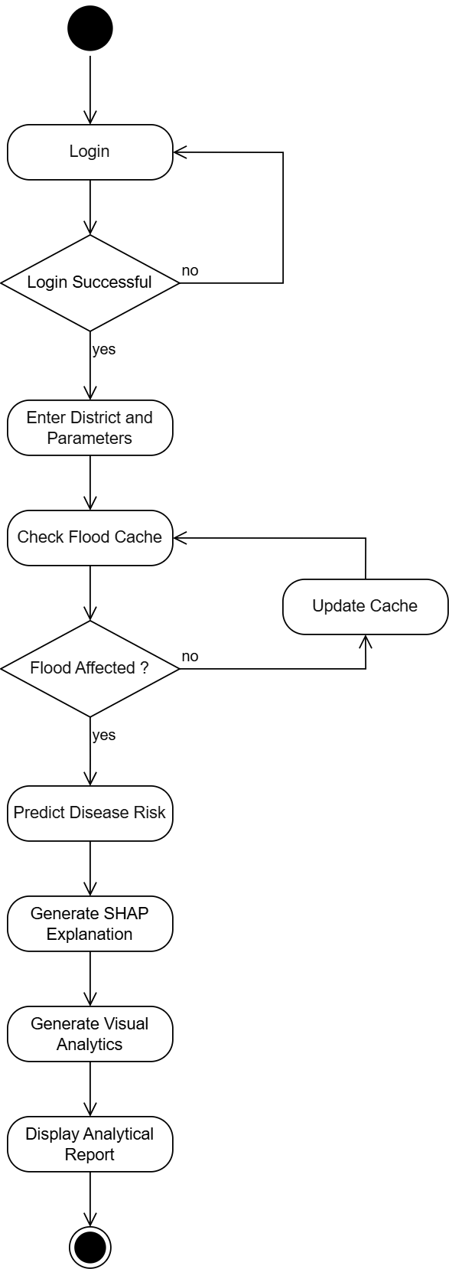


Activity Diagram

Slide 10
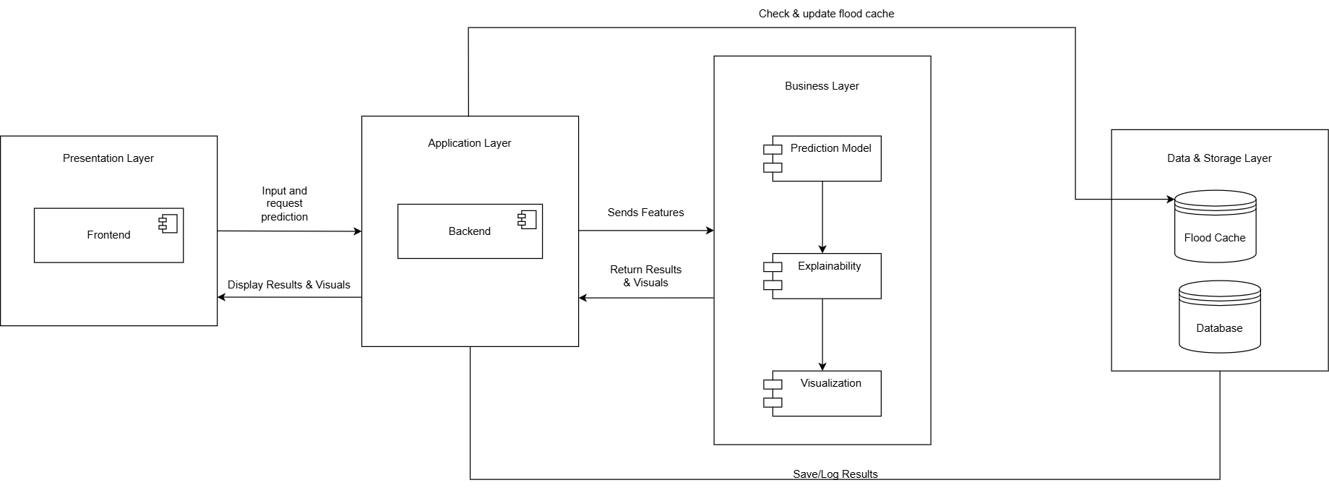
System Architecture Diagram

Slide 11
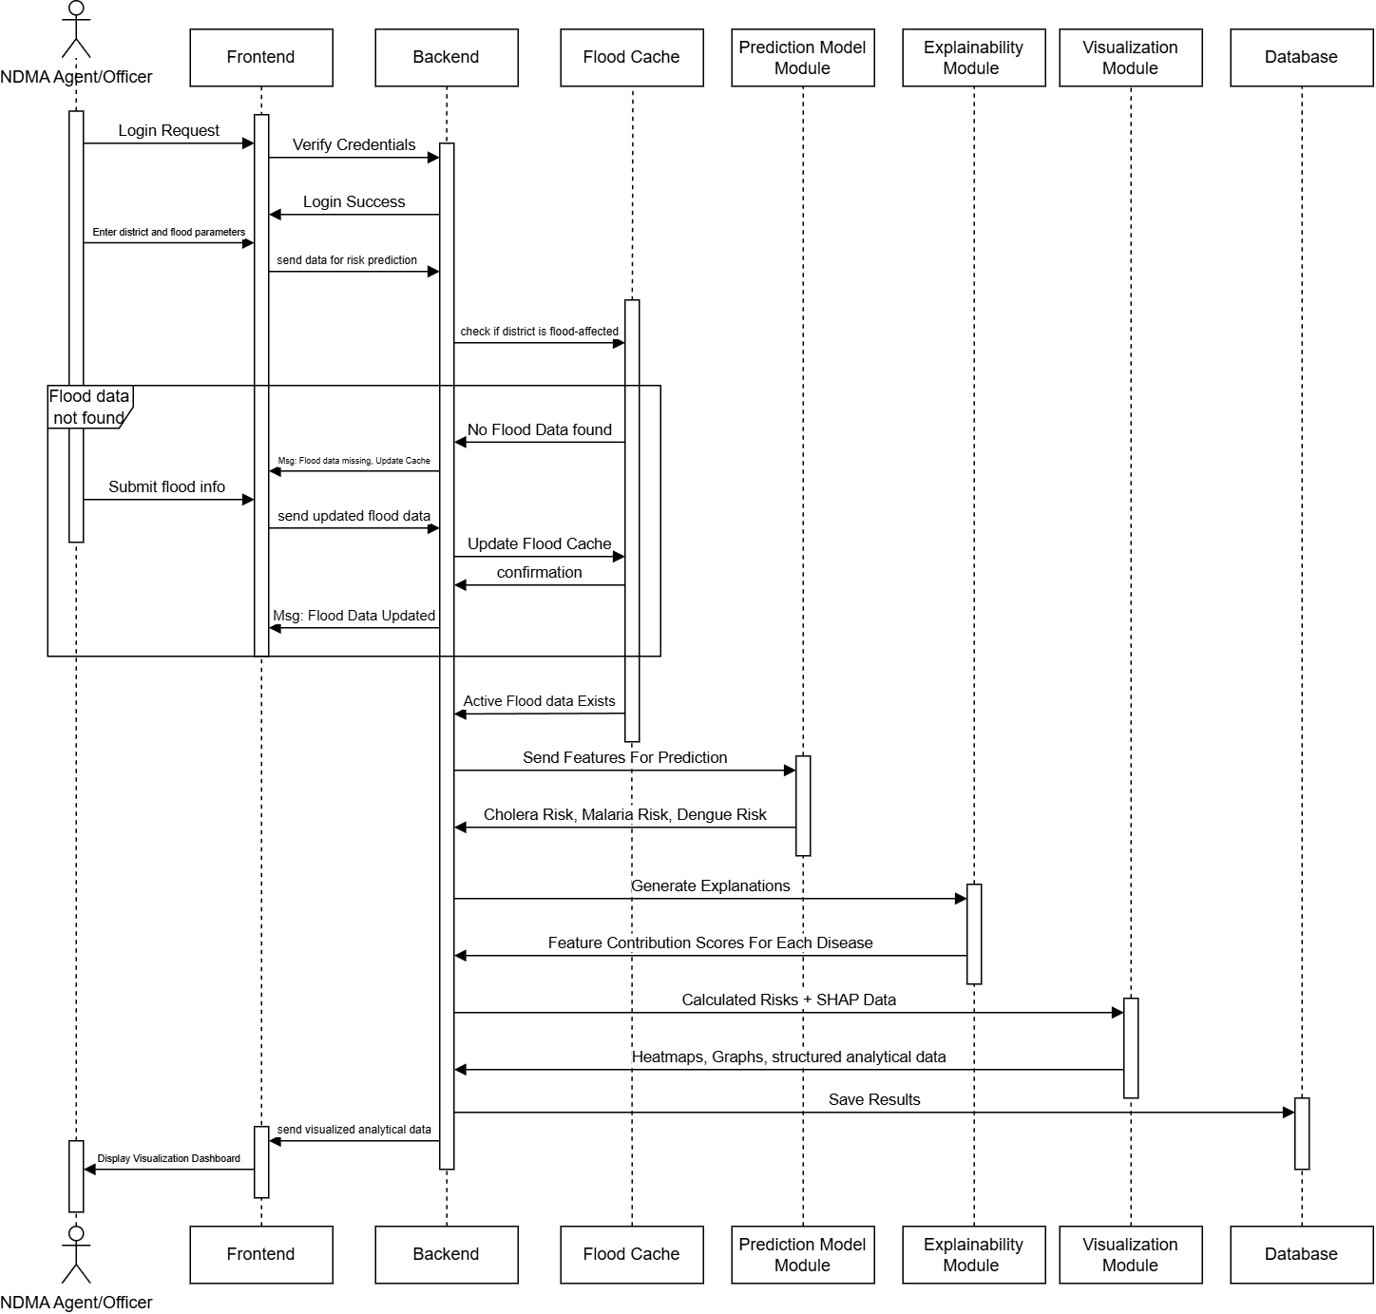
Sequence Diagram

Slide 12
Software Development Plan
We used Agile Development Methodology with iterative cycles.
Data Collection and Preparation:
Manually collected multi-district weekly health and environmental data.
Cleaned, validated, and standardized dataset.
Created final processed dataset for model training.
ML Model Development:
Trained three separate CatBoost regression models
Malaria_Risk_next_week
AD_Risk_next_week
Typhoid_Risk_next_week

Slide 13
Software Development Plan
UI & Frontend Development:
Design UI for the web-based Frontend of the system.
Develop the Frontend
FYP-1 Deliverables Completed
Literature review
Problem identification & scope
UML designs
Complete dataset collection
Preprocessing pipeline + feature engineering
Final processed dataset
Trained prediction models
Testing script with real example input
Frontend Developed for login and prediction pages.

Slide 14
Datasets
Weather Data:
We used open-meteo api for the weather data.
Open-Meteo Api Link
Used to get weather data, rainfall, temperature etc.
The Historical Weather API is based on reanalysis datasets and uses a combination of weather station, aircraft, buoy, radar, and satellite observations to create a comprehensive record of past weather conditions. These datasets are able to fill in gaps by using mathematical models to estimate the values of various weather variables.

Slide 15
Datasets
Epidemiological Data:
NIH was the main source for the disease’s data.
NIH Reports
Sourced district wise disease data also ensured that temporal alignment. We scrapped the data from the pdf reports using scripts.
NIH Weekly Bulletins which report weekly cases of the diseases, district wise.

Slide 16
Datasets
Geospatial & Static District Data:
Data of population, area, and Elevation etc.
Open-meteo Api Link
Wikipedia
Used open-meteo Api for elevation and Wikipedia and other sources for different

Slide 17
Data Acquisition
Epidemiological Data
Collected weekly health bulletins from the National Institute of Health (NIH), Pakistan.
Extracted district-level case counts for Malaria, Acute Diarrhea (AD), and Typhoid.
Ensured temporal alignment of disease cases with environmental factors for modeling.
Meteorological Data
Retrieved historical weather patterns using the Open-Meteo API.
Key environmental parameters included:
Average Temperature
Average Rainfall
Average Humidity
Geospatial & Static District Features
Gathered through web scraping and official sources.
Captured invariant features of each district:
Elevation
Sanitation Index
Geographical Area
River Status

Slide 18
Data Processing
Data Cleaning & Filtering
Removed anomalies such as districts with 0 population to ensure data reliability.
Converted numeric columns (e.g., rainfall, temperature, humidity, population, elevation) to numeric types and District column to category type.
Imputed missing values:
Environmental features (temperature, rainfall, humidity) filled with 0 when missing.
Static district features (elevation, area, river status, sanitation index) filled with mean values.
Target Variable Normalization
Calculated disease risk per 10,000 people for Malaria, Acute Diarrhea (AD), and Typhoid.
Created next-week targets by shifting risk values forward in time, enabling week-ahead predictions.
Outlier removal: filtered extreme risk values beyond the 99th percentile.
Temporal Sequencing & Feature Engineering
Sorted data hierarchically by Year → District → Week Index to preserve chronological order.
Generated lag features for environmental variables (lag-1 and lag-2 weeks) to capture temporal dependencies.
Created rolling averages (3-week and 5-week windows) for rainfall, temperature, and humidity to smooth short-term fluctuations.
Final dataset: complete, time-aware, and enriched with temporal context for CatBoost modeling.

Slide 19
Data Processing
Data Cleaning & Filtering
Removed anomalies such as districts with 0 population to ensure data reliability.
Converted numeric columns (e.g., rainfall, temperature, humidity, population, elevation) to numeric types and District column to category type.
Imputed missing values:
Environmental features (temperature, rainfall, humidity) filled with 0 when missing.
Static district features (elevation, area, river status, sanitation index) filled with mean values.
Target Variable Normalization
Calculated disease risk per 10,000 people for Malaria, Acute Diarrhea (AD), and Typhoid.
Created next-week targets by shifting risk values forward in time, enabling week-ahead predictions.
Outlier removal: filtered extreme risk values beyond the 99th percentile.
Temporal Sequencing & Feature Engineering
Sorted data hierarchically by Year → District → Week Index to preserve chronological order.
Generated lag features for environmental variables (lag-1 and lag-2 weeks) to capture temporal dependencies.
Created rolling averages (3-week and 5-week windows) for rainfall, temperature, and humidity to smooth short-term fluctuations.
Final dataset: complete, time-aware, and enriched with temporal context for CatBoost modeling.

Slide 20
Training Pipeline
CatBoost Model Parameters
Iterations: 1500
Learning rate: 0.03
Depth: 6
Loss function: RMSE
Early stopping: 100 rounds
1. Data Preparation
Load processed dataset with engineered features and normalized disease risk.
Convert numeric columns, fill missing values, and ensure data consistency.
Separate categorical (District) and numeric features.
2. Target Selection
Define targets: (Malaria_Risk_next_week) (AD_Risk_next_week) (Typhoid_Risk_next_week)
Drop rows with missing target values.
3. Chronological Train-Test Split
Split dataset based on week_index to preserve temporal order.
Reserve the last 8 weeks as the test set.
Training set contains all prior weeks to prevent data leakage.

Slide 21
Training Pipeline
4. Model Training
Train CatBoost Regressor separately for each disease risk target.
Use RMSE loss and early stopping.
CatBoost handles categorical features natively (District).
5. Evaluation & Prediction
Predict on chronologically separated test set.
Compute performance metrics:
>MAE (Mean Absolute Error)
>RMSE (Root Mean Squared Error)
>R² Score
7. Output & Artifacts
Trained model files (.cbm) for each target.
Predictions CSV for test weeks.
Feature importance CSV for model interpretation.
Metadata JSON/pickle storing model configuration and performance metrics.

Slide 22
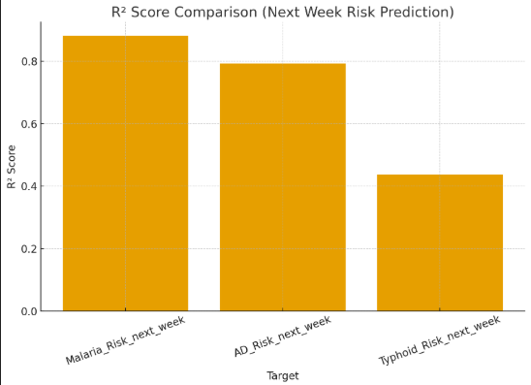
Results
Malaria Model
MAE = 1.95
RMSE = 3.34
R2 = 0.88
AD Model
MAE = 1.54
RMSE = 2.35
R2 = 0.79
Typhoid Model
MAE = 0.17
RMSE = 0.25
R2 = 0.43

Slide 23
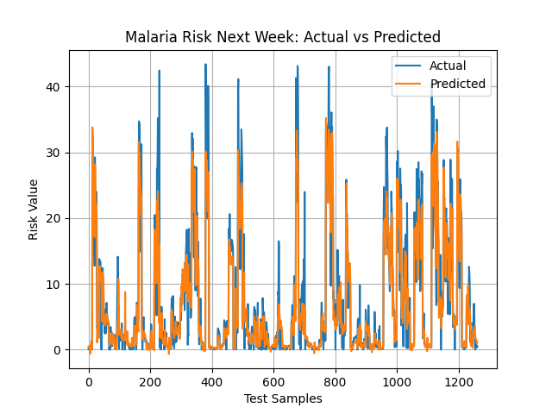
Results

Slide 24

Frontend UI

Slide 25
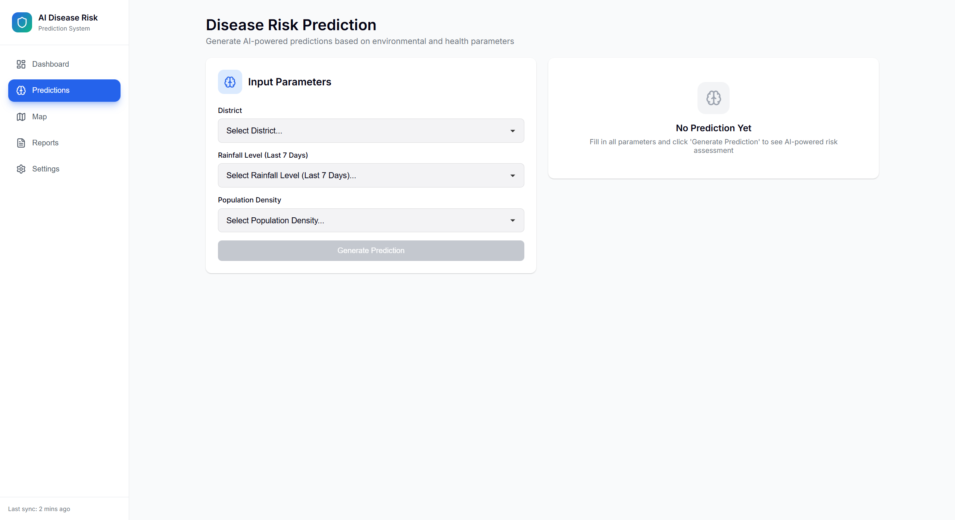
Frontend UI

Slide 26
Objectives
FYP 1 | FYP 2
Task 1: Initial Research and Planning Define problem statement and project scope Identify key objectives and outcomes Assign roles and responsibilities within team Finalize workflow and modules (Flood, Disease, UI) Prepare proposal and get supervisor approval | Task 1: Advanced Model Development & Training • Tune hyperparameters and improve accuracy • Add multi-disease prediction capability (AD, Malaria, Typhoid) • Integrate SHAP for feature importance • Include temporal data and flood recurrence handling
Task 2: Literature Review and Design Study existing research on flood prediction, climate-disease modeling, and GIS-based systems Identify feature correlations (rainfall, NDVI, humidity, etc.) Finalize system architecture and model flow Plan dataset structure and required parameters | Task 2: Front-end Development • Develop web interface for NDMA analysts • Create data input form and visualization dashboard • Integrate model with backend API
Task 3: Dataset Collection and Preprocessing Collect historical data from open datasets and reports Combine disease, and environmental data Handle missing values, normalize and encode features Prepare labeled dataset for model training | Task 3: Testing, Optimization, Evaluation & Deployment • Perform unit and integration testing • Optimize model and interface performance • Conduct system testing and validation • Deploy final system (local/cloud)
Task 4: Model Design CatBoost Regression Model. Define input-output mappings Train and evaluate baseline models Perform EDA and visualize feature correlations Prepare performance metrics and documentation | Task 4: Final Documentation & Presentation • Prepare detailed project report and poster • Record demonstration video • Final presentation and viva • Submit final deliverables

Slide 27
Gantt Chart
2025
2026
Sep
Oct
Nov
Dec
2026
Feb
Mar
Apr
May
Task 1
Initial Research & Planning
Task 1
Advanced Model Development & Training
Jan - Feb
Sep – Oct
Task 2
Literature Overview
& Design
October
February
Task2
Front-end Development
Task 3
Dataset Collection
& Preprocessing
Oct - Nov
Task3
Testing, Evaluation, Optimization &
Deployment
Mar - Apr
Task 4
Model Design & Development
Nov - Dec
Task 4
Final Documentation & Presentation Preparation
Apr - May

Slide 28
Teamwork FYP-1
Member 1
Collect and preprocess flood and disease datasets (NDMA, WHO, historical reports).
Develop the basic Frontend.
Design and manage the database structure for event and disease timelines.
Develop predictive model for post-flood disease risks.
Ensure accuracy through model testing and evaluation.
Member 2
Collect and preprocess flood and disease datasets (NDMA, WHO, historical reports).
Develop the Pre-Processing Data Pipeline.
Develop predictive model for post-flood disease risks.
Ensure accuracy through model testing and evaluation.

Slide 29
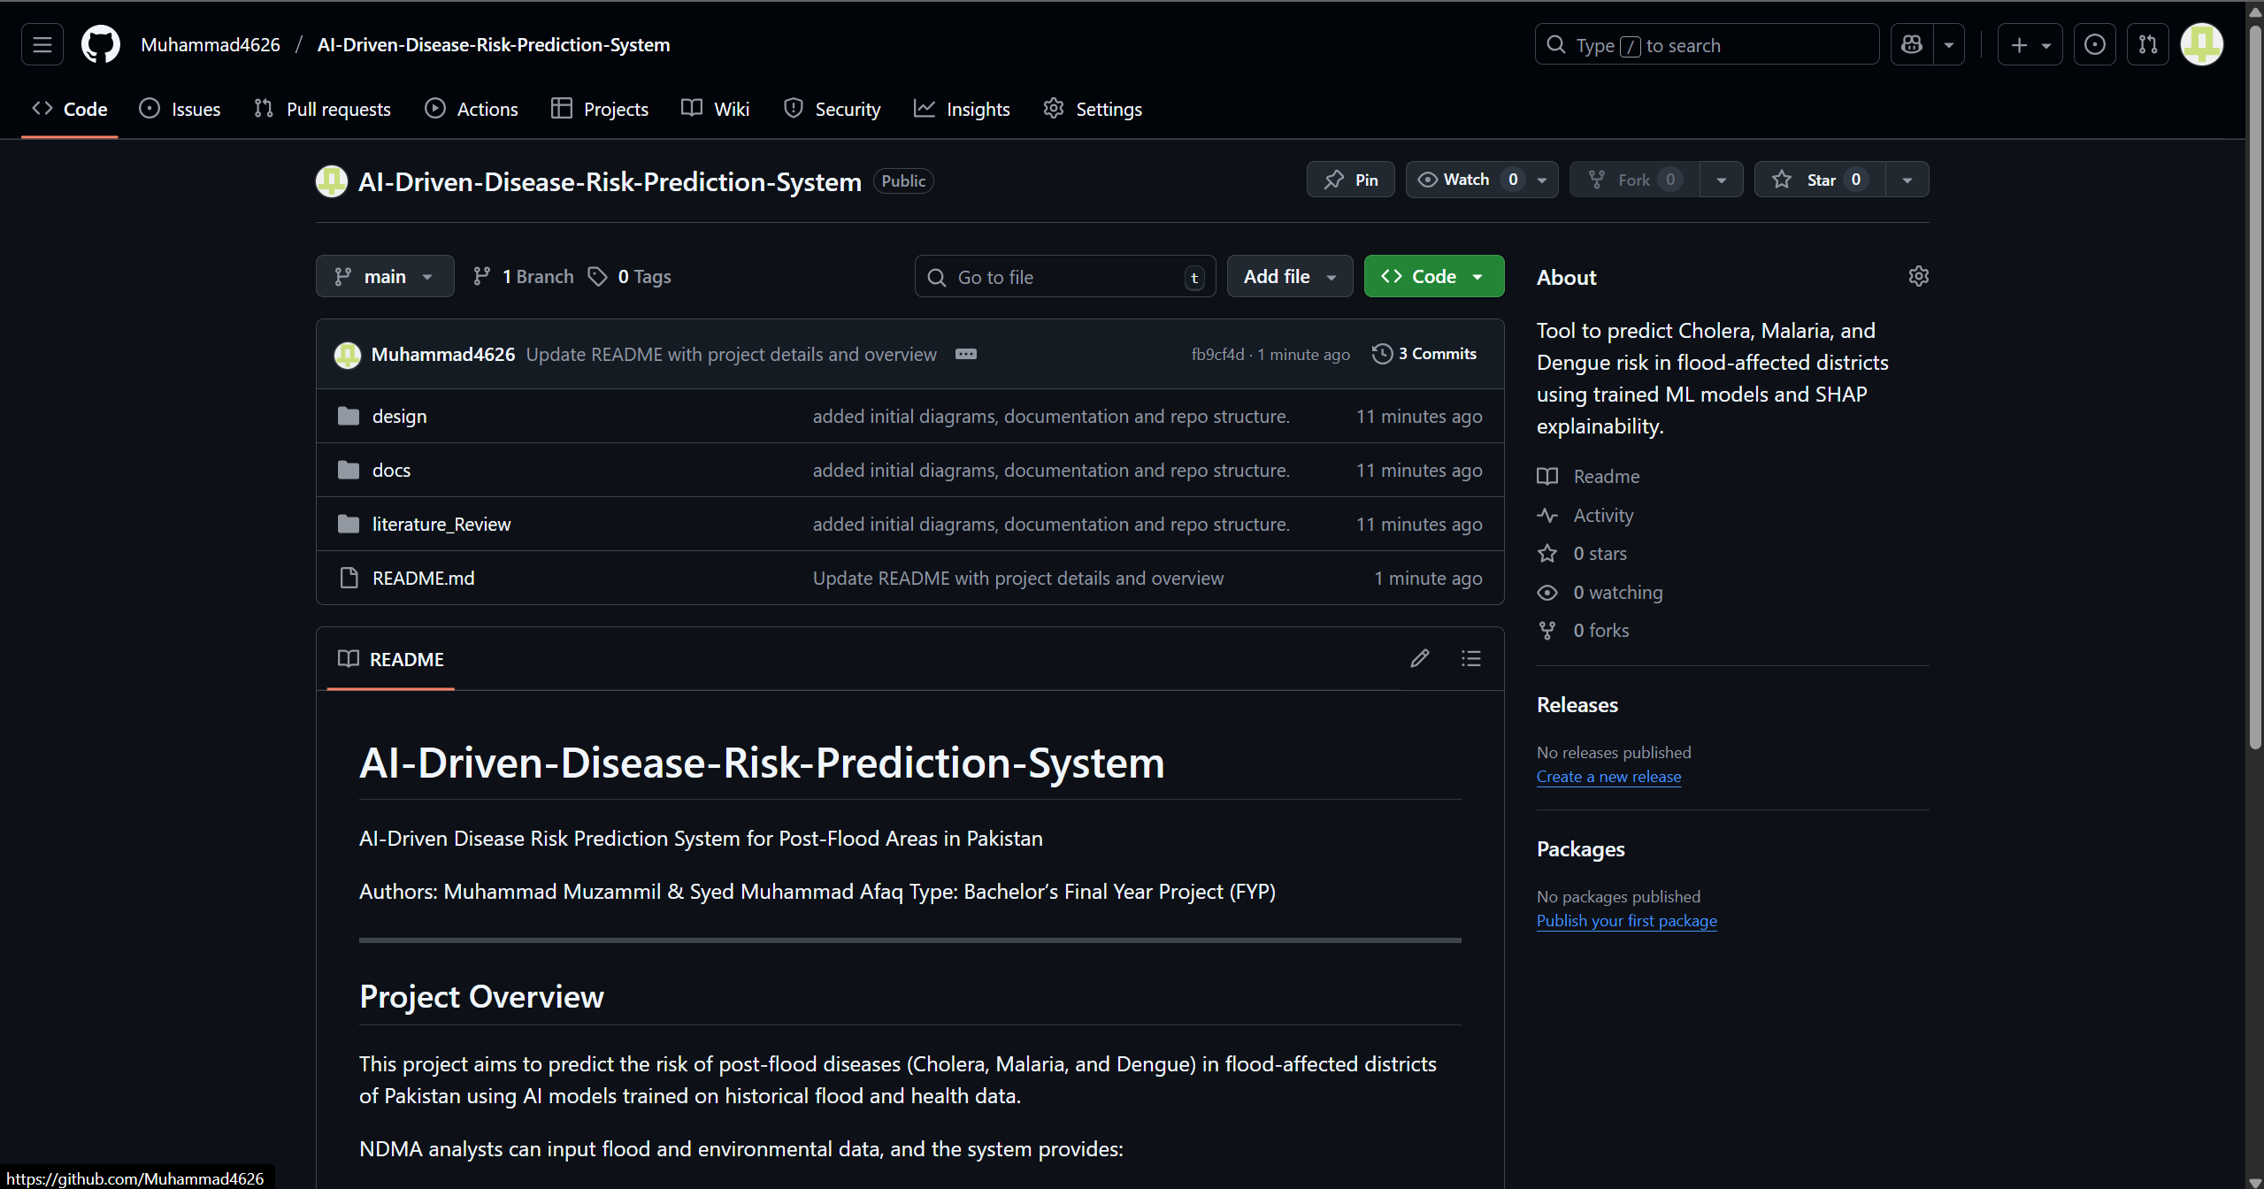
GitHub Link
GitHub Repo

Slide 30
References
[1] L. I. Vohra, M. Aqib, H. Jamal, Q. Mehmood, and F. Yasin, “Rising cases of dengue and malaria in flood affected areas of Pakistan: A major threat to the country’s healthcare system,” Disaster Medicine and Public Health Preparedness, vol. 17, no. 5, pp. 1–2, 2023. [Online]. Available: https://www.cambridge.org/core/services/aop-cambridge-core/content/view/87D81594995B2FE8A4854FC436C7A522/S1935789322002932a.pdf
[2] N. Nisar, Z. Iqbal, M. Sartaaj, A. Ikram, N. Javad, K. Ali, J. Anjum, M. A. K. Bettani, W. Shah, N. Tanveer, P. Cleary, C. Byers, A. Wilson, M. Salman, and M. A. Aldeyab, “Mortality associated with priority diseases in flood-affected areas using District Health Information System (DHIS2) during September–December 2022: Pakistan experience,” Disaster Medicine and Public Health Preparedness, vol. 18, art. e89, 2024. [Online]. Available: https://www.cambridge.org/core/services/aop-cambridge-core/content/view/B78C75F357F634F146C98FB60B24C6EF/S1935789324000776a.pdf
[3] H. Schultz, “A Climate Change Calamity: Assessing the Impact of Flooding on Waterborne Disease Burden in Pakistan,” M.P.H. thesis, Yale School of Public Health, New Haven, CT, Jan. 2024. [Online]. Available: https://elischolar.library.yale.edu/cgi/viewcontent.cgi?article=2432&context=ysphtdl
[4] M. Hussain, M. A. Cifci, T. Sehar, S. Nawaz, and K. Rashid, “Machine learning based efficient prediction of positive cases of waterborne diseases,” BMC Medical Informatics and Decision Making, vol. 23, no. 11, pp. 1–16, 2023. [Online]. Available: https://link.springer.com/content/pdf/10.1186/s12911-022-02092-1.pdf
[5] V. Jayaramu, Z. Zulkafli, S. De Stercke, M. N. Ahmad, and N. R. Abdullah, “Leptospirosis modelling using hydrometeorological indices and random forest machine learning,” International Journal of Biometeorology, vol. 67, no. 3, pp. 423–437, 2023. [Online]. Available: http://irep.iium.edu.my/110725/8/110725_Leptospirosis%20modelling%20using%20hydrometeorological_Scopus.pdf
[6] A. Yosri, M. Ghaith, and W. El-Dakhakhni, “Deep learning rapid flood risk predictions for climate resilience planning,” Journal of Hydrology, vol. 631, Mar. 2024, art. no. 130817. [Online]. Available: https://pdf.sciencedirectassets.com/271842/1-s2.0-S0022169423X00213/1-s2.0-S0022169424002117/main.pdf
[7] Z. Demissie, P. Rimal, W. M. Seyoum, A. Dutta, and G. Rimmington, “Flood susceptibility mapping: Integrating machine learning and GIS for enhanced risk assessment,” Applied Computing and Geosciences, vol. 23, Sep. 2024, art. no. 100183. [Online]. Available: https://pdf.sciencedirectassets.com/320472/1-s2.0-S2590197424X00038/1-s2.0-S2590197424000302/main.pdf

Slide 31
References
[8] S. V. Taral, “A Comparative Review of Predictive Models for Waterborne Disease Outbreaks,” International Journal of Advanced Computer Engineering and Communication Technology, vol. 14, no. 1, pp. 278–286, 2025.
[9] A. K. Siddiqi, “Devastating floods to dengue epidemic — a deadly combination for Pakistan’s public health,” Annals of Medicine and Surgery, vol. 85, Feb. 2024, art. no. 104561. [Online]. Available: https://journals.lww.com/annals-of-medicine-and-surgery/_layouts/15/oaks.journals/downloadpdf.aspx?an=01845215-202402000-00039
[10] M. Saeed et al., “Flood Risk Analysis in Sindh, Pakistan: Predicting the Most Affected Tehsil Using Statistical and Machine Learning Models with Comprehensive Data,” Asian Bulletin of Big Data Management, vol. 4, no. 3, Aug. 2025. [Online]. Available: https://www.researchgate.net/publication/384989122_Flood_Risk_Analysis_in_Sindh_Pakistan_Predicting_the_Most_Affected_Tehsil_Using_Statistical_and_Machine_Learning_Models_with_Comprehensive_Data
[11] J. Zhang, W. Guo, et al., “Data-Driven Innovations in Flood Hazard Assessment with Machine Learning,” Earth: Environmental Sustainability, vol. 2, no. 2, Jul. 2025. [Online]. Available: https://www.researchgate.net/publication/395366837_Data-Driven_Innovations_in_Flood_Hazard_Assessment_with_Machine_Learning
[12] S. Paul et al., “Prediction of dengue annual incidence using seasonal climate variability in Bangladesh between 2000 and 2018,” PLOS Global Public Health, vol. 2, no. 5, May 2022, art. no. e0000047. [Online]. Available: https://journals.plos.org/globalpublichealth/article?id=10.1371/journal.pgph.0000047
[13] O. E. Santangelo, V. Gentile, S. Pizzo, D. Giordano, and F. Cedrone, "Machine Learning and Prediction of Infectious Diseases: A Systematic Review," Mach. Learn. Knowl. Extr., vol. 5, no. 1, p. 175, 2023, doi: 10.3390/make5010013. [Online]. Available: https://www.mdpi.com/2504-4990/5/1/13
[14] S. V. Taral, "A Comparative Review of Predictive Models for Waterborne Disease Outbreaks," Int. J. Adv. Comput. Eng. Commun. Technol., vol. 14, no. 1, pp. 278–286, 2025. [Online]. Available: https://journals.mriindia.com/index.php/ijacect/article/view/455

