Slide 1
AURA Forge
Governed Adaptive Engineering for FitGPT
Give each software change only the autonomy it deserves.
LaunchCode Agentic Engineering Capstone
Muhammad Imran
Notes:
Goal: Open with the project thesis.
What to say: This project is AURA Forge. It is not a FitGPT feature demo. FitGPT is the real codebase I used to test an agentic engineering system that decides how much autonomy a change deserves.
What to point at: Point to the thesis box on the right.
Transition: Next, explain why the old fixed route was the problem.
[Sources]
- docs/capstone/stakeholder-one-pager.md
- docs/capstone/final-rubric-audit.md

Slide 2
Fixed autonomy made simple changes too expensive
The same route was being applied to changes with very different risk.
Planner
Human
Implementer
Reviewer
Tester
Human
PM
LOW
HIGH
Full route wasted time and cost
on a documentation-only change.
Removing governance would have
been unsafe for policy-sensitive work.
02
Notes:
Goal: Show why fixed autonomy is wrong.
What to say: Before AURA, representative changes went through the same full path: Planner, human approval, Implementer, Reviewer, Tester, another human approval, and Project Manager. That was defensible for high risk, but too heavy for low risk.
What to point at: Point across the fixed route, then contrast LOW and HIGH.
Transition: Now show how AURA makes the route deterministic and risk-based.
[Sources]
- docs/capstone/control-baseline-comparison.md
- docs/routing-and-tool-grant-map.md

Slide 3
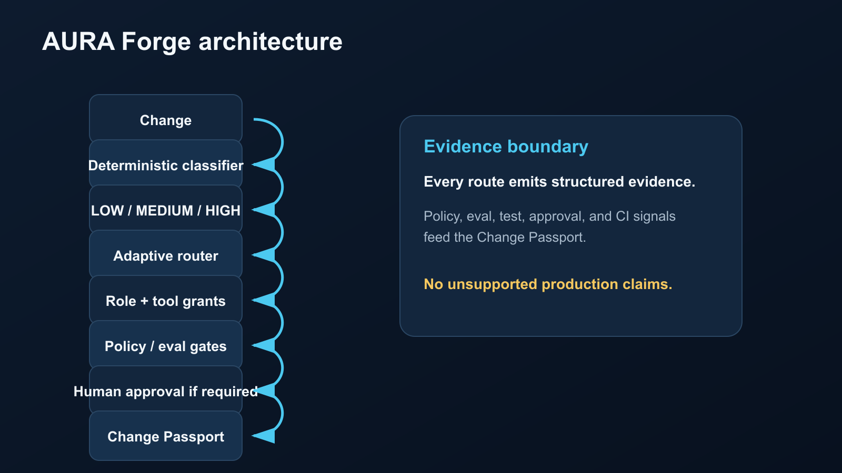
AURA Forge routes each change by risk
A deterministic classifier selects risk before any route is chosen.
Core idea
The classifier does not implement code, grant tools, or call a model. It only determines LOW, MEDIUM, or HIGH. The router then assigns roles, tools, gates, and human checkpoints.
03
Notes:
Goal: Explain the architecture clearly.
What to say: AURA separates risk classification from execution. The classifier is deterministic and model-free. The router uses that result to choose roles, tools, gates, and approvals.
What to point at: Point from Change through Change Passport.
Transition: Next, compare the three actual routes.
[Sources]
- docs/capstone/final-architecture.md
- docs/capstone/risk-classifier.md
- docs/capstone/adaptive-routing.md

Slide 4
LOW gets speed; HIGH keeps governance
The route is lighter only when the risk is lower.
Adaptive route matrix
LOW
Implementer -> Reviewer -> deterministic gates
MEDIUM
Implementer -> Reviewer -> Tester -> final approval
HIGH
Planner -> plan approval -> Implementer
-> Reviewer -> Tester -> policy/eval gates
-> final approval -> PM
Human checkpoints
LOW 0 MEDIUM 1 HIGH 2
HIGH is not optimized away.
04
Notes:
Goal: Make adaptive autonomy concrete.
What to say: LOW kept an implementer, an independent reviewer, and deterministic gates. MEDIUM kept implementer, reviewer, tester, and one final approval. HIGH kept the full governed route including final approval and Project Manager.
What to point at: Point to each route row, especially the complete HIGH row.
Transition: Next, explain how the evidence was measured.
[Sources]
- docs/capstone/adaptive-routing.md
- docs/capstone/aura-results.md

Slide 5
The experiment compared matched scenarios
Control first, freeze the router, then measure AURA.
AF-LOW-001
AF-MEDIUM-
001
AF-HIGH-001
Documentation /
accessibility
Bounded executable
test change
Governance / MCP
policy-sensitive
Matched rules
Same locked 16-point quality rubric. Control route measured first. Router frozen before AURA measurements. Infrastructure failures preserved separately.
05
Notes:
Goal: Establish credibility of the experiment.
What to say: I used three representative scenarios: a LOW documentation change, a MEDIUM executable/test change, and a HIGH governance-sensitive change. I measured the fixed control route first, froze the router, then measured AURA.
What to point at: Point to the three scenario cards and the matched-rules line.
Transition: Now show the measured results.
[Sources]
- docs/capstone/representative-scenarios.md
- docs/capstone/quality-rubric.md
- docs/capstone/control-vs-aura-impact.md

Slide 6
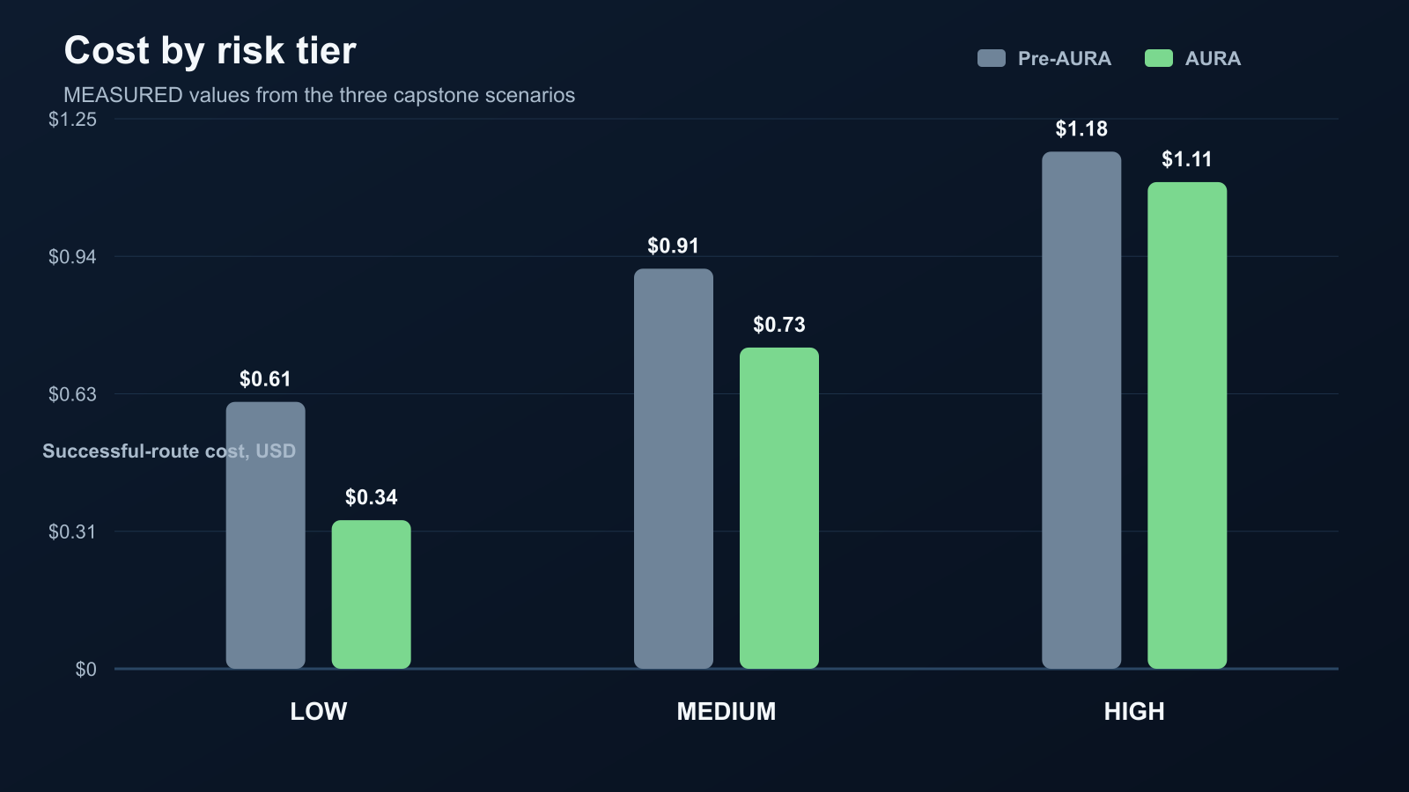
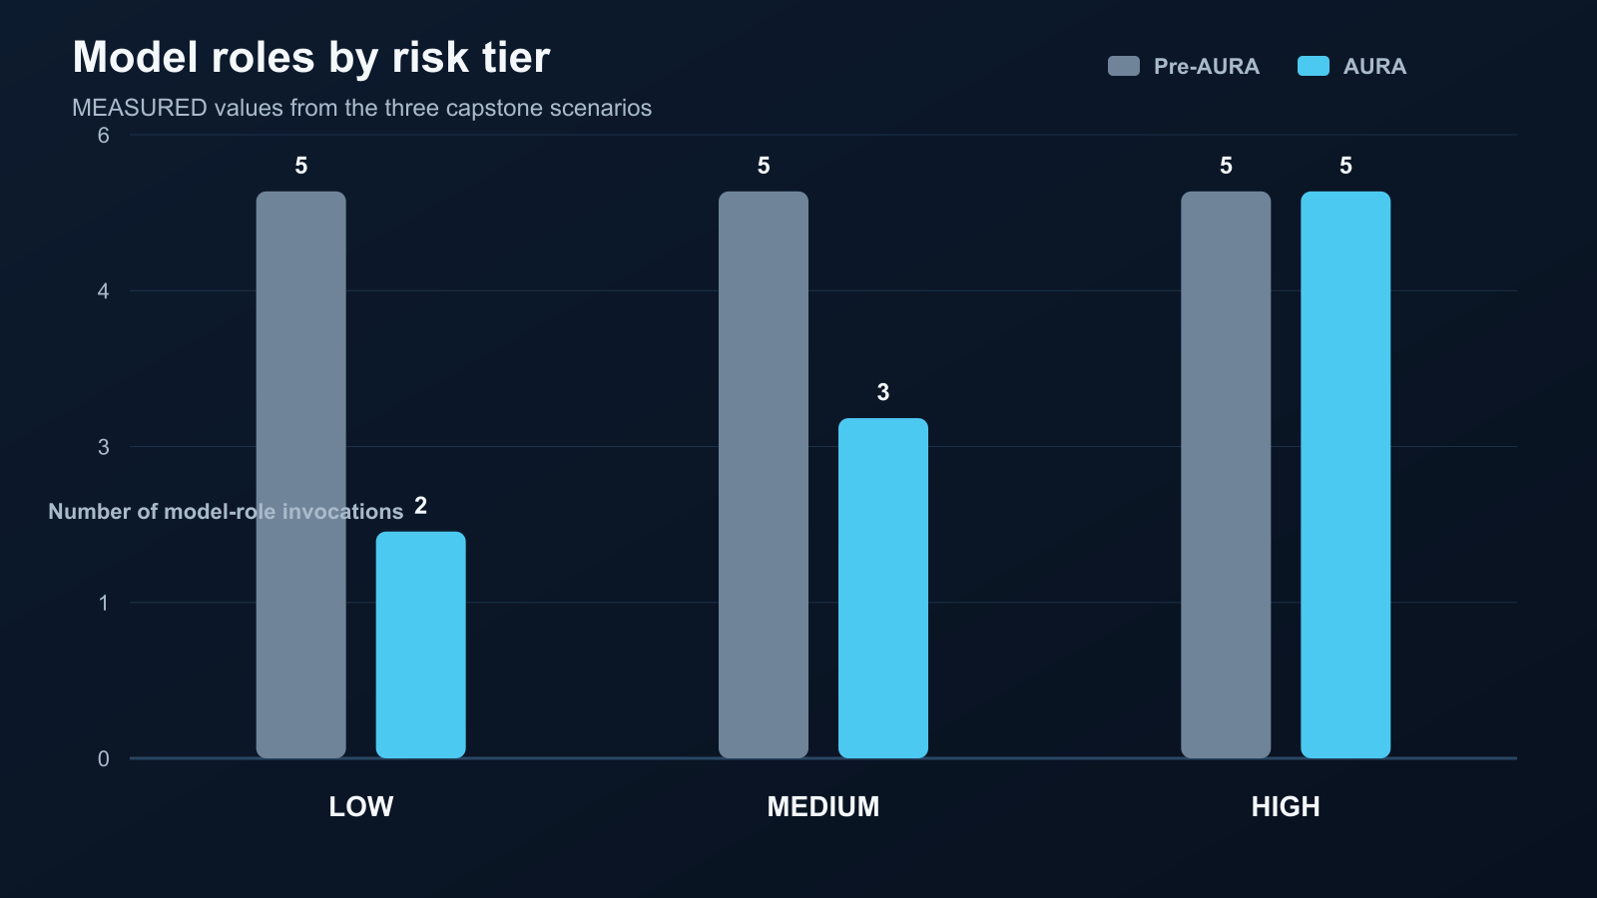
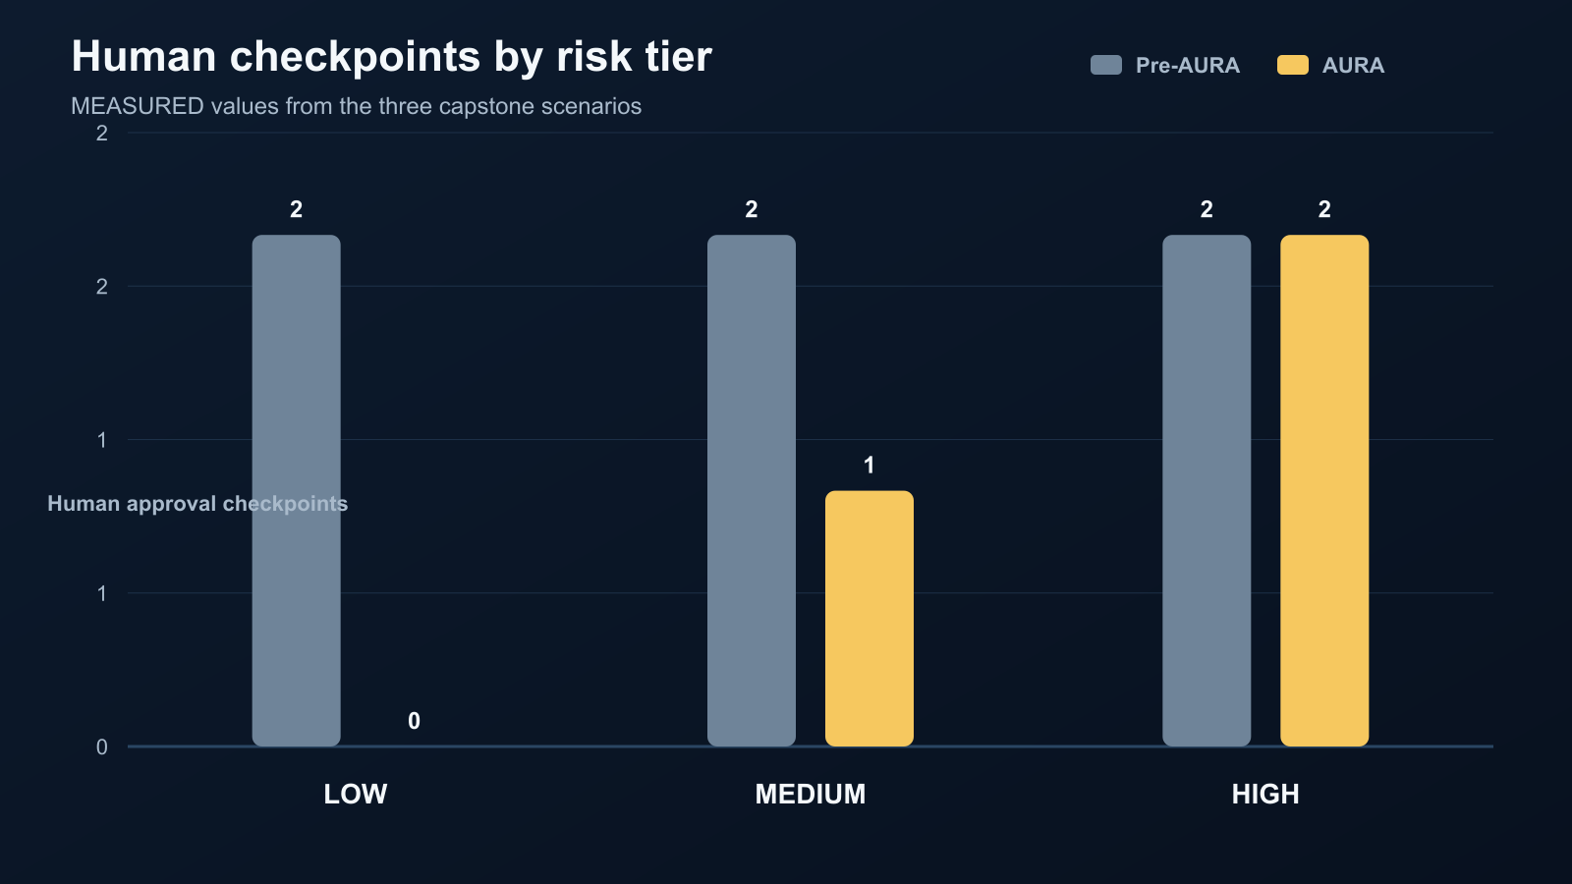
Measured results: less overhead, stronger quality
Measured impact across the three representative scenarios.
Cost by tier
Model roles
Human checkpoints
Pre-AURA
AURA
Pre-AURA
AURA
Pre-AURA
AURA
$1.18
$1.11
5
5
5
5
2
2
2
2
$0.91
$0.73
3
$0.61
1
2
$0.34
0
LOW
MED
HIGH
LOW
MED
HIGH
LOW
MED
HIGH
19.22%
33.33%
50%
44/48 -> 48/48
cost reduction
fewer model roles
fewer human checkpoints
quality improved
06
Notes:
Goal: Present the measured result without overclaiming.
What to say: Across the three representative scenarios, AURA improved quality from 44 out of 48 to 48 out of 48. Successful-route cost dropped 19.22 percent, model roles dropped 33.33 percent, and human checkpoints dropped 50 percent.
What to point at: Point at LOW first because it shows the largest reduction, then call out HIGH retaining governance.
Transition: Next, show that governance was not only documented; it stopped overreach.
[Sources]
- docs/capstone/control-vs-aura-impact.md
- docs/capstone/aura-results.md

Slide 7
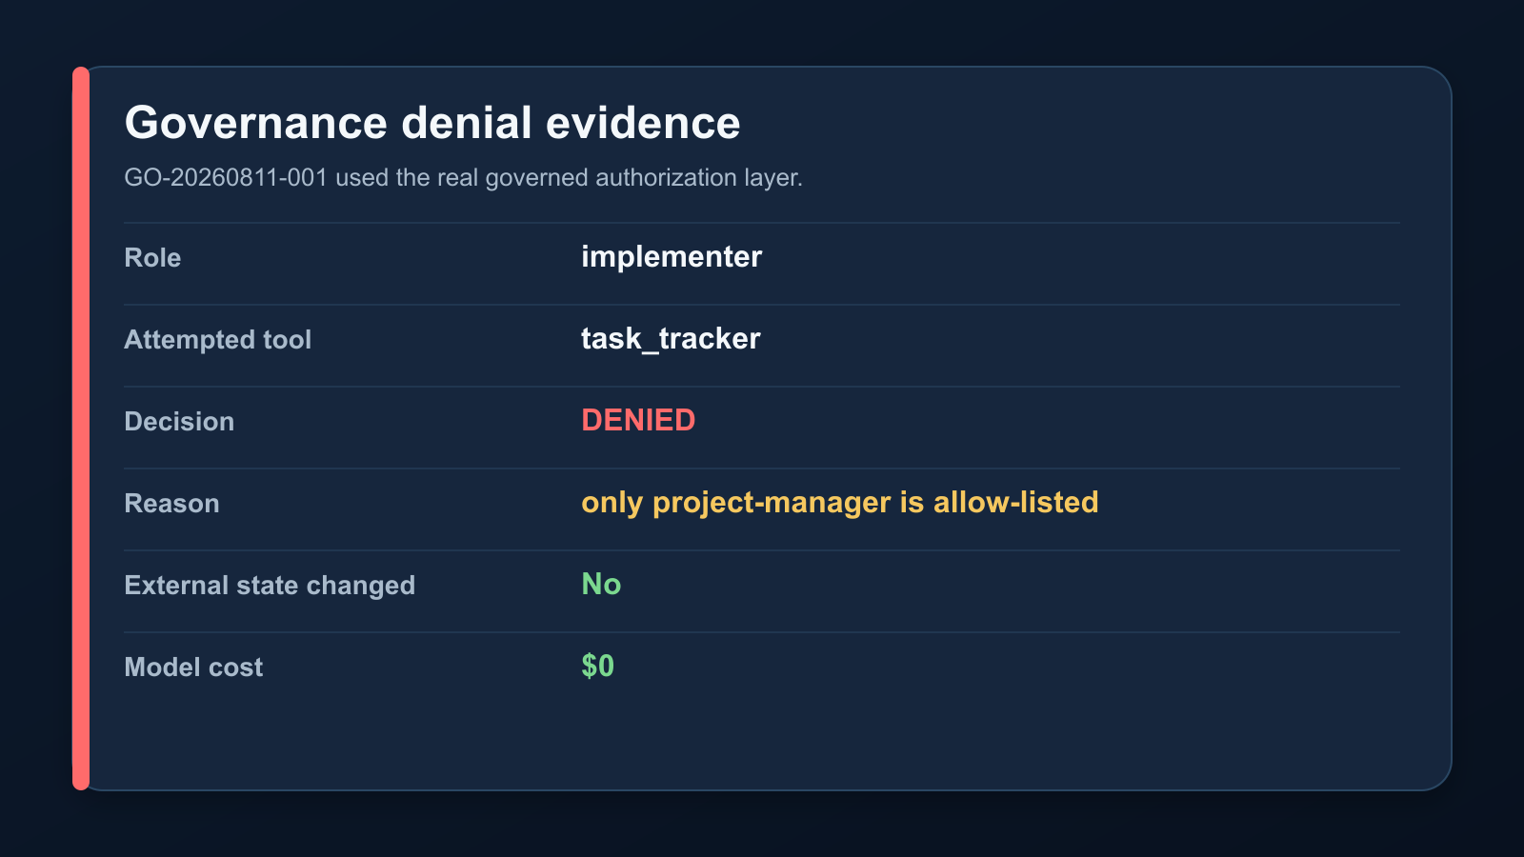
Governance stopped a real overreach attempt
The runtime denied a Project-Manager-only action from an implementer.
Sanitized denial
Authorization error: role 'implementer' is not on the allow-list for task_tracker. Allowed roles: ['project-manager'].
This matters because the role that changes files cannot also mark the work complete.
07
Notes:
Goal: Make the safety story visible.
What to say: This is the most important demo moment. An implementer attempted to use the Project-Manager-only task tracker. The real governed authorization layer denied it. No external state changed, and the model cost was zero.
What to point at: Point to DENIED, then read the sanitized denial sentence.
Transition: Next, connect this local governance boundary to CI gates.
[Sources]
- docs/capstone/governance-overreach-demo.md
- docs/capstone/governance-ci-local-verification.md

Slide 8
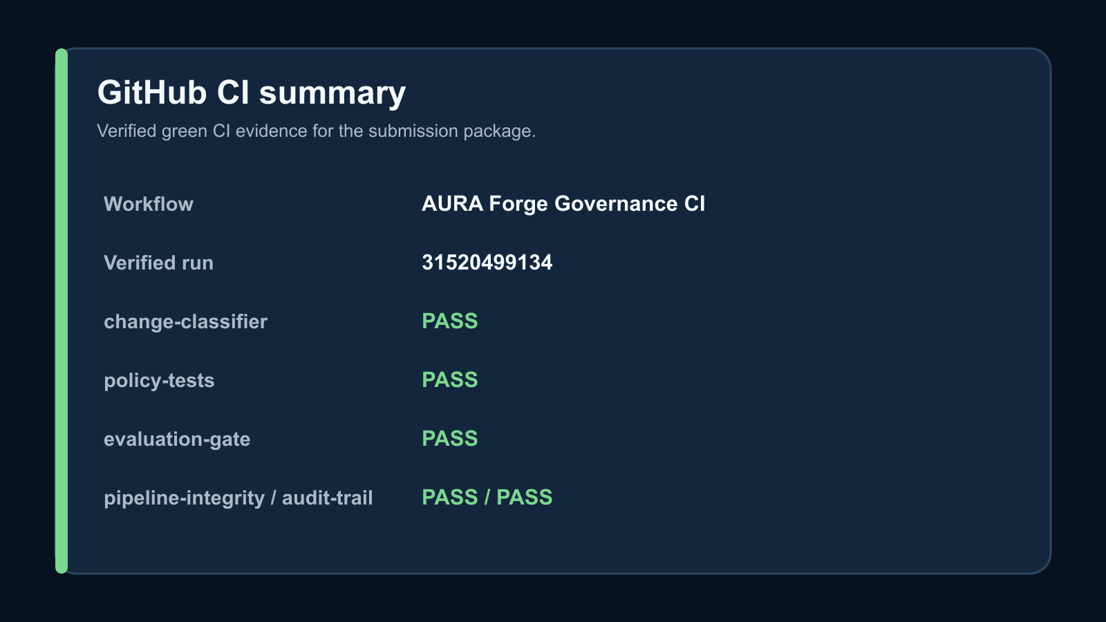
CI made the engineering gates visible
A verified green CI run captured the submission-package evidence.
CI path
first failed CI ->
diagnosis -> repair ->
green CI
Verified submission-package CI run 31520499134 passed change classification, policy tests, evaluation, pipeline integrity, audit trail, and advisory graceful skip.
08
Notes:
Goal: Show that the project is eval-gated.
What to say: The repository did not stop at local files. The submission package passed GitHub Actions in verified green run 31520499134. The advisory review also behaved safely: when the AI secret was unavailable, it skipped gracefully instead of failing open.
What to point at: Point to run 31520499134 and the green job list.
Transition: Next, show how all of this evidence is packaged.
[Sources]
- docs/capstone/governance-ci-results.md
- docs/capstone/final-evidence-snapshot.md

Slide 9
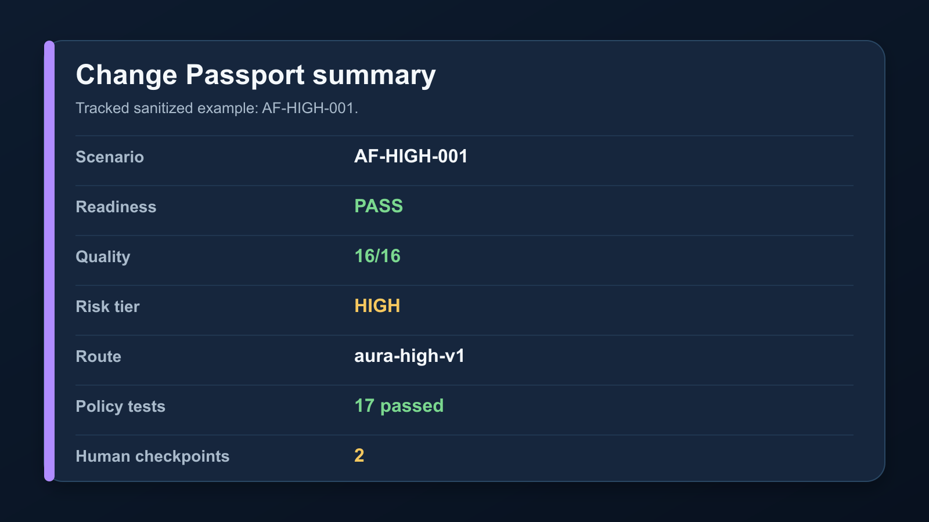
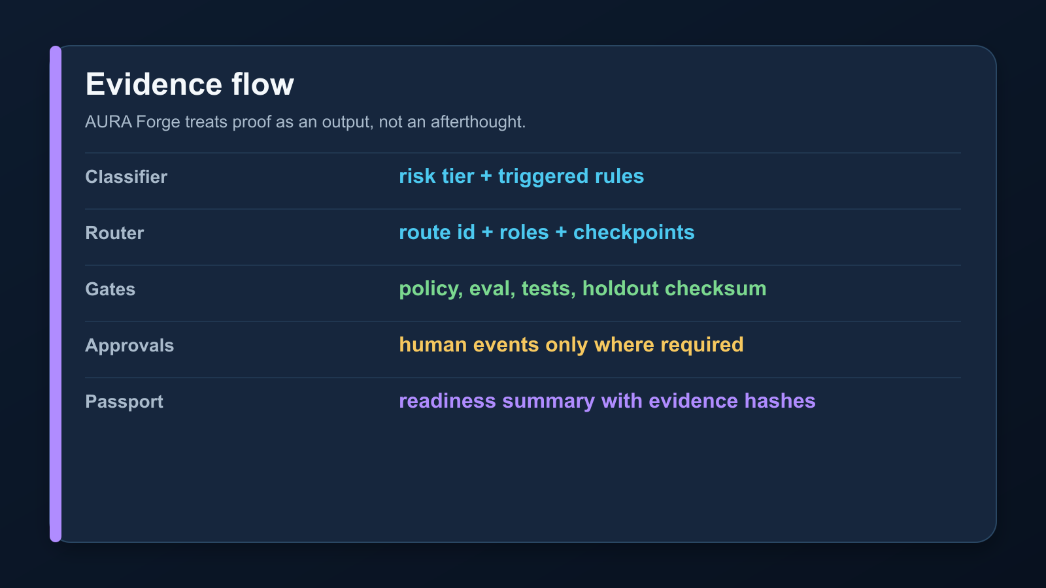
Change Passport proves readiness
Readiness is backed by machine evidence, not a claim.
A separate deterministic conversion showed one narrow factual check could run with $0 model cost and about 0.156 ms local runtime.
09
Notes:
Goal: Explain the Change Passport and right-tool lesson.
What to say: The Change Passport pulls together risk tier, route, roles, tests, approvals, policy, CI, and readiness. I also found that some work should not be agentic at all. A narrow config/docs check became deterministic code with zero model cost.
What to point at: Point to the Passport fields, then the evidence-flow asset.
Transition: Close by stating the bounded impact and remaining human tasks.
[Sources]
- docs/capstone/change-passport.md
- docs/capstone/evidence/change-passport-AF-HIGH-001.json
- docs/capstone/deterministic-conversion.md

Slide 10
Impact is measured, bounded, and honest
The best agentic system knows when not to use agents.
Measured impact
Limitations
Quality improved. LOW and
MEDIUM overhead dropped.
HIGH governance stayed in place.
Three representative
scenarios only. No production
deployment. Advisory AI was
unavailable in CI and safely skipped.
Final takeaway: AURA Forge gives each change the minimum autonomy it deserves, then proves the route stayed inside policy.
10
Notes:
Goal: Close with the honest takeaway.
What to say: The measured evidence supports the thesis, but only for these three representative scenarios. The important result is not just lower cost. It is matching autonomy to risk and proving the system stayed governed.
What to point at: Point to measured impact, limitations, and final takeaway.
Transition: End the recording and move to submission links/checklist.
[Sources]
- docs/capstone/control-vs-aura-impact.md
- docs/capstone/final-rubric-audit.md

