Slide 1
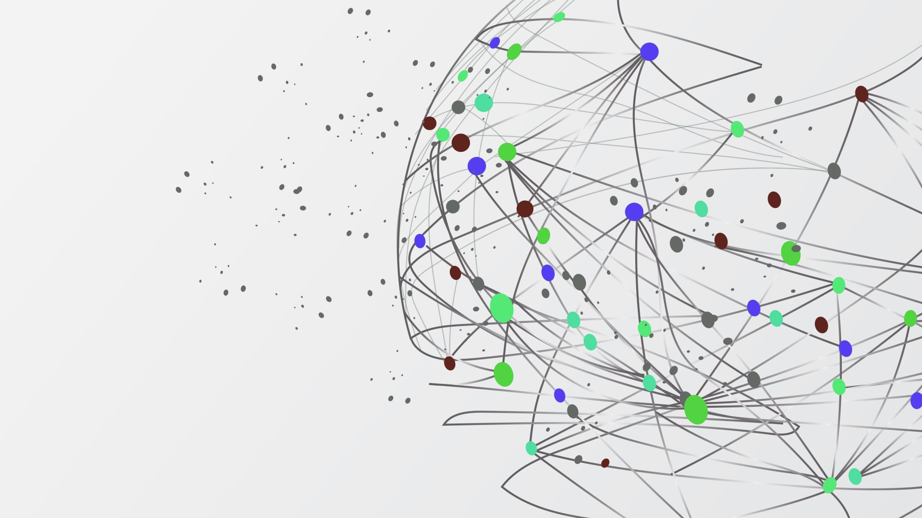
Sales Data and Predictions
Muhammad Hashim
Abbas

Slide 2
Goals
Analyse and clean the data (Python)
Extract insight and complex patterns (Python, SQL)
Use Machine Learning to predict Churn (Python)
Visualise the data and insights (Power BI)

Slide 3
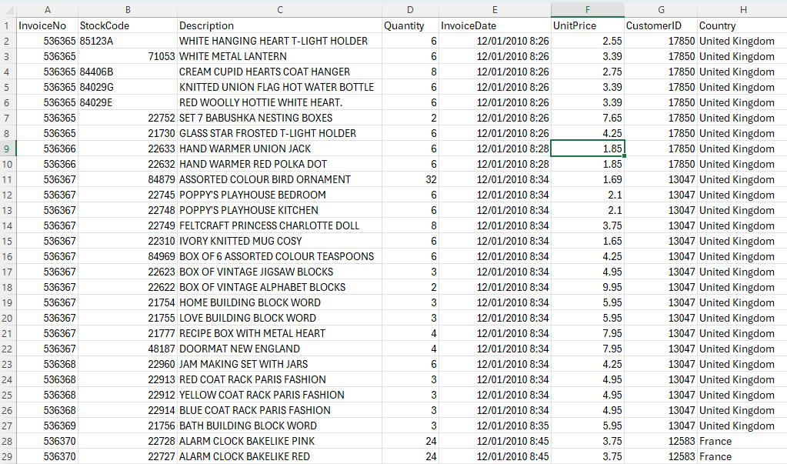
About the data
Dataset obtained from Kaggle, contains customer segmentation details
~542k rows
Ordering countries mainly in Europe/UK
4367 customers, later cleaned and reduced to 4315 for improved feature extraction

Slide 4
Skills utilised
Data Processing:
Attain clean usable data, get visualisations, perform machine learning analysis and develop dashboards, to visualise the data, increase sales, retain customers.
ML
Ethics of using AI for during the process, data safety/security and privacy
If data is confidential, care should be taken while taking assistance from AI chatbots (Claude, ChatGPT)
ML Models
Logistic Regression, Decision Trees, Random Forest, K-Means Clustering

Slide 5
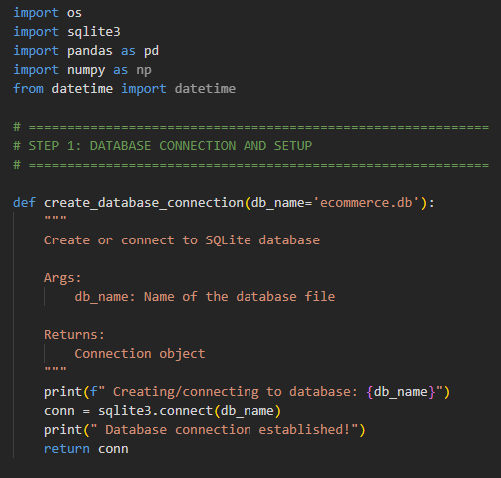
Database setup
Database name ecommerce.db
Sqlite3 module used for creating database
Schema
Four Tables added to the empty database ecommerce.db
Customers
Products
Invoices
Invoice_items

Slide 6
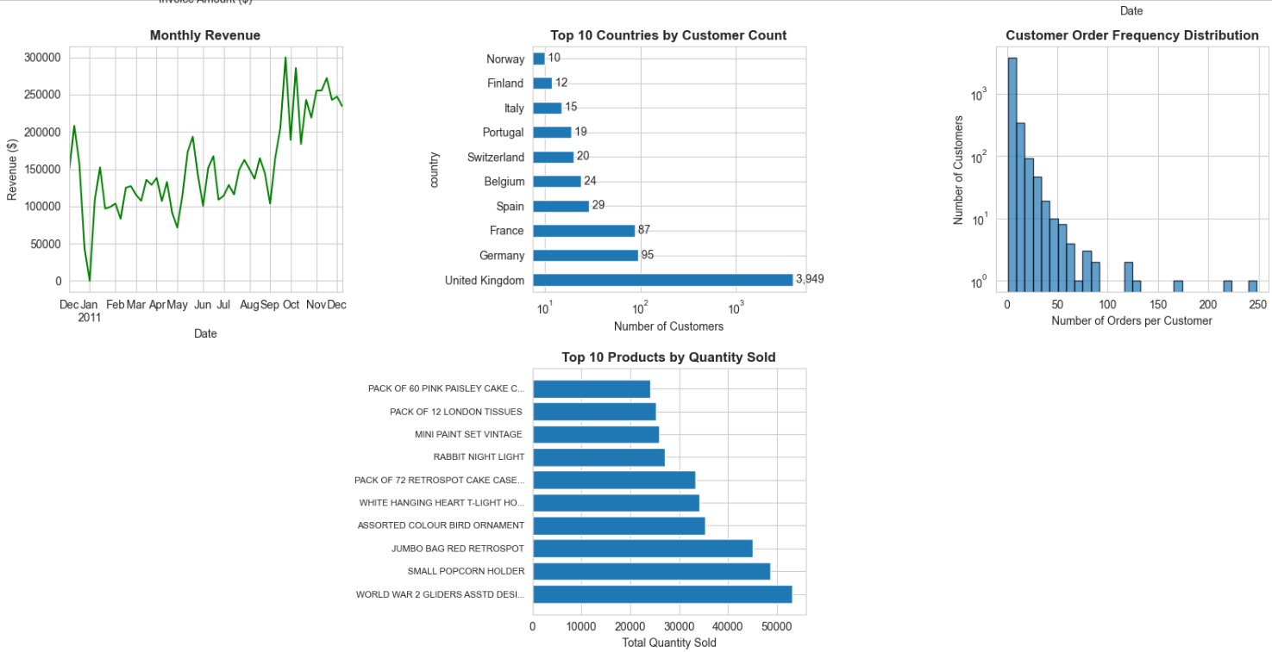
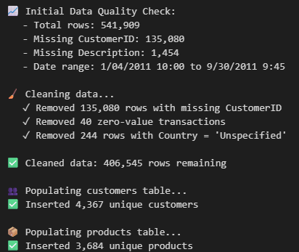
Data cleaning and basic insights

Slide 7
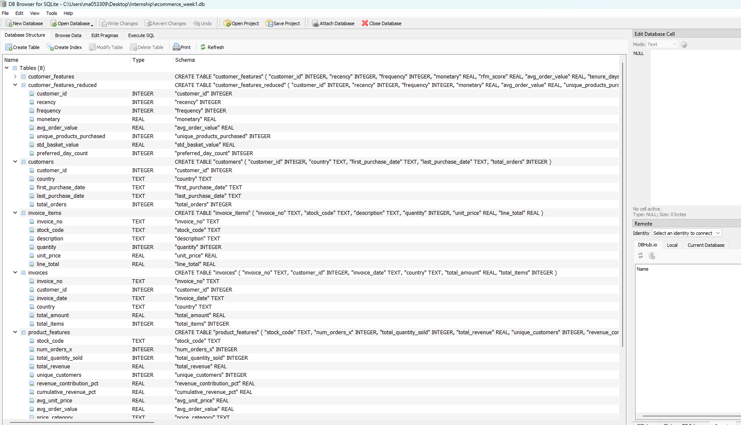
Database and querying
DB Browser for SQLIte
Executed 9 different SQL queries to extract deep insights

Slide 8
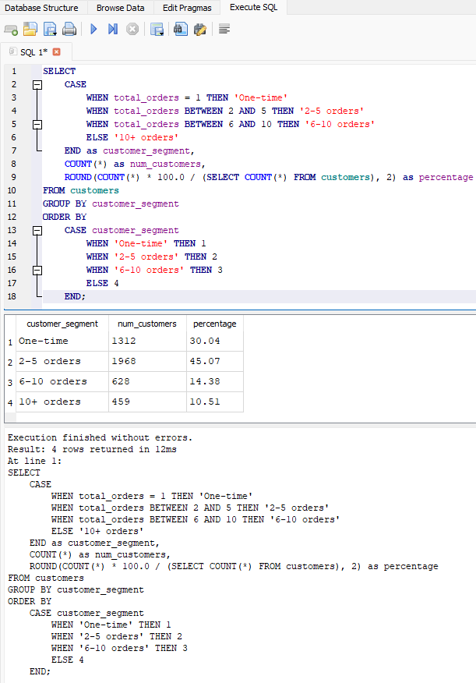
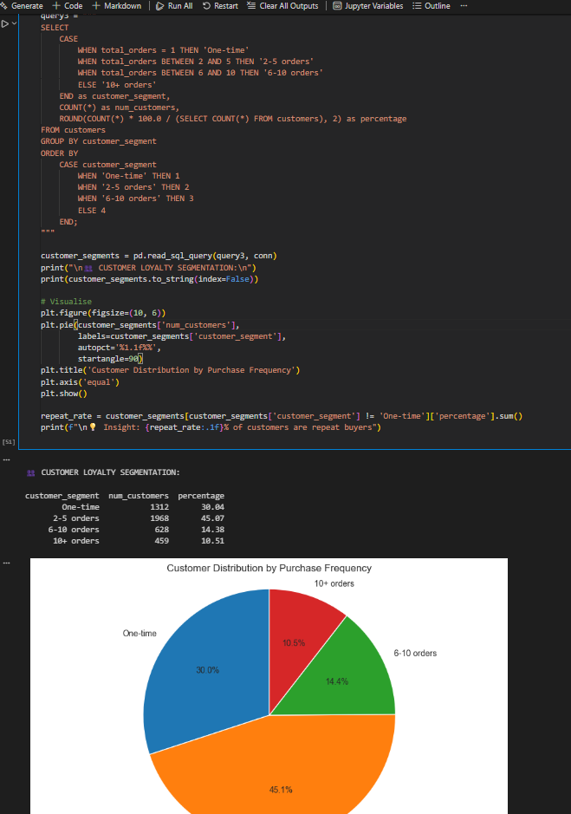
Query Example

Slide 9
Further queries using SQL
Top 10 performing customers
Top 10 countries by revenue
Top 10 best selling products
Top 10 products by revenue generated
Monthly revenue trend and monthly order volume
Busiest days of the week
Customer value by revenue (VIP, Medium, Low)
Top 10 product combinations by revenue

Slide 10
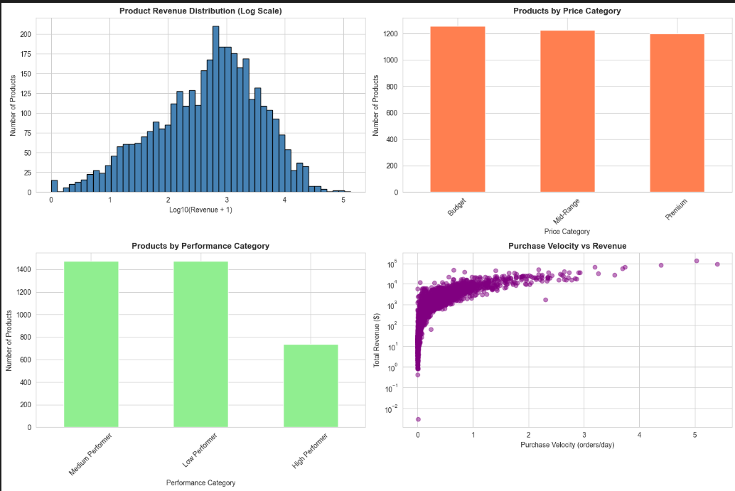
Extracted Insights
RFM Analysis
Recency, Frequency, Monetary

Slide 11
Feature engineering
Multiple new features extracted from the insights, e.g.
days_since_last_purchase
purchase_trend
trend_magnitude
preferred_category
preferred_category_spend
category_diversity
avg_basket_size
std_basket_size
min_basket_size
max_basket_size
avg_unique_products
std_unique_products
avg_basket_value
std_basket_value
min_basket_value
max_basket_value
preferred_day

Slide 12
Feature engineering (reduction)
Most of the features had correlation with each other (>0.8)
Final set of useful features with reasonable collinearity
customer_id
Recency
Frequency
Monetary
avg_order_value
unique_products_purchased
std_basket_value
preferred_day_count

Slide 13
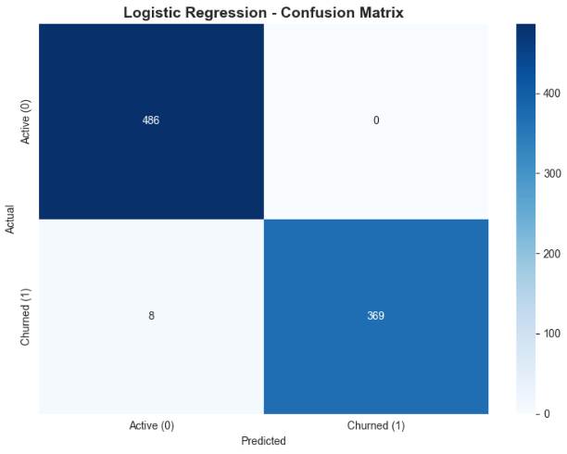
ML (Logistic Regression)
Problem question: Is the customer going to be inactive?
CHURN
A customer with last order 60 days ago
Base model to predict: Logistic Regression
Train-test split: 80-20
Results: Too close to ideal because we used Recency to define Churn. Then used Recency to predict Churn.

Slide 14
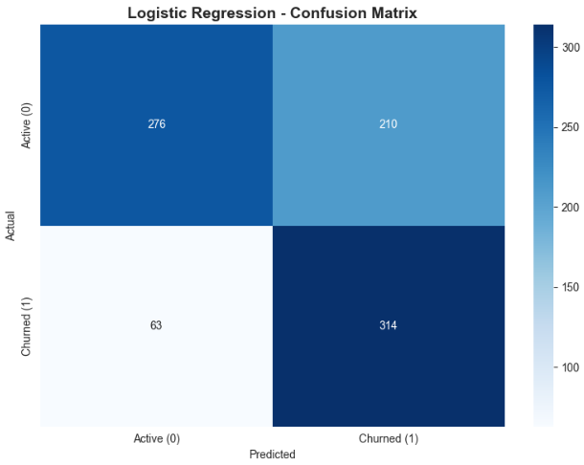
ML cont’d (Logistic Regression)
Correct and adjusted results
Model Performance:
Accuracy: 0.6837
Precision: 0.5992
Recall: 0.8329
F1-Score: 0.6970
ROC-AUC: 0.7598

Slide 15
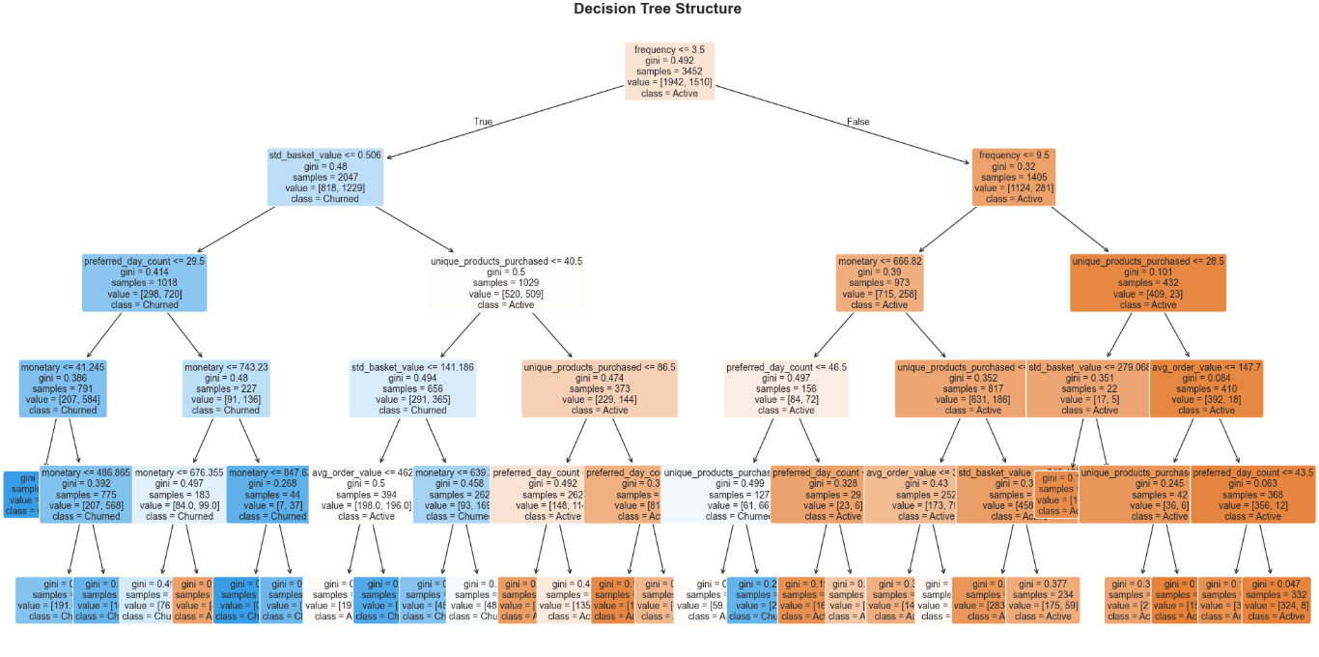
ML cont’d (Decision Trees)
Number of leaves: 29
Max depth: 5
Model Performance:
Accuracy: 0.6663
Precision: 0.6320
Recall: 0.5650
F1-Score: 0.5966
ROC-AUC: 0.7435

Slide 16
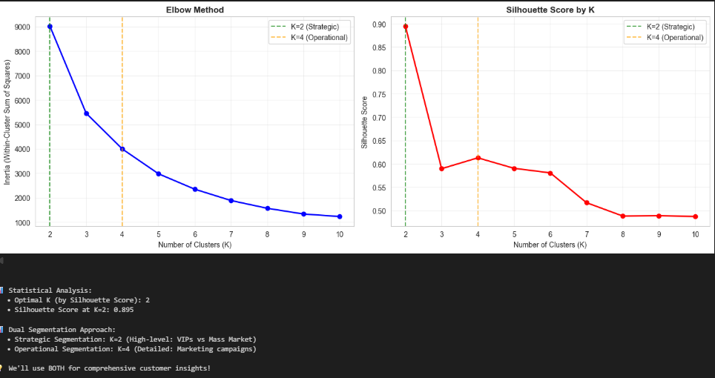
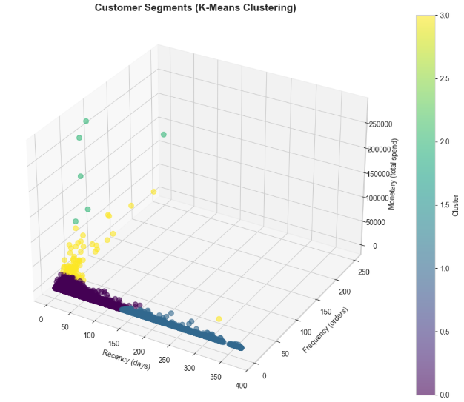
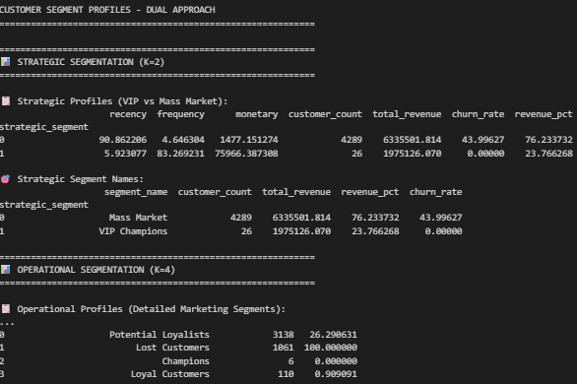
ML cont’d (K-Means Clustering)

Slide 17
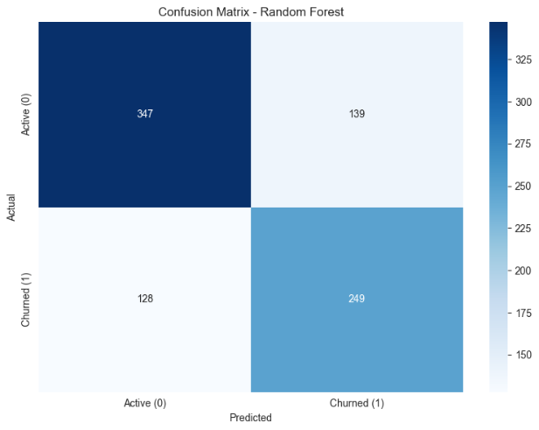
ML cont’d (Random Forest)
Number of trees: 100
Max depth: 10
Model Performance:
Accuracy: 0.6906
Precision: 0.6418
Recall: 0.6605
F1-Score: 0.6510
ROC-AUC: 0.7610

Slide 18
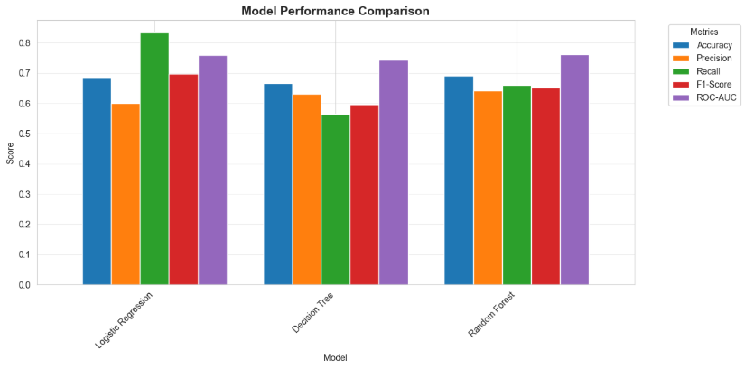
Model Performance
Final Selection:
Logistic Regression because of the comparatively better Recall (83%)

Slide 19
Machine Learning (Ethical Consequences)
Customer bias while predicting churn
Underrepresented customers likely to be predicted as ”churned”
Transparency (ML as Black Box)
Overreliance on machine learning
Not always correct, needs human oversight

Slide 20
Challenges
A lot of noise in the customer data
Figuring out what actually is affecting the data
Cleaning the features and deciding which cleaned features to keep
Extracting useful customer insights from the selected features

Slide 21
Achievements (Self assessment)
Achieved the original goals and tasks
The results of machine learning models are still not ideal
Work is diverse and uses variety of tools (SQL, Python, ML, Power BI)
Final work provides a lot of visuals and provide deep insights to the data and trends
Learning:
SQL database creation and querying
Extracting useful and complex insights out of a seemingly simple dataset
Implementing Machine Learning models and comparing results
Interactive visualisation data to see customised insights
Improvements can be made to ML for getting better model results

