Slide 1
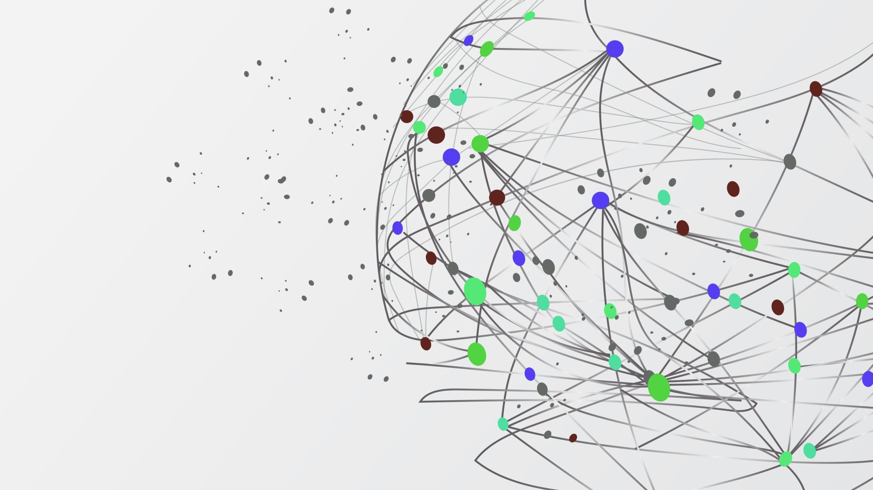
Sales Data and Predictions
Muhammad Hashim
Abbas

Slide 2
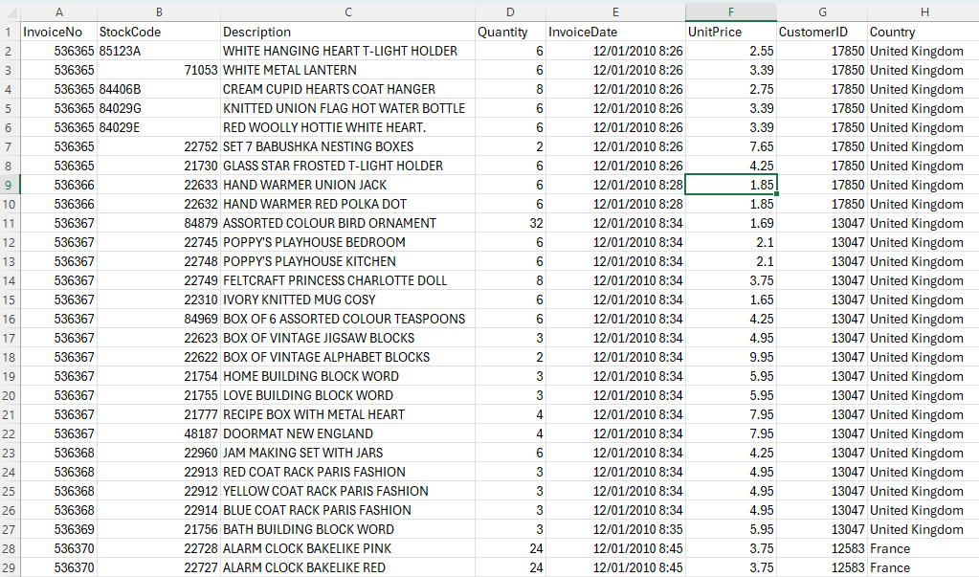
About the data
Analyse and build predictions based on the Sales Data
Dataset obtained from Kaggle, contains customer segmentation details
~542k rows
Ordering countries mainly in Europe/UK
4367 customers, later cleaned and reduced to 4315 for improved feature extraction

Slide 3
Skills utilised
Data Processing:
Attain clean usable data, get visualisations, perform machine learning analysis and develop dashboards, to visualise the data, increase sales, retain customers.
ML
Ethics of using AI for during the process, data safety/security and privacy
ML Models
Logistic Regression, Decision Trees, Random Forest, K-Means Clustering

Slide 4
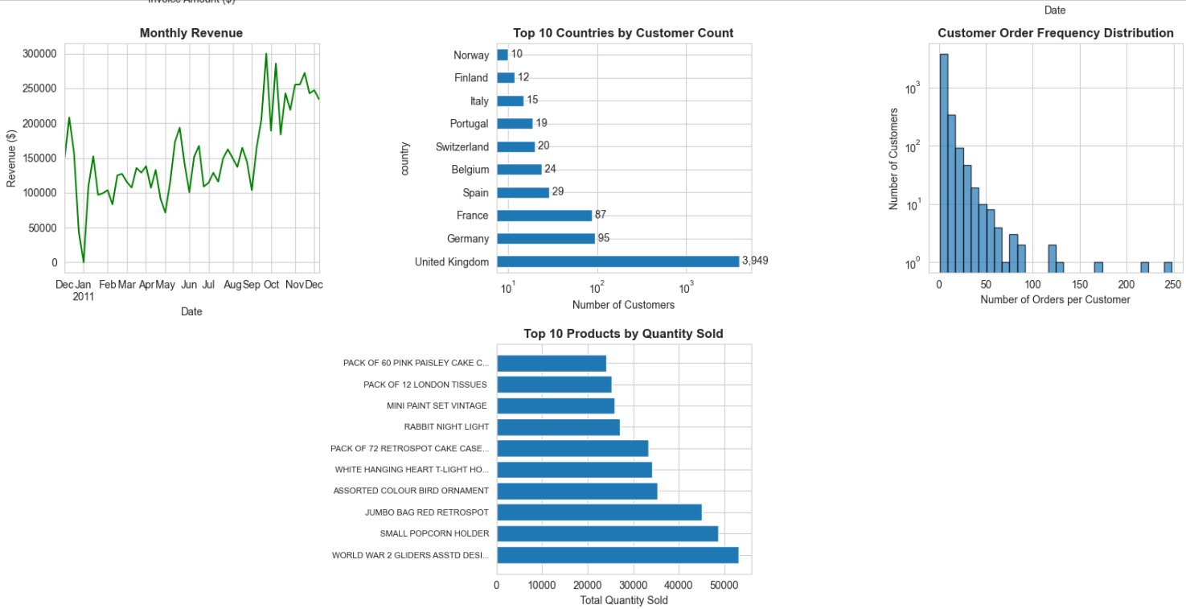
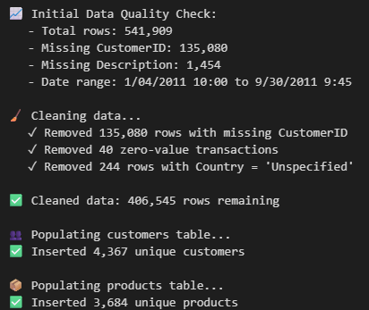
Data cleaning and basic insights

Slide 5
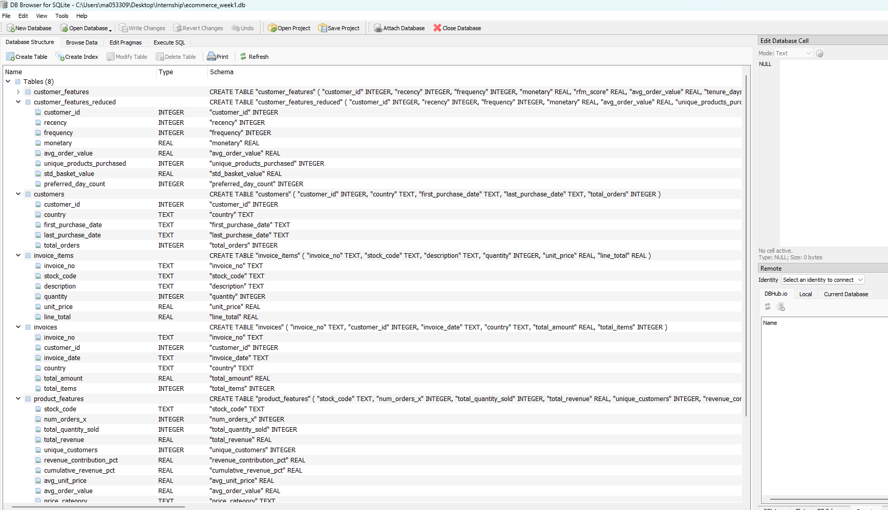
Database and querying
DB Browser for SQLIte
Executed 9 different SQL queries to extract deep insights

Slide 6
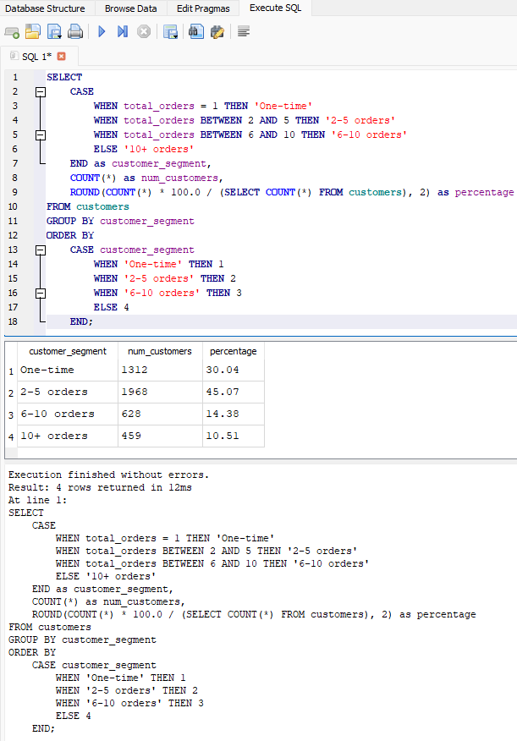
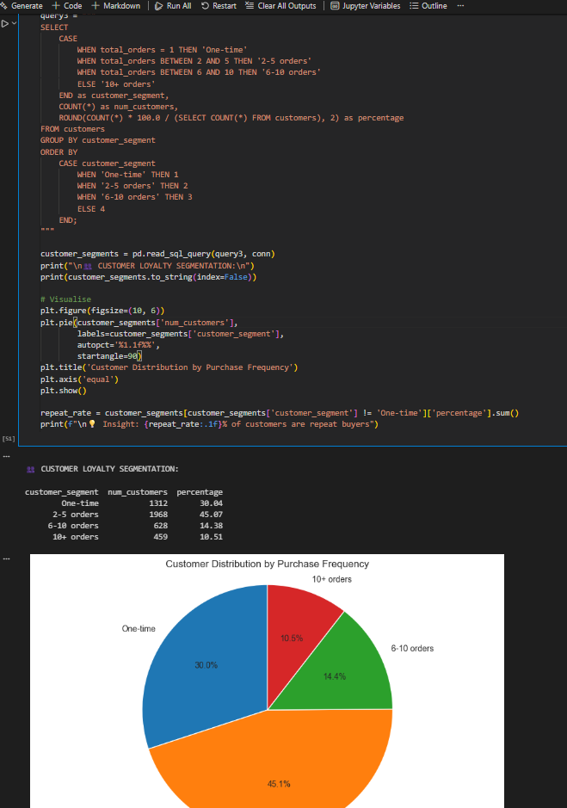
Query Example

Slide 7
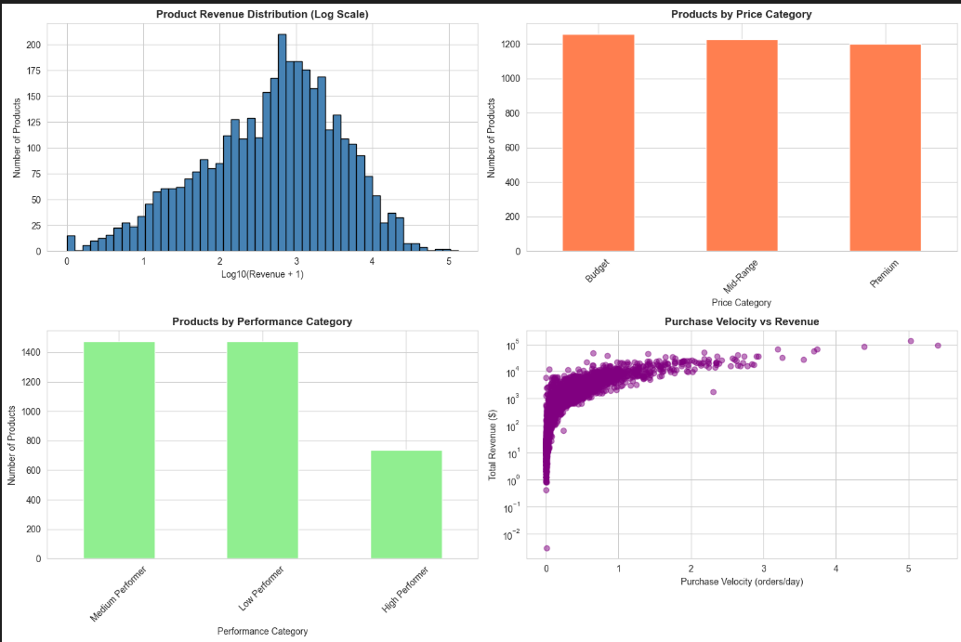
Extracted Insights
RFM Analysis
Recency, Frequency, Monetary

Slide 8
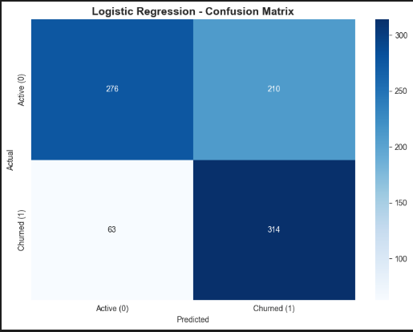
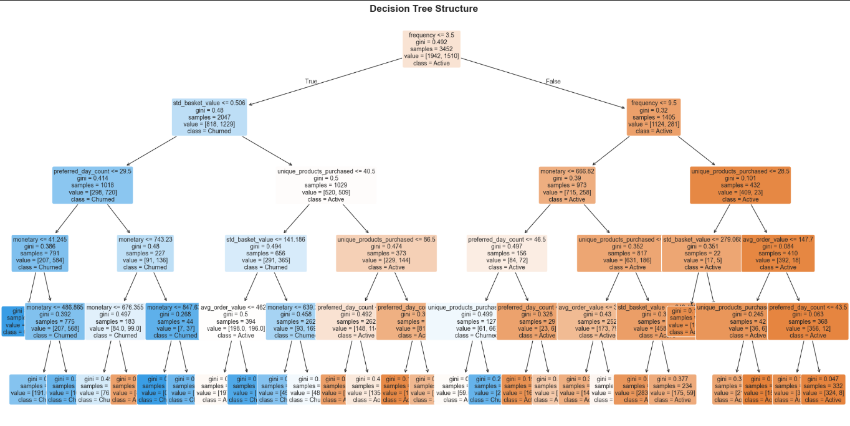
ML Models
Logistic Regression
Churn was the main metric which has been used.
Decision Tree

Slide 9
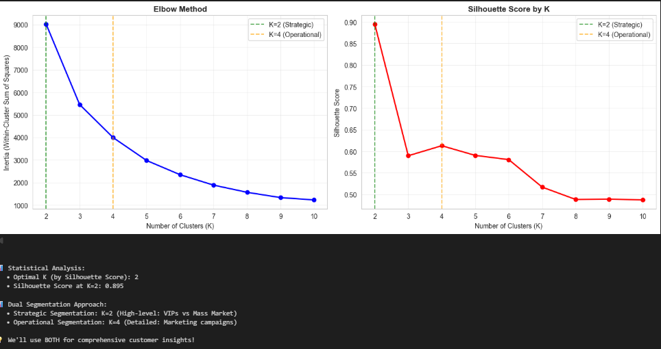
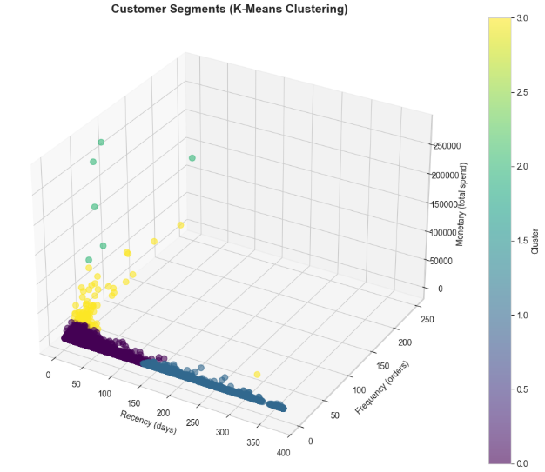
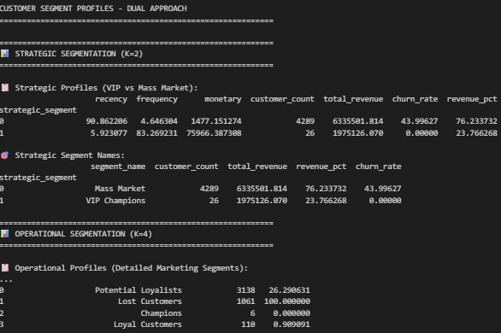

Slide 10
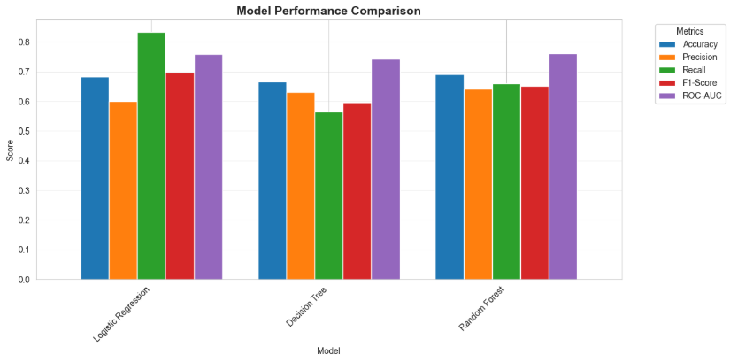
Model Performance
Final Selection:
Logistic Regression because of the comparatively better Recall (83%)

