Slide 1

The National University of Computer and Emerging Sciences
Unsupervised Learning
Data Science

Slide 2
Density-based Clustering
Density based clustering algorithms forms clusters based on the density of regions.
A dense cluster is a region which is “density connected”
The density of points in that region is greater than a minimum threshold.
They can find clusters of arbitrary shapes.
DBSCAN is an example of density-based clustering algorithm.

Slide 3
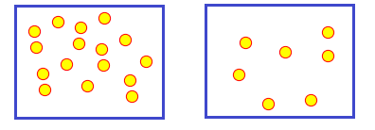
Density-based Clustering
Highly Dense Region vs Less Dense Region

Slide 4
Density-based Clustering
All clustering methods use almost the same approach
Calculate similarities and then add to the cluster
k-means is generally good, but:
Need to specify the number of clusters in beginning
K-Means may fail for different shapes.
Outliers can affect its performance ;
A slight change in data points might affect the clustering outcome.
DBSCAN clustering can overcome these.

Slide 5
DBSCAN Clustering Algorithm
Density-based spatial clustering of applications with noise (DBSCAN).
Published by Ester et. al. in 1996
The algorithm finds dense areas and expands these recursively to find clusters.
It can discover clusters of different shapes and sizes
Can perform well even with outliers.

Slide 6
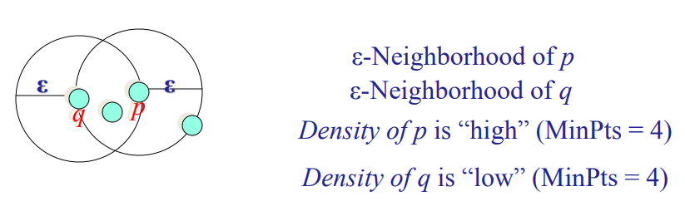
DBSCAN Clustering Algorithm
The DBSCAN algorithm uses two parameters:
eps (ε): A distance measure that will be used to locate the points in the neighborhood of any point.
minPts: The minimum number of points (a threshold) clustered together for a region to be considered dense.

Slide 7
DBSCAN Clustering Algorithm
Given ε and MinPts, categorize the data points into three exclusive groups.
Core point: Having more than a specified number of points (MinPts) within radius (ε)
Border point: It has fewer than MinPts within ε but is in the neighborhood of a core point.
Noise point: It is any point that is not a core point nor a border point.

Slide 8
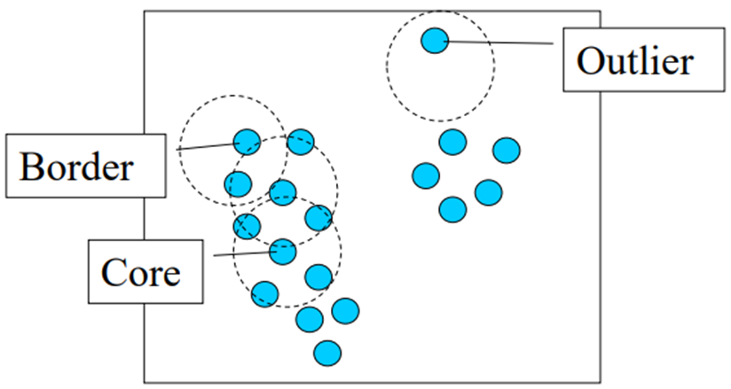
DBSCAN Clustering Algorithm
ε = 2, minPts = 4

Slide 9
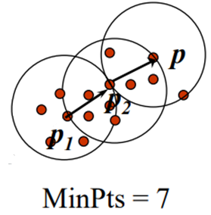
DBSCAN Clustering Algorithm
Density-Reachable (directly and indirectly):
A point p is directly density-reachable from p2
p2 is directly density-reachable from p1

Slide 10
DBSCAN Clustering Algorithm
p ← p₂ ← p₁ form a chain
p is (indirectly) density-reachable from p₁
p₁ is not density-reachable from p

Slide 11
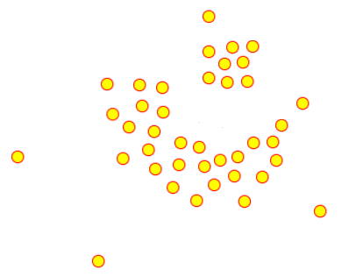
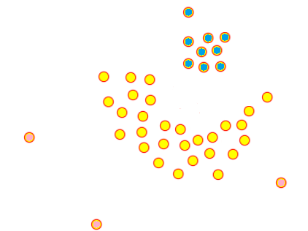
DBSCAN Clustering Algorithm
High Density

Slide 12
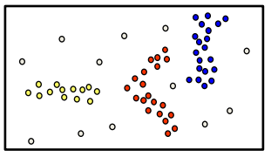
DBSCAN Clustering Algorithm
Basic idea – Clusters are dense regions in the data space, separated by regions of lower object density
A cluster is defined as a maximal set of density connected points
Discovers clusters of arbitrary shape

Slide 13
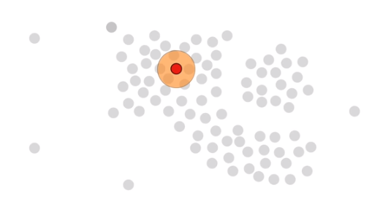
DBSCAN Clustering Algorithm

Slide 14
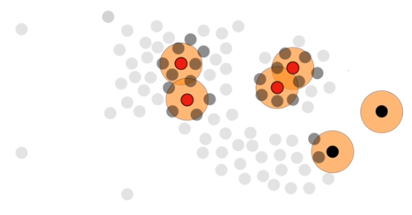
DBSCAN Clustering Algorithm

Slide 15
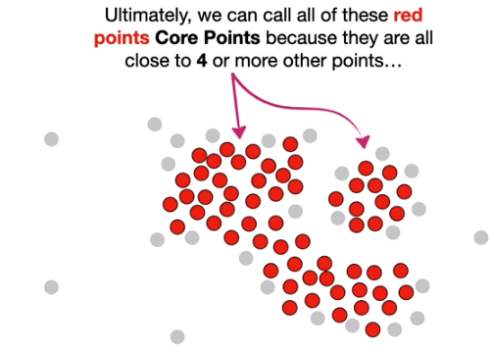
DBSCAN Clustering Algorithm

Slide 16
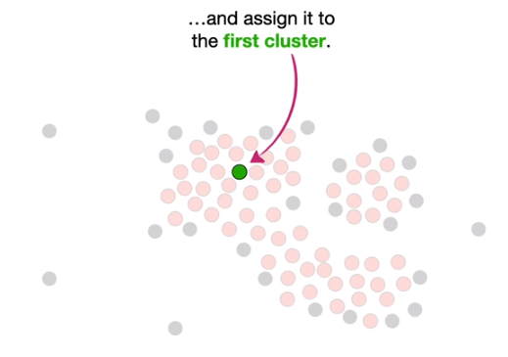
DBSCAN Clustering Algorithm

Slide 17
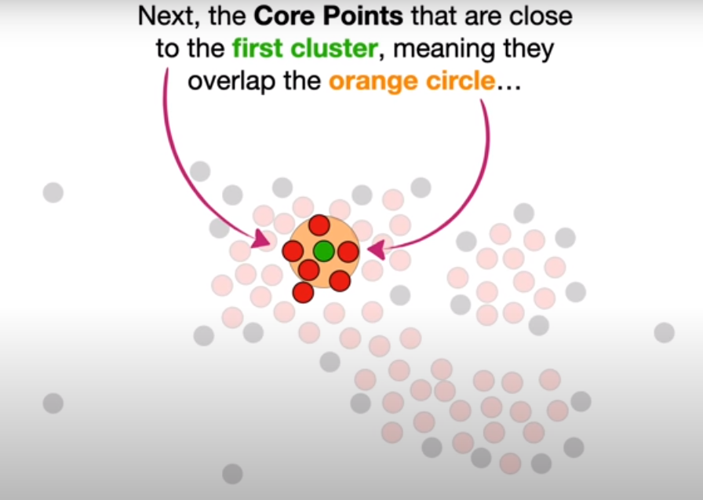
DBSCAN Clustering Algorithm

Slide 18
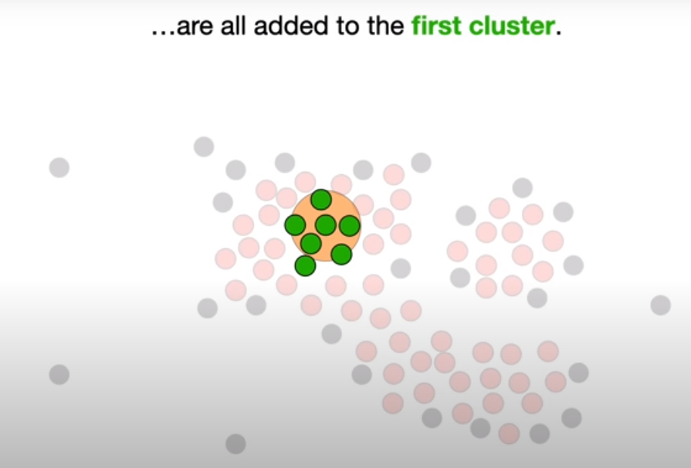
DBSCAN Clustering Algorithm

Slide 19
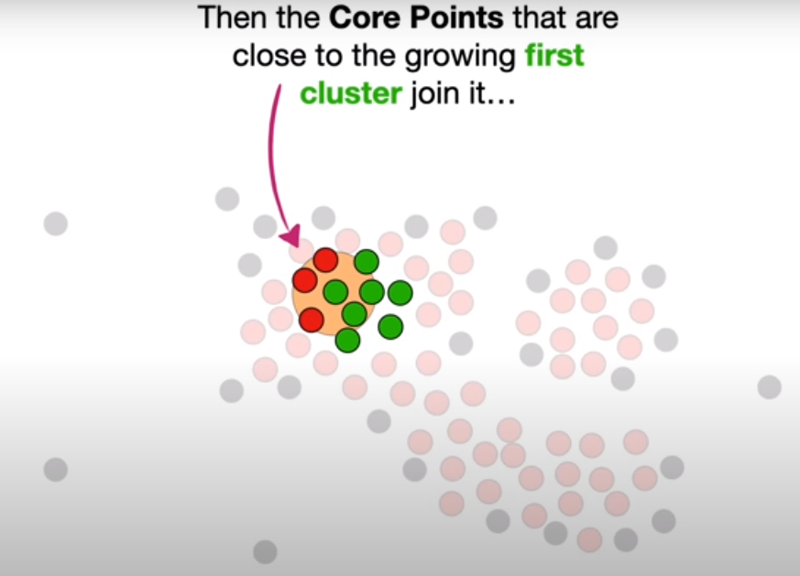
DBSCAN Clustering Algorithm

Slide 20
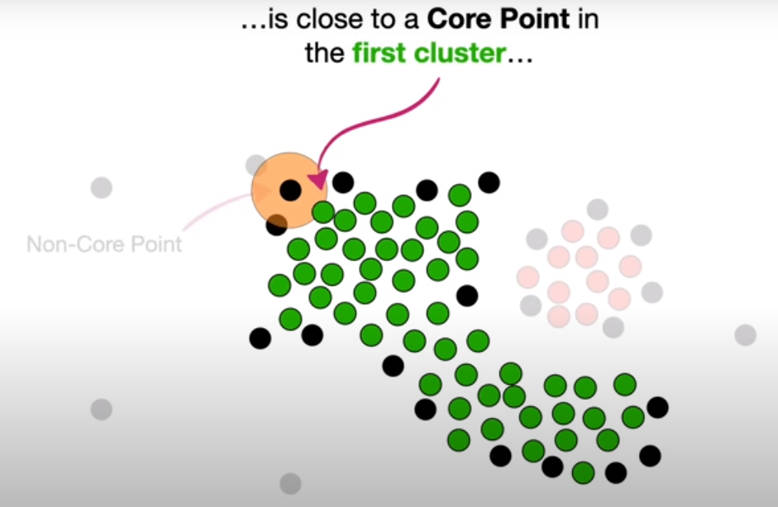
DBSCAN Clustering Algorithm

Slide 21
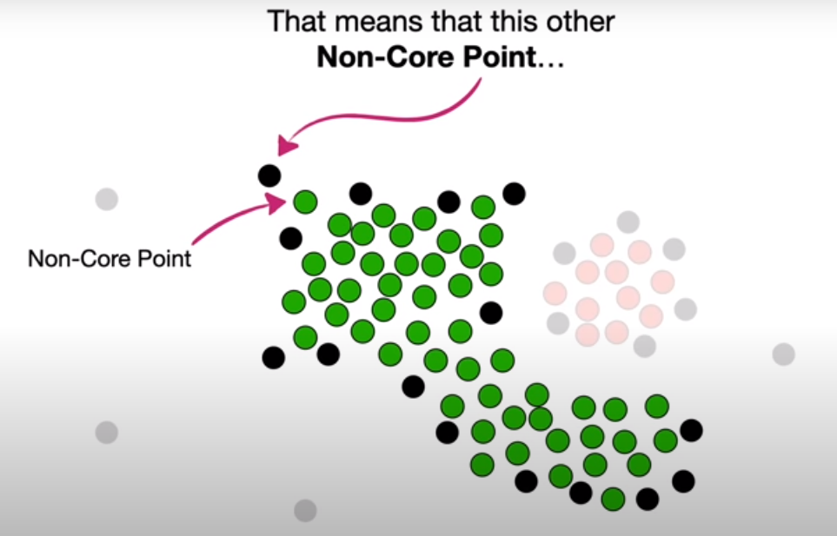
DBSCAN Clustering Algorithm

Slide 22
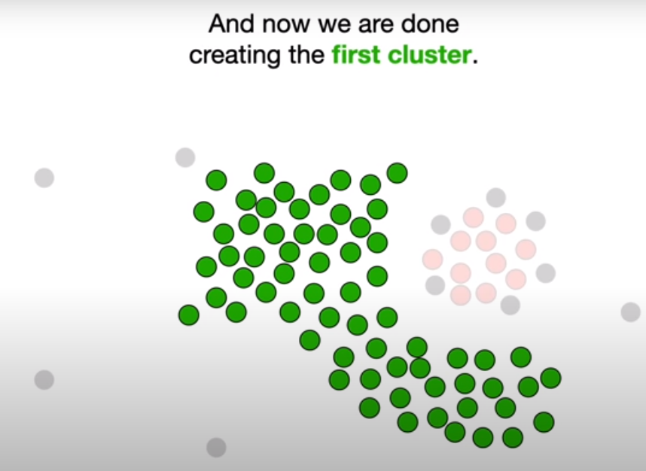
DBSCAN Clustering Algorithm

Slide 23
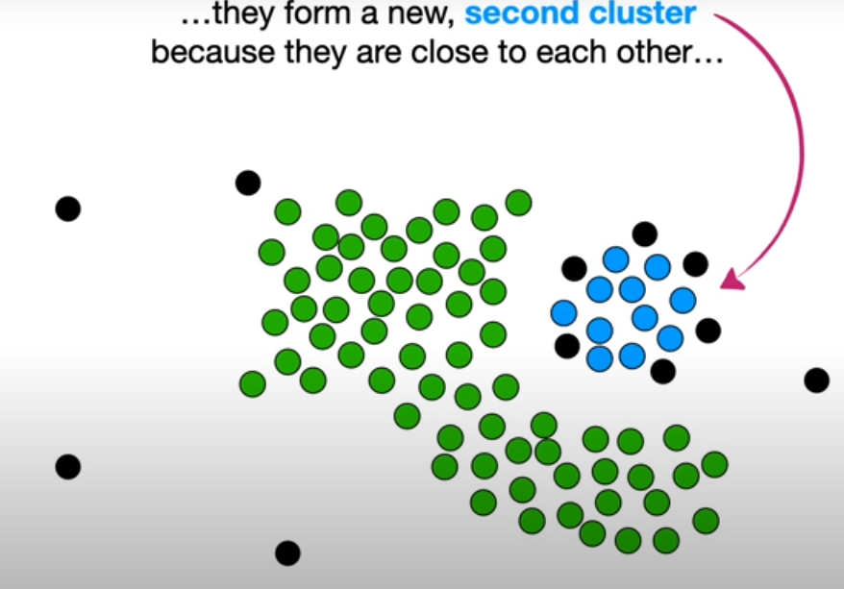
DBSCAN Clustering Algorithm

Slide 24
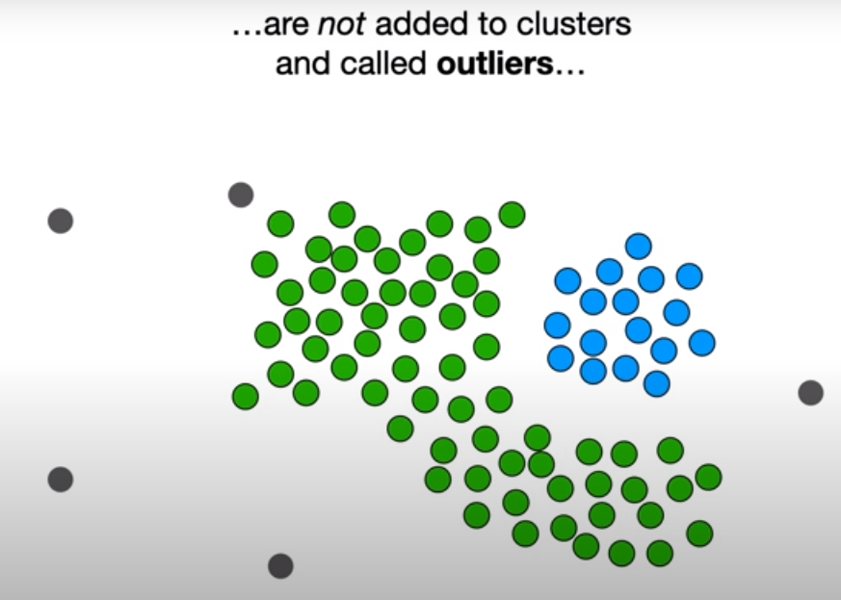
DBSCAN Clustering Algorithm

Slide 25
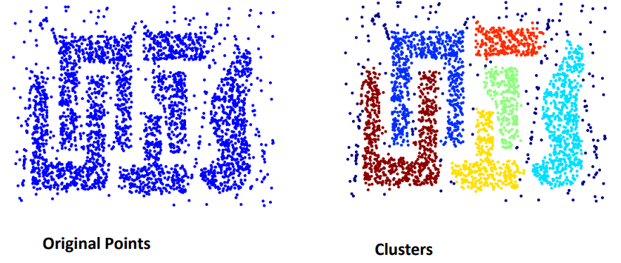
Advantages
Resistant to Noise
Can handle clusters of different shapes and sizes

Slide 26
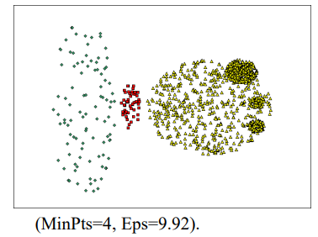
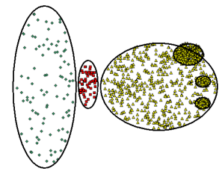
Weaknesses
Cannot handle varying densities
Sensitive to parameters—hard to determine the correct set of parameters

Slide 27
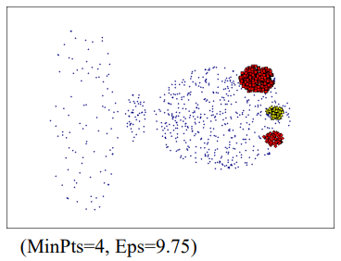
Weaknesses

Slide 28
References
Animation
https://www.naftaliharris.com/blog/visualizing-dbscan-clustering/
https://www.youtube.com/watch?v=RDZUdRSDOok&t=294s&ab_channel=StatQuestwithJoshStarmer
https://www.naftaliharris.com/blog/visualizing-dbscan-clustering/

Slide 29
Thank You ☺

