Slide 1

The National University of Computer and Emerging Sciences
Introduction to K-Nearest Neighbors
Data Science
Muhammad Zulqarnain
Department of Computer Science

Slide 2
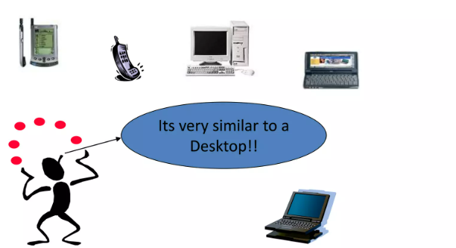
Instance Based Learning

Slide 3
Different Names
K-Nearest Neighbors
Memory-Based Reasoning
Example-Based Reasoning
Instance-Based Learning
Lazy Learning

Slide 4
What is KNN?
A powerful classification algorithm used in pattern recognition
K nearest neighbors stores all available cases and classifies new cases based on a similarity measure (e.g. distance function)
A non-parametric lazy learning algorithm (An instance based learning method)
Lazy learning methods defer the decision of how to generalize beyond the training data until a new query instance is observed
Eager learning methods commit to the target model at the time of training

Slide 5
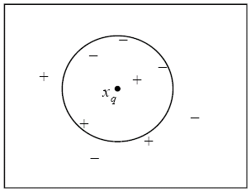
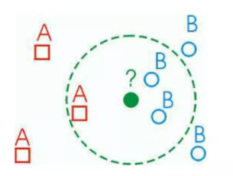
KNN: Classification Approach
An object (a new instance) is classified by a majority votes for its neighbor classes.
The object is assigned to the most common class amongst its k nearest neighbors (measures by a distance function)
Note that 1-nearest neighbor classifies x_{q} as positive, whereas 5-nearest neighbor classifies it as negative

Slide 6
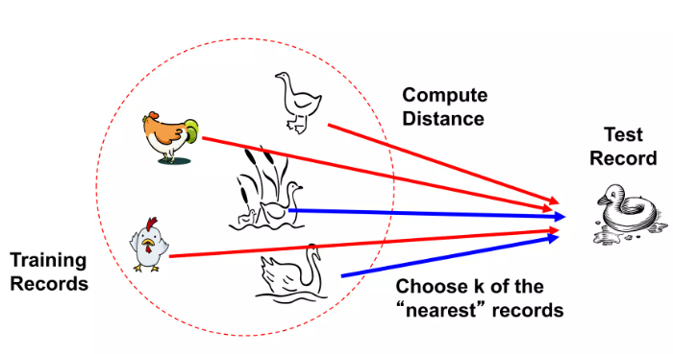
Distance Measure

Slide 7
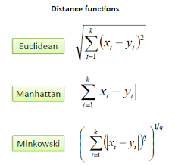

Distance measure for continuous Variables
Distance functions
Calculate the distance between new example ( E ) and all examples in the training set
Euclidean distance between two examples
X=[x₁.x₂.x₃,…,x_{n}]
Y=[y₁,y₂,y₃,…,y_{n}]
The Euclidean distance D(X,Y) between X and Y is defined as:

Slide 8
K-Nearest Neighbor Algorithm
All the instances correspond to points in an n-dimensional feature space
Each instance is represented with a set of numerical attributes
Each of the training data consists of a set of vectors and a class label associated with each vector.
Classification is done by comparing feature vectors of different k nearest points.
Select the k-nearest example to E in the training set
Assign E to the most common class among its k-nearest neighbors

Slide 9
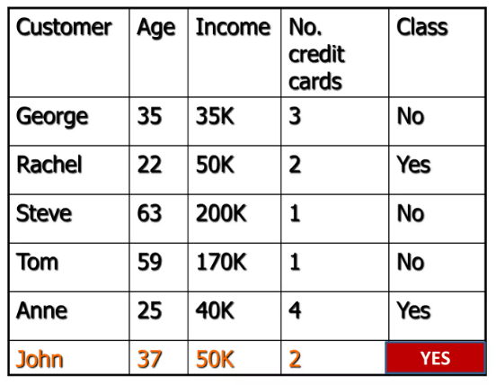
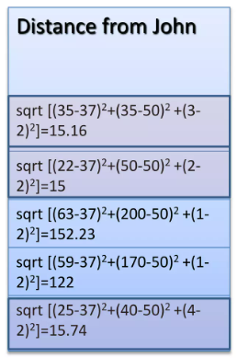
3-KNN: Example

Slide 10
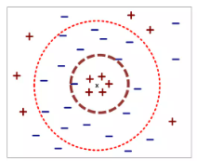
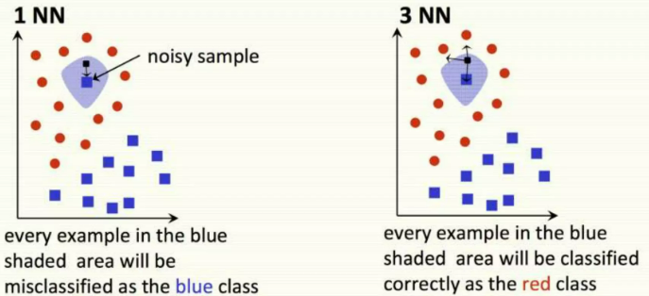
How to choose K?
If K is too small, it is sensitive to noise points
Larger K works well. But too large K may include majority points from other classes.
Rule of thumb is K < sqrt(n), where n is number of examples

Slide 11
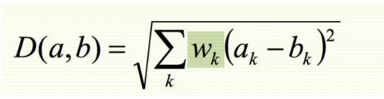
KNN Feature Weighting
Scale each feature by its importance for classification.
Can use our prior knowledge about which features are more important .
Can learn the weights w_{k} using cross validation

Slide 12

Feature Normalization
Distance between neighbors could be dominated by some attributes with relatively large numbers.
E.g. income of customer
Arises when two features are in different scales.
Important to normalize those features.
Mapping values to numbers between 0-1

Slide 13
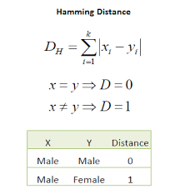
Nominal/Categorical Data
Distance works naturally with numerical attributes.
Binary value categorical data attributes can be regarded as 1 or 0.

Slide 14
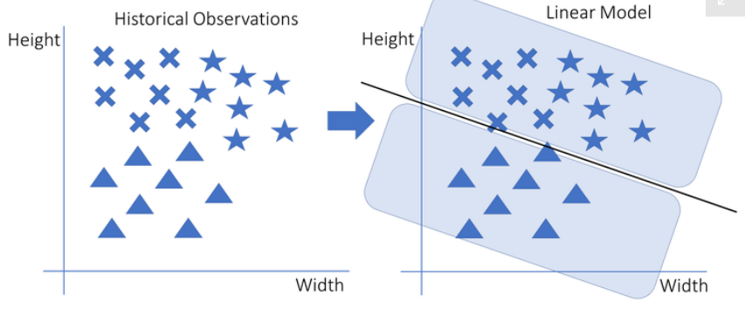
KNN is a Nonlinear Algorithm
KNN just like Decision Trees are an example of non-linear models.

Slide 15
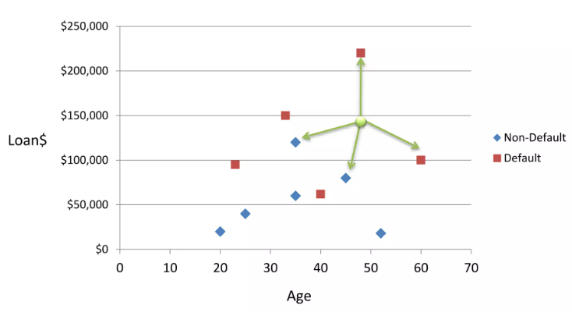
KNN Classification

Slide 16
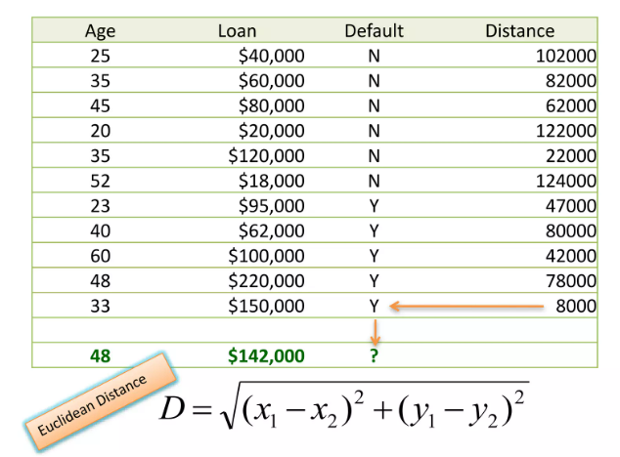
KNN Classification - Distance

Slide 17
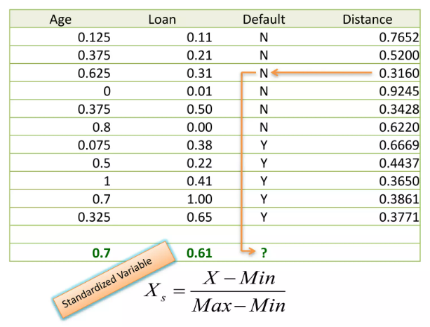
KNN Classification – Standardized Distance

Slide 18
KNN
Strengths
Very simple and intuitive
Can be applied to the data from any distribution
Good classification if the number of samples is large enough.
Weaknesses
Takes more time to classify a new example
Need to calculate and compare distance from new example to all other examples.
Choosing k may be tricky.
Need large number of samples for accuracy

Slide 19
KNN Building in Python
Importing Required Libraries
# Load libraries
import pandas as pd
from sklearn.neighbors import KNeighborsRegressor # Import KNN Classifier
from sklearn.model_selection import train_test_split # Import train_test_split function
from sklearn.metrics import mean_squared_error #Import scikit-learn metrics module for accuracy calculation

Slide 20
KNN Building in Python
Loading Data

Slide 21
KNN Building in Python
Splitting Data
To understand model performance, divide the dataset into a training set and a test set.
Split the dataset by using the function train_test_split() and pass 3 parameters features; target, and test_set size
X_train, X_test, y_train, y_test = train_test_split(X, y, test_size=0.2, random_state=12345

Slide 22
KNN Building in Python
Building the model
To understand model performance, divide the dataset into a training set and a test set.
knn_model = KNeighborsRegressor(n_neighbors=3)
knn_model.fit(X_train, y_train)
from math import sqrt
train_preds = knn_model.predict(X_train)
mse = mean_squared_error(y_train, train_preds)
rmse = sqrt(mse)
rmse

Slide 23
KNN Building in Python
Building the model
test_preds = knn_model.predict(X_test)
mse = mean_squared_error(y_test, test_preds)
rmse = sqrt(mse)
rmse

Slide 24

Questions?

