Slide 1
Javascript
DOM – Document Object Model
Events

Slide 2
BOM
BOM stands for Browser Object Model, and it refers to the set of JavaScript objects provided by the browser to interact with the browser window and everything outside of the web page's content (the DOM).
While the DOM (Document Object Model) deals with the structure and content of the web page, the BOM allows interaction with the browser environment itself.

Slide 3
Window Object
The window object represents an open window in a browser.
It is browser’s object (not Javavscript’s) and is automatically created by browser.
It is a global object with lots of properties and methods.

Slide 4
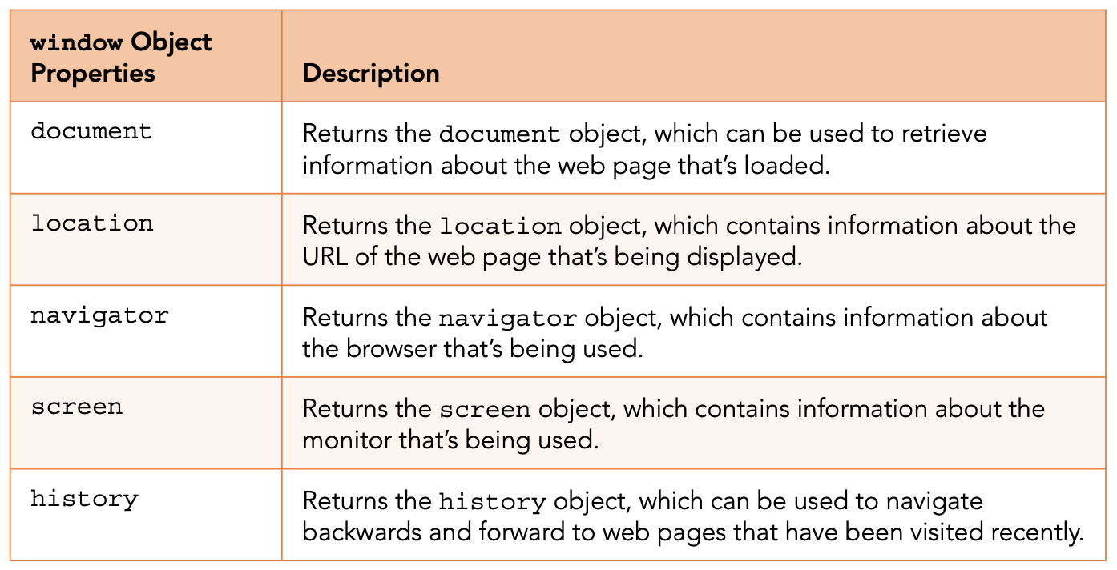
window Object
When you launch a browser or you launch a new tab within a browser window, the browser creates a new window object.

Slide 5
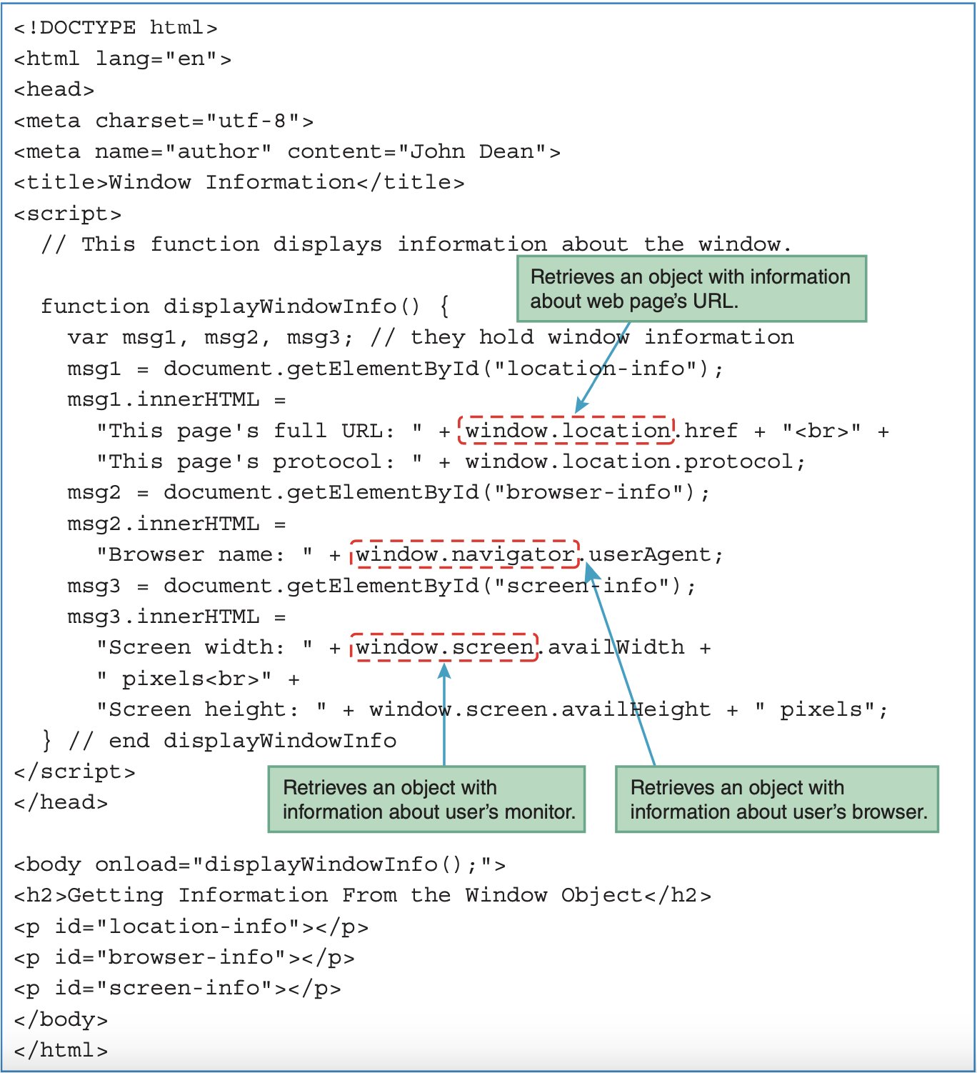

Slide 6
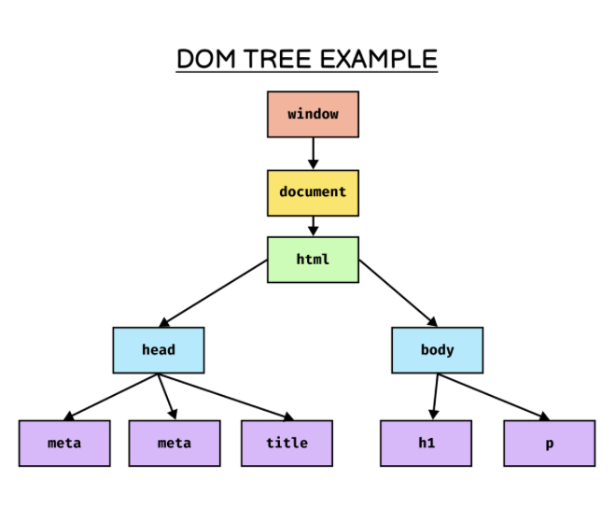
Document Object Model (DOM)
When a webpage is loaded, the browser creates a DOM of the page.

Slide 7
DOM Manipulation
Selecting with id
document.getElementById("myId"))
Selecting with class
document.getElementsByClassName("myClass")
Selecting with class
document.getElementsByTagName("p")

Slide 8
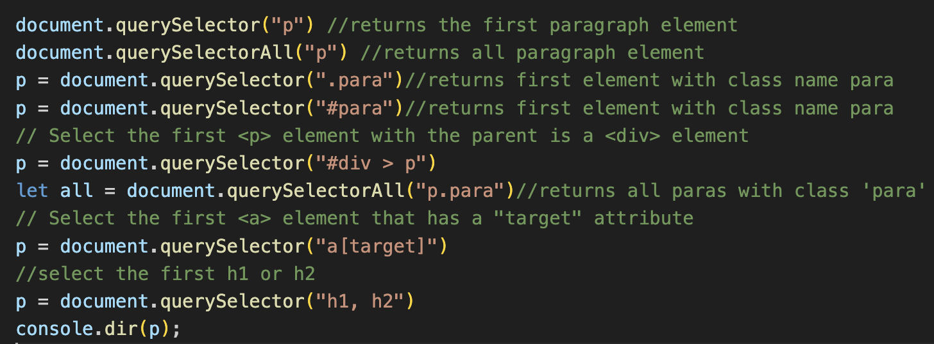
document.querySelector

Slide 9
DOM manipulation
Properties:
tagName: returns tag for element nodes
innerText: returns the text content for the element and all its children
innerHTML: returns the plain text or html contents in the element
textContent: returns textual content even for hidden elements

Slide 10
Practice questions
Create a H2 heading element with text – “Hello Javascript”. Append “from Comsats student” to this text using JS.
Create 3 divs with common class name “box”. Access them and add some unique text to each one of them.

Slide 11
DOM manipulation
Attributes:
getAttribute(attr)
setAttribute(attr, val)
Example:
let ref = document.querySelector("a").getAttribute("href");
console.log(ref)
Style
node.style
Example: document.querySelector(“p”).style.color = “red”;
Notes:
All style properties in css are available with the same names without hiphen and with camel casing, for example: font-size in css is fontSize in JS.

Slide 12
DOM Manipulation
Insert element: let el = document.createElement(“div”);
node.append(el) //adds at the end of the node(inside)
node.prepend(el) //adds at the start of the node(inside)
node.before(el) //adds at the start of the node(outside)
node.after(el) //adds at the end of the node(outside)
Delete element: node.remove()

Slide 13
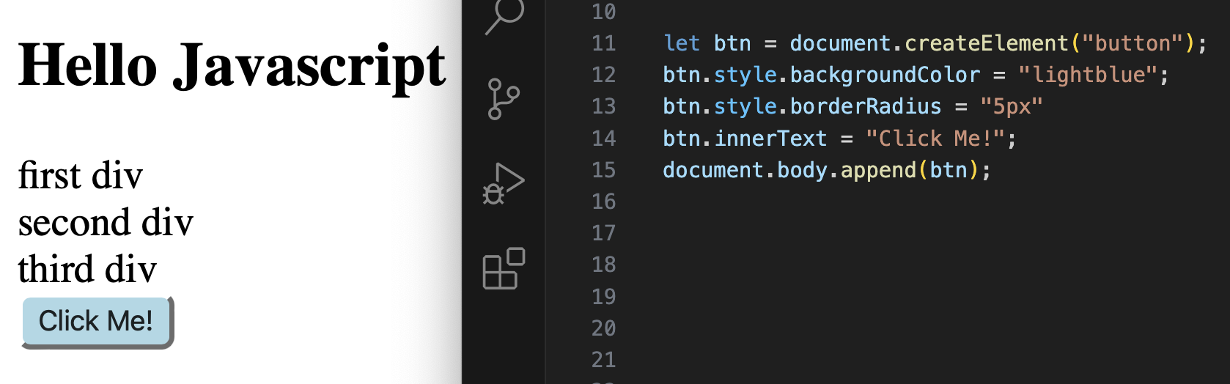

Slide 14
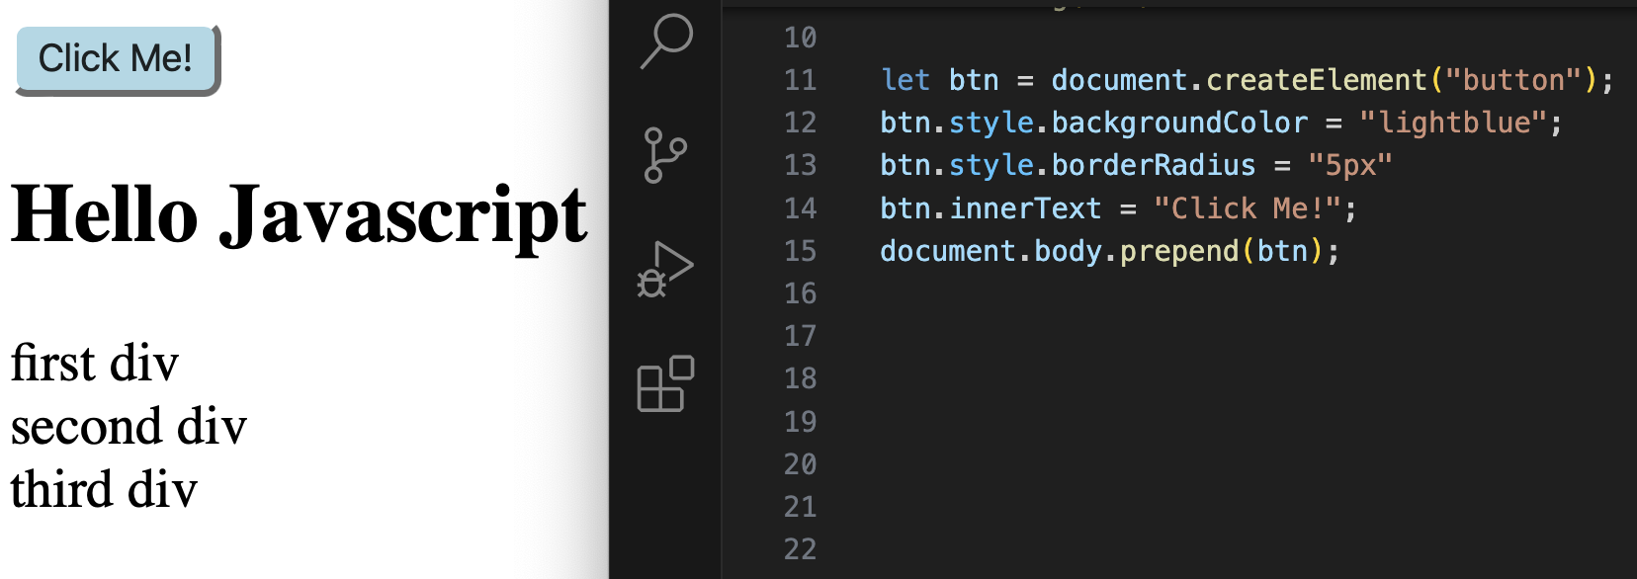

Slide 15
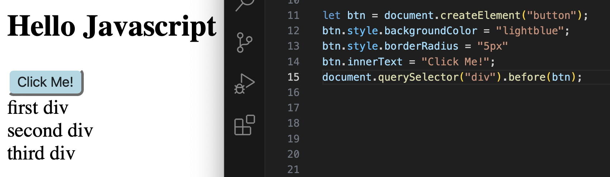

Slide 16
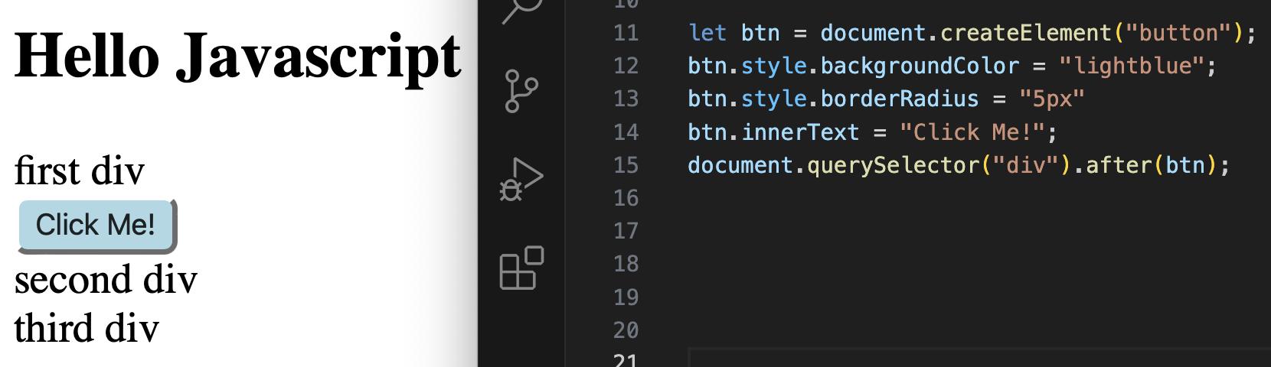

Slide 17
Practice Questions
Create a new button element and give it a text “Click Me”.
Create a <p> tag in html, give it a class and some styling. Now create a new class in CSS and try to append this class to the <p> element.
Did you notice, how you overwrite the class name when you add a new one?
Solve this problem using classList.

Slide 18
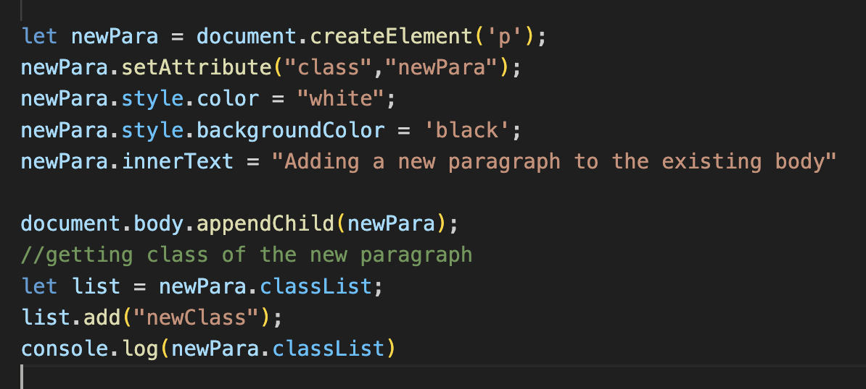
Solution - 2

Slide 19
Events
The change in the state of an object is known as an event.
Events are fired to notify code of “interesting changes” that may affect code execution.
Mouse events (click, double click, etc.)
Keyboard events(keypress, keyup, keydown etc.)
Form events (submit etc.)
Print event & many more.

Slide 20
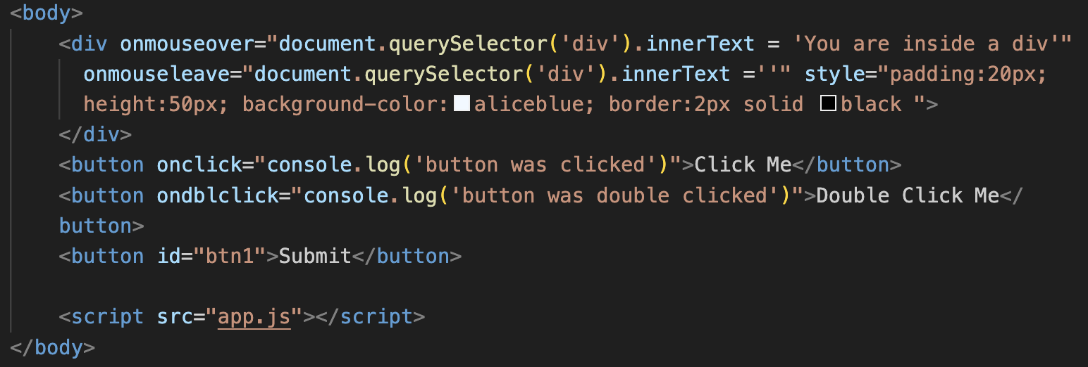
Event handling
You can add inline event handlers

Slide 21
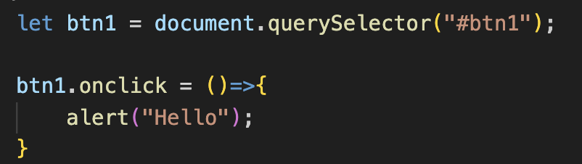
Event handling
Adding external javascript code
node.event = () => { }
External javascript code has higher precendence compared to inline javascript.
If two same handlers are written, then the one written last will have higher precendence

Slide 22
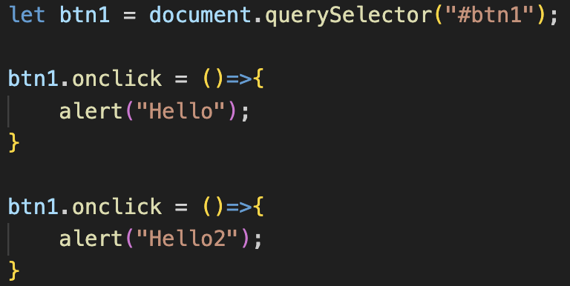
Event handling
Here, the code written in app.js will have more precedence compared to inline javascript. And second handler in app.js has higher precendence.
So Hello2 will be displayed in alert.

Slide 23
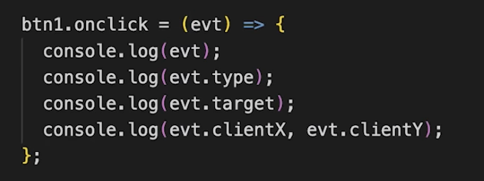
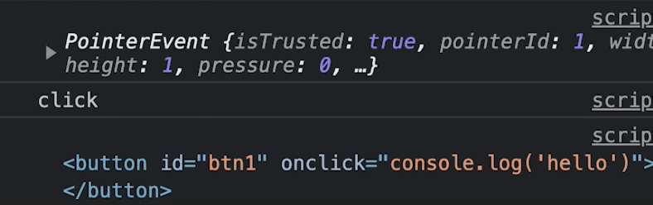
Event Object
It is a special object that has details about the event.
All event handlers have access to Event Object’s properties and methods.
node.event = (e)=>{
//handle event
}
e.target, e.type, e.clientX, e.clientY

Slide 24
Event Listeners
node.addEventListener(event, callback)
node.removeEventListener(event, callback)
Callback is the event handler
The callback reference should be same to remove
You can add more than one event handlers for the same event and all of them will be executed.

Slide 25
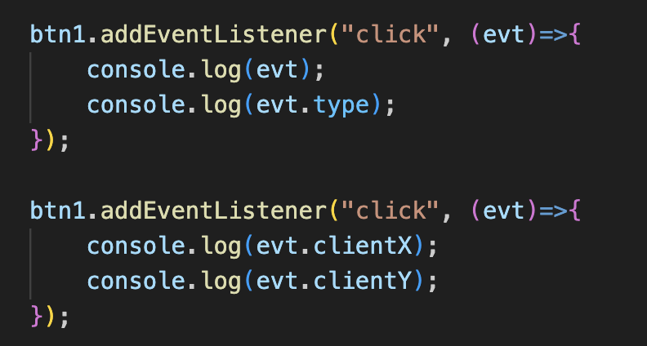
Event Listeners

Slide 26
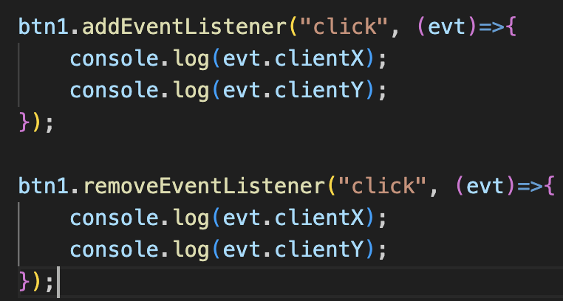
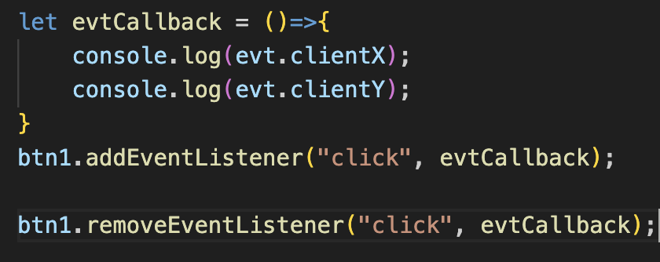
Event Listeners
While removing event listeners, we should save the function in a variable and then remove the same function, as passing a callback declaration will be treated as a different function and will be alloted a different location in memory.
Event will be removed
Event will not be removed

Slide 27
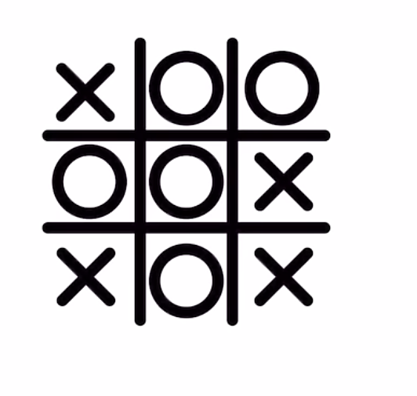
Practice Question
Create a toggle button that changes the screen to dark mode when clicked and light mode when clicked again.
Build a tic-tac-toe game.

Slide 28
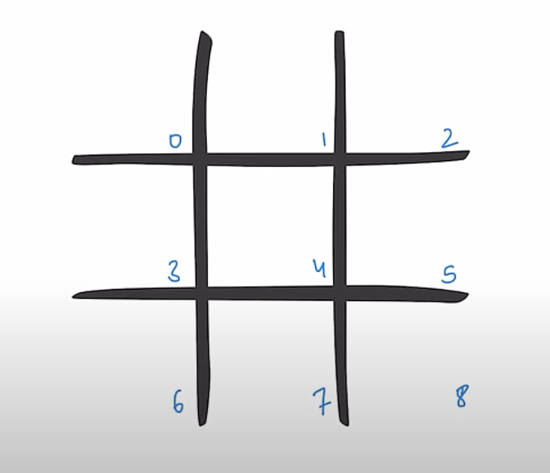
Tic-tac-toe
Logic:
Track the id of the 0-8 boxes
Identify the winning pattern: for e.g: in horizontal orientation, we have three winning patterns (0,1,2), (3,4,5) and (6,7,8). There are total 8 winning patterns.
These boxes should be clickable so better to create buttons

Slide 29
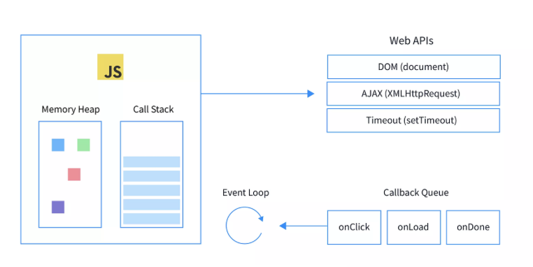
Event Loop
Notes:
JavaScript is single-threaded, so it can do only one thing at a time. The event loop decides which task should run next.
The normal execution is single threaded and in case a user presses 2-3 buttons one after the another, then those are placed in the event queue. These are excuted on FIFO principle. The event loop is performing these functions one after another.
If within an event queue, a single thread calls another function, then this kind of nested function is sent to call stack, and the first function waits until the called function is complete. In asynchronous functions, the async request is separated

