Slide 1
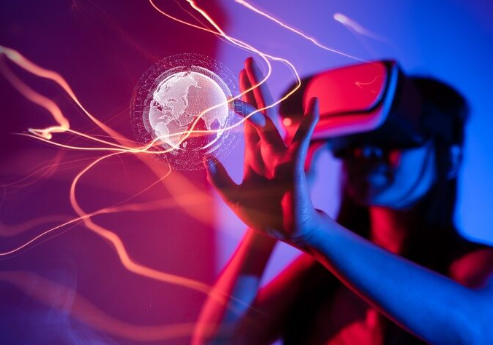
METAVERSE
BY M.ABRAR UL HAQ JILANI

Slide 2
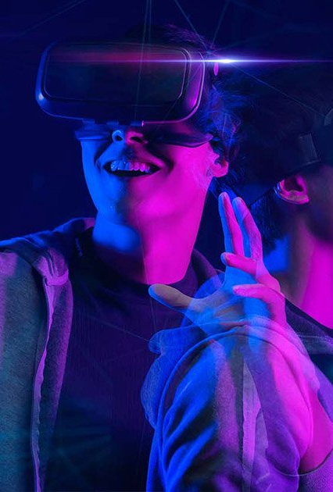
WHAT IS
METAVERSE
“Meta verse is the virtual world, where people will work, shop, interact with each other, party, and many more, all from their couches, beds in the physical world “
The metaverse is thought to be the next step in the evolution of the internet. It will manifest itself in a variety of ways, including gaming, online communities, and business meetings in which people collaborate using a digital facsimile or avatar of themselves.
Users navigate a virtual world that mimics aspects of the physical world using technologies such as virtual reality (VR), augmented reality (AR), artificial intelligence (AI), social media, and digital currency in the metaverse.

Slide 3
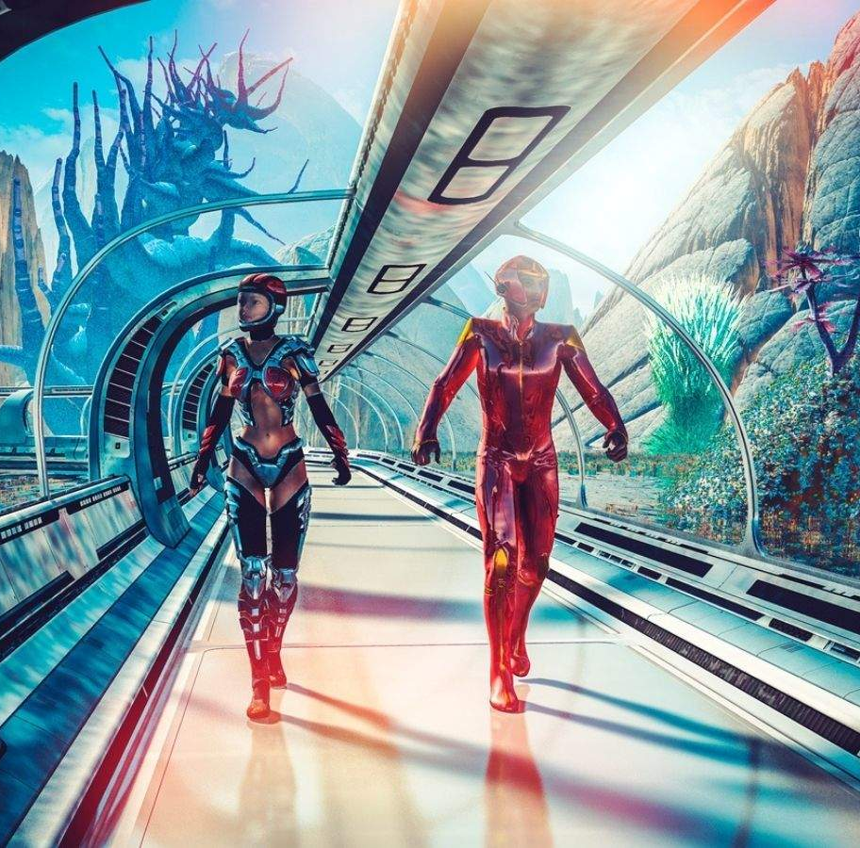
BRIEF
HISTORY
In 1992 The first time, the term “METAVERSE” was used by NEAL Stephenson in his novel SNOW CRASH, He just gave the idea of the virtual world, no specific definition was provided.
Several companies later created online communities based on the concept, the most notable of which was Second Life, which debuted in 2003.
Palmer Luckey, an 18-year-old entrepreneur, and inventor designed the Oculus Rift VR headset prototype in 2010. The revolutionary headset reignited interest in VR with its 90-degree field of vision and use of computer processing power.
Ernest Cline's Ready Player One helped popularize the concept of the metaverse. The 2011 dystopian sci-fi novel is set in a virtual world in 2045 called The Oasis. The world is accessed through a virtual reality visor and haptic gloves that allow users to grab and touch objects.
This Photo by Unknown Author is licensed under CC BY

Slide 4
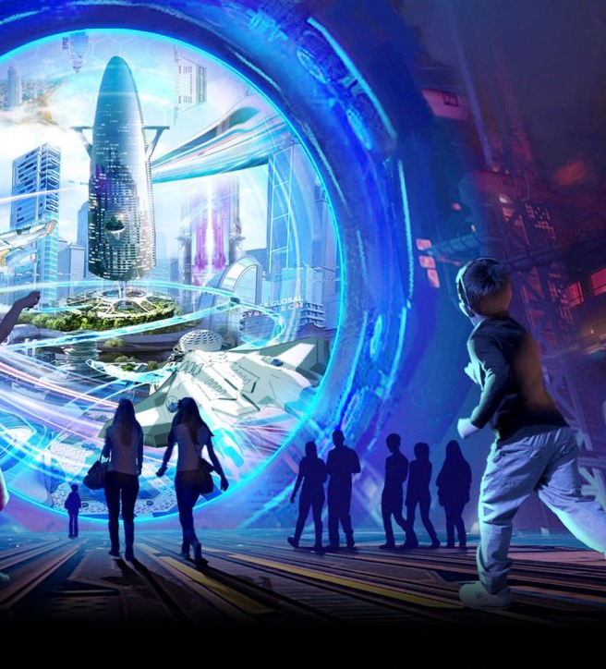
BRIEF
HISTORY
Facebook acquired Oculus VR in 2014 in a $2 billion deal
In 2014, Sony and Samsung both announced the development of their own VR headsets, and Google released its first Cardboard device and Google Glass AR glasses.
Microsoft's HoloLens headsets were released in 2016, introducing mixed reality (AR and VR) for the first time. We can create a holographic image in front of us with HoloLens, then place it in the real world and manipulate it with augmented reality.
Apple added Lidar (Light Detection and Ranging) to iPhones and iPads in 2020, allowing for better depth scanning for better photos and AR, as well as paving the way for future mixed-reality headsets.
In 2021, Facebook changed its name to Meta, indicating its commitment to shaping the metaverse's future.

Slide 5
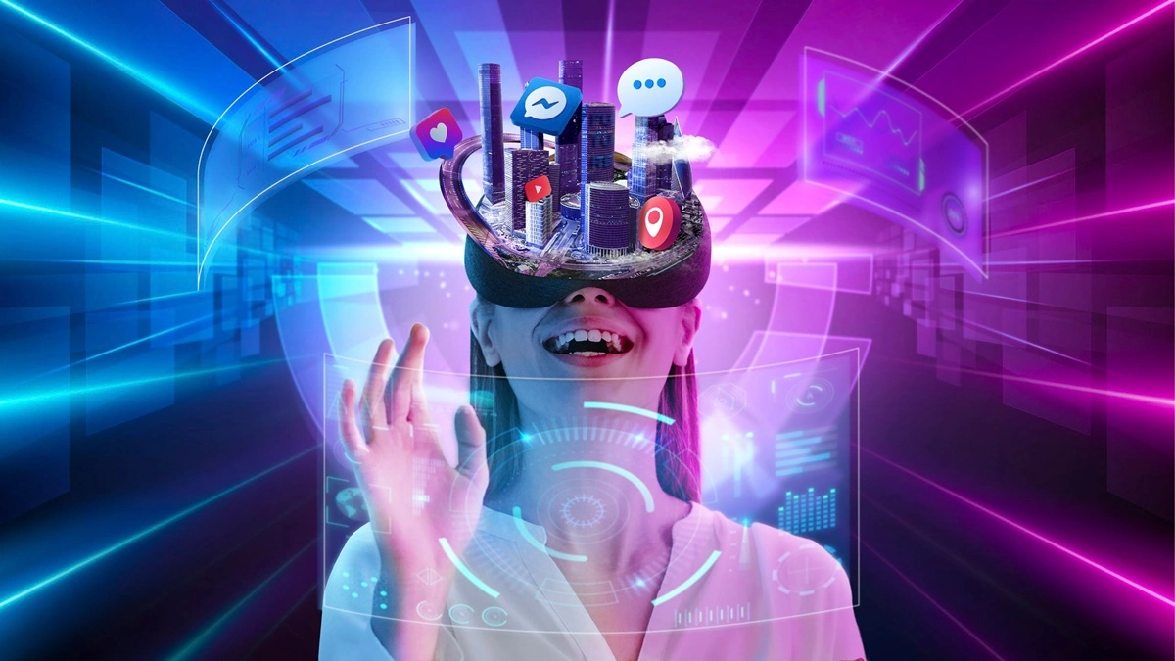
METAVERSE
PRECEPTION
There is no proper definition of the Metaverse, each company defines it differently.
As per Microsoft CEO, the metaverse is a platform that turns the “entire world into an app canvas”.
Mark Zuckerberg’s concept is to create a virtual world where everyone will stay connected no matter how physically far they are from each other, you will always be just one avatar to each other.

Slide 6
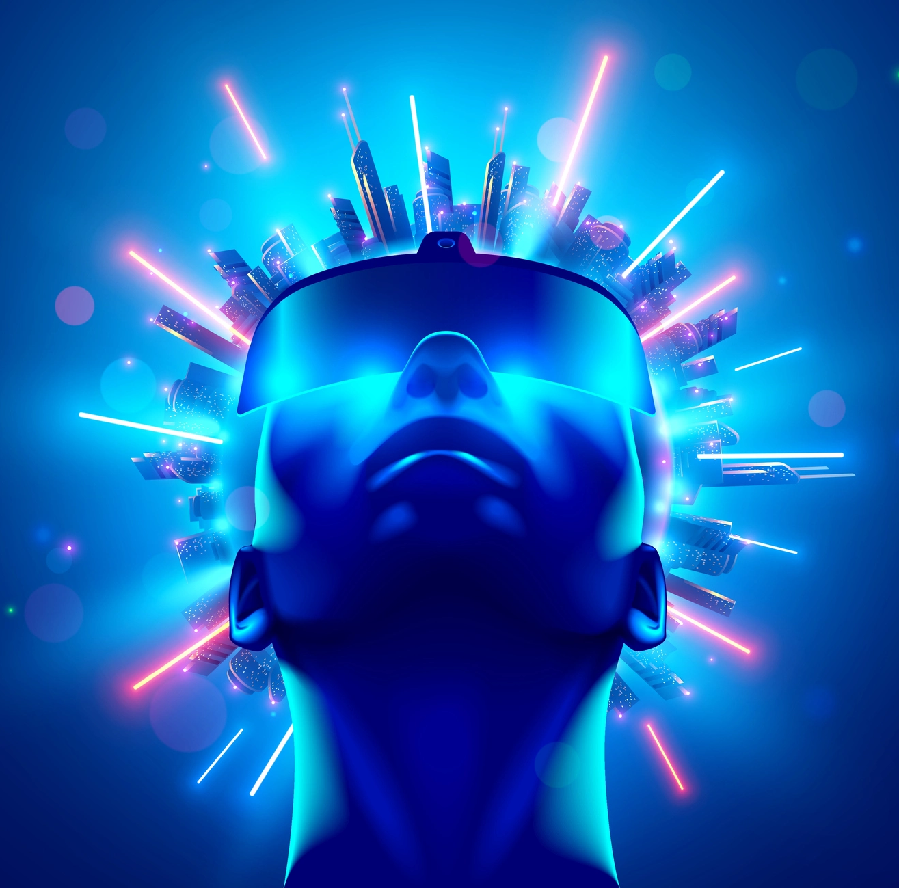
METAVERSE
IN THE FUTURE VISION OF EVERY COMPANY
The sheer number of companies that see potential value in the Metaverse speaks to the size and diversity of the opportunity.
In 2021, the Match Group, owner of many dating apps such as Tinder, Hinge, and OkCupid shows great interest in the Metaverse and announced that its services would soon receive “augmented features, self-expression tools, conversational AI and a number of what we would consider metaverse elements, which have the element to transform the online meeting and getting-to-know-each-other process.
Chinese megacorporations Tencent, Alibaba, and ByteDance are showing great interest and also working to get themselves ahead in the metaverse in order to stumble over their domestic competitors.
Gaming industry is looking at Metaverse as a revolution in their field, big fishes such as Sony, Microsoft, Nintendo, EA, T2, and many more are working on metaverse-based multiplayer games.

Slide 7
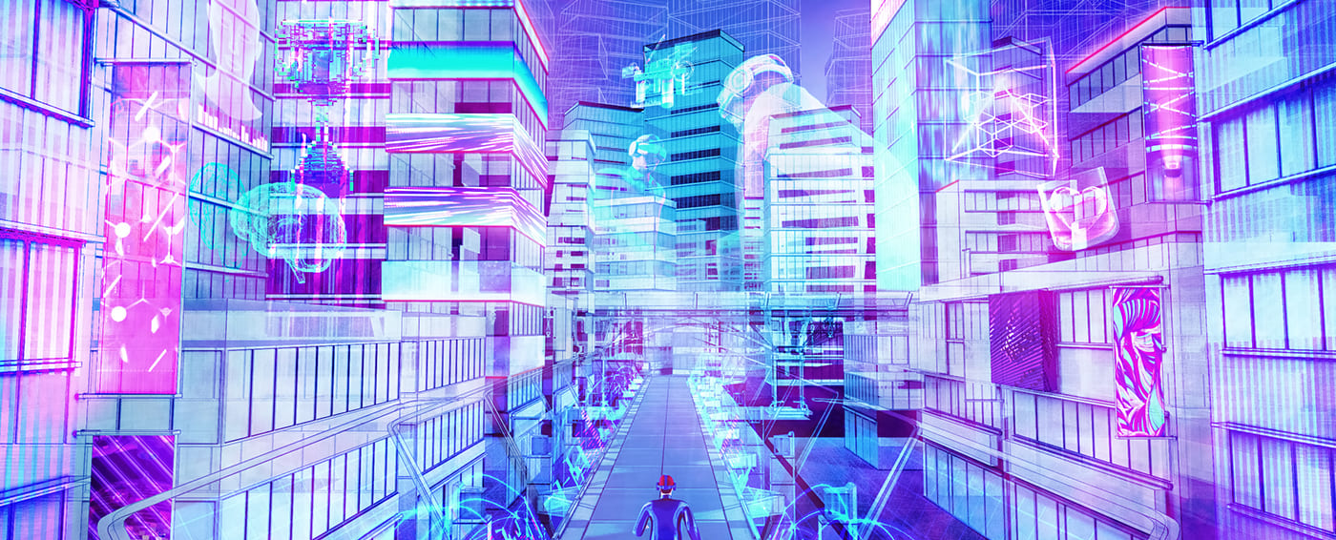
METAVERSE
BLESSING &
RISK.
METAVERSE will change the world completely as it
Will
The biggest challenges that will METAVERSE have to face.
Privacy issues
Tracking/Surveillance of kids’ activities
Health concerns
Access Inequality
METAVERSE laws
Desensitization
Connecting the world and negating physical distance.
Immersive experience
Better social interaction online
Revolution in Gaming
New business opportunities
Improvement in the online education system
Positive impact on crypto-currencies and NFTs
Improvement in online working

Slide 8
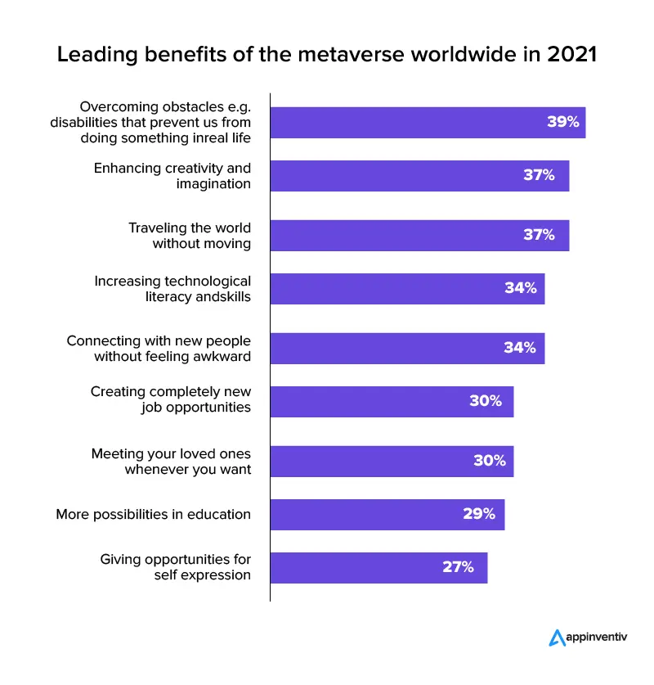
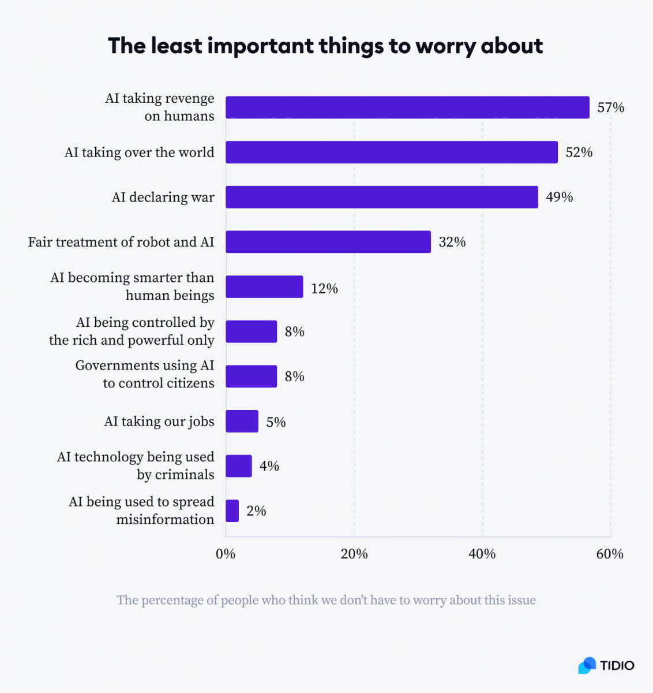

Slide 9
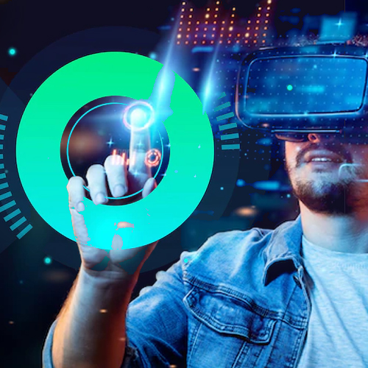
CONCLUDING
NOTE
The metaverse is like the internet in the 80s and 90s, and everyone had their own set of definitions and vision. People go on the internet to "browse." However, people can "live" in the metaverse to some extent.
The Metaverse is still in its early stages. It is unknown how long it will take to fully develop or how well it will replicate real life. However, one thing is certain: it has the potential to be the next virtual reality revolution.

