Slide 1

CS-234: Computer Organization and Assembly Language Cache
Dr. Sara Shakil Qureshi

Slide 2
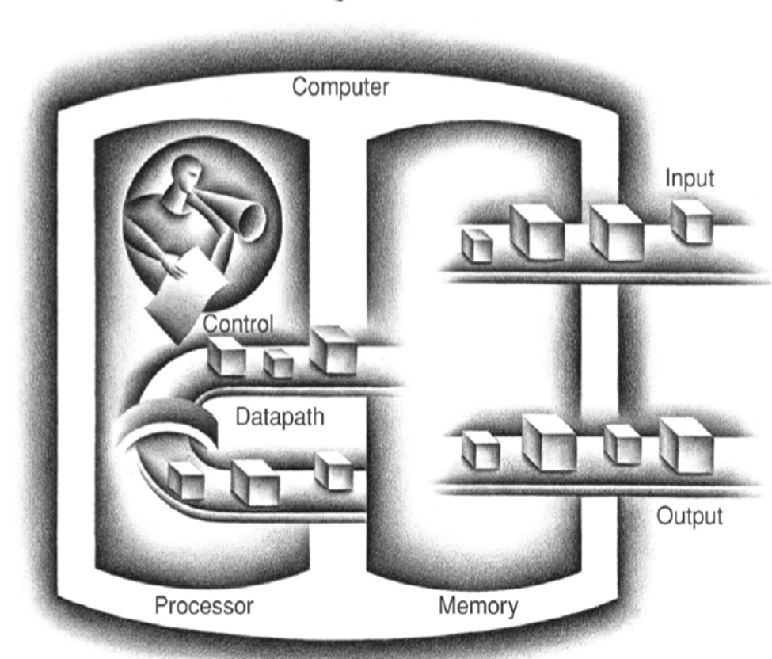
Computer Organization

Slide 3
Interfacing in Microprocessor
The process of connecting external devices such as memory and I/O peripherals to the microprocessor, allowing control and data exchange.
Types
Memory Interfacing
I/O Interfacing
Memory-Mapped I/O and Isolated I/O
Data transfer
Timing and control
Address decoding

Slide 4
IA-32 Modes of Operation
Real Mode
Protected Mode
System Management Mode
Virtual 8086 Mode

Slide 5
IA-32 Modes of Operation
Real Mode
Can access only 1MB Memory (beyond 80286) – 16-bit
For MS-DOS
One task at a time (Single-Tasking), no protection
Programs can access Shared Memory Locations
Protected Mode
Can access only 4GB RAM, 32-bit
For Windows, Linux
Allows multi-tasking, memory protection
Memory Reservation for each Program

Slide 6
IA-32 Modes of Operation
System Management Mode (SMM)
Special purpose mode used by system/firmware.
Implementing Functions : Power Management, hardware control & System Security
Usually implemented by Computer Manufacturers
Invisible to OS
Virtual Mode
Being in Protected Mode: The processor can directly execute a program in Real Mode
Can access only 1MB Virtual Memory (beyond 80286) – Emulating real mode inside protected mode

Slide 7
IA-32 Memory Management
Segmented Memory Model – Real Mode
– Calculating linear addresses
Flat Memory Model – Protected Mode

Slide 8
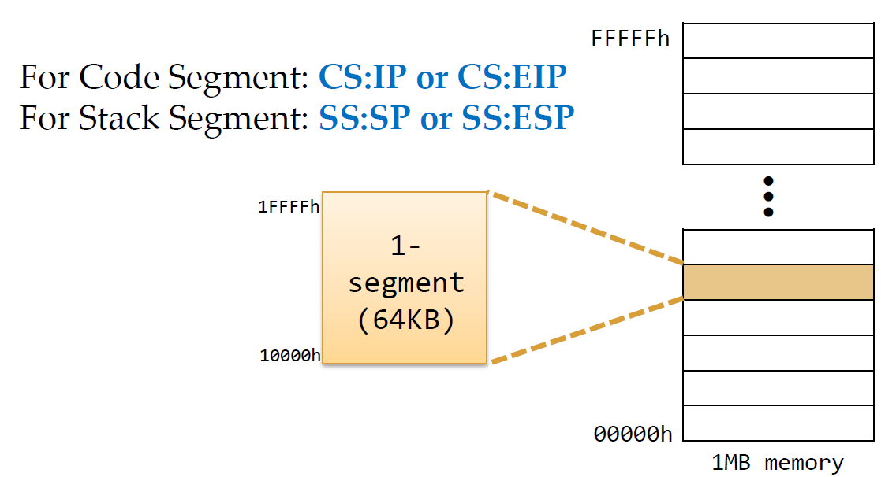
Segmented Memory Model
Format ~ Segment : Offset

Slide 9
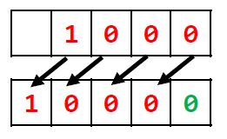
Segmented Memory Model
Linear Address Calculations:
1000h:5000h Calculate linear address.
Linear Address Calculations:
New Seg. Address 10000h
Add offset into new Address Offset Address 5000h
Linear Address =15000h

Slide 10
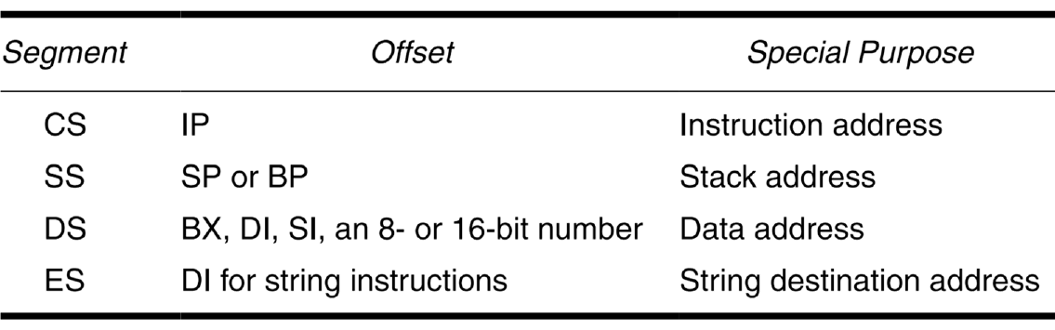
Segmented Memory Model

Slide 11
Memory
Volatile memory (RAM)
Information decays naturally or is lost when electrical power is switched off
Nonvolatile memory (ROM)
Once recorded, information remains without deterioration until deliberately changed
No electrical power is needed to retain information
Magnetic-surface memory (HDDs, magnetic tapes)
Are non-volatile

Slide 12
Memory
Semiconductor memory
May be either volatile or nonvolatile
Nonerasable memory
Cannot be altered, except by destroying the storage unit
Semiconductor memory of this type is known as read-only memory (ROM)
For RAM the organization is a key design issue

Slide 13
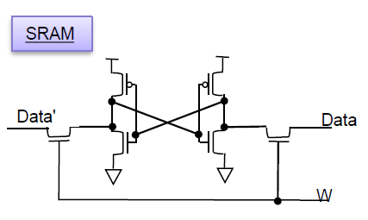
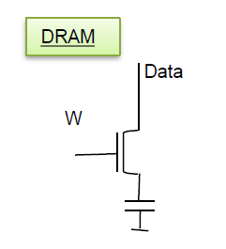
Memory
Types of RAM
SRAM:
Memory cell uses Flip-Flop to store a Bit
Requires 6 Transistors
Holds Data as long as power supplied
Faster and reliable but more costly
DRAM:
Memory cell uses MOS transistor and capacitor to store a bit
More compact than SRAM
Stores data in capacitors
Typical refresh rate 15.625 µs

Slide 14
Memory Hierarchy
In computer architecture, it is the organization of different types of memory, such as registers, cache and main memory based on speed, capacity and cost.
Faster, smaller and more expensive memory closer to the CPU
Slower, larger and cheaper memory far from the CPU

Slide 15
Memory Hierarchy
Design constraints on a computer’s memory conclude by three questions:
How much, how fast, how expensive
There is a trade-off among access time, cost, and capacity
Faster access time, greater cost per bit
Greater capacity, smaller cost per bit
Greater capacity, slower access time

Slide 16
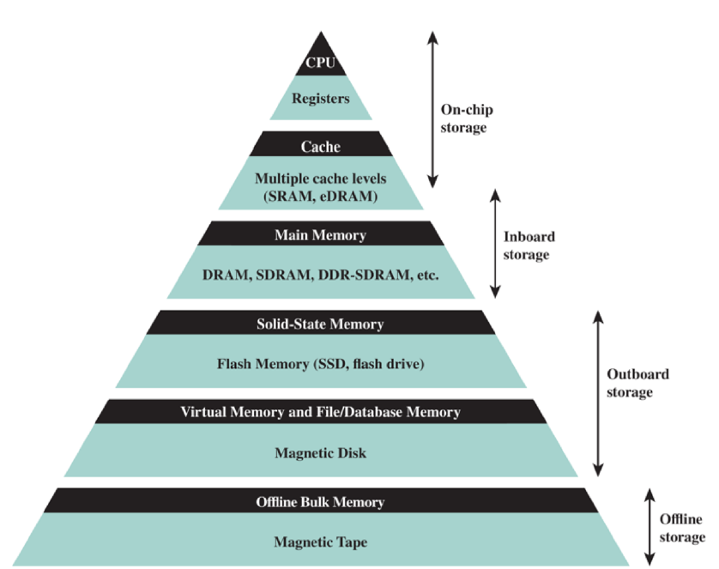
Memory Hierarchy

Slide 17
Cache
It is a small high speed memory that acts as a buffer between the CPU and main memory
Stores frequently accessed data and instructions
Advantages:
Faster data access
Improved system performance
Reduced latency

Slide 18
Cache
Cache Hit
It occurs when the requested data is found in the cache, providing quick data retrieval.
Cache Miss
It happens when the requested data is not found in the cache and requires to be retrieved from the main memory.
High cache miss rates slow down the performance

Slide 19
Cache Operation
CPU requests contents of memory location.
Check cache for this data.
If present, get from cache (fast).
If not present, read required block from main memory to cache.
Then deliver from cache to CPU.

Slide 20
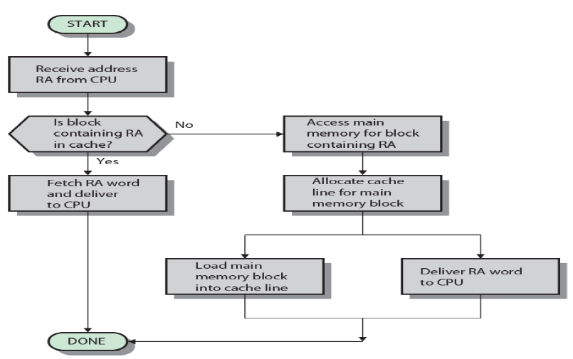
Cache Operation Flowchart

Slide 21
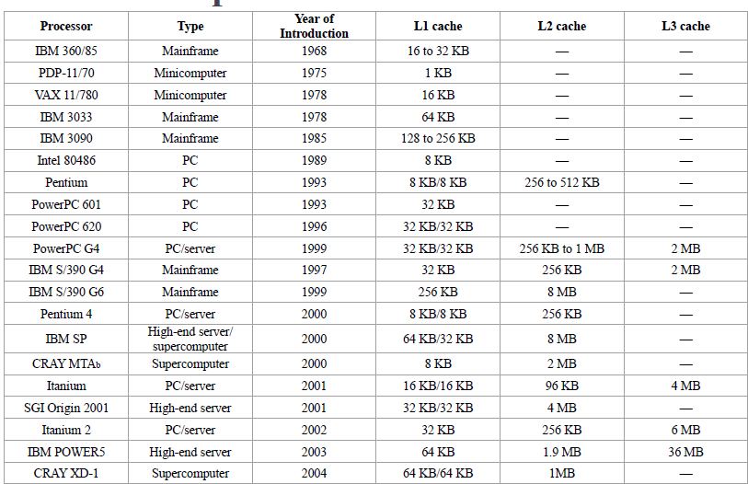
Cache Sizes

Slide 22
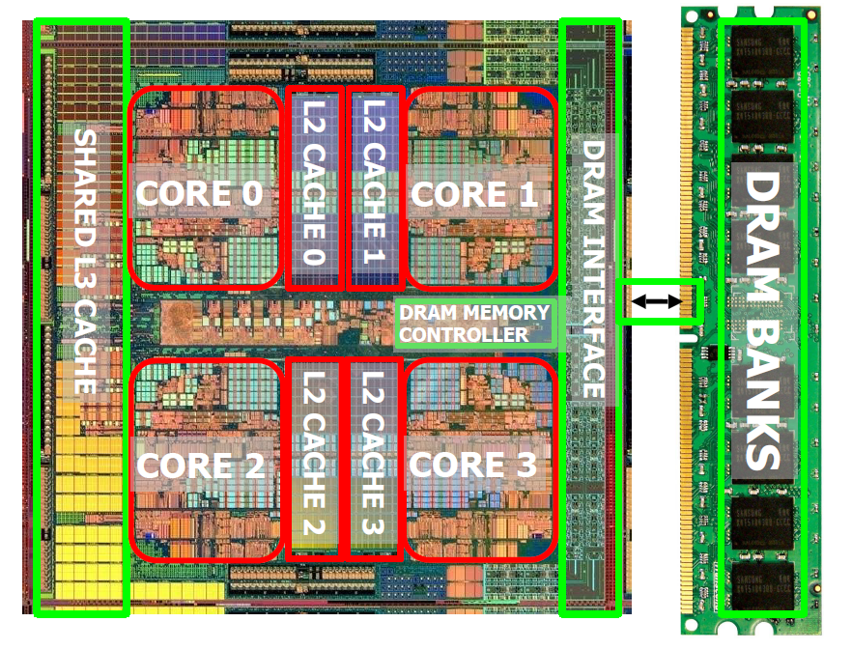
Memory

Slide 23
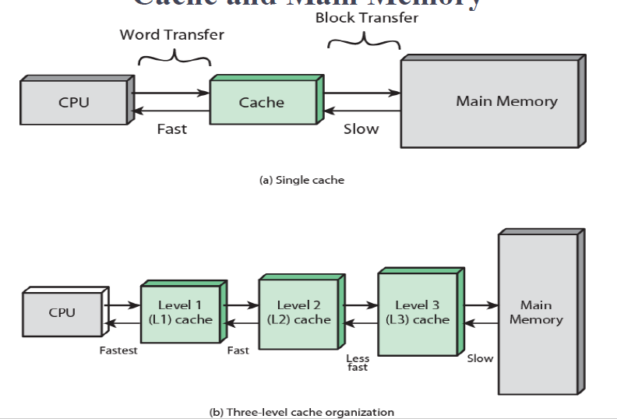
Cache and Main Memory
Computer Organization and Architecture, Eleventh Edition by William Stallings

Slide 24
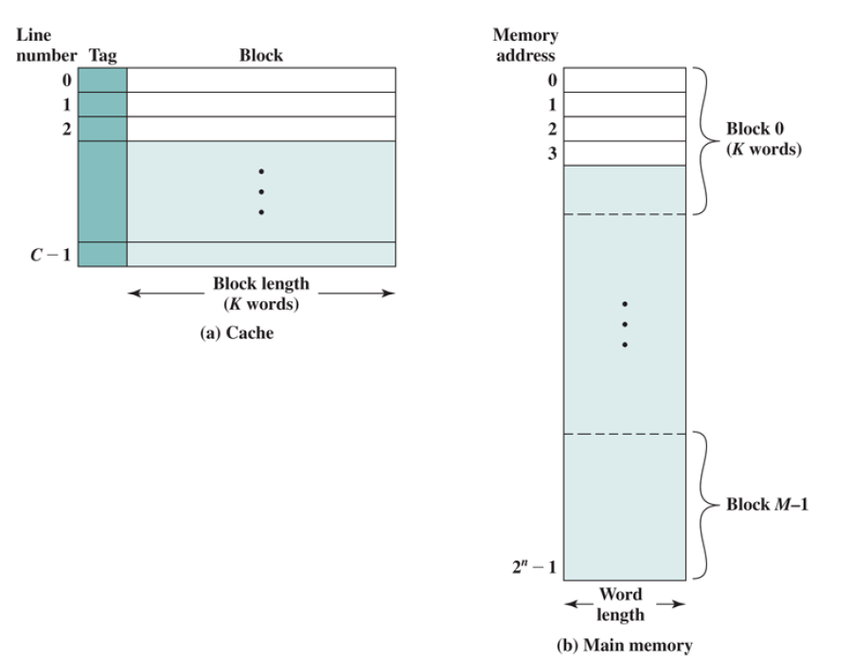
Cache and Main Memory
Computer Organization and Architecture, Eleventh Edition by William Stallings

Slide 25
Block: The minimum unit of transfer between cache and main memory.
Frame: To distinguish between the data transferred and the chunk of physical memory
Line: A portion of cache memory capable of holding one block, (i.e., all bytes of the line are typically drawn in one row).
Tag: A portion of a cache line that is used for addressing purposes

Slide 26
Memory Mapping
Because there are fewer cache lines than main memory blocks, an algorithm is needed for mapping main memory blocks into cache lines
Direct Mapping
Associative Mapping
Set Associative Mapping
Computer Organization and Architecture, Eleventh Edition by William Stallings

Slide 27
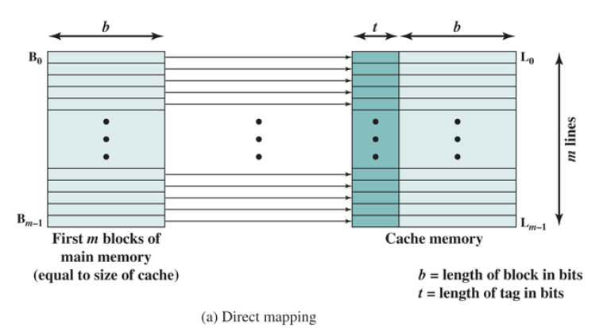
Direct
Each block of main memory can map to only one unique line of cache.

Slide 28
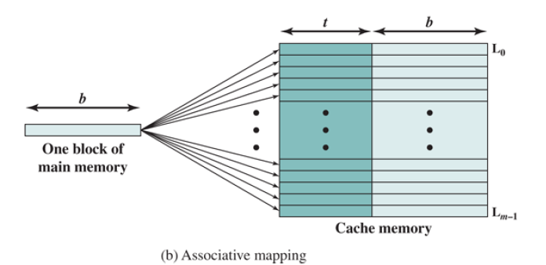
Associative
Each block of main memory can map to any line of cache.
Tag portion of address used to check every line for hit on that line.

Slide 29
Set Associative
Each block of main memory maps to one unique cache set.
Line portion of address used to access cache set
Tag portion used to check every line in that set for hit on that line.
Computer Organization and Architecture, Eleventh Edition by William Stallings

Slide 30
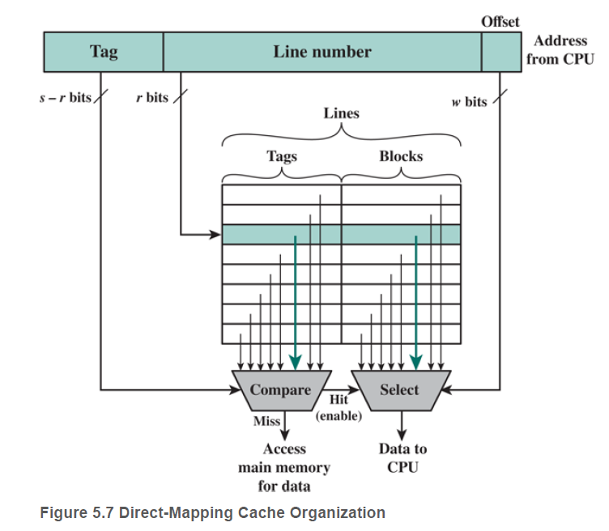
Direct Mapping
Computer Organization and Architecture, Eleventh Edition by William Stallings

Slide 31
Example
Main Memory Size = 32B
Cache Size = 16B
Block Size = 4 Bytes
How many lines for Cache memory? 16 B /4 B=4 lines
How many address lines for accessing cache memory lines?
2^2 =4, address lines for Cache is 2
How many Blocks in main memory?
32 B/4 B =8 blocks
How many address lines for accessing Main memory?
2^5 =32 , address lines for main memory is 5
Computer Organization and Architecture, Eleventh Edition by William Stallings

Slide 32
Example
Main Memory Size = 16 MB
Cache Size = 64 KB
Block Size = 4 Bytes
How many lines for Cache memory? 64 KB /4 B=16 K lines
How many address lines for accessing cache memory lines? 2^14 =16 K, address lines for Cache is 14
How many Blocks in main memory?
16 MB/4 B =4 Mega blocks
How many address lines for accessing Main memory?
2^24 =16 M, address lines for main memory is 24
Address length =24= (22+2)=(s + w) bits
Address length =24= (tag+line+word)= (8+14+2)
Computer Organization and Architecture, Eleventh Edition by William Stallings

Slide 33
Direct Mapping
When the cache hardware is presented with an address from the processor, the Line Number portion of the address is used to index into the cache. A compare function compares the tag of that line with the Tag field of the address.
If there is a match (hit), an enable signal is sent to a select function, which uses the Offset field of the address and the Line Number field of the address to read the desired word or byte from the cache.
If there is no match (miss) then the select function is not enabled and data is accessed from main memory, or the next level of cache.

Slide 34
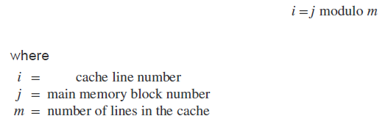
Direct Mapping
Address length = (s + w) bits
Number of addressable units = 2^(s+w) words or bytes
Block size = line size = 2^w words or bytes
Number of blocks in main memory = 2^(s+ w)/2^w = 2s
Number of lines in cache = m = 2^r
Size of tag = (s – r) bits
Computer Organization and Architecture, Eleventh Edition by William Stallings

