Slide 1
Prometheus

Slide 2
Topics
Prometheus Introduction
Continuous Monitoring with Prometheus
Prometheus Architecture
Prometheus Metrics & its Types
Prometheus Installation
Prometheus User Interface
Custom Rules
Alert Management System - Demo

Slide 3
Prometheus Introduction
It is a Software application used for event monitoring and alerting
It records real-time metrics in a time series database built using a HTTP pull model.
Records any purely numeric time series
Designed for Reliability
It can monitor both Machine-centric and Highly dynamic service oriented architectures.
It pull based tools

Slide 4
Continuous Monitoring with Prometheus
Applications Exception
Server CPU
Memory Usage
Storage Spikes

Slide 5
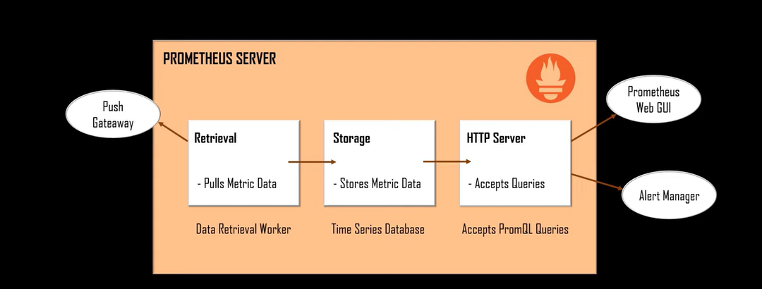
Prometheus Architecture

Slide 6
Prometheus Metrics & its Types
Each unit of a target such as CPU utilization or Memory Consumption are known as Metrics
Sever collects the metrics from the targets using PromQL processes them and then show it on GUI.
Following are the types of Metrics:
Counters
Histogram
Gauges
Summary

Slide 7
Prometheus Metrics : Counters
Record a value that only goes up
Query how fast the value is increasing
For Example: No. of requests, Error Count, Task Completed .etc

Slide 8
Prometheus Metrics : Gauges
Record a value that only goes up and down
You do not have to Query its rate
For Example: Speedometer, Current Memory Usage.

Slide 9
Prometheus Metrics : Histogram
Take many measurements of a value, to later calculate averages or percentiles.
You know what the range of values will be up front, so you can define your own.

Slide 10
Prometheus Metrics : Summary
Its like Histogram
The main difference between these two is that in Summary you don’t know the initial values. Summary show the details over multiple time series.
Take many measurements of a value to later calculate averages or percentiles
You don’t know what range of values will be up front so cannot use histograms

Slide 11
Prometheus Installation

Slide 12
Prometheus User Interface

