Slide 1
Bash Scripting

Slide 2
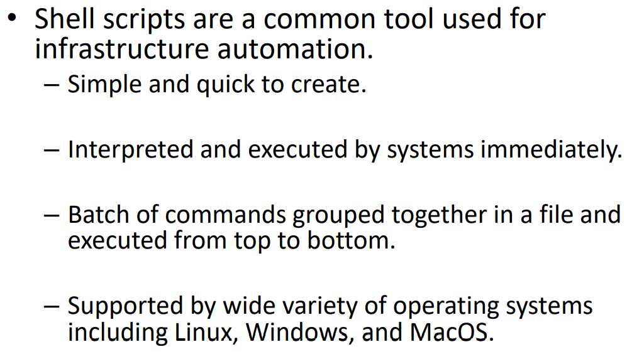
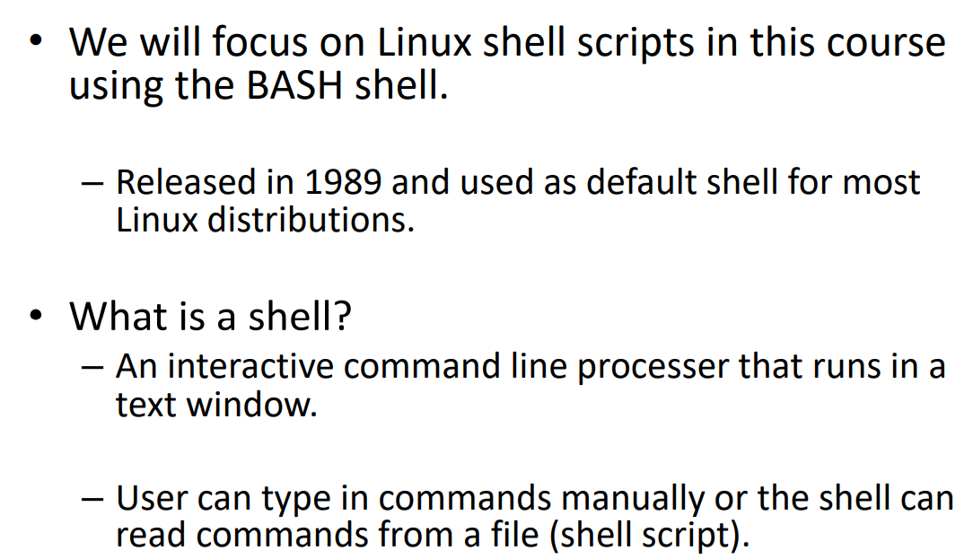
Shell Scripting

Slide 3
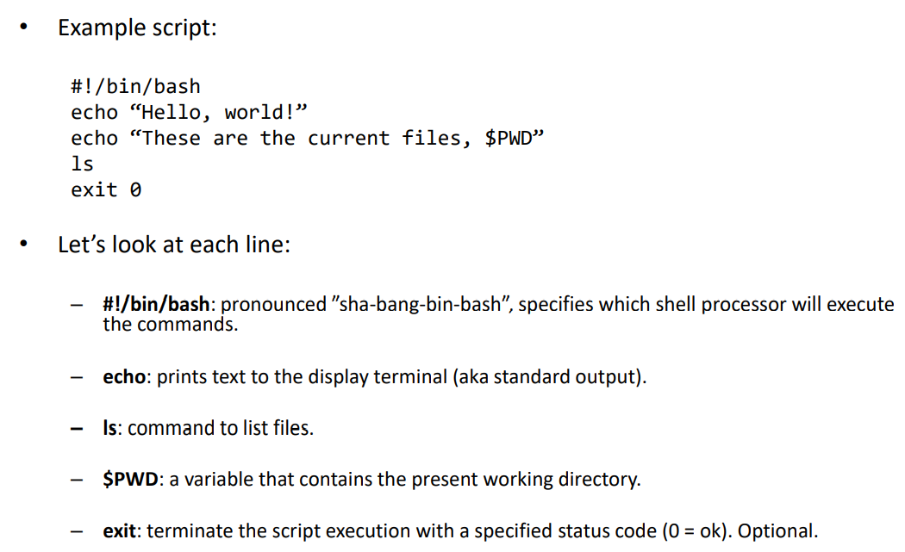
Bash Scripting

Slide 4
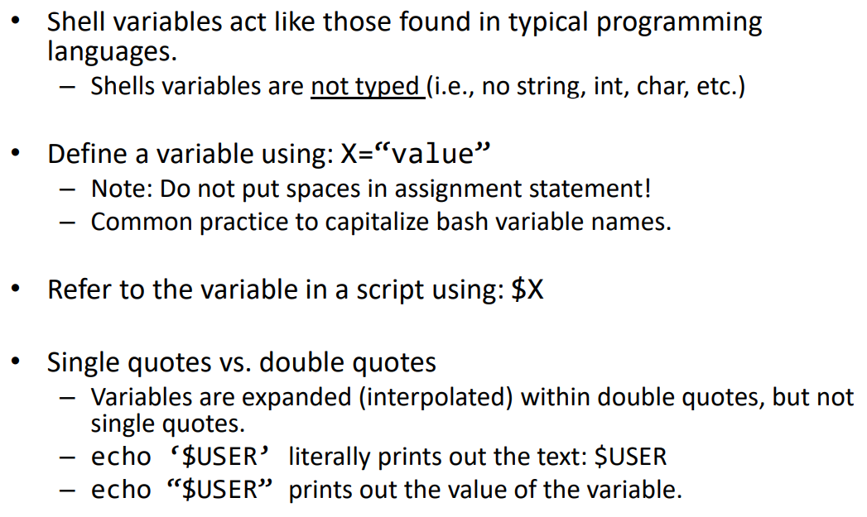
Bash Scripting : Variables

Slide 5
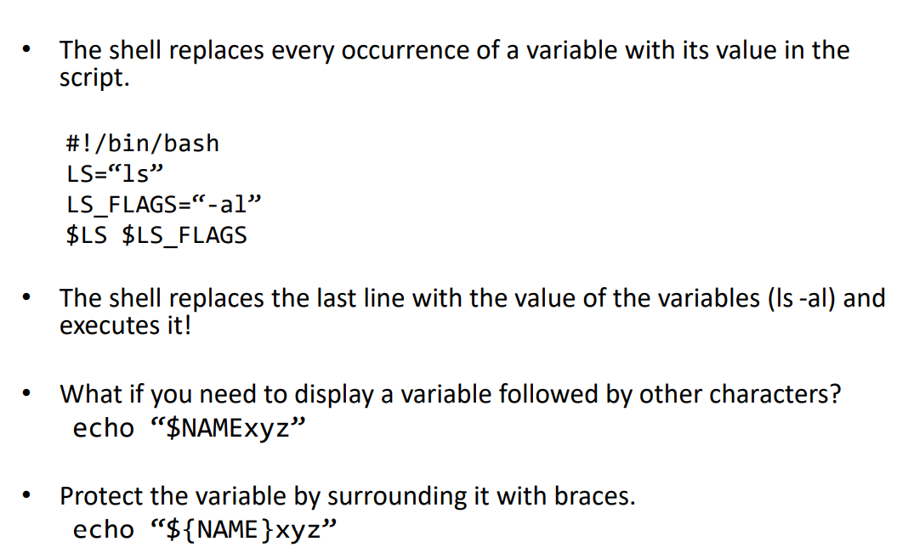
Bash Scripting : Variables

Slide 6
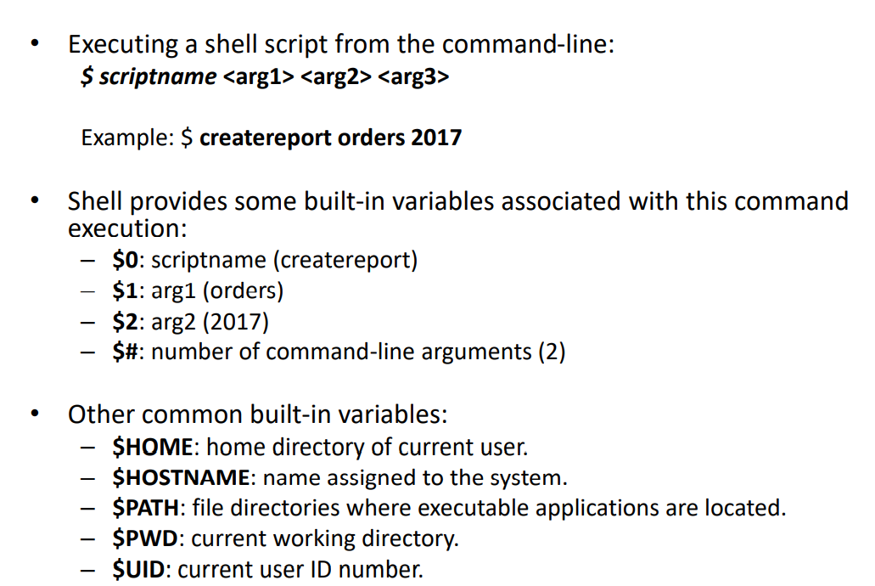
Bash Scripting : Variables

Slide 7
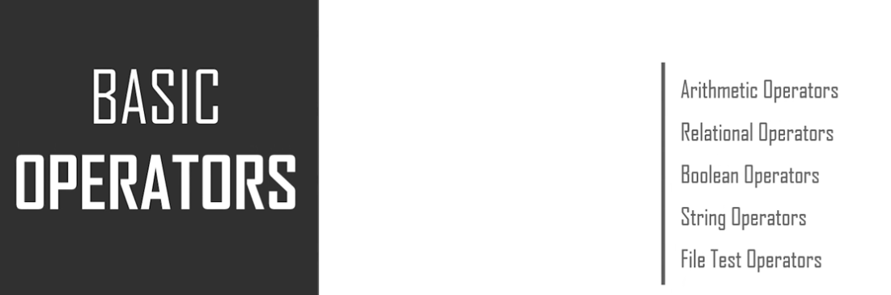
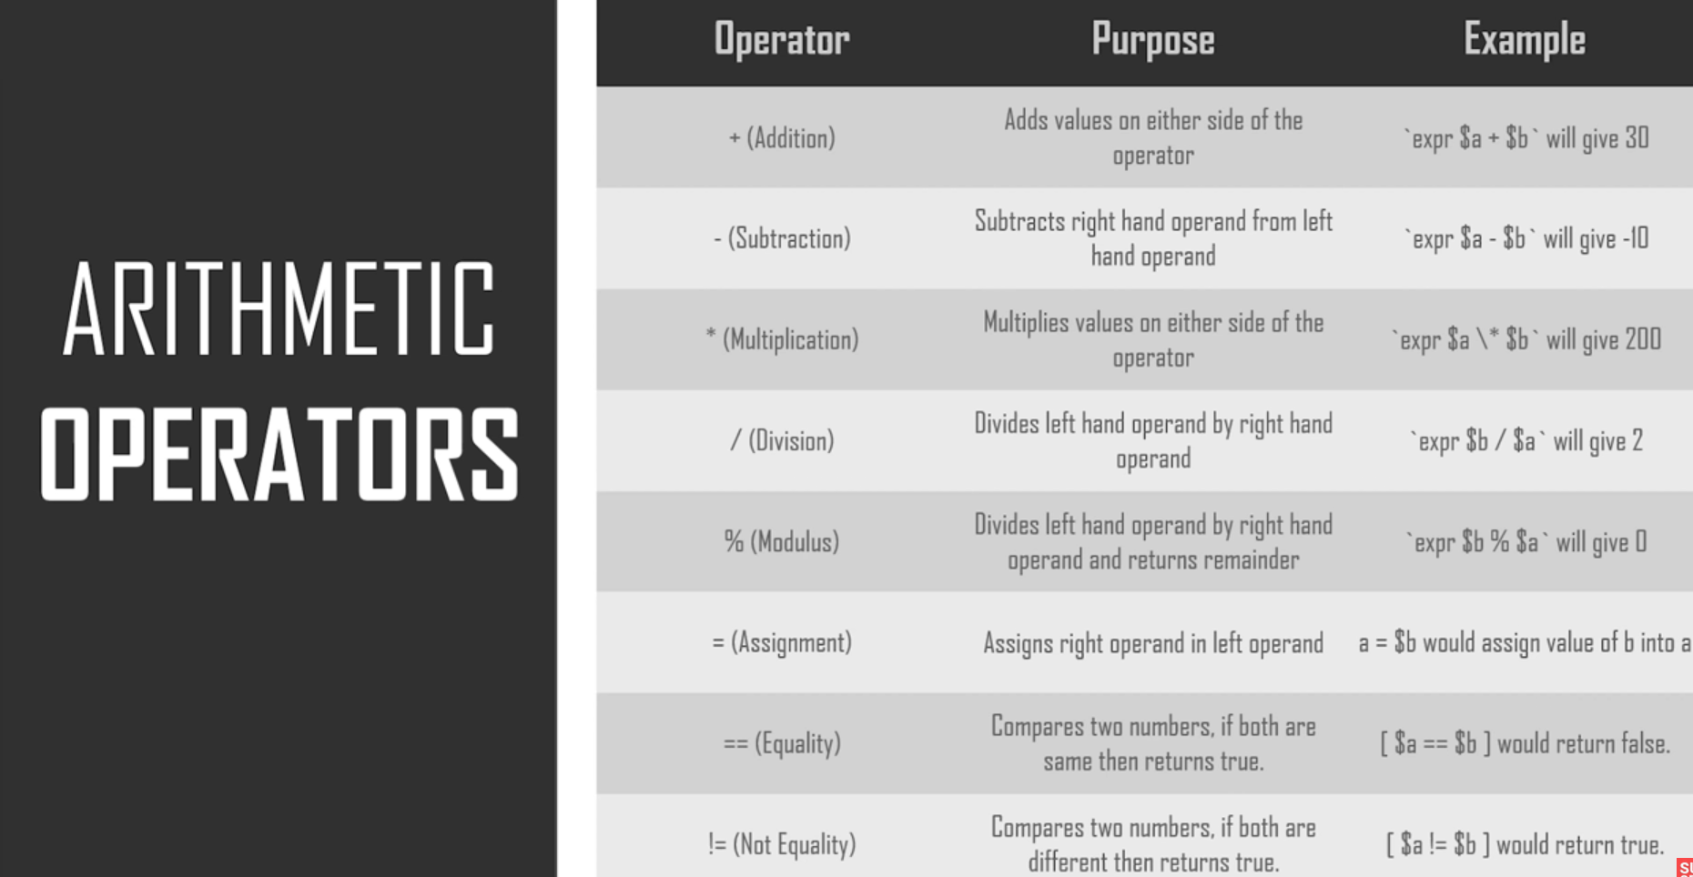
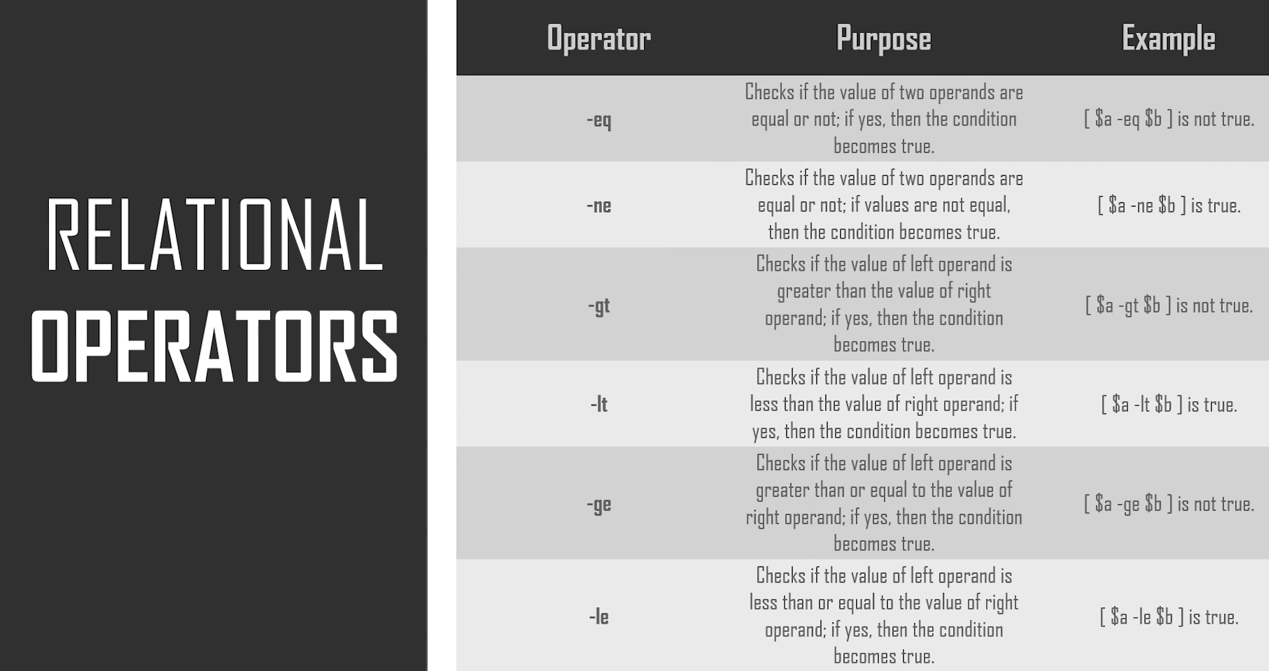
Bash Scripting : Basic Operators

Slide 8
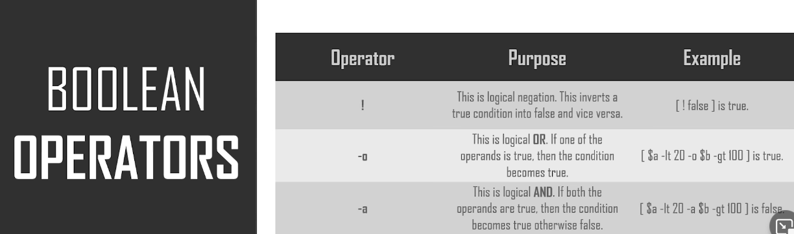
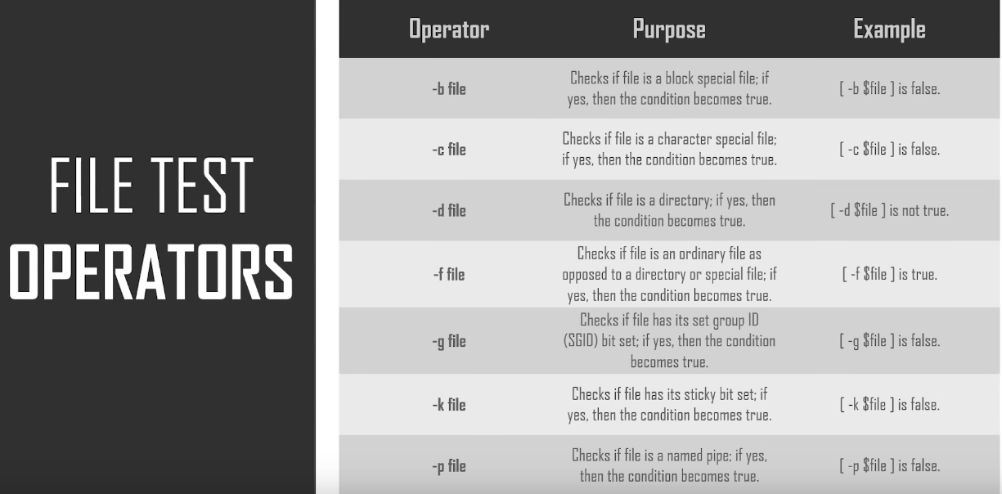
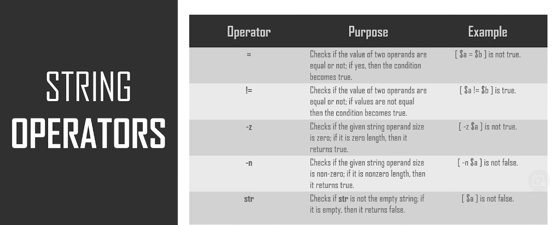
Bash Scripting : Basic Operators

Slide 9
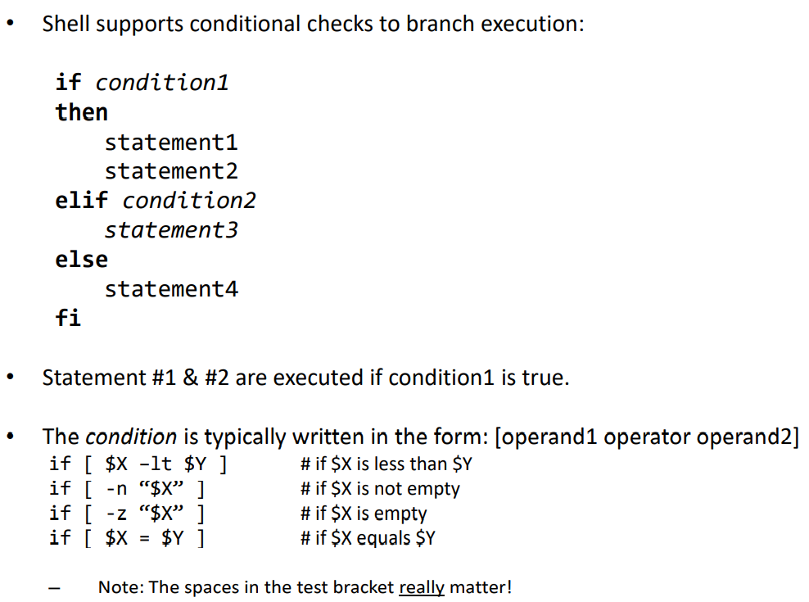
Bash Scripting : Conditionals

Slide 10
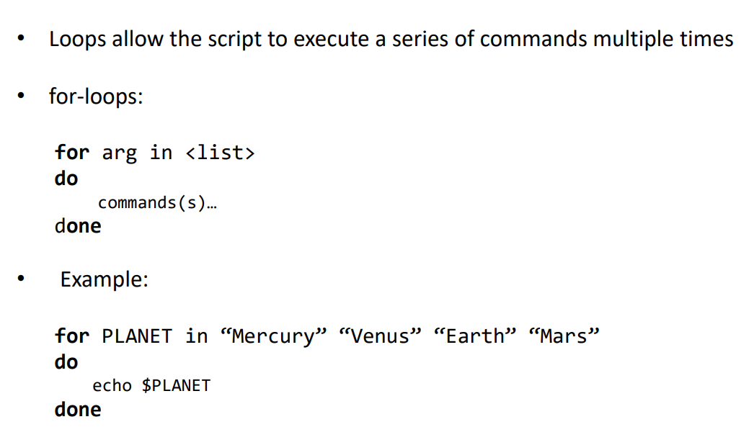
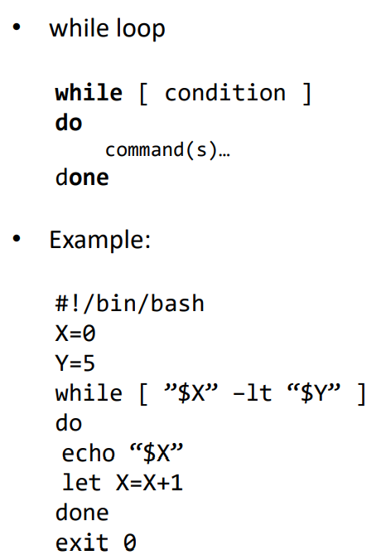
Bash Scripting : Loops

Slide 11
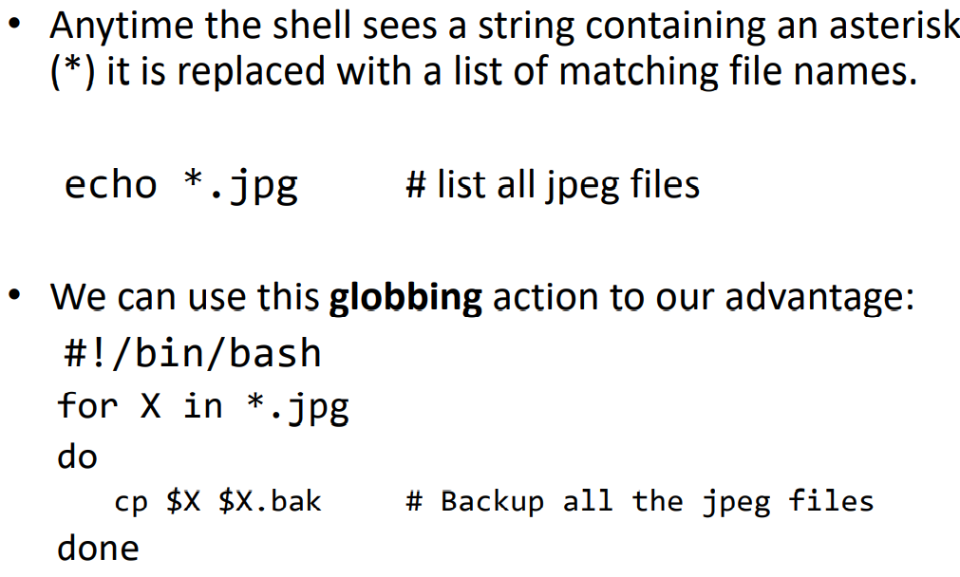
Bash Scripting : Loop Globbing

Slide 12
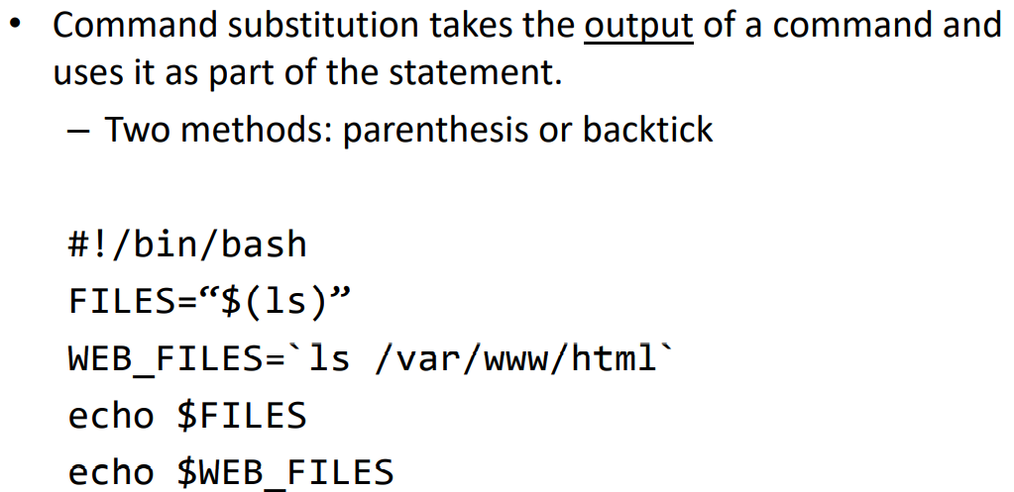
Bash Scripting : command substitution

Slide 13
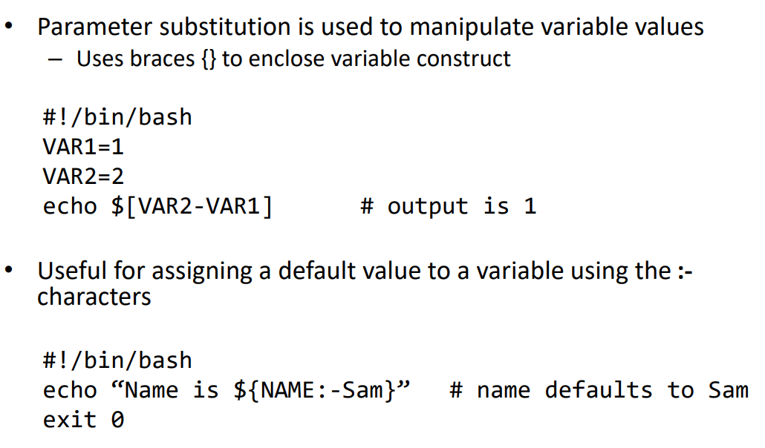
Bash Scripting : parameter substitution

Slide 14
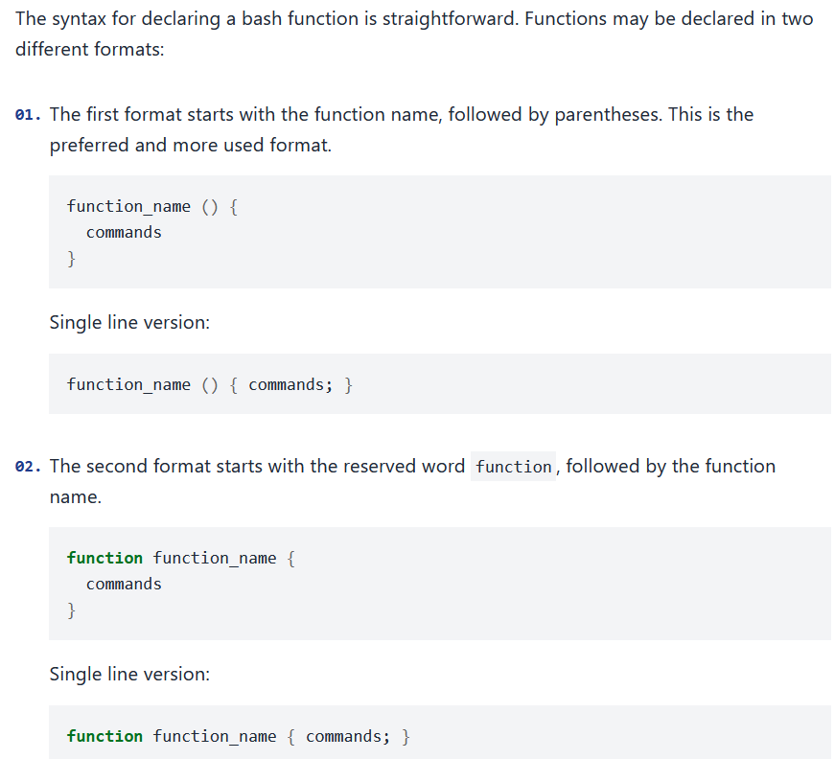
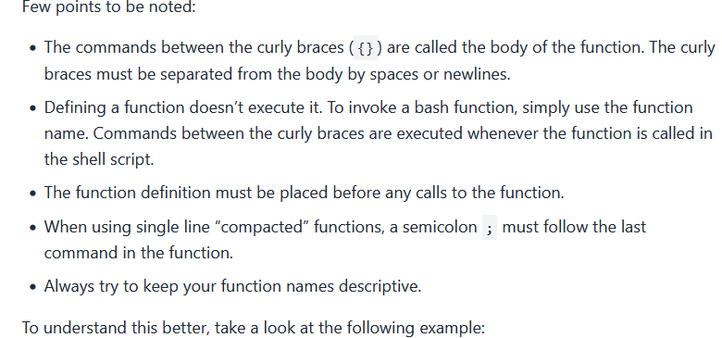
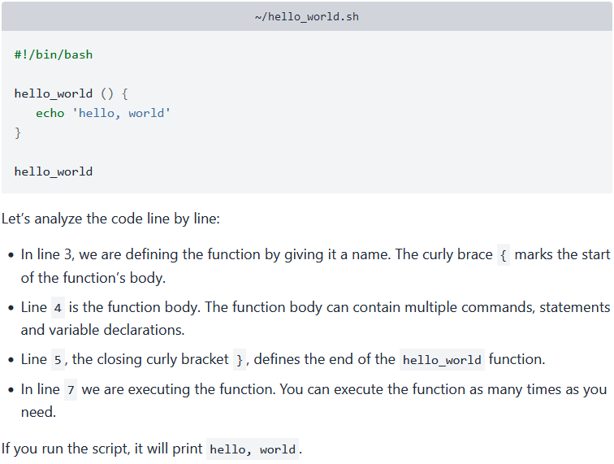
Bash Scripting : Functions

Slide 15
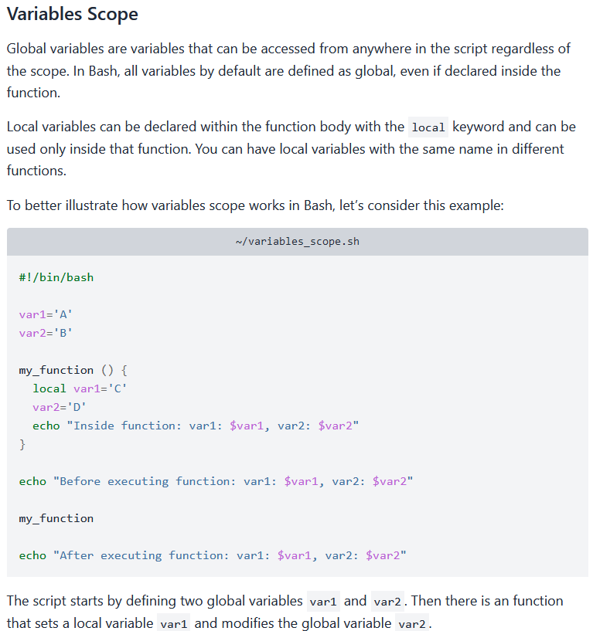
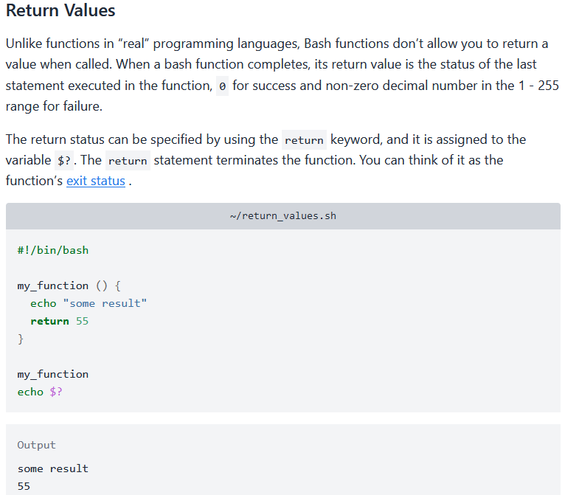
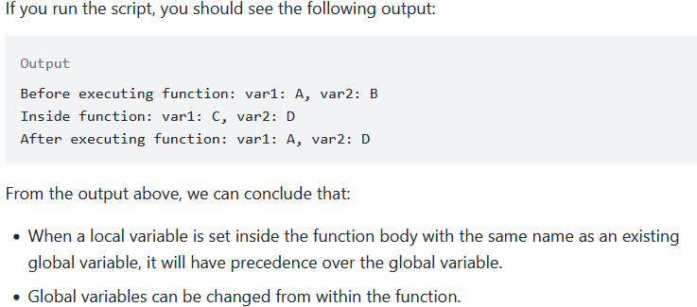
Bash Scripting : Functions

Slide 16
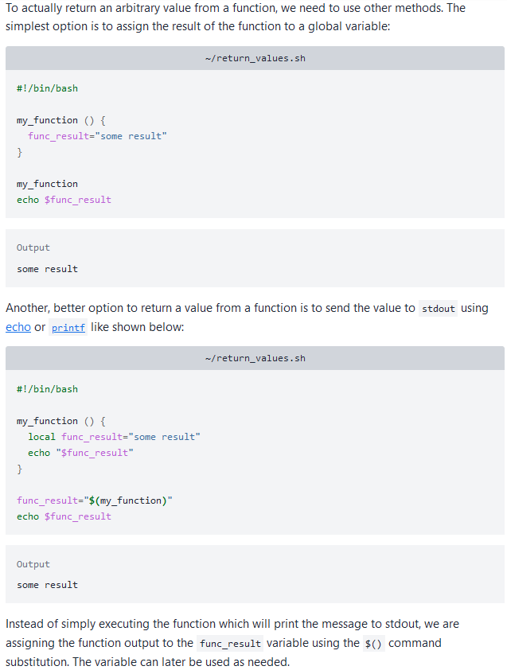
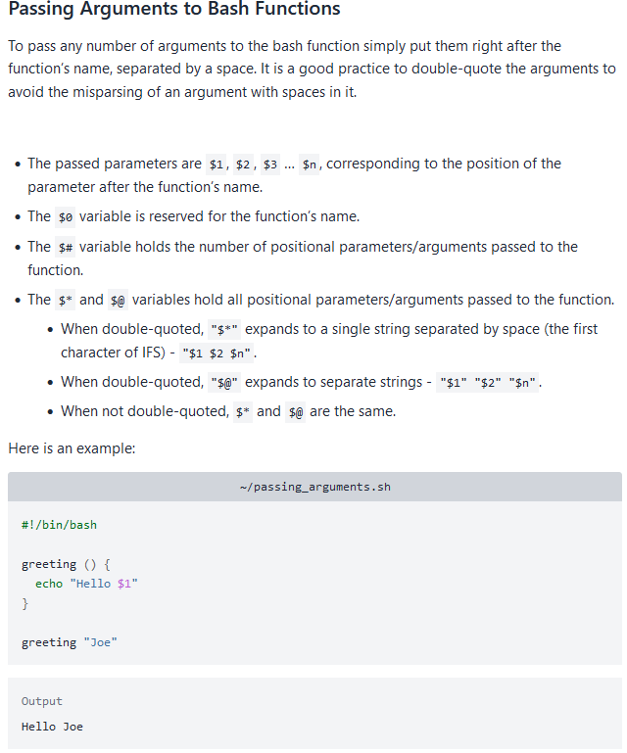
Bash Scripting : Functions

Slide 17
Scripting for DevOps
Bash : https://www.youtube.com/watch?v=GtovwKDemnI
PowerShell : https://www.tutorialspoint.com/powershell/index.htm
Python: https://www.w3schools.com/python/
Scripting with Python: https://www.youtube.com/watch?v=9F6zAuYtuFw

