Slide 1
PowerShell

Slide 2
Topics
Overview
Features
Variables
Operators
Looping
Conditions
Arrays
Functions
Modules

Slide 3
Overview
Windows PowerShell is a command-line shell and scripting language designed especially for system administration. Its analogue in Linux is called as Bash Scripting. Built on the .NET Framework, Windows PowerShell helps IT professionals to control and automate the administration of the Windows operating system and applications that run on Windows Server environment.
Windows PowerShell commands, called cmdlets, let you manage the computers from the command line. Windows PowerShell providers let you access data stores, such as the Registry and Certificate Store, as easily as you access the file system.
In addition, Windows PowerShell has a rich expression parser and a fully developed scripting language. So in simple words you can complete all the tasks that you do with GUI and much more.

Slide 4
Features
Cmdlets − Cmdlets perform common system administration tasks, for example managing the registry, services, processes, event logs, and using Windows Management Instrumentation (WMI).
Task oriented − PowerShell scripting language is task based and provide supports for existing scripts and command-line tools.
Consistent design − As cmdlets and system data stores use common syntax and have common naming conventions, data sharing is easy. The output from one cmdlet can be pipelined to another cmdlet without any manipulation.
Simple to Use − Simplified, command-based navigation lets users navigate the registry and other data stores similar to the file system navigation.
Object based − PowerShell possesses powerful object manipulation capabilities. Objects can be sent to other tools or databases directly.
Extensible interface. − PowerShell is customizable as independent software vendors and enterprise developers can build custom tools and utilities using PowerShell to administer their software.

Slide 5
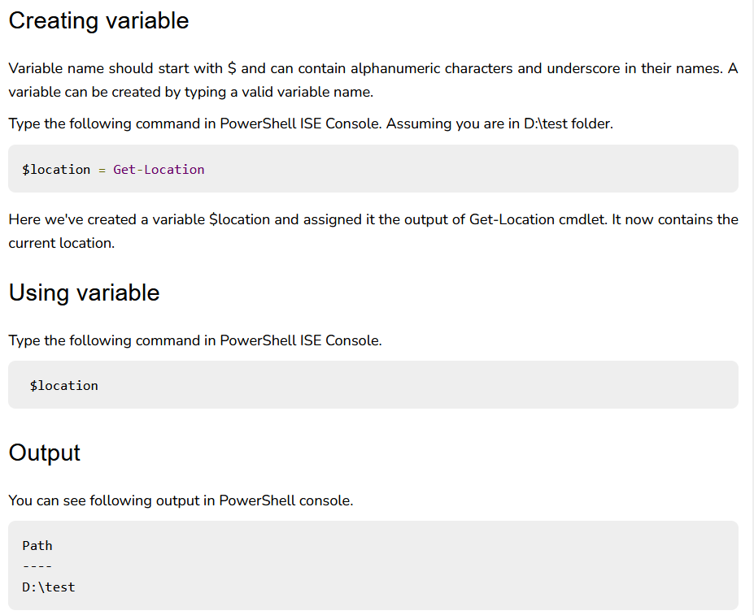
Variables

Slide 6
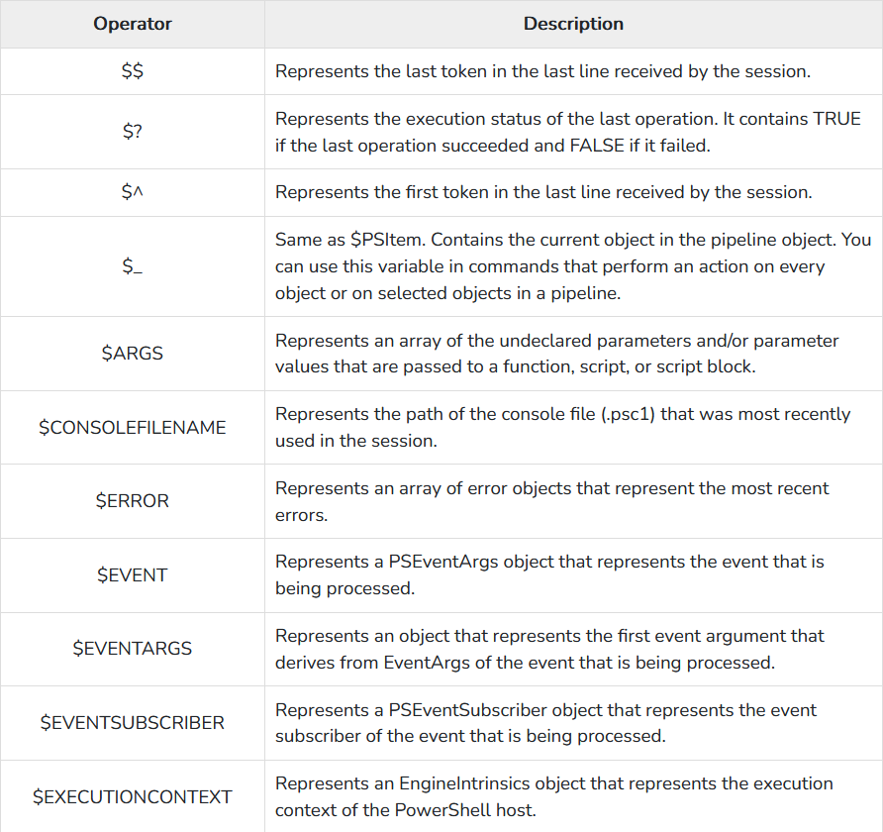
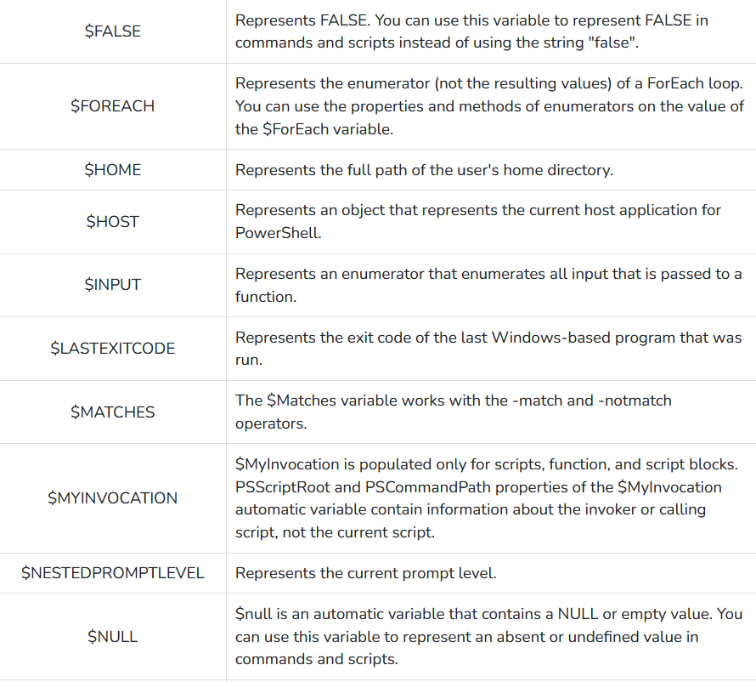
Special Variables

Slide 7
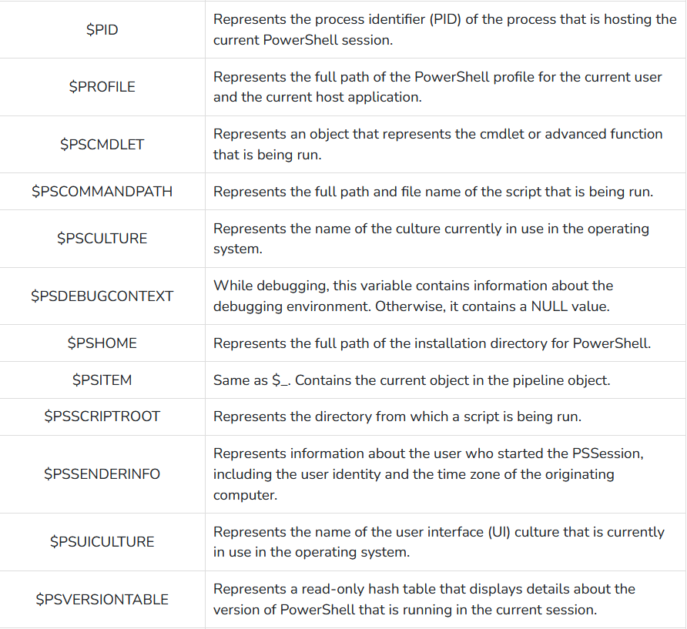
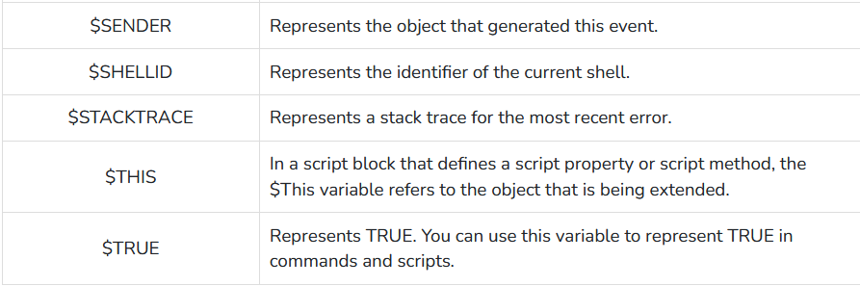
Special Variables

Slide 8
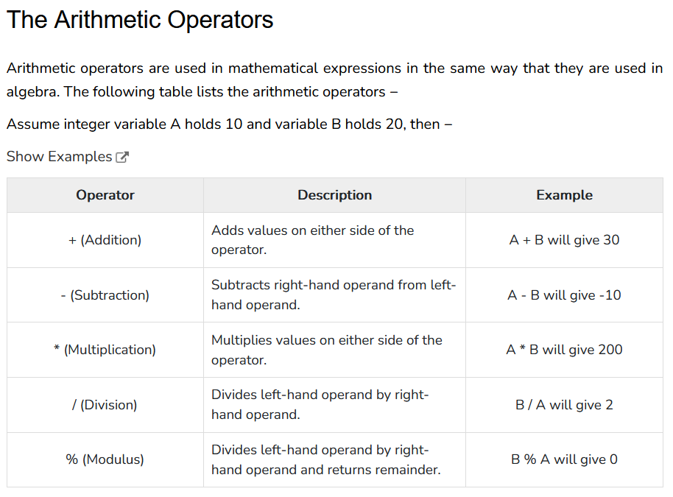
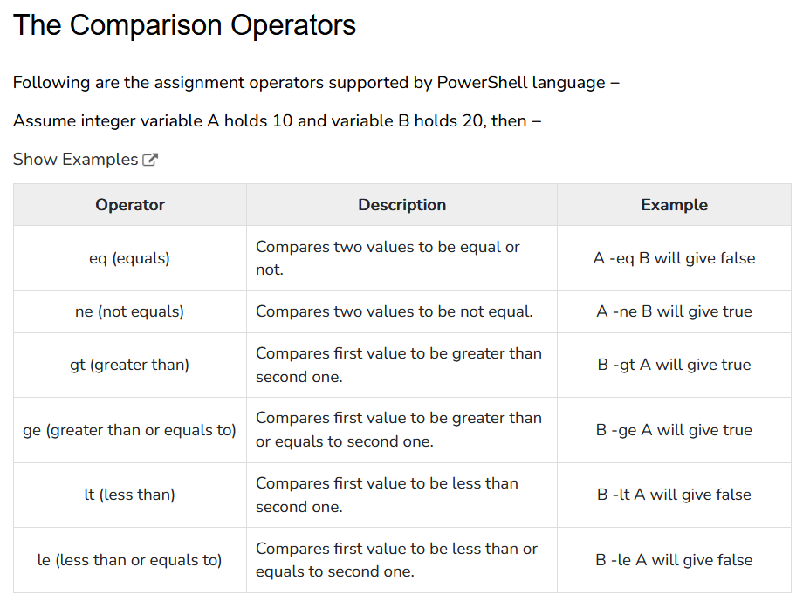
Operators

Slide 9
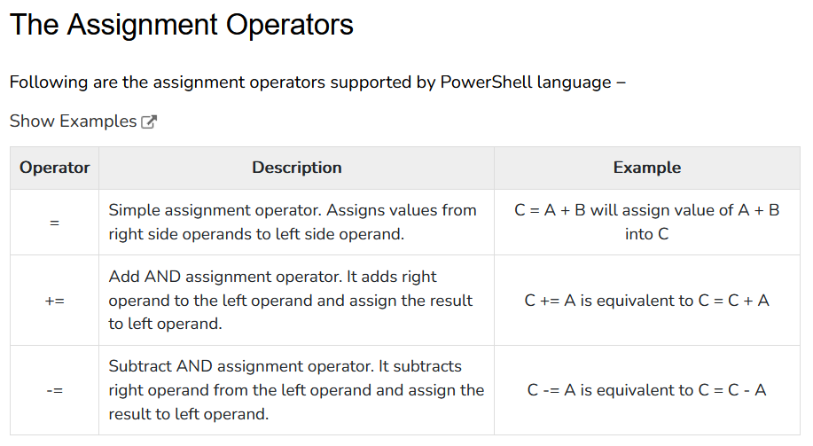
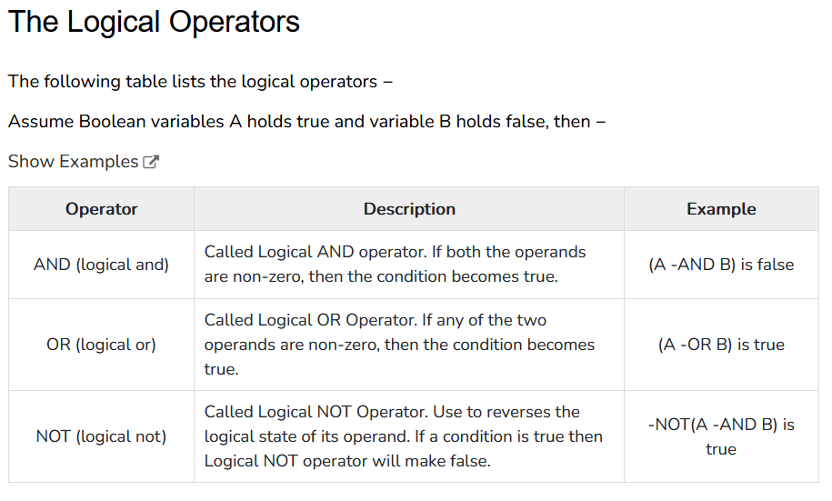
Operators

Slide 10
Operators

Slide 11
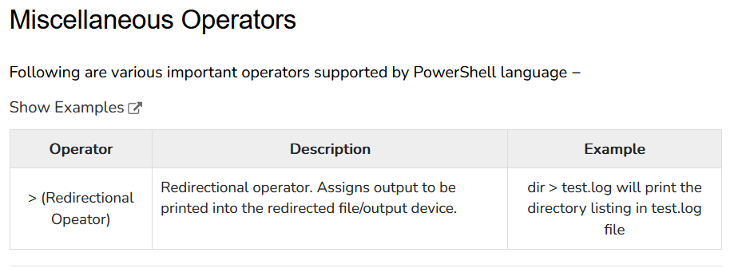
Operators

Slide 12
Loop
A loop statement allows us to execute a statement or group of statements multiple times. PowerShell programming language provides the following types of loop to handle looping requirements:
For
For each
While
Do-while

Slide 13
Conditions
Decision making structures have one or more conditions to be evaluated or tested by the program, along with a statement or statements that are to be executed if the condition is determined to be true, and optionally, other statements to be executed if the condition is determined to be false.
If
If-Else
Nested IF
Switch

Slide 14
Arrays
PowerShell provides a data structure, the array, which stores a fixed-size sequential collection of elements of the any type. An array is used to store a collection of data, but it is often more useful to think of an array as a collection of variables or objects.

Slide 15
Functions
In PowerShell, functions are named blocks of reusable code that can perform specific tasks. They allow you to encapsulate a set of instructions into a single unit, making your scripts more modular, organized, and easier to maintain.
Functions in PowerShell are defined using the function keyword, followed by the function name and a set of curly braces {} to enclose the function body.

Slide 16
Modules
PowerShell modules are self-contained units of functionality that encapsulate reusable code, including cmdlets, functions, variables, and other resources. They provide a way to package and distribute PowerShell code for easy sharing and reuse across different scripts and environments. Modules allow you to organize your code into logical units and enhance the modularity and maintainability of your PowerShell solutions.
AzureRM (old) and Az are examples of module for Azure

